Slide 1
European challenges in gene editing by CRISPR/Cas9
Iraklis Litinas, Rusne Mackeviciute, Pascal Krüger

Slide 2
Participants
Rusne Mackeviciute – Mentor (Lithuania)
Iraklis Litinas
(Greece)
Pascal Krüger
(Germany)

Slide 3
Linearizing plasmid pBR322 by PSTI
-The linearized form of pBR322 (4361 BP) migrates slower as the supercoiled form of pBR322 (c)
-The cut with the restriction enzym PstI was succesfull

Slide 4
gRNA-Synthesis
-We see the gRNA wich we synthesised in step 2 in
line (s)

Slide 5
Cutting the linearized plasmid by CRISPR/Cas9
- In lane 1 and 2 we see just one big band wich is the linearized plasmid.
- We see in line 3 a small and a large band. On the lower side of lane 3 we see the gRNA.
- Our plasmid was not fully cutted by CRISPR

Slide 6
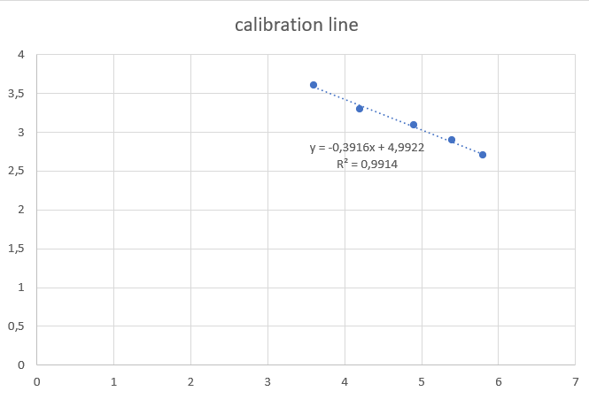
Calibration line/Conclusion
l(cm) | L=Bp | log(L)
3,6 | 4000 | 3,60205999
4,2 | 2000 | 3,30103
4,9 | 1250 | 3,09691001
5,4 | 800 | 2,90308999
5,8 | 500 | 2,69897
l₁(cm)=3.4
l₂(cm)=4.3
L₁=3.66 (4579 BP)
L₂=3.30 (2033 BP)

