Slide 1
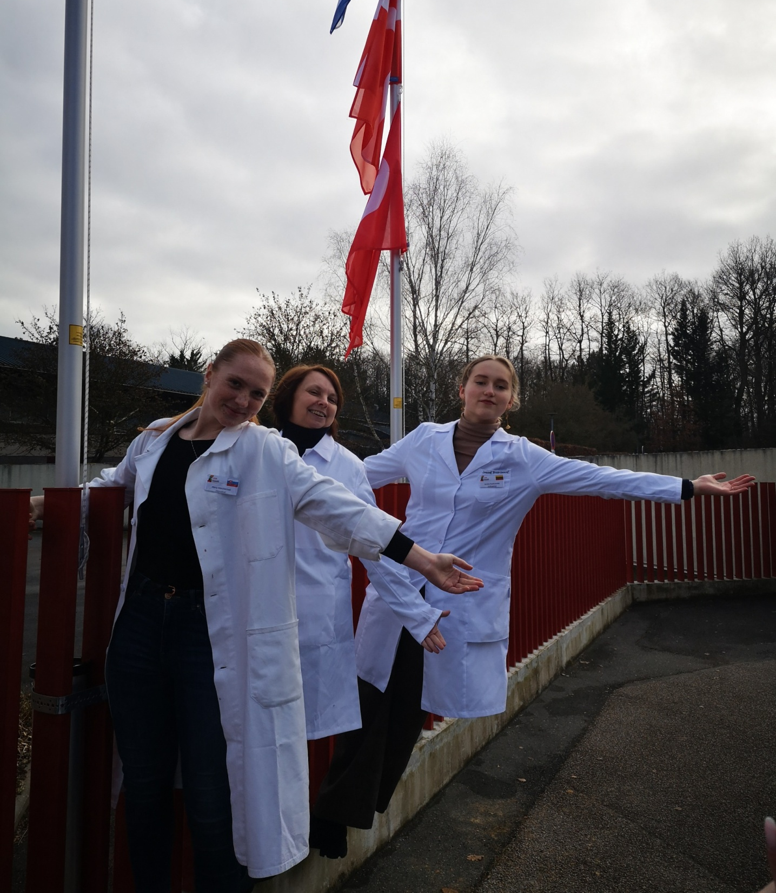
CRISPR Cas9 by in vitro
Group 5:
Jorune Budriunaite, Lithuania
Magdalena Dróżdż-Korbyla, Poland
Hana Melcherová, Slovakia

Slide 2
Plasmid linearising We linearized the plasmid using a restrictase and we proved it by electrophoresis. The linearized plasmid did not go as far as supercoiled plasmid which is labelled C for control.

Slide 3
gRNA synthesis The S1 was incubated so there were perfect conditions for gRNA synthesis, that is why is the sample 1 has a visible band. The control did not show up, because it was on ice, that means the temperature was too low for the RNA polymerase to work.

Slide 4
CRISPR cut Only in a sample 3 the plasmid is cut, because there were both Cas9 and guide RNA added. We proved it by electrophoresis. There are two bands, but we can not see them properly because of the bad UV lightning and self made gel (they were more visible on the phone).
1 2 3
M

Slide 5
Calibration line
According to our calibration line and measurements,
the larger fragment of cut plasmid has 3246 Bp
and the shorter and less visible one has around
1350 Bp.
In total there are
4596 Bp
in our cut plasmid.

Slide 6
Conclusion
As we saw in the pictures before, the plasmid linearising and gRNA synthesis were done successfully.
However, the CRISPR cut was not visible enough, probably because of self–made electrophoresis gel and unsuitable UV–light, but it was noticeable that the third sample had its fragment further as were the first two, so the cut was successful.

