Slide 1
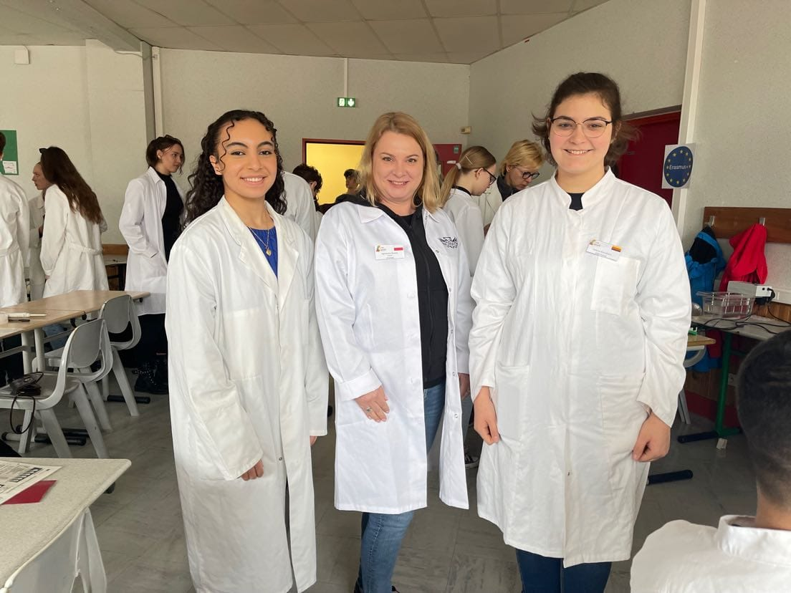
Groupe 19
Agniezka Nowak, Ines Karoui, Helena Burckhart

Slide 2
Linearisation of a Plasmid
....

Slide 3
gRNA Synthesis

Slide 4
CRISPR Cut

Slide 5
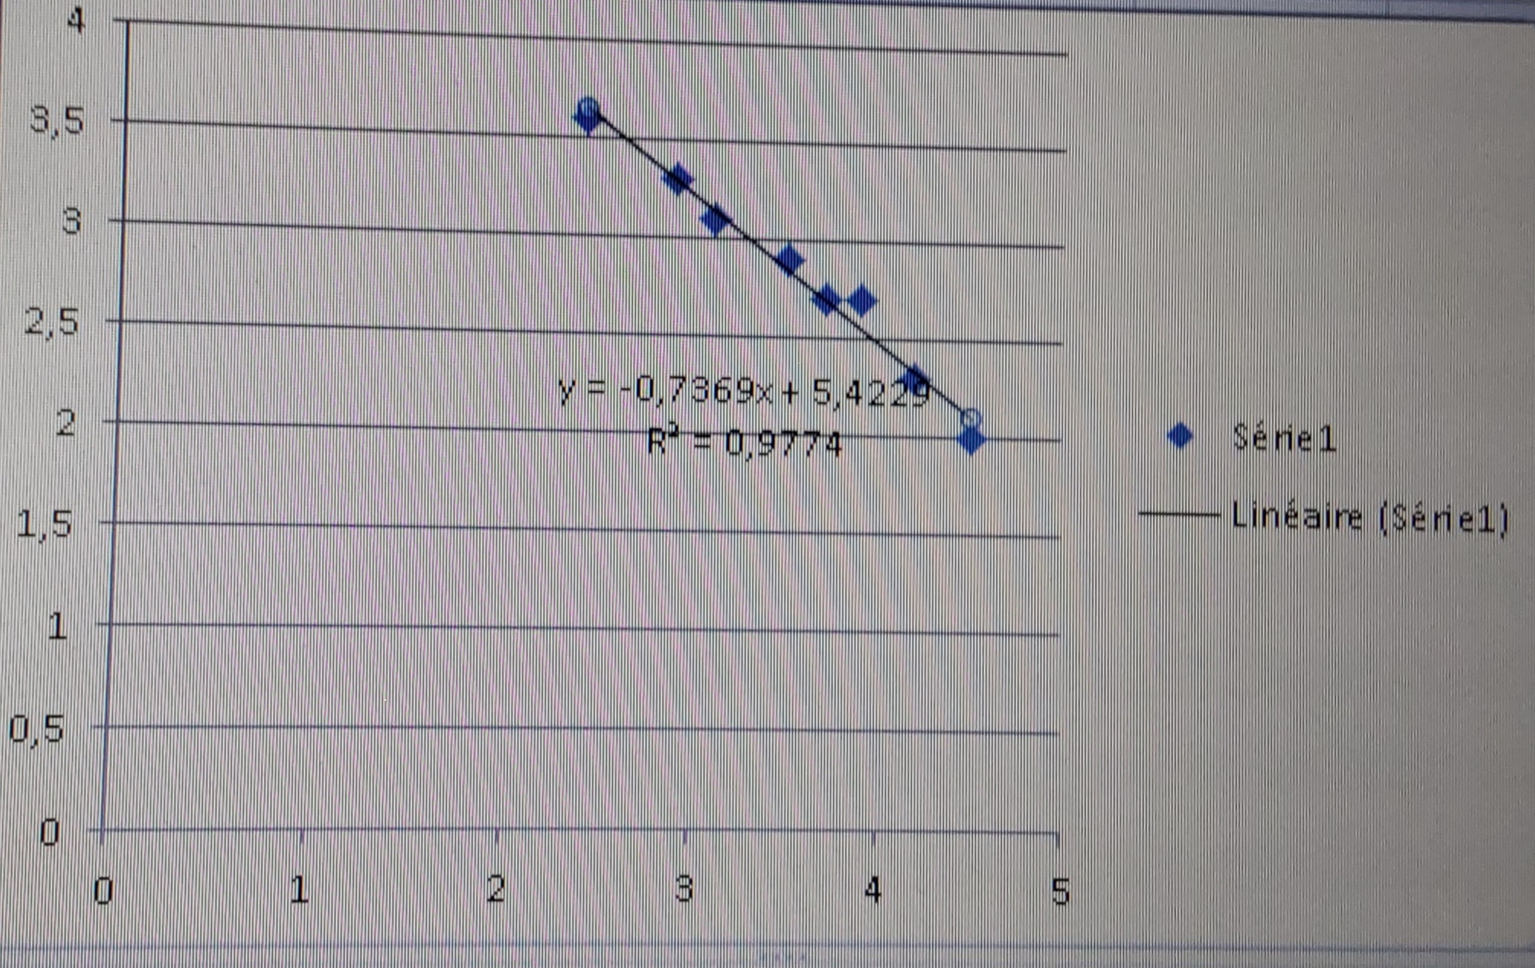
Calibration line
Tube 1: 5819 Bp
Tube 2: 5346
Tube 3: 3807 Bp

Slide 6
Conclusion
Importance of the Correct use of the duplex DNA
The cut didn’t work as intended
Duplex DNA was not incubated
The bands weren’t shown as intended

