Slide 1
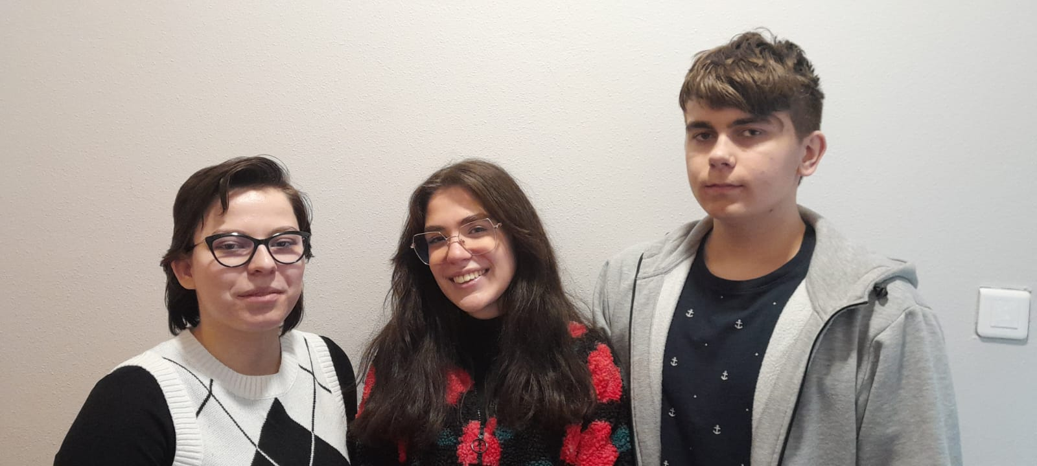
Group 11 Results
Julie Collard-Petit, Timotej Gonda, Angela Topalovska

Slide 2
Linearization of pBR322
C- Supercoiled Plasmid
11/19- Linearized Plasmid
C 11
c 11 12 13 14 15 c 16 17 18 19 c c
-We have successfully cut the supercoiled plasmid with Pstl

Slide 3
Synthetization of gRNA
-We have successfully synthesized gRNA

Slide 4
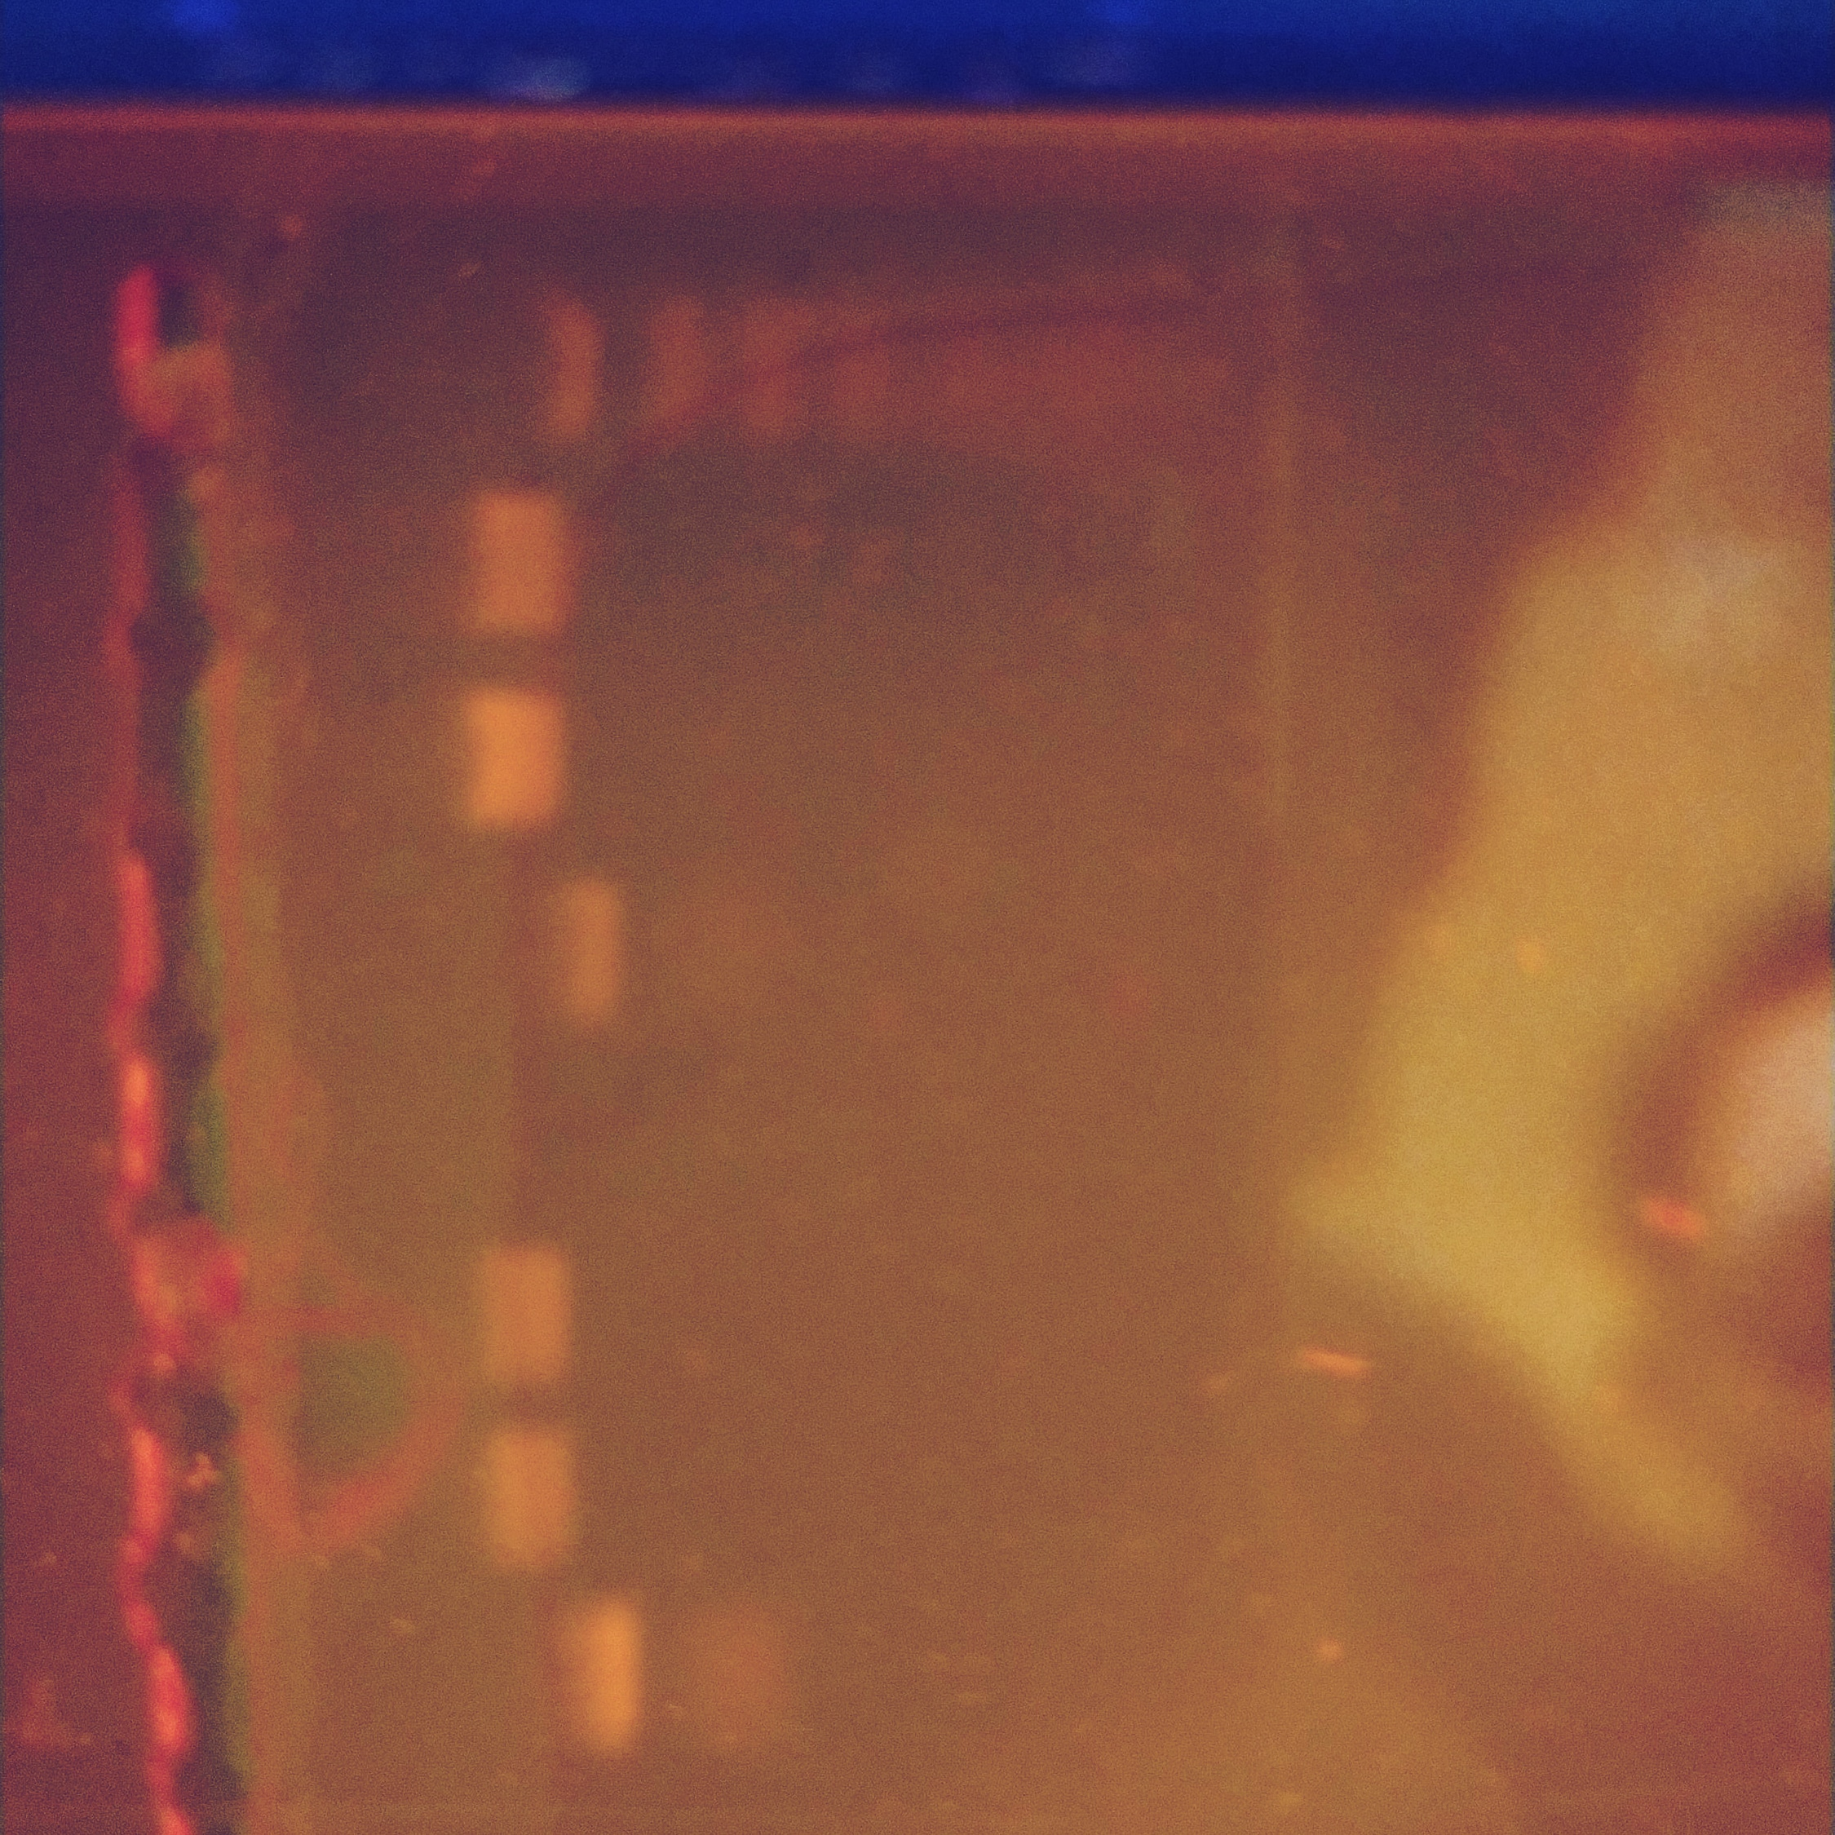
Cutting linearized plasmid with CRISPR Cas9
1- pBR322
2- pBR322 and Cas9
3- pBR322 and
Cas9 + mRNA complex
1 2 3

Slide 5
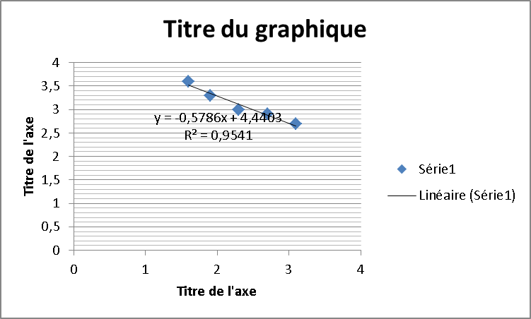
Calibration Curve
1 2
1- 3270 2- 1679

Slide 6
do not use agarose gel
use two light filters to block the light better
and photoshop final photo to see dim lines
use same pipettes and tips

