Slide 1

European challenges in gene editing by CRISPR
CRISPR IN VITRO

Slide 2
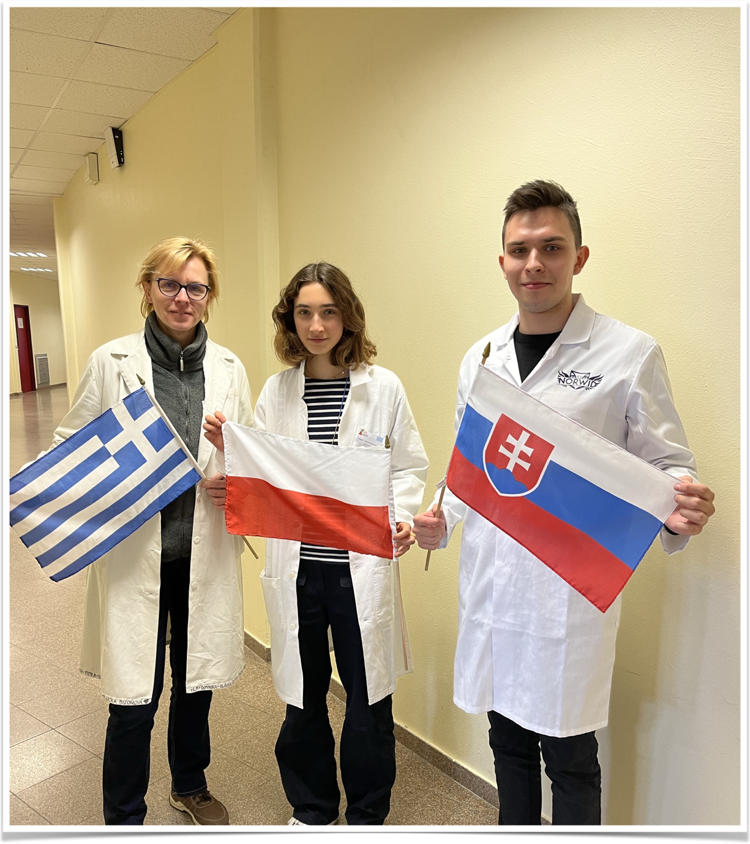
Group 15
Maria-Anna Kontaratou (Greece)- Mentor
Bartosz Kowalczyk (Poland)
Lucia Bizonova (Slovakia)

Slide 3
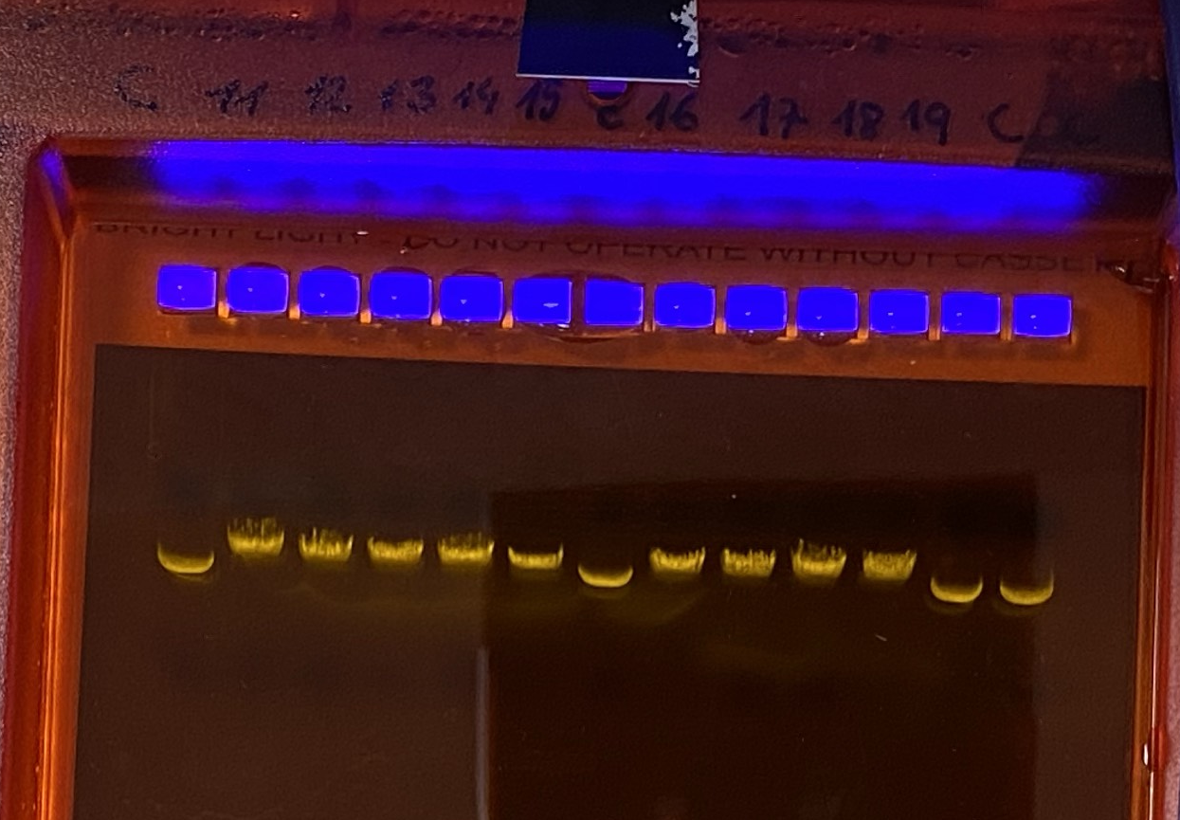
Linearazing supercoiled plasmid pBR322
R- Digested linearized plasmid
R
C
C(control)- Undigested supercoiled
form of plasmid

Slide 4
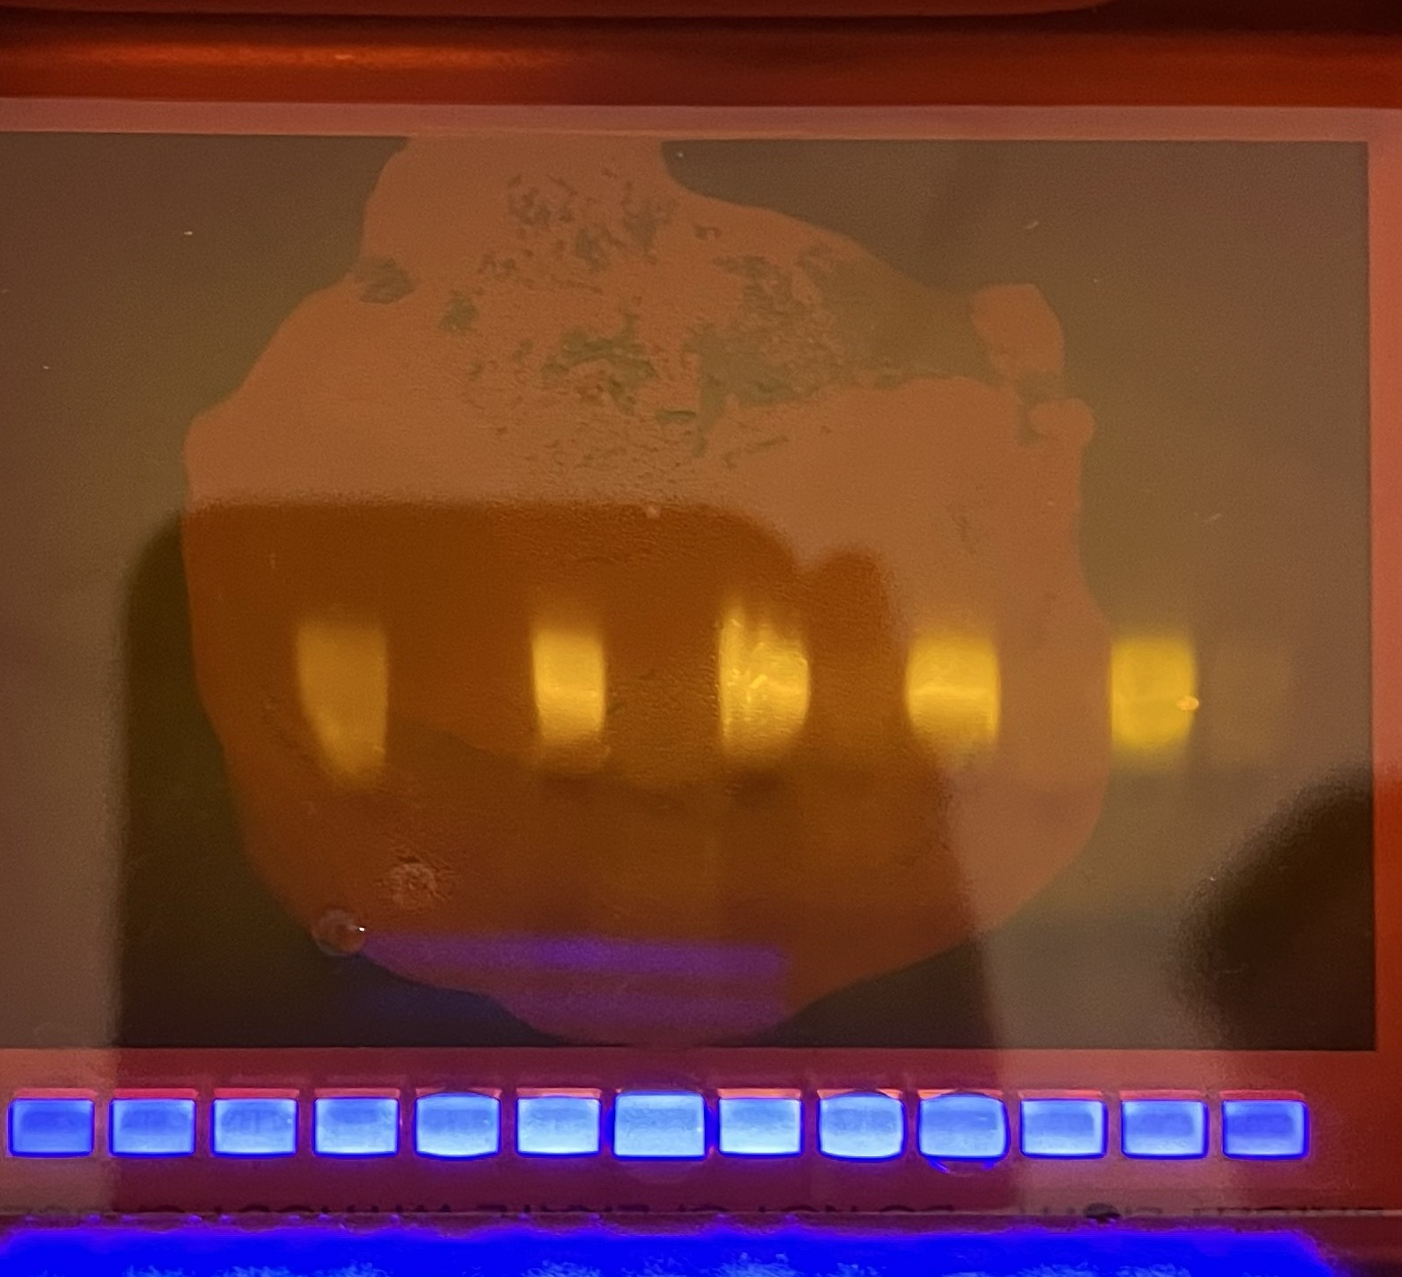
gRNA synthesis
S
S- Synthesized gRNA
The wells on left and the right side of the S are filled with the control samples, which do not contain RNA.
There are not visible during the electrophoresis.
That is proof that T7 polymerase worked
properly and our gRNA is synthesized
15

Slide 5
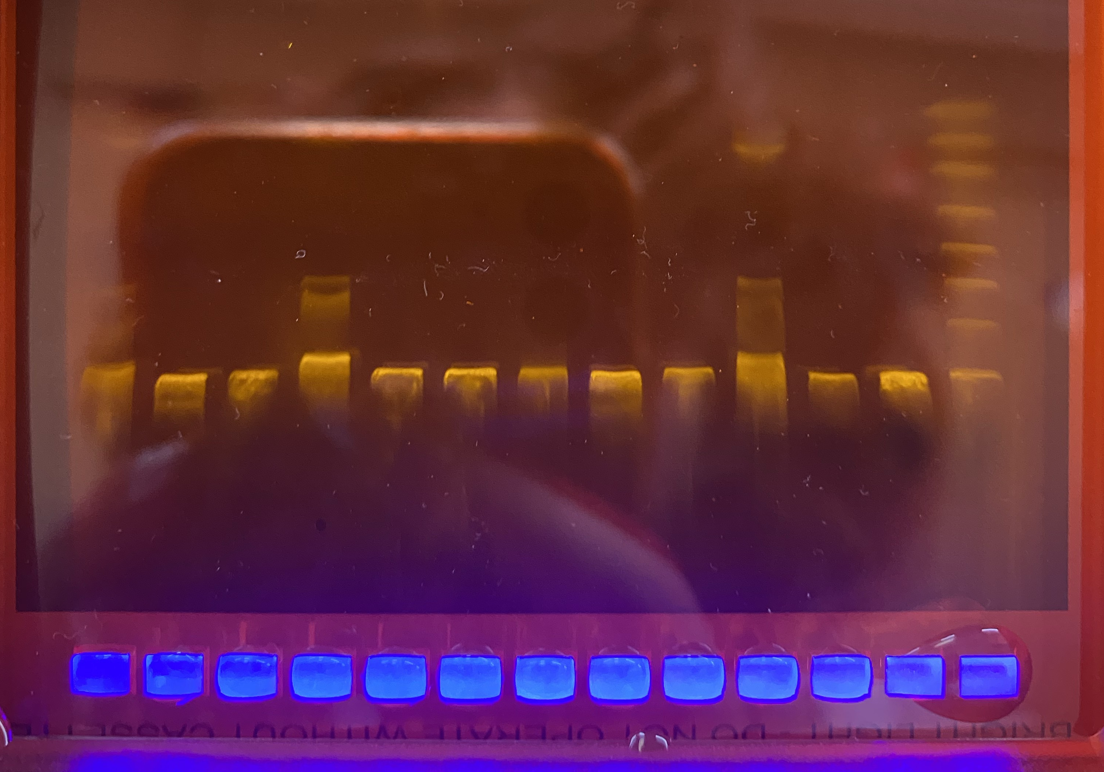

CRISPR/Cas9 cut
Marker
DNA cut with CRISPR

Slide 6
Calibration line
CRISPR measurement-1
Marker [cm] | Base pairs | Log A
8,3 | 4000 | 3,6
9,8 | 2000 | 3,3
11 | 1250 | 3,1
12,1 | 800 | 2,9
13,2 | 500 | 2,7
CRISPR measurement
Fragments [cm] | Log B | Base pairs
8,85 | 3,49 | 3098
11 | 3,1 | 1256

Slide 7
Conclusion
After calculations results are very close to the expected ones:
Fragment 1: in round numbers 3099bp (expected 3098bp)
Fragment 2: 1256bp (expected 1263bp)
Relative error of the measurement of the first fragment is 0,033%
Relative error of the measurement of the second fragment is 0,55 %
The evaluation indicates that the experiment with a use of CRISPR in vitro was conducted correctly. DNA of plasmid pBR322 was cut in the selected place.

