Slide 1
International experiences in implementing EAFM
Robert Stephenson

Slide 2
Full Spectrum Sustainability Objectives/Outcomes
Ecological objectives
Productivity and trophic structure
Biodiversity
Habitat and ecosystem integrity
Economic objectives
Economic viability and prosperity
Livelihoods
Distribution of access and benefits
Regional economic benefits to community
Social (including cultural) objectives
Health and wellbeing
Sustainable communities
Indigenous and other cultures
Ethical activities
Institutional objectives
Legal obligations including to indigenous peoples,
Good governance structure,
Effective decision-making processes
The scope of EAFM
is increasing
2018 Fish & Fisheries https://doi.org/10.1111/faf.12296
2019 CJFAS https://doi.org/10.1139/cjfas-2017-0345
2020 E&S https://doi.org/10.5751/ES-11509-250201 2021 FMARS https://doi.org/10.3389/fmars.2021.630547

Slide 3
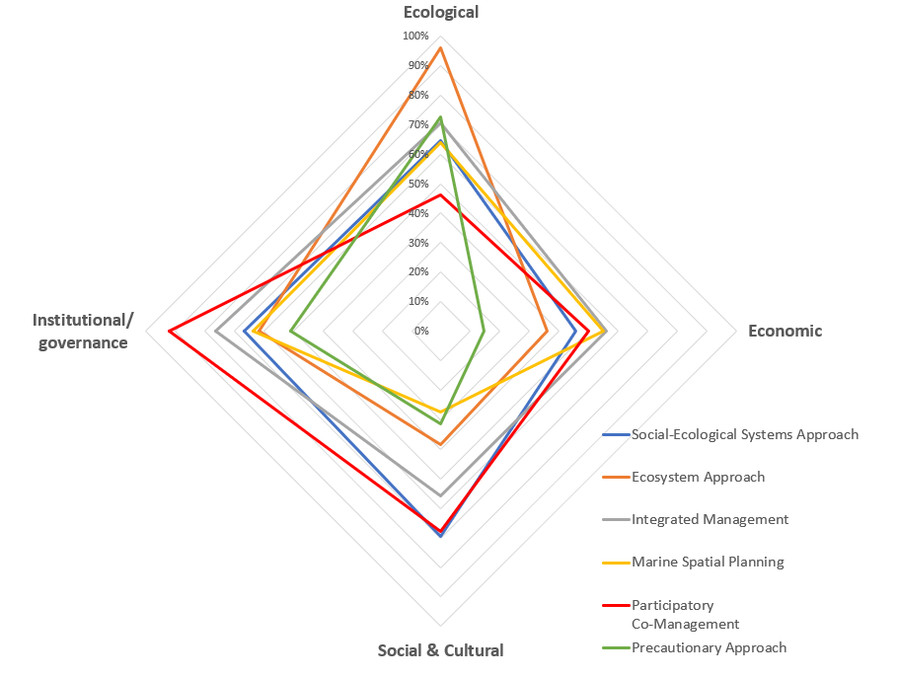
Ecosystem approach compared to other sustainability-related concepts.
Stephenson et al. 2021 FMARS
https://doi.org/10.3389/fmars.2021.630547
Notes:
Major sustainability-related concepts are evolving to have similar scope ...but have different emphasis

Slide 4
USA
NOAA EBFM Roadmap: https://media.fisheries.noaa.gov/2020-09/01-120-01.pdf

Slide 5
Australia: EBFM → EBM with risk assessment → MSE → Fishery ’Healthcheck’

Slide 6
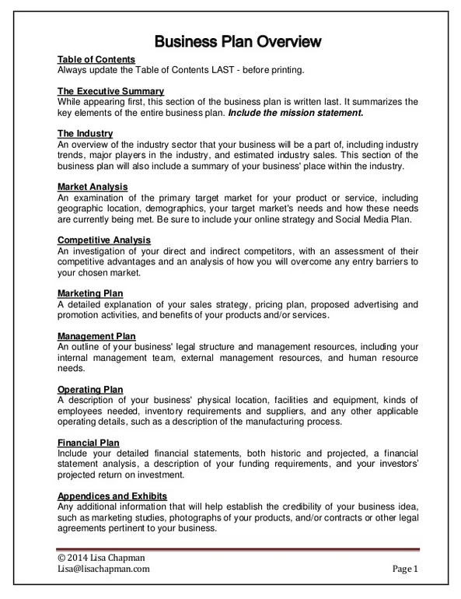
EAM can overcome shortcomings of current management:
Current species-based management
Groundfish
Herring
Scallop
Lobster
etc
Fishery plans
No evaluation
cumulative effects
Different and
Incomplete objectives
No evaluation
of tradeoffs

Slide 7
Ecosystem approach should influence plans to have common objectives (with performance metrics):
Groundfish
Herring
Scallop
Lobster
etc
Fishery plans
Key ecological, economic, social and governance
objectives
Evaluation of
cumulative effects of all fisheries in an area
Evaluation of tradeoffs

Slide 8
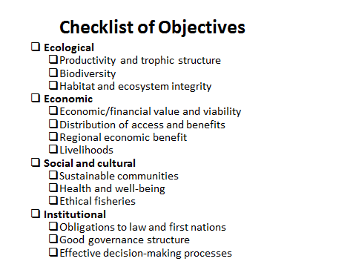
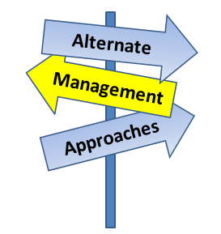
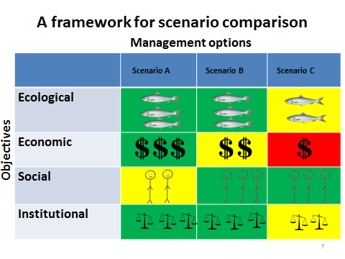
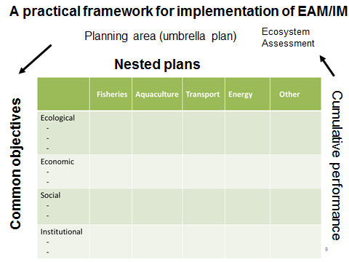
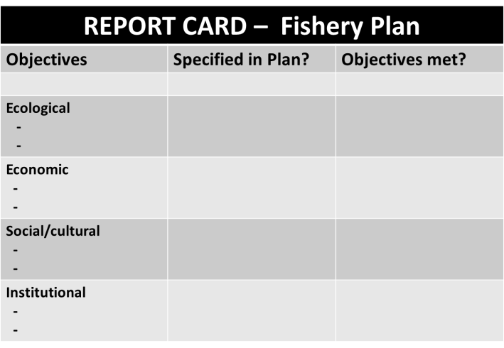
(a)
2018 Fish & Fisheries https://doi.org/10.1111/faf.12296
(b)
(c)
EAM
Framework
uses
(d)
(e)

Slide 9
A framework for scenario comparison, evaluation of tradeoffs, and advice:
Management options
 | Scenario A | Scenario B | Scenario C
Ecological: -Objective 1 -Objective 2 …
Economic: -Objective 1 -Objective 2 …
Social and cultural: -Objective 1 -Objective 2 …
Institutional: -Objective 1 -Objective 2 …
Diverse values/objectives
Scenarios may be compared in several ways…relatively, qualitatively or quantitatively

Slide 10
Evolution of Ecosystem Approach
Expanding scope of considerations
Ecological, Single species
Ecological, Multi-species
Economic
Social/cultural
Governance
Scale of Application
EAFM
EAFM + risk assessment
MSE
Regional Ocean Management Plans
Integrated Management
Uses
Development of objectives
Framework for advice
Scenario comparison
Report card
Template for MSP and IM

Slide 11
Ecosystem approaches to fisheries management...going forward:
Will evolve to include ecological, economic, social/cultural and institutional/governance considerations
Are the key to evaluation of trade-offs and cumulative effects
Can/should form the basis for integration across fishery plans as well as for MSP and IM.
Contact: robert.Stephenson@dfo-mpo.gc.ca

