Slide 1
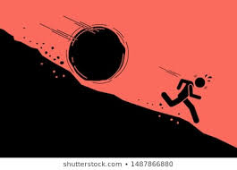
Why are we here?
The direction Revolution is going Look back on the past 9 years; How we started out activism; humanitarian, demonstrations, DC’s advocacy and , Media Examine Time to take step back, RE-EVALUATE WHY & HOW WE ENDED UP HERE?

Slide 2

Your , Our Vision …….
Long Path, longer than expected Assad, Iran, Shia Militia Groups persistent Struggle may be longer , certainly not easier More Challenges on the way Don’t Think will get easier ARE WE PREPARED ? So What We Should Do?

Slide 3
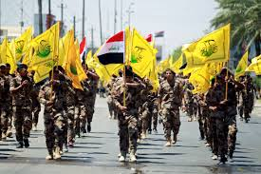
Ideology Struggle
Satanic Regime of Iran won’t give in /up
Mission of Domination
Preparing & Building generations of hate
Planning for generations to come
How to Stop them, Push back,& Conquer
Are we PREAPRED ????
What’s OUR plan ???

Slide 4
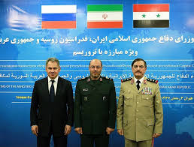
ASSAD IS NOT ALONE
Assad, Iranian Regime, Militias, Russia fighting us UNITED
Are we??
How and Why the Russian-Iranian-Hezbollah Axis Has Won the War in Syria

Slide 5
THE SYRIANS GOOD AND BAD
Away from politics
HARD WORKING
ACHIEVERS
SMART,
PRIDE AND PROUD
COMPETE WEO
ATTITUDE WHYTO FOLLOW, I CAN DO THE SAME
DISLIKE TO FOLLOW A PATH, I MAKE MY OWN, LEAVE ME ALONE,
FUNDS TO TAKE THE CREDIT OR COMPETING TOWARDS IT

Slide 6
CAESAR & Syrian DC’s Lobby Groups
Leverage over the regime
Our lobbying groups; responsibility of enforcement of its application
New Bill in the Senates on the way
Will strip Assad’s legitimacy
They responsiblie of making Assad release:
Before Caesar is not similar to After Caesar

Slide 7
Idlib
BEFORE Idlib WON’T be similar to AFTER Idlib
MUST SHOW THEM THAT
Fall of Idlib is not equal end of Revlution
Look back at the HISTORY, many Revolutions
Time to RE-CALCULATE , RE-GROUPING, RE-ORGNIZE,
RE-STRUCTURE OUR UNITY, OUR ORGNIZING EFFORTS
HOW WE –RESTRUCTURE
LOOK AT OTHERS

Slide 8
National Council of Resistance of Iran
The (NCRI) Iranian political organization based in France
A broad-based coalition; NCRI and the People's Mujahedin of Iran (MEK) to be synonymous,
Umbrella organization or alias for the MEK
Only "nominally independent" political wing or front for MEK
Both led by Massoud Rajavi and his wife Maryam Rajavi.

Slide 9
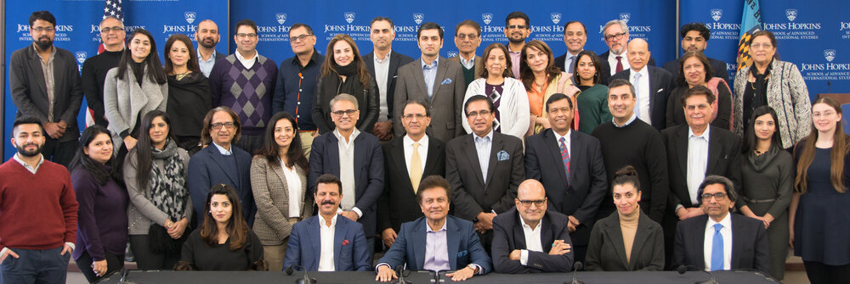
The American Pakistan Foundation (APF)
Empower the Pakistani American community and build bridges between the United States and Pakistan Pakistani Americans represent a vibrant and successful community that prioritizes charity, giving back to local communities, and investing in its homeland of Pakistan. tan.

Slide 10
The Assembly of Syrian American Community
National Board
(19-21)
President & VP
Humanitarian
Committee
Human Rights Committee
Media Campaign
Advocacy
&
lobbying
Committee
Rapid Response Committee
Political Committee
Regional Board 1
Regional Board 2
Regional Board 3
Regional Board 4
Regional Board 5
Regional Board 6

