Slide 1
Agents Intervening against Delirium in the intensive care unit (AID-ICU) Trial medication
Nina Christine Andersen-Ranberg
Lone Musaeus Poulsen (sponsor)
Department of Anaesthesiology and Intensive Care Medicine
Zealand University Hospital Koege, Denmark
aid-icu@cric.nu
www.cric.nu/aid-icu

Slide 2
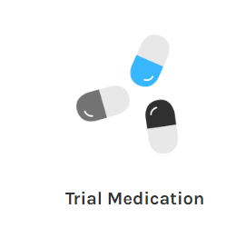
Trial medication

Slide 3
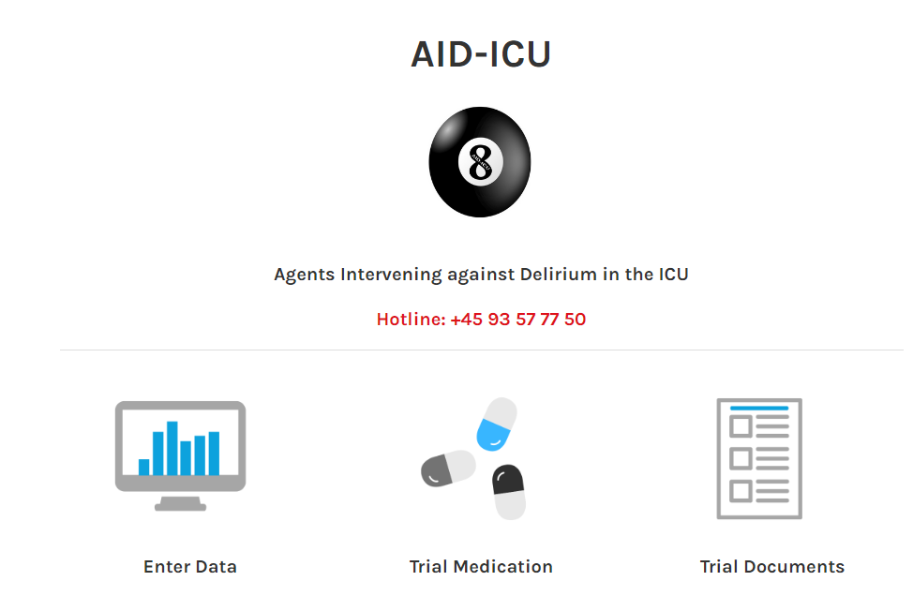
Go to www.cric.nu/aid-icu

Slide 4
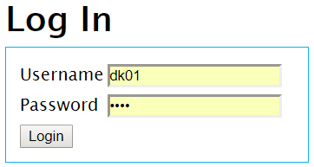
Login
Login with the shared login of your department

Slide 5
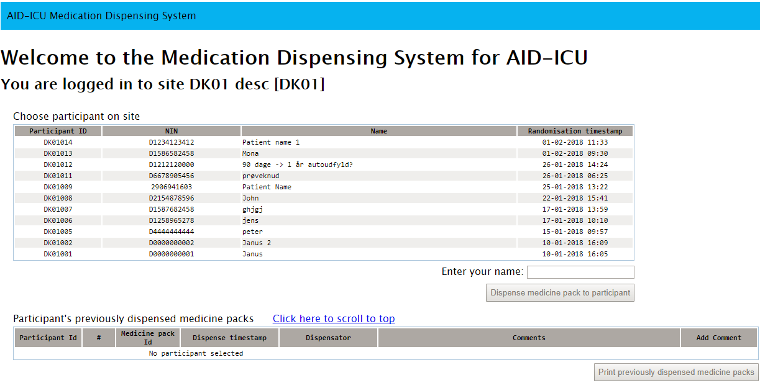
Dispensing trial medication
Mark the relevant patient at the list

Slide 6
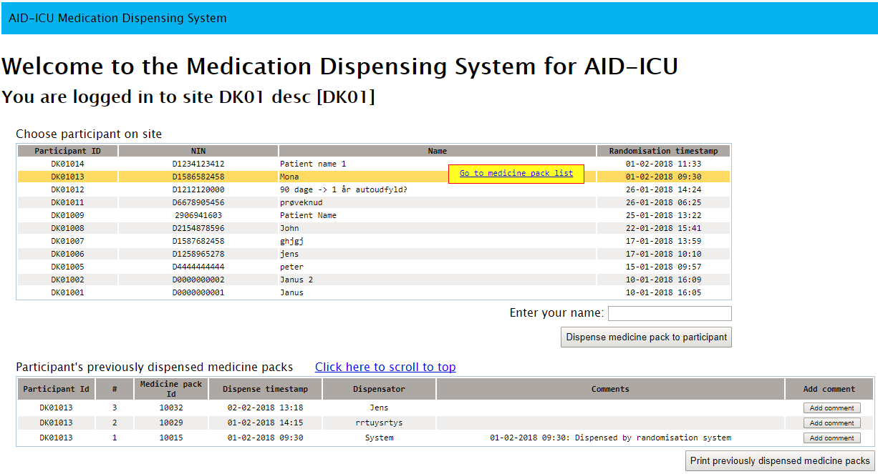
Dispensing trial medication
2. Enter your name

Slide 7
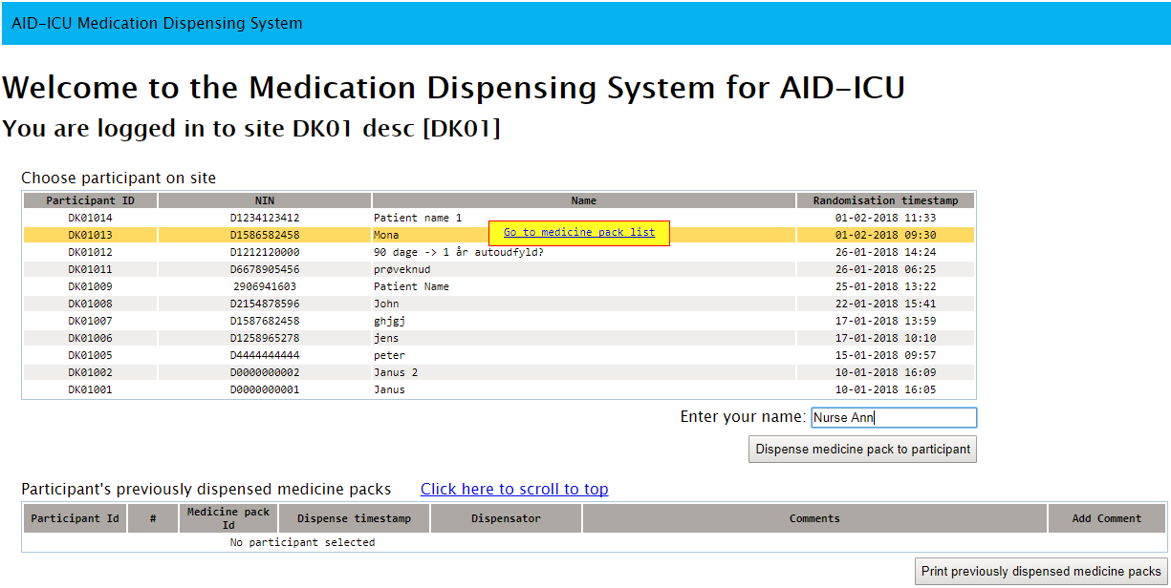
Dispensing trial medication
3. Press ‘Dispense medicine pack to participant’

Slide 8
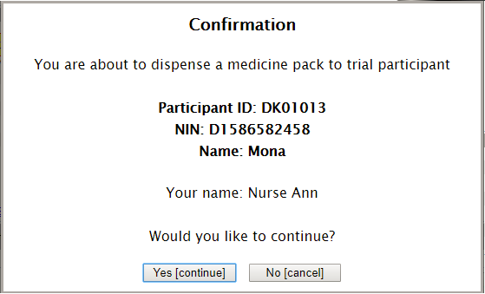
Confirm

Slide 9
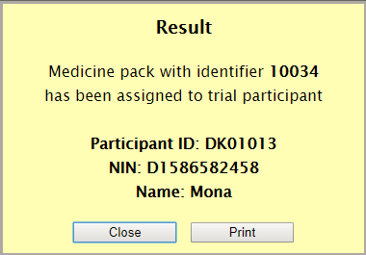
Package identification number is allocated
Find the package and administer the allocated trial medication to the patient.
One package contain 3 identic ampules
You have the option to print the package identification number.

Slide 10
Finding previously allocated ampules
Mark the relevant patient at the list

Slide 11
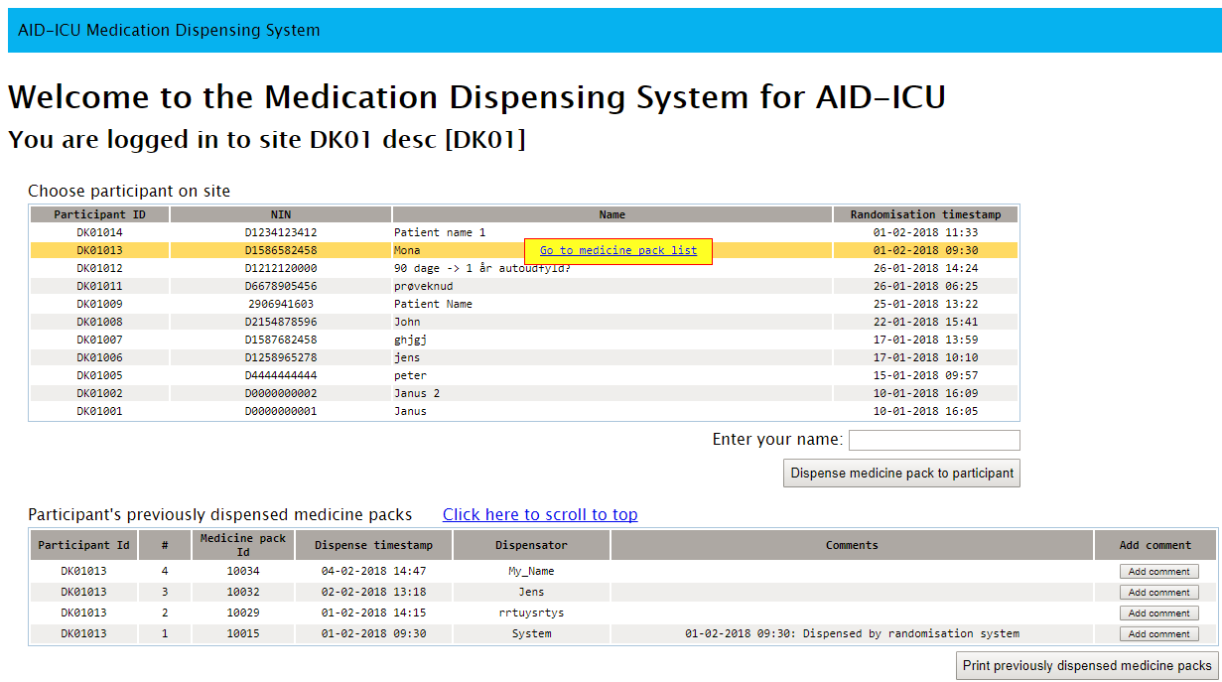
Find previously allocated ampules
A list of ampule/package identification numbers previously allocated to the patient will be shown in the bottom of the main screen.
Option to print the list.

Slide 12
If problems, use ‘Add comment’
If you experience a problem with the ampule or an issue during administration of the medication, please use the ‘Add comment’ button in the right side. If necessary, run through the procedure again to allocate a new ampule/package identification number.

Slide 13
Summary
A new package has to be allocated every day at cric.nu/aid-icu during the intervention period as long as the patient does not meet pausing criteria
If p.n. medication is needed, additional packages can be dispensed. Max daily dose is 20 mg
Mark the patient, write your name, press “Dispense trial medication”
Use ‘Add comment’ if you identify a problem with the package/ampule and allocate a new one if necessary

