Slide 1
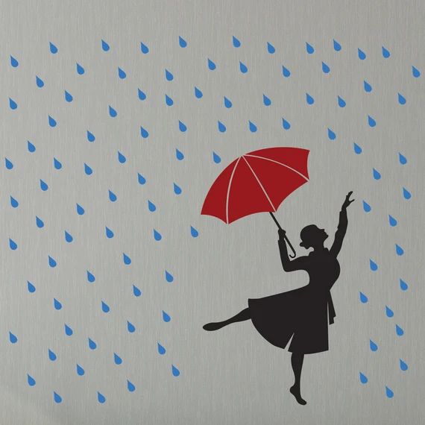
Sometimes it's not about waiting for the storm to pass.
It's about learning how to dance in the rain.
Warm greetings from Tainá

