Slide 1
Wetlands:
Climate change & the
Chester Wetland Centre
Dr Christian Dunn

Slide 2
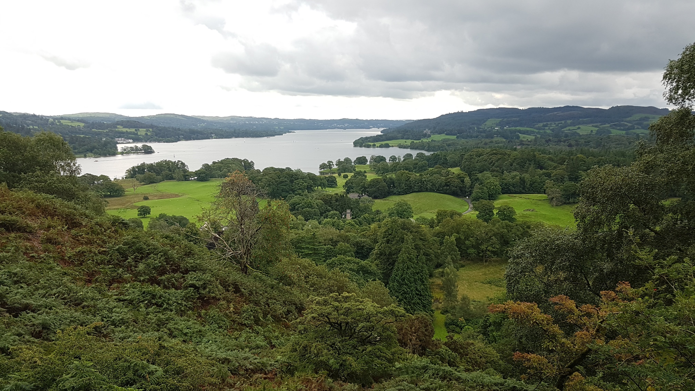

Slide 3
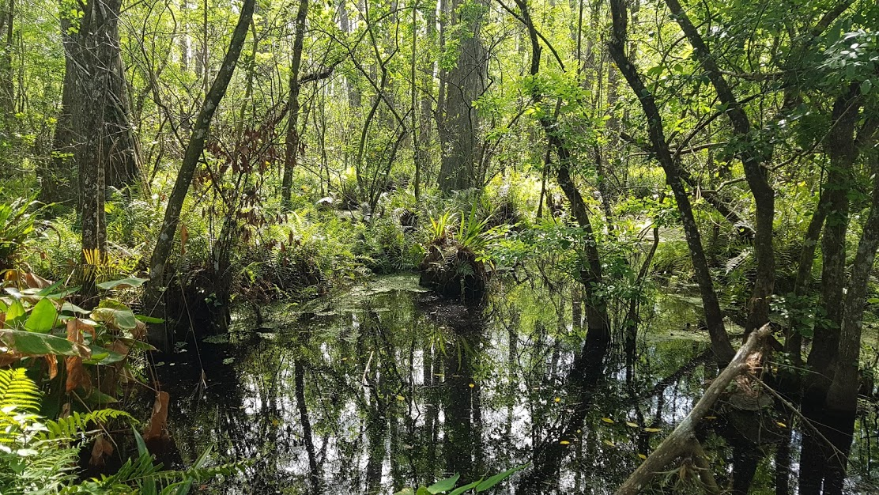
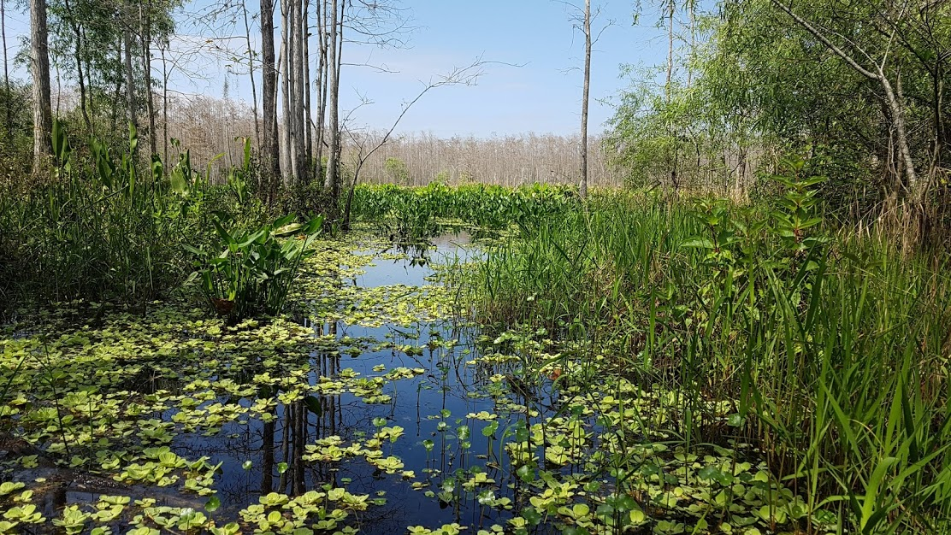
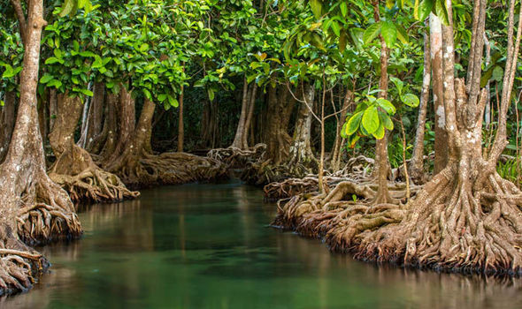
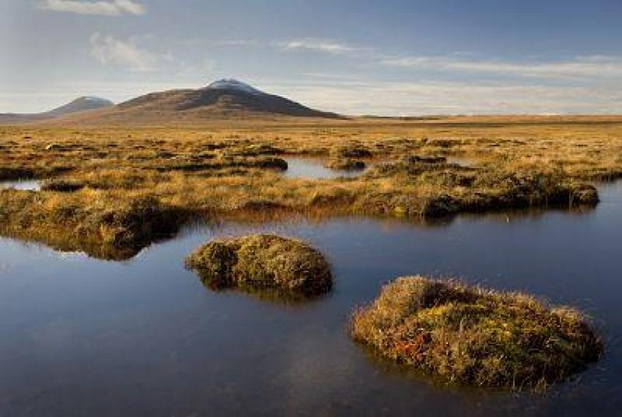
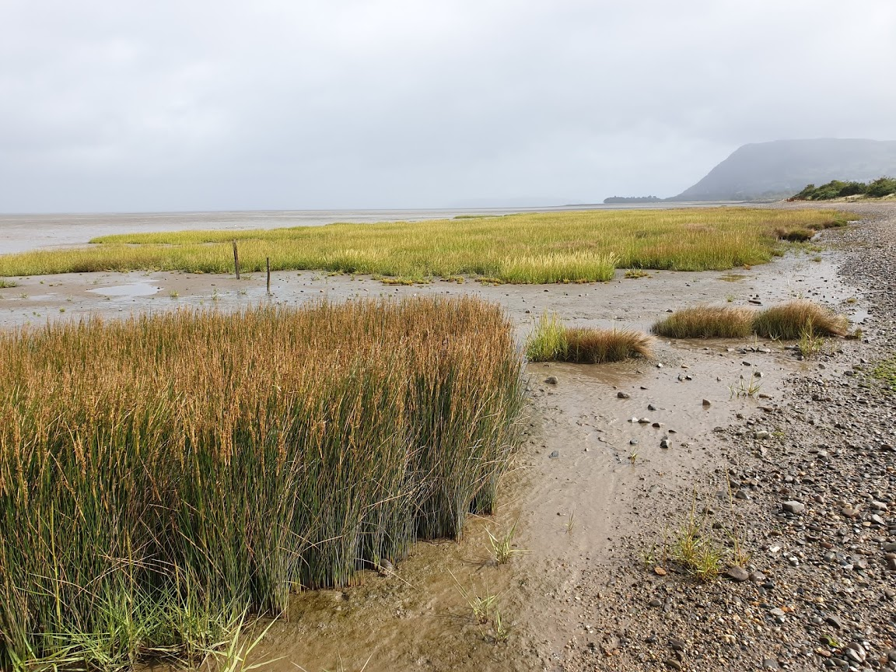

Slide 4
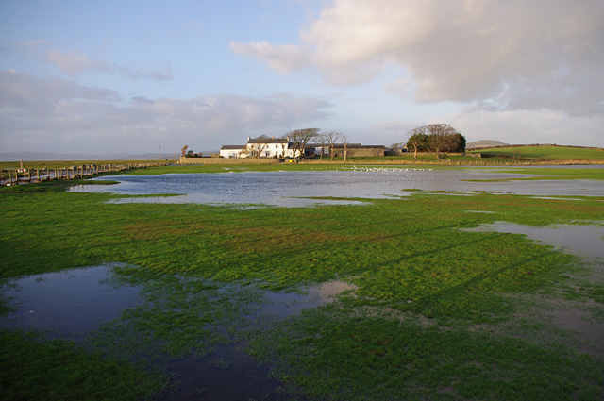
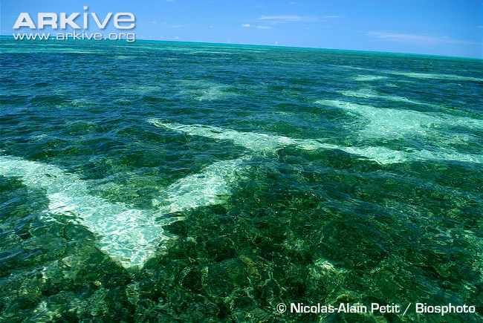
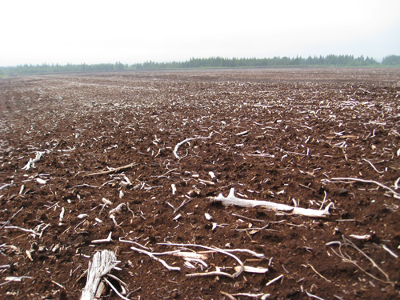

Slide 5
“To work in them you normally need wellies but you don’t need a boat”

Slide 6
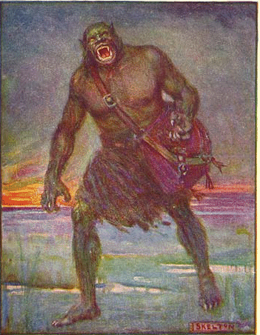
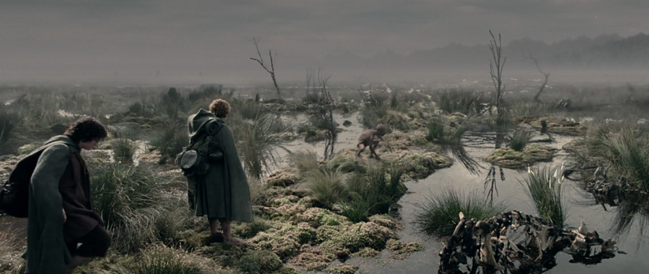

Slide 7
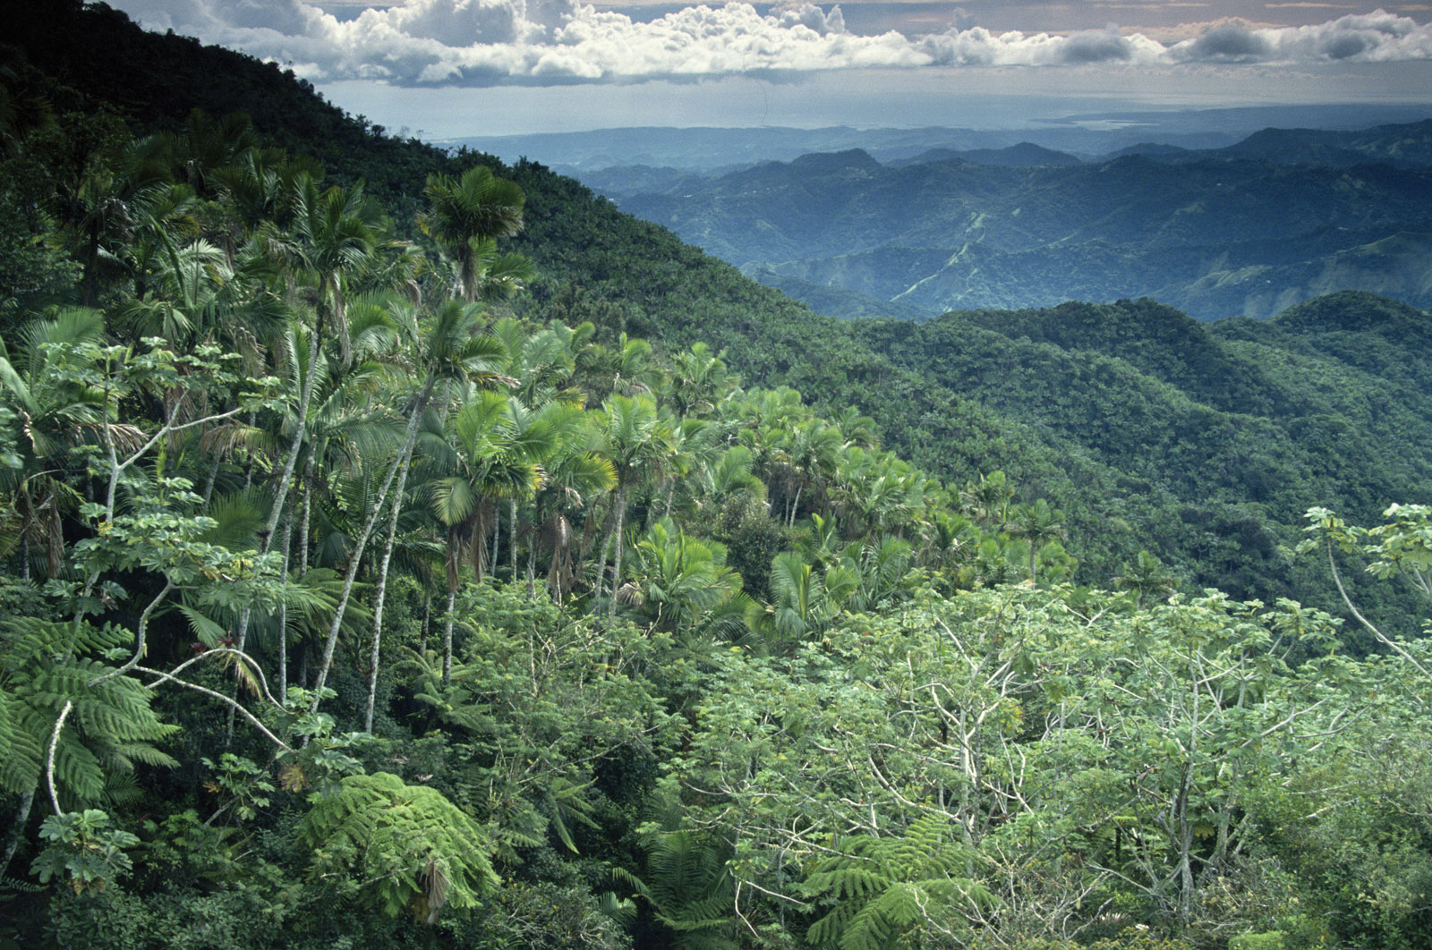

Slide 8
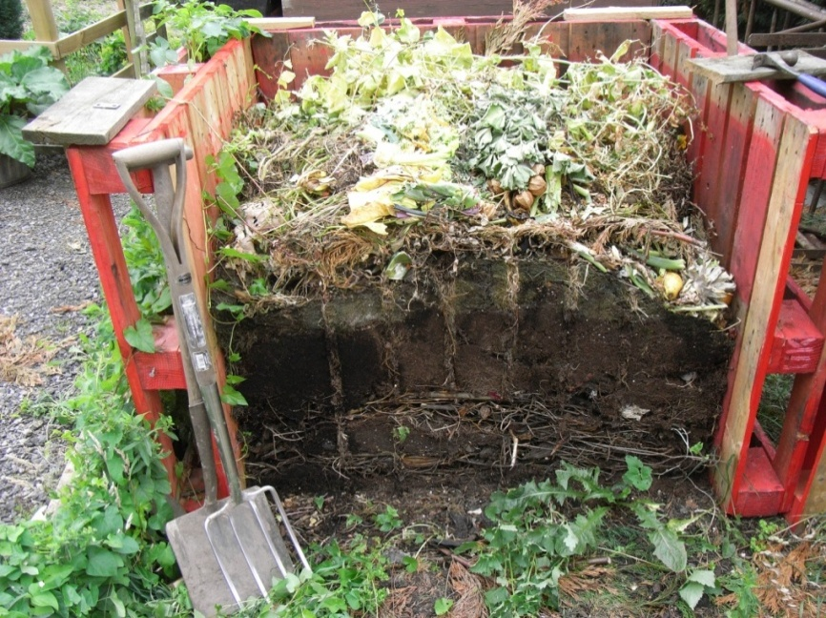
Giant inefficient compost heaps

Slide 9
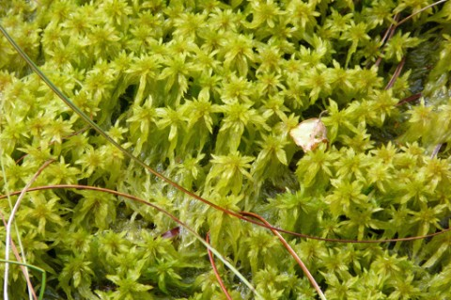
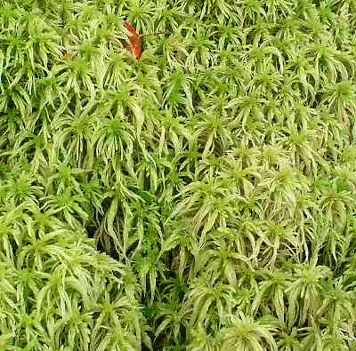
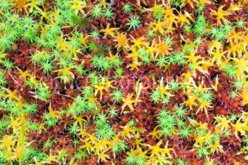
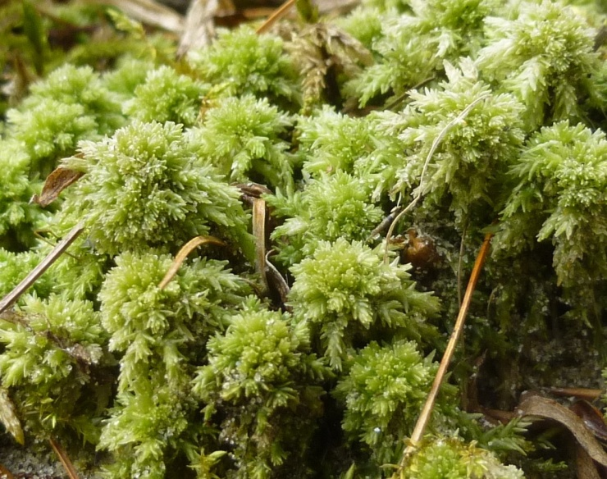
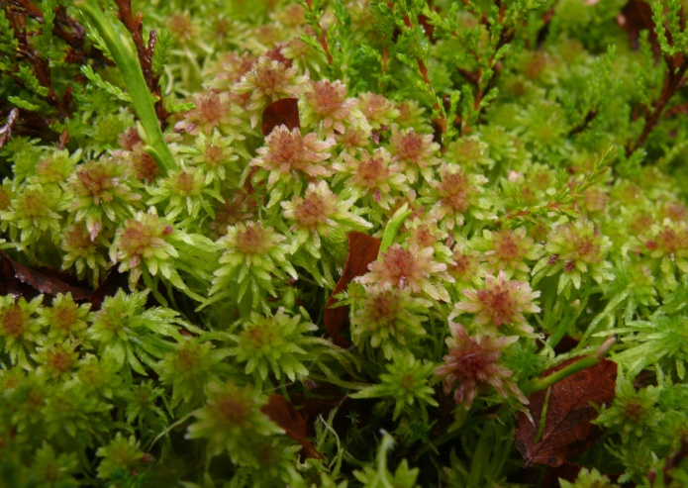
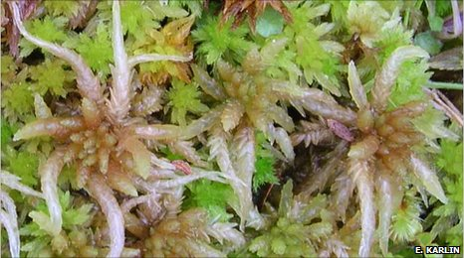

Slide 10
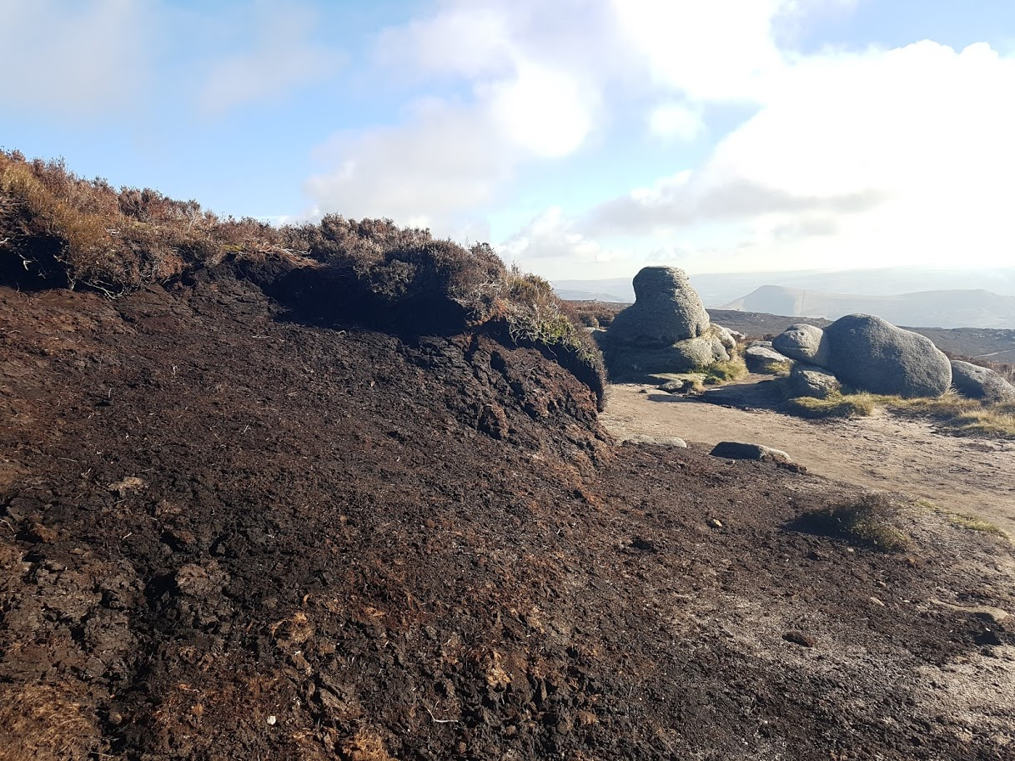
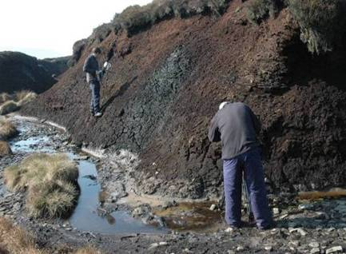
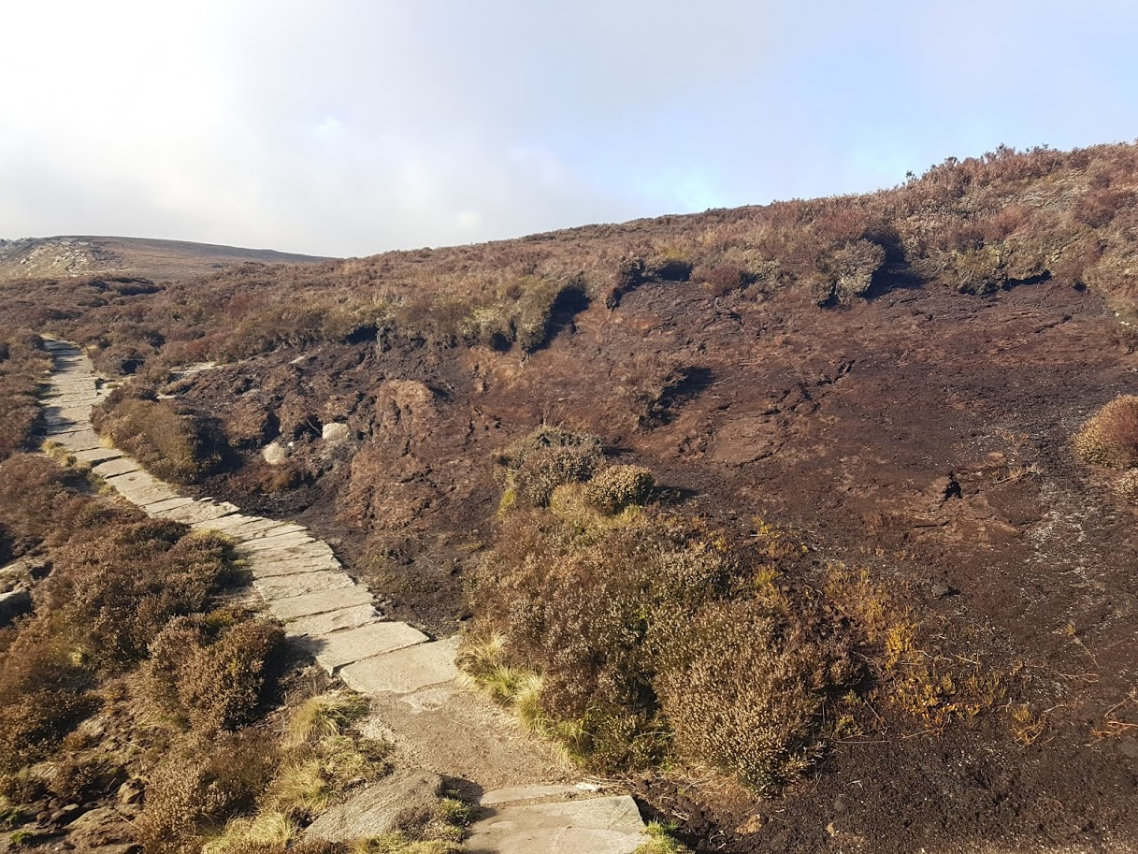

Slide 11
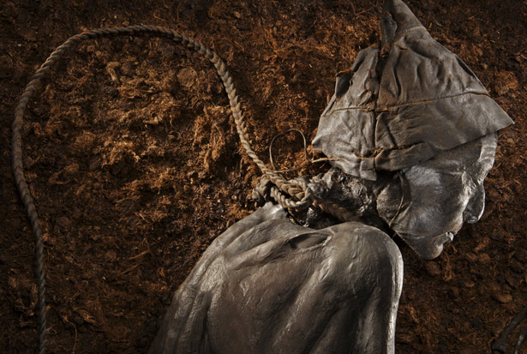
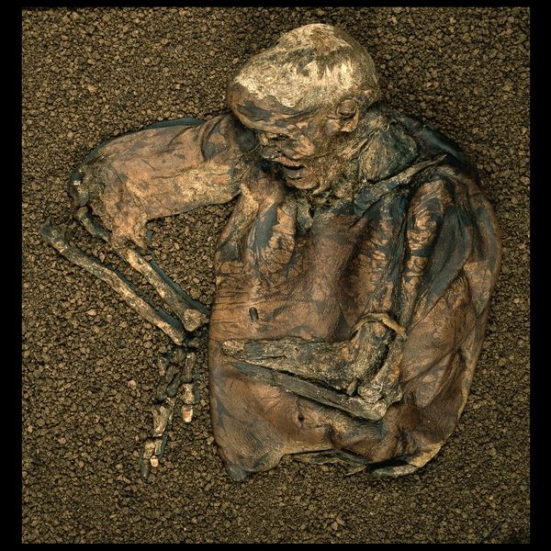
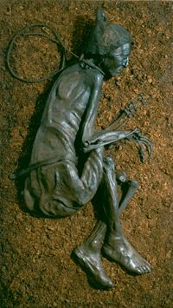
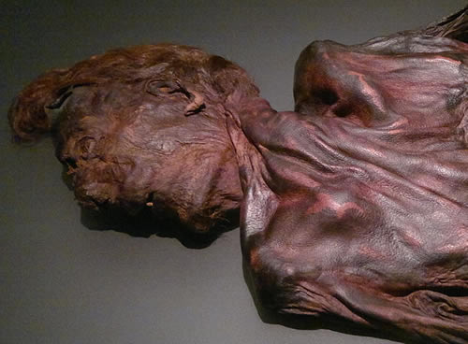
Lindow Man
Cheshire
1984
2,000 years old
Tollund Man
Denmark
1950
2,500 years old
Cashell Man
Ireland
2011
4,000 years old
Notes:
Lindow Man discovered in Lindow Moss near Wilmslow in Cheshire, by commercial peat cutters. One year after the discovery of the partial remains (the head) of a 2,000 year old woman (Lindow Woman). Police thought it was the head of missing woman. The woman’s husband who was in prison on another charge admitted the murder. But radiocarbon dating showed this was not the case.
Lindow Man discovered by the same workers. One of which picked up what he thought was a piece of wood off the elevator of the peat-shredding machine. Threw it at his friend but when the mud fell off they saw it was a human foot.
25 years old. Officially Lindow II as other remains (four in total) have been found there. Though not as well preserved as this. Done very little manual labour - well manicured finger nails. His last meal included unleavened bread made from wheat and barley, cooked over a fire in which heather hand been burnt.
Met a gruesome death. Struck on the top of his head with heavy object such as a narrow bladed axe. Blow to the back from a knee which broke a rib. Had a thin cord tied around his neck which could have been used to strangle him or break his neck. When he was dead he had his throat cut. Placed face down in bog.
Ritual killing, maybe by druids.
Tollund Man
Denmark
1950
2,500 years old
Probably the best preserved pre-historic body in the world
Tollund Man – named after the nearby village to the bog where he was found.
Probably 30-40 years old. Only side of the body that had been turned upwards in the excavation showed signs of decomposition.
Discovered in 1950 by two brothers. So well preserved they alerted the local police. They thought it was the body of a school boy who had gone missing from Copenhagen.
Hanged. Placed into a grave dug into the peat. Probably as a sacrifice.
Cashell Man
Ireland
2011
4,000 years old
Cashell Man – earliest bog body with intact skin. Hairs and pores can be seen.

Slide 12
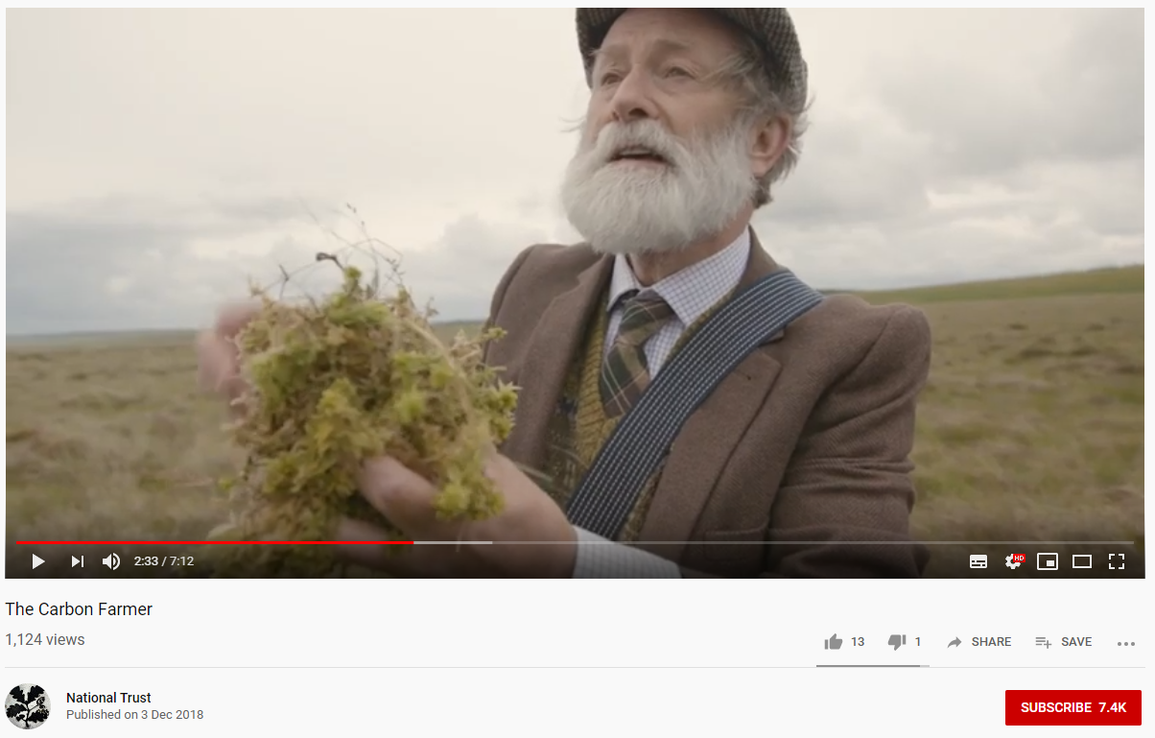
Carbon Farming
Notes:
https://www.youtube.com/watch?v=YRg7yqc7GsY

Slide 13
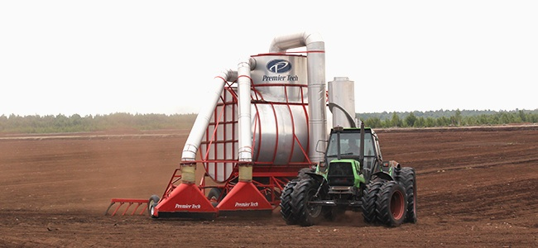
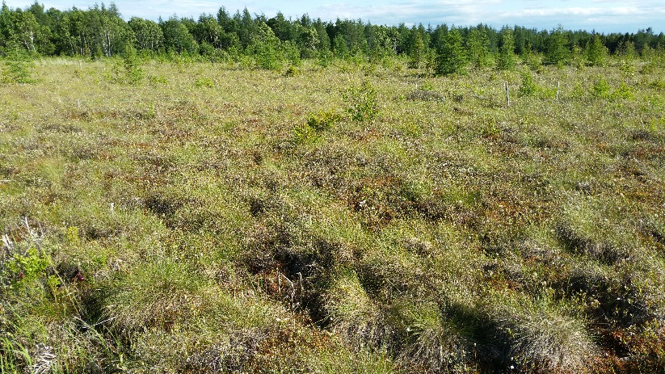
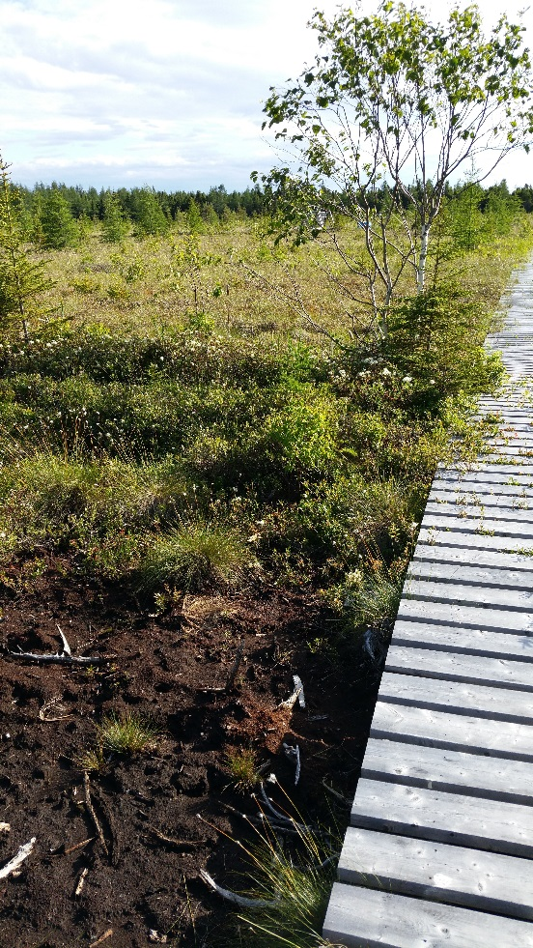
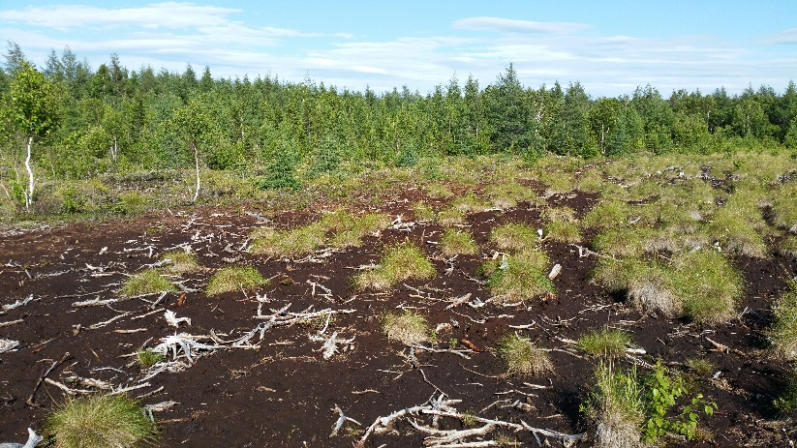

Slide 14
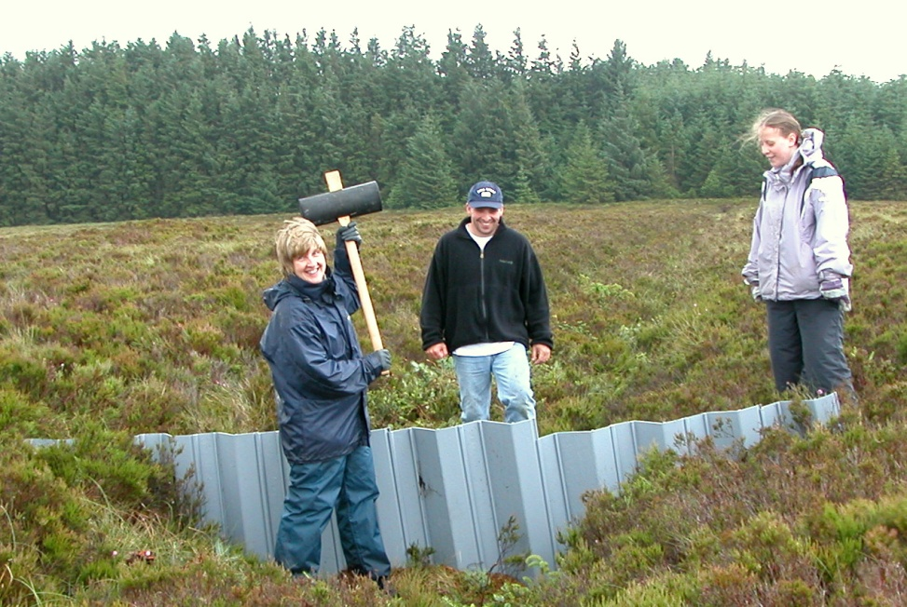
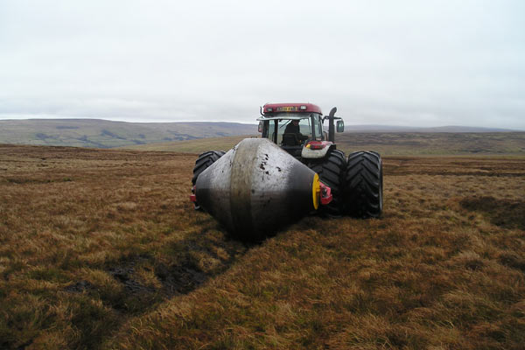
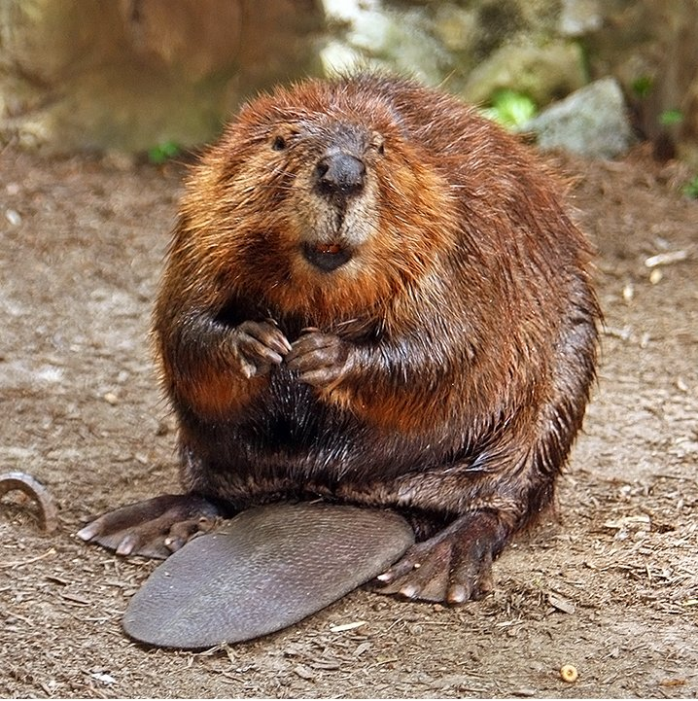
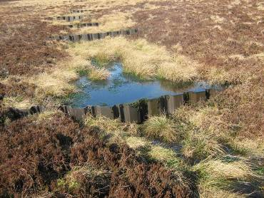
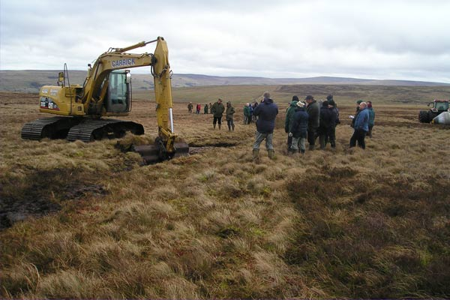
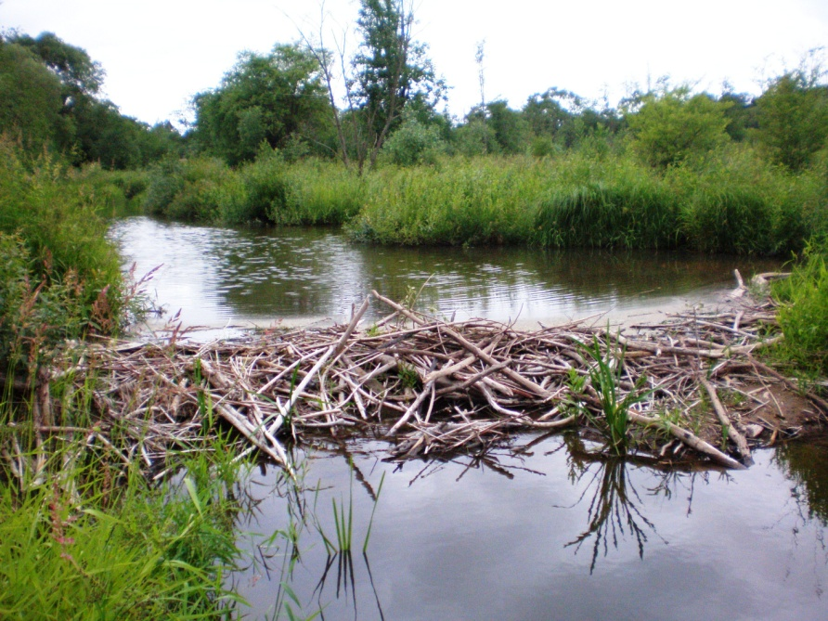

Slide 15
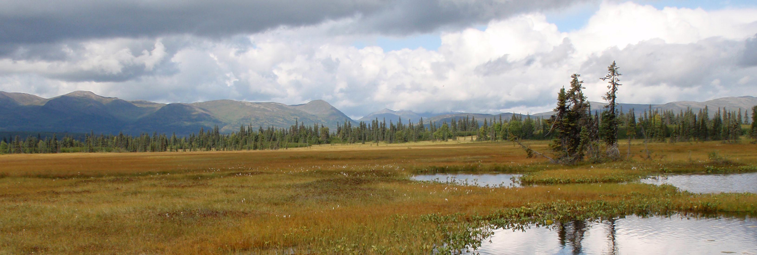
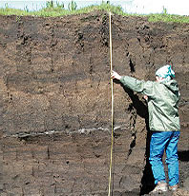
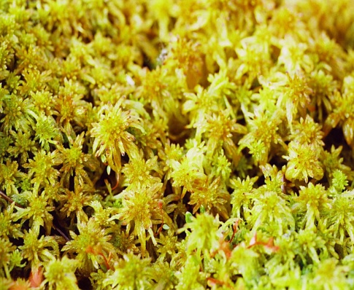

Slide 16
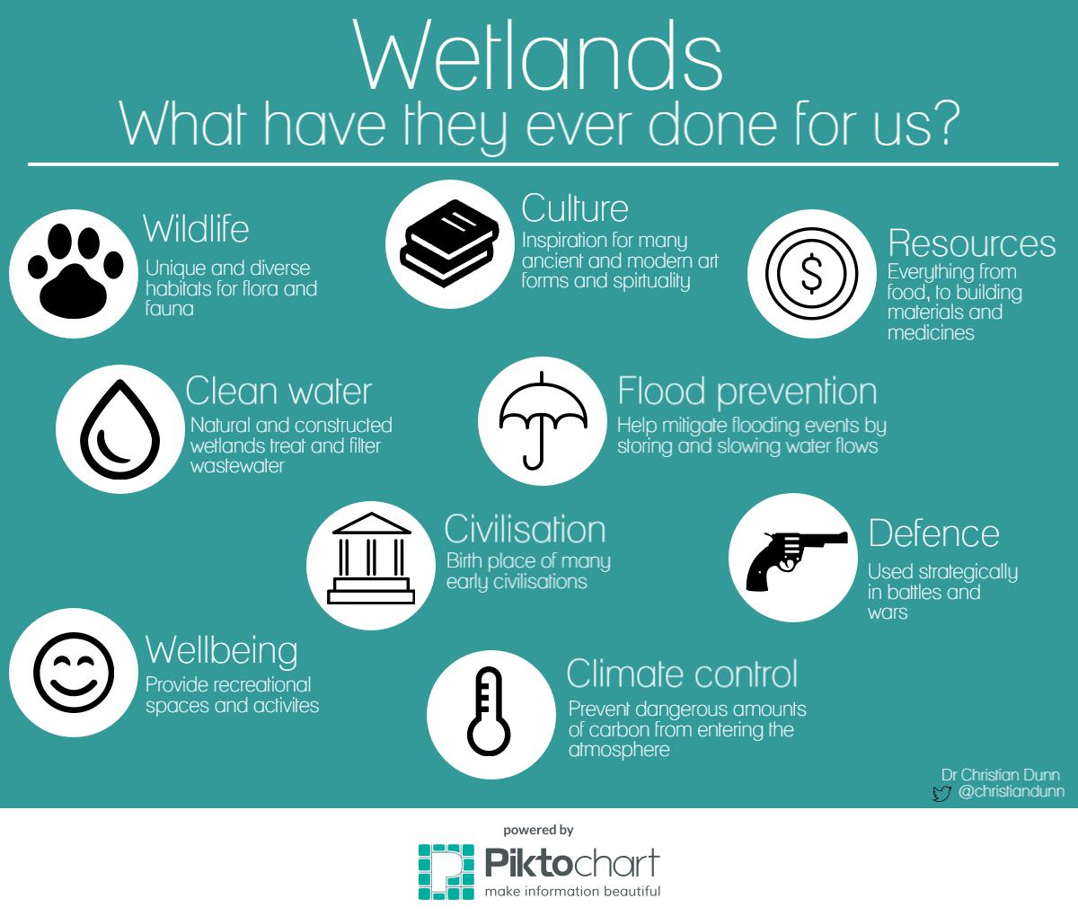

Slide 17

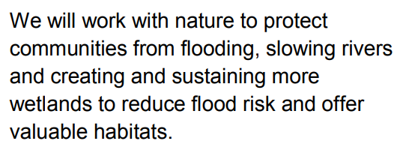

Slide 19
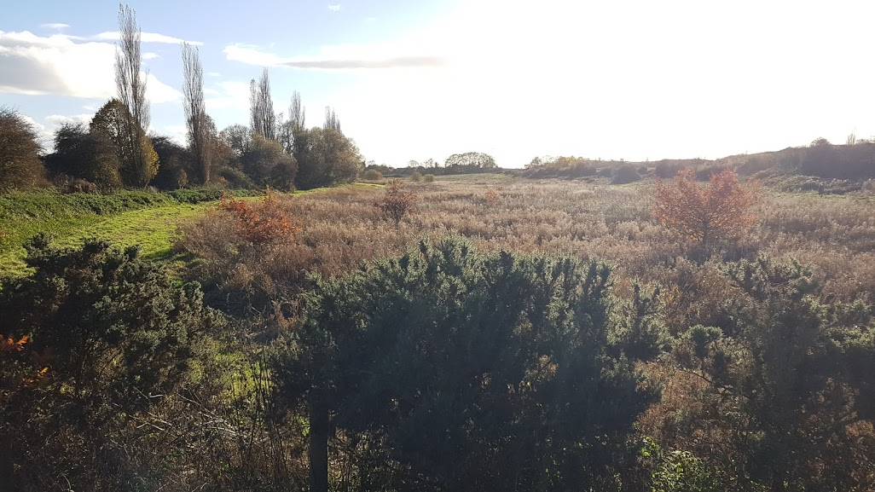

Slide 20
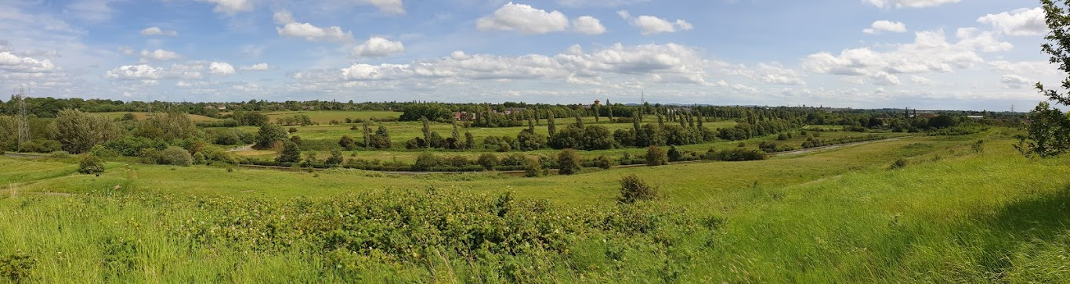
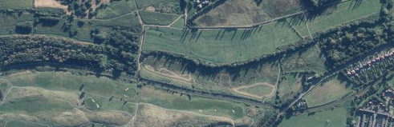
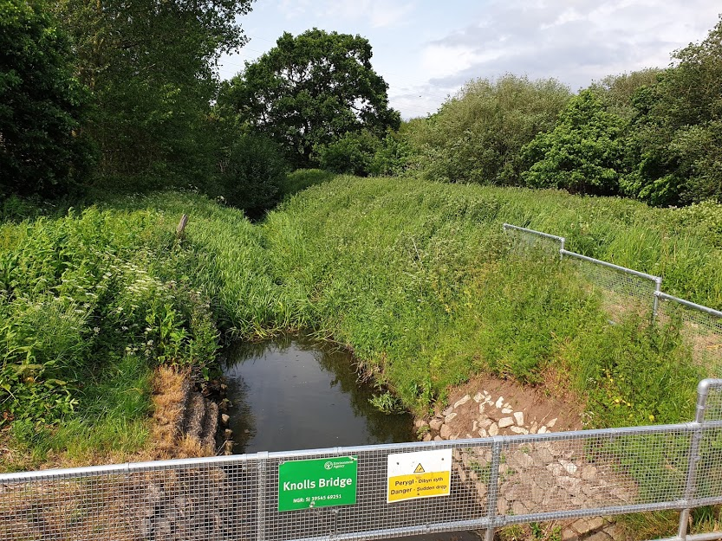
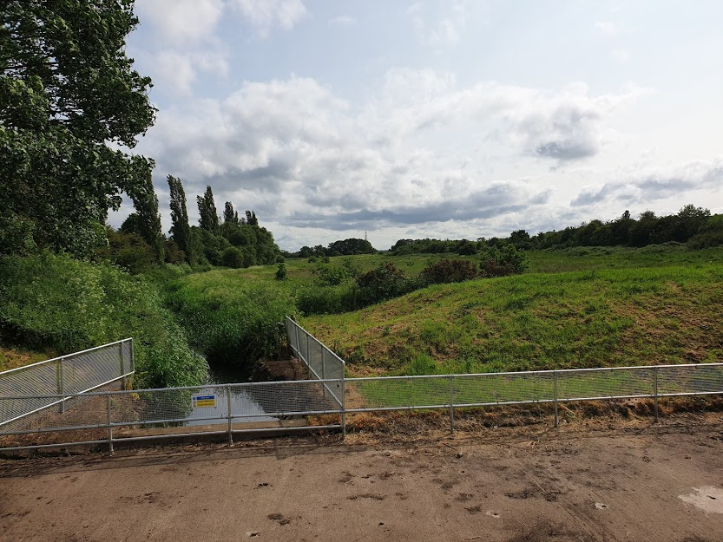

Slide 21
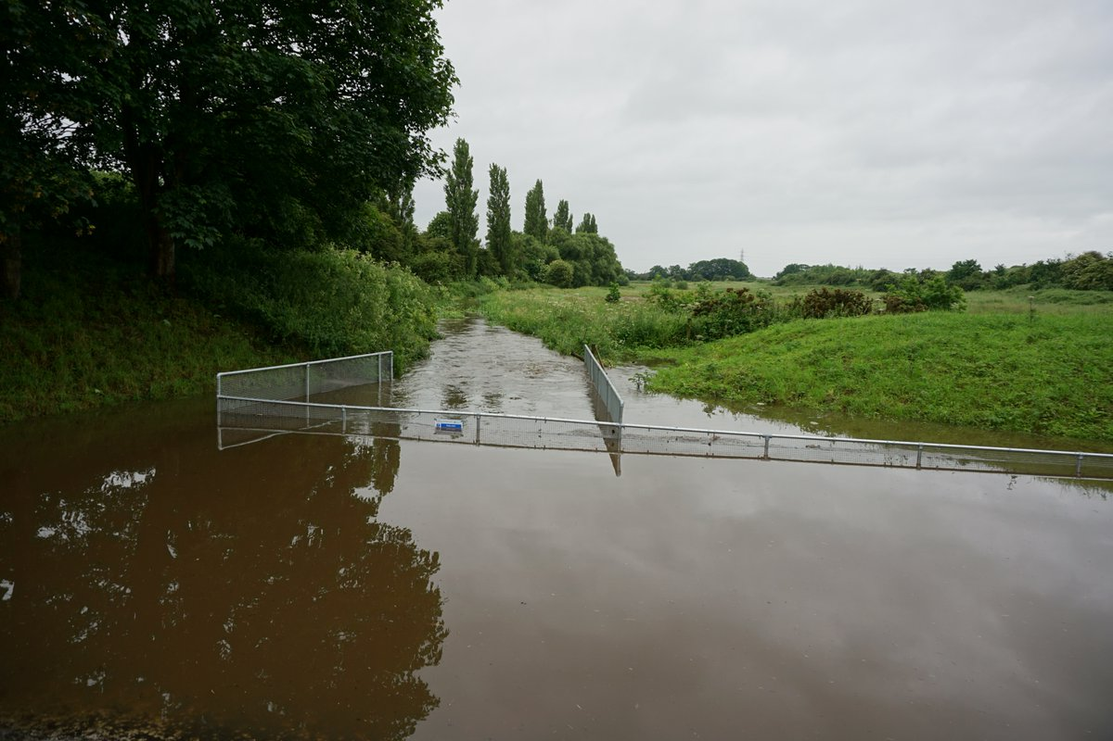
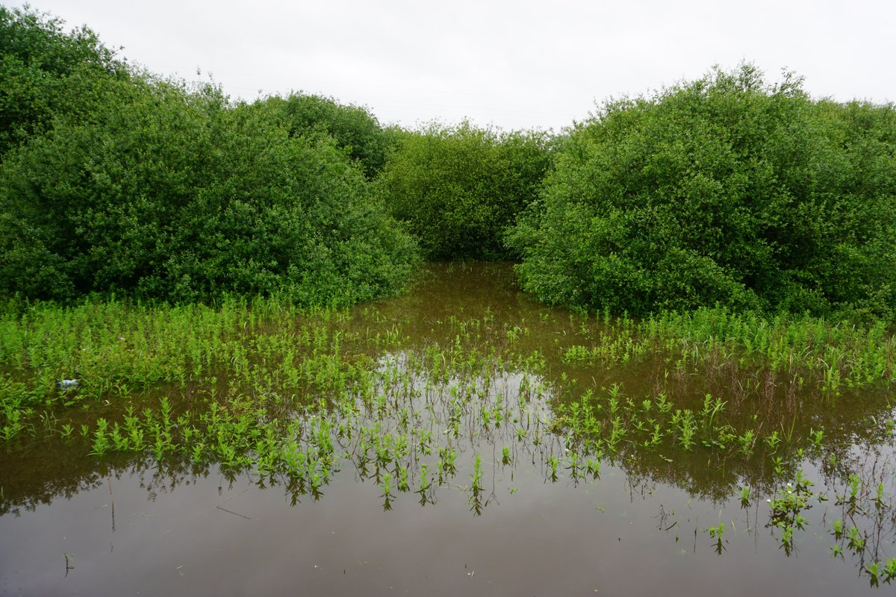
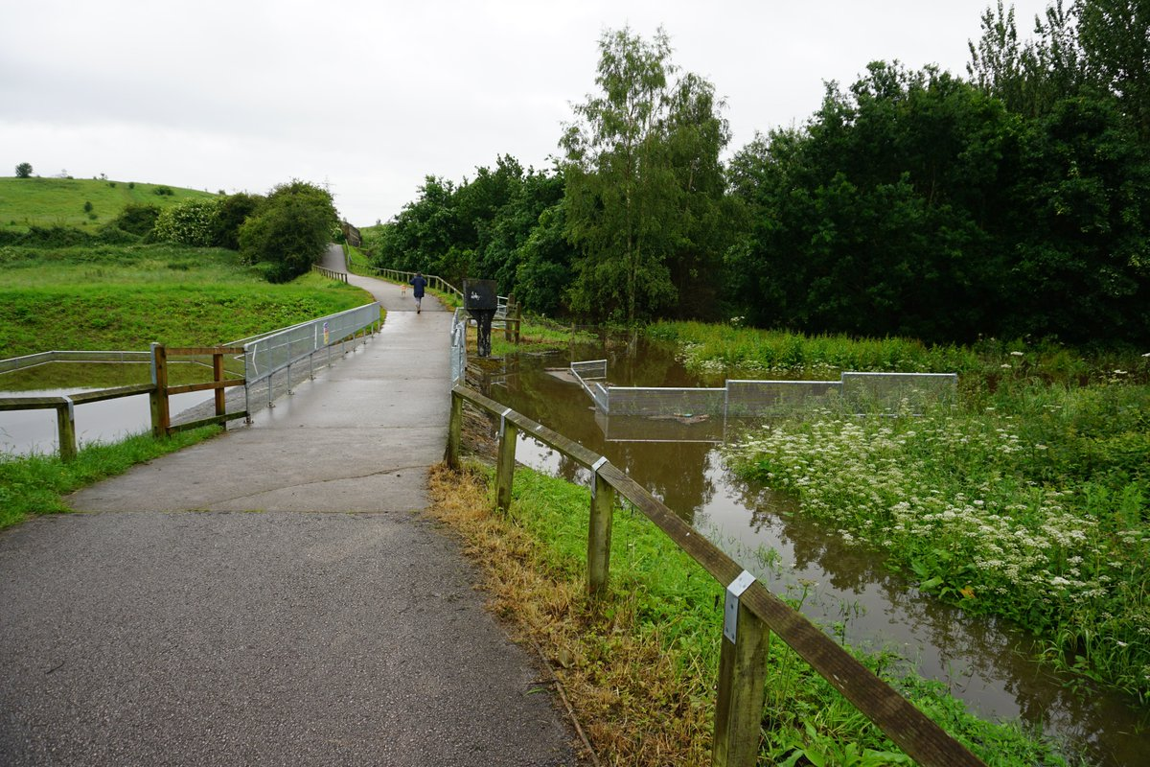

Slide 22



Wet meadow

Slide 23

Wet meadow
Brief periods of flooding and longer periods of saturation
Occasional standing water
High plant diversity
Attract large numbers of birds, small mammals and insects
Meadow – regular vegetation removal
Becoming rarer in the UK
The Hay Wain. John Constable. 1821
Notes:
a wet meadow does not have standing water present except for brief to moderate periods during the growing season. Instead, the ground in a wet meadow fluctuates between brief periods of flooding and longer periods of wetness. Wet meadows often have large numbers of wetland plant species, which frequently survive as buried seeds during dry periods, and then regenerate after flooding. Wet meadows therefore do not usually support aquatic life such as fish. They typically have a high diversity of plant species, and may attract large numbers of birds, small mammals and insects including butterflies.

Slide 24
How?
Amount of water (and when)
Quality of water
Vegetation management

Slide 26

Where we’re at…
Advisory panel
  EA, CWaC, Friends group, Land Trust, local MP and councillors, Bangor University, Chester Zoo, Cheshire Wildlife Trust, Chester University, TCV Merseyside, Friends of the Earth Chester & District
Project group
Land acquisition
Surveys
Fundraising

Slide 27
The steps
1
2
Building initial treatment wetland & irrigation channels
Flood water holding area. Vegetation management.
3
4
Board walks and educational resources
Hide/educational centre

Slide 28
The wins
Create a rare, beautiful and valued habitat
Increase biodiversity
Aid flood mitigation
Treat water pollutants
Educate
Research site
Wellbeing

Slide 29



The potential?
London Wetland Centre

Slide 30

Chester Wetland Centre

