Slide 1
PREPARATION AND CHARACTERIZATION OF PHOTON UPCONVERTING CATALYSTS FOR PHOTO WATER SPILTTING HYDROGEN PRODUCTION.
Asitha U. Malikaramage,
University of Peradeniya,
Peradeniya,
Sri Lanka.

Slide 2
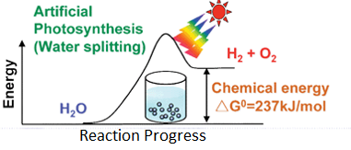
What is Water splitting ?
Highly endothermic process; ΔH > 0
“Thermodynamically Uphill” reaction
Semiconductors are used as light harvesters

Slide 3
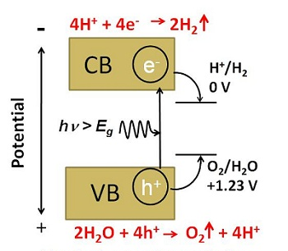
Band-gap Requirement for water photo-splitting:
Notes:
A photo catalytic water splitting reaction over a semiconductor material

Slide 4
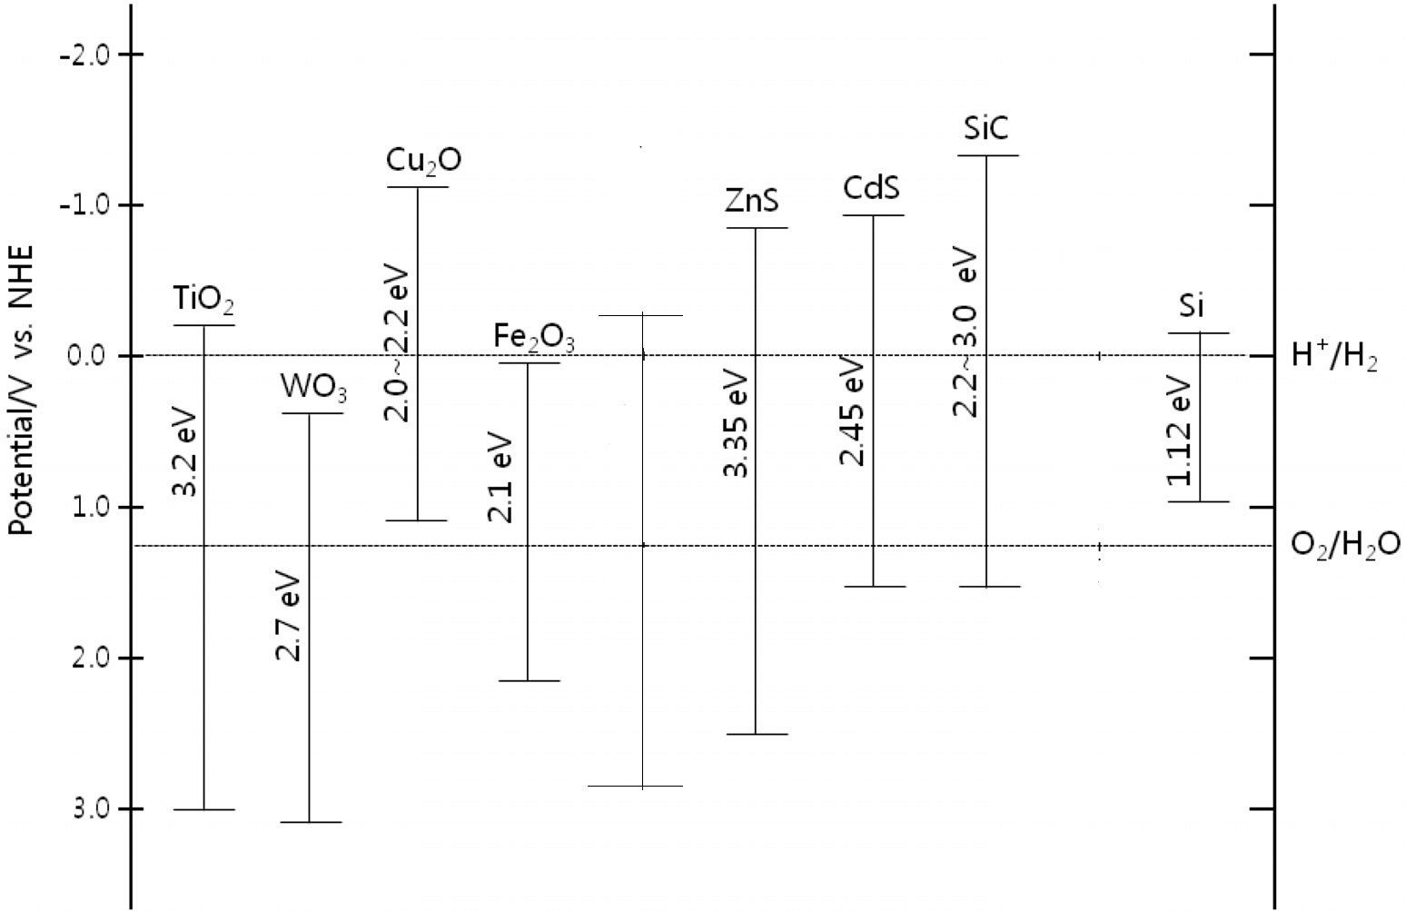
Common Semiconductors:
Lower edge position of the conduction band
SrTiO₃
3.2 eV
Upper edge position of the valence band

Slide 5
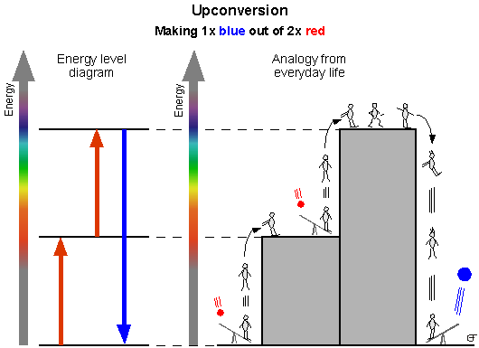
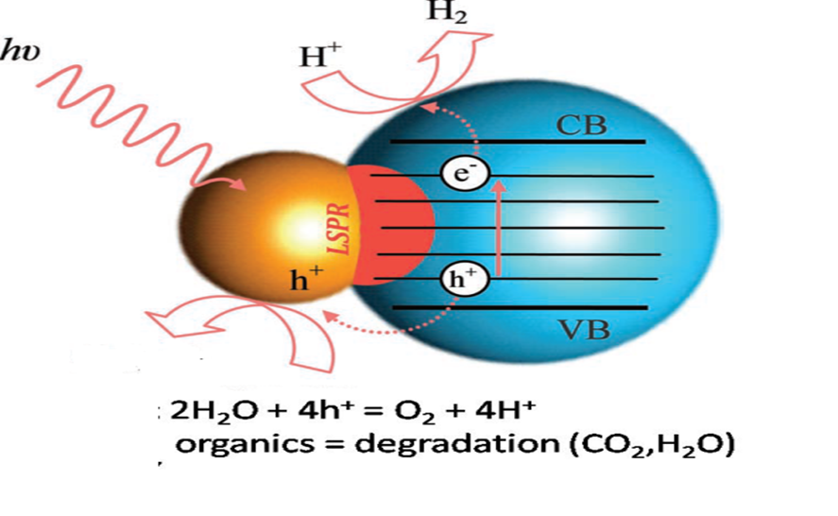
Photon Upconversion and Localized Surface Plasmon Resonance (LSPR) in photo water splitting
Proposed photocatalytic process for efficient hydrogen generation
using the Ag- TiO₂ nanostructures, based on excitation of the LSPR
under visible-light and infrared irradiation
Schematic diagram of photon upconversion phenomina

Slide 6
Synthesis
Preparation of UCM
TTIP + IrCl3 + Ag(NO₃) +Ethanol
+Glacial Acetic acid
Mixed and stirred for 30 min and adjust the P^{H} value for 3-5 using conc. Diluted KOH
Sol gel
Refluxed at 200 ºc for 48 hours using a mixture of diethelene glycole and hexane as the solvent (
Autoclaved the mixture in 150ºC for 2 hours and dried the sample in vacuumed oven at 100 ºC

Slide 7
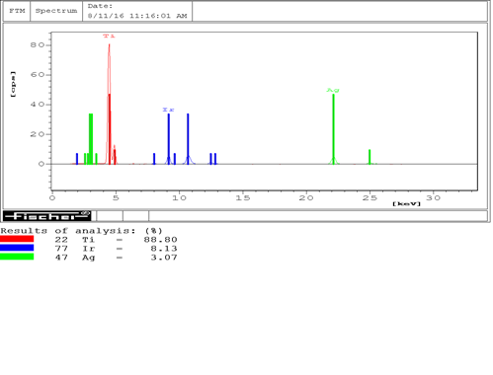
Characterization
XRF data

Slide 8
XRD data
TiO₂ phase (Anatase form)
IrO₂ phase

Slide 9
AgO phase
Ag phase

Slide 10
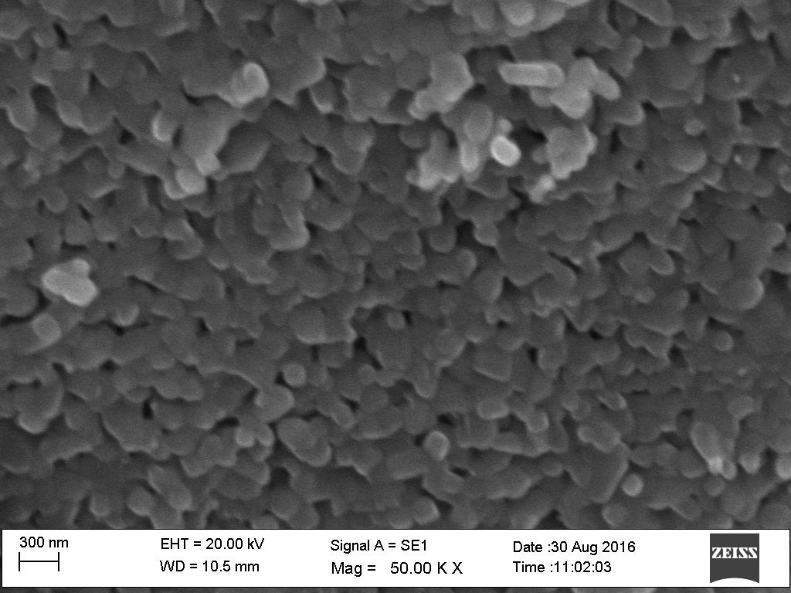
SEM Images
Non sintered
Sintered
Figure 03 . SEM images of Ag/Ir doped TiO2 nanoparticles

Slide 11
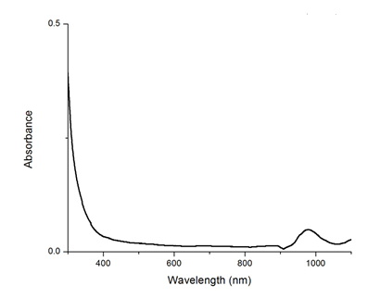
UV-visible absorbance spectra
Figure 04 . UV –visible absorbance spectra for the sample

Slide 12
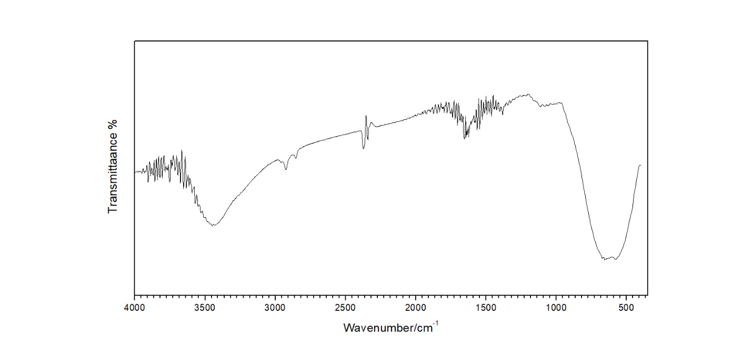
FTIR spectroscopy
Figure 05. FTIR spectroscopy
huge peak around 600 cm⁻¹ typically it represents the Ti-O-Ti bonds and Metal attachments to the Ti atom. So this can be used as a confirmation of Ti-Ir and Ti-O-Ir bonding.

Slide 13
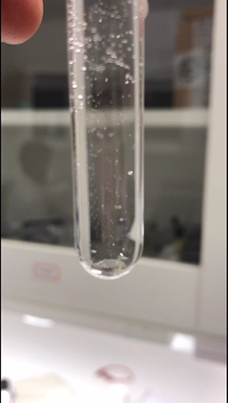
When only distilled water used to produce the hydrogen and oxygen . Efficiency of hydrogen production reduced with time. (5 mins).
To overcome this problem Ethanol was introduced as a scarifying agent .
So this can be also used to degrade organic pollutants to smaller molecules (CO2 , CH2O,…ect)
2h+ + C2H5OH / 2H+ + CH3CHO
Video 01: Photo water splitting under 1 sun

Slide 14
Conclusions
Iridium / silver nano-composite can be used as an efficient photo water splitting material.
The material can be used to degrade organic pollutants in water in favorable of purifying water.

Slide 15
Future works
To measure the hydrogen evolution rate from the GC –TCD technology
Get TEM images of the material.
Do the further characterization of new hydrothermally grown nanorods /nanoflowers assisted water splitting material.
Introduce Holmium , Samarium and Gadolinium to the material.

Slide 16
Thank you !!

