Slide 1
FLOWCELL SYSTEM Automated Bleed-off System (ABS)
®
Dec 2019
Patent Pending

Slide 2
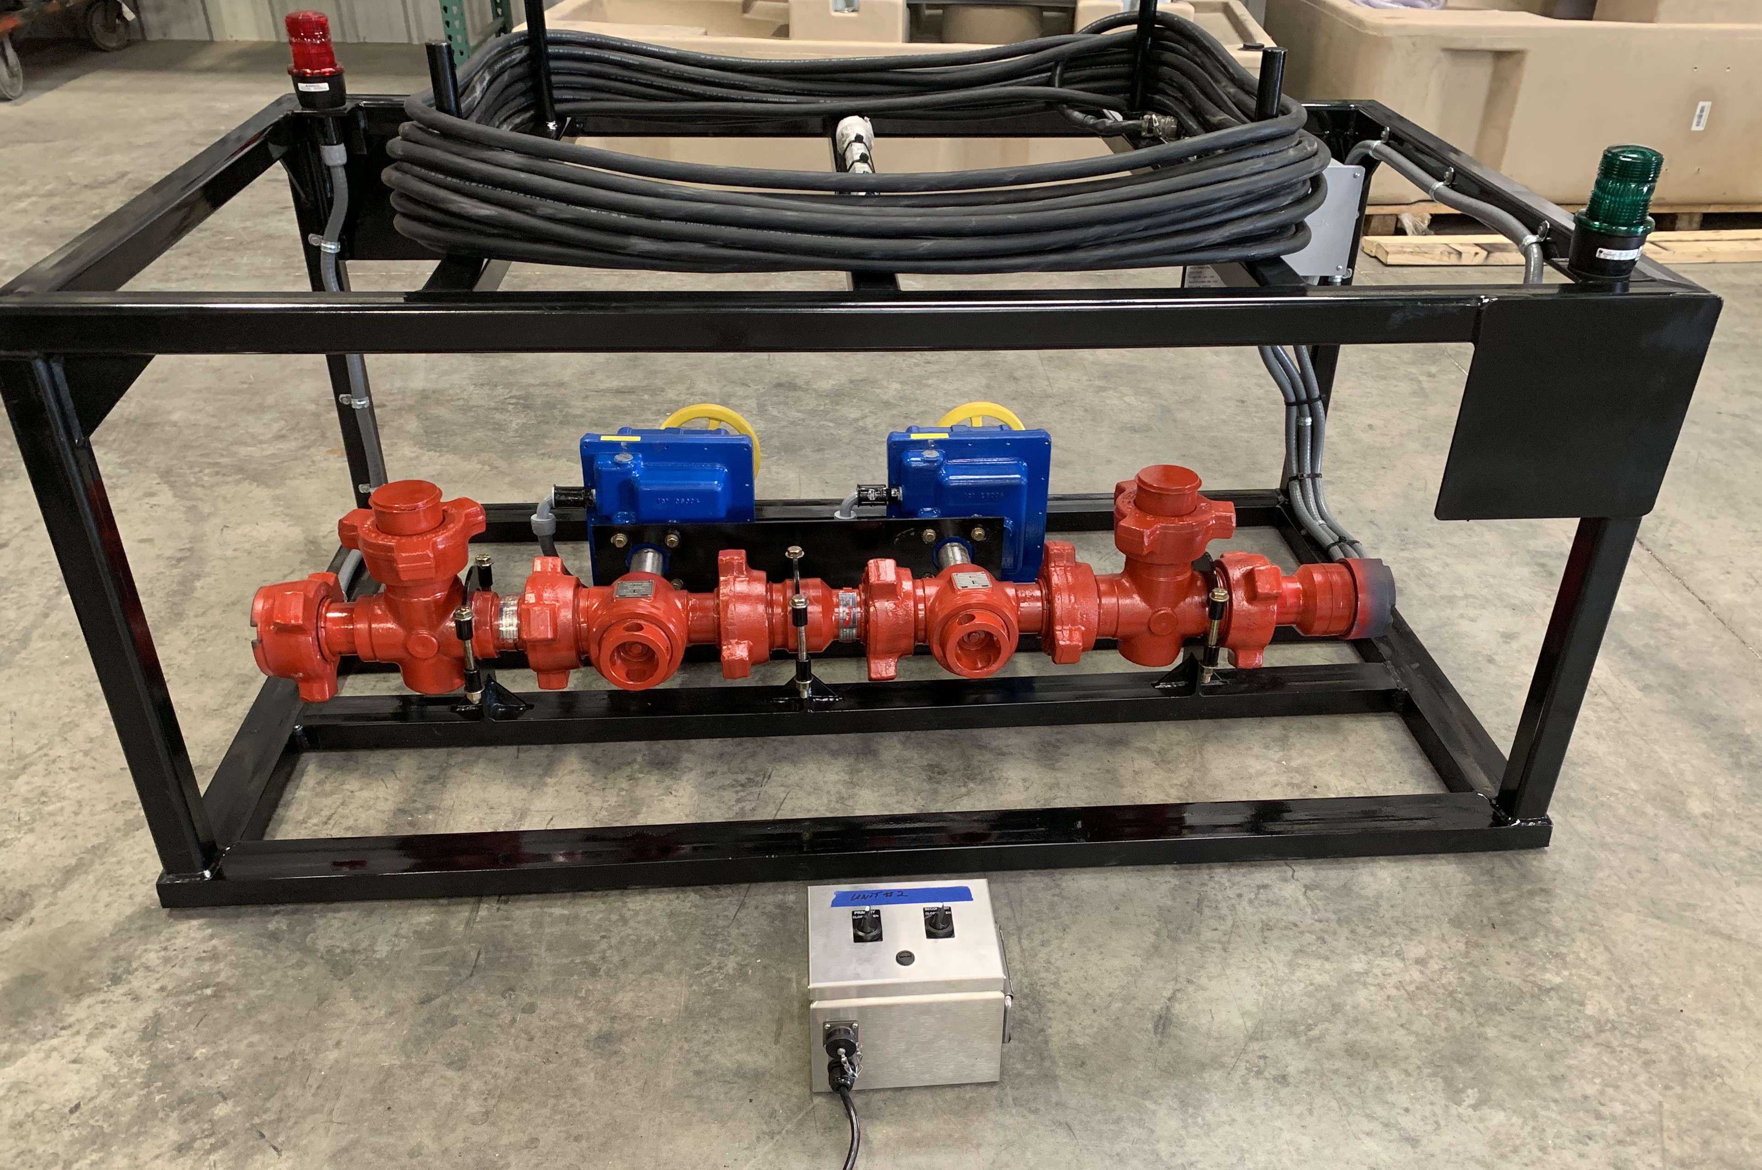
ABS Objectives
Replace manual bleed-off systems with true remote-control capabilities to bleed-off high pressure from frac treating iron
Eliminate need for personnel to manually bleed-off pressure from frac iron by entering the Red-Zone
Provide a feedback mechanism to clearly delineate pressure status of frac iron remotely
Offer scalable system that can handle various sizes of treating iron and multiple configurations for additional components (Pressure Relief Valves, Pressure Sensors, Burst Discs)

Slide 3
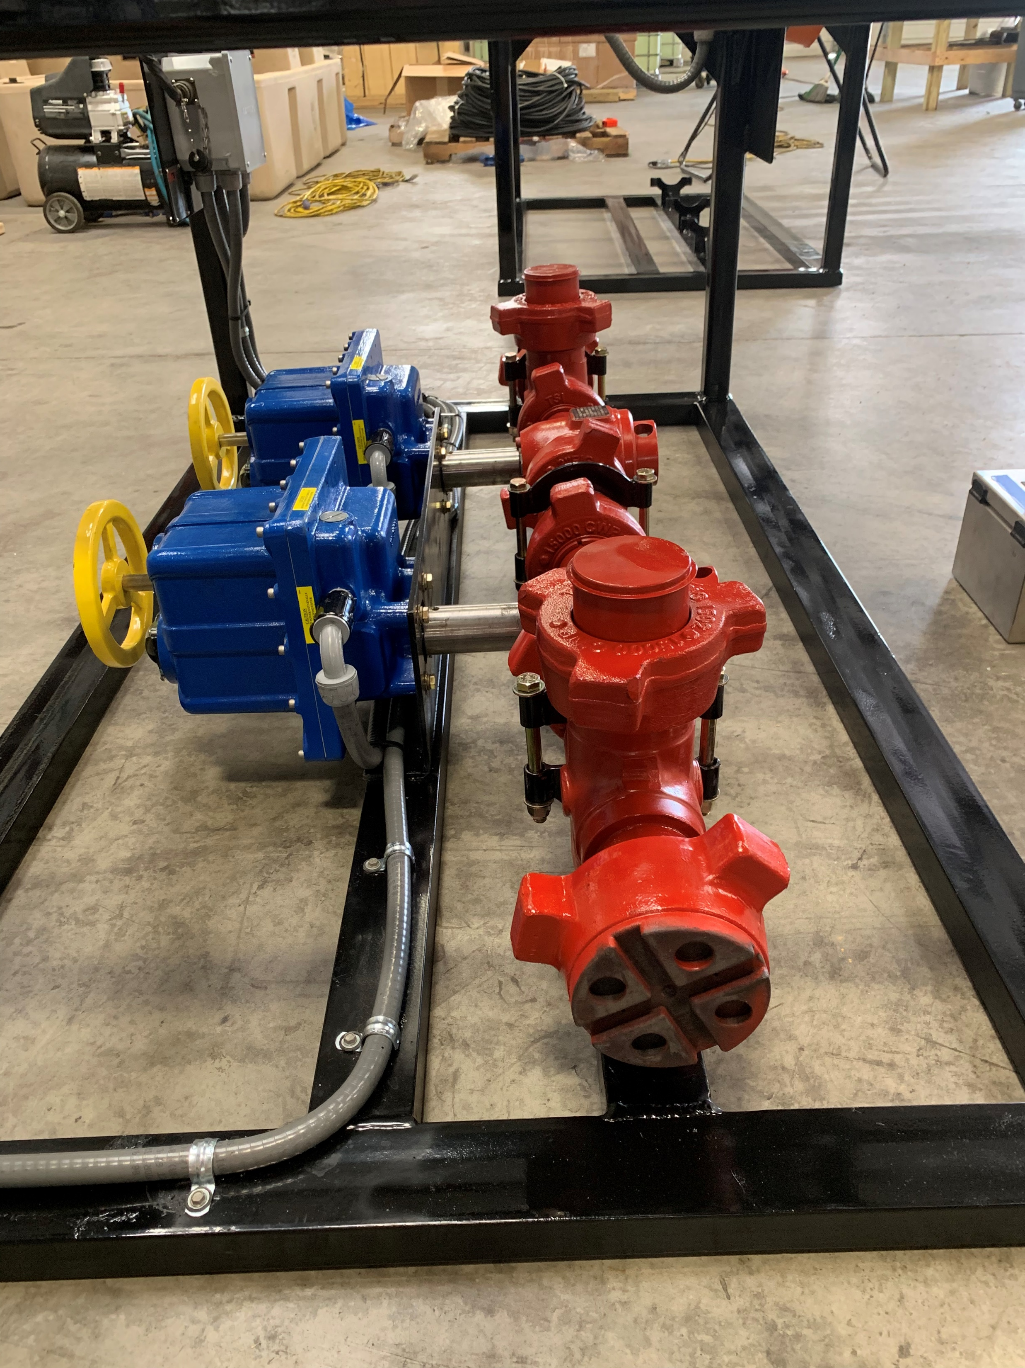
ABS Features & Benefits
Skid based unit
Base model has a 2”1502 Treating Iron system
Remote actuated bleed-off or plug valves driven by 110V electric motors which include:
Limit switches to fully closed position (RED Beacon) and fully open position (Green Beacon)
Opening torque: 15,000 PSI at 187 Newton-Meters
Supplied with a 150ft cable for power and control of the valves from the Data Van complete with deutz connectors
Remote-control box with independent switches for each valve

Slide 4
ABS Configuration Options
Scalable solution for various size treating iron (2”, 3”, 4”) as well as varying heights of centerline as per customer needs
Multiple valve options including 2x2 or 2x1 Bleeder Valves (recommended) or Plug Valves
Positive displacement choke for controlled pressure bleed-off
2 additional ports (tee with female end), which can be utilized as additional pressure ports for independent pressure monitoring
Optional configurations for Pressure Relief Valves and/or burst discs
Configurable system which can be customized as per clients standard operating procedures

Slide 5
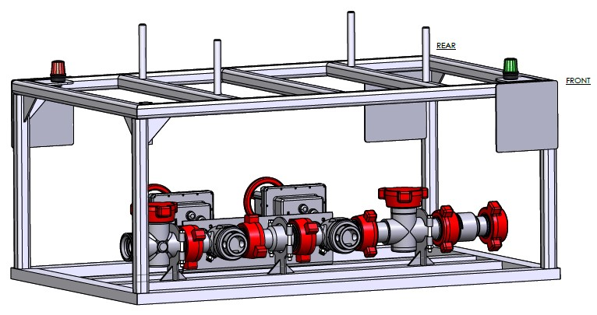
ABS Engineered
L: 68 1/2”, W: 40”, H: 29 1/8”

