Slide 1
The state of IP law in the Nordic countries - Denmark
By Attorney-at-law Peter-Ulrik Plesner (DK)

Slide 2
1 Current legislative changes

Slide 3
(i) The establishment of an IP enforcement unit
Purpose
Establishing an IP enforcement unit to provide guidance for individuals, SME's and other public authorities in order to ensure the enforcement of IP rights
Legal framework
Forms a part of the former government's "growth plan" from 2013
Originally enacted by Act no. 309 of 28 March 2015 as an amendmend to the Danish Trademark Act, Danish Design Act, Danish Patent Act and Danish Utility Models Act
Still not entered into force due to notification issues
Notification procedure at the EU Commission turned out negatively
State aid issues → only a market failure as to SME's (small and medium sized enterprises)
→ New Act is expected to enter into force on 1 January 2017
Expected budget: DKK 600,000 (approx 80,600 EUR) which amounts to 1 ½ full-year equivalent – ½ in reality)

Slide 4
(i) The establishment of an IP enforcement unit
The enforcement unit's tasks
To function as a "contact point" for privat individuals, companies and government authorities
To provide guidance in specific cases in relation to the enforcement and protection of IP rights
To deliver written opinions upon request, see section 45(b) (2) → such opinions are not binding
Fee for written opinion → DKK 1,500 (approx. EUR 200)
Can only deliver opinions regarding registered rights
To assist the police and the prosecution service in matters regarding counterfeiting

Slide 5
2 Important court decisions

Slide 6
(i) F&H v Bodum – PI case
Facts
The case concerns F&H's patent covering a cheese cutter
Bodum's invalidity claim
Bodum claimed that F&H's cheese cutter lacked novelty → German citation
Further, Bodum claimed that the procedure at DKPTO had been insufficient
Bodum's claim on no infringement
Bodum's cheese cutter did not wear at ball-shaped handle similar to F&H's cheese cutter
Legal issues
How will the Maritime and Commercial High Court handle the question on validity in PI cases?
Has the examination of invalidity claims intensified?

Slide 7
(i) F&H v Bodum – PI case
The Maritime and Commercial High Court's decision
The Court examined the German citation
The Court nevertheless found that there was an assumption of validity
Decision: Bodum's cheese cutter infringed F&H's patent
The Bodum cheese cutter did perform all of the patent claims except of the ball-shaped handle
The Bodum cheese cutter solved the same technical problem as the patent-in-suit → infringement based on equivalence
Our comments
The decision shows that the Maritime and Commercial High Court has chosen a more in-depth examination as to the validity by examining the German citation → nevertheless, the Court decides that there is an assumption of validity

Slide 8
(ii) Oticon v GN ReSound – PI case
Facts
The case concerns the validity and infringement of Oticon's patent and utility model covering an antenna technology for a hearing aid
GN ReSound claimed that the requirements of granting a PI were not met i.a. because Oticon had not exploited of the patent-in-suit by marketing any new hearing aids containing the patent-in-suit
Oticon claimed infringement of a sub claim with the same wording as the utility model
Legal issues
Requirements for granting a PI
Interpretation of section 413 of the Danish Administration of Justice Act

Slide 9
(ii) Oticon v GN ReSound – PI case
The Maritime and Commercial High Court's decision
Patent and utility model assumed valid
Oticon had rendered probable that GN ReSound's products infringed Oticon's patent and utility model
However, PI not granted because requirements under section 413 of the Danish Administration of Justice Act are not met
The High Court's decision – PI appeal:
Patent and utility model assumed valid
PI granted with the following reasoning:
"(…) Based on the above, the High Court finds that the grant of a preliminary injuntion in i.a. cases regarding the infringement of patents and utility models continously can – and often will – constitute the primary protection of the said rights and that the provision in the Danish Administration of Justice Act, section 413 (3) must be applied and interpreted in the light hereof."

Slide 10
(iii) The "Lyrica" case – PI case
Facts
The case concerns Pfizer's "second-medical-use" patent regarding the use of medicinal products comprising "pregabalin" for the treatment of pain
At the time, Krka marketed a medicinal product comprising "pregabalin" for the treatment of anxiety and epilepsy (which are not protected by the Pfizer patent)
Nevertheless, Danish pharmacies would sell Krka's product for the treatment of pain and thereby infringe Pfizer's patent
Legal issues
The interpretation of the legislation regarding the substitution of medicinal products in Denmark in relation to "second-medical-use" patents

Slide 11
(iii) The "Lyrica" case – PI case
The Maritime and Commercial High Court's decision
The Court found that Krka did not infringe Pfizer's patent
The Court found, however, that the Danish pharmacies did infringe the patent when selling Krka for the treatment of pain
→ PI granted
Our comments
The case is interesting since it is the first time in Danish legal history that a PI covering all pharmacies in Denmark is granted
The case led to the amendment of the Danish legislation regarding substitution of medicinal products in relation to second-medical-use patents

Slide 12
(iv) The "MONTANA" and "TRIPP TRAPP" cases
Facts and legal issues
The cases concerns the scope of protection of the copyright relating to the industrial designs of the MONTANA shelve and the TRIPP TRAPP chair
The Danish courts have previously ruled that both the MONTANA shelve and the TRIPP TRAPP chair are entitled to copyright protection
UfR 2001.747 H ("Tripp Trapp") and UfR 1999.1859 SH ("Montana")
Also, the Danish courts have found infringement in other earlier cases
UfR 2011.2736H ("Tripp Trapp") and UfR 2004.1085 H ("Montana")

Slide 13
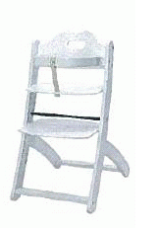
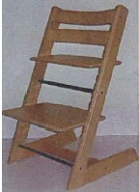
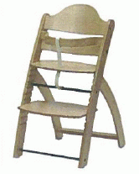
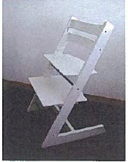
(iv) The "MONTANA" and "TRIPP TRAPP" cases
The TRIPP TRAPP cases – UfR 2015.992 H and UfR 2015.979 H
Scope of protection:
"The destinctive characteristics of the design of the Tripp Trapp chair is partially the straight lines and very cogent shape and partially the use of the "L-shape" for the side bars as well as the horizontal legs of the chair"
Neither the DAN chair nor the Steve chair constituted such slavish imitations
→ no infringement
The Tripp Trapp chair The Steve chair The Tripp Trapp chair The DAN chair

Slide 14
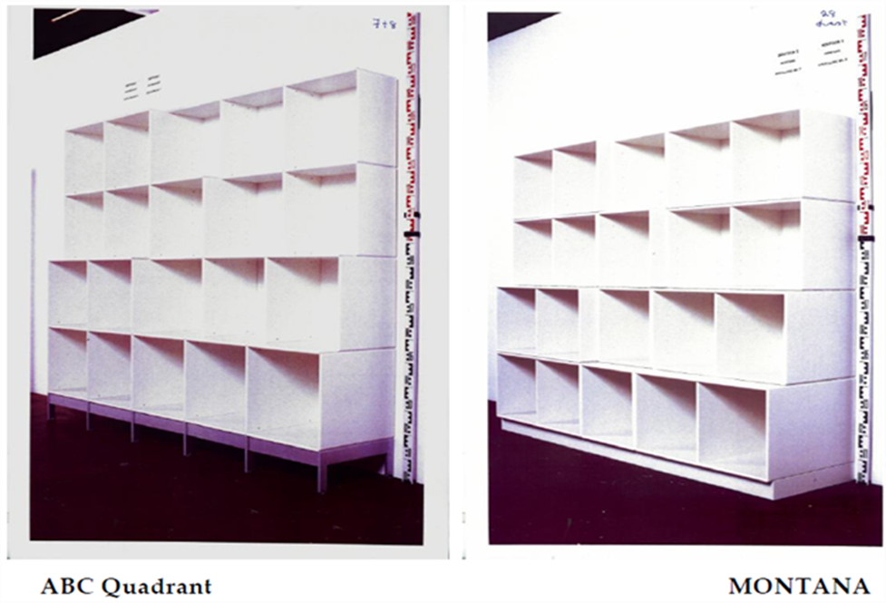
(iv) The "MONTANA" and "TRIPP TRAPP" cases
The MONTANA case – UfR 2014.3539 H
Scope of protection:
"Since the MONTANA shelve is a functional product created in a functionalistic idiom, copyright protection only applies to very slavish imitations"
The ABC Quadrant shelve did not constitute such slavish imitation
→ no infringement

Slide 15
(iv) The "MONTANA" and "TRIPP TRAPP" cases
Our comments
The decisions show that the bar to receiving copyright protection in general is generally low
Furthermore, the decisions show that the scope of copyright protection for industrial designs is slightly narrow when it comes to the functional designs of the product
→ "slavish imitations"
The court is likely to put emphasis on expert appraisals when determining the question of infringement (see the Tripp-Trapp cases)

Slide 16
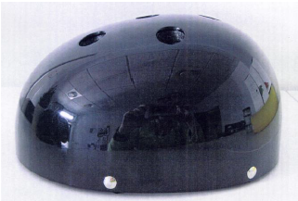
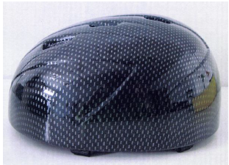
(v) Yakkay v Stormwear
Facts
Stormwear sold bike helmets under the name "Cocoons" with different detachable covers
Yakkay sold a similar bike helmet with different covers bought separately
Issue → Did Stormwear's "Cocoons" bike helmet infringe Yakkay's EU design registered bike helmet?
Yakkay's bike helmet Stormwear's bike helmet

Slide 17
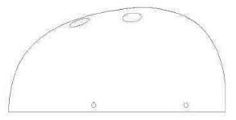
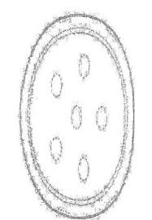
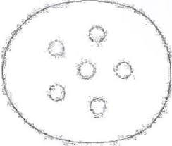
(v) Yakkay v Stormwear
Yakkay's EU design registration
Helmet seen from the side Helmet seen from the front
Helmet seen from underneath Helmet seen from above

Slide 18
(v) Yakkay v Stormwear
Legal issues
The interpretation of the EU Design Regulation
Article 25 (1) (b), cf. Article 4 and 6 → "individual character"
Article 6:
"A design shall be considered to have individual character if the overall impression it produces on the informed user differs from the overall impression produced on such a user by any design which has been made available to the public (…)"
The parties' main arguments
Stormwear claimed that Yakkay's bike helmet lacked novelty and individual character → invalid design registration
Further, Stormwear claimed that Yakkay's bike helmet constituted a "compound product" → no infringement
Yakkay claimed that Stormwear had not proven that the design registration was invalid and Yakkay also claimed that the helmets were almost identical

Slide 19
(v) Yakkay v Stormwear
The Maritime and Commercial High Court's decision
The EU design registration only covered the shell of the bike helmet and hence the Yakkay helmet did not constitute a "compound product"
The "Cocoons" bike helmet constituted an infringement
The Surpreme Court
No referral to the CJEU → No doubt of how to interpret the EU Design Regulation
The Yakkay bike helmet did not constitute a "compound product" → only the design registration as graphically published should therefore be taken into account when determining the validity of the design registration as well as the infringement
→ EU design registration valid
→ Stormwear's bike helmet constituted an infringement of Yakkay's design rights

Slide 20
Plesner
Plesner Law Firm
Amerika Plads 37
DK-2100 Copenhagen
Denmark
Phone: +45 33 12 11 33
VAT-No.: 42 93 85 13
www.plesner.com
The contents of this presentation is made available to the public for informational purposes and are not intended as and cannot replace legal advice. Plesner shall not be held liable for any use of the information contained in the presentation. If you need legal advice, you are very welcome to contact Plesner.

