Slide 1
Cyber Security – The Role of Audit Executives
Presentation at the 40th General Meeting of the Association of Chief Audit Executives of Banks in Nigeria (ACAEBIN)
Tope S. Aladenusi,
Partner, Cyber Risk Services, Deloitte Nigeria
20 September 2018

Slide 2
Cyber Security is a Rapidly Ascending Board Agenda Item
With the rapid technology advancement, organizations are exposed to cyber risks now more than ever. Audit committees and board members world wide are seeing cybersecurity as a top risk, underscored by recent headlines and increased government and regulatory focus
The forces driving growth and efficiency may create a broad attack surface
Technology becomes more pervasive
Changing business models
More data to protect
Threat actors with varying motives
Technology
expansion
Evolving
Data growth
Cybersecurity
business
models
Motivated
attackers
Sources: Deloitte Thought Leadership Materials
Notes:
World Economic Forum Global Risks Perception Survey 2017–2018. states cyber risk as the most prominent risk only after extreme climatic events and natural disasters
Recent obligations U.S. Securities and Exchange Commission (SEC) relating to cybersecurity risks and incidents “Registrants should address cybersecurity risks and cyber incidents in their Management’s Discussion and Analysis of Financial Condition and Results of Operations (MD&A), Risk Factors, Description of Business, Legal Proceedings and Financial Statement Disclosures.” SEC Division of Corporate Finance Disclosure Guidance: Topic No. 2 - Cybersecurity
One of the foundational drivers behind the update and release of the 2013 COSO Framework was the need to address how organizations use and rely on evolving technology for internal cotrol purposes
CBN IT Standards Blue Print, CBN Cyber Security Framework, GDPR, Nigeria Cyber Security Law
Technology becomes more pervasive
Internet, cloud, mobile, and social are mainstream platforms inherently oriented for sharing
Employees want continuous, real-time access to their information
Changing business models
Service models have evolved—outsourcing, offshoring, contracting, and remote workforce
More data to protect
Increased volume of customers’ personal, account, and credit card data, as well as employee’s personal identifiable information and also company trade secrets
The need to comply with privacy requirements across a wide array of jurisdictions
Threat actors with varying motives
Hackers to nation states
Continuously innovating and subverting common controls
Often beyond the reach of a country’s law enforcement
Organised crime is monetising the cyberspace, exploiting vulnerabilities in computer systems to compromise and remotely control computers, recording key strokes, monitoring screen displays and manipulating the computer user into divulging sensitive data.
Cyberspace being borderless allows any attacker to route their assaults through multiple countries and jurisdictions, complicating investigation and law enforcement.
Companies run the risk of losing substantial amounts of sensitive company information to malicious employees, who could also potentially remove it from company premises or introduce malicious software to corrupt company databases or sabotage network operations.
Corporate espionage by companies is commonplace in cyberspace. Attacks often target sensitive intellectual property and there have been multiple instances of major firms with its security compromised over many months and losing substantial amounts of sensitive data during these attacks.
Activism is also prevalent in cyberspace with sabotage and denial of service attacks growing progressively frequent. In the past, they would be attributed to ‘hacktivist’ groups such as Anonymous; but increasingly attacks point to political motivations.

Slide 3
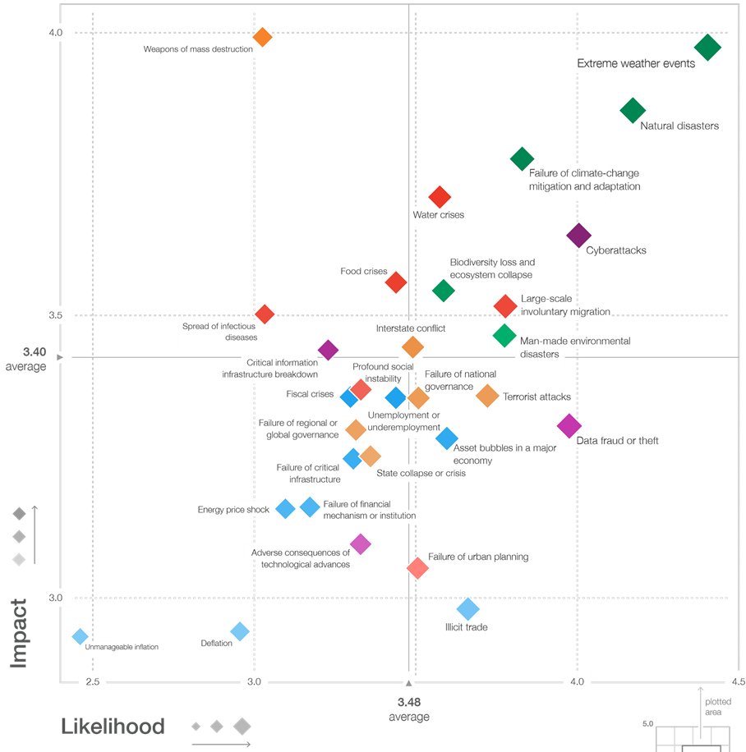
Cyber Risks Top the List
Cyber Attacks top the list of man-made attacks, closely following natural disasters. The survey was conducted with respondents worldwide who assessed the potential risks for their impact and likelihood over a 10 year period.
Source: World Economic Forum Global Risks Perception Survey 2017–2018.

Slide 4
Risk Evaluation … The Buck Stops Here
Effective risk management is the product of multiple layers of risk defense. Internal Audit should support the board’s need to understand the effectiveness of cybersecurity controls.
Incorporate risk-informed decision making Define risk appetite and escalate risks outside of tolerance Mitigate risks, as appropriate
1st Line of defence business and IT functions
2nd Line of defence information and technology risk management function
Establish governance and oversight Set risk baselines, policies, and standards Implement tools and processes Monitor and call for action, as appropriate
Independently review program effectiveness Provide confirmation to the board on risk management effectiveness Ensure that regulatory requirements and disclosure obligations for cybersecurity risks are met
3rd Line of defence
Internal Audit
Sources: Deloitte Thought Leadership Materials

Slide 5
Are Our Internal Audit Teams Ready for The Future ?
Today’s Audit programs are facing myriad of challenges in being able identify, monitor and report the Cyber Security risks facing the Banks in Nigeria
Constant need for skills upgrade
Audit Plans not reflecting continuous audit needs
Auditor seen as Police, not as Pal
Inadequate monitoring of audit remediation
Cyber Security risks not given adequate priority in Audit reporting
Sources: Deloitte Thought Leadership Materials

Slide 6
Transforming Cyber Defenses – CAE’s Role
Cybersecurity is a business issue as it exceeds the boundaries of IT, and cyber risk needs to be managed with as much discipline as financial risk. The 5 pronged approach to achieve that is:
Is in place, Is comprehensive and aligns with the Bank’s goals
Ensure that adequate controls, risk management, and remediation
Cyber Strategy
Participate and understand the Governance, Policies, Processes, Procedures, investments, support the development of executive-led cyber risk program
Framework
Perimeter defenses, identity management, and data protection, access controls, antivirus, DLP, WAF, NAC, etc.
Secure
Resilient
Ensure that incident response protocols are in place, business continuity, testing and reporting
Incident response protocols, forensics, and business continuity and disaster recovery plans
Ensure that adequate threat intelligence, detection mechanisms, and early remediation is in place
Vigilant
SIEM, DAM, Threat Intelligence, security monitoring, and behavioral and risk analyses
Sources: Deloitte Thought Leadership Materials

Slide 7
Evolution or Irrelevance? Audit Teams are at a Cross Road
Some concerns that the Audit Committees will need to ensure to stay relevant and dynamic include;
Chief Audit Executives (CAE)s recognize the need for change
Dynamic reporting is poised to increase
Internal Audit needs more impact and influence
Innovation is key to meeting the demands ahead
Gaps in skills must be addressed
Reviews of strategic planning and risk management will increase.
Use of alternate resourcing models will expand
Stable Internal Audit budgets may present challenges
Embracing Analytics presents major opportunities
Embracing Cyber Security Internal Audit to address increasing cyber risks

Slide 8
Thank You
The views and opinions expressed in this presentation are those of the author and do not in any way represent the views of the author’s employer. You should not act upon the information contained in this publication without obtaining specific professional advice. No representation or warranty (express or implied) is given as to the accuracy or completeness of the information contained in this publication. The author does not accept or assume any liability, responsibility or duty of care for any consequences of you or anyone else acting, or refraining to act, in reliance on the information contained in this publication or for any decision based on it.

