Slide 1
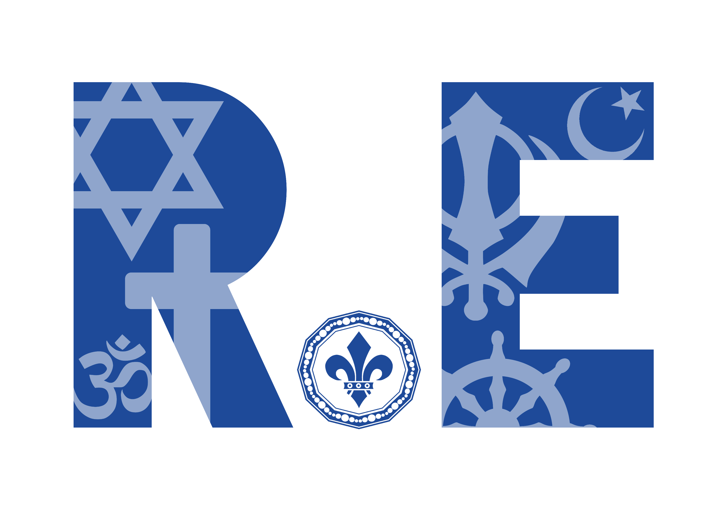
KNOWLEDGE ORGANISERS AND ASSESSMENT

Slide 2
Year 1
“Exploring religion and belief in the modern world; joyfully, creatively and confidently.”

Slide 3
Year 1: What do Christians believe God is like?
What do Christians believe God is like?
Key knowledge:
Christians believe in God, and that they find out about God in the Bible.
Christians believe God is loving, kind, fair and forgiving, and also Lord and King.
Some stories show these Christian beliefs.
Christians worship God and try to live in ways that please him.
God | supreme being; creator and ruler of the universe
Christian | a person who believes in Christianity
Bible | Holy book for Christians
parable | a story with a moral or spiritual meaning
belief | thinking that something is true
worship | showing God honour/respect
forgiveness | choosing to let go of anger or bad feelings towards someone who did something they shouldn’t have
Luke | a book of the Bible which shares the story and teachings of Jesus
“Exploring religion and belief in the modern world – joyfully, creatively and confidently.”

Slide 4
Year 1 What do Christians believe God is like?
What do Christians believe God is like?
Cut out the hexagons. Then, arrange the hexagons in sequences and groups. You should justify any connections made by annotating your links.
Forgiveness
Bible
Parables
Belief
Luke 5
Christian
Worship
Loving and kind
God
Based on work by Pam Hook (HookEd) on Solo Taxonomy
“Exploring religion and belief in the modern world – joyfully, creatively and confidently.”

Slide 5
Year 1: What do Christians believe God is like?
Why does Christmas matter to Christians?
Key knowledge:
Christians believe that Jesus is God and that he was born as a baby in Bethlehem.
The Bible points out that his birth showed that he was extraordinary (for example, he came to bring good news (e.g to the poor, in Luke).
Christians celebrate Jesus’ birth, and Advent for Christians is a time for getting ready for Jesus’ coming.
Christian | a person who believes in Christianity
Nativity | the story of the birth of Jesus
Jesus | the son of God
Mary | the mother of Jesus
Joseph | Jesus’ earthly father
shepherd | someone who looks after sheep
Bethlehem | a town in Israel where Jesus was born
Christmas | the celebration of Jesus’ birth
angel | a messenger from God
advent | The four Sundays and weeks before Christmas
“Exploring religion and belief in the modern world – joyfully, creatively and confidently.”

Slide 6
Year 1 Why does Christmas matter to Christians?
Why does Christmas matter to Christians?
Cut out the hexagons. Then, arrange the hexagons in sequences and groups. You should justify any connections made by annotating your links.
Nativity
Jesus
Christmas
Mary
Luke 1 and 2
Christian
Advent
Joseph
Based on work by Pam Hook (HookEd) on Solo Taxonomy
“Exploring religion and belief in the modern world – joyfully, creatively and confidently.”

Slide 7
Year 1: What is the good news that Jesus brings?
What is the good news that Jesus brings?
Key knowledge:
Christians believe Jesus brings good news for all people.
For Christians, this good news includes being loved by God, and being forgiven for bad things.
Christians believe Jesus is a friend to the poor and friendless.
Christians believe Jesus’ teachings make people think hard about how to live and show them the right way.
Christian | a person who believes in Christianity
Jesus | the son of God
friendship | People who like and know one another
forgiveness | choosing to let go of anger or bad feelings towards someone who did something they shouldn’t have
Peace | A sense of calm, no conflict or quiet.
Gospel | Meaning “Good News”. What the books of Matthew, Mark, Luke and John from the Bible are called.
Charity | A group of people who helping out others (often by giving money)
disciples | Jesus’ twelve special friends who followed him (sometimes called Apostles)
“Oh no, Jesus, not him.”
“Exploring religion and belief in the modern world – joyfully, creatively and confidently.”

Slide 8
Year 1 What is the good news that Jesus brings?
What is the good news that Jesus brings?
Cut out the hexagons. Then, arrange the hexagons in sequences and groups. You should justify any connections made by annotating your links.
forgiveness
Jesus
charity
friendship
Bible
Christian
peace
disciples
gospel
Based on work by Pam Hook (HookEd) on Solo Taxonomy
“Exploring religion and belief in the modern world – joyfully, creatively and confidently.”

Slide 9
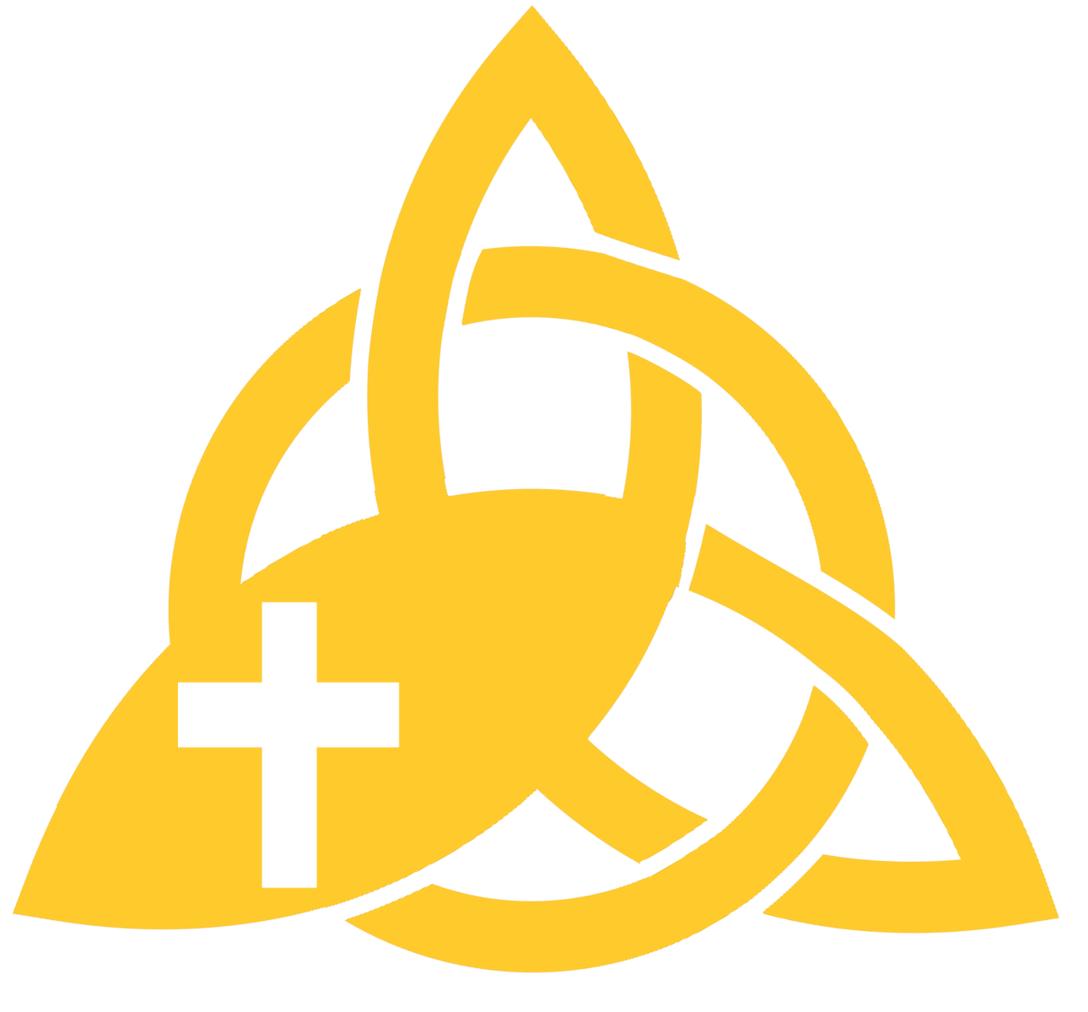
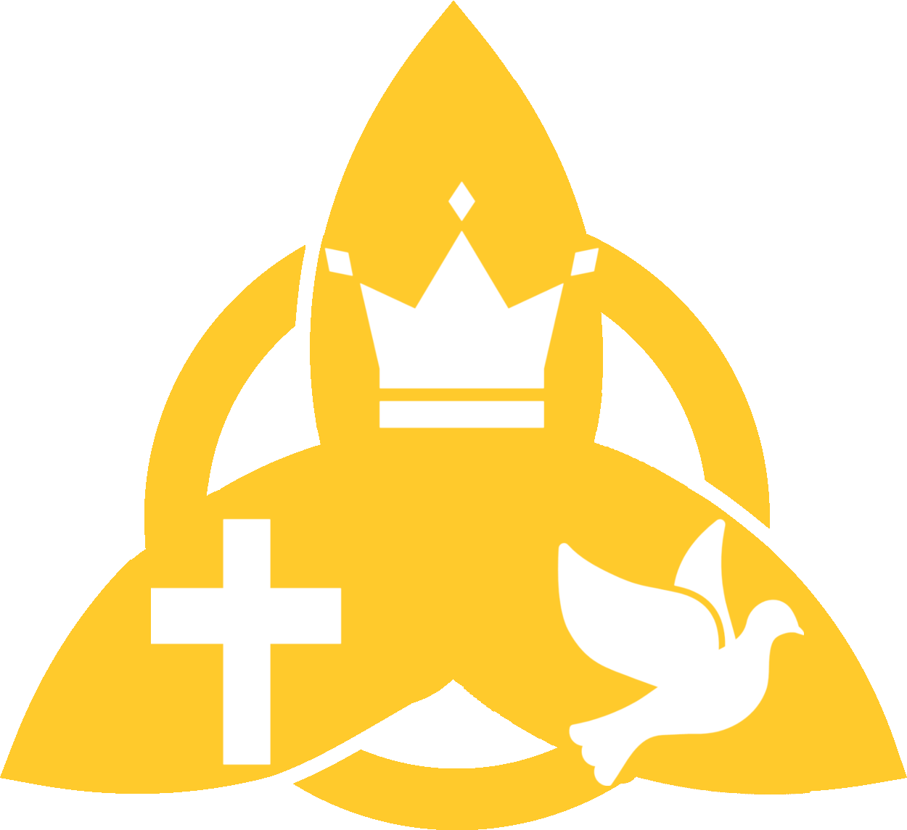
Year 1: Why does Easter matter to Christians?
Why does Easter matter to Christians?
Key knowledge:
Easter is very important in the ‘big story’ of the Bible.
Christians believe Jesus rose again, giving people hope of a new life.
Entering Jerusalem
Christian | a person who believes in Christianity
Easter | the events around the death and resurrection of Jesus
Jesus | the son of God
resurrection | Jesus coming back from the dead
sin | an act of wrongdoing against God’s law
forgiveness | choosing to let go of anger or bad feelings towards someone who did something they shouldn’t have
heaven | where Christians believe they will be when they die, with God
salvation | being rescued by God from sin and its consequences
The last supper
Jesus’ crucifixion
Jesus’ resurrection
Jesus appears
“Exploring religion and belief in the modern world – joyfully, creatively and confidently.”

Slide 10
Year 1 Why does Easter matter to Christians?
Why does Easter matter to Christians?
Cut out the hexagons. Then, arrange the hexagons in sequences and groups. You should justify any connections made by annotating your links.
Church
Sin
Christian
Heaven
Salvation
Forgiveness
Based on work by Pam Hook (HookEd) on Solo Taxonomy
“Exploring religion and belief in the modern world – joyfully, creatively and confidently.”

Slide 11
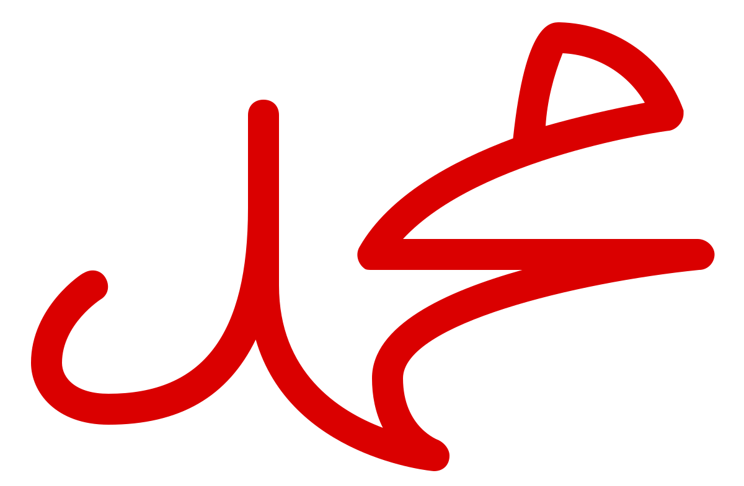
Year 1: How do some Muslims show Allah is compassionate and merciful?
How do some Muslims show Allah is compassionate and merciful?
Key knowledge:
Muslims believe in Allah – the one true God – and that Allah is a compassionate God.
Muslims believe that prophet Muhammad (PBUH) is an example for all Muslims to follow.
Muslim | a person who follows the Islamic religion
Islam | The religion that Muslims follow
Muhammad (PBUH) | Allah’s last prophet (his messenger). He is very special to all Muslims.
Qur’an | A Muslim’s special holy book. Always treated with respect and never put on the floor.
Ramadan | A special month of fasting
Fasting | Not eating or drinking from sunrise to sunset.
Eid al-Fitr | The festival of ending the fast
Allah | The Arabic word for God.
mosque | A Muslim place of worship
Arabic | The language of the Qu’ran and the language spoken in the Middle East
compassionate | Feeling and showing concern for others.
“Exploring religion and belief in the modern world – joyfully, creatively and confidently.”

Slide 12
Year 1: How do some Muslims show Allah is compassionate and merciful?
How do some Muslims show Allah is compassionate and merciful?
Cut out the hexagons. Then, arrange the hexagons in sequences and groups. You should justify any connections made by annotating your links.
Allah
Mosque
Muslim
Islam
compassionate
Fasting
Muhammad (PBUH)
Ramadan
Qur’an
Eid al-Fitr
Arabic
Based on work by Pam Hook (HookEd) on Solo Taxonomy
“Exploring religion and belief in the modern world – joyfully, creatively and confidently.”

Slide 13
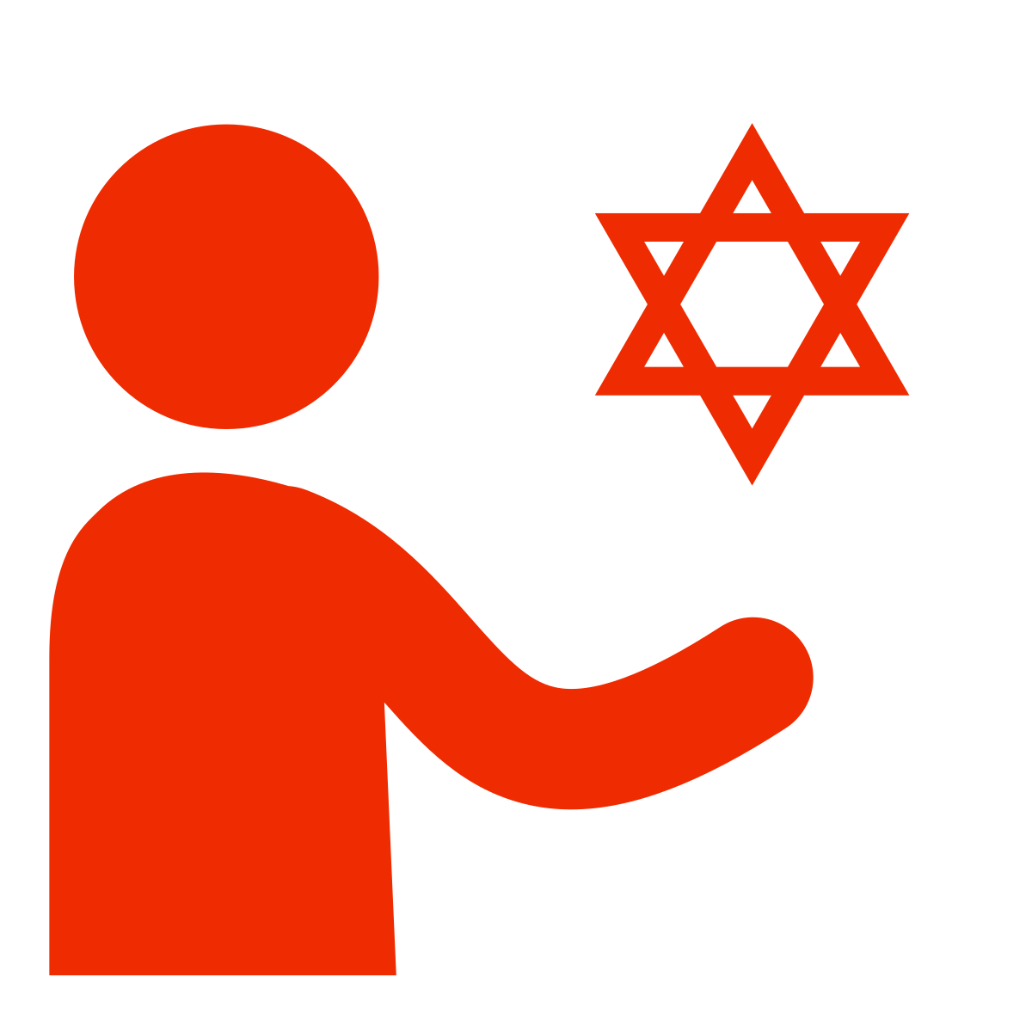
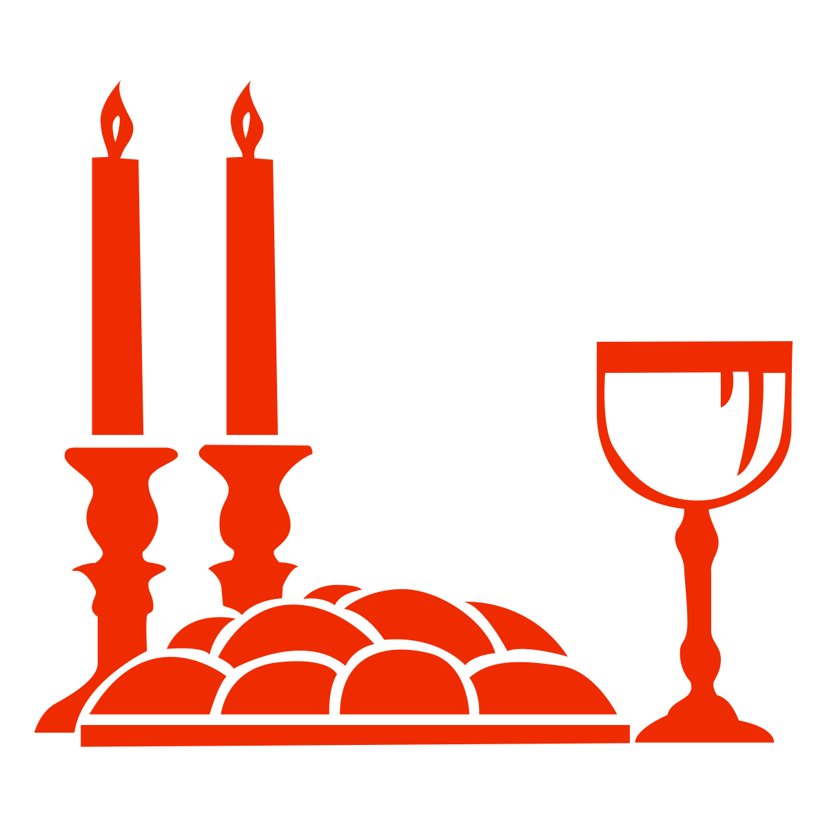
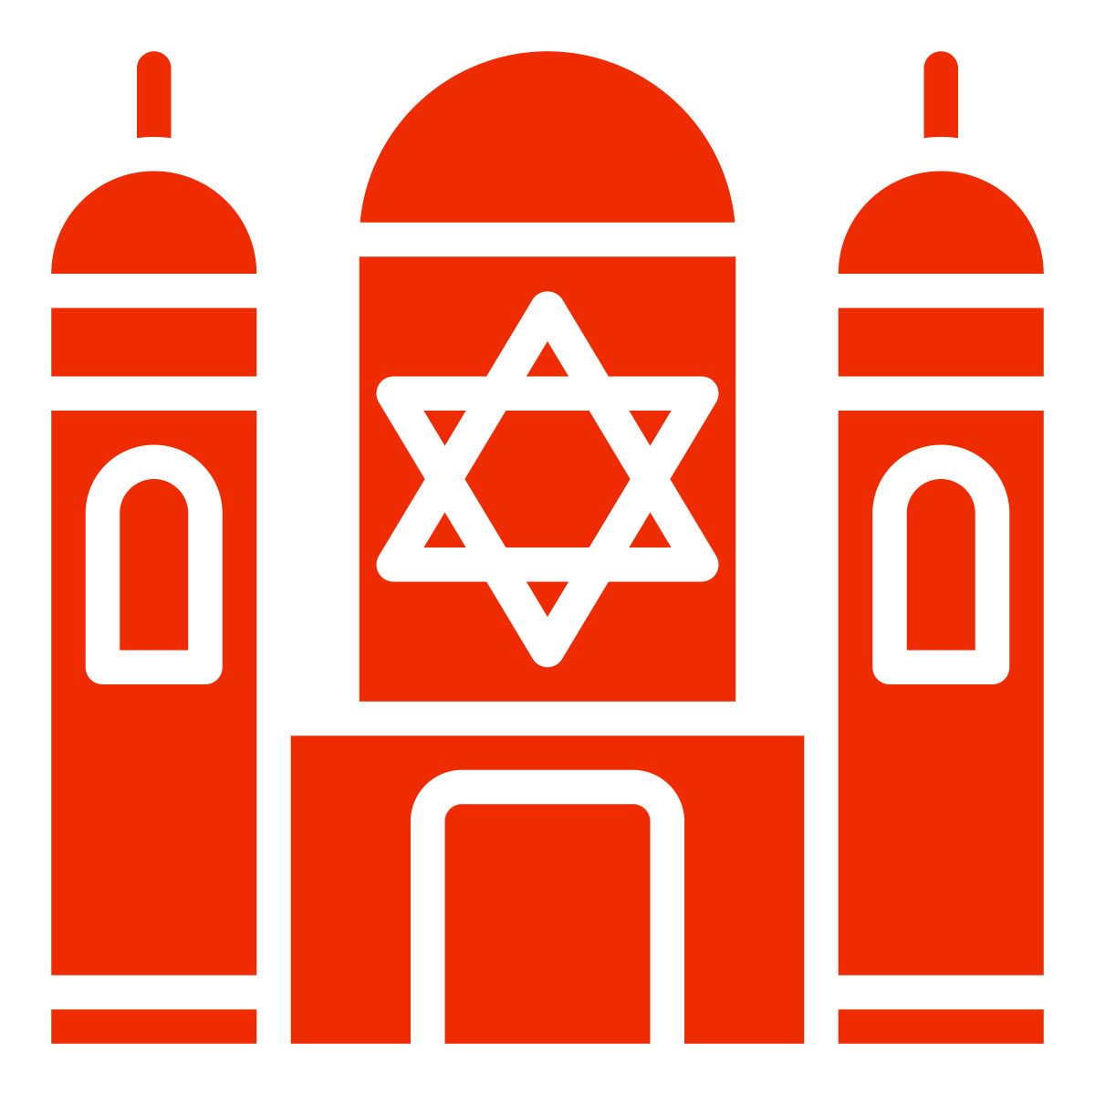
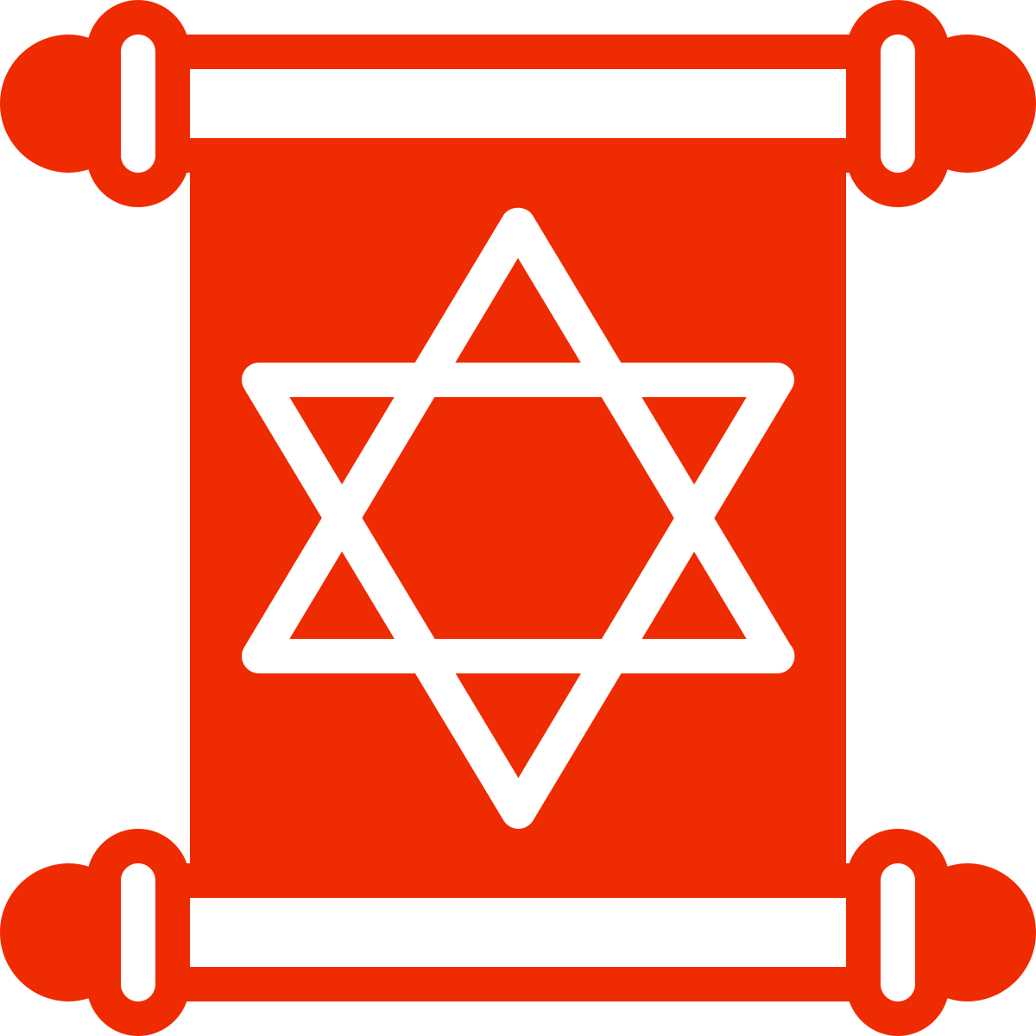
Year 1: Why is learning to do good deeds so important to Jewish people?
Why is learning to do good deeds so important to Jewish people?
Key knowledge:
Mitzvah is the Jewish word for good deed or action. It is something G-d asks all Jews to do.
Jews believe it’s a mitzvah (good deed) to: • HELP others in need.
• WELCOME others.
• GIVE money to help other people
• CARE for the world.
Mitzvahs make a Jewish person feel like they belong.
Jewish | Some families are Jewish. Jewish people believe in G-d and follow a book called the Torah.
Mitzvah (Mitzvot) | the Jewish word for a good deed(s)
Tikkun Olam | healing the world
Tzedakah box | For giving money to help other people
Shabbat | the Jewish day of rest, starting at sunset on Friday to sunset on Saturday
synagogue | a place for Jewish worship, study and community
Torah | the first part of the Jewish Bible.
“Exploring religion and belief in the modern world – joyfully, creatively and confidently.”

Slide 14
Year 1: Why is learning to do good deeds so important to Jewish people?
Why is learning to do good deeds so important to Jewish people?
Cut out the hexagons. Then, arrange the hexagons in sequences and groups. You should justify any connections made by annotating your links.
Jewish
Torah
Tzedakah box
mitzvah
Story of Ruth
Help
Welcome
Give
Care
Shabbat
Tikkun Olam
Charity
synagogue
Based on work by Pam Hook (HookEd) on Solo Taxonomy
“Exploring religion and belief in the modern world – joyfully, creatively and confidently.”

Slide 15
Year 2
“Exploring religion and belief in the modern world; joyfully, creatively and confidently.”

Slide 16
Year 2 Who made the world?
Who made the world?
Key knowledge:
1
Christians believe that God created the universe.
Christians believe the Earth and everything in it are important to God.
Christian believe God has a unique relationship with human beings as their Creator and Sustainer.
Christians believe humans should care for the world because it belongs to God.
2
3
4
God | supreme being; creator and ruler of the universe
Christian | a person who believes in Christianity
creation | the action of making something
creator | person or thing that makes something
Bible | Holy book for Christians
Genesis | first book of the Bible
harvest | the time when crops are gathered
sustain | to make stronger and support
generosity | being kind and giving
thankfulness | feeling and expressing gratitude
5
6
7
“Exploring religion and belief in the modern world – joyfully, creatively and confidently.”

Slide 17
Year 2 Who made the world?
Who made the world?
Cut out the hexagons. Then, arrange the hexagons in sequences and groups. You should justify any connections made by annotating your links.
Harvest
Thankfulness
Sustain
Genesis 1
Generosity
Church
Based on work by Pam Hook (HookEd) on Solo Taxonomy
“Exploring religion and belief in the modern world – joyfully, creatively and confidently.”

Slide 18
Year 2: What do Christians believe God is like? (Deeper)
Why does Christmas matter to Christians? (Deeper)
Key knowledge:
Christians believe that Jesus is God and that he was born as a baby in Bethlehem.
The Bible points out that his birth showed that he was extraordinary (for example, he is worshipped as a king, in Matthew) and that he came to bring good news (for example, to the poor, in Luke).
Christians celebrate Jesus’ birth, and Advent for Christians is a time for getting ready for Jesus’ coming.
incarnation | Jesus is God in flesh
Nativity | the story of the birth of Jesus
Jesus | the son of God
Mary | the mother of Jesus
Joseph | Jesus’ earthly father
shepherd | someone who looks after sheep
magi | sometimes called wise men, brought gifts to Jesus
Bethlehem | a town in Israel where Jesus was born
Christmas | the celebration of Jesus’ birth
angel | a messenger from God
advent | The four Sundays and weeks before Christmas
“Exploring religion and belief in the modern world – joyfully, creatively and confidently.”

Slide 19
Year 1 Why does Christmas matter to Christians?
Why does Christmas matter to Christians?
Cut out the hexagons. Then, arrange the hexagons in sequences and groups. You should justify any connections made by annotating your links.
Nativity
Jesus
Christmas
Mary
Matthew 1-2
Christian
Advent
Incarnation
Based on work by Pam Hook (HookEd) on Solo Taxonomy
“Exploring religion and belief in the modern world – joyfully, creatively and confidently.”

Slide 20
Year 2: What is the good news that Jesus brings? (Deeper)
What is the good news that Jesus brings? (Deeper)
Key knowledge:
Christians believe Jesus brings good news for all people.
For Christians, this good news includes being loved by God, and being forgiven for bad things.
Christians believe Jesus is a friend to the poor and friendless.
Christians believe Jesus’ teachings make people think hard about how to live and show them the right way.
11:9-13
17:11-19
Christian | a person who believes in Christianity
God (the Father) | Christians believe that God created everything
Jesus | the son of God
prayer | a way to talk to God
forgiveness | choosing to let go of anger or bad feelings towards someone who did something they shouldn’t have
Gospel | Meaning “Good News”. What the books of Matthew, Mark, Luke and John from the Bible are called.
thankfulness | feeling and expressing gratitude
13:45-46
“Exploring religion and belief in the modern world – joyfully, creatively and confidently.”

Slide 21
Year 2 What is the good news that Jesus brings? (Deeper)
What is the good news that Jesus brings? (Deeper)
Cut out the hexagons. Then, arrange the hexagons in sequences and groups. You should justify any connections made by annotating your links.
Jesus
prayer
thankfulness
Bible
Christian
God (the Father)
gospel
Based on work by Pam Hook (HookEd) on Solo Taxonomy
“Exploring religion and belief in the modern world – joyfully, creatively and confidently.”

Slide 22
Year 2: Why does Easter matter to Christians? (Deeper)
Why does Easter matter to Christians? (Deeper)
Key knowledge:
Easter is very important in the ‘big story’ of the Bible. Jesus showed that he was willing to forgive all people, even for putting him on the cross.
Christians believe Jesus builds a bridge between God and humans.
Christians believe Jesus rose again, giving people hope of a new life.
Entering Jerusalem
Cleansing the temple
Christian | a person who believes in Christianity
Easter | the events around the death and resurrection of Jesus
Jesus | the son of God
resurrection | Jesus coming back from the dead
sin | an act of wrongdoing against God’s law
forgiveness | choosing to let go of anger or bad feelings towards someone who did something they shouldn’t have
heaven | where Christians believe they will be when they die, with God
salvation | being rescued by God from sin and its consequences
lent | A time of preparing (getting ready) for Easter
The last supper
Jesus on trial
Jesus’ crucifixion
Jesus’ resurrection
Jesus appears
“Exploring religion and belief in the modern world – joyfully, creatively and confidently.”

Slide 23
Year 2 Why does Easter matter to Christians? (Deeper)
Why does Easter matter to Christians? (Deeper)
Cut out the hexagons. Then, arrange the hexagons in sequences and groups. You should justify any connections made by annotating your links.
Church
Sin
Christian
Lent
Salvation
Forgiveness
Based on work by Pam Hook (HookEd) on Solo Taxonomy
“Exploring religion and belief in the modern world – joyfully, creatively and confidently.”

Slide 24
Year 2: How does a Muslim show their submission and obedience to Allah?
How does a Muslim show their submission and obedience to Allah?
Key knowledge:
Muslim means ‘one who ‘submits’ or who willingly does what God (Allah) wants them to do.
Muslims pray five times a day
Muslim | a person who follows the Islamic religion
Islam | The religion that Muslims follow (means submission)
Muhammad (PBUH) | Allah’s last prophet (his messenger). He is very special to all Muslims.
Qur’an | A Muslim’s special holy book. Always treated with respect and never put on the floor.
submission | for Muslims this means obeying Allah creator of all.
Bismillah | This means ‘in the name of Allah’. The first words in the Qur’an. Muslims say this before starting anything.
Adhan | The Adhan is the Muslim call to prayer performed in Arabix. It announces the beginning of a set period of prayer
Muezzin (mu’adhin) | One who calls the adhan, five times a day, by a muezzin from the top of a minaret (tower on the mosque)
Salat | The ritual prayer of Muslims, performed five times daily in a set form.
Allah | The Arabic word for God.
mosque | A Muslim place of worship
Arabic | The language of the Qu’ran and the language spoken in the Middle East
“Exploring religion and belief in the modern world – joyfully, creatively and confidently.”

Slide 25
Year 2: How does a Muslim show their submission and obedience to Allah?
How does a Muslim show their submission and obedience to Allah?
Cut out the hexagons. Then, arrange the hexagons in sequences and groups. You should justify any connections made by annotating your links.
Allah
Mosque
Muslim
submission
Bismillah
Salat
Muhammad (PBUH)
Adhan
Qur’an
Muezzin
Arabic
Based on work by Pam Hook (HookEd) on Solo Taxonomy
“Exploring religion and belief in the modern world – joyfully, creatively and confidently.”

Slide 26
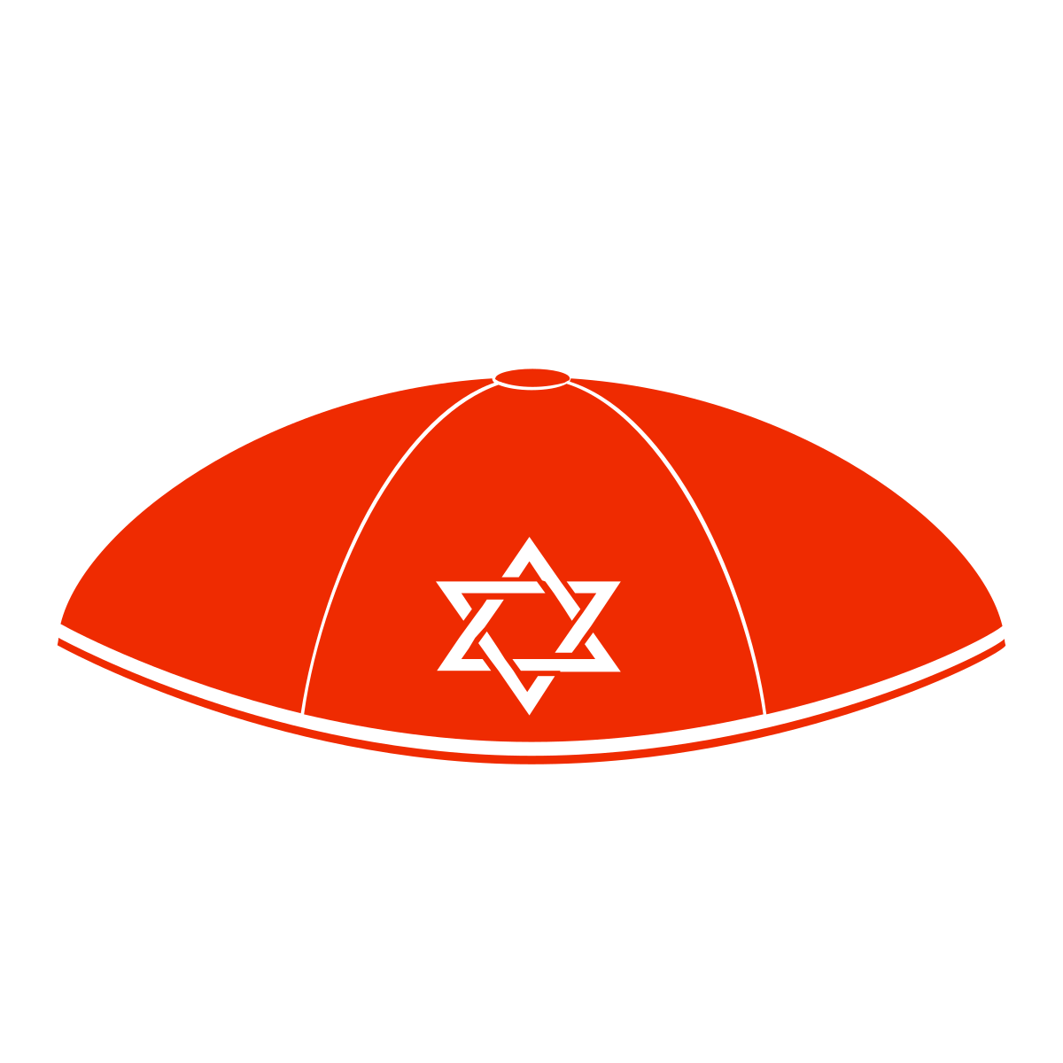
Year 2: Why do Jewish families say so many prayers and blessings?
Why do Jewish families say so many prayers and blessings?
Key knowledge:
Jewish people:
• Say prayers and blessings to God because it reminds them how great God is.
• Say thank you to God for all he provides.
• Have a day of rest each week called Shabbat.
• Pray at both home and the synagogue.
• Sometimes wear special clothes.
Jewish | some families are Jewish. Jewish people believe in G-d and follow a book called the Torah.
Sukkah | a special hut built during the festival Sukkot
Kippah | A head covering for Jewish people
Tallit | A Jewish prayer shawl
Shabbat | the Jewish day of rest, starting at sunset on Friday to sunset on Saturday.
synagogue | a place for Jewish worship, study and community
Torah | the first part of the Jewish Bible.
Havdalah ceremony | marks the end of Shabbat.
Tefillah | the Hebrew word for prayer
Berakhot | blessings
“Exploring religion and belief in the modern world – joyfully, creatively and confidently.”

Slide 27
Year 2: Why do Jewish families say so many prayers and blessings?
Why do Jewish families say so many prayers and blessings?
Cut out the hexagons. Then, arrange the hexagons in sequences and groups. You should justify any connections made by annotating your links.
Jewish
Torah
Sukkah
Havdalah ceremony
Kippah
Shabbat
Tallit
Berakhot
synagogue
Tefillah
Based on work by Pam Hook (HookEd) on Solo Taxonomy
“Exploring religion and belief in the modern world – joyfully, creatively and confidently.”

Slide 28
Year 3
“Exploring religion and belief in the modern world; joyfully, creatively and confidently.”

Slide 29
Year 3: What is it like to follow God?
What is it like to follow God?
I make connections between
promises in the story of Noah
and promises that Christians
make at a wedding ceremony
I can respond to the story of Noah
I clearly outline the account of Noah as told in Genesis
I reflect on how promises have an impact on followers of God
I can define a covenant and give some examples
I know the difference between the Old and New Testaments
I make connections with other faiths and worldviews
I make links between the story of Noah and the idea of covenant
40
Bible | Holy book for Christians
Old Testament | the first part of the Christian Bible, comprising thirty-nine books
covenant | a formal agreement/promise
promise | an assurance that someone will try their best to do something
Genesis | the first book of the Bible (and the Torah)
People of God | another name for the children of Israel
Israel | Jacob was given this name after wrestling with an angel, the nation that descended from him took its name from him.
wedding | a celebration of the covenant of marriage
sin | an act of wrongdoing against God’s law
“Exploring religion and belief in the modern world – joyfully, creatively and confidently.”

Slide 30
Year 3 What is it like to follow God?
What is it like to follow God?
Cut out the hexagons. Then, arrange the hexagons in sequences and groups. You should justify any connections made by annotating your links.
Following God
The people of God
Old Testament
Wedding
Genesis 6:5-9:17
40
Sin
Promise
Covenant
Based on work by Pam Hook (HookEd) on Solo Taxonomy
“Exploring religion and belief in the modern world – joyfully, creatively and confidently.”

Slide 31
Year 3: What is the Trinity
What is the Trinity?
I make connections between the Trinity and how Christians live their lives today
I can respond to the story of Jesus’ baptism
I understand the meaning of incarnation
I reflect on how Christians show their beliefs about God in worship
I know Christians believe God is Trinity (Father, Son and Holy Spirit)
I know the difference between a Gospel and letter in the Bible
I make connections with other faiths and worldviews
I express my own ideas about what the God of Christianity is like
Bible | Holy book for Christians
New Testament | the second part of the Christian Bible, comprising twenty-seven books
Trinity | God the Father, God the Son and God the Holy Spirit
baptism | Christian ceremony using water that represents being clean and having a new life with God.
Gospel | a record of Jesus’ life/teaching, the first 4 books of the New Testament
The Grace | a special Christian prayer
Holy Spirit | the third part of the Trinity, God as spiritually active in the world (sometimes known as the Holy Ghost)
John | a cousin of Jesus who baptised people
incarnation | God coming to earth in flesh as Jesus
“Exploring religion and belief in the modern world – joyfully, creatively and confidently.”

Slide 32
Year 3 What is the Trinity?
What is the Trinity?
Cut out the hexagons. Then, arrange the hexagons in sequences and groups. You should justify any connections made by annotating your links.
Holy Spirit
Jesus
Christmas
Baptism
Matthew 3
Christian
Gospel
Incarnation
Based on work by Pam Hook (HookEd) on Solo Taxonomy
“Exploring religion and belief in the modern world – joyfully, creatively and confidently.”

Slide 33
Year 3: What is the meaning of the Aum symbol?
What is the meaning of the Aum symbol?
I reflect on how Hindus show their beliefs through their actions
I can respond to the story of the man in the well
I understand about some meanings of the Aum symbol in Hinduism.
I know how Aum is used in worship and meditation
I know how Aum is related to Hindu creation narratives
I know some ways Hindus worship
I make connections with other faiths and worldviews
I can name three Hindu deities and list some of their characteristics
Aum | sacred sound/symbol in Sanatan (Hindu) Dharma (sometimes written as om)
artefact | a culturally or historically interesting man-made object
deity | Hindu deities (the gods and goddesses of Sanatan (Hindu) Dharma)
Brahman | For Sanathani (Hindus), Brahman is the Ultimate Reality. Brahman is beyond human understanding and often shown using the aum symbol
atman | the spark of Brahman inside each animal/human being (jiva)
Brahma | the deity who created the universe
shrine | a place where gods or goddesses are worshipped
mandir | a Sanatani (Hindu) place for worship
meditation | thinking carefully, deeply (and often silently) about a subject
worship | to show love to a deity/deities
creation | the beginning of the universe; Sanatan (Hindu) Dharma has a number of different creation narratives.
“Exploring religion and belief in the modern world – joyfully, creatively and confidently.”

Slide 34
Year 3 What is the meaning of the Aum symbol?
What is the meaning of the Aum symbol?
Cut out the hexagons. Then, arrange the hexagons in sequences and groups. You should justify any connections made by annotating your links.
Aum
Brahman
worship
creation
Man in the Well
mandir
shrine
Brama
Sanatani
Hindu
atman
Based on work by Pam Hook (HookEd) on Solo Taxonomy
“Exploring religion and belief in the modern world – joyfully, creatively and confidently.”

Slide 35
Year 3: Why do Christians call the day Jesus died ‘Good Friday’?
Why do Christians call the day Jesus died ‘Good Friday’?
I make connections between Holy Week events and how Christians live their lives today
I can suggest reasons Christians call the day Jesus died ‘Good Friday’
I know where Salvation fits in the Bible’s ‘big story’.
I reflect on how Christians show their beliefs about Easter in Church
I know the main events of Holy Week as told in the Bible.
I understand why Holy Week events matter to Christians
I express my own ideas about what the Holy Week stories might mean
I make connections with other faiths and worldviews
salvation | being rescued by God from sin and its consequences
Gospel | a record of Jesus’ life/teaching, the first 4 books of the New Testament
synoptic | the gospels of Matthew, Mark and Luke are called the synoptic gospels because they have many of the same stories
sin | an act of wrongdoing against God’s law
resurrection | Jesus coming back from the dead
forgiveness | choosing to let go of anger or bad feelings towards someone who did something they shouldn’t have
heaven | where Christians believe they will be when they die, with God
lent | A time of preparing (getting ready) for Easter
Easter | the events around the death and resurrection of Jesus
“Exploring religion and belief in the modern world – joyfully, creatively and confidently.”

Slide 36
Year 3: Why do Christians call the day Jesus died ‘Good Friday’?
Why do Christians call the day Jesus died ‘Good Friday’?
Cut out the hexagons. Then, arrange the hexagons in sequences and groups. You should justify any connections made by annotating your links.
Forgiveness
Church
Sin
heaven
Christian
Lent
Salvation
Based on work by Pam Hook (HookEd) on Solo Taxonomy
“Exploring religion and belief in the modern world – joyfully, creatively and confidently.”

Slide 37
Year 3: When Jesus left, what was the impact of Pentecost?
When Jesus left, what was the impact of Pentecost?
I explore how Pentecost is celebrated in Church today
I express my own thoughts and discuss others on Pentecost
I know the story of Jesus’ ascension.
I describe some ways that Pentecost and the Church are linked
I can retell the story of Pentecost
I explore where Pentecost fits in the ‘big story’ of the Bible.
I make connections between ascension and Pentecost.
I make connections with other faiths and worldviews
Trinity | The Christian belief there is one God; Father, Son and Holy Spirit
Kingdom of God | Where God rules — not a geographical territory, but in human hearts and minds, lives and communities.
Disciples | a biblical word for assembly or gathering, regularly used to refer to the building where these meetings take place
Holy Spirit | the third part of the Trinity, God as spiritually active in the world (sometimes known as the Holy Ghost)
Pentecost | a celebration that takes place 50 days after Easter Sunday marking when the Holy Spirit came to Jesus’ disciples/followers. Sometimes called Whit Sunday or Whitsun.
Ascension | After Jesus had died and was resurrected, he ascended into heaven.
Acts of the Apostles | Sometimes just called Acts. The fifth book of the New Testament written by the same author as the book of Luke.
“Exploring religion and belief in the modern world – joyfully, creatively and confidently.”

Slide 38
Year 3: When Jesus left, what was the impact of Pentecost?
When Jesus left, what was the impact of Pentecost?
Cut out the hexagons. Then, arrange the hexagons in sequences and groups. You should justify any connections made by annotating your links.
Holy Spirit
Acts
disciples
Ascension
Pentecost
Kingdom of God
Christian
Church
Jesus
Based on work by Pam Hook (HookEd) on Solo Taxonomy
“Exploring religion and belief in the modern world – joyfully, creatively and confidently.”
“Exploring religion and belief in the modern world – joyfully, creatively and confidently.”

Slide 39
Year 3: Why do Muslims call Muhammad the ‘Seal of the Prophets’?
Why do Muslims call Muhammad the ‘Seal of the Prophets’?
I make connections between art and Muslim beliefs
I can suggest what Muslims might learn from a story about Muhammad’s life
I know what Muslims believe about prophets.
I reflect on how some Muslims celebrate Milad an-Nabi
I recall key details about Muhammad and his life.
I describe the Shahadah and know where/when it is used
I know where you might find evidence of Muhammad in a mosque
I make connections with other faiths and worldviews
Muslim | a person who follows the Islamic religion
Islam | The religion that Muslims follow (means submission)
Muhammad (PBUH) | Allah’s final prophet (his messenger). He is very special to all Muslims; respected but not worshiped.
Qur’an | A Muslim’s special holy book. Always treated with respect and never put on the floor.
Prophet | Someone chosen by Allah to deliver a message. Muslims believe Allah sent thousands of prophets, but Muhammad was the last one.
Shahadah | The Muslim profession of faith (‘there is no god but Allah, and Muhammad is the messenger of Allah’).
Allah | The Arabic word for God.
mosque | A Muslim place of worship
Arabic | The language of the Qu’ran and the language spoken in the Middle East
“Exploring religion and belief in the modern world – joyfully, creatively and confidently.”

Slide 40
Year 3: Why do Muslims call Muhammad the ‘Seal of the Prophets’?
Why do Muslims call Muhammad the ‘Seal of the Prophets’?
Cut out the hexagons. Then, arrange the hexagons in sequences and groups. You should justify any connections made by annotating your links.
Allah
Mosque
Muslim
Milad an-Nabi the Prophet’s birthday
Prophet
Islam
Hadith
Muhammad (PBUH)
Qur’an
Shahadah
Arabic
Based on work by Pam Hook (HookEd) on Solo Taxonomy
“Exploring religion and belief in the modern world – joyfully, creatively and confidently.”

Slide 41
Year 4
“Exploring religion and belief in the modern world; joyfully, creatively and confidently.”

Slide 42
Year 4 What do Christians learn from the creation story?
What do Christians learn from the creation story?
I can explore how the fall fits into the big picture of the Bible
I can make connections between creation, the fall and the Ten Commandments
I can outline the account of creation as told in Genesis
I understand the Christian idea of stewardship
I know the story of ‘the Fall’ in Genesis 3
I can name some of the Ten Commandments
I know what the Ten Commandments are and why they exist
I can suggest and explain ideas about what Christians learn from the Creation Story.
God | supreme being; creator and ruler of the universe
Christian | a person who believes in Christianity
creation | the action of making something
creator | person or thing that makes something
Bible | Holy book for Christians
Genesis | first book of the Bible
Ten Commandments | a set of rules given to Moses by God
The Fall | the story of how people fell apart from God
stewardship | supervising or taking care of something
thankfulness | feeling and expressing gratitude
“Exploring religion and belief in the modern world – joyfully, creatively and confidently.”

Slide 43
Year 4 What do Christians learn from the creation story?
What do Christians learn from the creation story?
Cut out the hexagons. Then, arrange the hexagons in sequences and groups. You should justify any connections made by annotating your links.
Ten Commandments
Thankfulness
Stewardship
Genesis
The Fall
Based on work by Pam Hook (HookEd) on Solo Taxonomy
“Exploring religion and belief in the modern world – joyfully, creatively and confidently.”

Slide 44
Year 4: What is the Trinity (Deeper)
What is the Trinity? (Deeper)
I make connections between the Trinity and how Christians live their lives today
I can respond to the words of John Chapter 1
I understand the meaning of incarnation
I reflect on Christian beliefs of incarnation
I know Christians believe God is Trinity (Father, Son and Holy Spirit)
I know connections between the Gospels
I make connections with other faiths and worldviews
I express my own ideas about what the God of Christianity is like
Bible | Holy book for Christians
New Testament | the second part of the Christian Bible, comprising twenty-seven books
Trinity | God the Father, God the Son and God the Holy Spirit
Nativity | the story of the birth of Jesus
Gospel | a record of Jesus’ life/teaching, the first 4 books of the New Testament
Jesus | the second part of the Trinity, God the Son
Holy Spirit | the third part of the Trinity, God as spiritually active in the world (sometimes known as the Holy Ghost)
John | fourth book of the New Testament and a gospel
incarnation | God coming to earth in flesh as Jesus
Christmas | the celebration of Jesus’ birth
advent | the four Sundays and weeks before Christmas
“Exploring religion and belief in the modern world – joyfully, creatively and confidently.”

Slide 45
Year 4 What is the Trinity? (Deeper)
What is the Trinity? (Deeper)
Cut out the hexagons. Then, arrange the hexagons in sequences and groups. You should justify any connections made by annotating your links.
Holy Spirit
Jesus
Christmas
John 1
Luke 1-2
Matthew 1-2
Christian
Gospel
Incarnation
Nativity
Based on work by Pam Hook (HookEd) on Solo Taxonomy
“Exploring religion and belief in the modern world – joyfully, creatively and confidently.”

Slide 46
Year 4: What kind of world did Jesus want?
What kind of world did Jesus want?
I make connections between the teachings of Jesus and how Christians live their lives today
I understand the meanings of the word “gospel”
I can name a number of Jesus’ disciples and recount how they were called.
I make clear links between the calling of the first disciples and Christians today
I reflect on what Jesus’ actions towards others might mean for Christians.
I make simple connections between the Gospels
I can give examples of how a member of the clergy might follow Jesus’ teaching
I make connections with other faiths and worldviews
SP
A
SP
A
Ja
Jo
New Testament | the second part of the Christian Bible, comprising twenty-seven books.
Jesus | the second part of the Trinity, God the Son.
disciples | Jesus’ twelve special friends who followed him and his teaching (sometimes called Apostles)
Gospel | meaning “Good News”. A record of Jesus’ life/teaching, often used to describe the first 4 books of the New Testament.
synoptic | the gospels of Matthew, Mark and Luke have many of the same stories, share sequencing and wording. They are referred to as the synoptic gospels.
clergy | a selected group of people who help lead Christian churches.
“Exploring religion and belief in the modern world – joyfully, creatively and confidently.”

Slide 47
Year 4 What kind of world did Jesus want?
What kind of world did Jesus want?
Cut out the hexagons. Then, arrange the hexagons in sequences and groups. You should justify any connections made by annotating your links.
SP
A
Ja
Jo
Jesus
prayer
thankfulness
disciple
Bible
Christian
clergy
gospel
Based on work by Pam Hook (HookEd) on Solo Taxonomy
“Exploring religion and belief in the modern world – joyfully, creatively and confidently.”

Slide 48
Year 4: Why do Christians call the day Jesus died ‘Good Friday’? (Deeper)
Why do Christians call the day Jesus died ‘Good Friday’? (Deeper)
I can offer suggestions about what the narrative of the last supper and Judas’ betrayal might mean
I can suggest reasons Christians call the day Jesus died ‘Good Friday’
I know where Salvation fits in the Bible’s ‘big story’.
I make clear links between gospel texts and how Christians remember Holy week events
I know the main events of Holy Week as told in the Bible.
I understand how the Last Supper was important
I express my own ideas about what the Holy Week stories might mean
I make connections with other faiths and worldviews
salvation | being rescued by God from sin and its consequences
Gospel | a record of Jesus’ life/teaching, the first 4 books of the New Testament
synoptic | the gospels of Matthew, Mark and Luke are called the synoptic gospels because they have many of the same stories
sin | an act of wrongdoing against God’s law
resurrection | Jesus coming back from the dead
forgiveness | choosing to let go of anger or bad feelings towards someone who did something they shouldn’t have
heaven | where Christians believe they will be when they die, with God
lent | A time of preparing (getting ready) for Easter
Easter | the events around the death and resurrection of Jesus
“Exploring religion and belief in the modern world – joyfully, creatively and confidently.”

Slide 49
Year 4: Why do Christians call the day Jesus died ‘Good Friday’? (Deeper)
Why do Christians call the day Jesus died ‘Good Friday’? (Deeper)
Cut out the hexagons. Then, arrange the hexagons in sequences and groups. You should justify any connections made by annotating your links.
Forgiveness
Church
Sin
Christian
Lent
Salvation
Based on work by Pam Hook (HookEd) on Solo Taxonomy
“Exploring religion and belief in the modern world – joyfully, creatively and confidently.”

Slide 50
Year 4: Why does a Sanatani/Hindu want to collect good karma?
Why does a Sanatani/Hindu want to collect good karma?
I reflect on how Hindus show their beliefs about reincarnation
I can describe how Hindus do Sewa
I can describe why Hindus do acts of kindness
I can use religious terms to describe how Snakes and Ladders represents some Hindu beliefs
I can describe what Hindus might learn from a story in the Panchatantra
I know some ways Hindus worship
I make connections with other faiths and worldviews
I can recognize some of the things that influence me to do good or bad
Aum | sacred sound/symbol for Sanatani (Hindus) sometimes written ‘om’
Brahman | For Sanatani (Hindus), Brahman is the Ultimate Reality. Brahman is beyond human understanding and often shown using the aum symbol
atman | the spark of Brahman inside each animal/human being (jiva)
mandir | a Sanatan/Hindu place for worship
karma | actions and the results of the actions themselves
sewa | serving others in a variety of ways without any reward or personal gain
Panchatantra | a collection of ancient Indian animal fables
samsara | the process of life, death and rebirth / reincarnation
moksha | ultimate enlightenment, the end of the death and rebirth cycle
chitram moksha | the game of snakes and ladders
“Exploring religion and belief in the modern world – joyfully, creatively and confidently.”

Slide 51
Year 4 Why does a Sanatani/Hindu want to collect good karma?
Why does a Sanatani/Hindu want to collect good karma?
Cut out the hexagons. Then, arrange the hexagons in sequences and groups. You should justify any connections made by annotating your links.
Aum
Brahman
sewa
moksha
mandir
karma
samsara
Panchatantra
atman
Based on work by Pam Hook (HookEd) on Solo Taxonomy
“Exploring religion and belief in the modern world – joyfully, creatively and confidently.”

Slide 52
Year 4: Why is the Torah such a joy for the Jewish Community?
Why is the Torah such a joy for the Jewish Community?
I make connections between artefacts and Jewish beliefs
I can talk about influences in my life and community
I know how the Torah is used in the synagogue
I reflect on why Jewish people read, study and celebrate the Torah as part of their faith/way of life
I recall key details about what Jewish People do at Simchat Torah
I recall some the stories of Moses
I know what the Aron Kodesh is and how it shows the Torah’s importance
I make connections with other faiths and worldviews
Jewish | some families are Jewish. Jewish people believe in G-d and follow a book called the Torah.
synagogue | a place for Jewish worship, study and community
Torah | the first part of the Jewish Bible. A very important text for Jewish people containing G-d’s rules.
Simchat Torah | a joyous holiday that celebrates the Jewish love of Torah. It marks the end of the annual cycle of weekly Torah readings and the beginning of the new cycle.
Bimah | Where the Torah scroll is placed ready for reading
Mezuzah | a decorative case fixed to the entrance of a Jewish home containing some of the Torah which reminds people to love G-d and follow his commandments.
Holy Ark (Aron Kodesh) | The cupboard where the Torah scrolls are kept in a synagogue
Hebrew | the language of the Torah
“Exploring religion and belief in the modern world – joyfully, creatively and confidently.”

Slide 53
Year 4: Why is the Torah such a joy for the Jewish Community?
Why is the Torah such a joy for the Jewish Community?
Cut out the hexagons. Then, arrange the hexagons in sequences and groups. You should justify any connections made by annotating your links.
Jewish
Torah
Simchat Torah
Bimah
Holy Ark (Aron Kodesh)
Shabbat
Mezuzah
Hebrew
synagogue
Moses
Based on work by Pam Hook (HookEd) on Solo Taxonomy
“Exploring religion and belief in the modern world – joyfully, creatively and confidently.”

Slide 54
Year 5
“Exploring religion and belief in the modern world; joyfully, creatively and confidently.”

Slide 55
Year 5: What does it mean if God is loving and holy?
What does it mean if God is loving and holy?
I can present different views about what God is like within Christianity
I weigh up how biblical ideas and teaching about God might make a difference in the world today
I understand that Christians see God as omnipotent, omniscient and eternal
I understand some ways that Christians respond to God’s characteristics
I identify different types of Biblical text using accurate technical terms
I can explain why Christians see God as both loving and holy.
I explain connections between Biblical texts and Christian ideas of God
I make connections with other faiths and worldviews
God | supreme being; creator and ruler of the universe
Christian | a person who believes in Christianity
Bible | Holy book for Christians
Psalms | a book of the Bible (and Torah) with sacred songs and hymns
Isaiah | a prophetic book from the Old Testament
1 John | a letter from the New Testament
worship | Showing God honour/respect
holy | being apart from all others; being pure; being without sin
omnipotent | having unlimited power/potential
omniscient | knowing everything
eternal | lasting or existing forever; without end
sin | an act of wrongdoing against God’s law
grace | the free and unmerited favour of God
“Exploring religion and belief in the modern world – joyfully, creatively and confidently.”

Slide 56
Year 5 What does it mean if God is loving and holy?
What does it mean if God is loving and holy?
Cut out the hexagons. Then, arrange the hexagons in sequences and groups. You should justify any connections made by annotating your links.
1 John 4:7–13
Isaiah 6:1–5
holy
Psalm 103
worship
grace
loving
Based on work by Pam Hook (HookEd) on Solo Taxonomy
“Exploring religion and belief in the modern world – joyfully, creatively and confidently.”

Slide 57
Year 5: Was Jesus the Messiah?
Was Jesus the Messiah?
I make connections between biblical texts, incarnation and Messiah using theological terms
I express my own thoughts on how far the world needs a Messiah
I explain the place of incarnation within the ‘big story’ of the Bible
I reflect on how far the idea that Jesus is Messiah is important and relevant today
I weigh up how the idea Jesus is Messiah makes sense in the wider story of the Bible
I explain how Christians put their beliefs about Jesus’ Incarnation into practice
I make connections with other faiths and worldviews
I explain the place of Messiah within the ‘big story’ of the Bible
Bible | Holy book for Christians
Trinity | The Christian belief there is one God; Father, Son and Holy Spirit.
Nativity | the story of the birth of Jesus
Gospel | a record of Jesus’ life/teaching, the first 4 books of the New Testament
Prophecy | A message from God. A number of books in the Bible are books of prophecy that point to a Messiah.
Messiah | a saviour or liberator of a group of people.
Saviour | God or Jesus Christ as the redeemer of sin and saver of souls.
John | fourth book of the New Testament and a gospel
Incarnation | God coming to earth in flesh as Jesus
Christmas | the celebration of Jesus’ birth
Advent | the four Sundays and weeks before Christmas
“Exploring religion and belief in the modern world – joyfully, creatively and confidently.”

Slide 58
Year 5 Was Jesus the Messiah?
Was Jesus the Messiah?
Cut out the hexagons. Then, arrange the hexagons in sequences and groups. You should justify any connections made by annotating your links.
Holy Spirit
Jesus
Christmas
Messiah
Incarnation
Prophecy
Christian
Gospel
Nativity
Based on work by Pam Hook (HookEd) on Solo Taxonomy
“Exploring religion and belief in the modern world – joyfully, creatively and confidently.”

Slide 59
Year 5: How can following God bring freedom and justice?
How can following God bring freedom and justice?
I identify ideas about freedom and justice from the text and share my opinions
I can respond to the story of Moses
I clearly outline eight events from Moses’ life as told in Exodus
I explain ways in which some Christians put beliefs in practice by trying to bring freedom to others
I can explain the concepts of freedom and salvation
I know how some Christians link this story to Jesus as saviour
I make connections with other faiths and worldviews
I make links between the story of Moses and the idea of freedom/salvation
10
Pentateuch | the first five books of the Bible and Old Testament (Torah)
covenant | a formal agreement/promise
promise | an assurance that someone will try their best to do something
Exodus | the second book of the Bible (and the Torah)
People of God | another name for the children of Israel
Israel | Jacob was given this name after wrestling with an angel, the nation that descended from him took its name from him
justice | to make something right; to bring equity and equality
freedom | being free to act/speak/think without hindrance or restraint
salvation | being rescued by God from sin and its consequences
“Exploring religion and belief in the modern world – joyfully, creatively and confidently.”

Slide 60
Year 5 How can following God bring freedom and justice?
How can following God bring freedom and justice?
Cut out the hexagons. Then, arrange the hexagons in sequences and groups. You should justify any connections made by annotating your links.
Following God
The people of God
Ten Commandments
Justice
Pentateuch
Exodus
Moses
Freedom
Salvation
Covenant
Based on work by Pam Hook (HookEd) on Solo Taxonomy
“Exploring religion and belief in the modern world – joyfully, creatively and confidently.”

Slide 61
Year 5: What did Jesus do to save human beings?
What did Jesus do to save human beings?
I make connections between Holy Week events and how Christians live their lives today
I can suggest what Christians believe Jesus did to save them
I know where Salvation fits in the Bible’s ‘big story’.
I reflect on how Christians show their beliefs through Holy Communion
I can link events from Holy Week to the concepts of salvation and sacrifice
I understand how Christians interpret the events of Holy Week in different ways
I express my own ideas about what the Holy Week stories might mean
I make connections with other faiths and worldviews
salvation | being rescued by God from sin and its consequences
Gospel | a record of Jesus’ life/teaching, the first 4 books of the New Testament
sacrifice | giving up someone/something for someone/something else
resurrection | Jesus coming back from the dead
forgiveness | choosing to let go of anger or bad feelings towards someone who did something they shouldn’t have
Holy Communion | a service of Christian worship with bread and wine
interpretation | a way of explaining the meaning of something
worship | showing God honour/respect
“Exploring religion and belief in the modern world – joyfully, creatively and confidently.”

Slide 62
Year 5: What did Jesus do to save human beings?
What did Jesus do to save human beings?
Cut out the hexagons. Then, arrange the hexagons in sequences and groups. You should justify any connections made by annotating your links.
forgiveness
Church
sin
interpretation
sacrifice
Christian
salvation
worship
Based on work by Pam Hook (HookEd) on Solo Taxonomy
“Exploring religion and belief in the modern world – joyfully, creatively and confidently.”

Slide 63
Year 5: How does the story of Rama and Sita inspire Hindus to follow their dharma?
How does the story of Rama and Sita inspire Hindus to follow their dharma?
I reflect on duties that we have in life and compare my ideas with others
I reflect on my personal response to the story of Rama and Sita
I can outline the story of Rama and Sita
I can describe practices and experiences involved for a Hindu in fulfilling one’s dharma
I make links between the Hindu belief of dharma and the story of Rama and Sita.
I describe how Hindus show the importance of duty at Raksha Bandhan
I can describe things Hindus do to show their beliefs during a wedding
I make connections with other faiths and worldviews
Rama
Sita
Ravana
Hanuman
dharma | this means duty, like playing an important part. Doing your duty.
Raksha Bandhan | a Hindu/Sanatani festival celebrating sibling sand the love and duty between them.
murti | an image, statue or idol of a deity in Hindu culture
ashrama | the four stages of life, traditionally: student, householder, retired, renunciation
divas | an oil lamp made from clay used during Diwali
Diwali | a Sanatani/Hindu festival of new beginnings and the triumph of good over evil and light over darkness
Ramayana | an epic story of over 25,000 verses that
rakhi | traditionally, a bracelet made of interwoven red and gold thread
“Exploring religion and belief in the modern world – joyfully, creatively and confidently.”

Slide 64
Year 5: How does the story of Rama and Sita inspire Hindus to follow their dharma?
How does the story of Rama and Sita inspire Hindus to follow their dharma?
Cut out the hexagons. Then, arrange the hexagons in sequences and groups. You should justify any connections made by annotating your links.
dharma
Raksha Bandhan
Sanatani / Hindu
ashrama (stage of life)
Diwali
The Ramayana
Based on work by Pam Hook (HookEd) on Solo Taxonomy
“Exploring religion and belief in the modern world – joyfully, creatively and confidently.”

Slide 65
Year 5: How does the teaching of the gurus move Sikhs from dark to light?
How does the teaching of the gurus move Sikhs from dark to light?
I can describe how Sikhs show their beliefs about God using the words of the Mool Mantar, or through the Ik Onkar symbol
I reflect on my personal response to the things that influence me
I know the meaning of ‘Guru’ and the purpose of a Guru
I can reflect on practices such as chanting and meditating that Sikhs perform
I make links between the stories of Guru Nanak and what Sikhs might learn
I describe how and why Sikhs show Granth the respect due to a living guru
I understand the significance of Ik Onkar as representing the Sikh belief in one God.
I make connections with other faiths and worldviews
Sikhi | Based on the belief in One God, the Sikh religion recognizes the equality of all human beings. Sikhism is a western term to describe this religion.
Sikh | Sikh (pronounced ‘seek’ in Britain but ‘sic’ is more accurate) means learner, disciple or follower of the Gurus.
Guru | For Sikhs this term means a teacher who gives guidance from God. The word Guru is composed of two terms: GU means darkness and RU- means Light. A guru is Human in form, divine (of God) in spirit.
Guru Nanak | The founder Guru of Sikhism regarded as the embodiment of Divine Light.
Guru Granth Sahib | The final Sikh Guru in the form of a book of hymns and prayers written by the gurus. Given the same respect as a living human Guru.
Waheguru | God has many names in Sikhism and Waheguru is probably the most important and most common
Ik Onkar | The fundamental Sikhi belief that, “There is only one God”
Gurdwara | A place of worship for a Sikh (Gurdwara means ‘door to the Guru’)
“Exploring religion and belief in the modern world – joyfully, creatively and confidently.”

Slide 66
Year 5: How does the teaching of the gurus move Sikhs from dark to light?
How does the teaching of the gurus move Sikhs from dark to light?
Cut out the hexagons. Then, arrange the hexagons in sequences and groups. You should justify any connections made by annotating your links.
Always remember God.
Work hard and be honest.
Share with the needy.
Sikhi
Sikh
Waheguru
Guru Nanak
Guru Granth Sahib
Guru
Mool Mantar
(Essential Teaching)
Ik Onkar
Gurdwara
Based on work by Pam Hook (HookEd) on Solo Taxonomy
“Exploring religion and belief in the modern world – joyfully, creatively and confidently.”

Slide 67
Year 6
“Exploring religion and belief in the modern world; joyfully, creatively and confidently.”

Slide 68
Year 6 Creation and Science: Conflicting or Complementary?
Creation and Science: conflicting or complementary?
I link Psalm 8 to Christian beliefs of Stewardship
I can respond to Psalm 8
I outline clearly the account of creation as told in Genesis
I understand the diversity of opinion about Creation within Christianity
I know at least 2 different interpretations of the Genesis creation text.
I can name 2 examples of scientists who are Christians
I can outline the cosmological view of creation
I make connections with other faiths and worldviews
controversy | a public disagreement or heated discussion
interpretation | explaining the meaning of something
creation | the action of bringing something into existence
cosmology | the science behind the origin and development of the universe
evolution | the process of development for living organisms
Genesis | the first book of the Bible (and the Torah)
Psalms | a book of the Bible (and Torah) with sacred songs and hymns
conflict | to be in disagreement with something
complementary | an idea or thinking that enhances another
“Exploring religion and belief in the modern world – joyfully, creatively and confidently.”

Slide 69
Year 6 Creation and Science: Conflicting or Complementary?
Creation and Science: conflicting or complementary?
Cut out the hexagons. Then, arrange the hexagons in sequences and groups. You should justify any connections made by annotating your links.
Psalm 8
Cosmology
Genesis
Complement
Conflict
Evolution
Science
Based on work by Pam Hook (HookEd) on Solo Taxonomy
“Exploring religion and belief in the modern world – joyfully, creatively and confidently.”

Slide 70
Year 6:What kind of king is Jesus?
What kind of king is Jesus?
I make connections between beliefs about the Kingdom of God and the actions of many Christians
I express my own thoughts on courageous advocacy and social justice
I explain how parables were used by Jesus to talk about the Kingdom of God
I reflect on whether the world could or should learn from Christian ideas
I weigh up different meanings and interpretations of parables
I explain the concept of the Kingdom of God
I make connections with other faiths and worldviews
I explain the place of God’s Kingdom within the ‘big story’ of the Bible
The Feast
The tenants in the vineyard
The unforgiving servant
Trinity | The Christian belief there is one God; Father, Son and Holy Spirit
Kingdom of God | Where God rules — not a geographical territory, but in human hearts and minds, lives and communities.
Church | a biblical word for assembly or gathering, regularly used to refer to the building where these meetings take place
parable | a story with a moral or spiritual meaning
courageous advocacy | the act of speaking out against an issue of injustice, often on behalf of those whose voice is not heard
social justice | creating a fair and equal society in which each individual matters, they have rights, and decisions made are fair and honest
“Exploring religion and belief in the modern world – joyfully, creatively and confidently.”

Slide 71
Year 6 What kind of king is Jesus?
What kind of king is Jesus?
Cut out the hexagons. Then, arrange the hexagons in sequences and groups. You should justify any connections made by annotating your links.
The Feast
Trinity
Social Justice
The tenants in the vineyard
Parable
Kingdom of God
Christian
Church
The unforgiving servant
courageous advocacy
Based on work by Pam Hook (HookEd) on Solo Taxonomy
“Exploring religion and belief in the modern world – joyfully, creatively and confidently.”
“Exploring religion and belief in the modern world – joyfully, creatively and confidently.”

Slide 72
Year 6: What would Jesus do?
What would Jesus do?
I reflect on biblical ideas, teaching, beliefs and how they relate to our own community
I understand the meanings of the word “gospel”
I can identify features of Gospel texts
I reflect on what Jesus’ actions towards others might mean for Christians.
I can outline Jesus’ teaching in the Sermon on the Mount
I explore interpretations of the Jesus’ healing miracles
I can make connections between Gospel texts and how Christians live
I make connections with other faiths and worldviews
disciples | Jesus’ twelve special friends who followed him and his teaching (sometimes called Apostles)
Gospel | meaning “Good News”. A record of Jesus’ life/teaching, often used to describe the first 4 books of the New Testament.
synoptic | the gospels of Matthew, Mark and Luke have many of the same stories, share sequencing and wording. They are referred to as the synoptic gospels.
parables | a story with a moral or spiritual meaning.
interpretation | explaining the meaning of something
healing | becoming better/healthy again
Sermon on the mount
Wise and Foolish Builder
Centurion’s servant
“Exploring religion and belief in the modern world – joyfully, creatively and confidently.”

Slide 73
Year 6 What would Jesus do?
What would Jesus do?
Cut out the hexagons. Then, arrange the hexagons in sequences and groups. You should justify any connections made by annotating your links.
Jesus
healing
interpretation
disciple
parable
Christian
gospel
Based on work by Pam Hook (HookEd) on Solo Taxonomy
“Exploring religion and belief in the modern world – joyfully, creatively and confidently.”

Slide 74
Year 6: What difference does the resurrection of Jesus make for Christians?
What difference does the resurrection of Jesus make for Christians?
I make connections between the resurrection and how Christians live their lives today
I can suggest reasons Christians call the day Jesus died ‘Good Friday’
I know where Salvation fits in the Bible’s ‘big story’.
I reflect on how Christian belief in the resurrection impacts Christian worship
I can link events from Holy Week to the concepts of salvation, resurrection, sacrifice, incarnation and hope
I understand how Christians interpret the resurrection accounts in the Bible
I express my own ideas about what the Holy Week stories might mean
I make connections with other faiths and worldviews
salvation | being rescued by God from sin and its consequences
Gospel | a record of Jesus’ life/teaching, the first 4 books of the New Testament
sacrifice | giving up someone/something for someone/something else
resurrection | Jesus coming back from the dead
heaven | Where Christians believe they will be when they die, with God
Holy Communion | a service of Christian worship with bread and wine
interpretation | a way of explaining the meaning of something
worship | showing God honour/respect
“Exploring religion and belief in the modern world – joyfully, creatively and confidently.”

Slide 75
Year 6: What difference does the resurrection of Jesus make for Christians?
What difference does the resurrection of Jesus make for Christians?
Cut out the hexagons. Then, arrange the hexagons in sequences and groups. You should justify any connections made by annotating your links.
resurrection
salvation
heaven
interpretation
worship
Based on work by Pam Hook (HookEd) on Solo Taxonomy
“Exploring religion and belief in the modern world – joyfully, creatively and confidently.”

Slide 76
Year 6: How do Sikhs put their beliefs about equality into practice?
How do Sikhs put their beliefs about equality into practice?
I can show how Sikhs express beliefs at the Gurdwara through different worship activities.
I can ask important questions about whether all people are
equal and compare my ideas with others, including a Sikh
I describe what a Sikh might learn from stories of how the young Nanak treated people
I can describe how the names ‘kaur’ and ‘singh’ show beliefs of equality
I describe what Sikhs might learn the story of Guru Amar Das and the Emperor
I describe the practice of the langar and how it helps Sikhs experience equality
I make links that show how the beliefs of Sikhs in equality and
service come from particular stories of Gurus and from the words of the Guru Granth
I make connections with other faiths and worldviews
Sikhi | Based on the belief in One God, the Sikh religion recognizes the equality of all human beings. Sikhism is a western term to describe this religion.
Sikh | Sikh (pronounced ‘seek’ in Britain but ‘sic’ is more accurate) means learner, disciple or follower of the Gurus.
Guru Nanak | The founder Guru of Sikhi regarded as the embodiment of Divine Light.
Guru Granth Sahib | The final Sikh Guru in the form of a book of hymns and prayers written by the gurus. Given the same respect as a living human Guru.
Gurdwara | A place of worship and community for a Sikh (Gurdwara means ‘door to the Guru’) Worshipping together reminds Sikhs they are all equal.
Langar | The free kitchen at the Gurdwara where all can eat. All are expected to help serve here
Patka | a Sikh head covering worn by many Sikh children in preference to its ‘bigger brother’ the turban.
Singh | means ‘lion’ a name for all Sikh boys
Kaur | Means ‘princess’ a name for all Sikh girls
“Exploring religion and belief in the modern world – joyfully, creatively and confidently.”

Slide 77
Year 6: How do Sikhs put their beliefs about equality into practice?
How do Sikhs put their beliefs about equality into practice?
Cut out the hexagons. Then, arrange the hexagons in sequences and groups. You should justify any connections made by annotating your links.
Kaur
Sikh
Langar
Patka
Guru Nanak
Guru Granth Sahib
Guru
Singh
Gurdwara
Based on work by Pam Hook (HookEd) on Solo Taxonomy
“Exploring religion and belief in the modern world – joyfully, creatively and confidently.”

Slide 78
Year 6: How did Buddha teach his followers to find enlightenment?
How did Buddha teach his followers to find enlightenment?
I can ask questions about why people belong to Buddhist communities and the challenges of being a Buddhist or belonging to a Buddhist community in Britain
I can ask questions
about the meaning and
purpose of life
I retell the story of the Buddha’s enlightenment
I use religious terminology to describe different practices of Buddhists in search of enlightenment.
I explain how and why a Buddhist used the image of a lotus
I explain Buddhist teachings including reference to the four noble truths
I can describe different practices of Buddhists in search of enlightenment on the Eightfold Path
I make connections with other faiths and worldviews
Buddha | The Buddha (also known as Siddhartha Gotama) was a spiritual teacher who lived in Ancient India. He is revered as the founder of the world religion of Buddhism.
enlightenment | Being fully awakened spiritually
eightfold path | The path Buddhists follow to end suffering. The last of the four noble truths.
Dharma wheel | The Noble Eightfold Path is often represented by means of the dharma wheel (dharmachakra).
four noble truths | The Buddha’s teaching: the truth of suffering, the truth of the cause of suffering, the truth of the end of suffering, and the truth of the path that leads to the end of suffering.
meditation | For Buddhists, meditation is a way of taking control of the mind.
“Exploring religion and belief in the modern world – joyfully, creatively and confidently.”

Slide 79
Year 6: How did Buddha teach his followers to find enlightenment?
How did Buddha teach his followers to find enlightenment?
Cut out the hexagons. Then, arrange the hexagons in sequences and groups. You should justify any connections made by annotating your links.
Buddha
eightfold path
lotus flower
dharma wheel
bodhi tree
Four noble truths
meditation
Based on work by Pam Hook (HookEd) on Solo Taxonomy
“Exploring religion and belief in the modern world – joyfully, creatively and confidently.”

