Slide 1

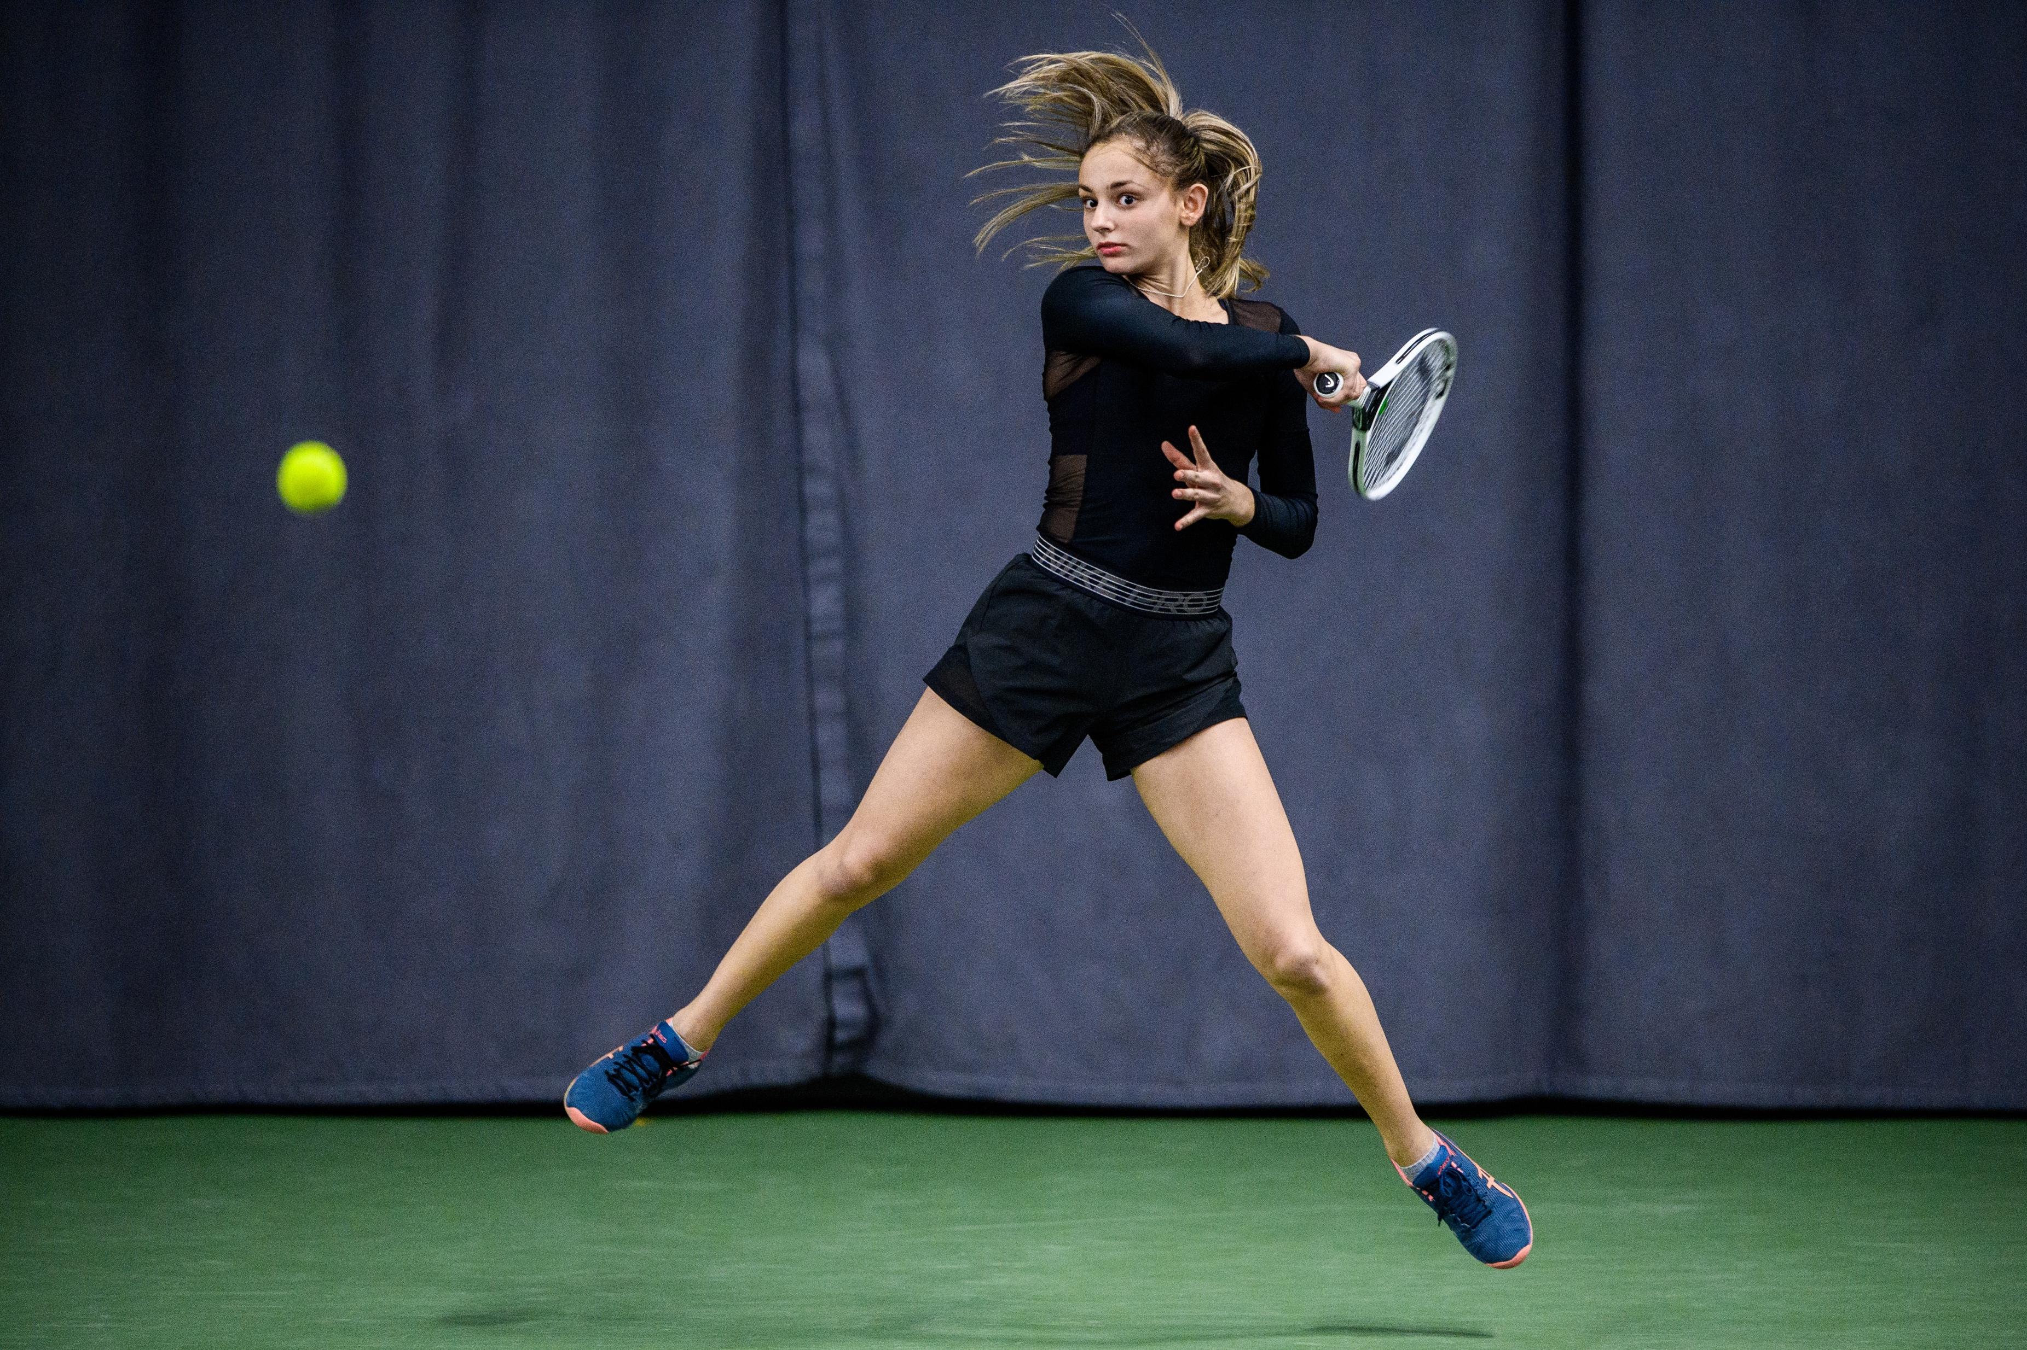
Partnership

Slide 2
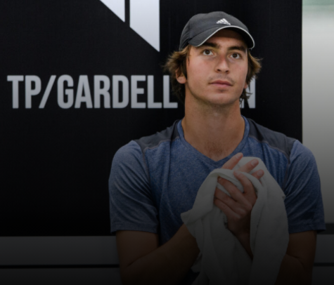
Agenda
EXECUTIVE SUMMARY
TP, MISSION & VISION
TP ASSETS
FUTURE
PREVIOUS PLAYERS
INCLUSIONS
TP IN MEDIA

Slide 3
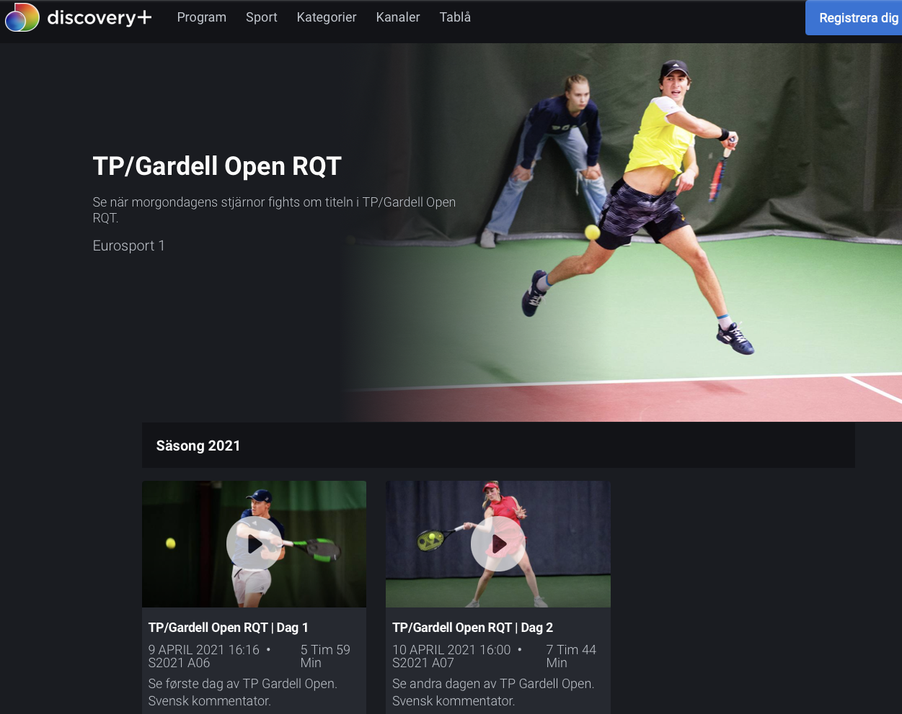
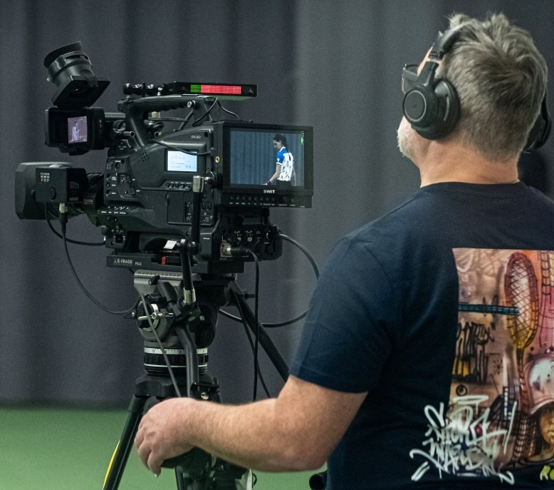
Executive summary
PARTICIPANTS
Best Nordic world-class tennis professionals expected to participate (men & women)
COVERAGE
  Streamed on Discovery+ and Eurosport Player all over Europe and YouTube globally.
  SVT, TV4, Aftonbladet, Expressen, Bildbyrån, media in other Nordic countries, social media e.g. Functional Tennis (341k followers), Tennis Legend (195k followers) etc.
  All Tennisportalen (TP) assets: Website; Instagram; Facebook; Twitter; YouTube; Podcast
  SPONSOR BENEFITS
  Brand building and exposure on-site and all over coverage assets to current and new target groups.
  Activation for all employees and customers.
  VIP treatment for selected employees and customers at tournaments. (TBD- Covid situation)

Slide 4
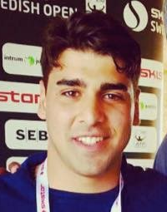
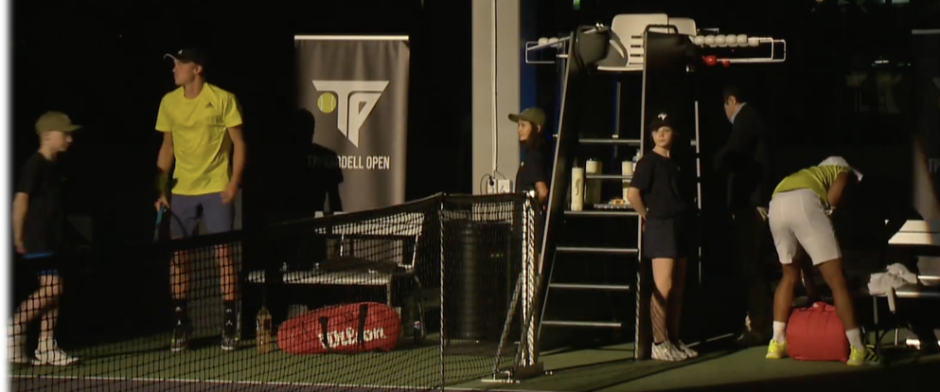
TP, Mission & VISION
Tennisportalen (TP) was founded 2013
Alexander Theodoridis, Founder & CEO
MISSION
Independent channel for Swedish and global tennis through all TP assets.
VISION
Complement and revolutionize current Swedish and international tennis assets.
Be a driving force in the success of Swedish and Nordic tennis now and in the future.

Slide 5
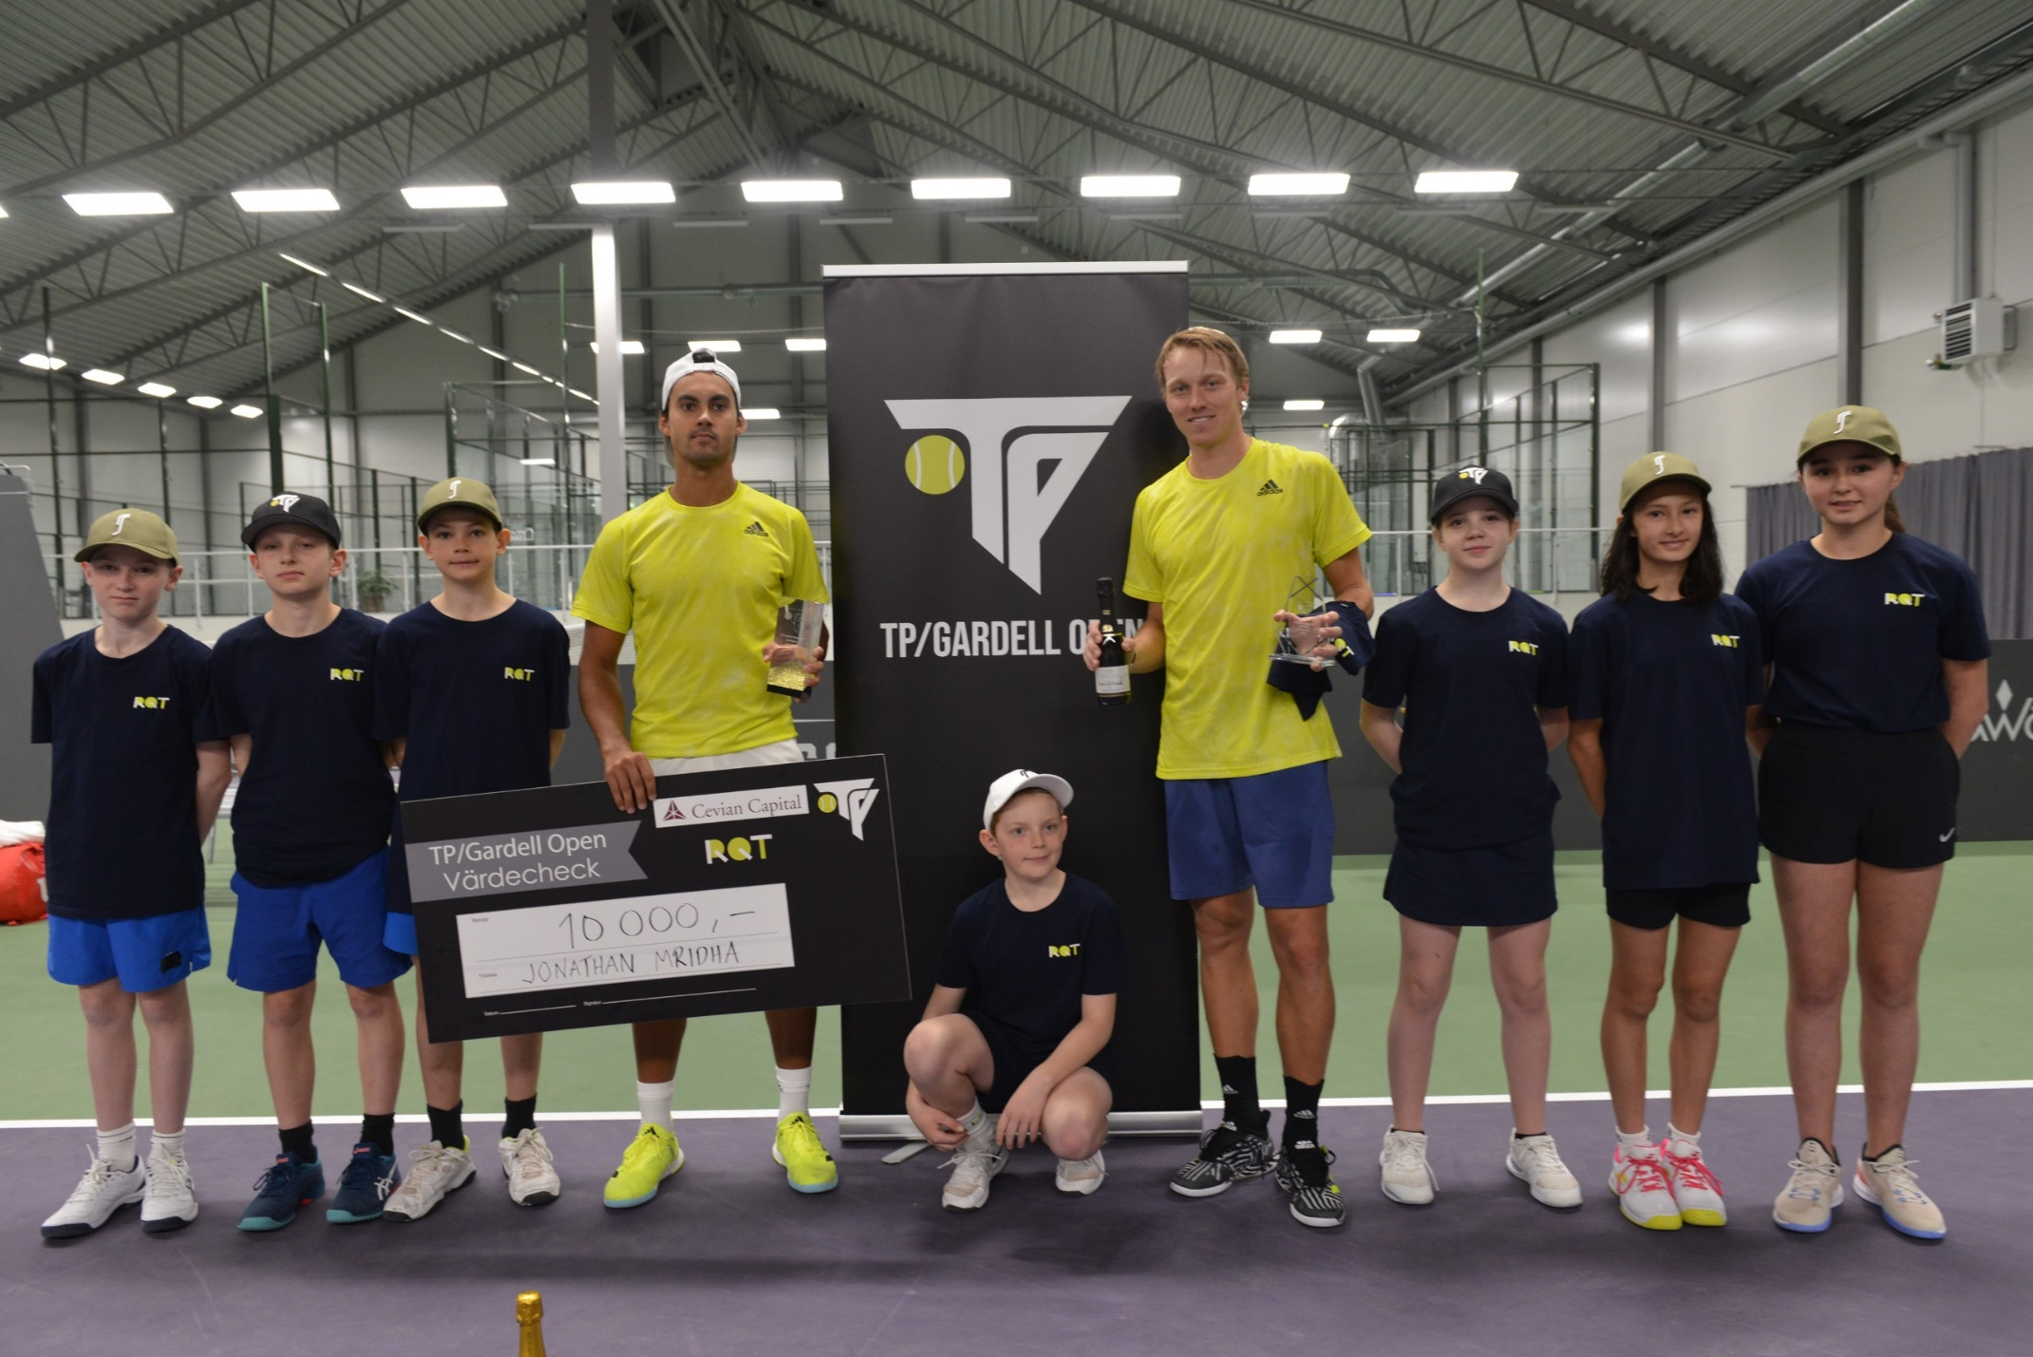
TP assets
WWW.TENNISPORTALEN.SE
INSTAGRAM
16 000 followers
FACEBOOK
2 500 followers
TWITTER
2 500 followers
YOUTUBE
1300 subscribers
SOURCE PODCAST
135 episodes to date, ca 5 000 downloads per episode
TP OPEN
Completed tournaments- 7 since 2019
Broadcasting rights- Discovery+ and Eurosport Player in Europe. Global stream on TP YouTube channel.
Media coverage- SVT, TV4, Aftonbladet, Expressen, Bildbyrån, media in other Nordic countries, social media e.g. Functional Tennis (341k followers), Tennis Legend (195k followers), etc.

Slide 6
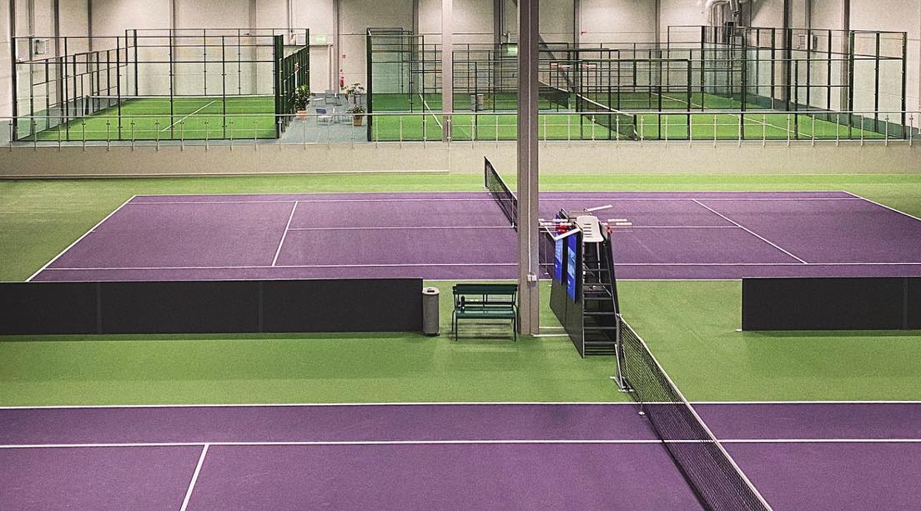
FUTURE
TP/RQT Masters 2022
Venue : RQT, Stora Wäsby, Stockholm, Sweden
Date : To be announced
Surface : Hard, indoor
Prize money: 50K SEK
TP Open
Venue : Båstad, Sweden
Date : To be announced
Surface : Clay, Outdoors
Prize money: 20k SEK
TP Open
Venue : Skåne/Stockholm, Sweden
Date : To be announced
Surface : Hard, indoor
Prize money: 20K
Notes:
All have both men’s and women’s tournaments meaning two tournaments per date. Winners in the two first tournaments are directly qualified + wildcards with the Nordic and the world's most exciting future names.

Slide 7
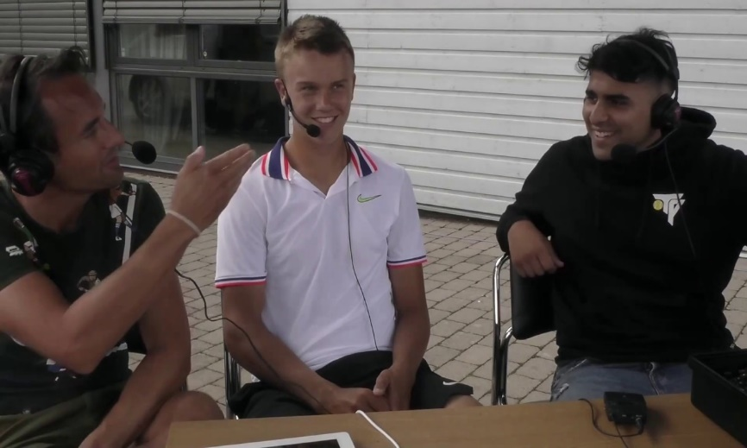
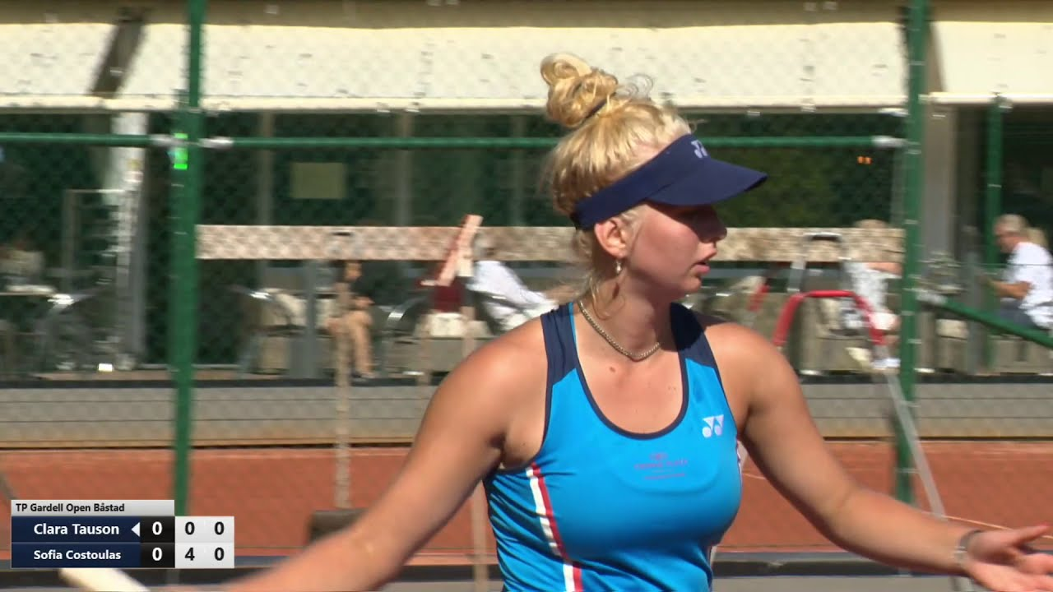

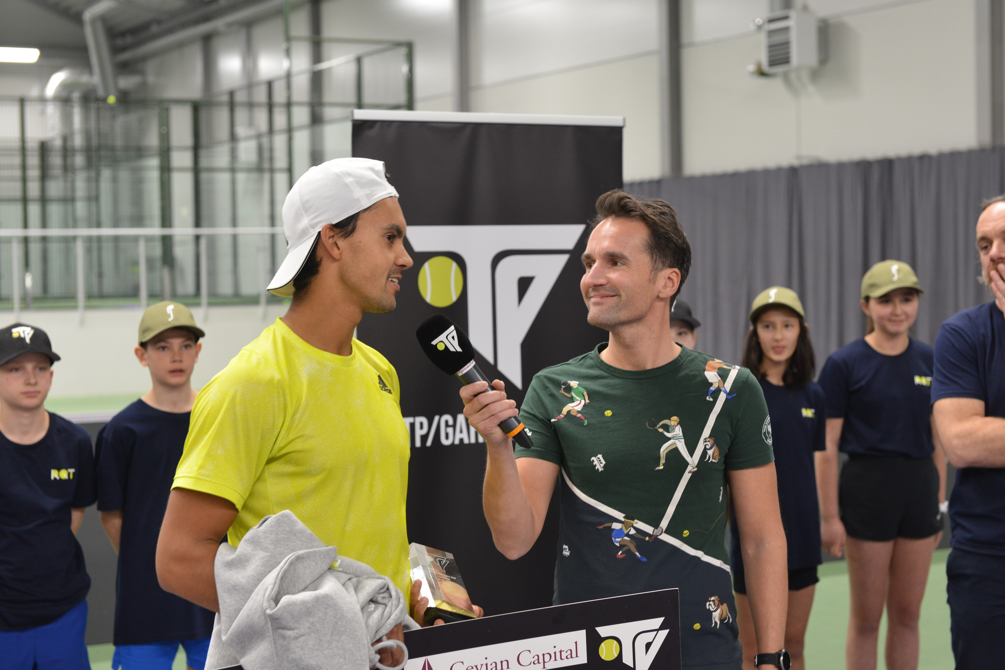
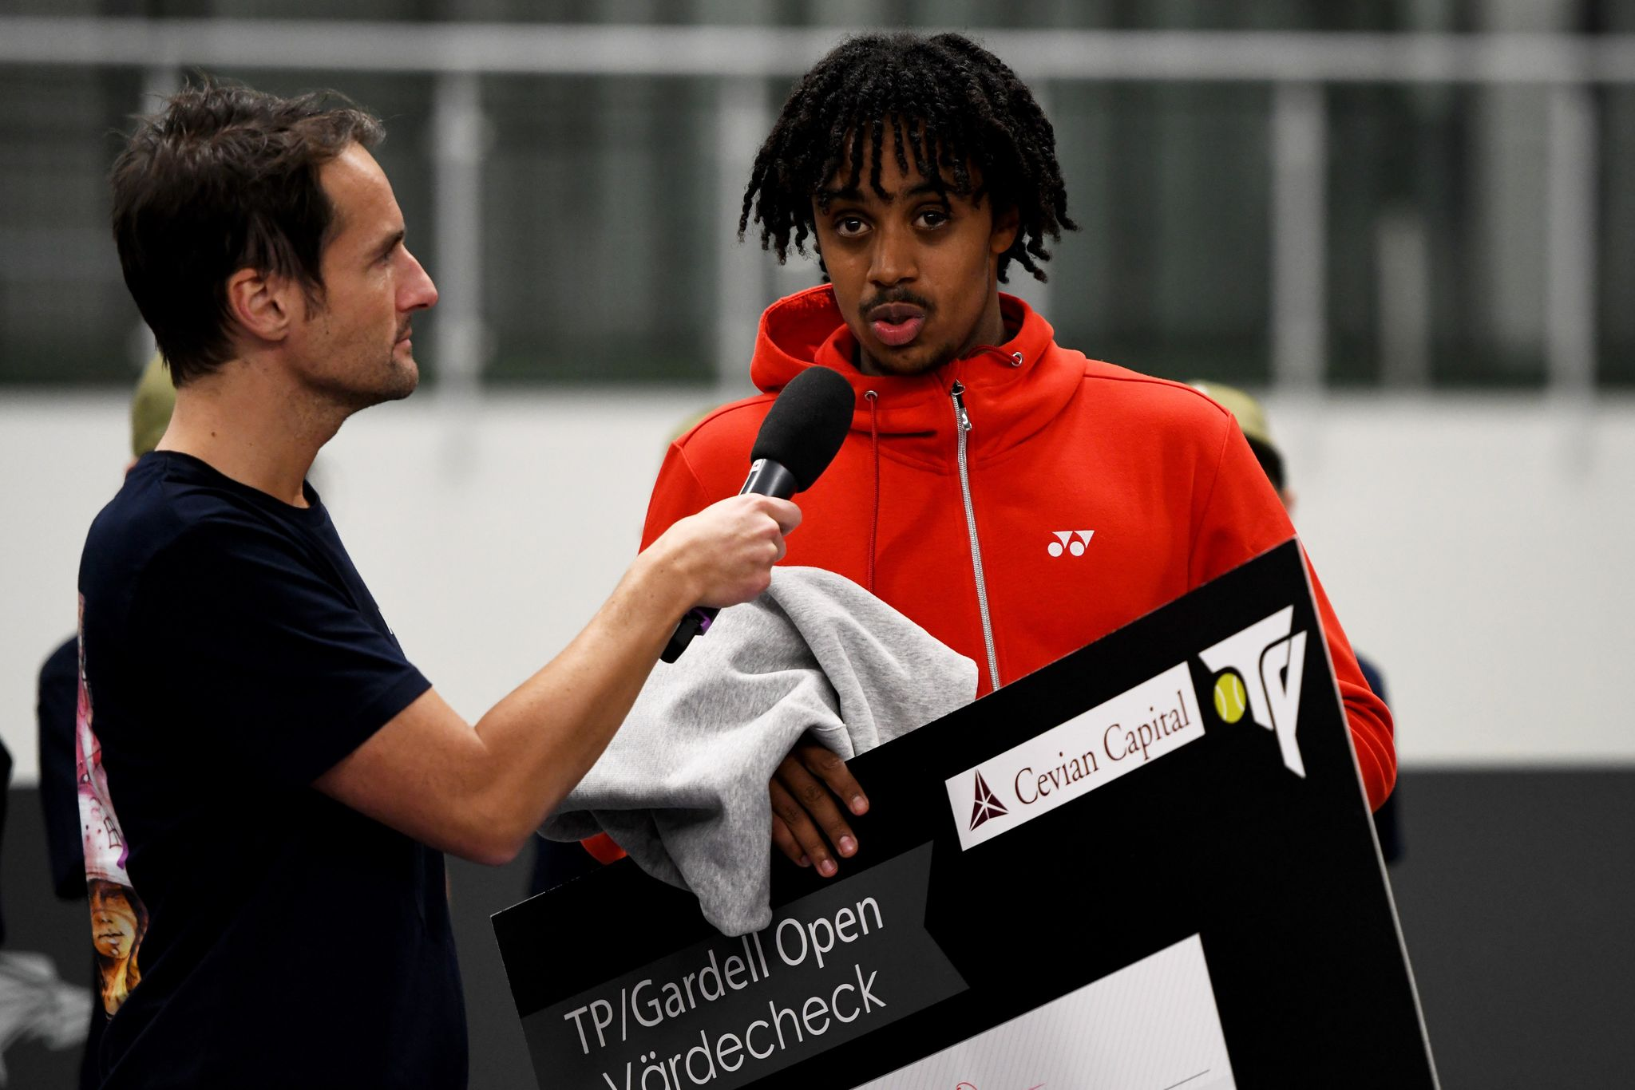

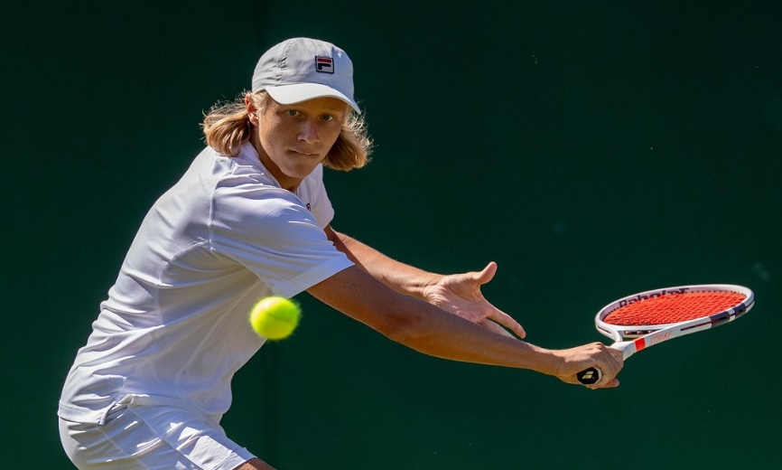
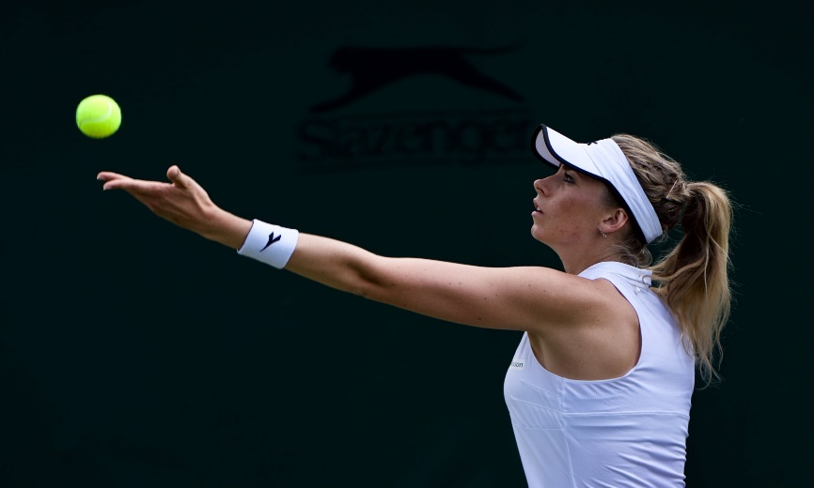
PREVIOUS PLAYERS
Holger Rune #108 ATP
TP Winner (1)
Clara Tauson #44 WTA
TP Winner (1)
Jonathan Mridha, 26
#524 ATP, TP Winner (2),
Davis Cup
Simon Yitbarek, 20
#786 ATP, TP Winner (2)
Leo Borg, 18
#21 Jr ITF
Cornelia Lister, 26
#89 WTA (Doubles)

Slide 8
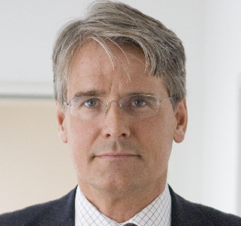
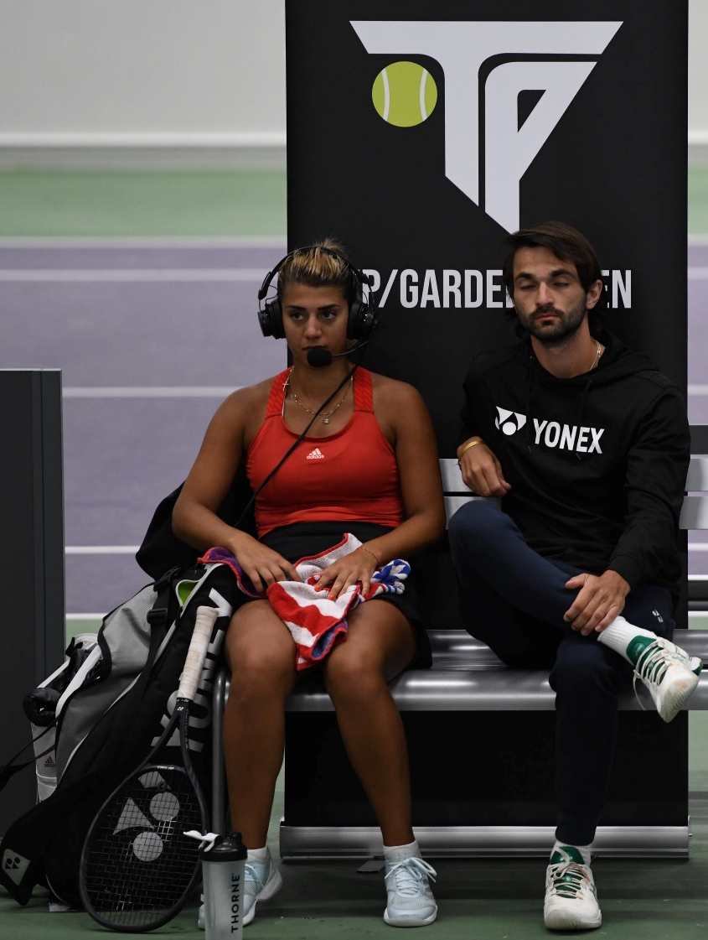
INCLUSIONS
TP/GARDELL OPEN
Previous TP partners include successful Swedish businessman, venture capitalist and tennis enthusiast Christer Gardell, Cevian Capital (AUM 16.5b USD)
    INCLUSIONS
    On-Court
    Title sponsor
    Centercourt name
    Roll-ups
    Ballboy t-shirts
    Towels
    Off-Court
    DJ
    VIP
    TP assets
    Podcast ”sponsored by” (5)
    Broadcast
    Stream-link
    Exposure on Eurospory/Discovery+ Digital platforms in all of Europe
    Cam
    Speaker- Opening & closing
    Match & player intros
    Mid-match interviews
    Commentary ”sponsored by” (>10x per day)
    CEO interview
    Other activations
    Pro-Am

Slide 9
TP IN MEDIA
Links:
https://www.svt.se/sport/tennis/broderna-ymer-namngav-yngre-brodern-efter-rafael-nadal
https://tv.aftonbladet.se/video/327592/svenska-christian-samuelssons-otroliga-slag
https://bildbyran.no/?q=Z0paMDA1ODtyMQ#photoview
https://sport.tv2.dk/tennis/2020-08-02-clara-tauson-er-tilfreds-efter-finalesejr-i-lidt-underligt-setup
https://www.expressen.se/sport/tennis/17-aringen-kritiseras-tranar-for-mycket/
Promo video: https://www.youtube.com/watch?v=LxeZQqUj5vE
Promo video 2: https://www.youtube.com/watch?v=TuVHOkC8rSw
Livestream: https://www.youtube.com/watch?v=AdfMmRfGWl4

Slide 10
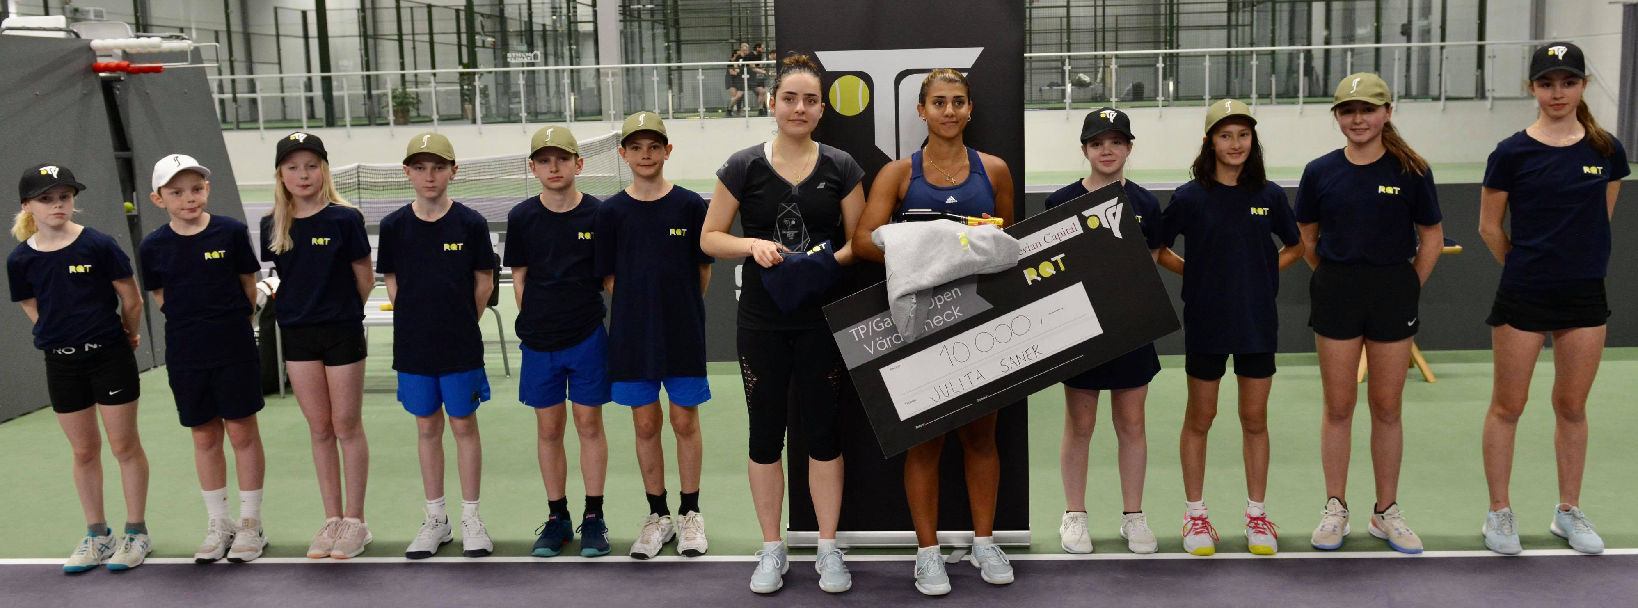
THANK YOU!
Alexander Theodoridis, Founder & CEO
+46 (0)72 944 59 12
alexander@tennisportalen.se

