Slide 1
Plural nouns

Slide 2



Sort the pictures into number groups. We use red lines to show how many. We add an ‘s’ when there is more than one.
One (1)
Two (2) or more
pies
apple
apples
cats
pie
cat

Slide 3

Fill in the table. Copy and paste images to make rows correct. Add lines and ‘s’ if needed.
What? | How many? | Word
 | 1 | pie
 | 2 | car
 | 4 | apple
 | 1 | car
 | 2
 |  | cat

Slide 4
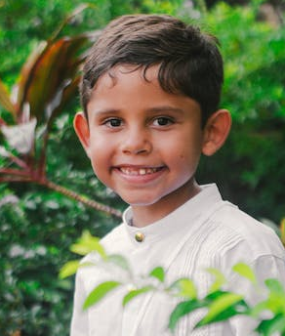
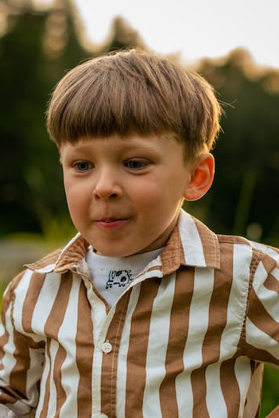


This is Billy. He likes the number 1.
He has 1 of everything.
This is Zak. He likes the number 10. He has 10 of everything.
Copy and paste pictures, words and lines to show what Zak has.
10
10 cats
1
1 cat
1 car
1 book
1 robot

