Slide 1


SEARCHING
FOR
RESEARCH DATA
- WORKSHOP -
FOR STUDENTS
Image from Genestro, iSTock

Slide 2
Programme
  Introduction (15 min.)
  Data search strategies (incl. short exercise) (30 min.
  Break (10 min.)
  Data search strategies continued (30 min.)
  Data search activity (20 min.)
  Peer discussion (incl. recap) (15 min.)
Notes:
1 min.
Welcome
Introduction to agenda. Briefly mention the overall intention with the course:
1) introducing the participants to a selection of search strategies in the context of data search;
2) for the participants to acquire basic skills in data search to be utilised in their studies.
Program:
Introduction (15 min.)
What is research data?
Why and what to expect when searching for data?
Be critical of your sources
Data search strategies (incl. short exercise) (30 min.)
Break (10 min.)
Data search strategies continued (30 min.)
Data search activity (20 min.)
Peer discussion (incl. recap) (15 min.)

Slide 3
Learning objectives
Upon completion of this workshop, the participant will have acquired:
  Basic knowledge of research data – data types and formats, etc.
  Knowledge of different search strategies and methods for searching for data.
  Basic knowledge of how to assess research data.
  Knowledge of conditions for reuse (licenses).
  Skills to find and navigate relevant research data using knowledge of search strategies.
Notes:
1 min
Change learning objectives if you apply sceniario 2 (30 minutes):
The learning objectives of the teaching are to provide the participants with:
Knowledge of various search strategies and methods for data retrieval.
Knowledge of how to use repositories and search engines for data searching.
Basic knowledge of how to assess research data.
Familiarity with conditions for reuse (licenses).
Change learning objectives if you apply sceniario 3 (15 minutes):
The learning objectives of the teaching are to provide the participants with:
Basic knowledge of research data.
Familiarity with various search strategies and methods for data retrieval.
Basic knowledge of how to assess research data.

Slide 4
Introduction
Image from Genestro, iSTock

Slide 5







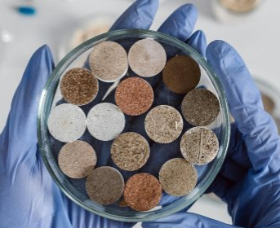
Different types of data
Audio
Tables
Video
Text
Samples
Images
All images are Public Domain from Pexels: https://www.pexels.com/da-dk/
Notes:
Approx. 2 min.
In some academic disciplines, researchers still think of numbers when you mention the phrase "research data". In the context of research, however, all of these examples can feature as empirical material, or research data.
What is important to note is that there is not a straightforward answer to the question of what defines research data. It often varies depending on the research project, as well as the academic discipline/field in which the research in question is conducted. If we were to generalise, one can say that research data are all the materials, results and analyses that are necessary to support or validate a research project's observations, findings, outputs or conclusions.

Slide 6
Data search – why?
Different purposes, e.g.:​
    Review existing research: what is already out there – not just in terms of scholarly literature but research data?​
    Reuse other people's research data in your own project rather than/as a supplement to your own data collection.​
    Draw inspiration from existing research data – e.g. how to structure an interview guide or designing a new project for your studies.
Notes:
Approx. 3 min.
So why would it be relevant to search for data? Consider these different purposes. [Walk through and discuss content on slide.] [To encourage the students to participate in the conversation, ask questions such as: Can you think of other reasons for conducting a data search? What is your main motivation in your own studies?]

Slide 7


What to expect when searching for data?
Relevant literature
Relevant data
You
You
Notes:
Approx. 1 min.
What can we then expect when searching for data? You are likely to have a very different experience compared to a "conventional" literature search – expect lots of dead ends and frustration.

Slide 8
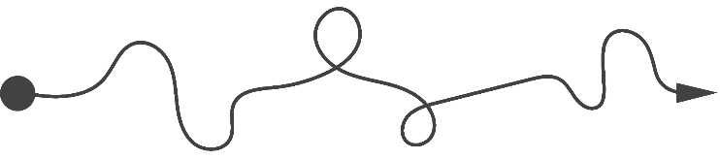
No standardized search strategies
Relevant data
(Research) data is not collected and indexed in the same way as literature, and there are no standardized search strategies.
This means:
  Generally, a less structured and systematic process compared to a literature search.
  An element of serendipity: You are likely to find interesting or relevant data by chance and often in unexpected places.
  Expect dead ends.
  Be prepared to be flexible in your approach - use a combination of strategies.
  The search process often extends over time and usually involves a social element (knowledge sharing with peers, your supervisor, etc.).
  TIP: use a logbook to document the search process.
You
Relevant literature
Notes:
Approx. 3 min.
The experience of dead ends and frustration can be explained by the fact that (research) data are not collected and indexed in the same way as literature. For instance, not all academic databases have data search features/research data indexed. In addition, there are many different research data repositories out there and many of these can be difficult to navigate.
[Walk through and discuss content on slide.] This reality has an effect on the search process:
No standardised search strategies for data
Generally a less structured and systematic process compared to literature search
An element of serendipity: likely to find interesting or valuable things by chance
Be prepared to come across dead ends – so be flexible in your approach and use a combination of methods
Depending on the purpose of your data search, consider adjusting/ expanding your search strategy/research question/keywords along the way if all strategies lead to dead ends.

Slide 9
Before you begin your search for data…
Consider this before you begin your search for data:
Do you need to narrow the scope of your search?
  by creating an explicit and well-defined research question, a list of keywords, etc. Adjust if/when necessary.
Do you need to consult a discipline-specific or cross-disciplinary source for research data?
  Search engines, databases, specific repositories.
Would it be useful/necessary to look for data outside of the research community?
  E.g., national and/or international organisation’s websites
! Expect a continuous assessment of the data during the search process (e.g., type, quality, relevance).
Relevant data
Notes:
Approx. 1 min.
It is important to note that this does not mean that you can't be strategic in how you search for data. Begin by planning your search and consider the following. [Walk through and discuss content on slide.]

Slide 10
Be critical of your sources
Be critical of the data you find - ask yourself if the information provided about the data is sufficient to help you decide whether it makes sense to reuse the data in your project.
Consider aspects such as:
Who generated the data?
For what purpose are the data generated?
How are the data generated?
Where did you find the data?
Which conditions are in place to use the data? (E.g., Creative Commons or other licenses)
Notes:
Approx. 1 min.
As is the case in any information search process, you should always be critical of the sources you use in your studies. [Walk through and discuss content on slide.]

Slide 11
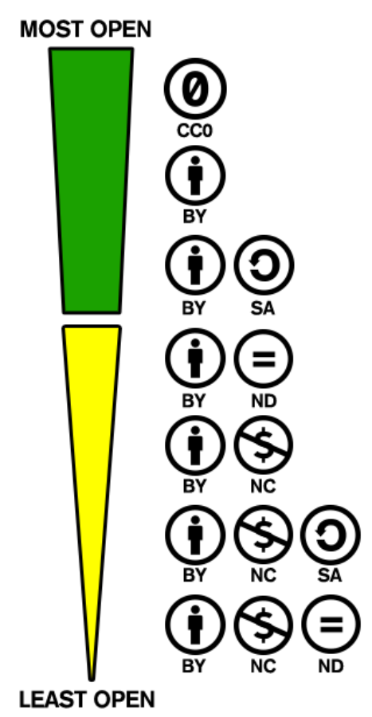
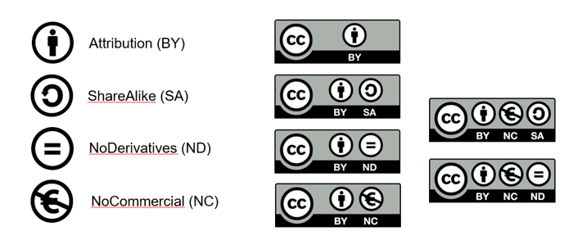
Reuse – Licenses
Creative Commons (CC)
Source: Creative Commons – Share your work
Source: Wikimedia Commons CC BY-SA 4.0
Notes:
Approx. 1 min.
Explain that CC licenses have a different degree of openness. You don’t have to go into the details but just explain that there are different types of licenses for different research outputs, including licenses for software and databases. Marking your work with a license is useful if you want to give the user of the work more rights, or just remind the user of your rights. If you actively use social media for disseminating your work, this could be a wise thing to consider when putting your work online.
BY: Licensees may copy, distribute, display and perform the work and make derivative works and remixes based on it only if they give the author or licensor the credits (attribution) in the manner specified by these.
SA: Licensees may distribute derivative works only under a license identical ("not more restrictive") to the license that governs the original work. (See also copyleft.) Without share-alike, derivative works might be sublicensed with compatible but more restrictive license clauses, e.g. CC BY to CC BY-NC.
ND: Licensees may copy, distribute, display and perform only verbatim copies of the work, not derivative works and remixes based on it.
NC: Licensees may copy, distribute, display, and perform the work and make derivative works and remixes based on it only for non-commercial purposes.

Slide 12
Data search strategies
Incl. exercises
Image from Genestro, iSTock

Slide 13
Search strategies - (Research) data can be searched for in ...
Strategy 1
Bibliographic databases
Strategy 2
Repositories
Strategy 3
Search engines
Strategy 4
Outside academia (organisations, governments, etc.)
Notes:
Approx. 1 min.
With this in mind, we will now present a number of strategies that we will ask you to work with/try out in short sequences.
[Walk through the four strategies mentioned on slide.]

Slide 14
Search strategies
Strategy 1
Bibliographic databases
Strategy 2
Repositories
Strategy 3
Search engines
Strategy 4
Outside academia (organisations, governments, etc.)
Notes:
Approx. 10 min. To run through strategy 1
We will start by looking at academic databases. You are probably already familiar with academic databases from your literature searches. In this context, however, we will look at a couple of databases that also have data search features.

Slide 15
Strategy 1 - Searching for research data in a bibliographic database
Bibliographic database:
An organised digital registry of literature
Some bibliographic databases index datasets the same way as they do with literature
In those bibliographic databases you will be able to find literature linked to datasets
Notes:
Approx. 10 min. To run through strategy 1
Definition of bibliographic database in common words: A bibliographic database is an organized digital collection of references to literature. It does not necessarily give you the full text of the article, merely the means to find it.

Slide 16
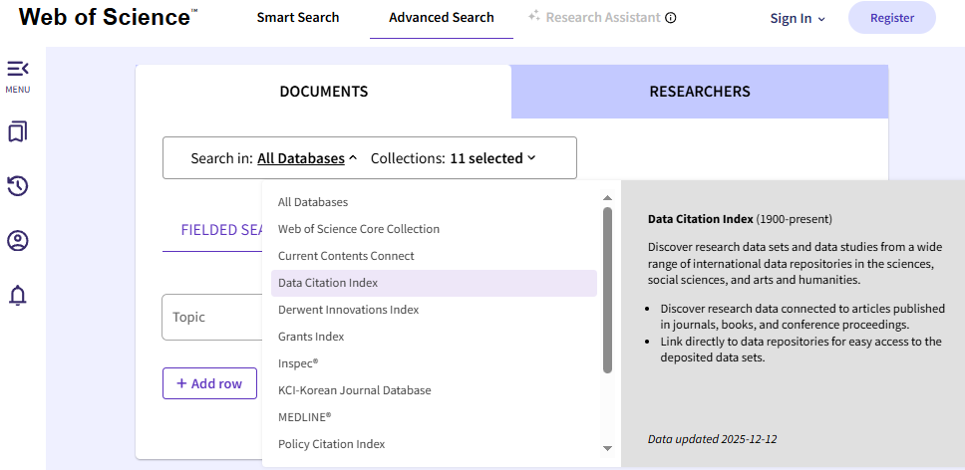
Strategy 1 - Searching for research data in a bibliographic database
In Advanced Search
Example A: Web of Science (Data citation Index)
Select
DataCitation Index
Notes:
Approx. 10 min. To run through strategy 1
In the first strategy, we look for research data indexed in academic databases. Let's focus on two examples: Web of Science [Example A] and Dimensions [Example B].
[Example A: Web of Science]
NOTE: Not all universities provide access to Web of Science and/or dataset search functions in some databases. Remember to clarify whether this is the case for the students attending the course; if so, you might consider only showing example B (which focuses on the database Dimensions.
[If showing the example "live"/directly in your browser, following these instructions:]
Access Web of Science in your browser and select Data Citation Index on the Web of Science landing page. You are now searching exclusively in the datasets that are indexed in the database.
Type in the keywords you want to find datasets on. Select filters to narrow down the search results if relevant.
Browse the results like you would in a literature search.
Click on a dataset that seems relevant to the topic and click on the title to access the metadata
Access the repository where the (meta)data is hosted.
[If you prefer to walk through the example in the slides, begin here instead:]
Access Web of Science in your browser and select Data Citation Index on the Web of Science landing page. You are now searching exclusively in the datasets that are indexed in the database.
[Go to the next slide]

Slide 17
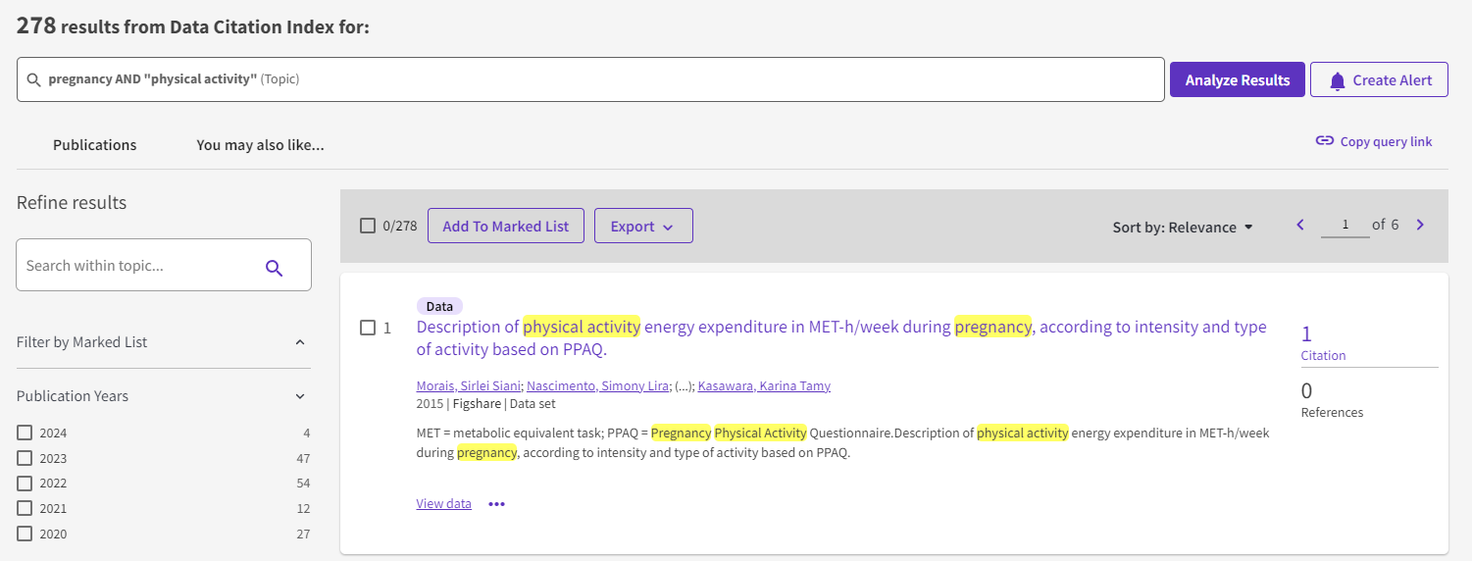
Strategy 1 - Searching for research data in a bibliographic database
Searching in Data Citation Index via Web of Science
Example A: Web of Science (Data citation Index)
Number of citations: click to get access to the list of citations
Click on the title to read the metadata and view the source
Notes:
Approx. 10 min. To run through strategy 1
[Example A: Web of Science, continued.]
Explain the content of the screenshot, highlighting where you are searching (Data Citation Index);
Then type in the keywords you want to find datasets on. Select filters to narrow down the search results if relevant.
Browse the results like you would in a literature search.
Click on a dataset that seems relevant to the topic and click on the title to access the metadata. Note that you can see the number of times a dataset has been cited by other works indexed in Web of Science (which might lead to additional literature/datasets/etc.).
When you have clicked on the dataset in question, read the metadata with the students and click on the link to access the repository where the dataset is hosted.
[End of example A]

Slide 18
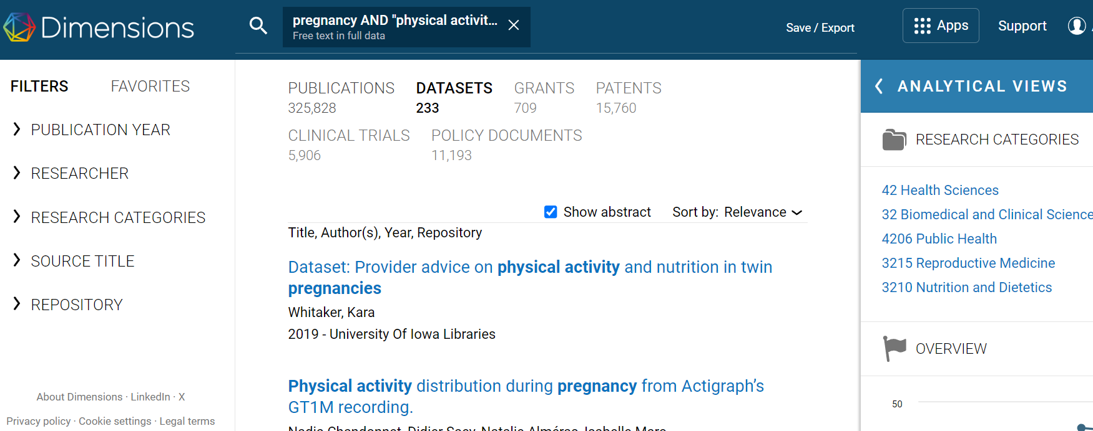
Strategy 1 - Searching for research data in a bibliographic database
Example B: Dimensions
NB: Sign up for access
Searching in datasets
Click on title to read the metadata and view the source
Notes:
Approx. 10 min. To run through strategy 1
[Example B: Dimensions.]
[If showing the example "live"/directly in your browser, follow these instructions:]
Access the database in your browser
Sign up. Once you have signed up, you can begin your data search in the database.
Select “datasets” at the top of the page
Enter the keywords you want to search for.
When you find a relevant dataset, click on the title to read the metadata
Access the repository where the (meta)data is hosted.
Additional information: often, you can also see connections between research articles and datasets.

Slide 19
Search strategies
Strategy 1
Bibliographic databases
Strategy 2
Repositories
Strategy 3
Search engines
Strategy 4
Outside academia (organisations, governments, etc.)
Notes:
Approx. 10 min. To run through strategy 2
We will now look at strategy 2: repositories. This is where the data and/or metadata is hosted. [Go to next slide where the term is explained in more detail.]

Slide 20
Strategy 2 - Search for research data in a repository
Repository:
A database of digital objects (e.g. datasets, articles, presentations).
A repository includes data, metadata and persistent identifiers (PIDs).
In the context of research data, a repository is where the (meta)data are hosted.
Repositories can be subject-specific, institutional or general.
…so where to begin?
Notes:
Approx. 10 min. To run through strategy 2
Walk through the definitions of repository on the slide to ensure the students understand the concept.
[To elaborate include the following explanation:] In a data repository, researchers can deposit data and metadata with the intention of both storing and sharing the data. The definition of a repository comes close to that of an archive, and the two terms are often used interchangeably. One important distinction can be made in the context of research data: here, a repository is usually focused on the sharing and reusage of information and is, in this sense, more "active" compared to an archive, which is often defined as more static because it is main purpose is merely to provide access to stored information.

Slide 21


Strategy 2 - Search for research data in a repository
Where do I find repositories relevant to my studies?
If you are not already familiar with a repository, try online platforms such as re3data.org or fairsharing.org. These are registers of existing international repositories of research data, including discipline-specific repositories.
If you cannot find any discipline-specific repositories, try searching in general repositories, e.g. Zenodo.
Notes:
Approx. 10 min. To run through strategy 2
In strategy 1, it was demonstrated how to search for and access datasets via academic databases. In strategy 2, we go directly to the source, namely the repositories where the data and/or metadata is hosted and can be accessed. Begin your search in a repository if you are already familiar with one. If not, try searching online registers (see slide for examples) of repositories to see if you can find ones that are relevant to your field/topic, e.g. discipline-specific repositories. For general repositories, see the handout for examples.
[In case a definition of 'registry' is relevant:]
Registry
"An official record book" **
A registry such as re3data.org points you towards relevant repositories (and thereby data)
Consider broad search in registries, e.g. disciplinary description and country
** “registry.” Merriam-Webster.com Dictionary, Merriam-Webster, https://www.merriam-webster.com/dictionary/registry. Accessed 17 Nov. 2023.

Slide 22
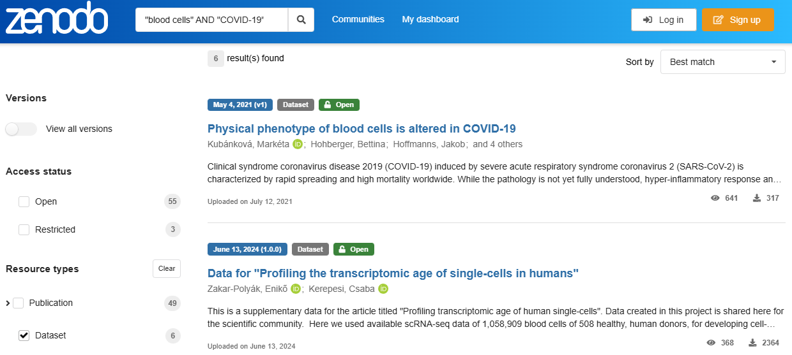
Strategi 2 - Searching for research data in a repository
Eksempel A: Zenodo
Search with keywords (using boolean operators if possible)
Select a dataset to explore
Choose resource type "Dataset"
Notes:
Ca. 10 min. til at gennemgå strategi 2
Lad os tage et kig på Zenodo, et af de generelle repositorier, hvor forskere fra hele verden kan deponere data fra deres forskningsprojekter. Bemærk, at Zenodo er et generelt repositorium og derfor ikke kun indeholder forskningsdata, men også forskellige andre forskningsresultater.
[Hvis eksemplet vises “live”/direkte i din browser, følg disse instruktioner:]
Gå ind på www.zenodo.org i din browser.
Indtast de nøgleord, du vil finde datasæt om. Vælg filtre, herunder “dataset” under “Resource types”, for at indsnævre søgeresultaterne.
Gennemse resultaterne.
Klik på et datasæt, der virker relevant for emnet, og klik på titlen for at få adgang til metadata og data, hvis det er gjort tilgængeligt.
Fremhæv nogle af de vigtigste funktioner og metadata (se slide).
[Hvis relevant, gør opmærksom på muligheden for avancerede søgeforespørgsler – se Zenodos søgeguide.]

Slide 23
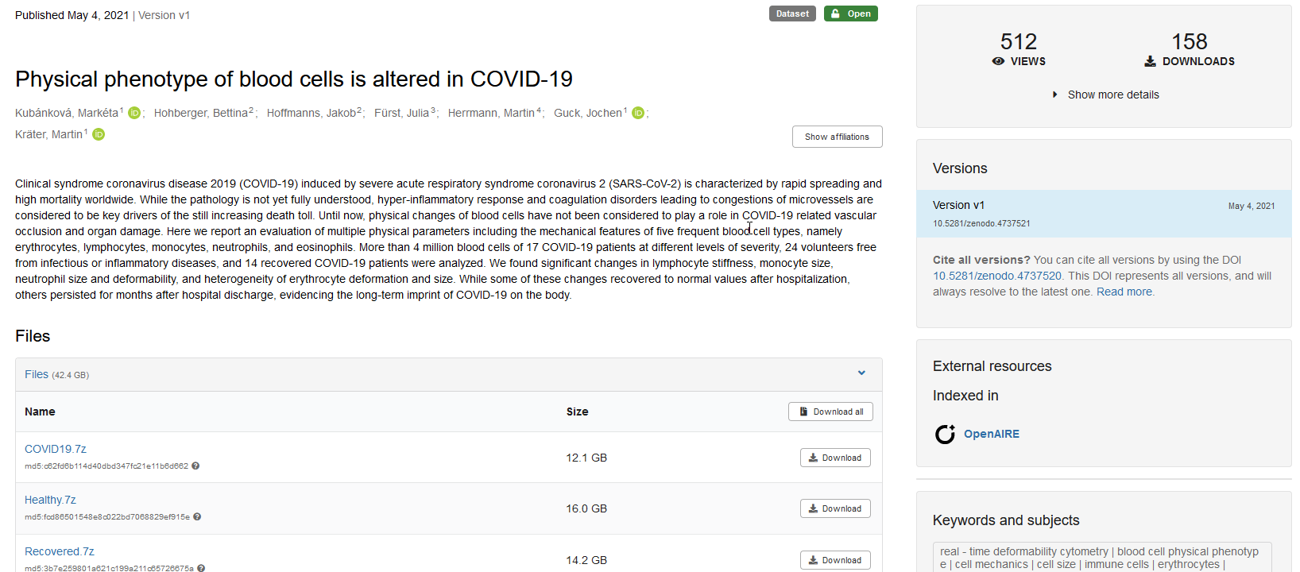
Strategy 2 - Searching for research data in a repository
Information about the data set in the right-hand side
Summary
Example A: Zenodo
Files for download
.7z is a compressed archive format, that can be un-compressed with 7-zip (an open source program).
Notes:
Approx. 10 min. To run through strategy 2
Let's have a look at Zenodo, one of the general repositories where researchers from all over the world can deposit data from their research project. Note that Zenodo is a general repository and so not only contains research data but various other research outputs.
[If showing the example "live"/directly in your browser, follow these instructions:]
Access www.zenodo.org in your browser.
Type in the keywords you want to find datasets on. Select filters, including "dataset" under "Resource types", to narrow down the search results.
Browse the results.
Click on a dataset that seems relevant to the topic and click on the title to access the metadata and data, if it is made accessible.
Highlight some of the key features and metadata (see slide).
[If relevant, draw attention to the possibility for advanced search queries – access Zenodo's search guide.]

Slide 24
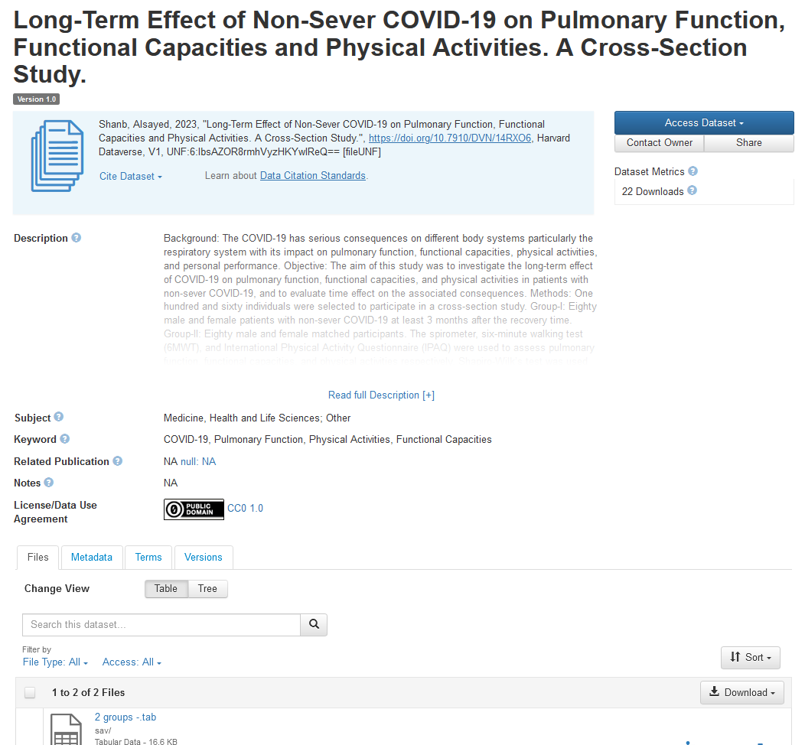
Strategy 2 - Search for research data in a repository
Example B: Harvard Dataverse
Abstract/
summary
Metadata - example, terms of use and versions of the data set
Keyword - General information about the data set
.tab is a spread sheet format, but it can be opened by any text editor.
Files for download
Notes:
Approx. 10 min. To run through strategy 2
Let's have a look at Harvard Dataverse, another example of a repository.
[If showing the example "live"/directly in your browser, follow these instructions:]
Access https://dataverse.harvard.edu/ in your browser.
Type in the keywords you want to find datasets on. Select filters, including "dataset", to narrow down the search results.
Browse the results.
Click on a dataset that seems relevant to the topic and click on the title to access the metadata and data, if it is made accessible.
Highlight some of the key features and metadata (see slide).
[If relevant, draw attention to the possibility for both basic and advanced search options– access guide here: finding data].

Slide 25
Exercise (10 min.)
Strategy 1:
Go to Data Citation Index in Web of Science and find the associated data for this article:
Jepson, Ruth; Harris, Fiona M.; Bowes, Alison; et al. (2012).
  Physical Activity in South Asians: An In-Depth Qualitative Study to Explore Motivations and Facilitators. PLOS ONE, Vol:‏ 7, Issue: 10, Article Number: e45333. doi: 10.1371/journal.pone.0045333
When you find the dataset, assess the data by considering the following questions:
Where are the data hosted (i.e. repository)?
Describe the type and format of the data.
Which rights do you have to use the data (i.e. which license is attached to the data)?
Strategy 2:
Go to Zenodo and find the following dataset:
"Summaries of interviews and workshop on citizen science and use of interactive walkable floormaps in schools”.
Assess the data by answering the following questions:
Who generated the data and what is their affiliation?
Is the data associated with a peer-reviewed article or a project? Write down the title of article/project.
Is the data in a textual, audio, visual or tabular format?
Which rights do you have to use the data (i.e. which license is attached to the data)?
How can you cite the dataset?
Notes:
Approx. 10 min.
Ask the students to do one of the exercises outlined on the slide. The students can work in pairs or individually.
Strategy 1:
Conduct a search where they look for the dataset that is associated with the article referenced on the slide. They can use DataCitation Index in Web of Science.
If the students manage to find the associated data for the article, ask them to do an initial assessment of the data by answering the 3 questions. Use this as an opportunity to highlight the importance of being critical when looking for relevant sources in the information search process; this also applies to data search. [If relevant, refer back to slide 10: "Be critical of your sources".]
Expected learning outcome of this excercise:
The point of these exercises is to ensure that the students acquire basic skills in searching for research data in a database and to be critical of the information they find.
Search protocol/answers to questions in strategy 1 – in case the instructor would like to walk through the exercise with the students afterwards:
Find it via Data Citation Index in Web of Science - "Physical Activity in South Asians: An In-Depth Qualitative Study to Explore Motivations and Facilitators"
Answer to question 1: The data is hosted in the data repository Figshare
Answer to question 2: Qualitative data, Docx. file format, textual
Answer to question 3: CC4.0: The Creative Commons Attribution license allows re-distribution and re-use of a licensed work on the condition that the creator is appropriately credited.
Strategy 2:
Conduct a search where they look for the dataset referenced on the slide on Zenodo.
When the students find the associated data for the article, ask them to do an assessment of the data by answering the 5 questions. Note that in this assessment, they are asked to be more thorough, paying attention to other key aspects of the metadata which can help determine whether the data set can be re-used. Use this as an opportunity to extend the points made in the exercise for Strategy 1. [If relevant, refer back to slide 10: "Be critical of your sources".]
Expected learning outcome of this excercise:
The point of these exercises is to ensure that the students acquire basic skills in searching for research data in a repository and to be critical of, and assess, the information they find in order to be able to determine whether they can re-use the data.
Search protocol/answers to questions – in case the instructor would like to walk through the exercise with the students afterwards:
Answer to question 1: Find it at Zenodo. Jeppe Læssøe, Prof Emeritus at Aarhus University
Answer to question 2: Associated with a project: The H2020 funded Research and Innovation Action project REGREEN Fostering nature-based solutions for smart, green and healthy urban transitions in Europe and China, 2019-24.
Answer to question 3: Textual.
Answer to question 4: CC4.0 - The Creative Commons Attribution license allows re-distribution and re-use of a licensed work on the condition that the creator is appropriately credited.
Answer to question 5: Læssøe, J. (2024). Summaries of interviews and workshop on citizen science and use of interactive walkable floormaps in schools [Data set]. Zenodo. https://doi.org/10.5281/zenodo.10604591.]

Slide 26

Break – 10 min.

Slide 27
Search strategies
Strategy 1
Bibliographic databases
Strategy 2
Repositories
Strategy 3
Search engines
Strategy 4
Outside academia (organisations, governments, etc.)
Notes:
Approx. 13 min. To run through strategy 3
We will now look at strategy 3: search engines.

Slide 28
Strategy 3 - Search engines and AI
Search engines can be helpful - also for searching for data.
Some search engines are developed specifically for data search. E.g., Google Dataset Search or DataCite Commons.
Sometimes, it is also helpful to try a "standard" internet search engine, for instance if you get stuck or if your repository does not yield any results.
GenAI can generate keywords and be used to check if you have missed something.
GenAI can suggest databases, websites, etc., where it might be relevant to search for your data.
NB If using a "standard" search engine or AI, it can be unclear why you get the answers you do and whether something has been overlooked in the process. So be critical (as always).
If you search for terms with a broad semantic meaning, be prepared for many irrelevant results.
Notes:
Approx. 13 min. To run through strategy 3
If you have not been able to find relevant data using strategy 1-2, try different search engines, e.g. Google and Google Scholar, as well as search engines specifically tailored for data search, incl. Google Dataset Search and DataCite Commons. Generative AI can also help to generate useful keywords or places to search.
However, please note that search engines such as Google can be opaque in how they generate results due to algorithms. They are not transparent in how/why they generate results.

Slide 29
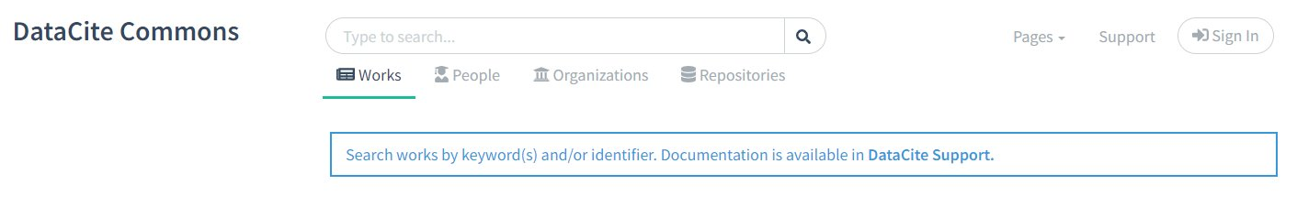

Strategy 3 - Search engines and AI
commons.datacite.org
datasetsearch.research.google.com
Notes:
Approx. 13 min. To run through strategy 3
Let's look at some examples: DataCite Commons and Google Dataset Search.
In DataCite Commons, you can search for researchers' outputs – journal articles, datasets, etc.
In Google Dataset Search, you search specifically for datasets.

Slide 30
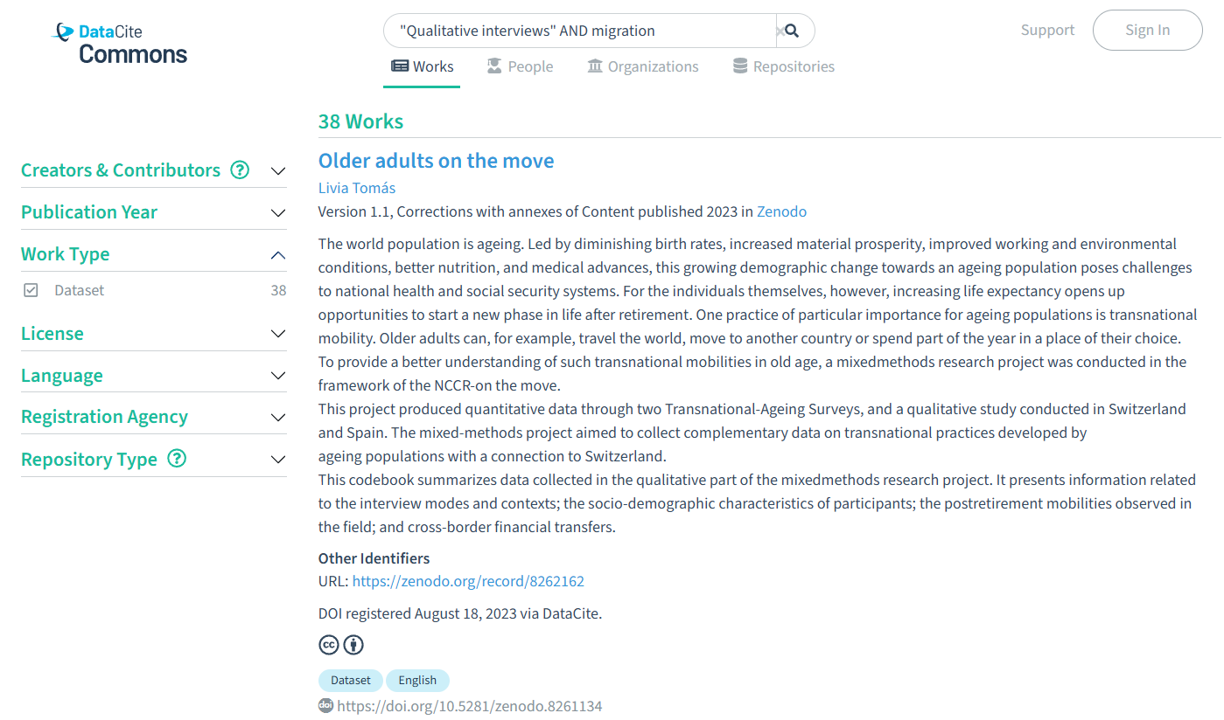
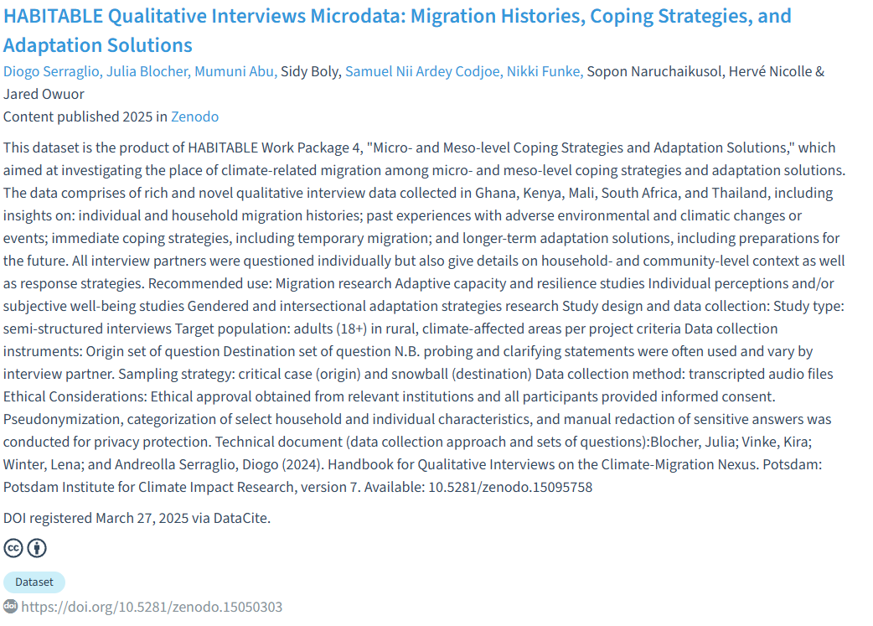
Strategi 3 - Search engines and AI
Search with keywords
Example A: DataCite Commons
Click on the dataset to read about the data and access via the repository
Select dataset as
"Work Type"
Notes:
Approx. 13 min. To run through strategy 3
[If showing the example "live"/directly in your browser, follow these instructions:]
Access https://commons.datacite.org in your browser.
Type in the keywords you want to find datasets on. Select filters, including "dataset", to narrow down the search results.
Browse the results.
Click on a dataset that seems relevant to the topic and click on the title to access the metadata and access the repository where the (meta)data is hosted.
[Go to the next slide.]

Slide 31
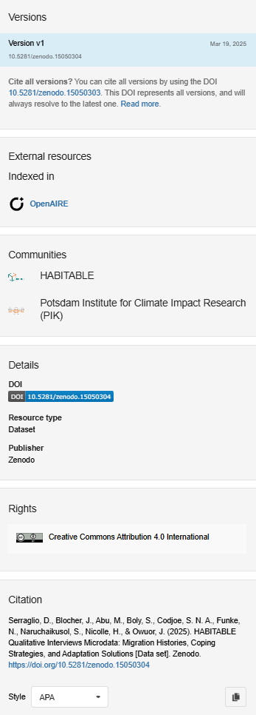
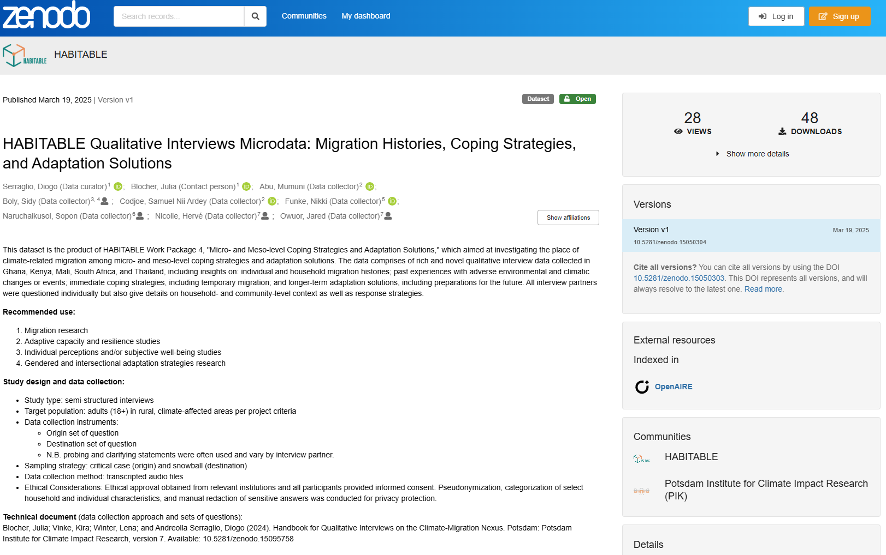
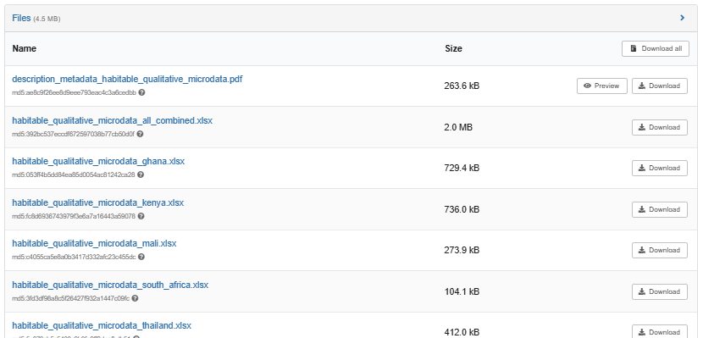
Strategi 3 - Search engines and AI
Example A: DataCite Commons
Zenodo
General overview of the dataset and metadata (authors, open/restricted, etc.)
Version, DOI, license etc.
See/click on files to access data
Notes:
Approx. 13 min. To run through strategy 3
[If showing the example "live"/directly in your browser, follow these instructions:]
Once you are ready to access the repository where the dataset is hosted, click on the link (which will take you to Zenodo).
Walk through the metadata to assess the dataset.

Slide 32
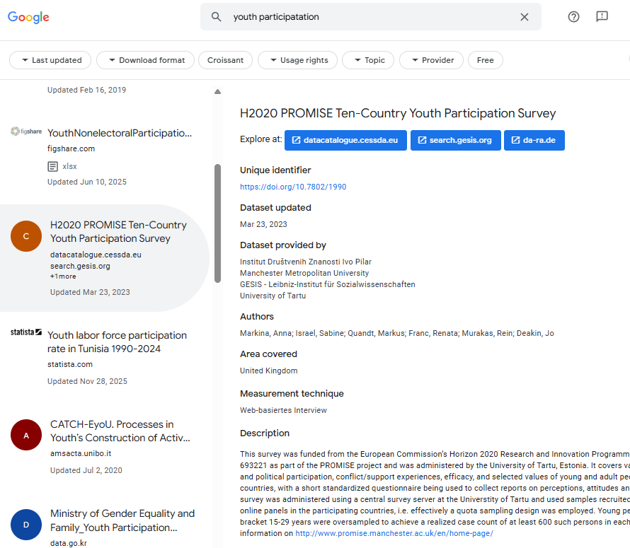
Strategi 3 - Search engines and AI
Example B: Google Dataset Search
Search with keywords
Click on a relevant dataset on the left
General overview of the dataset and metadata (authors, open/restricted, etc.)
Notes:
Approx. 13 min. To run through strategy 3
Google Dataset Search works similarly to the previous example.
[If showing the example "live"/directly in your browser, follow these instructions:]
Access https://datasetsearch.research.google.com/ in your browser.
Type in the keywords you want to find datasets on. Select filters, including "dataset", to narrow down the search results.
You will see results from various repositories. Browse the results.
Click on a dataset that seems relevant to the topic and click on the title to access the metadata and access the repository where the (meta)data is hosted.
[Go to the next slide.]

Slide 33
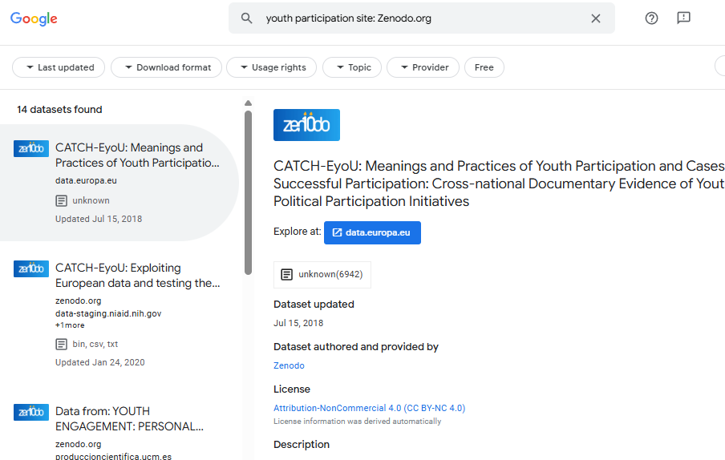
Strategi 3 - Search engines and AI
Example B: Google Dataset Search
You now only get results from Zenodo
TIP: To narrow down your search and search a specific website, add
site:URL
Ex.: youth participation site: zenodo.org
Notes:
Approx. 13 min. To run through strategy 3
Sometimes it is necessary to narrow your search down even further, and sometimes it is useful even to search one specific repository via Google Dataset Search. In this case, apply the following search technique to moderate your search: keywords site:url.
[If showing the example "live"/directly in your browser, follow these instructions:]
Access https://datasetsearch.research.google.com/ in your browser.
Type in the keywords you want to find datasets on.
Add "site:url", e.g. site:zenodo.org, to your query.
You will now only see results from this repository.

Slide 34
Exercise Strategy 3: (10 min.)
Exercise 1:
Go to DataCite Commons and find the article:
Jepson, Ruth; Harris, Fiona M.; Bowes, Alison; et al. (2012). Physical Activity in South Asians: An In-Depth Qualitative Study to Explore Motivations and Facilitators. PLOS ONE, Vol:‏ 7, Issue: 10, Article Number: e45333. doi: 10.1371/journal.pone.0045333
When you have found the article, consider the following questions:
Under which section can you see that there is a dataset attached to the article?
How many times has the dataset been downloaded in the repository?
How can you cite the dataset?
Exercise 2:
Go to Google Dataset Search and find the following dataset:
Becker, V., Bristow, R., & Iversen, R. (2025). A World without Images dataset (Version V1) [dataset].
When you have found the dataset, consider the following questions:
In which repository is the dataset published?
What is the authors' affiliation?
Which rights do you have to use the data (i.e. which license is attached to the data)?
Is the dataset linked to a peer-reviewed article?
If so, where is the article published?
Notes:
Approx. 10 min.
Ask the students to do one of the exercises outlined on the slide. The students can work in pairs or individually.
Exercise 1:
Conduct a search where they look for the article and dataset that is associated with the article referenced on the slide. They can use DataCite Commons but also Google to find the article.
If the students manage to find the article and associated data, ask them to answer the three questions. Use this as an opportunity to highlight the importance of being aware of being critical when looking for relevant sources in the information search process; this also applies to data search. [If relevant, refer back to slide 10: "Be critical of your sources".]
Exercise 2:
Conduct a search where they look for the dataset in Google Dataset Search.
When the students find the dataset, ask them to do an assessment of the data by answering the four questions. [If relevant, refer back to slide 10: "Be critical of your sources".]
Expected learning outcome of these excercises:
The point of these exercises is to ensure that the students acquire basic skills in searching for research data in a search engine, to be critical of the information they find, and assess the information in order to be able to determine whether they can reuse the data.
Search protocol/answers to questions – in case the instructor would like to walk through the exercise with the students afterwards:
Exercise 1:
Find the article via DataCite Commons (https://commons.datacite.org) - (search for first part of titel -> filter 2012) or Google (e.g. via Titel) – under Supporting Information you can find the dataset in Figshare (6 files)
In Figshare you can see how many times the dataset has been downloaded (213 times – 08.10.2025)
Citation: Jepson, Ruth; M. Harris, Fiona; Bowes, Alison; Robertson, Roma; Avan, Ghizala; Sheikh, Aziz (2016). Physical Activity in South Asians: An In-Depth Qualitative Study to Explore Motivations and Facilitators. PLOS ONE. Dataset. https://doi.org/10.1371/journal.pone.0045333
Exercise 2:
Find the dataset via Google Dataset Search (https://datasetsearch.research.google.com) - e.g. by searching for the titel. The dataset is published in DeiC Dataverse. (doi:10.60612/DATADK/5SCCEA)
All authors are from the University of Copenhagen (can be seen under metadata tap).
License CC BY 4.0: This license enables reusers to distribute, remix, adapt, and build upon the material in any medium or format, so long as attribution is given to the creator. The license allows for commercial use.
Yes. The dataset is related to two articles – Iversen, R., V. Becker, and R. Bristow (2024). “Figurative Representations in the North European Neolithic—Are They There?” In: Cambridge Archaeological Journal, pp. 1–19. doi 10.1017/S0959774323000537 and Becker, V. (2025). The Origin, Development and Decline of Lengyel Culture Figurative Finds. Open Archaeology, vol. 11, no. 1, 2025. doi 10.1515/opar-2025-0050

Slide 35
Search strategies
Strategy 1
Databases
Strategy 2
Repositories
Strategy 3
Search engines
Strategy 4
Outside academia (organisations, governments, etc.)
Notes:
Approx. 5 min. To run through strategy 4
We will now look at strategy 4: outside academia.

Slide 36
Strategy 4 - Search for data from outside the world of research
Depending on your research question, consider searching other places not previously mentioned, e.g.:
  Organisations (e.g. NGO‘s, authorities, international organisations) can have useful data
  (Note! Data are sometimes only available by request)
  Note that the systems often are “clumsy" (problems with weighting search terms, etc.),
  so be flexible in your searches or try to browse.
  Examples:
    Climate Trace
    ESA Climate Change Initiative Open Data Portal
    Danish National Archives (Rigsarkivet)
    Statistics Denmark
    Statistics Denmark – list of international organisations and statistical offices (in Danish)
    WorldBank Data
    For more examples, check the list of resources (handout)
Notes:
Approx. 5 min. To run through strategy 4
Sometimes it is relevant to search for "non-academic" data, i.e. data not collected for the purpose of research but in a governmental context, for instance. You would not normally find these "kinds" of data with strategy 1-3. In this instance, conventional search engines such as Google are the best options in terms of where to search.
[Highlight some examples if relevant:]
World Bank: database with free and open access data on global development. Free search and download.
ESA: the European Space Agency's database delivering free and open access to all of the initiative's satellite-derived climate data records.
Statistics Denmarks: a government department in Denmark conducting an array of user surveys and collecting and publishing statistical data about the Danish society. Many larger datasets are only available on request.
This strategy is often useful if you are looking for quantitative data. Let's look at an example from World Bank Data. [Next slide.]

Slide 37
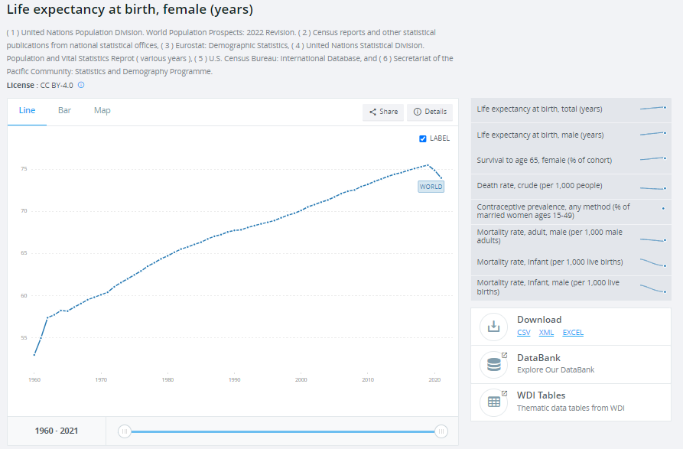
Strategy 4 - Search for data from outside the world of research
Information about the dataset
Similar datasets
Example: WorldBank Data
....
A database with free and open access to data on global development
.
License
Files for download
Notes:
Approx. 5 min. To run through strategy 4
[If showing the example "live"/directly in your browser, follow these instructions:]
Access https://www.worldbank.org/ in your browser.
Click on "How we work", then "Open data".
Do a comparative search of two countries to illustrate search process: enter the countries you are interested in, for instance Denmark, then Italy.
Select "Life expectancy at birth"; click on the graph.
Highlight important features that can help the students assess the data, e.g. licence, files for download.
NB: Be aware that statistics are as good as the method by which they are collected. The World Bank gets these statistics from the supplying countries and do not collect these themselves.

Slide 38
Data search activity
Image from Genestro, iSTock

Slide 39
Data search activity
(20 min.)
It is time to test the four strategies:
Group work: Search for data related to your own studies, or select one of three cases (see handout).
  Begin by brainstorming relevant keywords
  based on the topic.
  Set up your overall search strategy:
  What is your plan, and which strategy might be a useful starting point?
  Start the search.
  Tip: If you hit a dead end in the process, try one of the other strategies or consider revising your keywords.
Notes:
Approx. 20 min.
Time to put your newly acquired knowledge into action!

Slide 40
Data search activity, 20 min. (handout)
- If you prefer, you can work with one of the following cases.
Case 1 | You need data that sheds light on the relationship between ocean temperature and coral reef bleaching.
Case 2 | You would like to find research data that sheds light on the factors that influence people's trust in public institutions.
Case 3 | You need data that show the prevalence of diabetes (Diabetes Mellitus, type 1 or 2) in different countries or demographic groups.
Case 4 | You are looking for data that show the effect of nudging on people's choice of healthy foods.
Notes:
Examples of where to find datasets for the different cases:
Case 1: You need data that sheds light on the relationship between ocean temperature and coral reef bleaching.
Keywords: Climate, climate change, sea temperature, coral bleach*
Searches:
Google Dataset Search: climate change AND sea temperature AND coral bleach* - e.g. https://doi.org/10.3389/fmars.2022.938454.s002, https://doi.org/10.25909/25143128.v1, https://doi.org/10.6084/m9.figshare.4884389.v2
Web of Science - Data Citation Index: "climate change" AND "sea temperature" AND coral bleach* - e.g. https://datadryad.org/dataset/doi:10.5061/dryad.rfj6q57gz, https://doi.org/10.3389/fmars.2022.938454.s002
Zenodo: climate change AND sea temperature AND coral bleach - filter dataset - e.g. https://doi.org/10.5281/zenodo.7940011, https://doi.org/10.5281/zenodo.4448247
Case 2: You would like to find research data that sheds light on the factors that influence people's trust in public institutions.
Keywords: distrust, government agencies, politics, public administration, public authorities, public institutions, public opinion, transparency, trust
Searches:
DataCite Commons: trust AND government – filter datasets – e.g. https://doi.org/10.1787/1de9675e-en, https://doi.org/10.15139/s3/tgktej
Danish National Archives (Rigsarkivet) (only in Danish) - Beskrivelse af arkivmaterialer: tillid offentlige institutioner – e.g. 10.5279/dk-sa-dda-30460
European Social Survey (ESS) Data Portal: trust AND politics – e.g. https://doi.org/10.21338/ess11e04_1
Google Dataset Search: trust AND (public OR government*) AND institution* - e.g. https://doi.org/10.6084/m9.figshare.19388271, https://doi.org/10.7910/DVN/7FPDAJ
Web of Science – Data citation Index: trust AND (public OR government*) AND institution* - e.g. https://services.fsd.tuni.fi/catalogue/FSD2297, https://reshare.ukdataservice.ac.uk/851675/, http://urn.fi/urn:nbn:fi:fsd:T-FSD3977
Case 3: You need data that show the prevalence of diabetes (Diabetes Mellitus, type 1 or 2) in different countries or demographic groups.
Keywords: diabetes, diabetes Mellitus, prevalence, demograph*
Searches:
Google Dataset Search: diabetes Mellitus AND prevalence AND demograph* - e.g. https://doi.org/10.1371/journal.pone.0143084, https://www.statista.com/statistics/271464/percentage-of-diabetics-worldwide/
HealthData.gov - Catalog: diabetes-mellitus AND prevalence AND demograph* - filter external datasets - e.g. https://healthdata.gov/CDC/Selected-Trend-Table-from-Health-United-States-201/qkns-8p7f/about_data
Web of Science – Data Citation Index: "diabetes-mellitus" AND prevalence AND demograph* - e.g. https://doi.org/10.1371/journal.pone.0211193.t001
WHO data - Indicators – searchterm diabetes – e.g. https://data.who.int/indicators/i/C540135/1F96863
Case 4: You are looking for data that show the effect of nudging on people's choice of healthy foods.
Keywords: consumer, consumption, diet, eating, food, health, nudging, people, population
Searches:
DataCite Commons: nudging health food – filter dataset – e.g. https://doi.org/10.7910/dvn/lbmkwv, https://doi.org/10.6084/m9.figshare.29569878
Google Dataset Search: nudging health food – e.g. https://doi.org/10.3389/fpubh.2025.1644713.s001, https://doi.org/10.25625/XGYIU2
Web of Science - Data Citation Index: nudging health food - e.g. https://doi.org/10.3389/fpsyg.2023.1270207, https://doi.org/10.34894/3OZPWT

Slide 41
List of resources – examples (handout)
Repositories
Dryad: https://datadryad.org/
Figshare: https://figshare.com/
Harvard Dataverse: https://dataverse.harvard.edu/
Mendeley Data: https://data.mendeley.com/
Zenodo: https://zenodo.org/
Bibliographic databases with data search features
Dimensions: https://www.dimensions.ai/
Mendeley Data: https://data.mendeley.com/
Web of Science (Data Citation Index): https://www.webofscience.com/wos/woscc/basic-search
Bibliographic databases
Start your search in databases you are familiar with (Scopus, Web of Science, Proquest, Ebsco, Pubmed ….)
(Data) search engines and AI
DataCite Commons: https://commons.datacite.org/
Google Dataset Search: https://datasetsearch.research.google.com/
OpenAIRE Explore: https://explore.openaire.eu/
CoPilot: https://copilot.microsoft.com/
ChatGPT: https://chatgpt.com/
Examples of websites with data from outside the world of research
Climate trace: https://climatetrace.org/
Danish National Archives (in Danish): https://www.sa.dk/find/
ESA Climate Office: https://climate.esa.int/en/data/#/dashboard
Statistics Denmark: https://www.dst.dk/en/ or https://www.statistikbanken.dk/statbank5a/default.asp?w=1133
World Bank Data: https://data.worldbank.org/
European Social Survey (ESS) Data Portal: https://www.europeansocialsurvey.org/data-portal
WHO data: https://www.who.int/data
HealthData.gov: https://healthdata.gov/
Other
FAIRSharing: https://fairsharing.org/search?fairsharingRegistry=Database
Re3data: https://www.re3data.org/
Libguide "Searching for research data": libguides.ruc.dk/datasearch/opendatasources

Slide 42
Recap
Peer discussion: what did you find useful? What did you find challenging?
(15 min.)
Databases
”Associated Data”
Repositories
Zenodo
Search engines
DataCite Commons
When finding data
E.g. Web of Science:
”Data Citation Index”
Figshare
Re3data.org
OpenAIRE Explore
Google Dataset Search
Be critical of your sources:
Assess the data and metadata
Consider the context: does it make sense to reuse in your project?
Remember to look for the license
Notes:
15 min.
We have looked at different ways to search for data, consulting various examples and resources along the way. We have also considered the importance of being critical of the sources we find.
This final activity concludes the course. [Ask the students to do the following:]
Find one of your peers and discuss:
What did you find useful today?
What did you find challenging?
After 5 minutes, conclude with a joint discussion by asking the students to share what they talked about.

Slide 43
Material for Scenario 2 and 3
These last two slides are not intended for the 2-hour workshop but belong to the shorter versions of the course:
Scenario 2 – 45 min.: Exercises for repositories and search engines
Scenario 3 – 15 min.: Advertisement for the 2-hour workshop
See also the Teacher's guide for Scenario 2 and 3

Slide 44
Exercises: Repositories and Search engines (10 min.)
Exercise Strategy - Repositories:
Go to Zenodo and find the following dataset:
"Summaries of interviews and workshop on citizen science and use of interactive walkable floormaps in schools”.
Assess the data by answering the following questions:
Who generated the data and what is their affiliation?
Is the data associated with a peer-reviewed article or a project? Write down the title of article/project.
Is the data in a textual, audio, visual or tabular format?
Which rights do you have to use the data (i.e. which license is attached to the data)?
How can you cite the dataset?
Exercise Strategy - Search engines:
Go to Google Dataset Search and find the following dataset:
Becker, V., Bristow, R., & Iversen, R. (2025). A World without Images dataset (Version V1) [dataset].
When you have found the dataset, consider the following questions:
In which repository is the dataset published?
What is the authors affiliation?
Which rights do you have to use the data (i.e. which license is attached to the data)?
Is the dataset linked to a peer-reviewed article?
If so, where is the article published?
Notes:
SLIDE TIL SCENARIE 2
Approx. 10 min.
Ask the students to do one of the exercises outlined on the slide. The students can work in pairs or individually.
Exercise Strategy - Repositories:
Conduct a search where they look for the dataset referenced on the slide on Zenodo.
When the students find the associated data for the article, ask them to do an assessment of the data by answering the 5 questions. Note that in this assessment, they are asked to be more thorough, paying attention to other key aspects of the metadata which can help determine whether the data set can be re-used. Use this as an opportunity to extend the points made in the exercise for Strategy 1. [If relevant, refer back to slide 10: "Be critical of your sources".]
Expected learning outcome of this excercise:
The point of these exercises is to ensure that the students acquire basic skills in searching for research data in a repository and to be critical of, and assess, the information they find in order to be able to determine whether they can re-use the data.
Search protocol/answers to questions – in case the instructor would like to walk through the exercise with the students afterwards:
Answer to question 1: Find it at Zenodo. Jeppe Læssøe, Prof Emeritus at Aarhus University
Answer to question 2: Associated with a project: The H2020 funded Research and Innovation Action project REGREEN Fostering nature-based solutions for smart, green and healthy urban transitions in Europe and China, 2019-24.
Answer to question 3: Textual.
Answer to question 4: CC4.0 - The Creative Commons Attribution license allows re-distribution and re-use of a licensed work on the condition that the creator is appropriately credited.
Answer to question 5: Læssøe, J. (2024). Summaries of interviews and workshop on citizen science and use of interactive walkable floormaps in schools [Data set]. Zenodo. https://doi.org/10.5281/zenodo.10604591.]
Exercise Strategy – Search engines:
Conduct a search where they look for the dataset in Google Dataset Search.
When the students find the dataset, ask them to do an assessment of the data by answering the four questions. [If relevant, refer back to slide 10: "Be critical of your sources".]
Expected learning outcome of these excercises:
The point of these exercises is to ensure that the students acquire basic skills in searching for research data in a search engine, to be critical of the information they find, and assess the information in order to be able to determine whether they can reuse the data.
Search protocol/answers to questions – in case the instructor would like to walk through the exercise with the students afterwards:
Find the dataset via Google Dataset Search (https://datasetsearch.research.google.com) - e.g. by searching for the titel. The dataset is published in DeiC Dataverse. (doi:10.60612/DATADK/5SCCEA)
All authors are from the University of Copenhagen (can be seen under metadata tap).
License CC BY 4.0: This license enables reusers to distribute, remix, adapt, and build upon the material in any medium or format, so long as attribution is given to the creator. The license allows for commercial use.
Yes. The dataset is related to two articles – Iversen, R., V. Becker, and R. Bristow (2024). “Figurative Representations in the North European Neolithic—Are They There?” In: Cambridge Archaeological Journal, pp. 1–19. doi 10.1017/S0959774323000537 and Becker, V. (2025). The Origin, Development and Decline of Lengyel Culture Figurative Finds. Open Archaeology, vol. 11, no. 1, 2025. doi 10.1515/opar-2025-0050

Slide 45
WORKSHOP
FOR STUDENTS
SEARCHING FOR RESEARCH DATA
Learn how to obtain e.g.:
Practical experience with research data repositories and in finding associated data to peer-reviewed articles.
Experience in assessing research data and what you are allowed with the data.
Date: ...
Time: …
Location: ...
Address: ...
Registration: … no later than ... (max. … participants)
NB: Bring your own computer
Image from Genestro, iSTock

