Slide 1
Theory of light-induced Floquet topological states
  Nature Comm. 6, 7047 (2015)
Collaborators:
M. Claassen, A. F. Kemper, B. Moritz, T. Oka, J. K. Freericks, T. P. Devereaux
H. Hübener, U. de Giovannini, A. Rubio
Michael Sentef
CFEL Theory Seminar
Hamburg, January 20, 2016

Slide 2
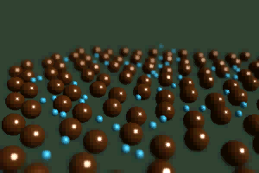
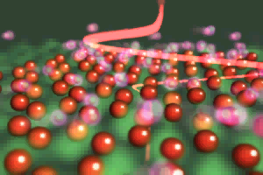


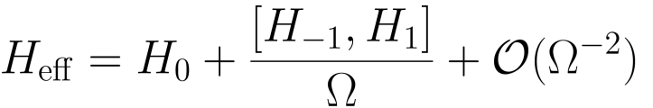
Artistic view of Floquet states
by Koichiro Tanaka (Kyoto university)
electrons in solids
Floquet state (photo-dressed state)

Slide 3
Outline
Floquet topological states
Topological band theory
+
Floquet theory of driven systems

Slide 4
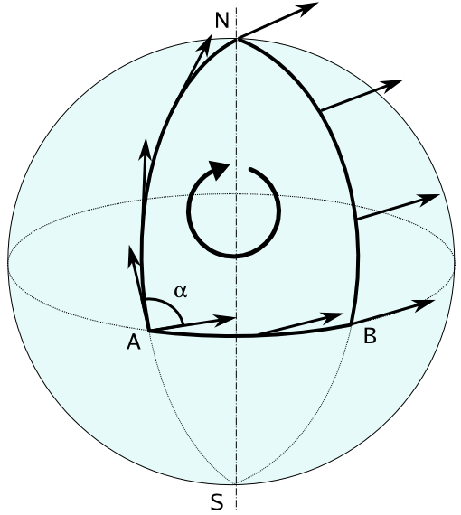
Topological states of matter
Global Change without Local Change illustrates Berry’s Phase

Slide 5






Topological states of matter
M. V. Berry, Proc. R. Soc. A 392, 45 (1984)
Start system in the n^{th} eigenstate
Adiabatic theorem tells us that we stay in the n^{th} eigenstate, but we can pick up a phase that does not affect the physical state.
Dynamical phase, but an additional phase is also allowed (this is called the Berry phase γ).

Slide 6

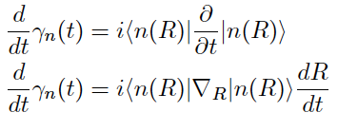

Topological states of matter
Equation for Berry’s phase
Operate with bra on l.h.s.
Dynamical phase, but an additional phase is also allowed (this is called the Berry phase γ).

Slide 7

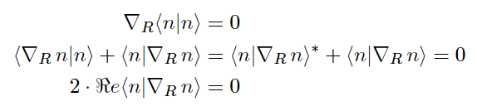
Topological states of matter
Berry phase, related to changes of the eigenstate when moved along path in parameter space.
Berry phase is real.

Slide 8





Topological states of matter
Berry connection as a gauge potential.
Under gauge transformation.
Gives no change to the Berry phase.
Berry phase is gauge invariant and can be measured, e.g. Aharonov-Bohm effect.

Slide 9
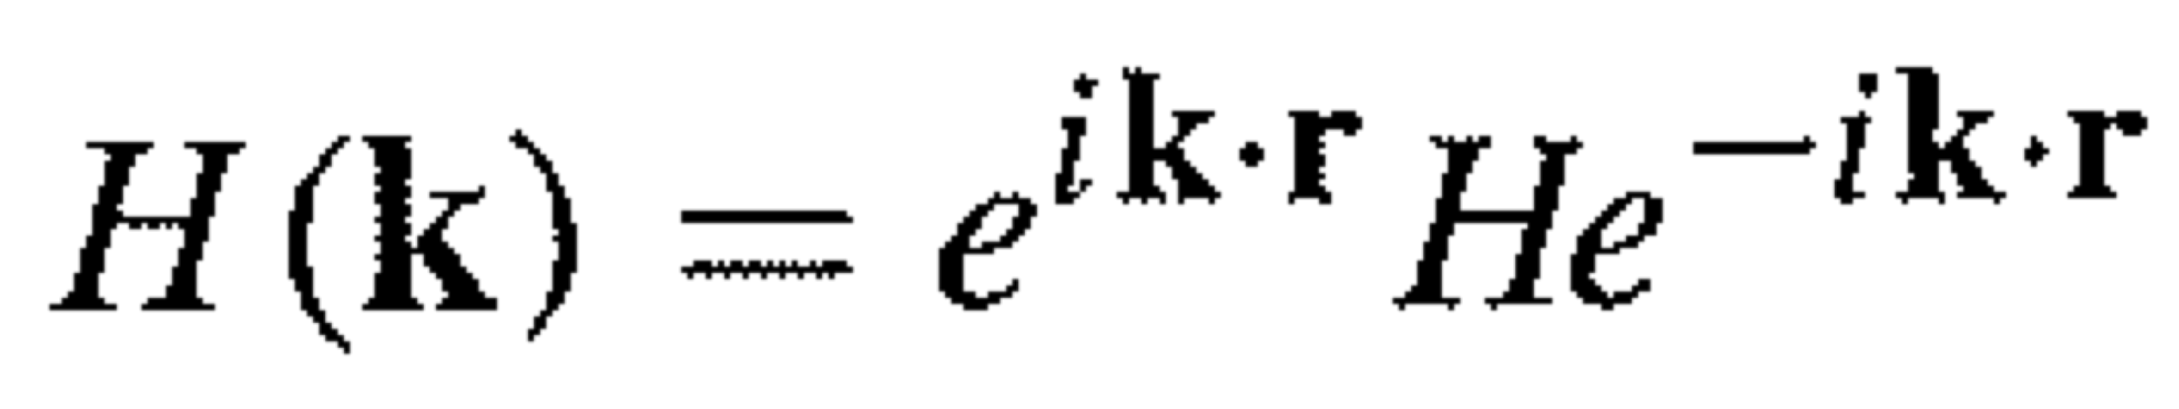
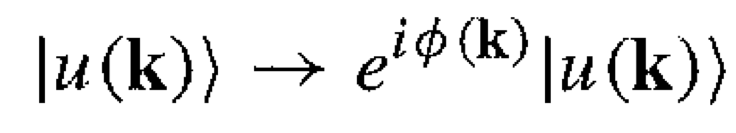
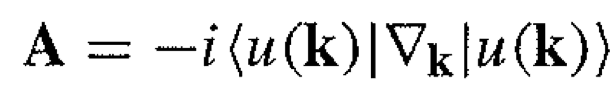
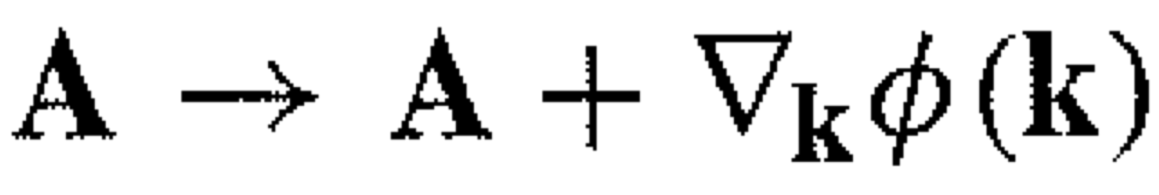
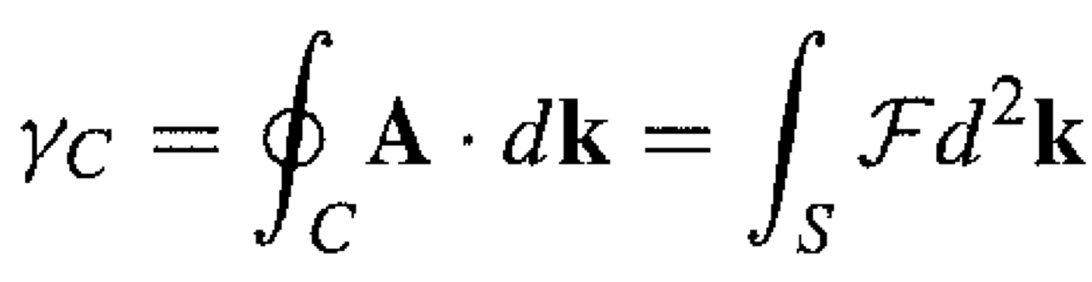
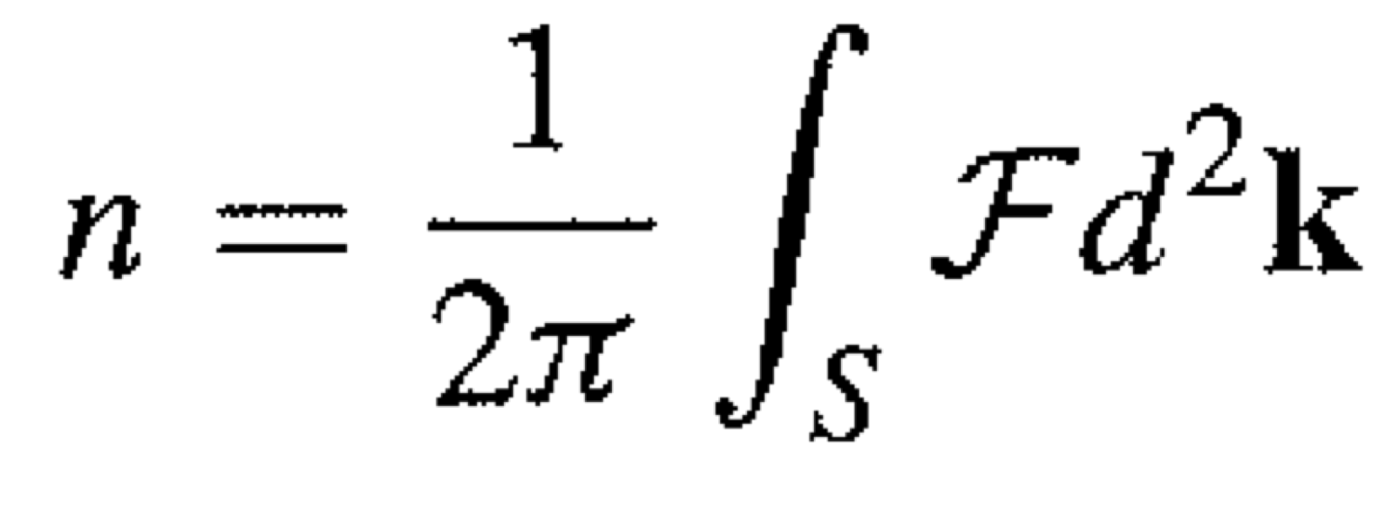
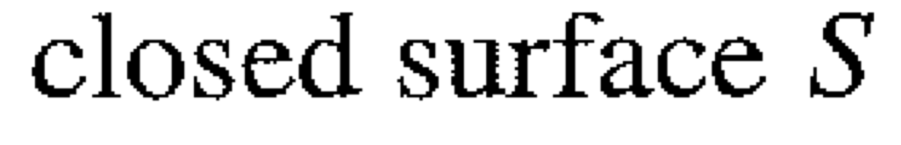
Topological states of matter
C. Kane, “Topological band theory and the Z2 invariant”, Chapter 1 in “Topological Insulators”, Elsevier (2013)
Topological band theory of solids
Bloch state under gauge transformation
Berry connection
Berry phase
F(k)
Chern number = topological invariant
= number of Dirac monopoles inside the surface

Slide 10
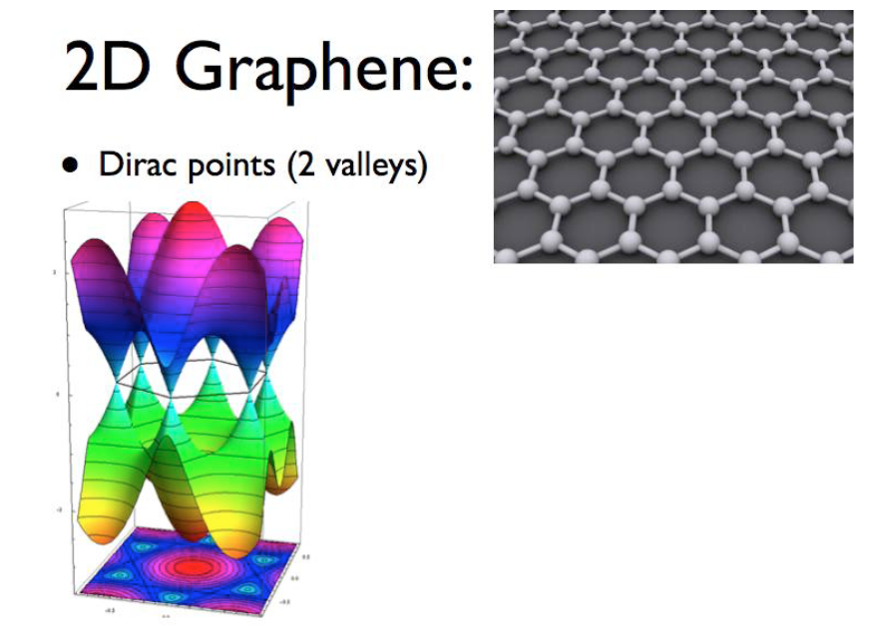
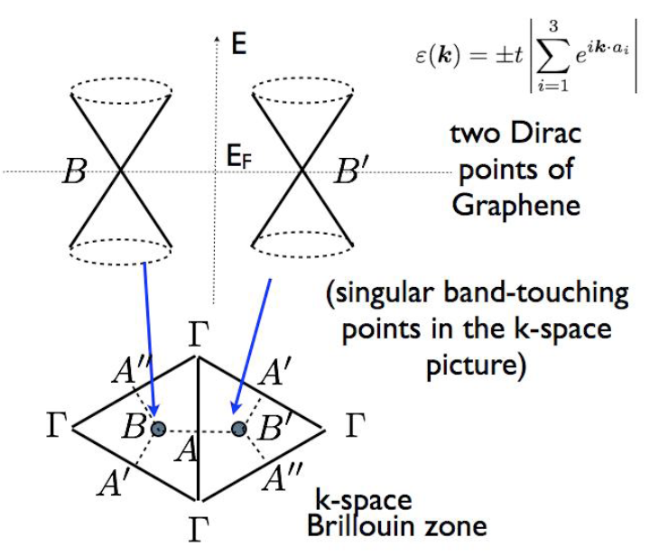
Topological states of matter

Slide 11
Topological states of matter
Dirac fermions in pseudospin representation: Decompose into Pauli matrices
p_{x} = q_{x}
p_{y} = q_{y}
p_{z} = m_{K}
Pseudospin winding <-> Berry phase
Berry phase on a closed loop around Dirac point is quantized = +/- π
+/- sign depends on sign of mass term m_{K}
+/- ½ Dirac monopole
Chern number C = sum of Dirac monopoles in the Brillouin zone
Distinguishes trivial from nontrivial (topological) insulators
C=0
C≠0

Slide 12
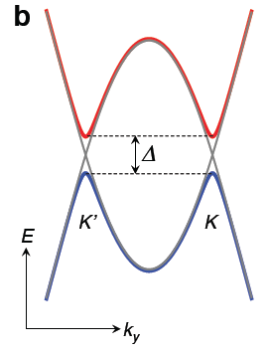
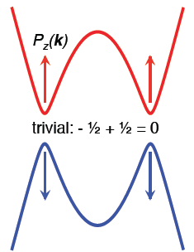
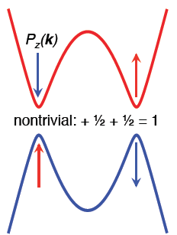
Topological states of matter
K vs. K’: opposite winding of in-plane pseudospin
m_{K} = m_{K’}
trivial insulator
m_{K} = − m_{K’}
nontrivial insulator

Slide 13
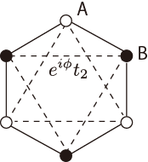
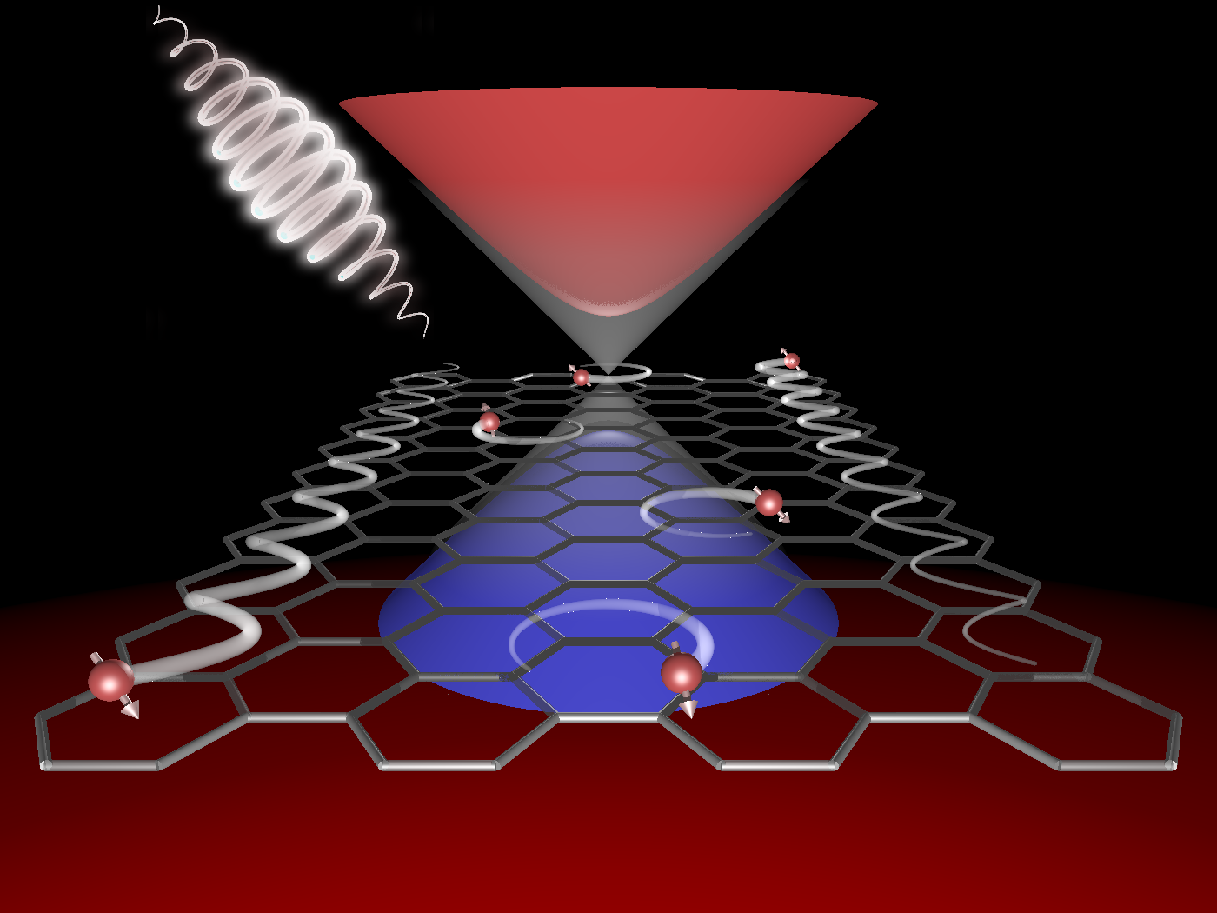
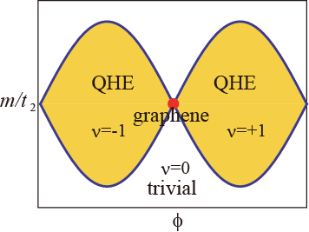
Floquet topological states
Graphene + circularly polarized light (breaks trs)
Haldane model (PRL 61, 2015 (1988))
breaks inv
?
pump
Local flux φ
Staggered field m
Fictitious fields!
breaks trs

Slide 14



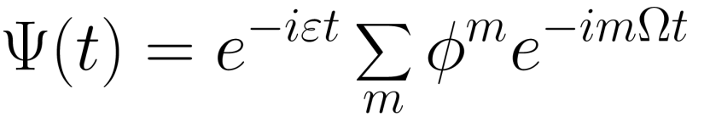
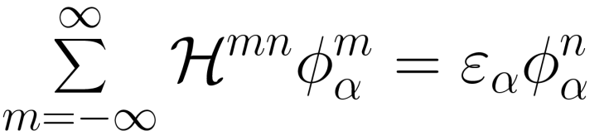
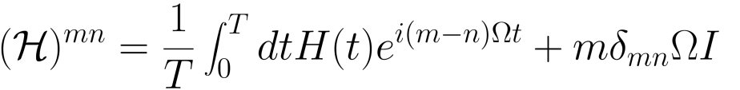


Floquet states of matter
time periodic system
“Floquet mapping”
=discrete Fourier trans.
Floquet Hamiltonian (static eigenvalue problem)
ε: Floquet quasi-energy
comes from the term
~ absorption of m “photons”

Slide 15

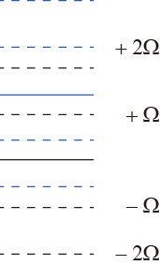
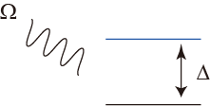

Floquet states of matter
Time-periodic quantum system
=
Floquet theory (exact)
~
effective theory
Fictitious fields!
Floquet theory
projection to the original
Hilbert space
two states + periodic driving
Hilbert sp. size
= original system
n-photon dressed state
Floquet side bands

Slide 16
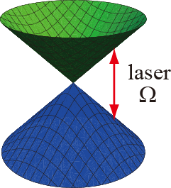



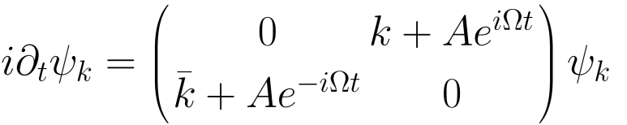
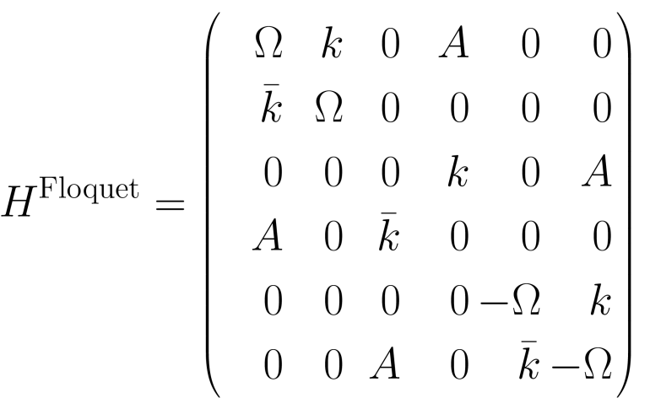
Dirac fermion + circularly polarized laser
coupling to AC field
time dependent Schrodinger equation
Floquet theory
truncated at m=0,+1, -1 for display

Slide 17

Dirac fermion + circularly polarized laser
1-photon absorbed state
0-photon absorbed state
-1-photon absorbed state

Slide 18
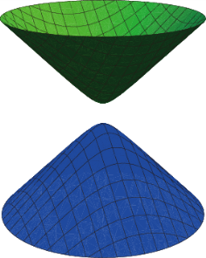
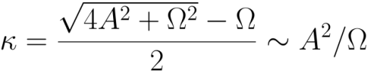
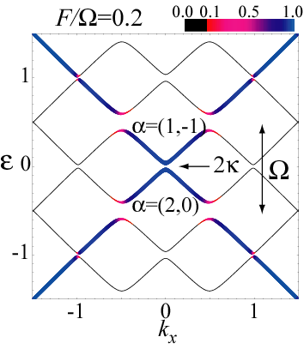
Dirac fermion + circularly polarized laser
Mass term =
synthetic field stemming from a real time-dependent field A(t)
2κ
1-photon absorbed state
0-photon absorbed state
-1-photon absorbed state
Oka and Aoki,
PRB 79, 081406 (2009)

Slide 19


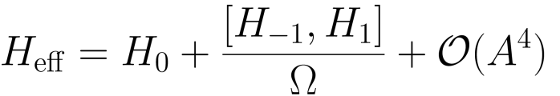
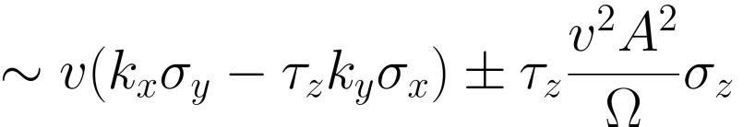
Dirac fermion + circularly polarized laser
Projection to the original Hilbert space
near Dirac point
2nd order perturbation
2κ
Dynamical gap
Mass term =
synthetic field stemming from a real time-dependent field A(t)

Slide 20
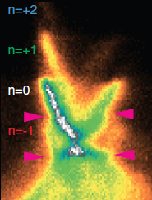
Floquet topological states in graphene
Bi₂Se₃
ω
E, polarization
gaps?
Wang et al.,
Science 342, 453 (2013)
Floquet + topology in ac driven systems:
Oka&Aoki PRB 79, 081406 (09), Kitagawa et al PRB 82, 235114 (10), Kitagawa et al PRB 84, 235108 (11), Lindner et al Nature Phys 7, 490 (11), Gu et al PRL 107, 216601 (11), Calvo et al APL 98, 232103 (11), Dora et al PRL 108, 056602 (12), Suarez Morell et al PRB 86, 125449 (12), Rudner et al PRX 3, 031005 (13), Iadecola et al, PRL 110, 176603 (13), Gomez-Leon&Platero PRL 110, 200403 (13), Fregoso et al PRB 88, 155129 (13), Perez-Piskunow et al, arXiv:1308.4362, Grushin et al, arXiv:1309.3571 … INCOMPLETE
Our work:
continuous field pulsed field?
exact time evolution, realistic parameters
Floquet states evolving in real time?
  Nature Comm. 6, 7047 (2015)

Slide 21
Floquet topological states in graphene
2x2 model for honeycomb tight-binding electrons:
Compute Green functions using exact time evolution:

Slide 22
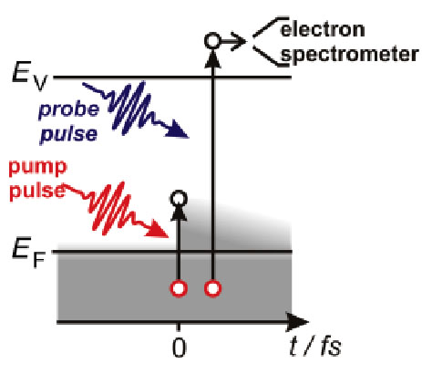
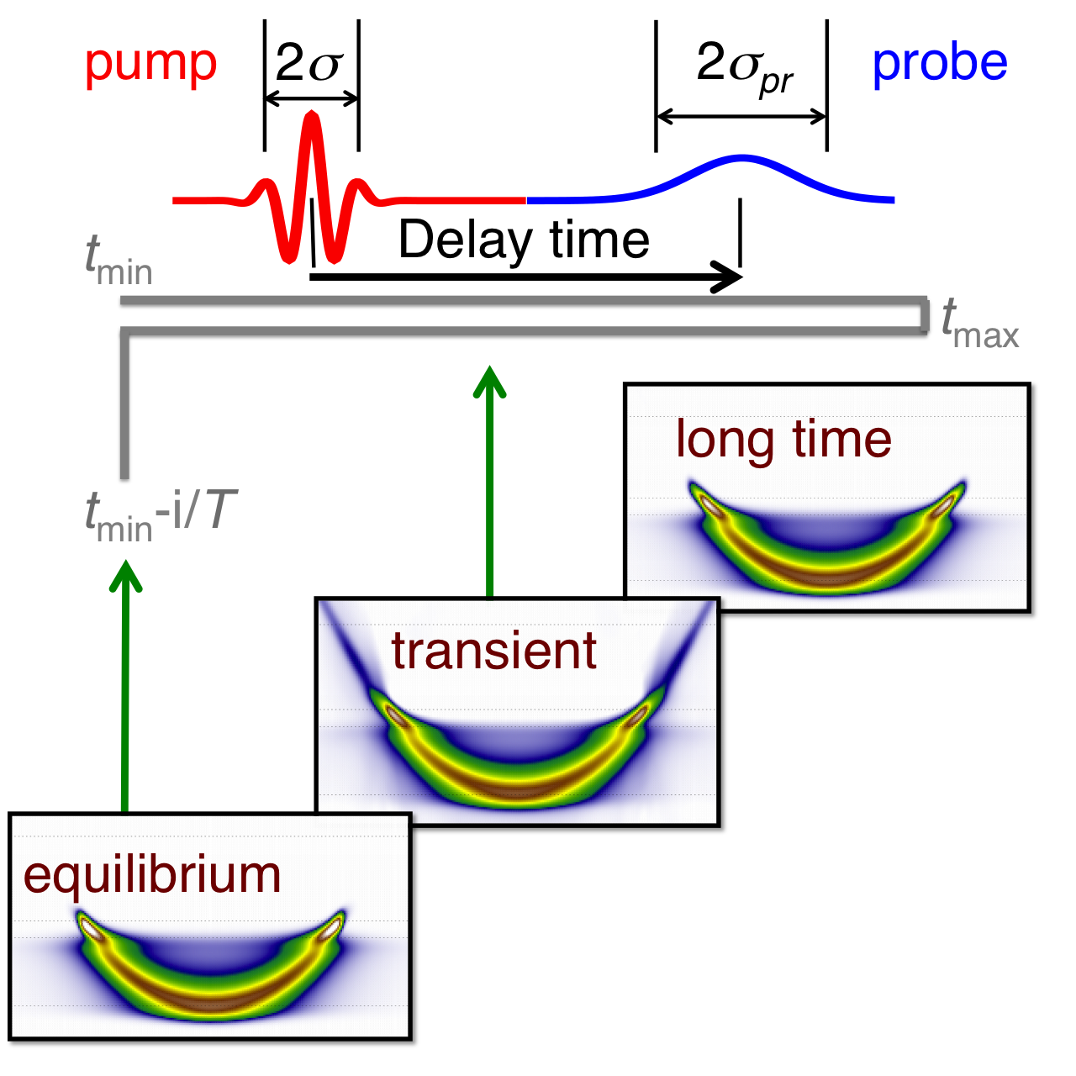
Floquet topological states in graphene
Obtain photocurrent from lesser Green function:

Slide 23
Floquet topological states in graphene
Circularly polarized laser induces energy gap
Good agreement with Floquet band structure

Slide 24
Floquet topological states in graphene
pseudospin <-> orbital content
determines Berry phase (topology)

Slide 25
Floquet topological states in graphene
Pseudospin components:
Pseudospin measures orbital configuration in bands

Slide 26
Floquet topological states in graphene
Pseudospin changes sign between K and K’
Light-controlled Berry phase

Slide 27
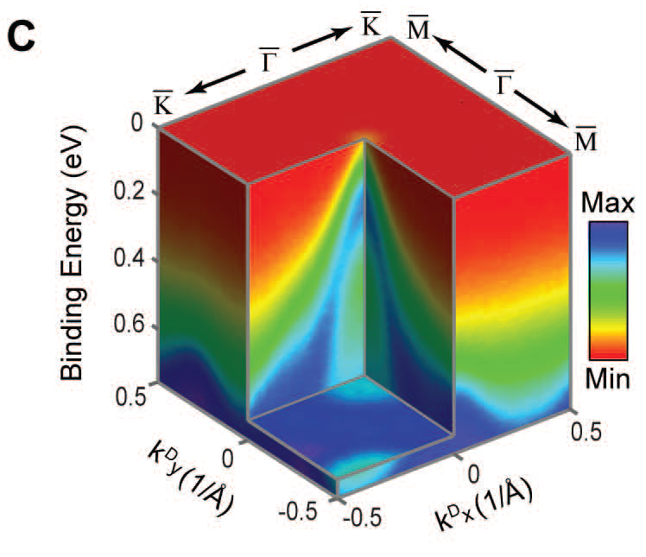
Beyond graphene: 3D NaBi
3D Dirac semimetal NaBi
Dirac point with spin-orbit = 2 degenerate Weyl points of opposite chirality
  Z. K. Liu et al., Science 343, 864 (2014)

Slide 28
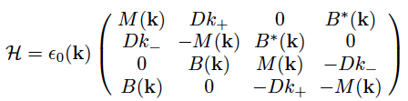
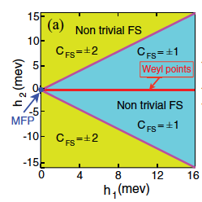
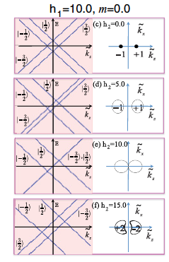
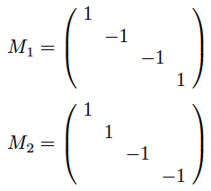
Beyond graphene: 3D NaBi
Proposed engineering of topological states via fictitious fields h₁, h₂ (analogue of Haldane model)
2x
+
Fictitious fields:
  Z. Wang et al., PRB 85, 195320 (2012)

Slide 29
Beyond graphene: 3D NaBi
Question: Can these fictitious fields be generated with lasers via Floquet engineering?
2x
+
Fictitious fields:
  Project with H. Hübener, A. F. Kemper, U. de Giovannini, A. Rubio

Slide 30
Beyond graphene: 3D NaBi
Question: Can these fictitious fields be generated with lasers via Floquet engineering?
Preliminary result using ab initio TDDFT + Floquet downfolding: yes (to some extent)
Splitting of two 3D Dirac point into two pairs of
Weyl points
undriven
driven
  Project with H. Hübener, A. F. Kemper, U. de Giovannini, A. Rubio

Slide 31
Beyond graphene: 3D NaBi
Question: Can these fictitious fields be generated with lasers via Floquet engineering?
Preliminary result using ab initio TDDFT + Floquet downfolding: yes (to some extent)
Splitting of 3D Dirac into 2 Weyl points
  Project with H. Hübener, A. F. Kemper, U. de Giovannini, A. Rubio

Slide 32
Beyond graphene: 3D NaBi
Question: Can these fictitious fields be generated with lasers via Floquet engineering?
Preliminary result using ab initio TDDFT + Floquet downfolding: yes (to some extent)
Signature of Dirac monopoles at Weyl pts in Berry curvature
  Project with H. Hübener, A. F. Kemper, U. de Giovannini, A. Rubio

Slide 33
Summary
Floquet states: engineering of fictitious gauge fields with real laser fields
laser control of topological states of matter
examples: 2D graphene, 3D Dirac semimetal
THANK YOU!

