Slide 1
Real-time study of light-enhanced superconductivity
arXiv:1505.07575
Collaborators:
A. F. Kemper, A. Georges, C. Kollath
Michael Sentef
APS March Meeting, Baltimore, 2016

Slide 2
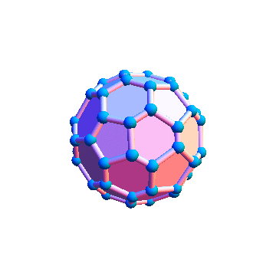
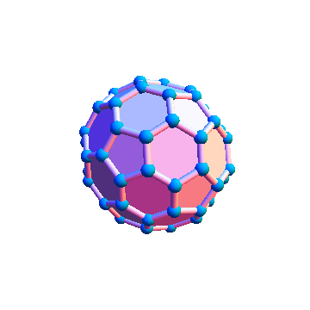
Light-induced superconductivity?
„Possible light-induced superconductivity in K3C60 at high temperature“
M. Mitrano et al., Nature 530, 461 (2016)

Slide 3
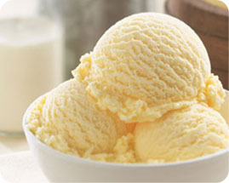
How to enhance boson-mediated SC?
BCS theory – plain vanilla SC (weak coupling)
  effective attraction V₀ ~ g²/(ħ Ω)
  e-boson coupling g
  boson frequency Ω
  electronic DOS N(E_{F})
Ω
Σ =
g
N(E_{F})
g
Migdal-Eliashberg theory
boson-mediated pairing

Slide 4
Nonlinear phononics
mid-IR light pulse
Rectification of a second (Raman) phonon via coherent driving of a first (IR) phonon
Enhancement of SC via enhanced DOS at Fermi energy?
„Nonlinear phononics“
M. Först et al., Nature Physics 7, 854 (2011)
A. Subedi, A. Cavalleri, A. Georges, PRB 89, 220301R (2014)
M. Knap et al., arXiv:1511.07874

Slide 5
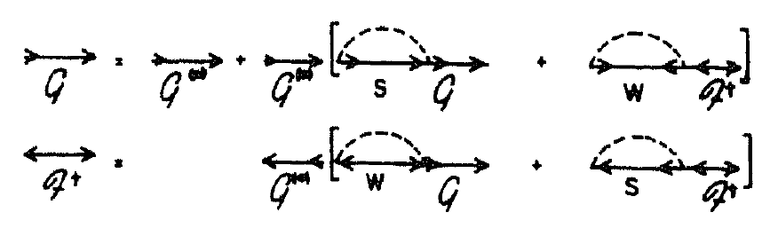
Model and Method
electrons (2D) + phonons + el-ph coupling (Holstein)
Migdal-Eliashberg, nonequilibrium Keldysh Green functions:
  Higgs paper, A. F. Kemper et al., PRB 92, 224517 (2015)
arXiv:1505.07575
Talk by A. F. Kemper, V01.3, Ballroom I, 3:42 PM
normal
anomalous
order parameter Δ,
condensate dynamics
el-ph single-particle
scattering

Slide 6
Hopping ramp
Enhancement of SC via enhanced DOS at Fermi energy?

Slide 7
Superconductor evolution
T_{c,0} = 135 K
Enhancement of SC strongly depends on initial thermal state

Slide 8
Enhancement during ramp
Order parameter enhancement ~Δ₀
determines time scale on which SC can be induced by quasistatic modification of effective pairing strength!

Slide 9
Superconductor evolution

Slide 10
Superconductor evolution
dashed: no dissipation (BCS only)
Dissipation of energy to phonons helps SC enhancement for fast ramps
Dissipation important for approach to final thermal state

Slide 11
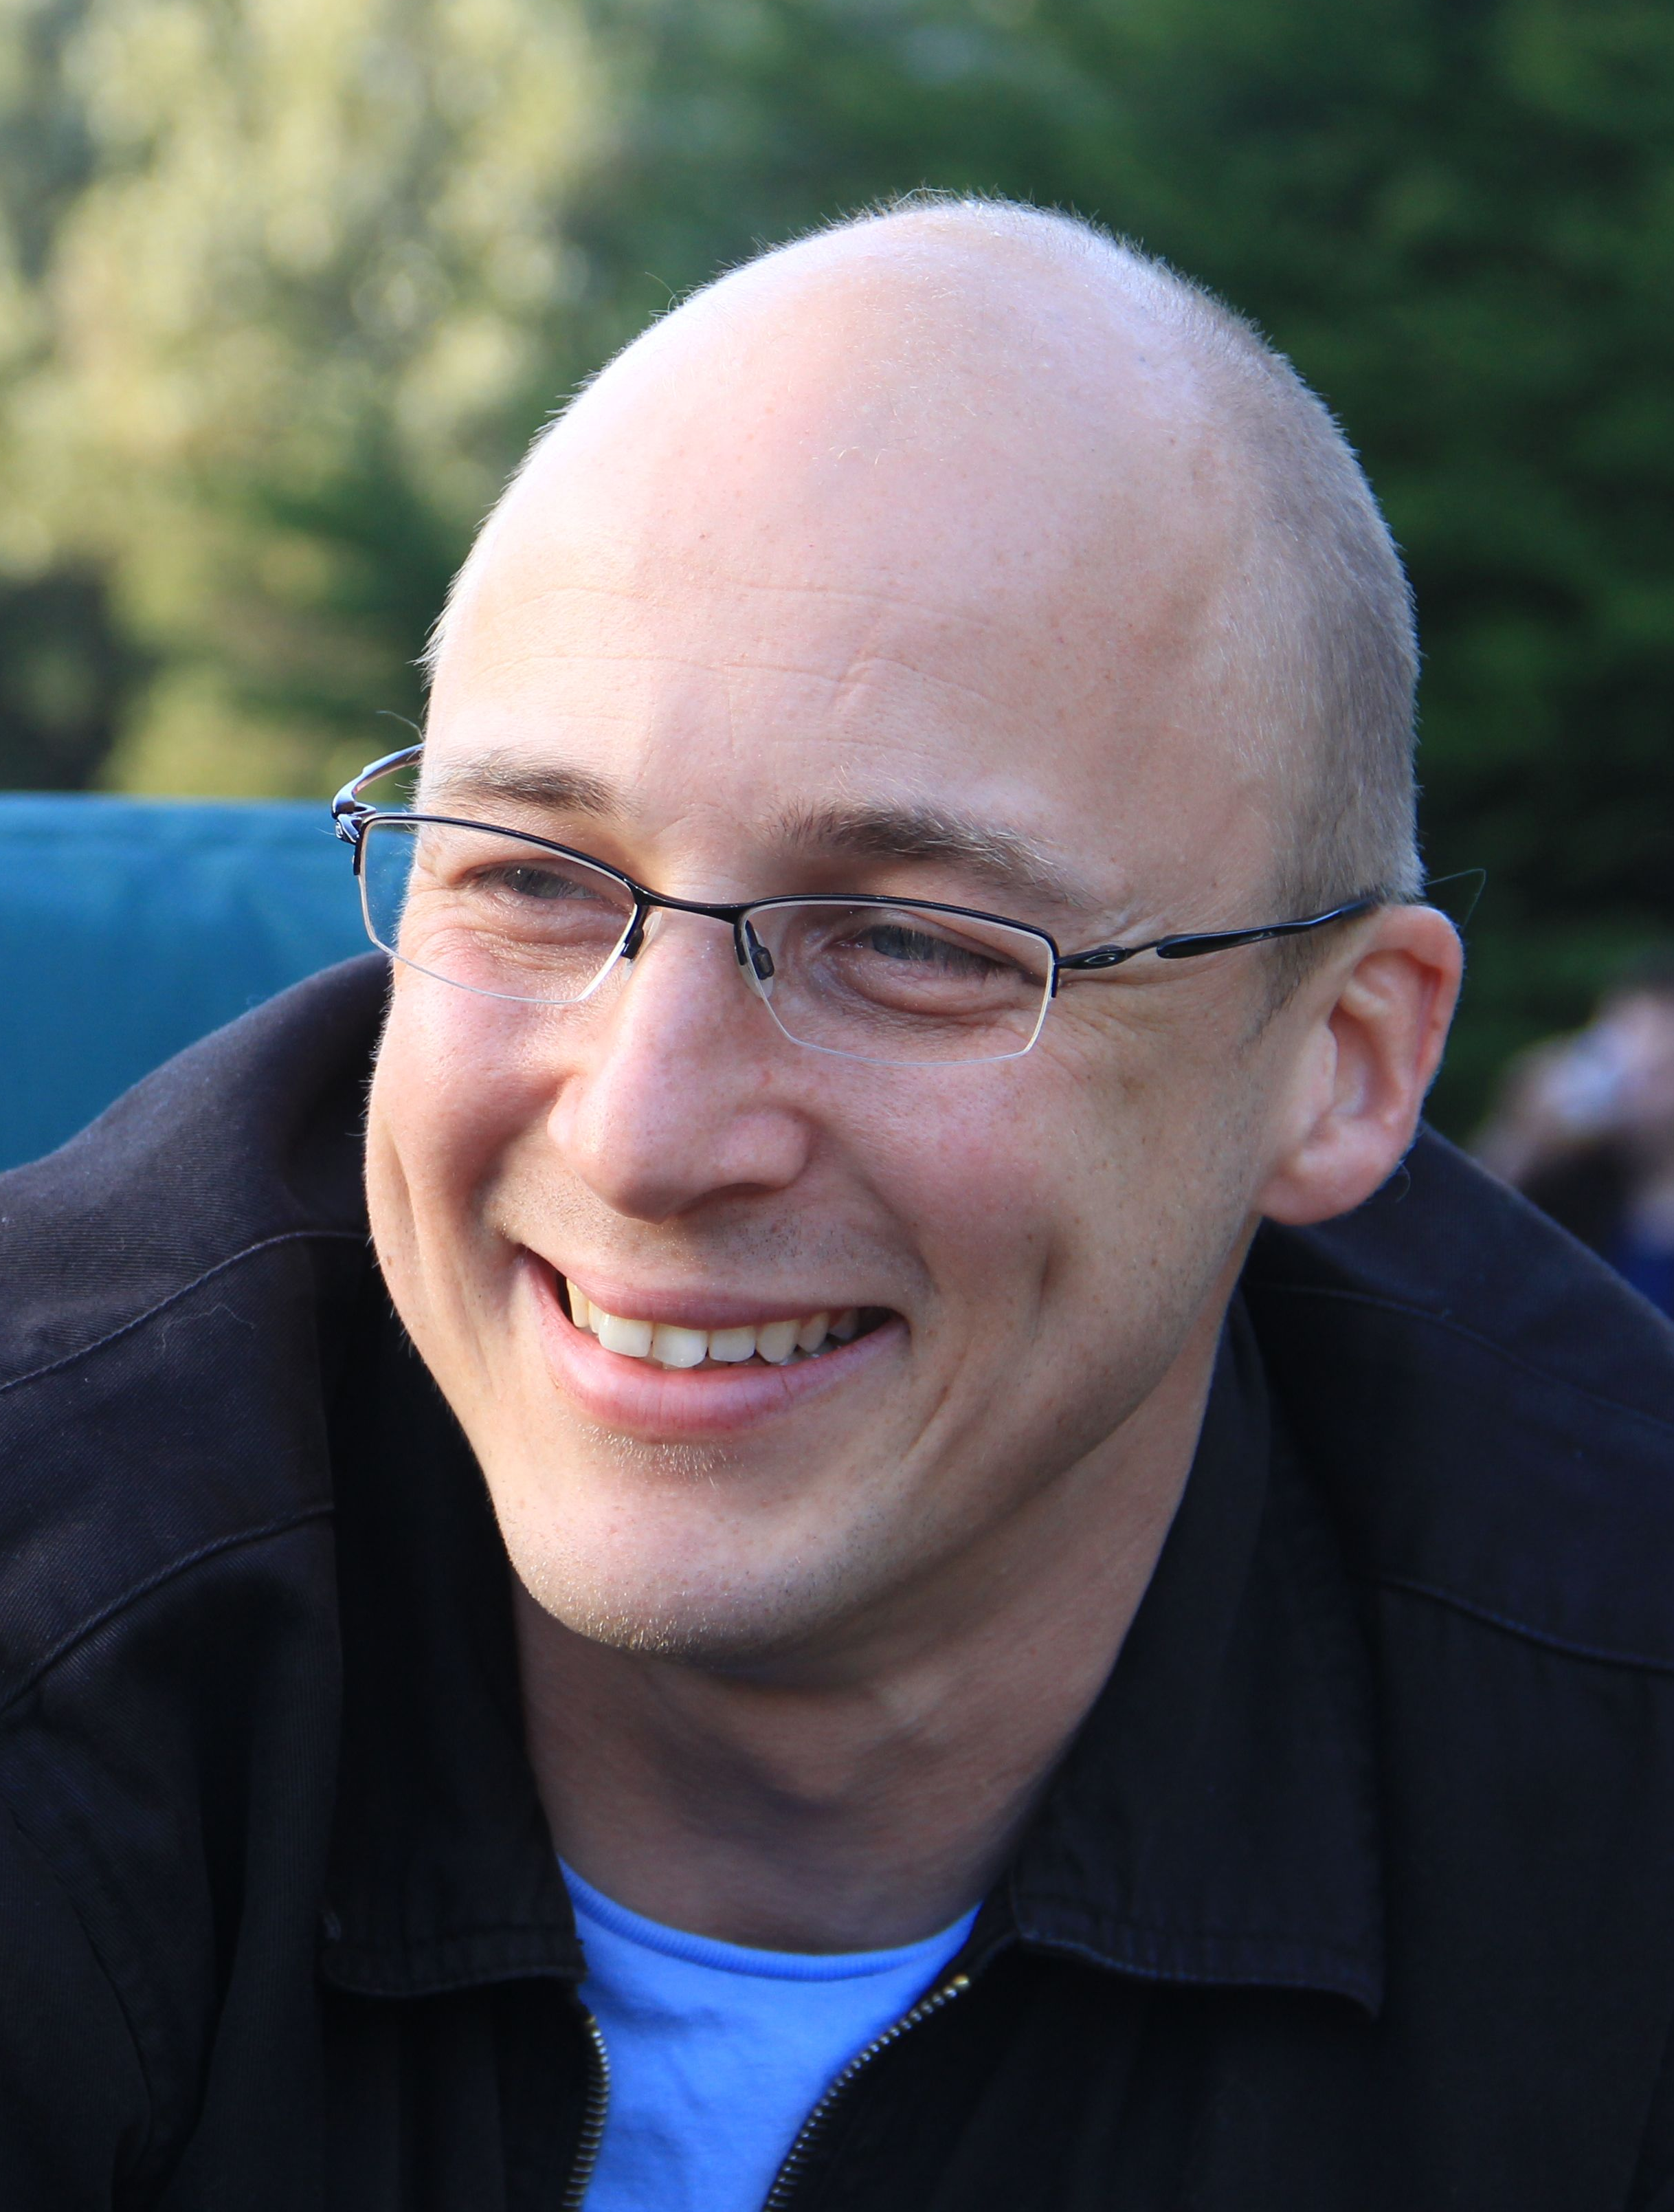
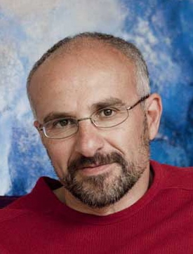
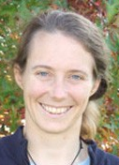




Summary
arXiv:1505.07575
Light-enhanced superconductivity via nonlinear phononics: order parameter versus dissipative dynamics
  A. F. Kemper A. Georges C. Kollath

