Slide 1
COMPANY PROFILE
Phone : +62 812 5293 9996
Email : owner@universalcrackers.com
Website : www.universalcrackers.com
Alamat : Jl. Masjid Nudur Hidayah, Desa/Kelurahan. Long Kali
Kec. Long Kali, Kab. Paser, Provinsi Kalimantan Timur
Kode Pos: 76283, Indonesia

Slide 2
Profile
Phone : +62 812 5293 9996
Email : owner@universalcrackers.com
Website : www.universalcrackers.com
Alamat : Jl. Masjid Nudur Hidayah, Desa/Kelurahan. Long Kali
Kec. Long Kali, Kab. Paser, Provinsi Kalimantan Timur
Kode Pos: 76283, Indonesia
PT.SATRIA URBAN PERKASA
Nama Perusahaan : PT. Satria Urban Perkasa
NPWP : 61.095.638.5-726.000
NIB : 2209220095515
Tanggal berdiri : 21 September 2022
Alamat Perusahaan : Jl.Masjid Nudur Hidayah, Desa/Kelurahan Long Kali,
Kec. Long Kali, Kab. Paser, Provinsi Kalimantan Timur,
Kode Pos: 76283, Indonesia.
Kegiatan usaha :
46100 - Perdagangan Besar Atas Dasar Balas Jasa (Fee) Atau Kontrak
46206 - Perdagangan Besar Hasil Perikanan
46324 - Perdagangan Besar Hasil Olahan Perikanan
46339 - Perdagangan Besar Makanan Dan Minuman Lainnya
46491 - Perdagangan Besar Peralatan Dan Perlengkapan Rumah Tangga
46696 - Perdagangan Besar Barang Bekas Dan Sisa-sisa
Tak Terpakai (Scrap)
46900 - Perdagangan Besar Berbagai Macam Barang

Slide 3
Tentang kami
Phone : +62 812 5293 9996
Email : owner@universalcrackers.com
Website : www.universalcrackers.com
Alamat : Jl. Masjid Nudur Hidayah, Desa/Kelurahan. Long Kali
Kec. Long Kali, Kab. Paser, Provinsi Kalimantan Timur
Kode Pos: 76283, Indonesia
PT.SATRIA URBAN PERKASA
Satria Urban Perkasa adalah perusahaan yang begerak di bidang ekspor impor dikhususkan bekerja sama dengan beberapa UMKM Daerah Jawa Timur guna membantu perekonomian sekitar serta membawa dan mengenalkan berbagai macam produk Indonesia di Manca Negara
VISI : • Menjadikan Satria Urban Perkasa sebagai perusahaan yang Inspiratif untuk mengembangakan dan mempromosikan berbagai macam produk khas Indonesia ke berbagai Negara dan Produktif dalam memajukan UMKM Indonesia.
MISI : • Menghadirkan kualitas produk terbaik • Memprioritaskan kualitas bahan baku produk • Memperkenalkan produk makanan khas Indonesia secara global • Mengembangkan keahlian SDM di wilayah sekitar • Memberikan pelayanan terbaik kepada konsumen • Menbentuk Satria Urban Perkasa menjadi perusahaan kokoh yang mendukung UMKM dan sumber daya sekitar serta membantu para warga untuk mendapatkan pekerjaan dan mengembangkan keterampilan.

Slide 4
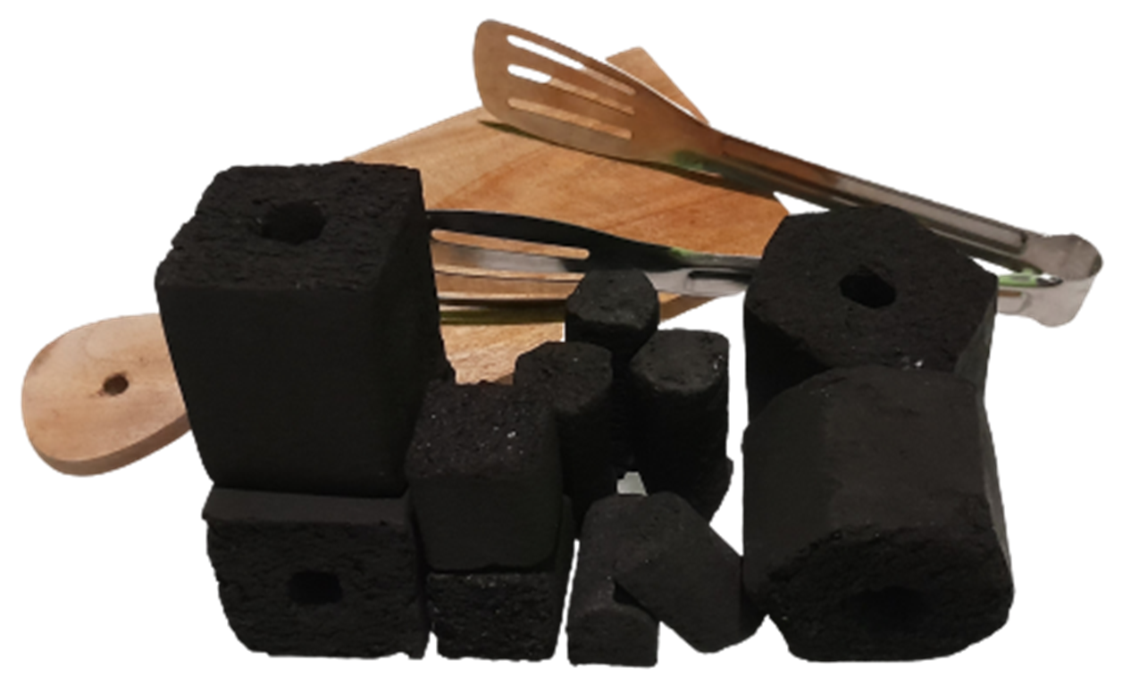
Produk Kami
Phone : +62 812 5293 9996
Email : owner@universalcrackers.com
Website : www.universalcrackers.com
Alamat : Jl. Masjid Nudur Hidayah, Desa/Kelurahan. Long Kali
Kec. Long Kali, Kab. Paser, Provinsi Kalimantan Timur
Kode Pos: 76283, Indonesia
PT.SATRIA URBAN PERKASA
COCONUT BRIQUETTE
SPECIFICATION
Fixed Carbon : Minimum 80%
Min Burn Time : 1 Hour
Ash Colour : White / Silver
Ash Content : 3% Max
Moisture : 5%
Volatile Matter : Less than 14%
Lighting Time : 90 - 120 Minutes
(Depending on size and shape of Briquettes)
Package : Customized

Slide 5
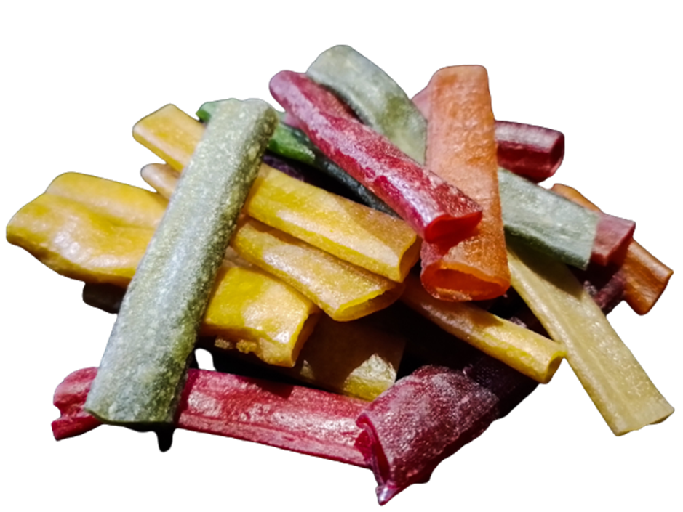
Produk Kami
Phone : +62 812 5293 9996
Email : owner@universalcrackers.com
Website : www.universalcrackers.com
Alamat : Jl. Masjid Nudur Hidayah, Desa/Kelurahan. Long Kali
Kec. Long Kali, Kab. Paser, Provinsi Kalimantan Timur
Kode Pos: 76283, Indonesia
PT.SATRIA URBAN PERKASA
IMPALA CRACKERS
IMPALA CRACKERS
Impala crackers is a traditional snacks originally from Indonesia which made of tapioca flour, onions, salt, sugar, flavorings etc. This crackers have a characteristic with a taste that tends to be savory and sweet, the shape is about 3-5 cm long before being processed with various colors. Our crackers are produced in East Java and are made with health standards and food licenses. For production, our factory is capable of producing up to 1 ton perday with advances machine technology.
How to store: simply stored in a dry place, all of our products can last up to 2 years. It is highly recommended to be sun-dried or in the oven before frying.

Slide 6
Produk Kami
Phone : +62 812 5293 9996
Email : owner@universalcrackers.com
Website : www.universalcrackers.com
Alamat : Jl. Masjid Nudur Hidayah, Desa/Kelurahan. Long Kali
Kec. Long Kali, Kab. Paser, Provinsi Kalimantan Timur
Kode Pos: 76283, Indonesia
PT.SATRIA URBAN PERKASA
PENTOL CRACKERS
PENTOL CRACKERS
Pentol crackers is a typical Indonesian snack made of tapioca flour, pentol/animal broth flavours, and salt flavourings. These crackers has savory and salty characteristics which are obtained from broth and flavoring and has a raw size of 2-3cm. Produced in East Java with 1 ton to 1.2 tons production capacity. Produced in health standardization and industrial food product certification.
How to store: simply stored in a dry place, all of our products can last up to 2 years. It is highly recommended to be sun-dried or in the oven before frying.

Slide 7
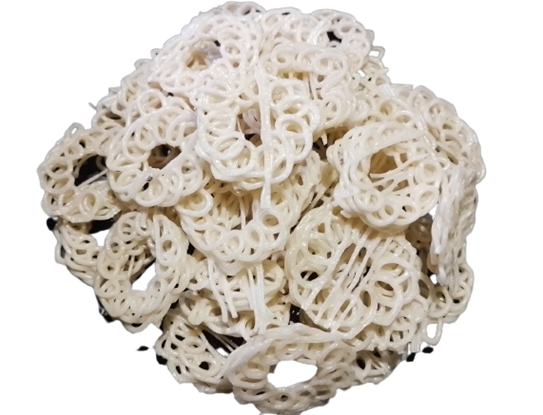
Produk Kami
Phone : +62 812 5293 9996
Email : owner@universalcrackers.com
Website : www.universalcrackers.com
Alamat : Jl. Masjid Nudur Hidayah, Desa/Kelurahan. Long Kali
Kec. Long Kali, Kab. Paser, Provinsi Kalimantan Timur
Kode Pos: 76283, Indonesia
PT.SATRIA URBAN PERKASA
SUSUR CRACKERS
SUSUR CRACKERS
Susur crackers is a processed Indonesian snack made from tapioca flour, onions, sugar, salt, etc. These crackers have a savory garlic flavor. In addition, these crackers can be requested by order in the desired size and color. In general, our fringe crackers are white in color with a (raw) diameter of 2–3 cm. Do not forget that the crackers we produce have passed health standards and are produced in East Java. Production capacity reaches 1000 kg per day.
How to store: simply stored in a dry place, all of our products can last up to 2 years. It is highly recommended to be sun-dried or in the oven before frying.

Slide 8
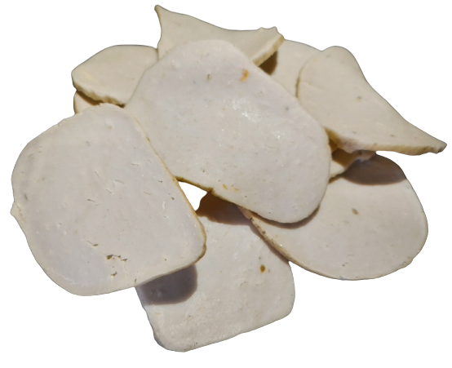
Produk Kami
Phone : +62 812 5293 9996
Email : owner@universalcrackers.com
Website : www.universalcrackers.com
Alamat : Jl. Masjid Nudur Hidayah, Desa/Kelurahan. Long Kali
Kec. Long Kali, Kab. Paser, Provinsi Kalimantan Timur
Kode Pos: 76283, Indonesia
PT.SATRIA URBAN PERKASA
FISH CRACKERS
FISH CRACKERS
Fish Crackers is a processed snacks made of marine resources of the north coast which is produced in East Java. It made of tapioca flour, fresh sea fish, salt, flavoring etc. This cracker has a fairly large shape (about 4-5cm in diameter before being processed) and has fish tasty. In addition, the fish crackers that we produce has passed the borax-free certification test and has MUI halal certification. The production capacity of this fish cracker reaches 500 kg/day.
How to store: simply stored in a dry place, all of our products can last up to 2 years. It is highly recommended to be sun-dried or in the oven before frying.

Slide 9
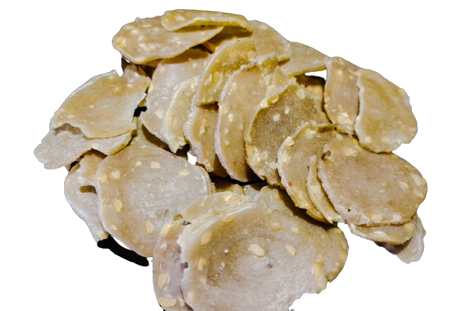
Produk Kami
Phone : +62 812 5293 9996
Email : owner@universalcrackers.com
Website : www.universalcrackers.com
Alamat : Jl. Masjid Nudur Hidayah, Desa/Kelurahan. Long Kali
Kec. Long Kali, Kab. Paser, Provinsi Kalimantan Timur
Kode Pos: 76283, Indonesia
PT.SATRIA URBAN PERKASA
TEMPE CRACKERS
TEMPE CRACKERS
Tempe crackers are snacks from Indonesia made from tapioca flour, selected soybeans, onions, salt and flavorings and have a size of 2-3cm before being processed. These crackers are produced in East Java and have a production capacity of 1 ton to 1.2 tons per day. Tempe crackers have a characteristic with a savory taste from soybeans. Produced with health standards and has industrial food product certification.
How to store: simply stored in a dry place, all of our products can last up to 2 years. It is highly recommended to be sun-dried or in the oven before frying.

Slide 10
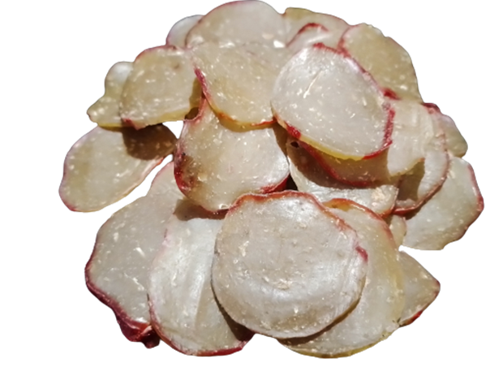
Produk Kami
Phone : +62 812 5293 9996
Email : owner@universalcrackers.com
Website : www.universalcrackers.com
Alamat : Jl. Masjid Nudur Hidayah, Desa/Kelurahan. Long Kali
Kec. Long Kali, Kab. Paser, Provinsi Kalimantan Timur
Kode Pos: 76283, Indonesia
PT.SATRIA URBAN PERKASA
PRWAN (REBON) CRACKERS
PRWAN (REBON) CRACKERS
Rebon prwan cracker is an individual creativity to make typical Indonesian snacks made from tapioca flour, rebon prawns, garlic, and salt and flavoring. It has raw size of 2-3cm. These crackers are produced in East Java and has 1 ton to 1.2 tons production capacity per day. Rebon prawn crackers has distinctive and savory taste which is produced by using rebon prawns themselves and of course these crackers are processed with health standards and industrial food product certification.
How to store: simply stored in a dry place, all of our products can last up to 2 years. It is highly recommended to be sun-dried or in the oven before frying.

Slide 11
Phone : +62 812 5293 9996
Email : owner@universalcrackers.com
Website : www.universalcrackers.com
Alamat : Jl. Masjid Nudur Hidayah, Desa/Kelurahan. Long Kali
Kec. Long Kali, Kab. Paser, Provinsi Kalimantan Timur
Kode Pos: 76283, Indonesia
CALL US

