Slide 1
Preparation of the activity
Make sure teacher-educators are placed in groups of 4-5 teacher educators.
Print-out the document _ CompetencyFramework_Activity. Make sure you print 1 sided and have one print for every group. Make sure all the different parts of the framework and the example activitys are cut-out.
Print-out the document ‘hand-out_framework’. One hand-out for every group.

Slide 2
The activity
First shortly introduce the competency framework (https://info-ted.eu/research/conceptual-framework/)
Then use the instruction on slide 4 to introduce the activity.
The goal is twofold:
  First to share experiences within the groups with specific parts of the framework/activities that are already used by teacher educator(s).
  Second to discuss what factors might be helpfull or hindering the implementation/the use of practices/.
After the activity helpfull and hindering institutional factors can be discussed to gain insight in what is necessary to maintain and/or futher develop diversity responsive practices within the teacher education programme.

Slide 3
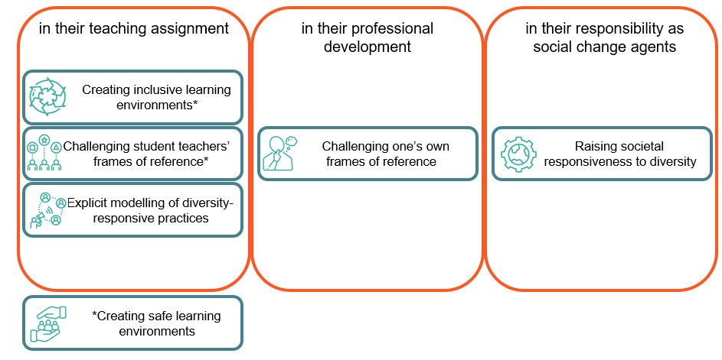
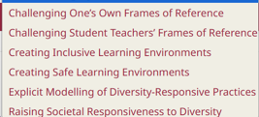
Competency framework
Ponet, B., Vantieghem, W., Tack, H., & Vanderlinde, R. (2025). Teacher educators’ distinctive contribution to education that serves all: introducing a conceptual framework based on a systematic literature review. European Journal of Teacher Education, 1-21.

Slide 4
Instruction
Open the enveloppes.
In them you will find:
  1) General introduction of the competencyframework
  2) One or two of the catogories with example practices
Read the information about the category and the example practices.
  Discuss, per example practice, if (and how) you have used the practice (or it is used within your institution).
  Order the practices from ‘most used’ to ‘least used’ (within the group)
  Discuss the top and bottem practice(s) using the hand-out.
      Write down the top (most used) practices – then discuss and write down contextual factors and knowledge, skills, attitudes that are supporting the wide(r) spread implementation of these practices.
      Write down the bottom (least used practices)– Discuss factors that might hinder using this practice and what is needed, or would help, for these practices to be implemented more (for example, policies, resources, teacher-educator professionalisation).

