Slide 1
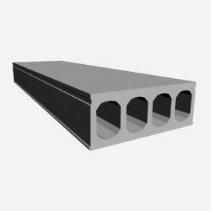
IPHA Sales and Marketing Seminar Barcelona 2018
How to sell hollowcore in Eastern European Countries
Ferrobeton Zrt.
Zoltán Vass
Szilárd Dubrovszky

Slide 2
List of contents
Introduction
Market focus – Non residental
Offers and quote chasing
Negotiation and next rounds
Final offer - Quote format
3. Market focus – Residental
Offers and quote chasing
Negotiation and next rounds
Final offer – Quote format
4. Customer loyalties
5. Conclusions

Slide 3
1. Introduction

Slide 4
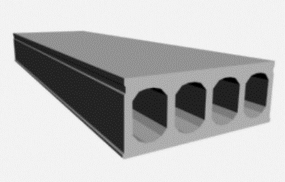
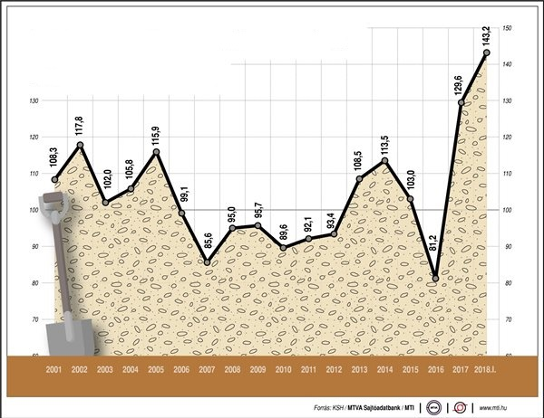
Introduction
The precast market

Slide 5
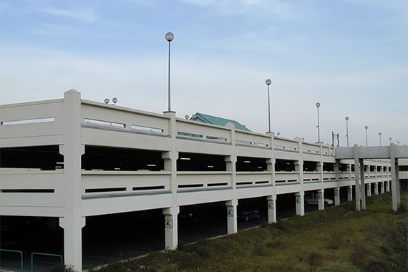
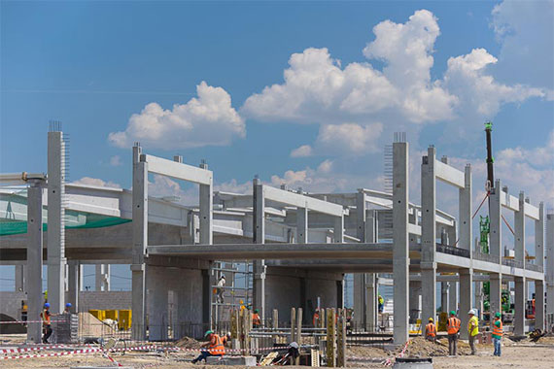
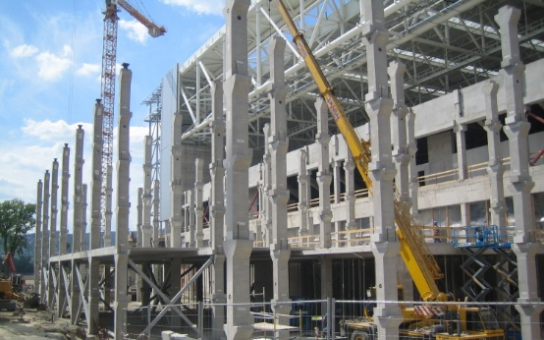
Introduction
Potential and target customers
1. General contractors (B2B)
Industrial
Logistic
Commercial
Communal
Residental
2. Retailers (B2B)
Residential
3. Small private investors (B2C)
Residential
90%
3%
7%

Slide 6
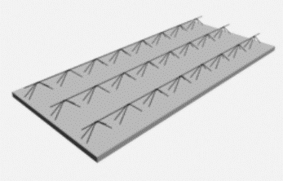
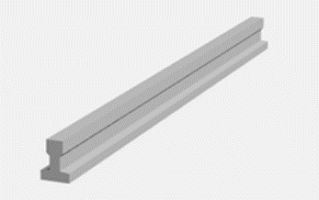
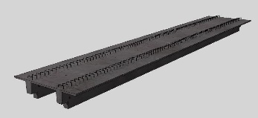
Introduction
Competitions
1. Investor needs
Technical needs
Lead time
Construction time
Price
2. Technical solutions
Hollow core
Ribbed shuttering slab
Shuttering slabs
TT panel
Beam ceiling (apartments)
Cast in-situ

Slide 7
Introduction
Getting enquiries
1. Investors
Preliminary survay
Technical opportunities
Capacity opportunities
Competition
Cost estimation
2. Designers
Engineering support
Cost estimation
Pre design support
Designer partnership
Designer tasks
3. Building contractors
Production
Transport
Assembly
Topping

Slide 8
2. Market focus
Non-residential
Residential

Slide 9
Market focus
Non residental - General contractors, investors
Typical cross- sections
20 cm thickness – 40 cm thickness
50 cm thickness comes only in extreme situations
Bid request channels
Mainly trough personal contacts
E-tender
Phone
E-mail
Public procurements
Type of enquiries
Typically hollowcore is only part of the whole bid

Slide 10
Market focus
Non residental - General contractors, investors
4. Bid request type
Concept plans
Authorization plans
Detailed execution plans
5. Offered services
Statical calculations
Production
Transportation
Assembly
Topping concrete (If asked for)

Slide 11
2.1. Offers and quote chasing

Slide 12
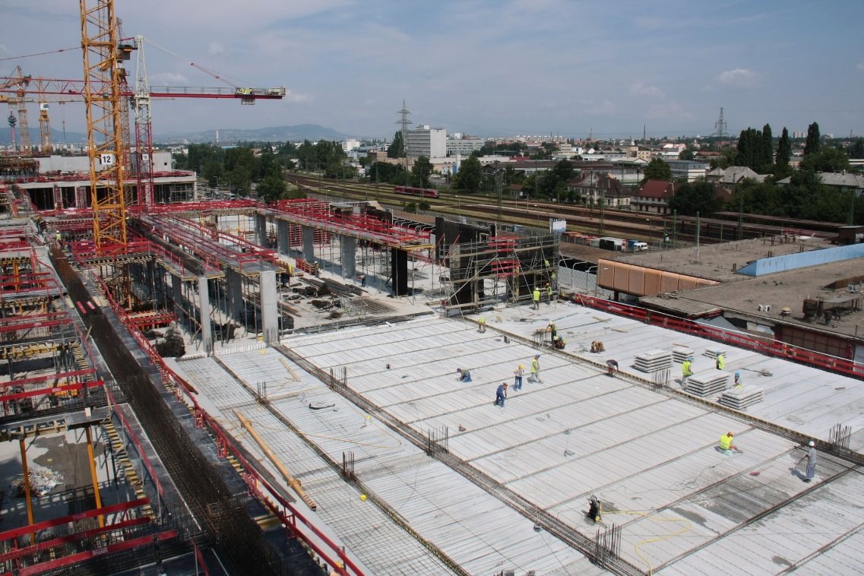
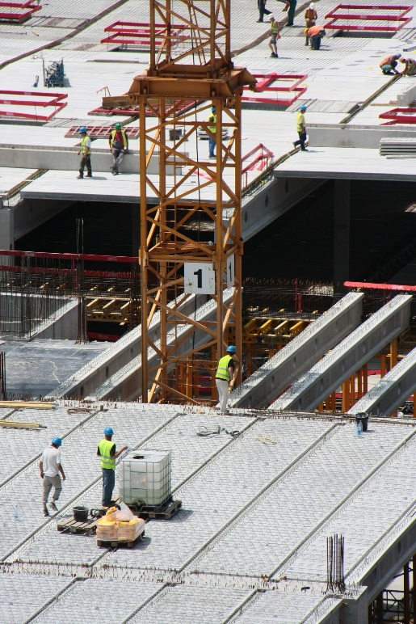
Offer
Getting equiry
E- mail / phone
Authorization plan
Bill of quantity
Only hollow core slab
Pre design support (previously)
100.000m² hollowcore slab
Handover in 7 months
Designer partnership
Transport to 200km
Installation with tower cranes

Slide 13
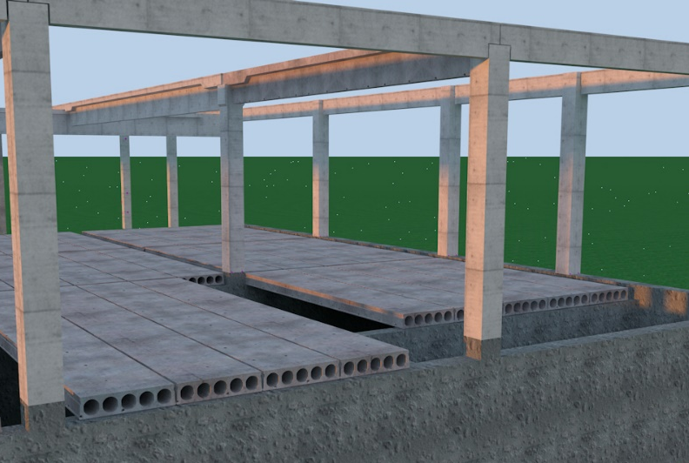
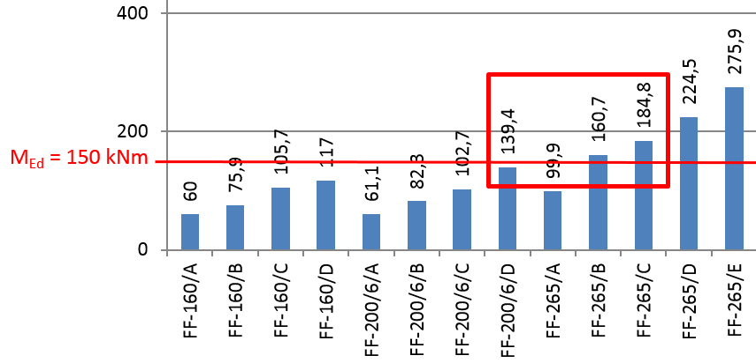
Offer
Technical / Sales needs
Loads
Spans
Statical calculations
Fire resistency
Special requirements (deflection limit)
Selection of standard elements
Pricing
Design
Production
Transport
Assebly
Deadline
Finance
Legal
FF265/B

Slide 14
Offer
Quote format
Contents of bid
Detailed element lists:
Lenghts
Cross-sections
Reinforments
Quantities
Prices:
Design
Production
Transport
Assembly
Topping
Quality and guarantee:
Statements
Standards
Quality assurance
Finance:
Invoicing
Payments
Retentions
Deadlines:
Schedueling
Delivery channel in this phase by e-mail

Slide 15
2.2 Negotiations and next rounds

Slide 16
Negotiation
Customer priorities
Discount
Price-cutting
Price-slashing
Price slope
Price drop
Price reduction
You probably gave the other business a cheaper price

Slide 17
Offer /following rounds
Fine tunes
FF220/6/D
FF255/B
FF265/B
20,56 cost unit / m2
6,5% cost reduction
20,60 cost unit / m2
6,3% cost reduction
21,99 cost unit / m2

Slide 18
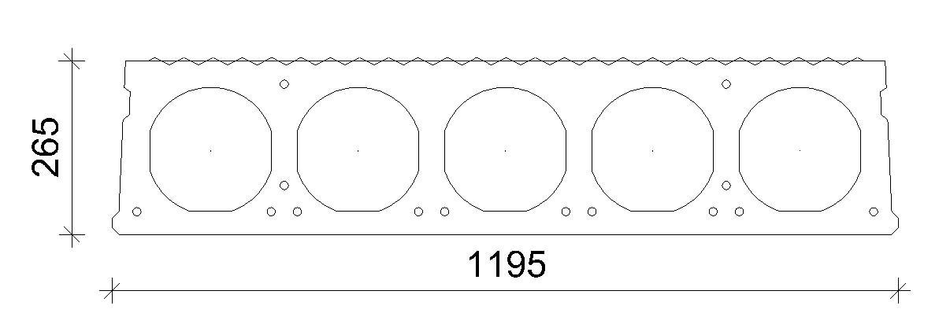
Roughening
The load bearing capacity can increase up to 120-160% depending on the Hollowcore slab’s type and the thickness of the top site concrete.
Fire resistance --- Requirement: REI 90
The positions of the bottom
strands are 5 mm higher
than in the original one.

Slide 19
2.3 Final offer – quote format

Slide 20
Offer / Final
Quote format
Contents of bid
Detailed element lists:
Lenghts
Cross-sections
Reinforcements
Quantities
Prices:
Design
Production
Transport
Assembly
Topping
Quality and guarantee:
Statements
Standards
Quality assurance
Finance:
Invoicing
Payments
Retentions
Deadlines:
Schedueling
Delivery channel in this phase by hand

Slide 21
2. Market focus
Non-residential
Residential

Slide 22
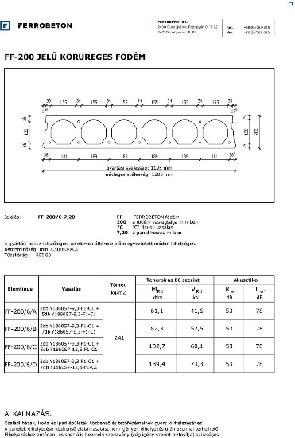
Customer focus
Residental - Small private investors, retailers
Typical cross- sections
16 cm thickness
20 cm thickness
2. Getting enquiries
Personally
Phone
E-mail
3. Type of enquiries
The customer wants a concrete product
The customer wants a roof slab, but doesn’t know the details
The customer wants technical proposal according the plans

Slide 23
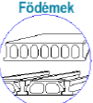
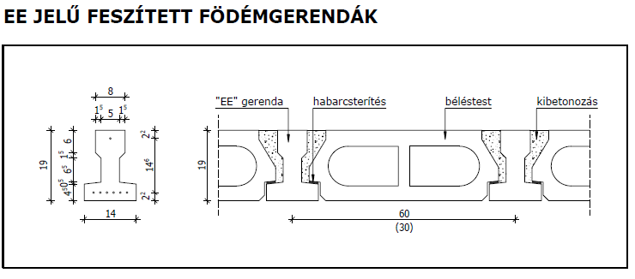
Customer focus
Residental - Small private investors, retailers
4. Typical roof solutions on the market
EE Type of beam + Béléstest
Hollowcore
Offered services
Statical calculations
Defining the type
Production
Transportation (If asked)
We do not undertake lifting, if asked for we can give assistance

Slide 24
3.1. Offers and quote chasing

Slide 25
Offers and quote chasing
Small private investors:
Walk in customers
Two main channels
Designers
Internet
Retailers
Long-term partnership with the EE beam and small accessiories
The same conditions for the hollow core

Slide 26
3.2 Negotiations and next rounds

Slide 27
Negotiation and next rounds
Residental - Small private investors, retailers
Customer needs
Technical needs
Lead time
Construction time
PRICE

Slide 28
Negotiation and next rounds
Residental - Small private investors, retailers
Investors – Walk in customers
Currently no direct marketing
~ 2.000 m2 /year currently
Personal contacts – chasing on the phone
Retailers – Long term partnership
Operating with price lists
Possibility to product connection
Yearly bonuses on the sold volume

Slide 29
3.3 Final offer – quote format

Slide 30
Content of the offer
1. Typical offer
Lump sum price
The holes, cutted elements are calculated during the offer. No extra costs
Documentation
Bill of quantities
Price for production and transport
Technical description ( surface quality!)
Payment conditions – mostly 30 days; advance payment

Slide 31
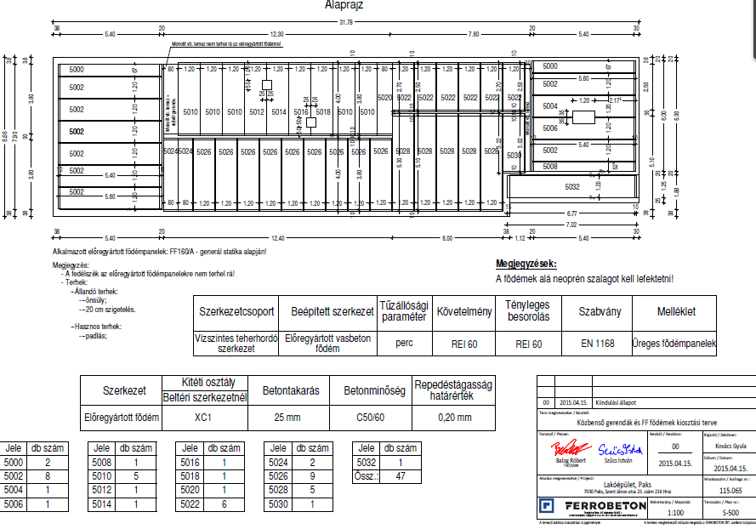
Documentation
Contents
Production designers statement
Bill of quantities
Fire resitance statement
LAYOUT PLAN

Slide 32
4. Customer loyalties

Slide 33
Customer Loyalities
Investors
Priorities
Best solutions
Win-win situation
Lead time
Reliability
Price
Quality
Brand
2. Loyality
Short term relationship
Weak loyality
Word of mouth (marketing)

Slide 34
Customer Loyalities
Designer and Management offices
Priorities
Engineering support (consultations)
Cost estimation
Pre design support
Design partnership
Design tasks
Bonus opportunities
2. Loyality
Permanent relationships
Strong engagement
Long term loyality

Slide 35
Customer Loyalities
General contractors
Priorities
Additional services (engineering)
Win-win solutions
Long term contract
Lead time (reliabilty)
Price
Payment
Quality
Priority partnersip
Brand
2. Loyality
Strong engagement (competition) vice versa
Long term loyality (last call)

Slide 36
Customer Loyalities
Small private investors (B2C)
1. Priorities
Additional services (engineering)
Rapid and simple administration
Lead time (deadlines)
Price
Payment
Quality
Follow up
2. Loyality
Not relevant
Word of mouth (marketing)

Slide 37
Customer Loyalities
Retailers (B2B)
Priorities
Additional services (engineering)
Long term contract
Lead time (reliabilty)
Price
Payment
Quality
Bonus opportunities
Brand
2. Loyality
Strong engagement (competition) vice versa
Long term loyality

Slide 38
5. Conclusions

Slide 39
The current market share of hollowcore is very low compared to western European countries.
More than 90% of the production is for the non-residenal market
Residental market must be the new focus.

Slide 40
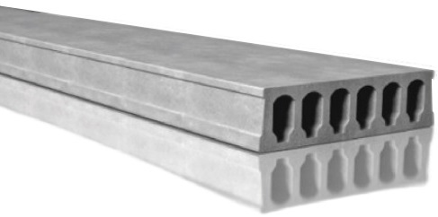
IPHA Sales and Marketing Seminar Barcelona 2018
Thank you for your attention
FERROBETON Zrt.

