Slide 1


Educational Material in cyber security

Slide 2

Security Event Processing
Level: ADVANCED (PROFESSIONAL)
Agenda
System Events
Security Events
  Types
  Logging
  Processing
    Tools & Techniques

Slide 3



Shreyas Srinivasa

Slide 4

What are the main takeaways for this content?
What are System Events?
What are System Security Events and Processes?
How are they logged?
Tools and Techniques
Indicators

Slide 5
System events
An introduction

Slide 6
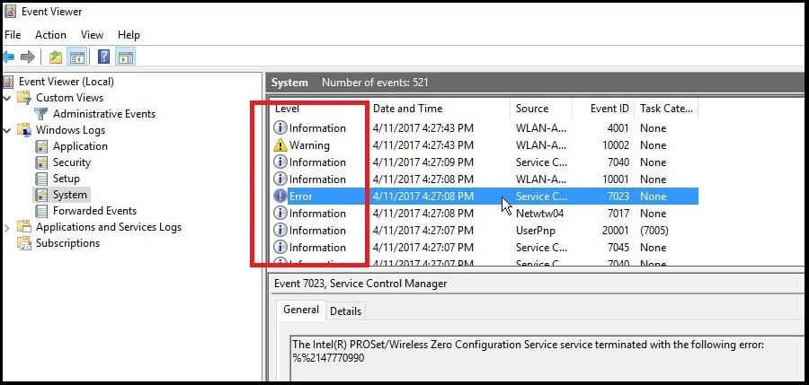
System Events
System events are essentially recordings of significant activities happening within a computer system.
These can include things like user logins, software installations, security incidents, or even minor errors. They function like a logbook, keeping track of what's going on inside the system.
Windows Event Viewer

Slide 7
System Events – The Purpose
Troubleshooting: event logs are invaluable for troubleshooting system issues.
  Diagnostics - When a problem arises, IT professionals or users can examine the logs to identify the event that might have triggered the issue. The details within the log entry can provide clues about the cause and help pinpoint the solution.
  Debugging – developers use the event logs for debugging application-specific issues
Security monitoring: Security-related events logged can help identify potential security threats.
  Unauthorized access: Suspicious login attempts, unauthorized access attempts, or unusual program activity can all be red flags.
  Suspicious Processes: Some malware spawn suspicious processes that aim at achieving persistence or establishing covert connections to a C&C
  Forensic Analysis
Compliance: Certain regulations in some industries might require organizations to maintain logs of system activity for auditing purposes. System event loggers help maintain a record that demonstrates compliance with these regulations.
  Audits
  Regulations

Slide 8
System “SECURITY” events
An introduction

Slide 9
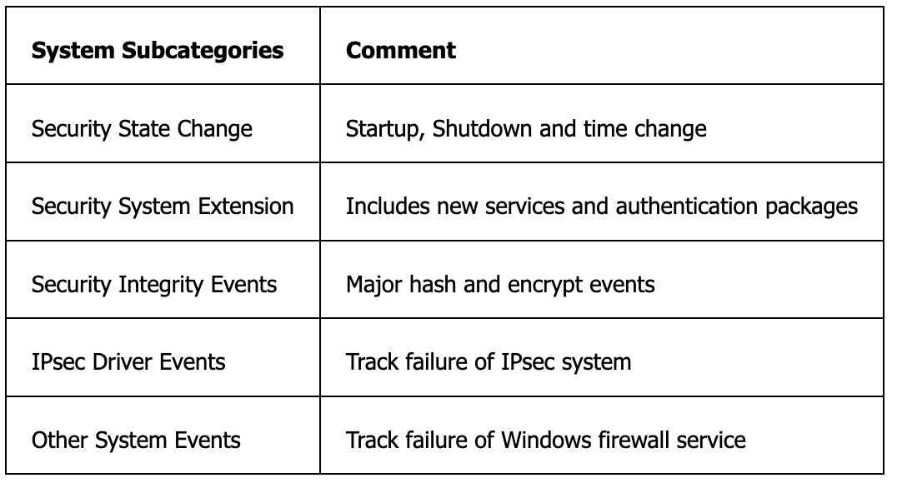
System SECURITY EventS
System The System category and its subcategories provide an eclectic mix of events that are relevant to security. For example, Windows logs event ID 4608 when the system starts up
Security State Change: Events in the Security State Change subcategory track keys system changes, such as system clock changes and the startup and shutdown of the system. These events are important because a Windows system is completely vulnerable while shut down at the mercy of anyone who has physical access and the proper skill
Every event uses the system time, so a change in system time could obscure or hide malicious actions or cause authentication problems

Slide 10
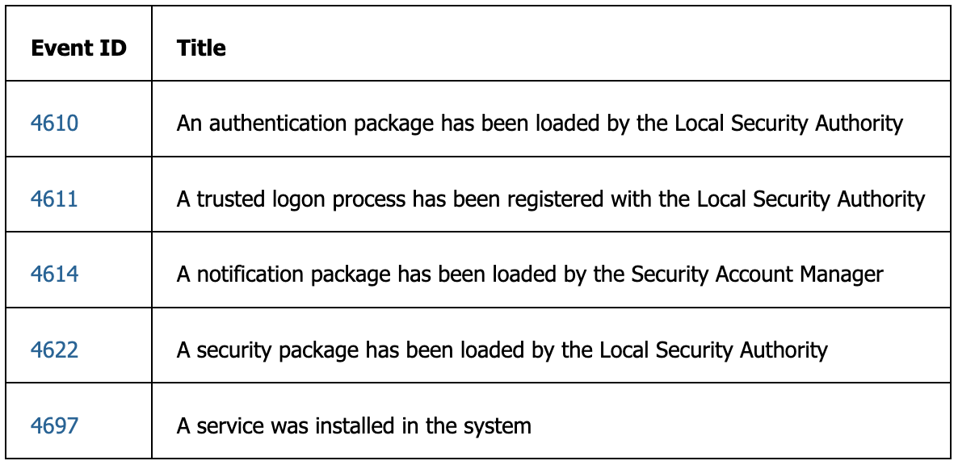
SECURITY SYSTEM EXTENSION
Security System Extension - The Windows security infrastructure supports extensibility through various types of plug-ins, and the Security System Extension subcategory logs all activity of such plug-ins.
The Windows security infrastructure is designed to be modular and to facilitate new, plug-in security functionality from Microsoft and third-party vendors. These plug-ins can be authentication packages, trusted logon processes, or notification packages.
Because the plug-ins are completely trusted modules of code that augment the operating system, Windows logs each plug-in as it loads, using the events in this subcategory
For example, When a service is installed on the system, event ID 4697 is generated

Slide 11
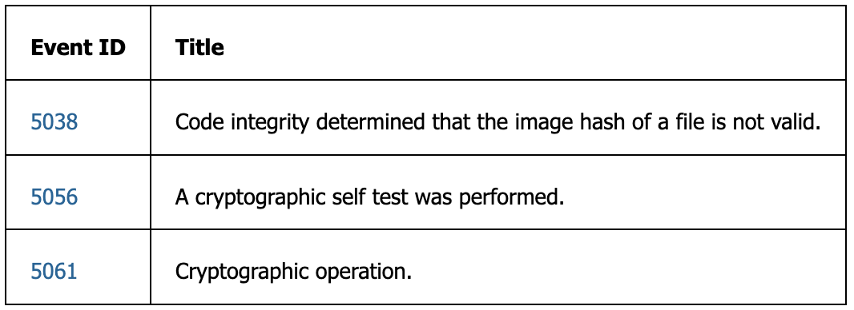
SECURITY INTEGRITY events
The Security Integrity Events subcategory logs at least three events that can affect the overall integrity of the system.
Event ID 5038 lists the path and file name of the image in question. This could mean that the hash was corrupted either intentionally or a possible Input/Output error in the system.
Event ID 5056 and 5061 seem to be part of normal operation of the system. Auditing may be needed for compliance purposes.

Slide 12
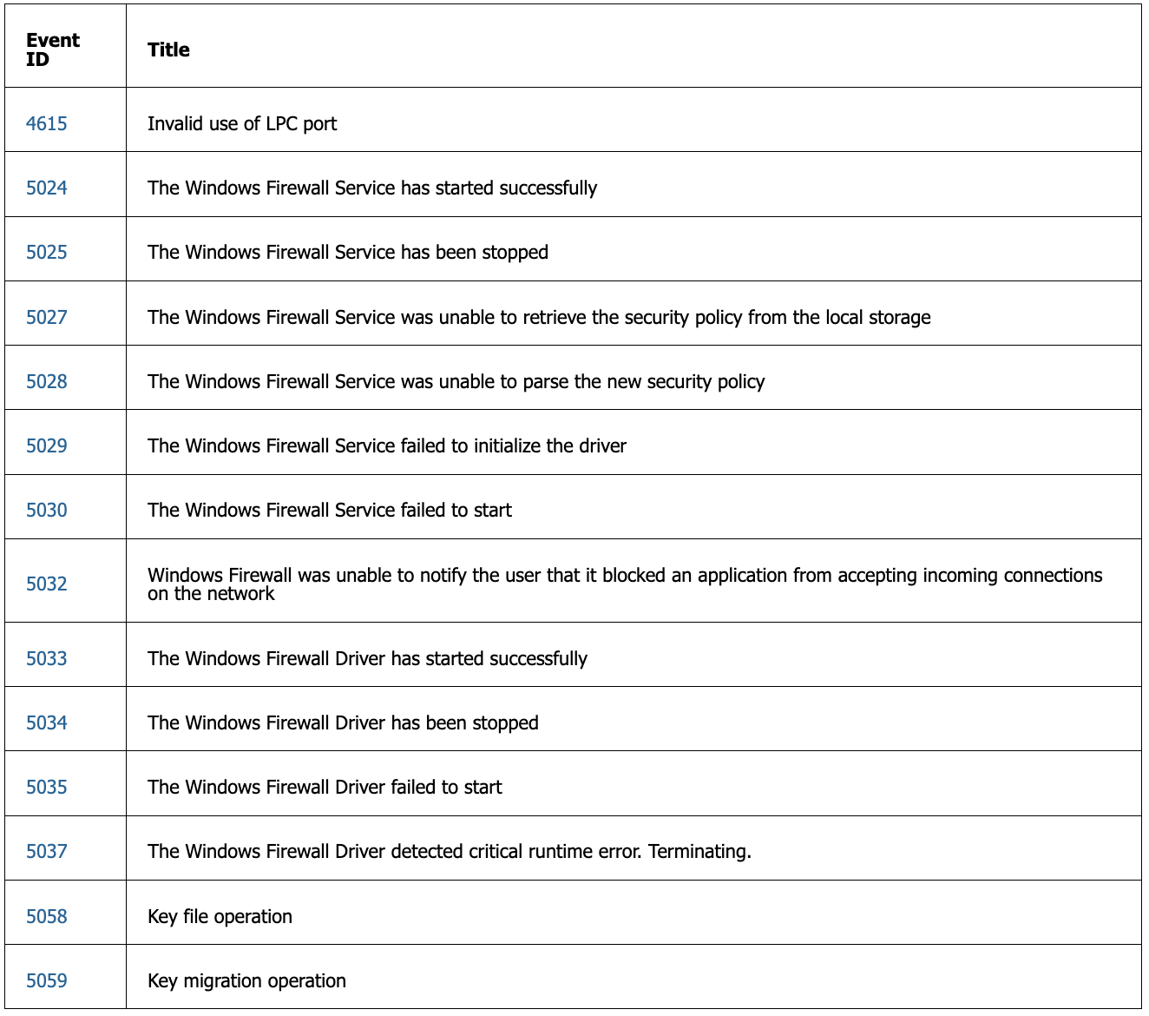
MORE SECURITY events …

Slide 13
EVENT LOGGING

Slide 14
EVENT LOGGING
System event loggers are software tools designed to capture and store information about significant occurrences within a computer system. These events can be generated by various sources, including:
  Hardware: Events related to hardware devices like connecting or disconnecting a USB drive, a printer running out of toner, or a fan malfunction.
  Software: Events related to programs, such as application crashes, successful installations, or software updates
  Security: Events related to security activities, including login attempts, failed password entries, or attempts to access unauthorized files.
  System: Events related to the operating system itself, like system startup and shutdown, configuration changes, or resource usage.

Slide 15
EVENT LOGGING – DEFAULT Loggers
Windows:
  Windows Event Log: The primary event logging mechanism on Windows systems. It records events generated by the operating system, applications, and security events. The Event Viewer tool provides a graphical interface to view, filter, and manage event logs.
Linux:
  Syslog: A standard logging system used by many Linux distributions. Syslog collects log messages from various system components and applications and stores them in text-based log files located in directories like /var/log. Tools like syslog or syslog-ng are often used to manage syslog messages.
  systemd journal: A modern logging system used by distributions adopting systemd. It stores log messages in a binary format, allowing for structured logging and efficient querying. The journalctl command is used to query and view systemd journal entries.
OSX:
  Unified Logging System: OSX uses a unified logging system to record system events, errors, and diagnostic information. Logs are stored in text-based files located in directories such as /var/log. Common log files include system.log, kernel.log, and secure.log. The Console application provides a graphical interface for viewing and managing logs, while command-line tools like log, log stream, and syslog offer additional capabilities for accessing and querying logs.

Slide 16
SYSTEM Loggers - ACTIVITY
Open a System Event Log from your OS
Windows – Click on Start>Event Viewer
Linux – Terminal> cd /var/log/journal > ls > nano ****.log
OSX - Terminal> cd /var/log/ > tail -10 appdiagnostics.log

Slide 17
Analysers

Slide 18
Analysis Tools
Name | Description
Syslog-ng | open-source syslog server offers more advanced log management capabilities compared to the standard syslog daemon. It provides features like filtering, routing, and integration with various analysis tools
Elastic ELK Stack | Combination of Elasticsearch, Logstash, and Kibana for log analysis, visualization, and monitoring.
Graphana Loki | Log aggregation system with querying and visualization capabilities, suitable for log analysis and monitoring.
Graylog | Centralized log management platform with search, filtering, alerting, and reporting features for log analysis.
Apache Metron | Cybersecurity platform for log analysis, threat detection, and incident response, with advanced analytics capabilities.
Security Onion | Network security monitoring and log analysis platform, pre-configured with ELK Stack for security analysis tasks.
Sagan | Lightweight log analysis engine for real-time intrusion detection and alerting based on log data analysis.
NXLog (Community) | open-source, multi-platform log management solution designed to collect, process, and forward log data from various sources. It supports a wide range of log sources, including Windows Event Logs, syslog, and application logs.

Slide 19
Processing:
Security information and event management

Slide 20
SIEM
A platform that combines Security Information Management (SIM) and Security Event Management (SEM) capabilities to provide comprehensive security monitoring, threat detection, incident response, and compliance management functionalities
Purpose: centralize the collection, aggregation, correlation, analysis, and visualization of security-related data from various sources within an organization's IT infrastructure.
Security Information Management (SIM): involves collecting real-time data from various security sources across your network, such as firewalls, servers, and applications. SIEM analyzes this data to identify suspicious activity that might indicate a potential security threat.
Security Event Management (SEM): involves aggregating and analyzing historical security data. SIEM can help you understand trends and patterns in security events, which can be helpful for identifying vulnerabilities and improving your overall security posture.

Slide 21

Find out more
https://gamess.dk/

Slide 22












Who is behind
Partners behind the project
Collaborators
Supported by

Slide 23


Who is behind

