Slide 1
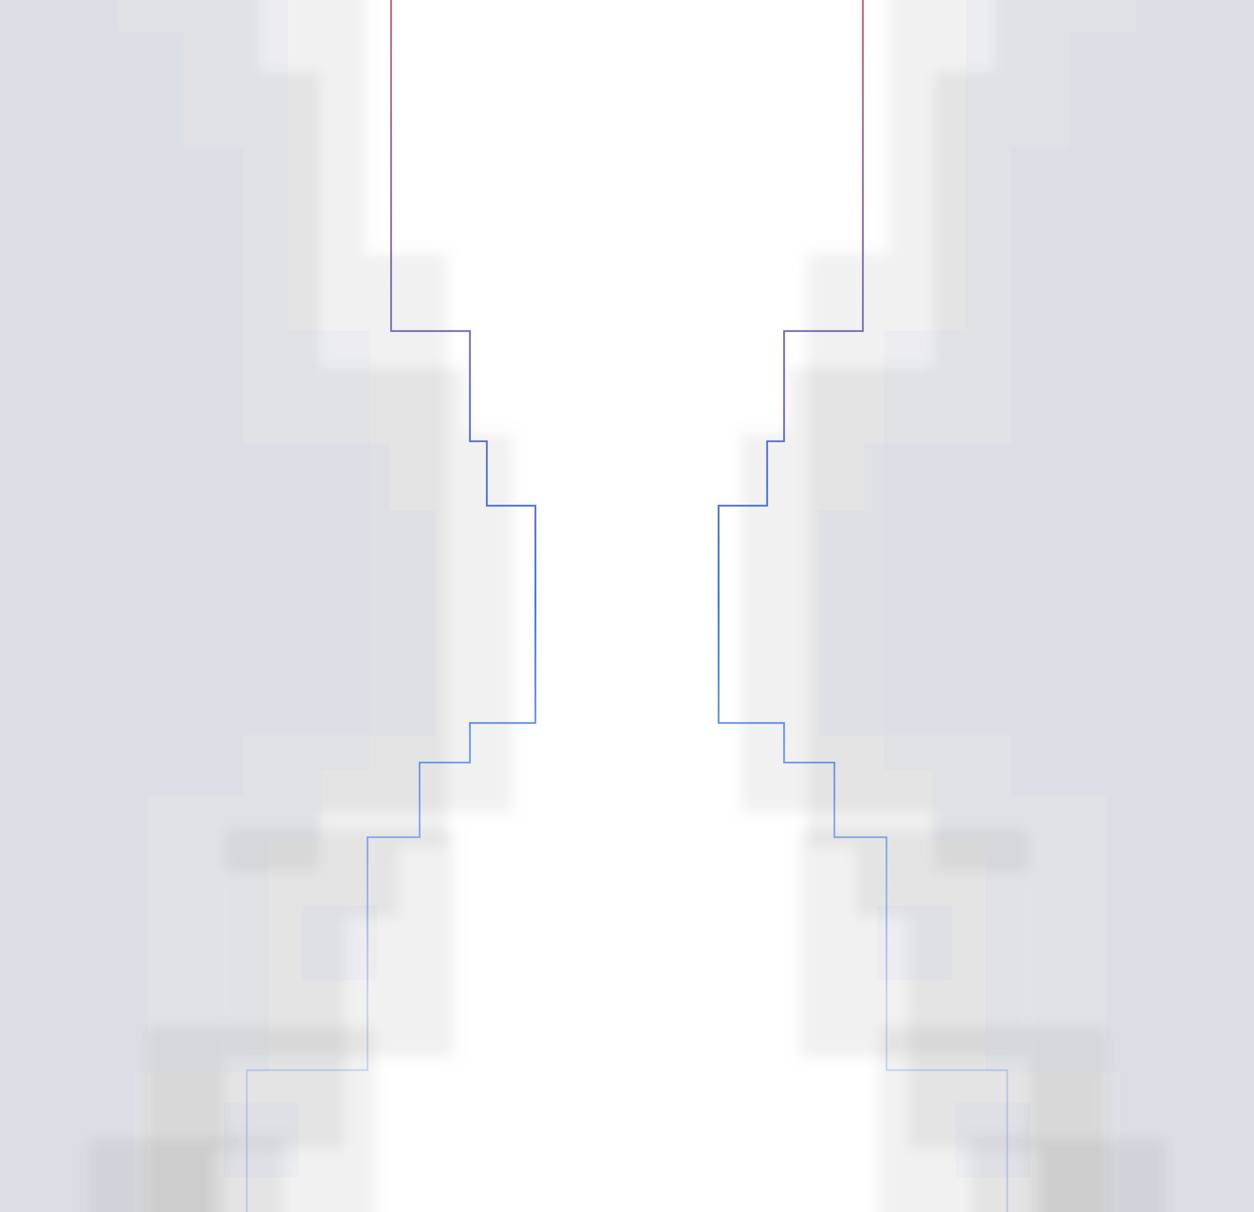

Network Communication Protocols

Slide 2

Agenda
Introduction to Network Communication Protocols
OSI Model
HTTP (Hypertext Transfer Protocol)
  Working
  Vulnerabilities
Telnet
  Working
  Vulnerabilities
SSH (Secure Shell)
  Working
  Vulnerabilities

Slide 3

Jens Myrup Pedersen
Professor
Institut for Elektroniske Systemer
Det Tekniske Fakultet for IT og Design
Communication, Media and Information technologies
Cyber Security Group

Slide 4
Key Takeaways
Content:
  Understanding Protocols:
    Grasp the fundamental workings of HTTP, Telnet, and SSH.
  Vulnerabilities Awareness:
    Identify common vulnerabilities associated with each protocol.
  Mitigation Strategies:
    Learn and apply security measures to mitigate risks.
  Secure Practices:
    Emphasize the importance of regular updates, strong authentication methods, and encrypted connections.

Slide 5
What are Network Protocols?
The term "protocol" comes from the Greek ‘protocollon’, meaning a description attached to a manuscript.
In networking, A network protocol is a set of rules and conventions that govern the communication between devices on a network, ensuring secure, timely, and organized data exchange. These protocols define how data is formatted, transmitted, and received, enabling interoperability and efficient communication between different devices and systems.

Slide 6
What do Network Protocols DO?
Data Encapsulation
Addressing
Routing and Switching
Error Detection and Correction
Flow Control
Sequencing
Connection Establishment and Termination
Data Encryption and Decryption
Authentication and Authorization
Session Management
Compression
Error Handling

Slide 7
Overview of the OSI Model
Layer | Description
7. Application | Provides network services to applications (e.g., HTTP, FTP, SMTP)
6. Presentation | Translates data between the application layer and the network format
5. Session | Manages sessions between applications (e.g., establishing, maintaining, and terminating connections)
4. Transport | Ensures reliable data transfer (e.g., TCP, UDP)
3. Network | Determines the best physical path for data (e.g., IP, routers)
2. Data Link | Handles error detection and correction from the physical layer (e.g., MAC addresses, switches)
1. Physical | Transmits raw bit stream over the physical medium (e.g., cables, hubs)
Notes:
What is OSI model ?
What role does it play in Networking?

Slide 8
Memorizing the OSI Model
To easily remember the seven layers of the OSI model, use this mnemonic:
"Please Do Not Throw Sausage Pizza Away"
Please - Physical Layer
Do - Data Link Layer
Not - Network Layer
Throw - Transport Layer
Sausage - Session Layer
Pizza - Presentation Layer
Away - Application Layer
Notes:
Explain students an easy way way to remember the OSI model

Slide 9
Layers and their role
Layer 7: Application Layer
  Level at which applications access network services.
    Represents services that directly support software applications for file transfers, database access, and electronic mail etc.
Layer 6: Presentation Layer
  Related to representation of transmitted data
    Translates different data representations from the Application layer into uniform standard format
    e.g. data encryption, and data compression.
Layer 5: Session Layer
  Allows two applications on different computers to establish, use, and end a session.
  e.g. file transfer, remote login
Notes:
Explain each layer and their tasks in OSI model

Slide 10
Layer 4: Transport Layer
  Manages transmission packets
    Repackages long messages when necessary into small packets for transmission
    Reassembles packets in correct order to get the original message.
  Handles error recognition and recovery.
    Transport layer at receiving acknowledges packet delivery.
    Resends missing packets
Layer 3: Network Layer
Manages addressing/routing of data within the subnet
  Addresses messages and translates logical addresses and names into physical addresses.
  Determines the route from the source to the destination computer
  Manages traffic problems, such as switching, routing, and controlling the congestion of data packets
  .
Routing can be:
  Based on static tables
  determined at start of each session
  Individually determined for each packet, reflecting the current network load.
Notes:
Explain each layer and their tasks in OSI model

Slide 11
Layer 2: Data Link Layer
  Packages raw bits from the Physical layer into frames (logical, structured packets for data).
  Provides reliable transmission of frames
    It waits for an acknowledgment from the receiving computer.
    Retransmits frames for which acknowledgement not received
Layer 1: Physical Layer
Transmits bits from one computer to another
Regulates the transmission of a stream of bits over a physical medium.
Defines how the cable is attached to the network adapter and what transmission technique is used to send data over the cable. Deals with issues like
  The definition of 0 and 1, e.g. how many volts represents a 1, and how long a bit lasts?
  Whether the channel is simplex or duplex?
  How many pins a connector has, and what the function of each pin is?
Notes:
Explain each layer and their tasks in OSI model

Slide 12
Protocols and Layers
Layer 4 - Transport Layer
  TCP (Transmission Control Protocol)
  UDP (User Datagram Protocol)
Layer 5 - Session Layer
  NetBIOS
  PPTP (Point-to-Point Tunneling Protocol)
Layer 6 - Presentation Layer
  SSL/TLS (Secure Sockets Layer/Transport Layer Security)
  MPEG (Moving Picture Experts Group)
Layer 7 - Application Layer
  HTTP (Hypertext Transfer Protocol)
  FTP (File Transfer Protocol)
  SMTP (Simple Mail Transfer Protocol)
  DNS (Domain Name System)
Layer 1 - Physical Layer
  Ethernet (physical signaling)
  USB
  IEEE 802.11 (Wi-Fi)
Layer 2 - Data Link Layer
  Ethernet (MAC, LLC)
  PPP (Point-to-Point Protocol)
  Ethernet (physical signaling)
  IEEE 802.11 (Wi-Fi)
Layer 3 - Network Layer
  IP (Internet Protocol)
  ICMP (Internet Control Message Protocol)
Notes:
Both Ethernet and Wi-Fi map to the Network Interface Layer (Layers 1 and 2 combined), supporting physical transmission and data link control.

Slide 13
Dive into some Protocols Details
Let’s explore functionalities and security issues of some protocols.

Slide 14
HTTP (Hypertext Transfer Protocol)
Content:
  Definition: A protocol for transferring hypertext requests and information on the internet
  Function: Basis for data communication on the World Wide Web
  Common uses: Web browsing, APIs, data exchange

Slide 15



HTTP - Working
  Client-server model: Client sends request, server responds
  Methods: GET, POST, PUT, DELETE, etc.
  Stateless protocol: Each request is independent

Slide 16
HTTP - Vulnerabilities
  Common vulnerabilities:
    Cross-Site Scripting (XSS)
    Cross-Site Request Forgery (CSRF)
    Man-in-the-Middle (MITM) attacks
  Mitigation techniques:
    Use of HTTPS
    Secure coding practices

Slide 17
Telnet
Definition: A protocol for accessing remote computers
Function: Allows users to log into remote systems
Common uses: Remote administration

Slide 18
Telnet - Working
  Client-server model: User connects to a remote server
  Transmission: Data sent in plaintext
  Port: Uses TCP port 23

Slide 19
Telnet - Vulnerabilities
Content:
  Common vulnerabilities:
    Lack of encryption
    Eavesdropping
    Credential theft
  Mitigation techniques:
    Use of SSH instead of Telnet
    Network segmentation

Slide 20
SSH (Secure Shell)
Definition: A protocol for secure remote login and other secure network services
Function: Encrypts data transmission to prevent eavesdropping and tampering
Common uses: Secure remote administration, file transfers

Slide 21
SSH - Working
  Client-server model: Establishes an encrypted connection
  Authentication: Uses keys or passwords
  Encryption: Ensures confidentiality and integrity

Slide 22
SSH - Vulnerabilities
Common vulnerabilities:
  Weak or stolen credentials
  Outdated software
Mitigation techniques:
  Use of strong, unique passwords or key pairs
  Regular updates and patches

Slide 23

Find out more
https://gamess.dk/

Slide 24










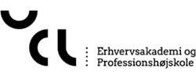

Who is behind
Partners behind the project
Collaborators
Supported by

Slide 25
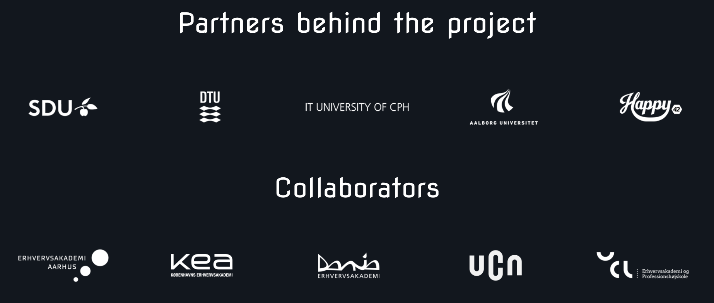

Who is behind

