Slide 1


Educational Material in cyber security

Slide 2

Malware analysis for beginners
Agenda
Malware
  What is malware
  Malware Lifecycle and characteristics
  Malware analysis
    Malware morphology
    Static and Dynamic analysis
    Detection, IOCs, Rules, MISP

Slide 3



Shreyas Srinivasa

Slide 4
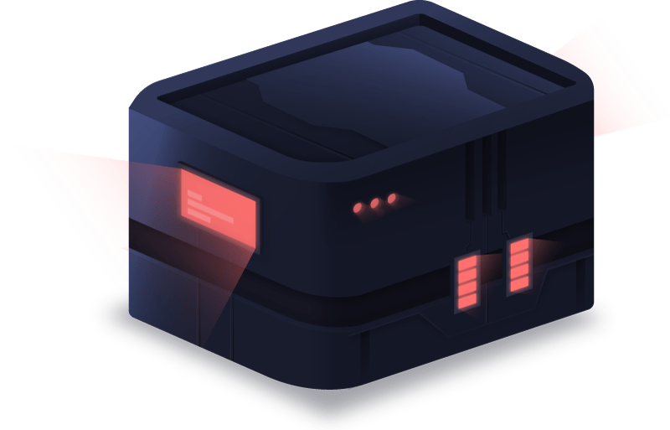
What are the main takeaways for this content?
Understand what is Malware
Malware types and characteristics
Introduction to analysing malware with static and dynamic analysis
Tools

Slide 5
malware
An introduction

Slide 6
What is Malware?
Simply put - “Malicious Software”
Intentionally designed with a strategy to inflict damage or disrupt, steal, exploit the target with/without unauthorized access
  with unauthorized access Ex: spyware, ransomware
  without unauthorized access Ex: adware, PUP (potentially unwanted programs)
Malware compromises the confidentiality, integrity or the availability of the system by exploiting existing vulnerabilities in a system or by creating new ones
Examples - ILOVEYOU, Conficker, Zeus, FinFisher, WannaCry, SuperFish, Stuxnet, HawkEye
Variants - Traditional, Polymorphic, Metamorphic, Fileless

Slide 7
Malware categories
Backdoor - Malicious code that installs itself onto a computer to allow the attacker access, Ex: PoisonIvy
Botnet - Attacker controls infected systems with C&C, Ex: Mirai botnet
Downloader - Malicious code that exists only to download other malicious code. Ex: Pony
Information-stealer malware - collects information from a victim’s computer and usually sends it to the attacker, Ex: Dridex
Launcher - Malicious program used to launch other malicious programs. Ex: Emotet
Rootkit - Malicious code designed to conceal the existence of other code, usually paired with backdoors, Ex: Stuxnet
Scareware - Malware designed to frighten an infected user into buying something, Ex: FakeAV
Spam-sender - Malware that infects a user’s machine and then uses that machine to send spam. Ex: ILOVEYOU
Worm or virus - Malicious code that can copy itself and infect additional computers Ex: Conficker

Slide 8
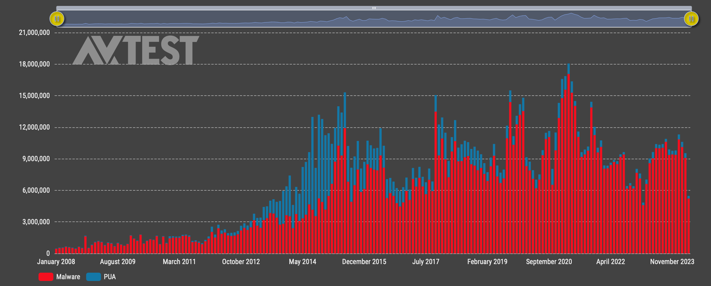
Total amount of malware and Potentially unwwanted applications growth over years
src: https://portal.av-atlas.org/malware

Slide 9
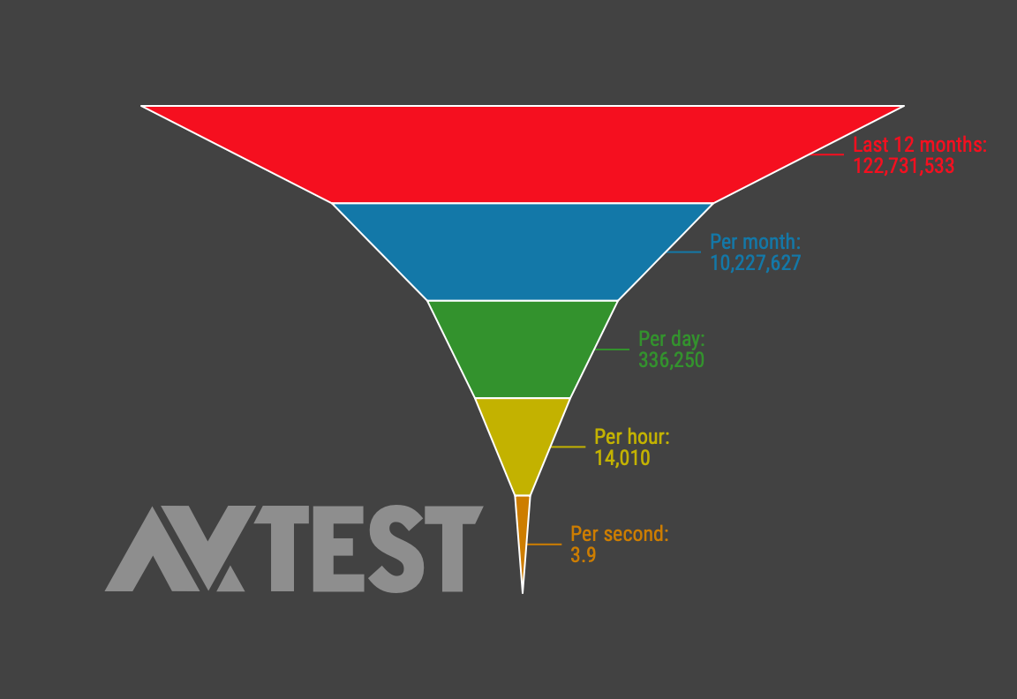
New malware and PUA observed by second
src: https://portal.av-atlas.org/malware

Slide 10
Malware EVOLVEMENT
Malware are continuously evolving
Higher impact
More discreet
Increased attacks

Slide 11
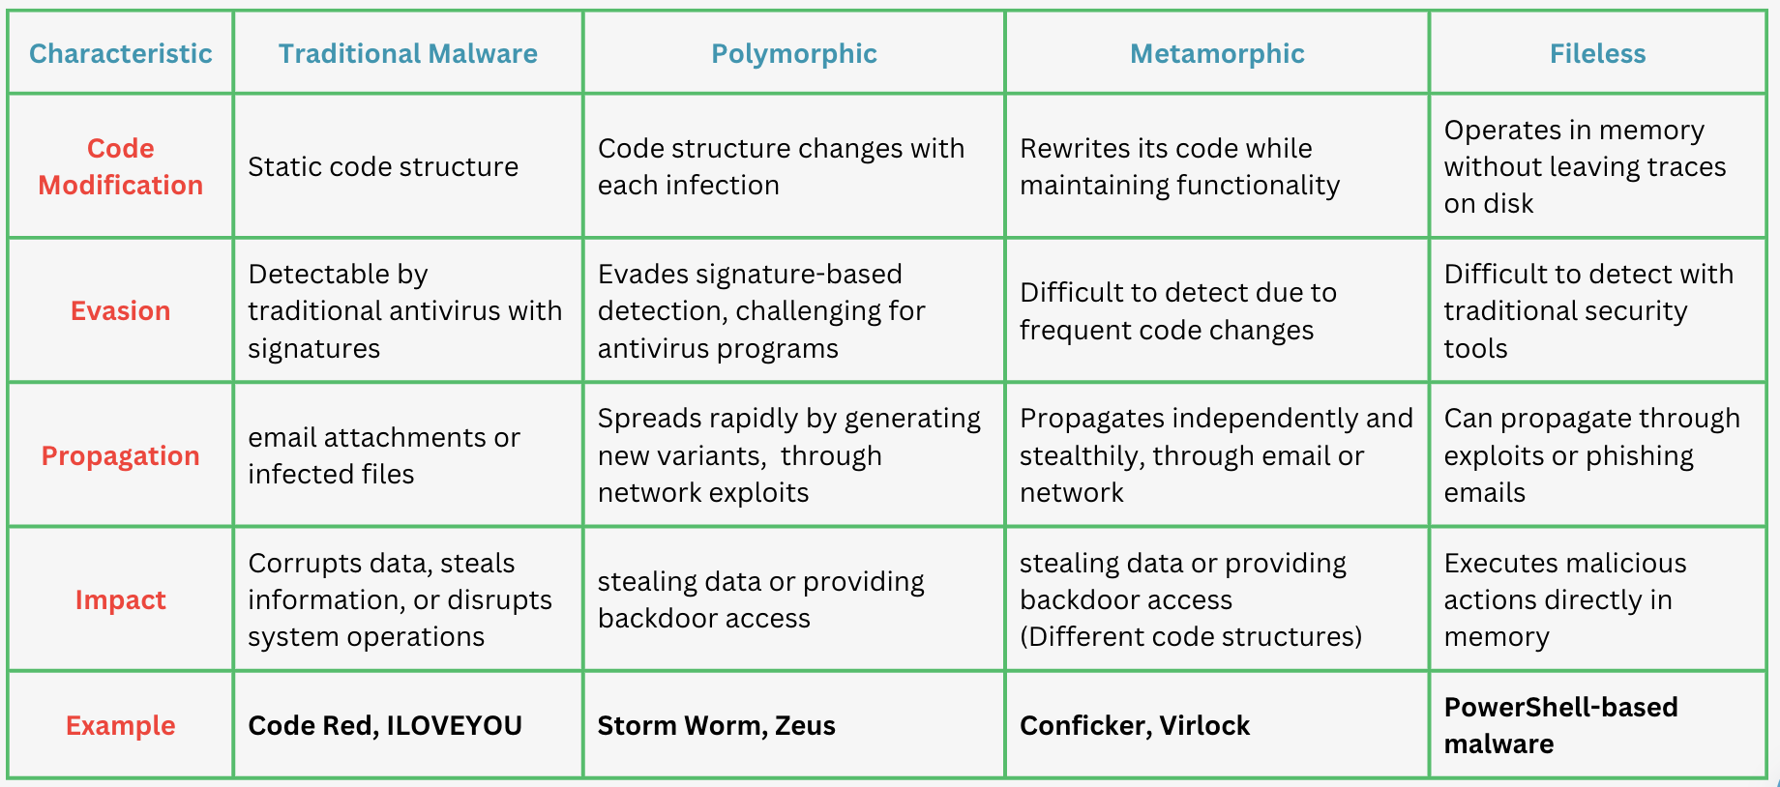
Malware variants

Slide 12
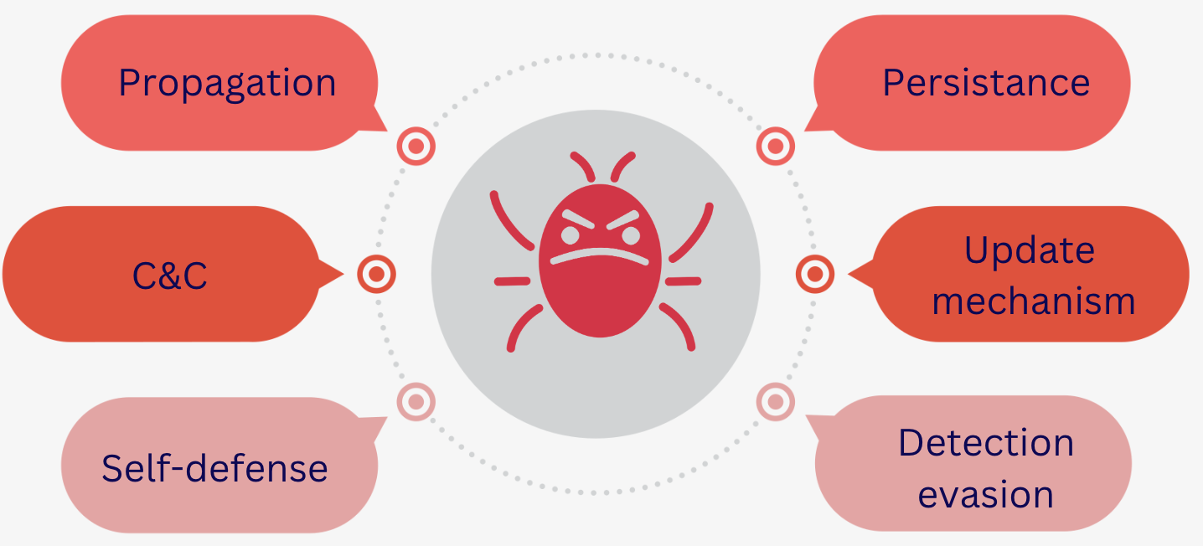
Malware CHARACTERISTICS

Slide 13

Malware analysis

Slide 14
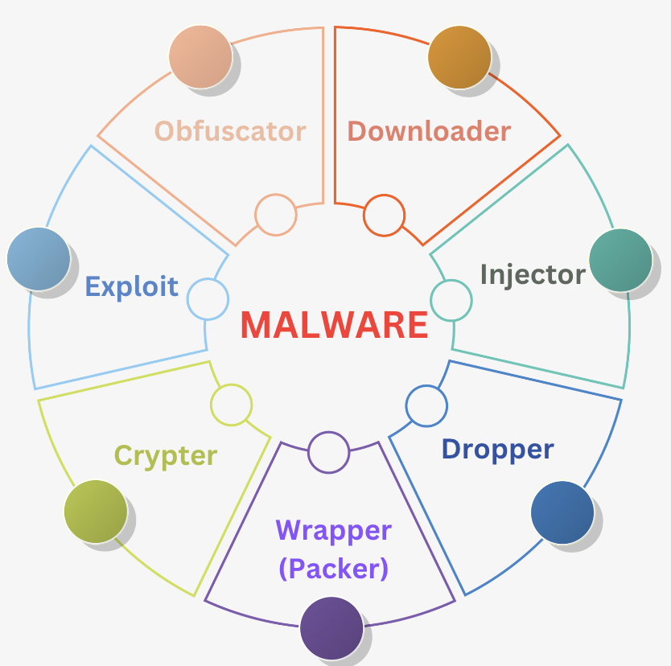
Malware morphology 101
Downloader: responsible for downloading other malware
Injector: inject code into other vulnerable processes
Dropper: Covert malware carrier
Wrapper (Packer): bundle the executables together for evasion
Crypter: Conceal malware, making detection and analysis harder
Exploit: Exploit code to breach system security to install malware
Obfuscator: conceals the code and intended purpose, making analysis difficult

Slide 15
Malware analysis
Static Analyis
  Analyzing the code or structure of a program to determine its function
  Ex: AV scanning, Hashing, Finding strings, Un-Packing, Reverse engineering, Dis-assembly
Dynamic Analysis
  Examination performed after executing malware
  It is the second step, after performing static analyis
  Observe the malware’s true functionality
  Ex: Sandboxing, Process monitoring, Process Explorer, Comparing Registry Snapshots, Network Sniffing

Slide 16
Analysis environment setup
“Do﻿nt do malware analysis on a machine you care about!”
Virtualization with Snapshotting capabilities
Isolation - Networking (Dont do malware analysis on a network you care about)
Use sandboxes -
  Private (Downloadable) - Cuckoo, Cape
  Public (Online) - Virustotal, any.run, Hybrid Analysis, Joe Sandbox, Tria.ge Sandbox
Limit access:Try to have a private, standalone setup, analyst machines for manual analysis
Transport the file under test with caution, zip and encrypt file before transport to VM
Always begin with static analysis! (Gather as much metadata)

Slide 17
Analysis environment setup
“Do﻿nt do malware analysis on a machine you care about!”
Typical suggested setup: (1 host, 3 VMs)
Get a host that is not your daily driver! (no personal files, documents, clean disk)
Setup virtualization on your host - VMWare, VirtualBox, UTM
Setup a private Sandbox like Cuckoo on VM-1
Setup Windows 10/11 on VM2 and REMnux Linux on VM3
Create a private network on your Virtualization software - Disable NAT
Install analysis tools on the Windows VM using FlareVM or download your preferred toolset
Suggested Guide: https://www.sentinelone.com/labs/building-a-custom-malware-analysis-lab-environment/

Slide 18

Basic static analysis

Slide 19
static analysis
AntiVirus scanning - using “many” AVs to scan the suspected file sample
  AVs use two methods for detecting maliciousness - Signature-based, Heuristics-based
  Ex: Virustotal, any.run, VX-underground
Hashing - common method used to uniquely identify malware.
  The malicious file is run through a hashing program that produces a unique hash that identifies that malware (a sort of fingerprint)
  Ex: making a hash of the malicious file with MD5 or SHA256
Finding Strings - Searching through the strings can be a simple way to get hints about the functionality of a program.
  A string in a program is a sequence of characters
  Ex: Using the Strings program (Microsoft) or strings (Linux)

Slide 20
OPTIONAL ACTIVITY (Windows os)
Task-1:
  Launch the Windows VM, download pestudio 9.58 free from winitor.com/download
  Click on file>open file> C:\Windows\SysWOW64\msra.exe (Browse to the file, do not paste)
  Observe the outputs for Footprints(Hashes), Indicators(TTPs), Virustotal, Entropy, Strings
Task-2:
  Close PEStudio and reopen
  This time open the file C:\Windows\loadlib.exe
*This activity is safe to do on your machine as we will scan some default Windows files.

Slide 21
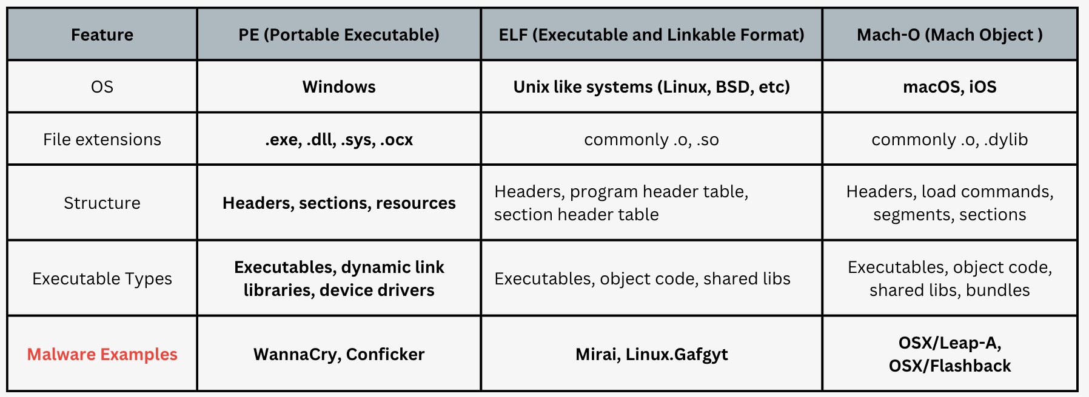
OS-based executable formats

Slide 22
ENTROPY – a measure of randomness
A measure of the disorder or randomness in a closed system
In terms of malware and files =>
  when data is packed or encrypted, the output is not structured and resembles more random, thereby high entropy
  in information theory, it is calculated using Shanon‘s Entropy (base 2), and hence the output range is 0-8
  If value is 7 or higher, there is a high probability that the file is packed
Entropy is a crucial metric in malware analysis for:
  Detection of encrypted/packed code
  Identification of Data Compression
  Differentiation of Code and Data
  Anomaly detection
Tools used for checking entropy => PEStudio, DiE, CFF Explorer, radare2

Slide 23

Basic DYNAMIC analysis

Slide 24
DYNAMIC ANALYSIS
Techniques involve running the malware safely, in a controlled and limited env
Observing the behavior of the suspicious file using monitoring tools like ProcMon, ProcExp, Wireshark ...
Effective way to observe the malware functionality
Should be performed after static analysis!
Another way to analyse is through Sandboxes -
  online - any.run, Joe Sandbox, GFI Sandbox ..
  offline, self setup - Cuckoo, CAPE

Slide 25
OPTIONAL ACTIVITY (Windows os)
Task-1:
  Launch the Windows VM, download pestudio 9.58 free from winitor.com/download
  Download ProcMon (https://learn.microsoft.com/en-us/sysinternals/downloads/procmon):
  Observe the process and filter them with type using the Filter tab
*This activity is safe to do on your machine as we will scan some default Windows files.

Slide 26

IoC and YARA
IOCs are artifacts or patterns of suspicious or malicious activity that indicate a security incident or compromise
hashes, IP addresses, domain names, registry keys, specific file paths, network traffic patterns, or behavioral signatures
Security analysts use IOCs to identify and respond to security incidents, whether it's a malware infection, a network intrusion, or other malicious activity
Can be Shared - An example too is YARA (Yet Another Ridiculous Acronym!)
YARA:
  flexible pattern matching tool designed for identifying and classifying malware and other threats
  rule-based language to define patterns of strings or byte sequences that characterize malware families, specific variants, or malicious behaviors
  widely used in malware analysis, incident response, and threat intelligence operations by security professionals and researchers worldwide

Slide 27
YARA EXAMPLE RULES
rule Example_Three
{
strings:
$MaliciousWeb1 = "www.scamwebsite.com"
$MaliciousWeb2 = "www.notrealwebsite.com"
$Maliciousweb3 = "www.freemoney.com"
$AttackerName1 = "hackx1203"
$AttackerName2 = "Hackor"
$AttackerName3 = "Hax"
condition:
any of them
}
rule Example_One
{
strings:
$string1 = "pay"
$string2 = "immediately"
condition:
($string1 and $string2)
}
rule Example_Two
{
strings:
$Hex_PDF = { 25 50 44 46 }
$Hex_PNG = { 89 50 4E 47 0D 0A 1A 0A }
condition:
any of them
}
More YARA rule examples here: https://github.com/reversinglabs/reversinglabs-yara-rules/tree/develop

Slide 28
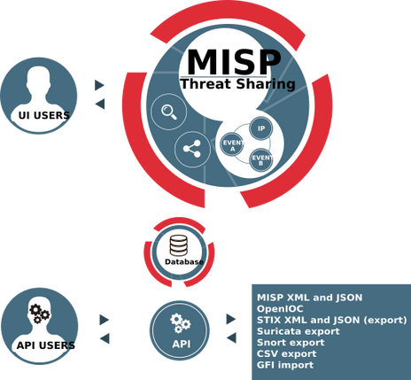
MISP (Malware information sharing platform)
open-source threat intelligence platform
to facilitate the sharing of structured threat information between organizations and communities.
security threats, including indicators of compromise (IOCs), malware samples, attack patterns, and other relevant data
Main features include:
  Information sharing
  Structured data model - STIX and OpenIOC
  Correlation and analysis
  Integration and automation
  Community collaboration
Exhaustive list => https://www.misp-project.org/feeds

Slide 29
Malware challenge – 1
ENTROPIA AT ITS FINEST
Hint
  Use RADARE2 and look at the entropy of the file
  Look into the section which has the highest entropy to find the flag

Slide 30

Find out more
https://gamess.dk/

Slide 31










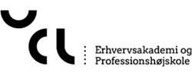

Who is behind
Partners behind the project
Collaborators
Supported by

Slide 32


Who is behind

