Slide 1


Educational Material in cyber security
Memory Safety and Code Verification in Rust

Slide 2

Who is the material for?
Students and professionals interested in methods and tools for eradicating memory safety issues.
Managers, software developers, and security professionals interested in evaluating whether they should use Rust in future projects.
Students and professionals interested in methods and tools for obtaining functional correctness guarantees on top of memory safety.
This material is primarily about defensive security, that is, how to guarantee that certain bugs cannot happen
Notes:
NB: It is possible to use only parts of the provided material for different groups. In particular, the first modules should be broadly accessible, whereas the later modules require some programming (ideally Rust) background.

Slide 3


Who Made this material?
Christoph Matheja
Technical University of Denmark
chmat@dtu.dk
www.cmath.eu
Supplementary material that will be provided alongside these slides:
Source code for examples, exercises, and challenges
Video lecture covering the slides and live coding for some examples

Slide 4

What are the main takeaways for this content?
There is no security without safety.
Rust‘s ownership and borrowing system statically guarantee safety by ensuring that references are either mutable or shared; for exceptions, a synchronization mechanism must enforce safety.
Flows provide a useful mental model for understanding how the Rust compiler checks memory safety and, in particular, lifetimes.
Program verification tools, such as Prusti, can provide stronger functional correctness guarantees but require additional annotations.
trade-off: writing more annotations ➔ more compile-time guarantees

Slide 5
Introduction
Why should I follow this course?

Slide 6

There is no security without safety
credits: Matt Miller, Microsoft Security Response Center
Memory safety is the absence of errors related to memory accesses.

Slide 7
The RusT Programming Language
Rust is a modern language aiming at safe systems programming
“The most beloved programming language since 2016”
“Rust is the industry’s best change at safe systems programming”
– Ryan Levic, Microsoft
credits: Stackoverflow

Slide 8

Characteristic Features of Rust
Memory safety
ownership & borrowing
Performance
memory control, zero-cost abstractions
Ergonomics
trait system
Build environment cargo, good error reporting

Slide 9
Our Focus
Reasoning about the safety features of Rust code
  mental models for memory safety
  functional correctness guarantees
This will help you to write safer and more secure code
  even if you never use Rust
But: this is not a Rust programming course
  Rust Book
  Rust by Example

Slide 10
Agenda
High-level overview
Memory basics
Ownership
Borrowing
The flow model
Prusti: guarantees beyond memory safety

Slide 11
1. High-level Overview
A non-technical metaphor illustrating how Rust ensures Memory Safety

Slide 12

Metaphor: ISSUES WITH Video Conferences
Problem: many participants in a video conference talk at once
➔ Data race: multiple agents access the same resource concurrently
How can we rule out such situations?

Slide 13
Metaphor: ISSUES WITH Video Conferences
Solution 1: one exclusive speaker

Slide 14

Metaphor: ISSUES WITH Video Conferences
Solution 2: everyone is muted and only listens

Slide 15
Metaphor: ISSUES WITH Video Conferences
Solution 3: a moderator assigns speaking rights

Slide 16
Metaphor: ISSUES WITH Video Conferences
Requirements for data races
aliasing
mutation
lack of synchronization
in video conferences
many agents use the same channel
and all can speak
and there is no moderator
Solution: prevent that all three requirements hold at the same time

Slide 17
How Rust Prevents Memory Safety Issues
Requirements for data races
aliasing
mutation
lack of synchronization
Data races and many memory safety issues can only arise if these three conditions are met
Rust’s high-level approach to safety guarantees
Enforce that there is either aliasing or mutation
Require synchronization for exceptions

Slide 18
2. Memory Basics
What we need to talk about Ownership, Borrowing, and Lifetimes in Rust
Notes:
We first briefly discuss some memory basics and how these lead to safety issues in C.
This is primarily to motivate Rust’s ownership and borrowing system and the issues it prevents.

Slide 19
Terminology
Value: a type and an element of that type
Place: a location holding the address of a value
Variable: a “named slot” for a value
Pointer: a value holding the address of a place
Reference: a pointer with a specific contract
  here: mutable &mut T and read-only &T
5:u8, 17:i32, 1.4:f64, “hej”:&str
:&str
‘h’
‘e’
‘j’

Slide 20
Identify all values, pointers, and variables
let a = 42;
let b = 43;
let c = &a:
let mut d = &a;
d = &y;
let e = “hello world”;
Notes:
- 5 values: 42:i32, 43:i32, &x, &y, “hello world”: &str
- 3 pointer values
- 5 variables: a, b, c, d, e
The places of these values are not all the same, so we need to have a look at memory layout

Slide 21
Memory Layout
stack
disposal when running out of scope
function frames
heap
dynamic data structures
disposal left to programmers
string literals, static variables
static data
disposal when execution ends
executable (read only)

Slide 22
Where are the places of the following values?
let a = 42;
let b = 43;
let c = &a:
let mut d = &a;
d = &y;
let e = “hello world”;
let tuple = (17, 3.14);
let b = Box::new(tuple);
let v = vec![1,2,3];
Notes:
The string “hello world” is a literal and thus located in the static data
Box::new creates a new heap-based value
vec! is a macro for creating a new vector, i.e. a dynamic data structure.

Slide 23
Where are the places of the following values?
let a = 42;
let b = 43;
let c = &a:
let mut d = &a;
d = &y;
let e = “hello world”;
let tuple = (17, 3.14);
let b = Box::new(tuple);
let v = vec![1,2,3];
Notes:
Colors indicate where the places of assigned values are located.

Slide 24
Stack frames
fn foo(x: &i32) -> i32 {
let a = 100;
a + *x
}
fn main() {
let _a: i32;
let b = -3;
let c = 1234;
// let c = _a;
let _d = foo(&c);
let _p = &b;
}
return address
main()
_a | ??:i32
b | -3:i32
c | 1234:i32
x | :&i32
_d |1334:&i32
foo(&c)
return address
Accessing uninitialized places is forbidden
_p | :&i32
a |100 :i32
Stack-discipline: automatically drop a frame when it runs out of scope

Slide 25
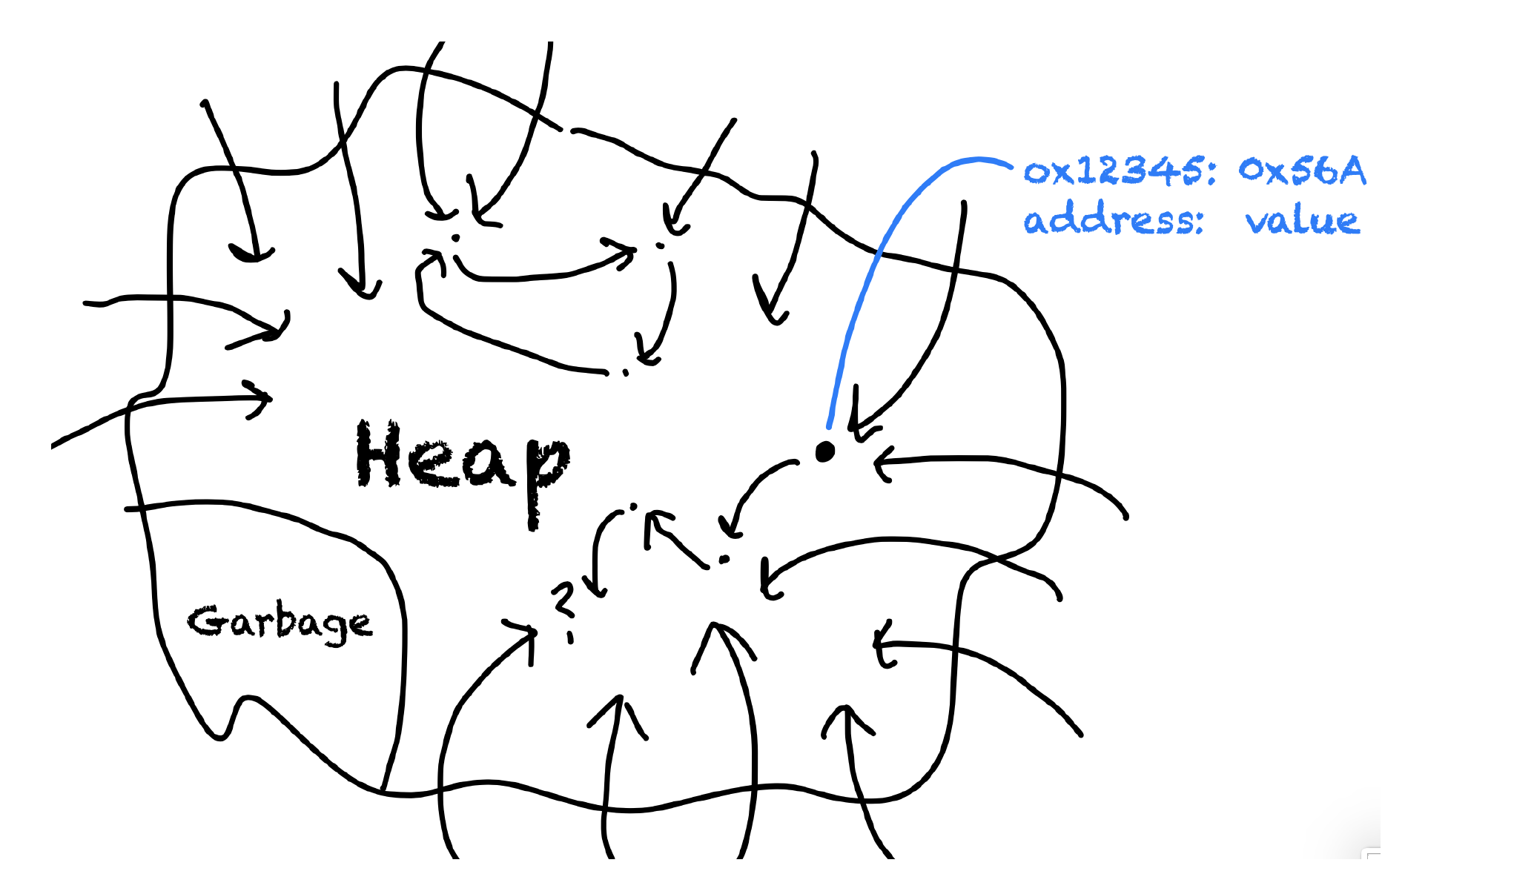
Heap
Disposal of heap-allocated values is left to the programmer
Memory error: an attempt to access a place with an illegal value
  uninitialized value
  dangling pointers to deleted values
  corrupted value (due to concurrency)

Slide 26
What could possibly go wrong?
Potential memory safety issues
x might point to an uninitialized value
bar might access the value of x
void foo(Struct* x, Struct* y)
{
bar(x);
free(x);
bar(y);
}
C
Notes:
We use the C programming language here to illustrate memory safety issues, which are ruled out by Rust.

Slide 27
What ELSE could possibly go wrong?
Potential memory safety issues
bar might access the value of x
x and y might be aliases, i.e. point to the same value
bar(y) attempts to access the value of y, which has previously been deleted via free(x)
➔ use-after-free bug
void foo(Struct* x, Struct* y)
{
bar(x);
free(x);
bar(y);
}
C
Notes:
We use the C programming language here to illustrate memory safety issues, which are ruled out by Rust.

Slide 28
What ELSE could possibly go wrong? II
Potential memory safety issues
bar might delete the value of x
free(x) will attempt to delete the value of x again
➔ double-free bug
void foo(Struct* x, Struct* y)
{
bar(x);
free(x);
bar(y);
}
C
Notes:
We use the C programming language here to illustrate memory safety issues, which are ruled out by Rust.

Slide 29
What ELSE could possibly go wrong? III
Potential memory safety issues
If x and y point do different values and bar does not delete anything, then the value of y might never be deleted
➔ memory leak
void foo(Struct* x, Struct* y)
{
bar(x);
free(x);
bar(y);
}
C
Notes:
We use the C programming language here to illustrate memory safety issues, which are ruled out by Rust.

Slide 30
Main reasons for memory safety issues in C
Manual disposal of heap locations
Mutable aliasing
➔ What are better memory disposal strategies?
void foo(Struct* x, Struct* y)
{
assert(x == y);
free(x);
Struct z = *y
}
C

Slide 31



Disposal strategies for Heap Memory
Metaphor: how to keep the office tidy?
Manual disposal
Garbage Collector
Ownership System
examples: C, C++
very efficient
no safety guarantees
➔ “control first”
examples: Java, C#
ensures safety at runtime
expensive
➔ “safety first”
examples: Rust
safety at compile time
efficient
➔ both: “clean desk policy”
Notes:
Everyone can do whatever he or she wants ➔ chaos ensues unless everyone is very disciplined (e.g. using the RAII idiom in C++).
Hire a janitor (garbage collector) ➔ works, but costs additional resources
Clean-desk policy (no one can leave before their desk has been cleaned up) ➔ enforces discipline
Rust’s disposal strategy through “ownership” can be thought of as an instance of the third approach.

Slide 32
3. Ownership
How Rust achieves Memory Safety (for code without Pointers)

Slide 33
Ownership rules – Part 1
For every value there is a unique place, called its owner
A value is disposed (or “dropped”) when its owner leaves scope
Variables own their values
Notes:
Remember the “clean desk policy”: Before you leave, throw away your trash…

Slide 34
Example
stack
heap
buffer
*
1
capacity
16
1
fn main() {
let mut v = vec![1,1,1];
for i in 3..10 {
let next = v[i-3] + v[i-2];
v.push(next);
}
println!(“P(1..10) = {:?}”, v);
}
length
3
1
10
allocate new vector with owner v
2
2
3
manipulate vector
4
5
7
v runs out of scope ➔ drop vector
9

Slide 35
Ownership rules – Part 2
For every value there is a unique place, called its owner
A value is disposed (or “dropped”) when its owner leaves scope
Variables own their values
Composite types (structs, tuples, vectors, ...) own their elements

Slide 36
Example
stack
heap
point
*
3.14
17
label
*
‘(‘
...
fn main() {
let point = Box::new( (3.14, 17) );
let label = format!(“{:?}”, point);
assert_eq!(label, “(3.14, 17)”);
}
// label and point are out of scope
// drop owned string and tuple
// drop 3.14:f32, 17:i32
// and characters of string
‘3’
allocate tuple with owner point
‘.’
‘1’
allocate string with owner label
‘4’
‘,’
‘1’
drop label, point, and their owned values
‘7’
‘)‘

Slide 37
Example
stack
heap
buffer
*
1
capacity
16
1
fn main() {
let mut v = vec![1,1,1];
for i in 3..10 {
let next = v[i-3] + v[i-2];
v.push(next);
}
println!(“P(1..10) = {:?}”, v);
}
length
3
1
10
allocate new vector with owner v
2
2
3
manipulate vector
4
5
7
v runs out of scope ➔ drop vector
9

Slide 38
Limitations
Memory consists of ownership trees with variables at the root
All values are dropped when leaving a function’s scope
➔ Move ownership to a new owner
struct Person { name: String, age: i32 }
let mut p = Vec::new();
p.push(Person{ name: “Eva”, age: 42});
p.push(Person{ name: “Adam”, age: 23});
// ...
p
*
8
3
42
*
8
4
23
Eva
Adam

Slide 39
Ownership rules – Part 3
For every value there is a unique place, called its owner
A value is disposed (or “dropped”) when its owner leaves scope
Variables own their values
Composite types (structs, tuples, vectors, ...) own their elements
Ownership can be moved to a new owner
  the old owner becomes an uninitialized place
  accessing the old owner is forbidden until it is initialized again

Slide 40
Example
Operations that move
assignments
passing values to a function
returning values from a function
fn main() {
let mut x = Box::new(17);
let mut y = x;
// fails: let z = x
*y = 42;
assert!(*y == 42);
}
x
*
17
let x = Box::new(17)
x
mvd
foo(Person { age: 32, ... })
y
17
*
fn bar(n: String) -> Person {
Person { age: 32, name: n }
}
x
mvd
y
42
*
x
mvd
y
drp

Slide 41
Mental Models for understanding Ownership
Low-level model: “what’s actually happening”
  Variables are places that hold possibly illegal bytes
  Ownership rules guide how long a variable is accessible
High-level model: “how we can reason about ownership”
  A variables exists as long as there is a capability flow to it
  and parallel flows do not conflict each other

Slide 42
Capability Flows
Idea: annotate programs with flows for each owner
  Taking ownership of a place starts a new flow (color indicates the owner)
  Moving a place stops the flow
  Accessing a place adds a flow from the last access to the current access
  mutable flow for values that can be modified (keyword “mut”)
  immutable flow for values that cannot be modified

Slide 43
Example
fn main() {
let mut x = Box::new(17);
let mut y = x;
let z = x;
*y = 42;
assert!(*y == 42);
}
There are two (mutable) flows

Slide 44

Rust’s flow-sensitive Analysis for Ownership
Checking ownership: check that all flows are compatible
  No access after move: no flow from an end-of-flow marker to a place
  Parallel flows for the same place (same color) must be immutable

Slide 45
Example
fn main() {
let mut x = Box::new(17);
let mut y = x;
let z = x;
*y = 42;
assert!(*y == 42);
}
incompatible flow
➔ access after move

Slide 46
Are all flows compatible?
let x = vec![1, 2, 3];
if y > 0 {
f(x); // x is moved to f
} else {
println!(“blabla”);
}
f(x); // x is moved to f

Slide 47
Are all flows compatible? No!
let x = vec![1, 2, 3];
if y > 0 {
f(x); // x is moved to f
} else {
println!(“blabla”);
}
f(x); // x is moved to f
If a place has been moved in one branch of a control flow statement and has not definitely been given a new value, it is uninitialized after the statement.
incompatible flow
➔ access after move

Slide 48
Are all flows compatible?
let mut x = vec![1, 2, 3];
while y > 0 {
foo(x); // x is moved to foo
y = y – 1;
}

Slide 49
Are all flows compatible? No!
let mut x = vec![1, 2, 3];
while y > 0 {
foo(x); // x is moved to foo
y = y – 1;
}
flow across loop iterations!
incompatible flow
➔ access after move

Slide 50
Are all flows compatible?
let mut x = vec![1, 2, 3];
while y > 0 {
foo(x); // x is moved to foo
y = y – 1;
x = bar() // move to x
}

Slide 51

Are all flows compatible? Yes!
let mut x = vec![1, 2, 3];
while y > 0 {
foo(x); // x is moved to foo
y = y – 1;
x = bar() // move to x
}
OK: x is re-initialized in the loop ➔ new flow

Slide 52
In what lines can we detect incompatible flows?
fn notify(v: Vec<Person>)
-> Vec<Person> {
for i in &v { println!(“{}”, i); }
v
}
fn P() -> mut Vec<Person> { vec![
Person { name: “Adam”, age: 27 },
Person { name: “Eva”, age: 42 },
Person { name: “Chris”, age: 32 },
]}
1 fn main() {
2 let mut ids = P();
3 ids.push(Person { ... });
4 notify(ids);
5 }
6 fn main() {
7 let mut ids = P();
8 ids = notify(ids);
9 ids.push(Person { ... });
10 }
11 fn main() {
12 let mut ids = P();
13 notify(ids);
14 notify(ids);
15 }
16 fn main() {
17 let mut ids = P();
18 let x = ids[0];
ids = notify(ids);
let y = x;
21 }

Slide 53
In what lines can we detect incompatible flows?
fn notify(v: Vec<Person>)
-> Vec<Person> {
for i in &v { println!(“{}”, i); }
v
}
fn P() -> mut Vec<Person> { vec![
Person { name: “Adam”, age: 27 },
Person { name: “Eva”, age: 42 },
Person { name: “Chris”, age: 32 },
]}
1 fn main() {
2 let mut ids = P();
3 ids.push(Person { ... });
4 notify(ids);
5 }
6 fn main() {
7 let mut ids = P();
8 ids = notify(ids);
9 ids.push(Person { ... });
10 }
11 fn main() {
12 let mut ids = P();
13 notify(ids);
14 notify(ids);
15 }
16 fn main() {
17 let mut ids = P();
18 let x = ids[0];
ids = notify(ids);
let y = x;
21 }

Slide 54
Moves and Data Structures
16 fn main() {
17 let mut ids = P();
18 let x = ids[0];
ids = notify(ids);
let y = x;
21 }
p
problem: vector id represents a contiguous area of memory
moved
42
*
8
4
23
Eva
Adam
One cannot move values out of data structures that do not permit holes in their representation, e.g. vectors or arrays

Slide 55
Moving in and out of Vectors
Approach 1: Only move the last value and resize the vector
Approach 2: Swap a value with the last value before move
Approach 3: Swap in another value for the one we take out
Approach 4: Create a new copy of an element instead of moving it
let x = ids.pop().expect(“vector empty”);
let x = ids.swap_remove(0);
let x = std::mem::replace(&mut ids[0], Person { ... });
let x = ids[0].clone();

Slide 56
Exception: Copy Types
Main advantage of ownership: safe & efficient disposal of resources
No advantage for simple types that only manage their own bits
  ➔ These types are always copied bitwise instead of moved
Custom copy types may only consist of other copy types
f32, f64, char, bool, usized, u8, i8, i32, ...
let mut ids = vec![1,2,3];
let x = ids[0]; // x is a copy of ids[0]
notify(ids); // nothing has been moved out of ids
#[derive(Copy, Clone)]
struct Point { name: i32, age: i32 }

Slide 57
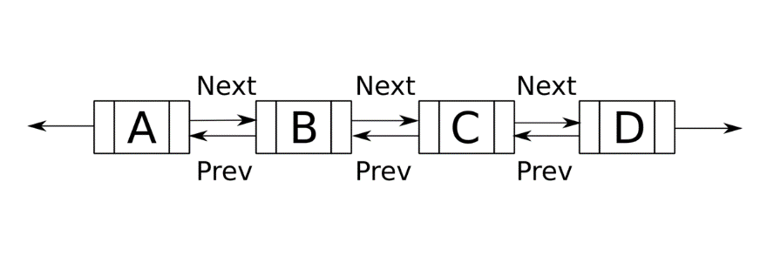
Exception: Reference Counting
Ownership enforces tree data structures
➔ It may be unclear who should own a resource
Escape hatch: reference-counted pointers (Rc)
  Clone only increments reference count
  Resources are dropped once count falls to zero
  Safety: Rc pointers can only be immutable
Who should own A,B,C,D?
a
b
c
let a = Rc::new(“hej”.to_string());
let b = a.clone();
let c = a.clone();
3
*
hej

Slide 58
4. References
How Rust checks memory Safety for code with Pointers

Slide 59
What could possibly go wrong?
use std:collections::HashMap;
// table of authors and their books
type Table = HashMap<String, Vec<String>>;
fn print(table: Table) {
for (author, books) in table {
println!(“works by {}”, author);
for book in books {
println!(“ {}”, book);
}
}
}
We move a table into print(…) but never give it back
➔ printing a table also destroys it!

Slide 60
Why borrowing?
Pointer: value holding the address of a place
fn average_age(a: Person, b: Person)
-> (Person, Person, f32)
{
(a, b, (a.age + b.age) / 2)
}
// so far: owning pointers
let x = Box::new(Person {...});
// drop x => drop person on the heap
let alice = Person { ..., age: 42 };
let bob = Person {..., age: 23 };
let (alice, bob, avg) =
average_age(alice, bob);
let (alice, ???, avg) =
average_age(alice, alice)
unergonomic solution: move values back to their original owner
error: can move only once!

Slide 61
references (or borrows)
References: pointers with a specific contract that temporarily borrow ownership.
Shared references &T
Create as many as you want
Read-only
Copy type
On creation: stop mutable flow
➔ owner cannot modify its value
All dropped: mutable flow returns to owner
Compiler may assume that the pointed to value does not change until the reference is dropped
Mutable references &mut
Create one with exclusive access for each place
Read and write
not a copy type
On creation: stop all flows from borrowed place
➔ owner cannot access its value
All dropped: flow returns to owner
Compiler may assume exclusive access to the immediate location pointed to (accessible via *)

Slide 62
Printing a table without destroying it
use std:collections::HashMap;
// table of authors and their books
type Table = HashMap<String, Vec<String>>;
fn print(table: &Table) {
// implicitly dereferenced to *table
for (author, books) in table {
println!(“works by {}”, author);
for book in books { // implicitly uses &Table
println!(“ {}”, book);
}
}
}
use shared reference
ownership returns to callee
print(&table);
table.insert(“Nichols”.to_string(),
vec![“Rust Book”.to_string()]);

Slide 63
What could possibly go Wrong?
fn caching(input: &i32, sum: &mut i32) {
// *input is the value input points to
*sum = *input + *input;
// can this fail?
assert_eq!(*sum, 2 * (*input));
}
The assertion never fails. The compiler is in its rights to read the value behind a shared reference only once.
In particular, we know that input and sum point to different values!

Slide 64
Do these Programs behave the same?
fn fun(input: &i32, sum: &mut i32) {
if *input == 1 {
*sum = 2
}
if *input != 1 {
*sum = 1
}
}
fn fun(input: &i32, sum: &mut i32) {
if *input == 1 {
*sum = 2
} else {
*sum = 1
}
}
Yes, the compiler can exploit that sum and input do not alias
➔ modifying the value of sum does not affect the value of input

Slide 65
Which statements are legal?
let mut a = 42;
let b = 23;
let mut y = &a;
a = 19;
*x = 17;
*y = &b;
a = b;
let z = &mut y;
*z = &a;
**z = b;
Notes:
a = 19; // illegal: a is borrowed
*y = 17; // illegal: y is a mutable shared borrow
y = &b; // ok: y is mutable
a = b; // ok: a is not borrowed
let z = &mut y; // ok mutable borrow of shared b.
*z = &a; // ok
**z = b; // illegal: write through shared borrow

Slide 66
Which statements are legal?
let mut a = 42;
let b = 23;
let mut y = &a;
a = 19; //illegal: a is borrowed
*y = 17; //illegal: y is a mutable shared borrow
y = &b; //ok: y is mutable
a = b; //ok: a is not borrowed
let z = &mut y; //ok: mutable borrow of shared b.
*z = &a; //ok
**z = b; //illegal: write through shared borrow

Slide 67
Taking ownership vs. mutable references
Mutable references are not responsible for dropping resources
Otherwise, having a mutable reference is almost identical to owning a value
Exception: moving values behind mutable references
fn moves(x: &mut Box<i32>) {
let y = *x;
}
fn moves(x: &mut Box<i32>) {
let y = std::mem::take(x);
let mut z = Box::new(17);
std::mem::swap(x, &mut z);
}
Bad: when the flow returns to the owner, we might attempt to drop a value twice!
Ok: leave another value in place
Ok: swap mut. refs without owning them

Slide 68
5. The flow model for References
A mental model for Checking memory Safety Using borrows and lifetimes

Slide 69
How Rust validates References
Rust’s borrow checker ensures that references are safe
  No reference is used after it has been dropped
  Shared references are read-only
  Mutable references give exclusive access
Analysis matches our mental model of capability flows
  Check that the flow of every reference we access does not conflict with parallel flows
  Moves and borrows create new and may block other flows
  Flow of reference ends: unblock flow of borrowed-from place
Rust assigns a name to flows and calls them lifetimes
Lifetime constraint: a variable’s lifetime must contain the lifetime of its borrows.

Slide 70
Example I
Lifetime constraint: a variable’s lifetime must contain the lifetime of its borrows.
let r;
{
let x = 1;
r = &x;
}
assert_eq!(*r, 1);
lifetime ‘x
lifetime ‘r
conflicting flows ➔ reject

Slide 71
Example II
Lifetime constraint: a variable’s lifetime must contain the lifetime of its borrows.
let r;
{
let x = 1;
r = &x;
assert_eq!(*r, 1);
}
lifetime ‘x
flow blocked
lifetime ‘r
flow unblocked
no conflicting flows ➔ accept

Slide 72
Example III
Lifetime constraint: a variable’s lifetime must contain the lifetime of its borrows.
let mut x = Box::new(42);
let r = &x;
if rand() > 0.5 {
*x = 84;
} else {
println!(“{}”, r);
}
println!(“{}”, x);
lifetime ‘a
r is not needed in this branch
➔ expire and unblock x
lifetime ‘a
r is needed in this branch
➔ x still blocked
no conflicting flows ➔ accept
even though lifetime appears to have “holes”

Slide 73
Example IV
Lifetime constraint: a variable’s lifetime must contain the lifetime of its borrows.
let mut x = Box::new(42);
let r = &x;
if rand() > 0.5 {
*x = 84;
} else {
println!(“{}”, r);
}
println!(“{}”, r);
What happens if we replace x by r in the last line?
lifetime ‘a
conflicting flows ➔ reject
Notes:
What happens if we replace x by r in the last print? We get a conflicting flow!

Slide 74
Example V
Lifetime constraint: a variable’s lifetime must contain the lifetime of its borrows.
let mut x = Box::new(42);
let mut z = &x;
for i in 0..100 {
println!(“{}”, z);
x = Box::new(i);
z = &x;
}
println!(“{}”, z);
lifetime ‘z
lifetime ‘z
no conflicting flows ➔ accept
Notes:
this might look strange when you think of lifetimes as scopes but it makes sense with flow model: when x is moved, z stops existing

Slide 75
Lifetimes In custom types
struct S {
r: &i32
}
// ...
let s;
{
let x = 10;
s = S { r : &x };
}
// bad: reads from dropped x
assert_eq!(*s.r, 10);
error: missing lifetime specifier
|
| r: &i32
| ^ expected lifetime parameter
How does the borrow checker validate the lifetimes of references inside of structs?
➔ lifetime annotations
‘x ‘a
’a must not outlive ’x
conflicting flow!
struct S {
r: &’static i32
}
struct S<’a> {
r: &’a i32
}
r can only refer to values that live until program termination
each instance of S gets a new lifetime constrained by usage
Notes:
this is bad: we attempt to read from a reference to x which is been dropped
‘static does not mean in static memory

Slide 76
Explicit Lifetime parameters
Explicit lifetime parameters reveal whether there are non-static references and how their lifetimes are related
struct S<’a> {
r: &’a i32
}
struct D {
s: S<‘static>
}
struct S<’a> {
r: &’a i32
}
struct D<’a> {
s: S<‘a>
}
read <‘a> as
for any lifetime ‘a
Restrictive:
D can only borrow values that live for the entire program
Permissive:
D can borrow any values, including those in local scope

Slide 77
Lifetimes of functions
fn g<’a>(p: &’a i32) { ... }
let x = 10;
g(&x) // ok: x flows into the call
fn g(p: &’static i32) { ... }
let x = 10;
g(&x) // fail: &x does not
// live until termination
read as: any lifetime that contains g works for ’a
read as: parameter must live until termination
result must live at least as long as input
fn parse<’a>(input: &’a [u8]) -> Record<’a> { ... }
Rust can often infer lifetimes for functions automatically
“whatever (non-static) references the returned record contains, they must point into the input buffer”

Slide 78
Example
result must live at least as long as values
fn min<’a>(values: &’a [i32]) -> &’a i32 {
let mut s = &v[0];
for r in &v[1..] {
if *r < *s {
s = r;
}
}
s
}
add flow from values to result
let s;
{
let values = [7, 4, 1, 0, 1, 4, 7];
s = min(&values)
}
assert_eq!(*s, 0);
error: `values` does not live long enough
conflicting flow from values to s

Slide 79
Example continued
result must live at least as long as values
fn min<’a>(values: &’a [i32]) -> &’a i32 {
let mut s = &v[0];
for r in &v[1..] {
if *r < *s {
s = r;
}
}
s
}
add flow from values to result
let s;
{
let values = [7, 4, 1, 0, 1, 4, 7];
s = min(&values);
assert_eq!(*s, 0);
}
error: `values` does not live long enough
no conflicting flows

Slide 80
Multiple Lifetime Parameters
One lifetime is sufficient unless a method returns a subset of a type’s references
struct StrSplit<’s, ’p> {
delimiter: &’p str,
document: &’s str,
}
impl<’s, ’p> Iterator for StrSplit<’s, ’p> {
type Item = &’s str;
fn next(&self) -> Option<Self::Item> { ... }
}
fn str_before(x: &str, c: char) -> Option<&str> {
StrSplit {
document: x, delimiter: &c.to_string()
}.next()
}
we get a reference into the original document
for ’s = ’p, result
would be constrained by the document and a local variable
➔ not possible

Slide 81
Checking lifetime parameters
Lifetimes parameters are types that interact with the borrow checker
A type’s variance describes which types can be used in its place
  Covariance
  Invariance
  Contravariance
’static subtype of ’a
read: outlives

Slide 82
Covariant Lifetimes
’static subtype of ’a
read: outlives
Allow subtypes instead of the actual type
T subtype S implies C<T> subtype C<S>
&’a T is covariant in ’a and T
fn foo(x: &Vec<&’a str>) { ... }
let y: &Vec<&’static str> = ...;
foo(y) // ok

Slide 83
Invariant lifetimes
’static subtype of ’a
read: outlives
Allow only the exact type
&mut T is invariant
fn foo(x: &Vec<&’a str>) { ... }
let y: &Vec<&’static str> = ...;
foo(y) // ok

Slide 84
Contravariant Lifetimes
’static subtype of ’a
read: outlives
Allow supertypes instead of the actual type
T subtype S implies Fn(S) subtype Fn(T)
Fn(T) is contravariant in T
// &’static str outlives &’a str
fn f(&’static str) // admits only ‘static
fn g(&’a str) // admits any lifetime ‘a

Slide 85
Lifetime Puzzle
Should the Rust compiler accept this?
Are both lifetime parameters needed?
struct MutString<‘a, ‘b> {
s: &’a mut &’b str
}
fn main() {
let mut s = “hello”;
*MutString { s: &mut s }.s = “world”;
println!(“{}”, s);
}
Notes:
Puzzle: the code no longer compiles if we only use one lifetime and its all because of variance
The strange syntax avoids a local variable x and then writing *x.s = “world”.

Slide 86
Puzzle Solution
struct MutString<‘a, ‘b> {
s: &’a mut &’b str
}
fn main() {
let mut s = “hello”;
*MutString { s: &mut s }.s = “world”;
println!(“{}”, s);
}
‘b ‘a
‘b = ‘static, lifetime of “hello”
‘a: lifetime of &mut s
covariance: ’static str shortened to ‘a str such that print can borrow from s
No conflicting flows ➔ accept
Notes:
Puzzle: the code no longer compiles if we only use one lifetime and its all because of variance
The strange syntax avoids a local variable x and then writing *x.s = “world”.

Slide 87
Puzzle Solution II
struct MutString<’a> {
s: &’a mut &’a str
}
fn main() {
let mut s = “hello”;
*MutString { s: &mut s }.s = “world”;
println!(“{}”, s);
}
‘a ‘a ‘a
’a = ‘static, lifetime of “hello”
’a: lifetime of &mut s
&’static mut str is invariant and cannot be shortened
conflicting flows: attempt to borrow while there is a mutable reference
➔ reject
One lifetime is insufficient
Notes:
Puzzle: the code no longer compiles if we only use one lifetime and its all because of variance
The strange syntax avoids a local variable x and then writing *x.s = “world”.

Slide 88
Exception: Interior Mutability
Some types allow sharing and mutation
Those types maintain the abstraction
  “exclusive read-write access XOR shared read-only access”
These types are safe but rely on external safety mechanisms (e.g. locks)
Two main kinds of interior mutability
  Mutex, RefCell: get a mutable reference through a shared reference
  Cell, sync::Atomic: replace an immutable value

Slide 89
Example: Mutex
fn critical(mutex: &Mutex<Data>) {
// get mutable reference
// block read access from others
let mut data = mutex.lock();
data.payload = 23;
// drop data => drop exclusive access
// => release lock
}

Slide 90
Example: Cell
struct Robot { count: Cell<u32>, ... }
impl Robot {
fn add_error(&self) {
let n = count.get();
self.count.set(n+1); // why ok?
}
fn has_errors(&self) -> bool {
self.count.get() > 0
}
}
Notes:
Cell is quite interesting in the way it guarantees safety:
It is not shareable across threads and never hands out a reference to the value it contains.
Since there are no references, it is always okay to move that value.

Slide 91
Wrap-UP: Rust’s Memory Safety Guarantees
Rust enforces aliasing XOR mutation
and requires synchronization for exceptions
Components
  Ownership system: for every value a unique owner is in charge of disposal
  Borrow checker: references are only used when they are valid
  Reference contracts: exclusive write-access XOR shared read-only access

Slide 92
6. Prusti
Obtaining guarantees beyond memory safety

Slide 93
What could possibly Go Wrong?
Task: write a Rust program that returns the absolute value of an integer (type: i32) x
fn abs(x:i32) -> i32 {
if x >= 0 {
x
} else {
-x
}
}
i32: 32-bit integers in two’s complement!
i32::MIN is -2_147_483_648i32
i32::MAX is 2_147_483_647i32
abs(i32::MIN) == ???
This is a safe Rust program
But: it’s also logically wrong!
➔ Rust does not guarantee functional correctness

Slide 94
Beyond Memory Safety
Rust comes with compile-time safety guarantees
  no uninitialized values, no dangling pointers, no data races
  no double-free, null pointer, or use-after-free bugs
  prevents many (but not all) memory leaks
Memory safety is enforced by checking privileges and obligations
  Ownership, borrowing, lifetimes
  The Rust compiler requires annotations to check safety
➔ Can we trade writing more annotations for stronger correctness guarantees
to also avoid logical security flaws?

Slide 95
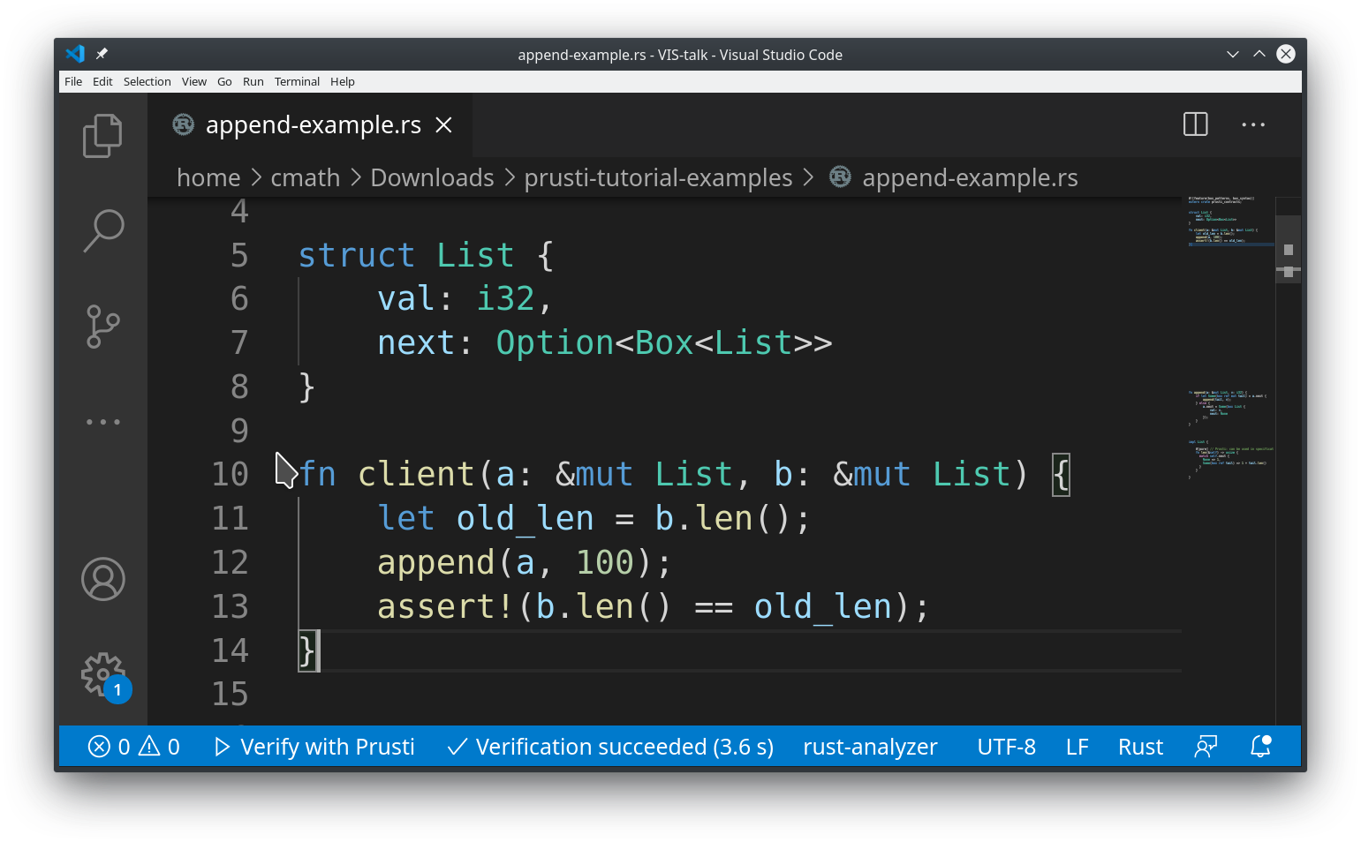
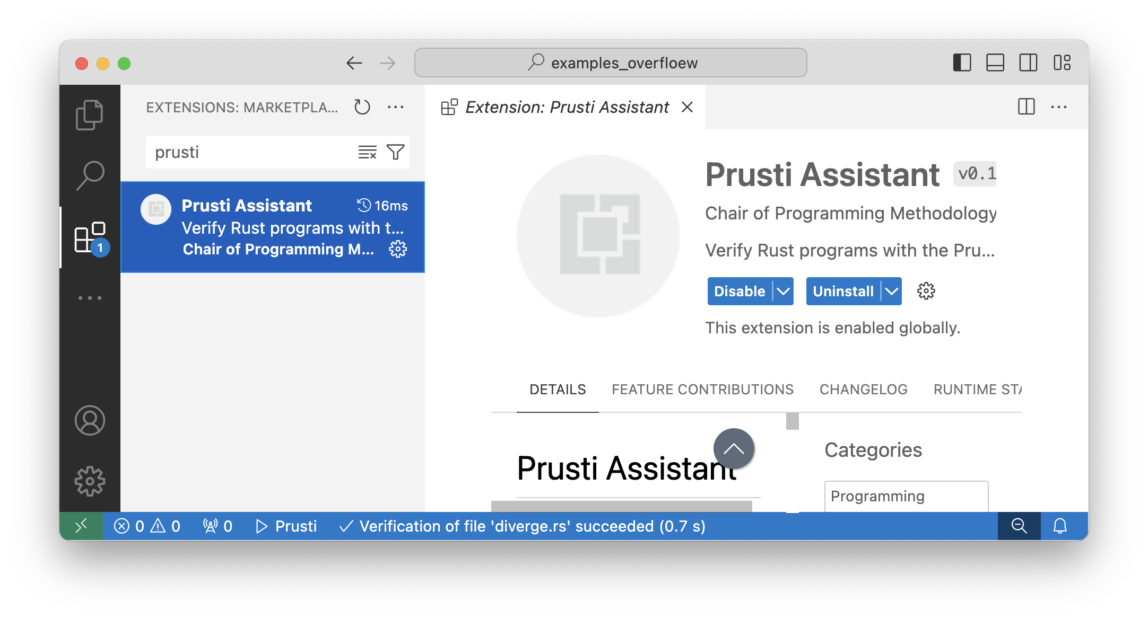
The Prusti Verifier
Tool for checking functional correctness of Rust functions
Implemented as a compiler plugin
Checks may require contract annotations written in a subset of Rust
Open-source VSCode plugin
  Can be installed via marketplace
  Search for “Prusti Assistant”
  Needs Java runtime
Notes:
The following slides are a placeholder to highlight Prusti’s main features.
For teaching, using the VSCode plugin of Prusti and demonstrating the mentioned features via live coding is strongly recommended.

Slide 96
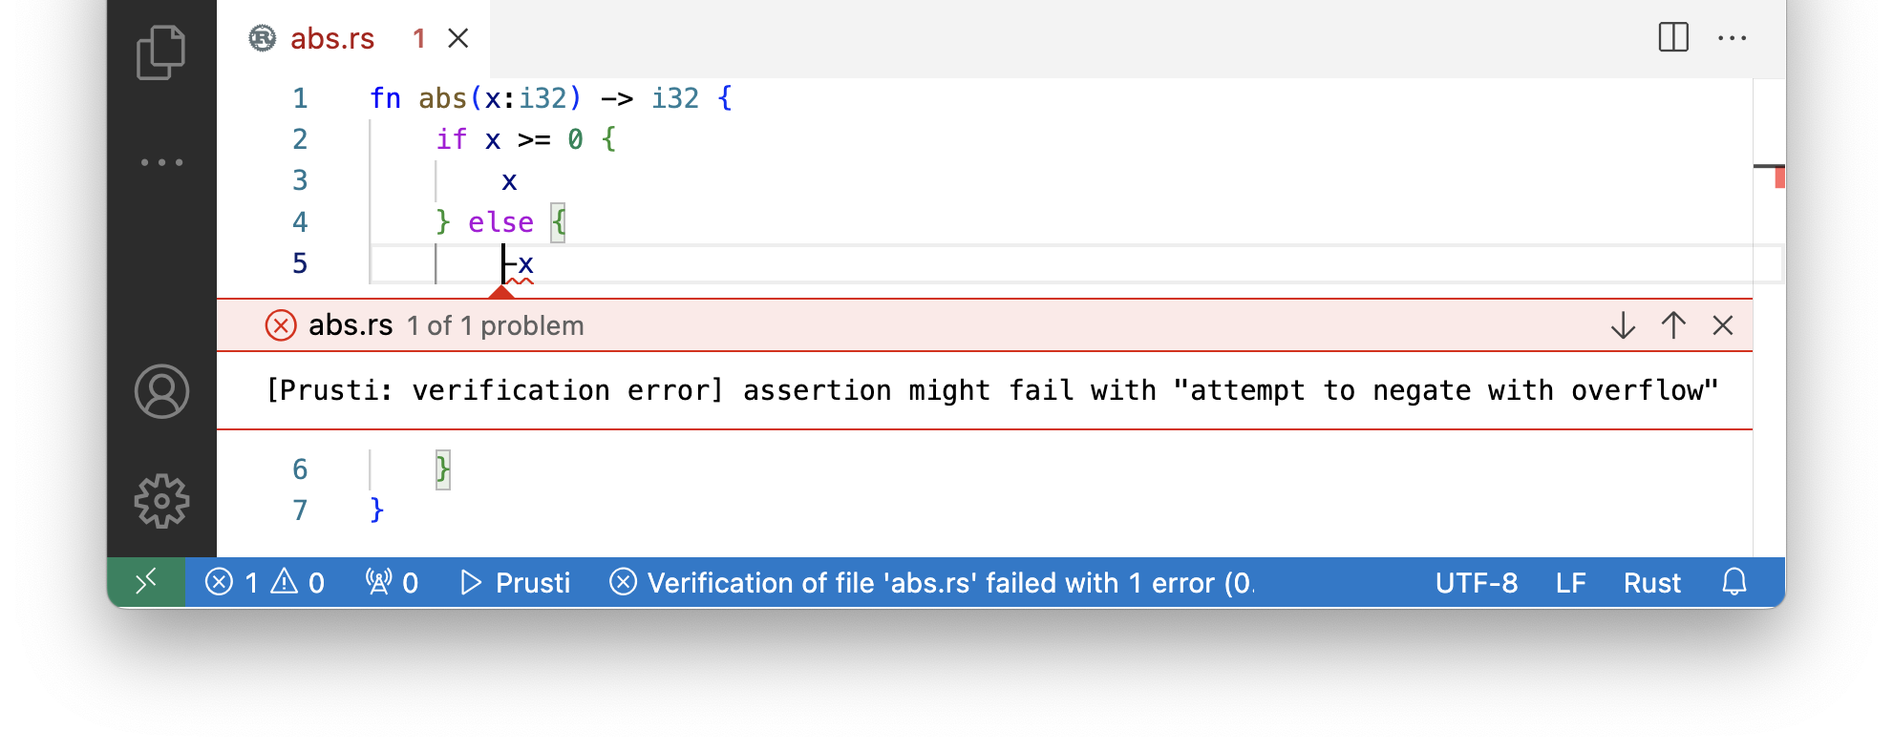
Absolute Value Revisited

Slide 97
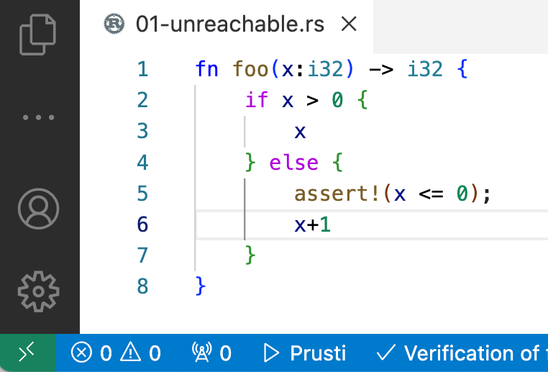
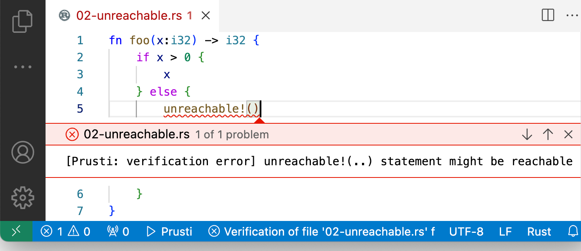
Assertions
Prusti checks that no Rust assertion fails
Conservative approach: compilation fails if correctness cannot be proven
➔ Requires annotations about inputs and outputs of functions

Slide 98
Contracts
Constrain inputs and results of functions
  requires keyword constrains inputs
  ensures keyword constrains outputs
  Constraints must be side-effect-free, terminating Rust expressions
Function implementors
  Privilege: assume inputs comply with contract
  Obligation: results must comply with contract
Function clients
  Privilege: assume results comply with contract
  Obligation: inputs must comply with contract
Precondition:
all 32-bit integers but the smallest one are ok
#[requires(x != i32::MIN)]
#[ensures(result >= 0)
#[ensures(result*result == x * x)]
fn abs(x:i32) -> i32
Postcondition:
the function’s result will be the absolute value of x

Slide 99
Meaning of Contracts
Precondition (before call):
all 32-bit integers but the smallest one are ok
Postcondition (after call):
the function’s result will be the absolute value of x
#[requires(x != i32::MIN)]
#[ensures(result >= 0)
#[ensures(result*result == x * x)]
fn abs(x:i32) -> i32
Whenever we execute a function whose parameters satisfy the precondition and execution terminates, then no run-time error occurs (e.g. an assertion failure) during execution and the postcondition holds upon termination.

Slide 100
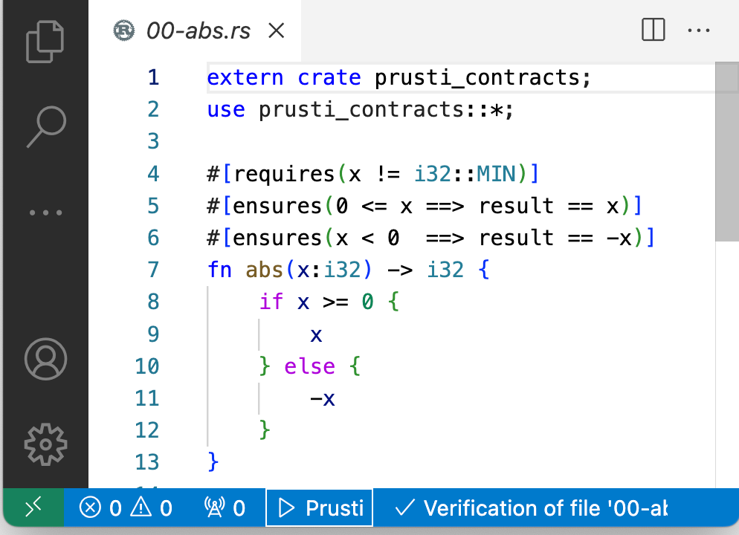
Absolute Value with Contract
Needed for using contract annotations
Precondition (“requires”):
assume x is not the smallest integer
Postcondition (“ensures”):
Prusti proves that the returned result is the absolute value of x
OK: precondition of abs allows this value

Slide 101
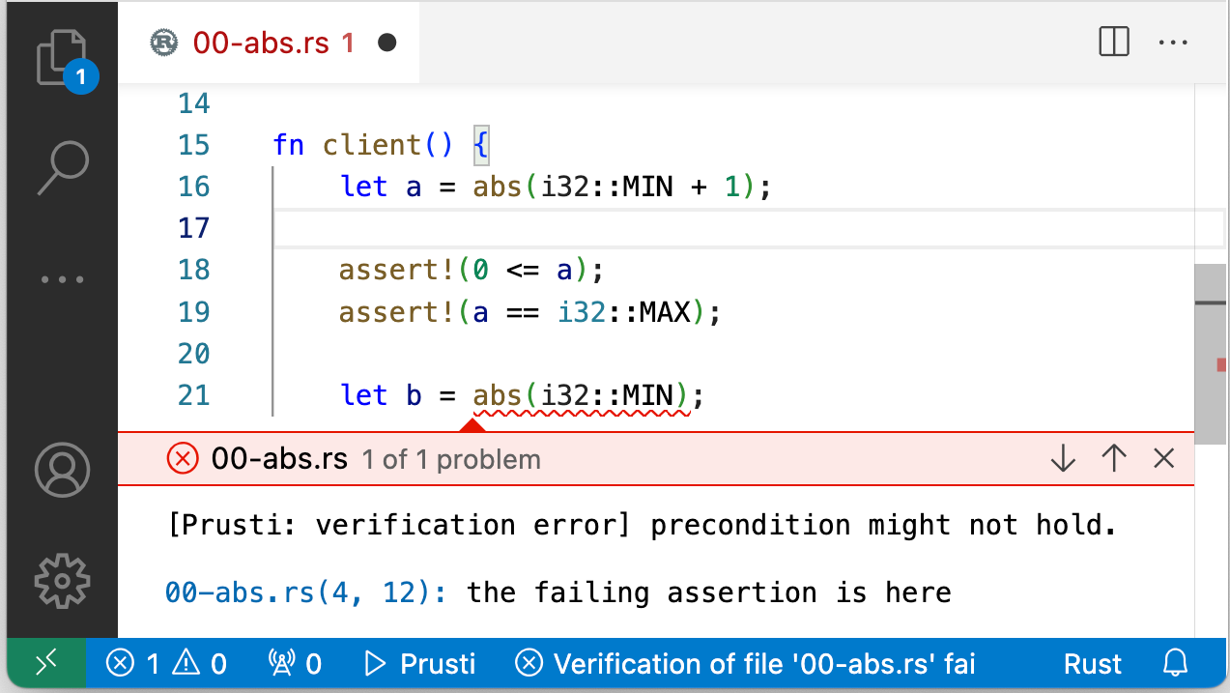
A Client of abs
OK: precondition of abs allows this value
assertions are known to hold due to postcondition of abs
ERROR: precondition of abs does not allow passing the smallest integer!

Slide 102
Modular Contract Verification
Prusti proves that every function meets its contract
  Default: pre- and postcondition are true
Modular verification
  To check calls, Prusti relies solely on the called function‘s contract
  Pros: Implementation changes ➔ clients do not have to be re-checked
  Cons: Possible false negatives if we do not write sufficiently strong contracts
#[requires(x != i32::MIN)]
#[ensures(result >= 0)
#[ensures(result*result == x * x)]
fn abs(x:i32) -> i32 {
x * sign(x)
}
#[requires(x != i32::MIN)]
#[ensures(result >= 0)
#[ensures(result*result == x * x)]
fn abs(x:i32) -> i32 {
if x >= 0 { x } else { -x }
}

Slide 103
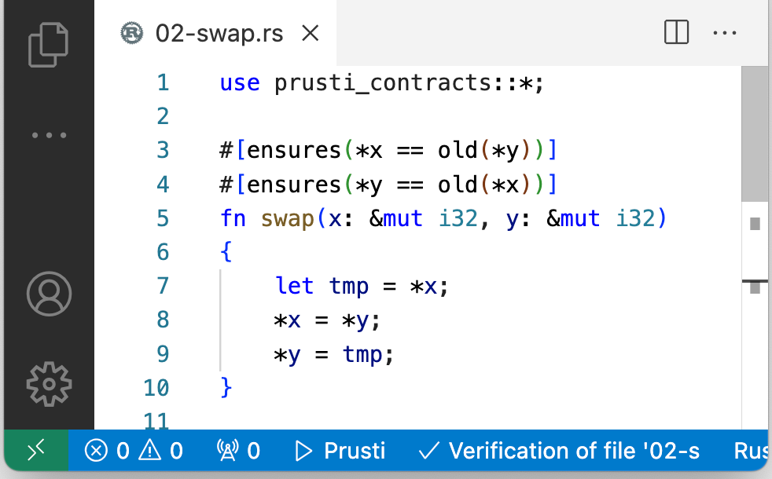
Example: Swap by reference
old(*y) refers to the value y points to before calling the swap function

Slide 104
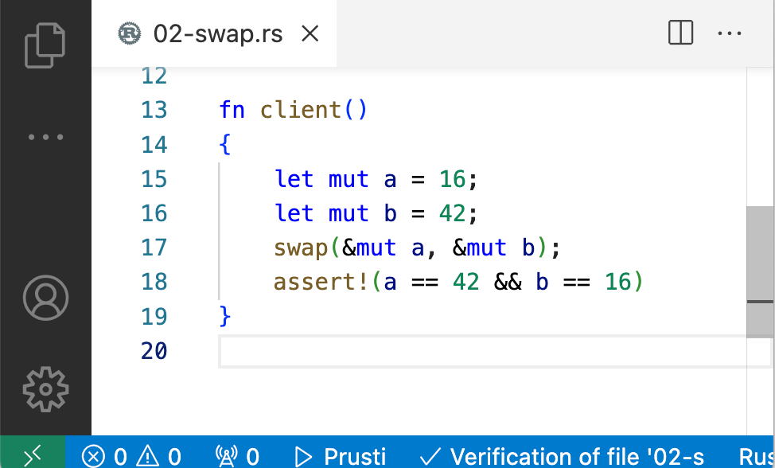
Example: Client of Swap

Slide 105
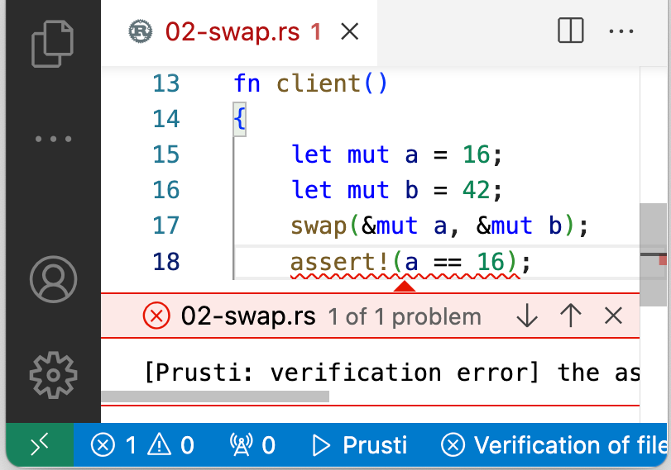
Example: Faulty Client of Swap

Slide 106
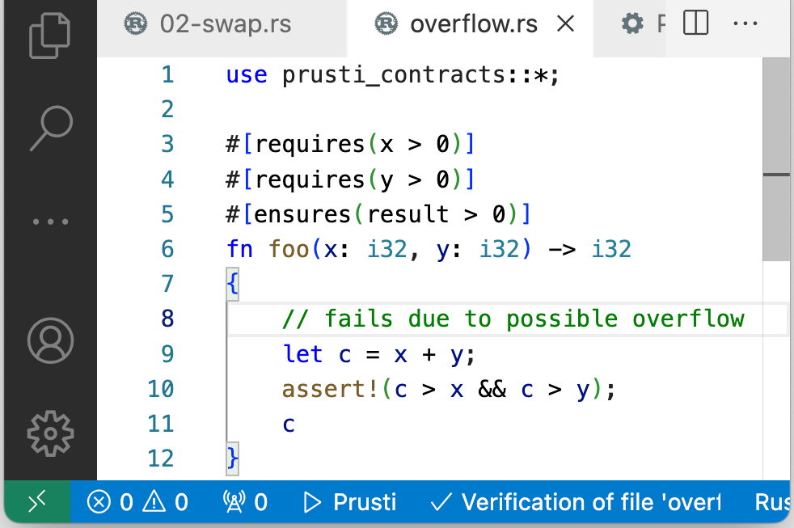
Ignoring Overflows
We sometimes do not care about overflows for a given contract
To disable overflow checks, add a file Prusti.toml with
check_overflows=false
From now on, we disable overflow checks to focus on other features

Slide 107
Pure Functions
Pre- and postcondition can contain arbitrary Rust code as long as it is pure
  i.e. specifications must have no side effects
Functions marked with the annotation #[pure]
  can be called in pre-and postconditions
  are checked to have no side effects
  are not modular, i.e. their implementation is inspected during contract verification
#[pure]
#[requires(x != i32::MIN)]
fn abs(x:i32) -> i32 {
if x >= 0 { x } else { -x }
}
#[requires(y != i32::MIN)]
#[requires(abs(y) > 5)]
fn client(y:i32) -> i32 {
y*y + 5
}
Notes:
The implementation of pure function is inspected because such functions are typcially simple and stable, think mathematical definitions, lengths of lists, getter functions, etc.
This is a design decision to avoid writing too many

Slide 108
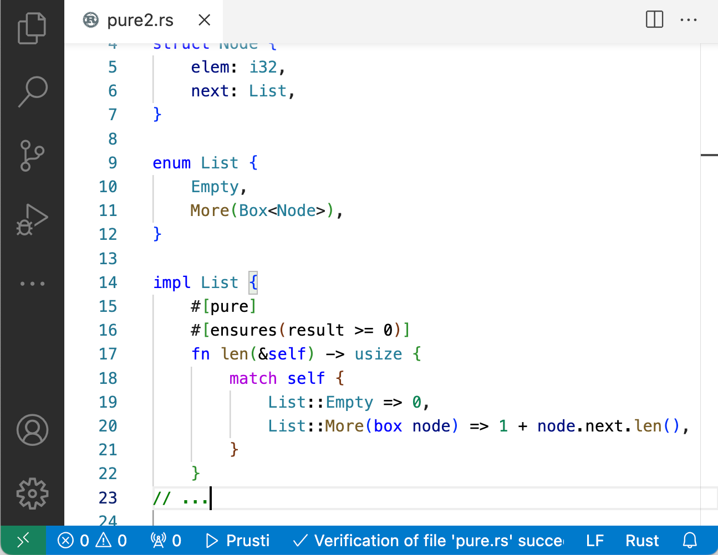
Example
pure function length allows referring to list length in specifications

Slide 109
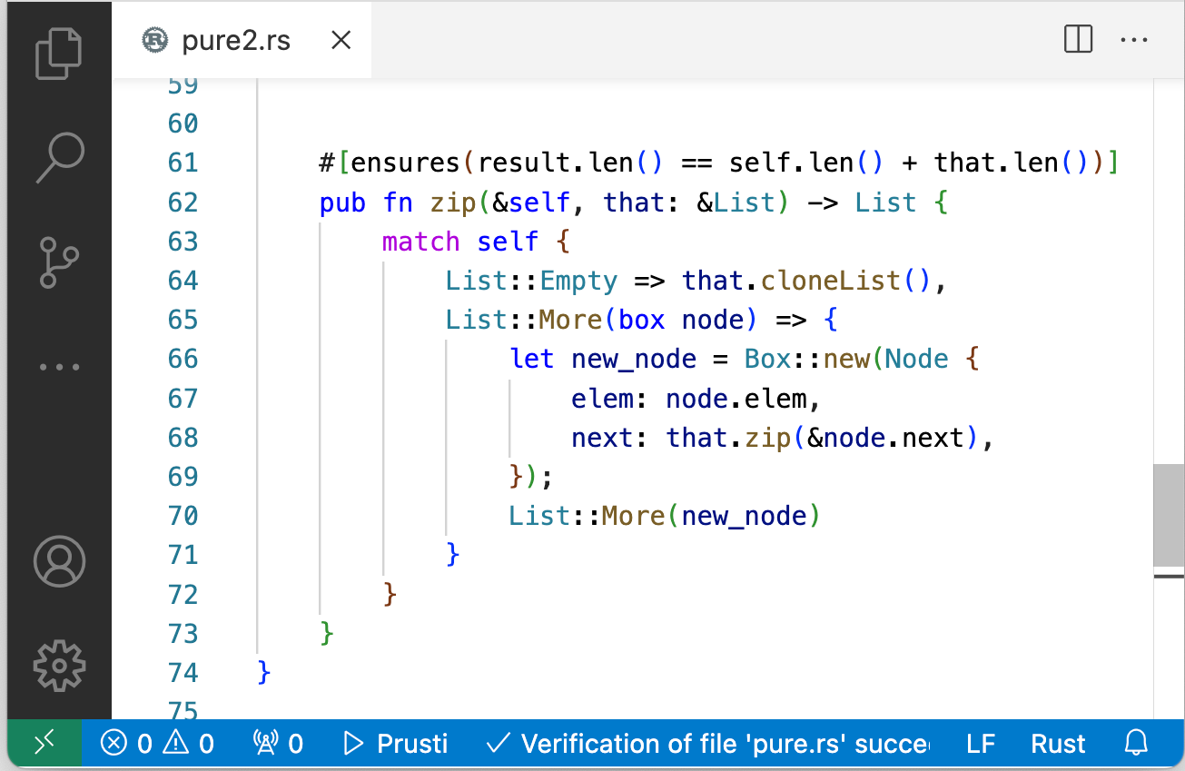
Example
Postcondition: zipping two lists into one yields a list whose length is equal to the sum of the two input lists

Slide 110
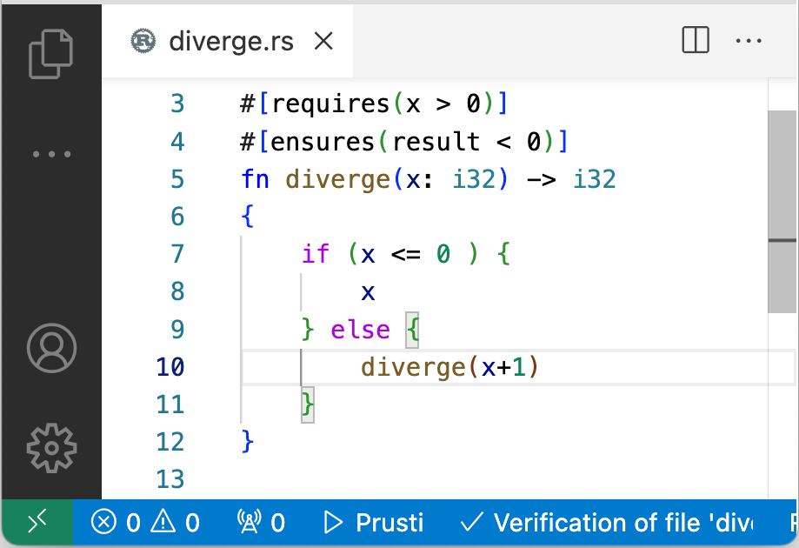
Termination
Prusti verifies contracts for partial correctness
➔ Non-terminating executions (via loops or recursion) are allowed
➔ Termination can be shown separately (e.g. with ranking functions)

Slide 111
Trusted Functions
Some code cannot be checked at compile time
Examples: unsupported features, foreign code, unsafe Rust, libraries
Pragmatic workaround: mark such functions as #[trusted]
  Prusti uses the contracts of #[trusted] functions
  Prusti does not check the implementation of #[trusted] functions
➔All results are only valid if trusted functions really adhere their contract
➔Put unverifiable code into trusted wrappers and check them by other means

Slide 112
Example
A wrapper for an unsafe function from the standard library
#[trusted]
#[requires(src.is_empty())]
#[ensures(dest.is_empty())]
#[ensures(old(dest.len()) == result.len())]
fn replace(dest: &mut Link, src: Link) -> Link {
// library function that cannot be verified
// because it needs unsafe Rust code
mem::replace(dest, src)
}

Slide 113
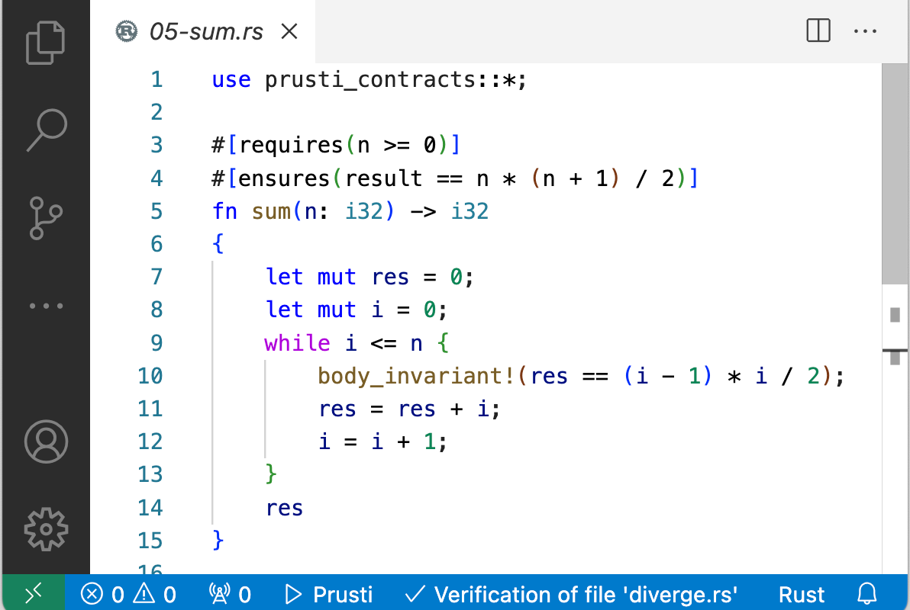
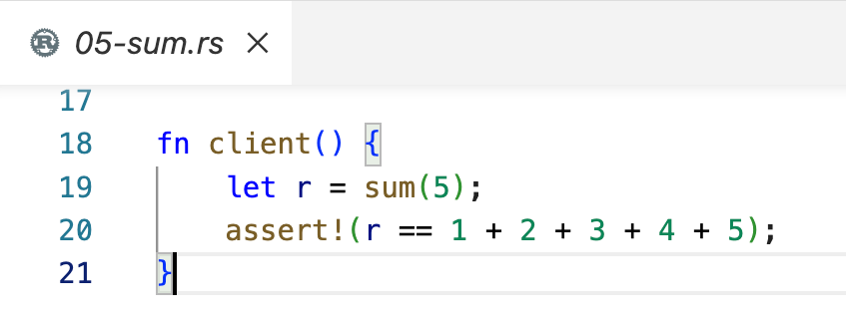
Loop Invariants
To verify loops, Prusti needs invariants
➔ Property that holds whenever reaches the annotation body_invariant!(…)

Slide 114
Summary: Prusti Specifications
Specifications: pure fragment of Rust’s Boolean expressions
#[requires(B)]: B must hold right before a function call
#[ensures(B)]: B must hold after a function call
  old(x) refers to the value of x at the beginning of a function
  result refers to a function’s returned value
#[pure] marks a function as usable in specifications
  Needs to be free of side effects
#[trusted] lets Prusti ignore checking a function’s implementation
In implementations: body_invariant!(B), assert!(B), unreachable!()
Notes:
Prusti actually supports a richer specification language including logical quantifiers.

Slide 115
Exercise
Consider the following Rust implementation of Bank accounts. Add annotations such that Prusti can prove that no money is illegally redirected from an account.
// # TODO
fn deposit(&mut self, amount: u32) {
self.bal = self.bal + amount;
}
// # TODO
fn withdraw(&mut self, amount: u32) {
self.bal = self.bal - amount;
}
// # TODO
fn transfer(&mut self,
other: &mut Account, amount: u32) {
self.withdraw(amount);
other.deposit(amount);
}
}
fn main() {}
use prusti_contracts::*;
struct Account {
bal: u32,
}
impl Account {
// # TODO
fn balance(&self) -> u32 {
self.bal
}

Slide 116
Solution
#[pure]
fn balance(&self) -> u32 {
self.bal
}
#[ensures(self.balance() == old(self.balance()) + amount)]
fn deposit(&mut self, amount: u32) {
self.bal = self.bal + amount;
}
#[requires(amount <= self.balance())]
#[ensures(self.balance() == old(self.balance()) - amount)]
fn withdraw(&mut self, amount: u32) {
self.bal = self.bal - amount;
}
#[requires(amount <= self.balance())]
#[ensures(self.balance() == old(self.balance()) - amount)]
#[ensures(other.balance() == old(other.balance()) + amount)]
fn transfer(&mut self, other: &mut Account, amount: u32) {
self.withdraw(amount);
other.deposit(amount);
}

Slide 117
Summary

Slide 118
What are the main takeaways for this content?
There is no security without safety.
Rust‘s ownership and borrowing system statically guarantee safety by ensuring that references are either mutable or shared; for exceptions, a synchronization mechanism must enforce safety.
Flows provide a useful mental model for understanding how the Rust compiler checks memory safety and, in particular, lifetimes.
Program verification tools, such as Prusti, can provide stronger functional correctness guarantees but require additional annotations.
trade-off: writing more annotations ➔ more compile-time guarantees

Slide 119
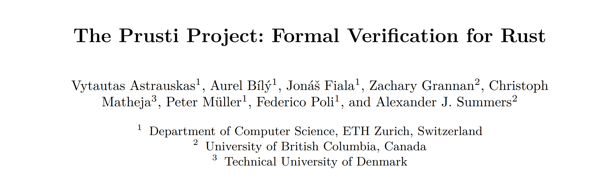
Further Reading
The Rust programming language
Gjengset, J. Rust for Rustaceans: Idiomatic Programming for Experienced Developers. No Starch Press, 2021.
www.prusti.org

Slide 120










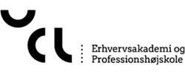

Who is behind
Partners behind the project
Collaborators
Supported by

Slide 121
Challenges

Slide 122
Challenges
Challenges will be similar to the examples and exercises on the slides:
Use the flow model to identify memory safety issues in Rust code.
  To capture the flag, one has to provide a unique solution consisting of a flow annotation for every line of source code and a judgment of whether there is a conflict.
  We will have three challenges of this form covering ownership, borrows, and lifetimes
Provide Prusti annotations at the marked places of a program to verify a functional correctness property, similar to the Bank account.
  We will have three challenges, including recursive and loopy code
Use Prusti to implement a proven-correct program
  We fix the function signatures and Prusti annotations and ask participants to write Rust implementations that satisfy the given contracts.
Notes:
It would also be interesting to

Slide 123
Comments on Challenges
  A fourth challenge would ask participants to write a proven-correct Rust code by themselves. While this would be the most challenging and arguably most intriguing task, we cannot guarantee that we can automatically provide a flag for all correct solutions.
  We thus opted to fix either the code or the annotations to simplify checking whether a solution is correct.

