Slide 2
In 2020, during the worst global pandemic in a century, nine nuclear-armed states spent $72.6 billion on their nuclear weapons, more than $137,000 per minute, an inflation adjusted increase of $1.4 billion from last year

Slide 3
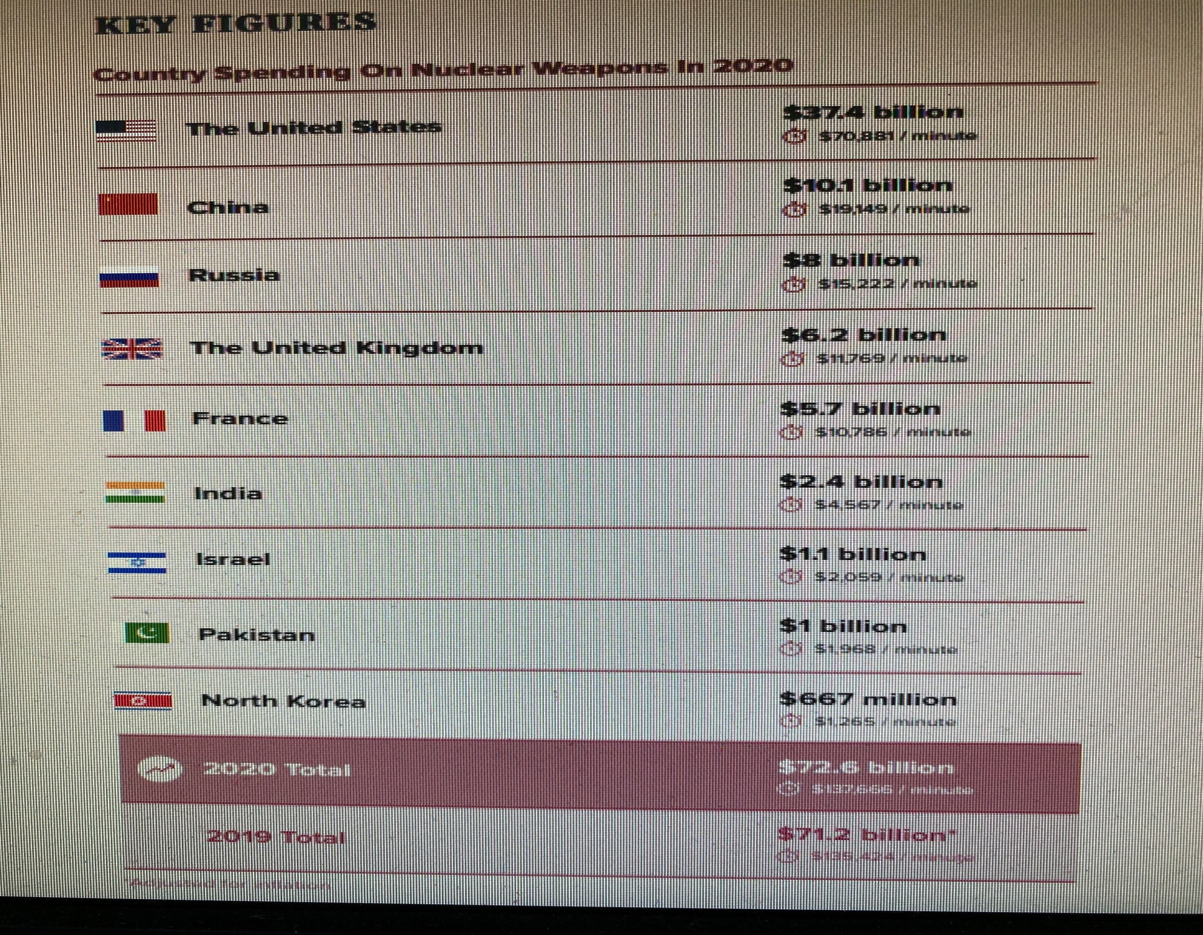

Slide 4
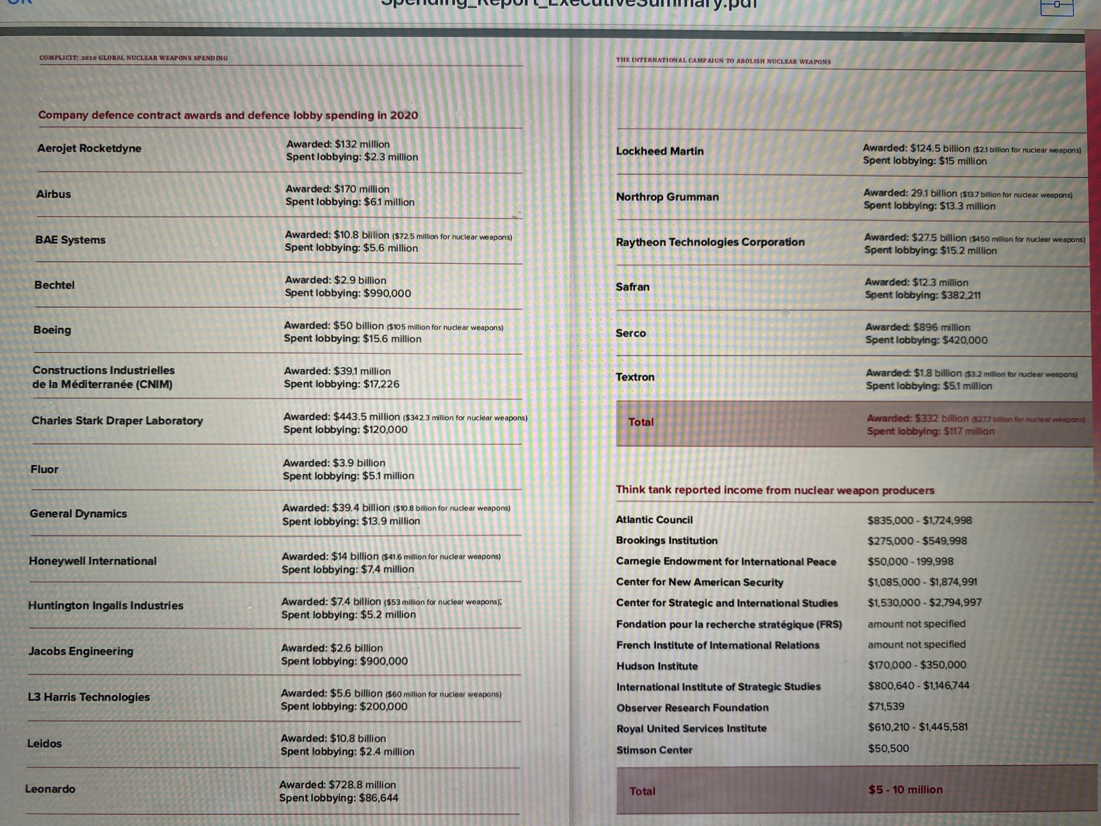

Slide 5
