Slide 1
II. A Cloud Thermostat Controls the Earth’s Climate, Not Greenhouse gasses! and I. Climate change is a myth!
John F. Clauser, retired experimental and theoretical physicist,
2022 Physics Nobel Laureate, Climate Change Denier
817 Hawthorne Drive Walnut Creek, CA 94596,
email: bobbi_john@jfcbat.com, website: johnclauser.com
Doctors for Disaster Preparedness
42nd Annual Meeting, El Paso, TX, July 6-7, 2024

Slide 2
Part I. Climate change is a myth
The IPCC and its collaborators have attempted to identify the dominant process or processes that control the Earth’s climate.
The IPCC and its collaborators have been tasked to use computer modeling and observational data to determine some very important parameters for the Earth’s climate, including
The Earth’s so-called power imbalance, thereby to prove global warming,
The Earth’s natural power-balance feedback-stability strength (sensitivity), thereby to claim a catastrophic imminent climate crisis,
The Earth’s albedo for the Earth’s clear-sky portion, cloudy-sky portion, and for the “all-sky” whole Earth.
The IPCC and its collaborators have grossly botched all of these efforts, and have dishonestly and intentionally erroneously claimed that there is a climate change crisis!
As a result, their whole argument leading to their claims of an impending climate catastrophe collapses. It is bogus!

Slide 3
The IPCC’s 1st sacred task – calculate and measure the Earth’s power imbalance p1.
The Earth’s net power imbalance is its incoming sunlight heating power (its power-IN), minus its two components of its outgoing cooling power - reflected sunlight and reradiated infrared radiant heat (its power-OUT).
More power flowing IN than power flowing OUT is the IPCC’s definition of global warming! A power-flow imbalance results in an energy buildup, that, in turn, causes a temperature rise, a. k. a. global warming.
The IPCC was tasked with calculating and measuring this power imbalance. I call this task “sacred”, because trillions of dollars ride on the accuracy of its measurement.
The IPCC claims with great certainty that the Earth has a proven net warming (positive) power imbalance. It claims that there is more sunlight power incident on the Earth heating it, than there is lost power cooling it.

Slide 4
The IPCC’s 1st sacred task – calculate and measure the Earth’s power imbalance p2.
Based on the IPCC’s claimed power imbalance and associated global-warming assertion, the IPCC and its collaborators assemble a house of cards argument that forebodes an impending climate change apocalypse/catastrophe.
However, one should claim confirmation of one’s modeling, only AFTER carefully looking at the experimental data, rather than BEFORE looking at the data.

Slide 5
The IPCC’s flawed house of cards
Global warming, IF PROVEN, in turn, leads to climate change.
Climate change, in turn, leads to an increased frequency of extreme weather events and other bad phenomena.
An increased frequency of extreme weather events leads to global apocalypse and to a climate crisis.
NOAA claims to have actually observed an increasing extreme weather event frequency
The IPCC’s claimed net warming power imbalance is further claimed to be caused by a buildup of atmospheric greenhouse gasses, especially of CO₂.
The IPCC demands trillions of dollars must be spent to limit, prevent, and reverse the atmospheric buildup of greenhouse gasses.

Slide 6
The IPCC’s house of cards collapses p.1
I assert that the IPCC and its contributors have not proven global warming!
All power-imbalance observational data are fully consistent with no warming
I assert that the IPCC’s further claims for an observation of a power imbalance are based on dishonestly fudged data.
The computer modeling uses seriously flawed physics and is incapable of simulating global warming.
NOAA further dishonestly claims that there is an observed increase in extreme weather events. NOAA’s claims are clearly bogus. I show here that their own published data disprove their own arguments.
Without global warming, there is no climate-change crisis!
The house of cards has collapsed.
The requested trillions of dollars are a total waste.

Slide 7
The IPCC’s computer modeling is seriously flawed
The computer modeling performed by the IPCC collaborator, the Goddard Institute for Space Studies, is totally incapable of simulating the past climate over several decades. It can’t simulate, even approximately, the Earth’s temperature history.
The computer modeling can’t get anywhere near close to simulating the Earth’s total albedo and the amount of reflected sunlight. The discrepancies with observed data (≈ 10-15 W/m²) are enomous!
The computer modeling ignores a whole factor of 2 discrepancy in the IPCC’s claimed observed cloudy-sky albedo. The IPCC is totally oblivious to this huge error (≈ 80 W/m²).

Slide 8
The CMIP5 computer modeling is unable to simulate the Earth’s surface temperature history over the past several decades.
The total disarray and total lack of reliability among the CMIP5 predictions was first highlighted by the former White House science advisor to Barack Obama Steve Koonin, in his recent (2021) book - Unsettled? What climate science tells us, what it doesn’t, and why it matters.

Slide 9
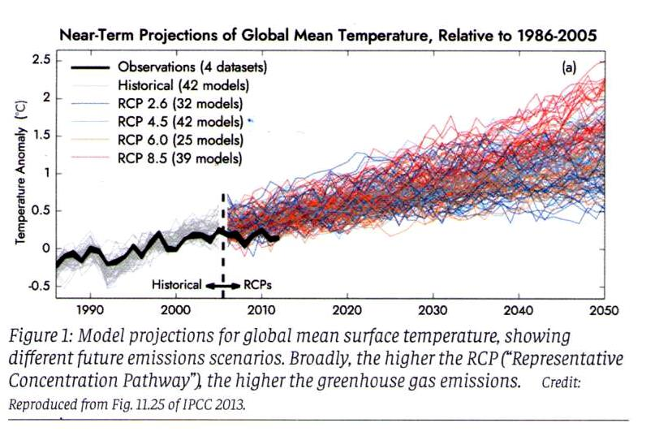
Flawed computer modeling estimates of the Earth’s temperature “anomaly” history
This graph is copied from [AR5, (IPCC, 2013) Fig 11.25].
This graph shows the CMIP5 computer modeling of the Earth’s temperature “anomaly”. The various computed curves display the Earth’s predicted (colored) and historical (gray) so-called “temperature anomaly”.
The solid black curve is the observed temperature anomaly.

Slide 10
Computer modeling estimates of the the Earth’s temperature “anomaly” history
IPCC reports, in general, hide errors in their actual values by instead showing only undefined “anomaly” values. No reference value is given to allow the reader to determine the actual temperature history. The missing reference value also prevents the reader from applying the Stephen-Boltzmann law to the results.
Note that not one of the 40+ models is capable of simulating the Earth’s past temperature anomaly history, let alone predict its future.
The major disagreement between theory and observation indicates that something is very wrong with the physics incorporated within the computer models. Their predictions are totally unreliable.

Slide 11
“Temperature anomaly” measurements are a very poor indicator of global warming → power imbalance is a better choice
Temperature measurements are mostly made over land. But land occupies only 30% of the Earth’s surface.
Temperature varies strongly from one spot to another (especially over land), and measurements are grossly under-sampled.
Land measurements are also subject to “urban heat island” effects.
A far better indicator of global warming is the Earth’s power imbalance.
The IPCC agrees! Instead, it defines global warming as a net power imbalance.
An important component of the power imbalance is the Earth’s albedo.

Slide 12
What is albedo?
Albedo is a fancy word for sunlight reflectivity fraction.
The Earth’s albedo is simply the fraction or ratio of reflected sunlight power (Shortwave Power-OUT) to incident sunlight power (Shortwave Power-IN).
The Earth’s Outgoing reflected power flows back out into space and does not heat the Earth. Increased albedo correspondingly equals increased cooling.
Measuring and/or calculating the Earth’s power imbalance, equivalently requires measuring and/or calculating the Earth’s albedo.
Correspondingly, any error made in calculating or measuring the albedo provides an associated error in in calculating or measuring the Earth’s power imbalance.

Slide 13
The CMIP5 computer modeling is pathetically incapable of simulating the Earth’s annually varying albedo
The CMIP5 computer modeling is also unable to simulate anywhere nearly correctly the Earth’s albedo (its sunlight reflectivity fraction).
The computer simulated sunlight reflected power and associated power imbalance error, are typically about fourteen times bigger than the claimed measured power imbalance, and about twenty five times bigger than the claimed measured power- imbalance error range.
Again, serious disagreement between theory and observation indicates that something is very wrong with the physics incorporated within the computer models.

Slide 14
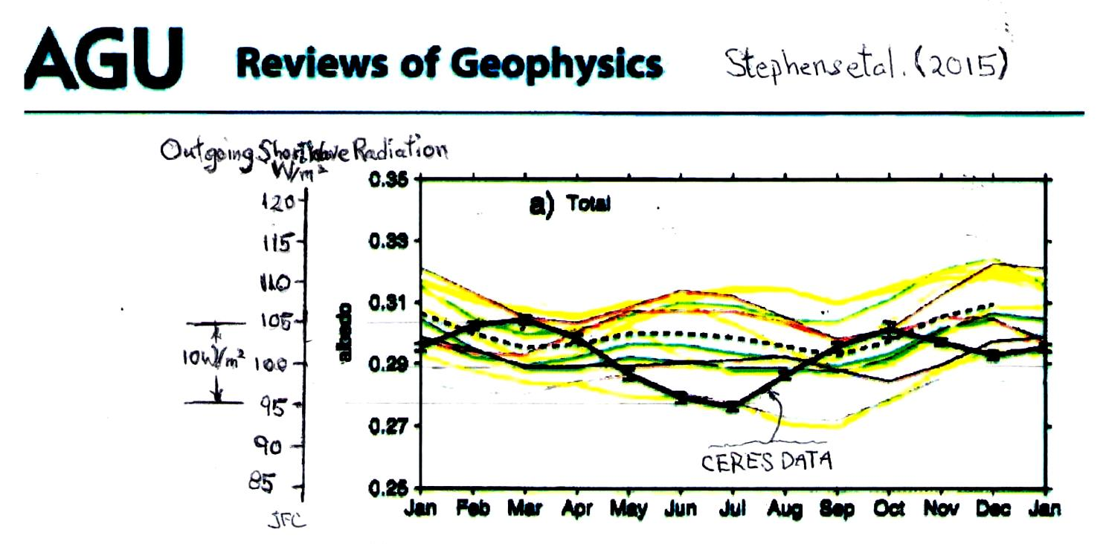
The IPCC’s flawed computer modeling estimates of the Earth’s albedo – p.1
Outgoing Shortwave Radiation (W/m²)
10 W/m²
albedo
CERES Data
The above Figure is reproduced from Stephens et al. (2015). It shows the IPCC’s CMIP5 computer modeling (the colored curves) of the Earth’s mean annual albedo temporal variation. The solid black curve is the Earth’s albedo measured by satellite radiometry.
Note that the annual variation is not sinusoidal.

Slide 15
The IPCC’s flawed computer modeling estimates of the Earth’s albedo – p.2
Outgoing Shortwave Radiation (W/m²)
10 W/m²
albedo
CERES Data
The added scale shows the associated reflected sunlight power. It assumes a constant solar irradiance – 340 W/m².
The IPCC claims that outgoing (reflected) power is about 100 W/m².
The so-called solar constant is not constant. (See below.)

Slide 16
Flawed computer modeling estimates of the Earth’s albedo – p.3
Outgoing Shortwave Radiation (W/m²)
10 W/m²
albedo
CERES Data
Note that the IPCC’s computer modeling is grossly incapable of simulating the observed Earth’s reflected power. It is especially incapable of simulating that power’s dramatic temporal fluctuation.
Typical simulation error is at least 10 – 15 W/m². Note that reflected (outgoing) power errors translate directly into power-imbalance errors.
The predicted oscillation phase is grossly in error.

Slide 17
Flawed computer modeling estimates of the Earth’s albedo – p.4
Outgoing Shortwave Radiation (W/m²)
10 W/m²
albedo
CERES Data
Despite more than 10-15 W/m² evident gross errors in the computer simulation’s calculated reflected power, the IPCC [AR6 (2021)] still claims that it has computer simulated and precisely measured this power, yielding an imbalance that is equal to 0.7 ± 0.2 W/m². – Huh?
Stephens et al. (2015) in this same article claim the “bad-penny” imbalance, 0.6 W/m². See below.
The IPCC’s AR6 (2021) does not show this Figure,

Slide 18
The so-called solar constant is not actually constant.
This Figure is also from Stephens et al. (2015). The solid curve on the bottom Figure (5d) shows the sinusoidal temporal variation of the (so-called) solar constant. Its variation is dominantly due to the ellipticity of the Earth’s orbit.
Correspondingly, the actual outgoing SW power’s non-sinusoidal annual variation (about 10 W/m²) is actually much greater than is shown by the previous Figure by about 22 W/m².
The total outgoing SW power correspondingly typically varies annually by about 32 W/m².

Slide 19
Measuring the power imbalance consists of measuring power-IN, measuring power-OUT, and subtracting. p.1
Recall, global warming is defined as more Power-IN than Power-OUT.
Power-IN is the sunlight power incident on the Earth. The IPCC and climate scientists call it Short Wavelength (SW) Radiation. It is about 340 Watts per square meter of the Earth’s surface area. It varies annually by about ± 11 W/m², (not including the additional variation of the solar constant.)
Power-OUT has two components:
One component is the sunlight energy that is directly reflected by the Earth back out into space. That component is claimed by the IPCC to be about 100 W/m².
The other component is the far-infrared heat re-radiated into space by a hot planet. It is claimed to be about 240 W/m². The IPCC calls the far-infrared heat radiation component, Long Wavelength (LW) Radiation.

Slide 20
Measuring the power imbalance consists of measuring power-IN, measuring power-OUT, and subtracting. p.2 Simple enough? Not really.
The problem is that power-IN and power-OUT are both huge numbers, and that the difference between them is miniscule – about 0.2% of power-IN.
That miniscule difference is the net imbalance that is sought, both experimentally and theoretically.
Unfortunately, the difference is so small that it is very difficult to measure accurately. Measurement errors of the large component powers readily swamp the resulting error of the very small difference power.
It is especially tough to measure the difference when power-IN and power-OUT are both also hugely varying, both in time and in space, in a seemingly random and irreproducible fashion.
Many, if not most observers admit that both satellite radiometry data and ocean heat content data measurement methods are incapable of determining the Earth’s power imbalance to the needed accuracy.

Slide 21
None of the reported data actually show a convincing net warming power imbalance.
A variety of methods has been employed to measure these three powers. They include satellite radiometry, (the ERBE, and CERES Terra and Aqua satellites), ocean heat content (OHC) measured using the ARGO buoy chain and XBT water sampling by ships, and finally by ground sunlight observations using the Baseline Surface Radiation Network (BSRN).
The various measured values are all in wild disagreement with each other.
Large data gaps are common, especially in the ERBE and OHC data.
Fabricating data to fill in the gaps is a scientific no-no. Nonetheless, it is commonly used in the data analysis.
Reported data are totally fudged in a manner that dishonestly changes them from showing no warming to showing warming!

Slide 22
What numbers are needed for the basic power-imbalance calculation?
Observed data are typically reported on a Figure that shows a map of the claimed power flow.
The power imbalance is conventionally reported at the Top Of Atmosphere (TOA) altitude.
The three needed numbers are readily available from the top line of a power-flow diagram.
If you don’t believe my claims of fudging, it’s easy enough to pull the numbers from the various power-flow diagrams, and verify the arithmetic yourself!

Slide 23
The power-imbalance arithmetic, itself, is quite simple.
A typical calculation proceeds as follows:
Incident ShortWave power +340 W/m² ± σ_{IN}
Outgoing ShortWave reflected power -100 W/m² ± σ_{SW-OUT}
Outgoing LongWave reemitted power -240 W/m² ± σ_{LW-OUT}
Sum=Net “observed” power imbalance IMBALANCE ± σ_{IMBALANCE}
RMS error-sum: σ_{IMBALANCE} = (σ_{IN}² + σ_{SW-OUT}² + σ_{LW-OUT}²)^{1/2}.
Important RMS error-sum crosscheck:
σ_{IMBALANCE} > σ_{IN}, σ_{IMBALANCE} > σ_{SW-OUT}, σ_{IMBALANCE} > σ_{LW-OUT}.
Is there global warming?
no global cooling if IMBALANCE ≤ σ_{IMBALANCE}
global warming if IMBALANCE > σ_{IMBALANCE}
Warning: Fudged arithmetic is highlighted in red on the slides.
Follow the proverbial recurring bad penny.)

Slide 24
The earliest data are reported by Stephen’s et al. (1981) and Ramanathan (1987) – p.1
Their results are based on only four partially analyzed months of observation by the ERBE satellite – (Apr. 1985, July 1985, Oct. 1985, Jan. 1986). (4 samples are woefully insufficient, given the non-sinusoidal albedo annual oscillation.)
Their resulting Top of Atmosphere net power imbalance results are as follows:
Stephens et al. Ramanathan (1981) (1987)
Incident ShortWave power (W/m²) +344 +343
Outgoing ShortWave power -103.2 -106
Outgoing LongWave power -234±7 -237
Net “observed” power imbalance +9 ± 10 0
jfc calculation +6.8 (warming) -3 (cooling)
Both Stephens et al. (1981) and Ramanathan (1987) data are fully consistent with zero net global warming and/or cooling.

Slide 25
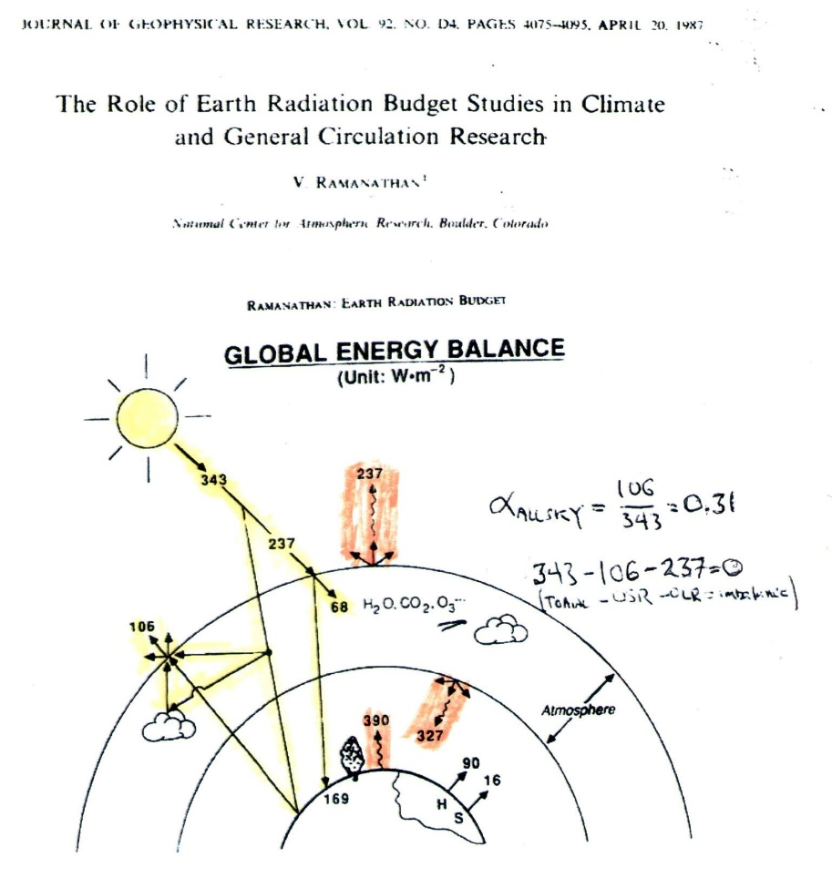
The earliest data are reported by Stephen’s et al. (1981) and Ramanathan (1987) – p.2
The 2003 US National Academy / National Research Council report “Understanding Climate Change Feedbacks (p.112)” cites the Ramanathan (1987) data analysis and comments that “The observations do not meet quality standards.”
Ramanathan (1987) was first to divide the whole sky into only two parts – clear-sky and cloudy-sky -for his analysis. His methodology is now universally used.

Slide 26
Loeb et al. (2009, 2012) use OHC data to “adjust” Ramanathan’s (1987) numbers, to show a net warming power imbalance – p.1
Loeb et al. (2012, p.111) admit upfront ”A limitation of the satellite data is their inability to provide an absolute measure of the net TOA radiation imbalance to the required accuracy level.”
Loeb et al. (2009, 2012) reanalyze and arbitrarily replace Ramanathan (1987)’s (extremely under-sampled) EREB satellite data with new values that now show a net global warming power imbalance.
They obtain their new preferred data values by switching modality from satellite-radiometry data to ocean heat content (OHC) data (also very sparsely sampled) from the ARGO buoy chain, and from XBT ship-based bathythermograph manually sampled water temperature data.
They base their action on a claimed increase in ocean heat content, as per speculation by Hansen et al, (2005, 2011).

Slide 27
Loeb et al. (2009, 2012) use OHC data to “adjust” Ramanathan’s (1987) numbers, to show a net warming power imbalance – p.2
Unfortunately, the ARGO and XBT data have a woefully sparse area sampling, and much worse accuracy than Loeb et al. claim. Lyman and Johnson (2008) fabricate data to fill in large OHC data gaps. (Data fabrication is one of our scientific little no-no’s.)
Their resulting Top of Atmosphere net power imbalance results:
EREB OHC OHC
satellite (2009) (2012)
Incident ShortWave power (W/m²) +340 +340
Outgoing ShortWave power -107 -99.5 various
Outgoing LongWave power -234.6 -239.6 ________
net power imbalance -1.6 + 0.9 +0.64 ± 0.11
(cooling) (warming) (warming)
THE BAD PENNY
Remember this proverbial BAD PENNY. It shows up again and again, and again.

Slide 28
Power imbalance analysis by Stephens et al. (2012) with grossly admittedly-fudged error estimates – p.1
Following Loeb et al., Stephens et al. (2012) also admit that satellite data are incapable of observing a net imbalance! The two groups join forces and switch to the use of Ocean Heat Content (OHC) data, as per the suggestion by Hansen et al, (2005, 2011).
Stephens et al. (2012) use OHC data and the Outgoing ShortWave power “adjustment” (fudge!) reported earlier by Loeb et al. (2009, 2012) to claim a net global-warming power imbalance (the BAD PENNY reappears!):
Incident ShortWave power (W/m²) +340.2 ± 0.1
Outgoing ShortWave power -100.0 ± 2.0
Outgoing LongWave power -239.7 ± 3.3
Net “claimed observed” power imbalance +0.6 ± 0.4 ← recurring BAD PENNY
(fudged warming)
Actual summation & assoc. RMS error (jfc) +0.5 ± 3.9 (no warming)

Slide 29
Power imbalance analysis by Stephens et al. (2012) with grossly admittedly-fudged error estimates – p.2
Stephens et al. (2012) and Loeb et al. (2012) admit to having “adjusted” the data.
Stephens et al.’s use of (visibly) incorrect arithmetic is another one of our scientific little no-no’s.
Stephen’s et al. do not mention how they calculate their (fudged) error bars.
Their error bars visibly fail the RMS error-sum crosscheck.
Loeb et al. (2012)’s BAD PENNY error limits are increased from ± 0.11 to ± 0.4, with no comment..

Slide 30
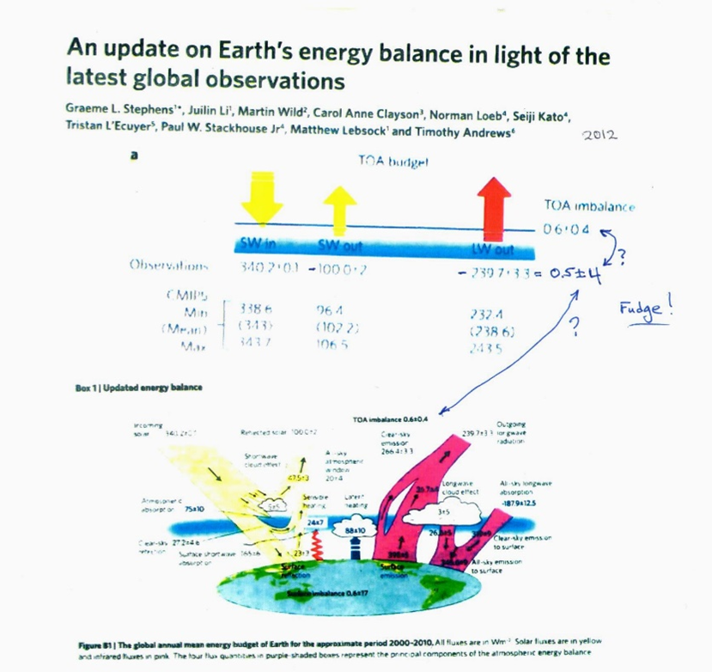
Stephens et al. (2012) power-flow diagrams show the fudged numbers
Figures 1 and B1 from Stephens et al. (2012), display bad arithmetic and compare it with the CMIP5 computer modeling.

Slide 31
L’Ecuyer et al. (2015) reanalyze the Ocean Heat Content (OHC) data and get different results and much larger error estimates than those reported earlier by Stephens et al. (2012)
Following the Stephens et al. (2012) estimate of the Earth’s power imbalance based on OHC data, L’Ecuyer et al. (2015) further revise Loeb et al.’s (2009, 2012) ocean heat content data analysis.
They correspondingly revise upwardly the (fudged) power imbalance error limits offered by Stephens et al. (2012). They do, however, provide their own “adjustments”, that they instead call constraints.
unconstrained constrained
Incident ShortWave power (W/m²) +340.0 ± 0.5 +340.2 ± 0.1
Outgoing ShortWave power -102 ± 4 -102 ± 4
Outgoing LongWave power -238 ± 3 -238 ± 2
Net “observed” power imbalance 0 ± 5.0 0 ± 3.5
(no warming) (no warming)

Slide 32
Power flow diagram from L’Ecuyer et al. (2015, Fig.1).
Numbers on the previous slide are extracted from the top line of this Figure.

Slide 33
Critiques by Trenberth et al. (2010, 2014) – p.1
Satellites measure the Top of Atmosphere energy balance, while Ocean Heat Content data apply to the surface energy balance. One may legitimately mix power-flux data at the two different altitudes, if and only if one fully understands all of the power-flow processes in the atmosphere that occur between the surface and the Top of Atmosphere.
If the latter requirement is not true, then one ends up with an “apples to oranges” comparison.
Trenberth et al. (2010, 2014) are highly critical of Loeb, Stephens, L’Ecuyer, and Hansen’s claimed “understanding” of the associated connection between the power flows at these two altitudes.
Trenberth and Fasullo (2010) point to a huge “missing energy” indicated by the difference between the satellite data and the OHC data power-imbalance calculations, and specifically ask “Where exactly does the energy go?”

Slide 34
Critiques by Trenberth et al. (2010, 2014) – p.2
Hansen et al. (2011) dismiss Trenberth and Fasullo’s alleged missing energy as being simply due to satellite calibration errors.
Trenberth, Fasullo and Balmesada (2014) further note that despite various considerations of the surface power balance, significant unresolved discrepancies remain, and they are skeptical of the power imbalance claims.
In effect, Trenberth et al. are the earliest “whistle blowers” to the above-mentioned data fudges.

Slide 35
Stephens and L’Ecuyer (2015) together offer a mea culpa admission to having made an “unjustified, ad hoc” choice between OHC data and CERES satellite data, and miraculously now claim simultaneously both zero and +0.6 +/- 0.4 W/m² power imbalance. – p.1
In response to repeated criticism by Trenberth et al. (2010, 2014), Stephens and L’Ecuyer (2015) together offer what amounts to a mea culpa article regarding the aforementioned data fudging.
They admit that “adjustments” do need to be made to obtain agreement (closure) between satellite data and ocean heat content data, and that these “adjustments” are very much larger (by about 10 W/m²) than their previously claimed power imbalance, +0.6 +/- 0.4 W/m².
Stephens and L’Ecuyer (2015) also admit that their choice of which data needs “adjustment” was made “in a totally ad hoc” fashion”, and that “there is no real evidence to support one adjustment approach over the other”

Slide 36
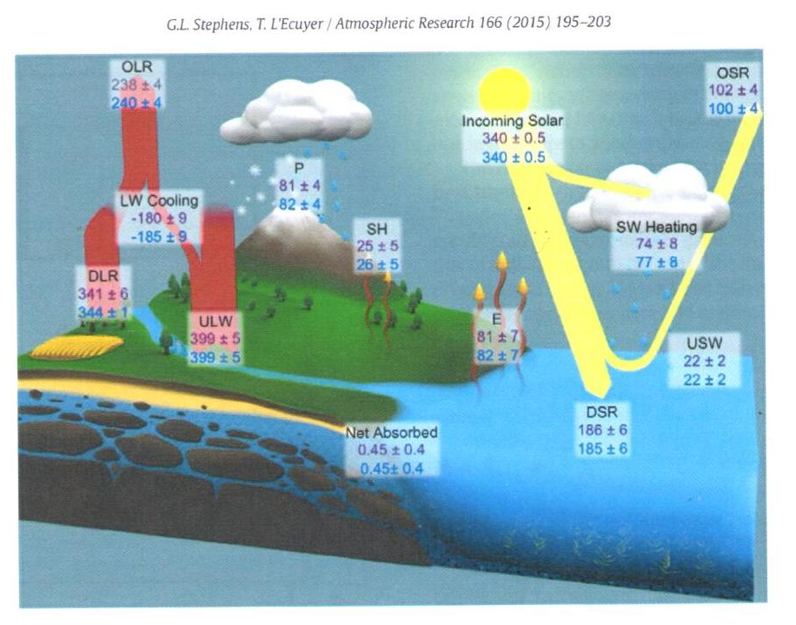
Power flow diagram from Stephens and L’Ecuyer (2015).
Numbers are extracted from the top two lines of this Figure.

Slide 37
Stephens and L’Ecuyer (2015) together offer a mea culpa admission to having made an “unjustified, ad hoc” choice between OHC data and CERES satellite data, and miraculously now claim simultaneously both zero and +0.6 +/- 0.4 W/m² power imbalance. – p.2
Amazingly, Stephens and L’Ecuyer (2015) persist in reporting (in their abstract line 5) the power imbalance = 0.6 +/- 0.4 W/m² ! The infamous Loeb et al. (2012) & Stephens et al. (2012) BAD PENNY reappears!.
OHC CERES (satellites)
Incident ShortWave power (W/m²) +340.0 ± 0.5 +340.0 ± 0.5
Outgoing ShortWave power -102 ± 4 -100 ± 4
Outgoing LongWave power -238 ± 4 -240 ± 4
Power imbalance reported +0.6 +/- 0.4 W/m² (=warming)
Net “calculated” power imbalances (jfc) 0 ± 5.6 0 ± 5.6
(no warming) (no warming)

Slide 38
Power imbalance analysis by Wild et al. (2019) and AR6 (2021) – power imbalance and error bars both fudged – p.1
Wild et al. (2019) report new Clear-sky (a.k.a cloud-free-sky) measurements to the data set using ground sunlight observations via the Baseline Surface Radiation Network (BSRN).
The Clear-sky measurements allow the calculation of a new Clear-sky albedo. (See below.)
The Wild et al. (2019) power-flow diagram is copied directly by AR6 (2021), except for added fudges. The power fluxes and error bounds presented here are copied directly from the top lines of their nearly identical power-flow diagrams. The fudged power imbalances and error limits are copied directly from the associated lower left-hand corners.

Slide 39
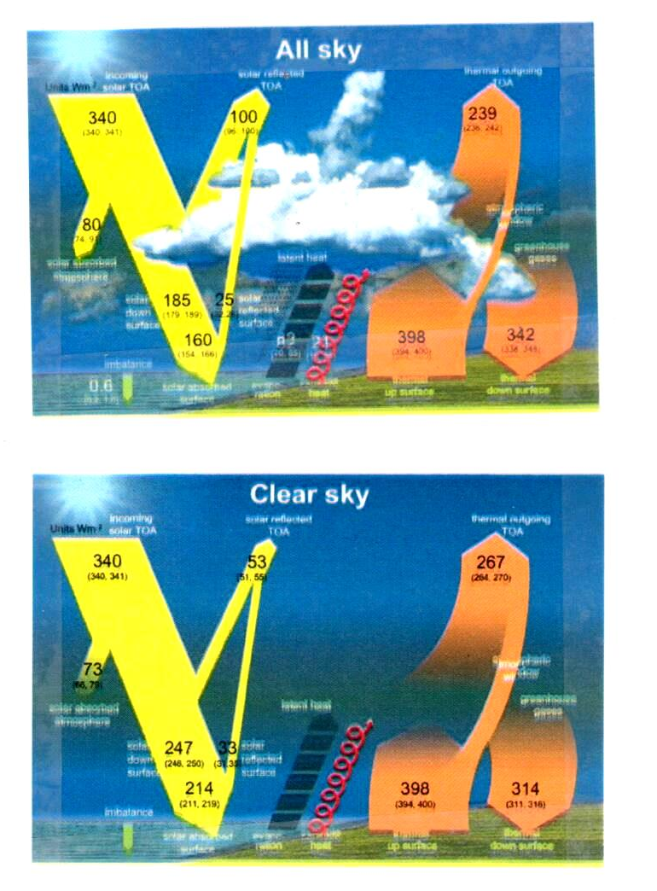
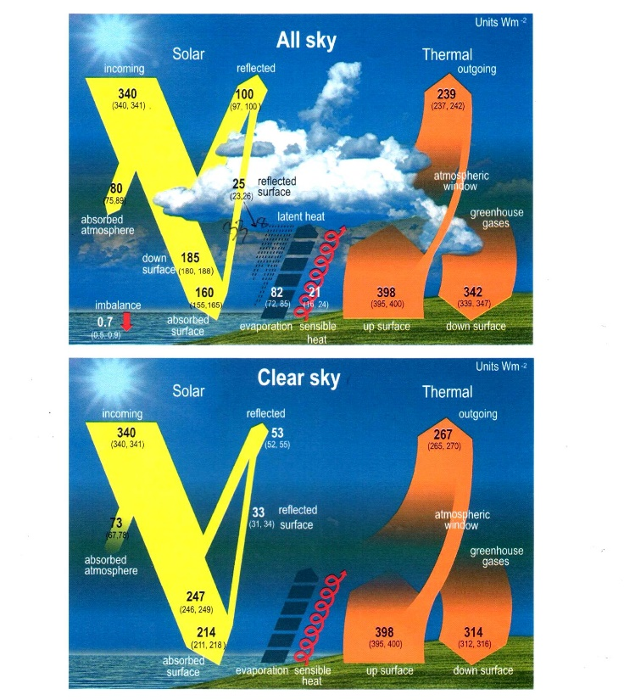
Wild (2019, left pair) & AR6 (2021, p.934), right pair) power-flow diagrams.

Slide 40
Power imbalance analysis by Wild et al. (2019) and AR6 (2021) – power imbalance and error bars fudged – p.2
Wild et al. (2019) AR6 (2021)
Incident ShortWave power (W/m²) see note** +340.5 ± 0.5 +340.5 ± 0.5
Outgoing ShortWave power -98 ± 2 -98.5 ± 1.5
Outgoing LongWave power -239 ± 3 -239.5 ± 2.5
Power imbalance (reported at lower +0.6 +/- 0.4 +0.7 ± 0.2
left-hand corner of the upper Figures) (warming) (strong warming)
Net “calculated” power imbalance (jfc) 3.5 ± 3.6 2.5 ± 3.0
(no warming) (no warming)
The infamous Loeb et al. (2012) & Stephens et al. (2012) global-warming BAD PENNY (with the Stephens et al. (2012) error-bar choice) reappears once again in Wild et al.(2019).
The Wild et al.(2019). & AR6 (2021) error bars visibly fail the RMS error-sum crosscheck!

Slide 41
Power imbalance analysis by Wild et al. (2019) and AR6 (2021) – power imbalance and error bars fudged – p.3
The arithmetically incorrect fudged numbers shown in red are the values reported at bottom of their power flow diagrams. My last line gives the correct summation.
Wild et al. (2019) introduce an innovative technique for data fudging: The Incident ShortWave power reported by previous power-flow maps (e.g. by Stephens and L’Ecuyer (2015), is typically 340.0 ± 0.1 W/m². Wild et al. (2019) and AR6 (2021) assume 340.0 ± 0.5 W/m², round upwardly the center of their asymmetric error-limit range by +0.5 W/m², and show both limits correspondingly rounded to the nearest whole number, as per 340 (340, 341) W/m². Note that they upwardly or downwardly round by +0.5 W/m². That trick shifts upwardly their calculated power imbalance by almost all of their reported net power imbalances, +0.6 +/- 0.4 and +0.7 ± 0.2.

Slide 42
In passing, note two important observations from the AR6 (2021) power flow diagram
#1. The cloudy-sky albedo that one calculates from this diagram is in error by about a factor of two.
#2. 73% of the sunlight energy incident on oceans (that cover 70% of the Earth’s area) is used not for warming the Earth, but for making clouds.
These observations are important for Part II.

Slide 43
#1 A very important observation from the AR6 (2021) and Wild et al. (2019) power flow diagrams → Cloud albedo 2X error!
Energy conservation theorem in terms of albedos: The albedo of a composite area is the area-weighted average of the individual component areas’ albedos – α _{ALL-sky} = f_{Clouds} X α_{Clouds} + f_{CLR-sky} X α_{CLR-sky} (See Appendices A,B.)
The AR6 all-sky diagram implies that the all-sky albedo is α_{ALL-sky} ≡ OSR_{ALL-sky} / TOA_{INC} = 100 / 340 = 0.3.
The clear-sky diagram for f_{CLR-sky} = 0.33 (i.e. for 33% of the Earth’s area) implies that the clear-sky albedo is α_{CLR-sky} ≡ OSR_{CLR-sky} / TOA_{INC} = 53 / 340 = 0.16.
For the cloud fraction, f_{Clouds} = 0.67, (for 70% of the Earth’s area) the albedo conservation corollary shows that the cloudy sky albedo is α_{Clouds} = 0.36, while other direct measurements indicate a value α_{Clouds} ≈ 0.8.
This value for α_{Clouds} is conspicuously wrong by about a factor of two!

Slide 44
#2 important observation: What does sunlight mostly do when it reaches the Earth’s surface?
It is commonly believed that sunlight that is absorbed by the Earth’s surface simply warms the surface. That may be true over land. But land represents only about 30% of the Earth’s surface.
Oceans cover 70% of the Earth’s surface. Correspondingly, about 70% of incoming sunlight falls on the oceans. Virtually all of the Earth’s exposed water surface occurs in the oceans.
Following the AR6 power-flow diagram, 160 W/m² is absorbed by the whole Earth, meaning that roughly 70% X 160 = 112 W/m² is absorbed by oceans.
The AR6 power-flow diagram indicates that 82 W/m² is used for evaporating water, and not for heating the surface. For the whole Earth, 82/160 = 51% (= more than half) of the input energy absorbed by the Earth is used, not for warming the Earth, but instead simply for making clouds.
Since clouds are mostly produced over the oceans (because that’s where the exposed water is), then 82/112 = 73% of the input energy absorbed by the Earth’s oceans is used, not for warming the Earth, but instead simply for making clouds.
The energy consumed in making clouds is clearly a dominant usage.

Slide 45
NOAA’s scientific disinformation hoax asserts that the frequency of extreme weather events is increasing
2012, Physics Today article “Predicting and Managing Extreme Weather Events” – Earth’s climate is warming, and destructive weather is growing more prevalent. Coping with the changes will require collaborative science, forward-thinking policy, and an informed public.”
Authors: Jane Lubchenco, undersecretary for oceans and atmosphere at the US Dept. of Commerce, and NOAA administrator, and Thomas Karl, Director of NOAA’s climatic data center and chair of the US Global Change Program.

Slide 46
NOAA’s disinformation hoax regarding an impending climate apocalypse
The Physics Today article asserts that there is an increase in the extreme weather event frequency that is associated with climate change in the three decades ending in 2012.
The article presents data in their Fig. 2a displaying NOAA’s Weather and Climate Extremes Index. That index is NOAA’s numerical composite measure of the frequency of so-called extreme weather events, including hot-spells, cold-spells, droughts, floods, land-falling hurricanes, etc. (EF3+ tornado frequency is conspicuously absent from the list, presumably because it was actually decreasing. See Koonin, pp.124-125)
The authors assert that their climate extremes index has “obviously” grown steadily over the last three decades. I assert here that their own data in their Fig. 2a disprove their own assertion.

Slide 47
Lubchenco and Karl’s Fig. 2a

Slide 48
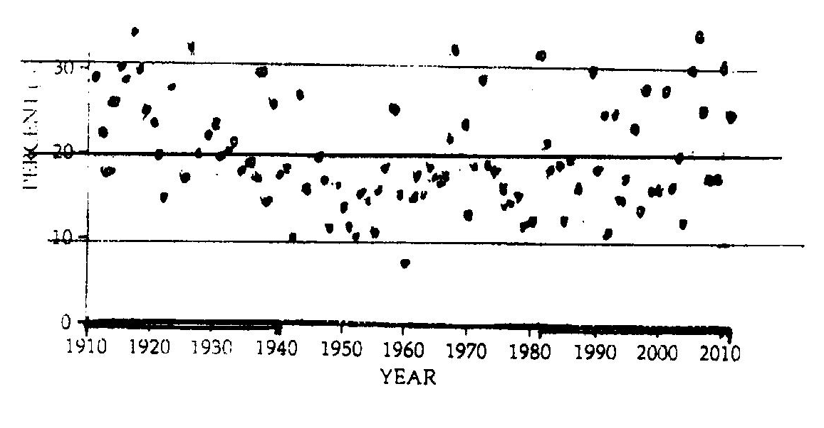
The two graphs below are traced directly from Fig. 2a. They are identical, except that one is plotted left-to-right reversed, i.e. backwards with time increasing to the left. If you look carefully, you will see that they are mirror images. If you can’t tell which one of these graphs is correctly plotted and matches the one on the previous slide, and which one is time-backwards, I assert that their claimed recent increase in extreme weather-event frequency is not obviously indicated by their data, as they claim. Their claim is false! Are you really confidently willing to bet trillions of dollars that you can tell which one is correct? These data portend the impending apocalypse, so Lubchenko and Karl claim.

Slide 49
Part I – Conclusions – p.1
The IPCC and its contributors claim the Earth has a net-warming energy imbalance. I show here that that claim is false.
A net-warming energy imbalance is the definition of global warming. Moreover, there is no energy crisis without global warming!
The IPCC bases its global warming claim on computer modeling of the Earth’s atmosphere and on observational data from a variety of observational modalities. Both the computer models and the observational data are grossly flawed.
The IPCC’s computer modeling and its predictions are totally unreliable. There is something clearly very wrong with the physics incorporated within these computer models. Since the computer models can’t even explain the past, why should anyone trust their prediction(s) for the future?
Not one of the observational modalities for measuring the Earth’s power imbalance convincingly shows a net global warming.

Slide 50
Part I – Conclusions – p.2
Various observers and the IPCC have dishonestly fudged their reported data, and have dishonestly changed it from showing No Warming, to showing Warming. Crucially important data fudges are revealed here and highlighted in red. If you don’t believe me, check my arithmetic.
The Data from Wild et al. (2019) and AR6 (2021) indicate a serious factor of two error in their implied cloudy-sky albedo ≈ 0.36. Direct measurements indicate a value ≈ 0.8.
The IPCC and NOAA further claim that the purported power imbalance has already caused an increase in dangerous extreme weather events. NOAA’s own data disprove their own claims.
I thus offer Great News. Despite what you may have heard from the IPCC and others, there is no real climate crisis! The planet is NOT in peril!
The IPCC’s (and NOAA’s) claims are a dishonest hoax. Trillions of dollars are being wasted. The climate crisis is a colossal trillion-dollar hoax.

Slide 51
Part I – Additional conclusions – p.3
The oceans comprise 70% of the Earth’s surface. 73% of the sunlight energy incident on the oceans does not warm the Earth. Instead, it is consumed by making clouds.
Cloud making is a dominant energy-usage mechanism.
Analysis of IPCC-reported data leads to a calculated albedo (sunlight reflectivity) for clouds (= 0.36) that is clearly very wrong - by about a factor of 2. Direct measurements suggest it is about 0.8. Alternatively, the IPCC’s data violate energy conservation laws.

Slide 52
Part II. A Cloud Thermostat Controls the Earth’s Climate, Not Greenhouse gasses!
The IPCC’s 2nd sacred task was to identify the dominant atmospheric process controlling the Earth’s climate.
I assert that the IPCC and its collaborators totally misidentify the Earth’s dominant climate process.
The IPCC incorrectly scapegoats atmospheric greenhouse gasses as the dominant cause of (non-existent) global warming.
Along with the IPCC’s use of fudged data, their misidentification leads the IPCC to give dangerous recommendations to policy makers

Slide 53
The dominant climate-control process is, in fact, the “cloud thermostat mechanism”.
The “cloud thermostat mechanism” provides a dominant natural feedback that provides the Earth with very strong temperature and climate stability.
Feedbacks associated with greenhouse gasses are negligible in comparison with cloud-thermostat feedback.
As a result, the Earth’s climate is robustly stable against huge increases in greenhouse gasses and other perturbations like volcanism.

Slide 54
The cloud thermostat’s source of strength
The cloud thermostat mechanism gains its enormous strength from the Earth’s observed very large cloud-cover variation and the associated reflected-sunlight power variation.
It is just like the thermostat in your home. The power-imbalance is never zero. In your home, the furnace is always either ON or OFF. The thermostat simply modulates the heating/cooling duty cycle.
Similarly to the furnace in your home, clouds either shadow the ocean (furnace-OFF), or they don’t (furnace-ON).
Doing so, they modulate their own production rate.
The equivalent furnace strength is the varying reflected-power magnitude.
As a result of the reflected power’s variation, the power imbalance is actually observed to be continuously strongly fluctuating by anywhere between 18 to 55 W/m² (40 to 77 W/m², if you include the solar constant’s annual variation).

Slide 55
Part II – The cloud thermostat - 3
Clouds thus modulate the reflected sunlight power and thereby control the Earth’s power imbalance, minimally with 18 W/m² available power range (ignoring the added 22 W/m² solar-constant variation)
This modulation strength is minimally 26 times the IPCC’s 0.7 W/m² claimed power imbalance, and 45 times the IPCC’s ± 0.2 W/m² power imbalance error range.
The above numbers use the IPCC’s assumed and questionable albedo parameters. With more realistic assumptions, the cloud-thermostat mechanism controls the Earth’s power imbalance with a 77 W/m² available power range, which is more than 100 times bigger than the IPCC’s 0.7 W/m² claimed power imbalance, and 192 times bigger than the IPCC’s ± 0.2 W/m² power-imbalance total error range.
The seemingly random fluctuation of the power imbalance is not random at all, but is actually a crucial part of a thermostat-like feedback mechanism that controls and stabilizes the Earth’s climate and temperature. It is observed by King et al. (2013) and by Stephens et al. (2015) to be quasi-periodic.

Slide 56
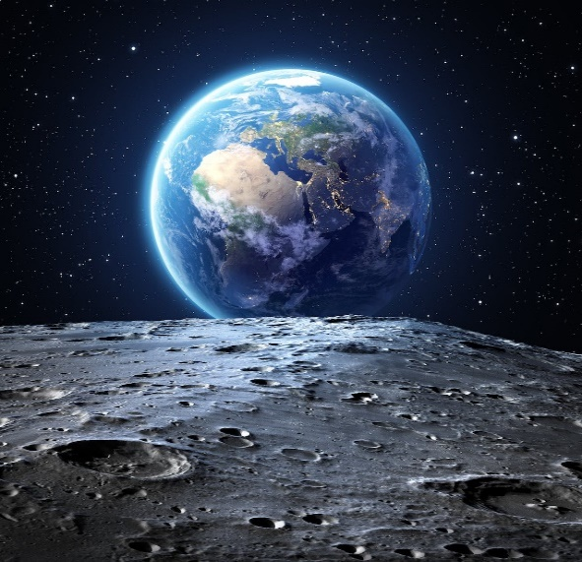
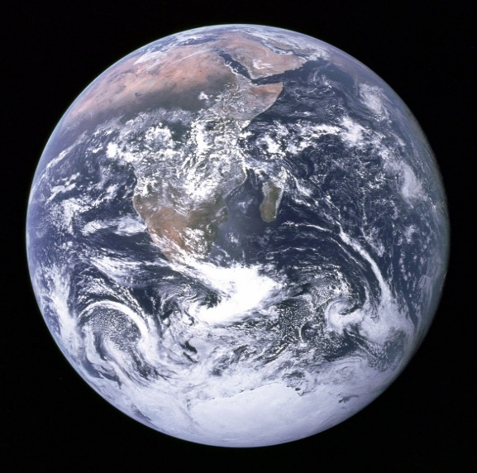
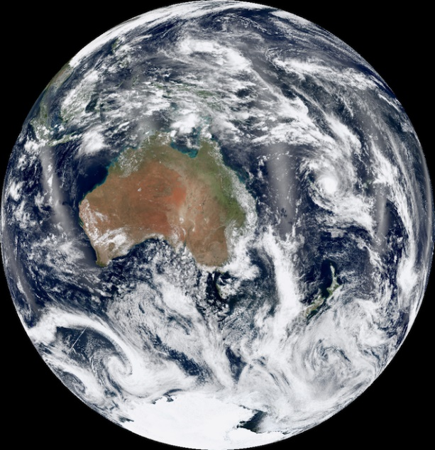
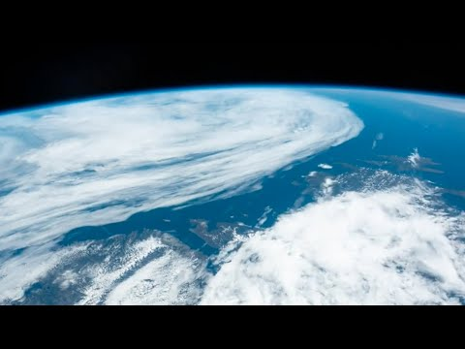
Some important and obvious but underappreciated properties of clouds
What does the Earth look like when viewed from space in sunlight?

Slide 57
There are 5 important take-home messages to be gleaned from these satellite photographs.
Cloud coverage area is highly variable over the Earth.
Clouds of all types appear bright white! Clouds reflect dramatically more sunlight than the rest of the planet does!
The photos (along with a large number of careful measurements) strongly suggest that the average cloud reflectivity (of sunlight) is about 0.8 – 0.9. (For comparison, white paper has a reflectivity of ≈ 0.99.)
The clear-sky (cloud-free) areas appear much darker than the clouds. The average reflectivity of land (green and brown areas) and ocean (dark blue areas) is ≈ 0.16.
By contrast, AR6 (2021) and Wild et al. (2019) claim that cloud reflectivity is ≈ 0.36, and that the whole Earth’s reflectivity is almost the same, 0.3. Something is clearly very wrong with the IPCC’s numbers.

Slide 58
Clouds cast dark shadows.
Clouds cast dark sharply-defined shadows on the surface below them. Just stand on a hillside or look down from an airplane on a partly cloudy day and watch the cloud shadows cast on the land below.
Watch your solar-panel output when a solitary cloud passes in front of the sun. Typically, the output drops to 50% or less.
Try reading a book indoors on a heavily overcast day without turning on the lights. You can’t. It’s too dark! Where did all of the missing sunlight go? Since water droplets negligibly absorb sunlight, the missing sunlight (typically 80-90% of it) got reflected back out into space.

Slide 59
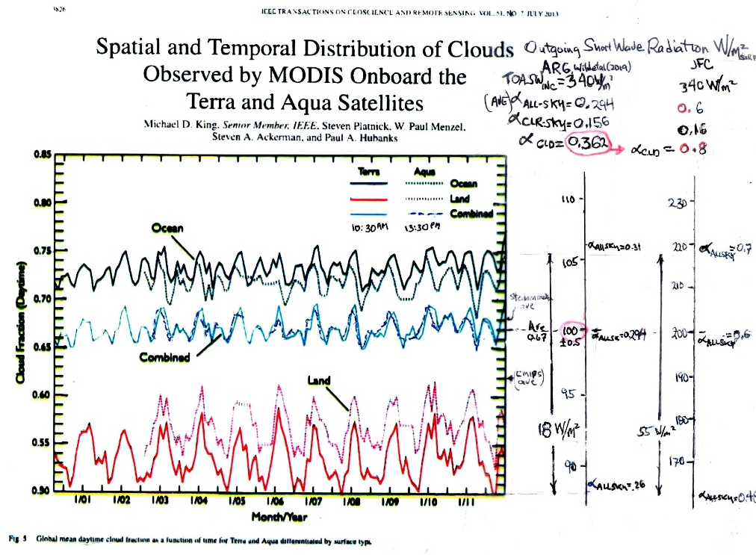
Satellite observations of cloud-cover fraction by King et al. (2013) – p.1
King et al. (2013) analyzed more than 12 years of data from the CERES Terra and Aqua sun-synchronous satellites, and measured the daytime fractional cloud cover, over ocean, land, and combined.
I have added Outgoing (reflected sunlight) SW power scales, assuming a constant solar input power, 340 W/m².
King et al. (2013) is ignored by AR6.

Slide 60
Satellite observations of cloud-cover fraction by King et al. (2013) – p.2.
The left-hand scale uses the parameters from the 2021 AR6 report. It assumes an all-sky albedo = 0.3, and a clear-sky albedo = 0.16.
Energy conservation (see Appendix B) further requires a cloudy-sky reflectivity (albedo) = 0.36. (an unreasonable value).
On this scale, reflected SW power fluctuates by as much as 18 W/m².

Slide 61
Satellite observations of cloud-cover fraction by King et al. (2013) – p.3.
The right-hand scale uses the same parameters, except that it assumes a cloudy-sky albedo = 0.8, as per the cloud photos and various measurements.
Reflected SW power then fluctuates by as much as 55 W/m².
If one further includes the 22 W/m² variation from the Earth’s orbit ellipticity, it fluctuates by as much as 77 W/m².

Slide 62
Satellite observations of cloud-cover fraction by King et al. (2013) –p.4.
The cloud-fraction variation is extremely strong and very rapid.
The difference between the adjacent solid and dotted lines (for land and ocean) is the average everyday variation in only three hours – from 10:30AM to 13:30PM.

Slide 63
Satellite observations of cloud-cover fraction by King et al. (2013) -5.
The albedo fluctuation data presented by Stephens et al. (2015, earlier slide), when compared with this Figure, shows that the albedo fluctuation is dominantly due to cloud-cover fraction variation.
Conclusion: Cloud-fraction variation, especially for clouds passing from ocean to land, strongly modulates the Outgoing sunlight power, and strongly affects the Earth’s power imbalance.

Slide 64
My cloud thermostat model – how does it work? p.1
Recall that the IPCC’s AR6 power-flow map asserts that 73% of the input energy absorbed by the Earth’s oceans is used, not for warming the Earth, but instead simply for evaporating seawater and making clouds, rather than for raising the Earth’s surface temperature. Recall that the Earth has a strongly varying cloud cover and albedo.
Temperature control of the Earth’s surface by this mechanism works exactly the same way as does a common home thermostat. A thermostat automatically corrects a structure’s temperature in the presence of varying modest heat leaks. For the earth, the presence of significant CO₂ in the earth’s atmosphere, manmade or not, provides, in fact, a very small heat leak (at most, about 2 W/m²).

Slide 65
My cloud thermostat model – how does it work? p.2
How does the cloud thermostat work? It works just like the furnace in your home. Clouds produce dark shadows. A high cloud-cover fraction equals a highly shadowed area, especially over the oceans. When clouds are present, the Earth’s furnace is effectively turned OFF. When clouds are not present, the Earth’s furnace is ON. As a result, cloudy days are cooler than sunny days.
When the ocean’s cloud-cover fraction is too high and the furnace is turned OFF, then the sea-surface temperature is too low. Importantly, sunlight is needed to evaporate seawater. With reduced temperature, the evaporation rate of seawater is significantly reduced. As a result, the ocean’s too-high cloud-cover fraction obediently starts to decrease. Very quickly, the too high cloud-cover fraction decreases (by evaporation and precipitation), and the temperature increases. Equilibrium cloud cover and temperature are restored.

Slide 66
My cloud thermostat model – how does it work? p.3
When the ocean’s cloud-cover fraction is too low, the surface temperature becomes too high, and the reverse process occurs. With low cloud cover, lots of sunlight reaches the ocean surface. Increased sunlit area then evaporates more seawater. The cloud-production rate obediently increases and the cloud-cover fraction stops being too low . Equilibrium cloud cover and temperature are again restored.
Depending on one’s assumption regarding cloud albedo, the cloud thermostat mechanism has minimally anywhere between 18 and 55 W/m² power available from cloud-fraction variability to overcome a wimpy 0.7 W/m² heat leak (allegedly blamed on greenhouse gasses) and to stabilize the Earth’s temperature, no matter what the greenhouse gas atmospheric concentration is!

Slide 67
The IPCC’s 3rd sacred task – calculate and measure the strength of naturally occurring climate-stabilizing feedback mechanisms
Given huge observed fluctuations in outgoing sunlight power and other external perturbations, including increased greenhouse gasses, volcanism, etc., the Earth’s climate and temperature, in fact, exhibit remarkable stability.
This evident stability is due to the presence of various natural feedback mechanisms.
The IPCC’s 3rd sacred task was to estimate the strengths of their various identified feedback mechanisms.
The IPCC’s misidentification of the dominant mechanism has lead the IPCC to the false conclusion that their identified natural feedback mechanisms have only marginal stability, and that there is an imminent “tipping-point” and climate crisis, whereinafter further added greenhouse gasses catastrophically cause what amounts to a thermal-runaway of the Earth’s temperature – i.e. a catastrophic climate crisis.
It is shown here that the cloud thermostat is overwhelmingly the strongest stabilizing feedback.
By comparison, the relative influence of greenhouse-gas destabilizing feedback(s) is found to be totally negligible, with respect to that of the cloud thermostat mechanism.

Slide 68
Analysis of atmospheric feedback systems.
Climate feedback systems are discussed extensively by the 2003 National Research Council / National Academy report “Understanding Climate Change Feedbacks”, by Sherwood et al. (2020 – the Ringsberg Castle study), and by AR6 (2021, Chapter 7.4).
The detailed calculation methodology used by Sherwood et al. (2020) is outlined in Appendix C.
Sherwood et al. (2020) unnecessarily assume ∂ f_{Clouds} /∂T_{surface} ≡ 0.
By removing their overly restrictive assumption, their methodology becomes applicable to the cloud thermostat mechanism.

Slide 69
Feedback strength of the cloud thermostat mechanism p.1
The cloud-thermostat mechanism’s feedback parameter is readily evaluated under the two scenarios associated with two choices for cloud albedo.
Details of the calculation are shown in Appendix D.
For comparison, the IPCC’s 2021 AR6 report (p.978) claims that climate stabilizing identified natural feedback mechanisms have a net (total) stabilizing strength of λ_{Total} = -1.16 ± 0.6 W/m²/K.
For additional comparison, (the misnamed) λ_{Planck} = -3.3 W/m²/K, is heretofore the strongest identified feedback component.
Using the AR6 value for cloud albedo, α_{Clouds} = 0.36 [from Wild et al. (2019)], we have λ_{Clouds} ≈ - 5.7 W/m² K, which 1.7 times larger than λ_{Planck} .

Slide 70
Feedback strength of the cloud thermostat mechanism p.2
Alternatively, using the more reasonable choice for cloud albedo, α_{Clouds} = 0.8, we have λ_{Clouds} ≈ -12.7 W/m² K. This value is 3.8 times larger than (the misnamed) λ_{Planck}.
These values are plotted as an extension of the AR6 Figure 7.1, which shows the feedback strength for various mechanisms. The total system strength is shown in the left-hand column.
Viewed as a temperature-control feedback mechanism, in either scenario, the cloud thermostat has the strongest negative (stabilizing) feedback of any mechanism heretofore considered.
It very powerfully controls and stabilizes the Earth’s climate and temperature.

Slide 71
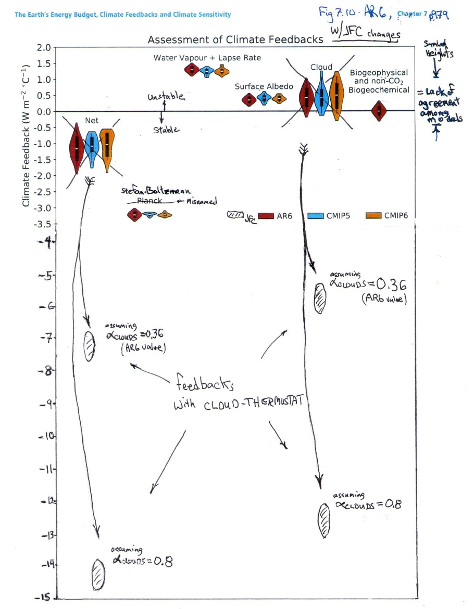
Comparative feedback sensitivities for various mechanisms.
AR6 (2021, Fig. 7.10, p. 979) estimates for the so-called feedback strengths (sensitivities) for various mechanisms.
The AR6 Figure is corrected by replacing their estimate of λ_{Clouds} , with the estimates calculated here for the cloud-feedback mechanism, under two scenarios - assuming cloud albedo = 0.36, and 0.8. In both scenarios, the cloud-feedback mechanism is dominant. [See Appendix D]

Slide 72
Part II - Conclusions
I have introduced here the cloud-thermostat mechanism. I show that it is the overwhelmingly dominant climate controlling feedback mechanism that controls stabilizes the Earth’s climate and temperature. It thereby prevents global warming and climate change.
The IPCC’s 2021 AR6 report (p.978) claims that climate stabilizing natural feedback mechanisms have a net (total) stabilizing strength of -1.16 ± 0.6 W/m²/K.
My cloud feedback mechanism has a net (total) stabilizing strength of anywhere between -5.7 to -12.7 W/m²/K, depending on the assumed cloud albedo (0.36 = IPCC value or 0.8 = observed value).
My mechanism’s overwhelmingly dominant strength confirms that it is the dominant feedback mechanism controlling the Earth’s climate.

Slide 73
Part II - Conclusions
The mechanism gains its strength from the Earth’s observed very large cloud-cover variation and the associated large power imbalance variation. The power imbalance is actually observed to be continuously strongly fluctuating by anywhere between 18 to 55 W/m² (40 to 77 W/m², if you include the solar constant’s annual variation). This large variation is the effective furnace strength.
My cloud thermostat mechanism provides nature’s own Solar Radiation Management System. This mechanism already exists. It is built in to nature’s own cloud factory. It works very well to stabilize the Earth’s temperature on a long term basis. And, it is free! By comparison, the IPCC’s various proposed mechanisms each cost trillions of dollars per year.

Slide 74
Part I – Additional conclusions – p.3
Following Ramanathan (1987), climate analysts in general divide the earth into only two independent portions - clear-sky and cloudy-sky.
Following more recent satellite observations by King et al. (2013), there are evidently, not two, but four independently important portions – clear- and cloudy-sky over ocean, and clear- and cloudy-sky over land. Since oceans comprise 70% of the Earth’s surface, the first two are clearly the most important.
The IPCC mistakenly totally ignores the importance of cloud-cover variability.
The IPCC mistakenly totally ignores the careful observations of cloud-cover extent and variability by King et al. (2013), and especially its observed dramatic ocean-land difference.

Slide 75
Recommendations for policy makers – p.1
There is no climate crisis! There is, however, a very real problem with providing a decent standard of living to the world’s now enormous population. There is indeed an energy shortage crisis. The latter is being unnecessarily exacerbated by what, in my opinion, is incorrect climate science, and by government’s associated incorrect muddled response to it.
Government and business are currently needlessly spending trillions of dollars on efforts to limit the greenhouse gasses, CO₂ and CH₄, in the Earth’s atmosphere.
CO₂ and CH₄ are not pollutants. They must be removed from every list of defined pollutants. They have a negligible effect on the climate. Trillions of dollars can be saved by this one simple measure alone! Additionally, the CO₂ Coalition points out that atmospheric CO₂ is actually beneficial.

Slide 76
Recommendations for policy makers – p.2
The IPCC mandates that trillions of dollars must be spent to stop greenhouse gas release into the environment with a so-called “zero-carbon” policy. This policy should be summarily terminated!
I recommend that all efforts to limit environmental carbon should be terminated immediately! Trillions of dollars can be saved by eliminating carbon caps, carbon credits, carbon sequestration, carbon footprints, zero-carbon targets, carbon taxes, anti-carbon policies and fossil-fuel limits, in energy policy and elsewhere.
Government subsidies for electric vehicles, all electric power, solar and wind power, etc. should all be eliminated.
Fossil fuels are perfectly OK to use.

Slide 77
Recommendations for policy makers – p.3
The IPCC also mandates multi-trillion dollar per year geoengineering projects including Solar Radiation Management Systems to stabilize the Earth’s climate, capture and otherwise reduce the atmospheric CO₂ levels. These projects should be cancelled.
All geoengineering programs to reduce global warming should be cancelled.
To paraphrase (and update for inflation) the late Sen. Everett Dirksen’s 1969 comment about the Vietnam war and Apollo programs, and redirect it to the IPCC’s anti-carbon policies - “A trillion here, a trillion there, and pretty soon you’re talking real money.”

Slide 78
Appendix A. An energy-conservation Theorem phrased in terms of albedos
Theorem: The albedo of a composite area is the area-weighted average of the individual component areas’ albedos -
α _{ALL-sky} = f_{Clouds} X α_{Clouds} + f_{CLR-sky} X α_{CLR-sky}
Definitions:
OSR_{ALL-sky} ≡ Outgoing SW Radiation irradiance for the whole Earth.
OSR_{CLR-sky} ≡ Outgoing SW Radiation irradiance in only the cloud-free areas of the Earth.
OSR_{Clouds} ≡ Outgoing SW Radiation irradiance in only the cloudy areas of the Earth.
TOA_{INC} ≡ Incident SW Radiation irradiance for the whole Earth.
f_{Clouds} ≡ cloudy-area fraction of the Earth.
f_{CLR-sky} ≡ cloud-free area fraction of the Earth.
α_{ALL-sky} ≡ OSR_{ALL-sky} / TOA_{INC} = albedo (SW reflectivity) for the whole Earth.
α_{CLR-sky} ≡ OSR_{CLR-sky} / TOA_{INC} = albedo for cloud-free areas of the Earth.
α_{Clouds} ≡ OSR_{Clouds} / TOA_{INC} = albedo for cloudy areas of the Earth.
Assumtions:
Conservation of area: f_{Clouds} + f_{CLR-sky} = 1. (1)
Conservation of energy, OSR_{ALL-sky} = OSR_{CLR-sky} + OSR_{Clouds}. (2)

Slide 79
Proof:
Evaluate the above expressions, using Equations (1) and (2) for α _{ALL-sky}, α_{Clouds}, and α_{CLR-sky} ,
α _{ALL-sky} = f_{Clouds} X α_{Clouds} + f_{CLR-sky} X α_{CLR-sky}, (3)
Corollary:
α _{Clouds} = α _{ALL-sky} / f_{Clouds} – ((1/ f_{Clouds}) – 1) α _{CLR-sky} (4)
This latter formula is useful for evaluating the cloudy-sky albedo when ALL-sky albedo, CLR-sky albedo, and cloud fraction are all known.

Slide 80
Appendix B. Application of the albedo conservation Theorem to data from the Fig. X.6 AR6 (2021 p.934) power-flow map data
The IPCC’s numbers from AR6 are shown here to require the (silly) number, α_{Clouds} = 0.36. The notation used here is defined above in Appendix A
The clear-sky area fraction is f_{CLR-sky} = 0.33, and the cloudy-sky fraction is f_{Clouds} = 0.67 (= 1 - f_{CLR-sky}). [King et al. (2013), Schmidt et al. (2014)].
The AR6 all-sky diagram implies that the all-sky albedo is α_{ALL-sky} ≡ OSR_{ALL-sky} / TOA_{INC} = 100 / 340 = 0.3.
The AR6 clear-sky diagram implies that the clear-sky albedo is α_{CLR-sky} ≡ OSR_{CLR-sky} / TOA_{INC} = 53 / 340 = 0.16.
The albedo conservation corollary (in Appendix A) then shows that the cloudy sky albedo is α_{Clouds} = 0.36.
This value for α_{Clouds} seems conspicuously wrong by about a factor of two! If true, then clouds in the NASA satellite photos of Fig. X.7 should appear as barely brighter (more reflective of light) than the whole-Earth average. They don’t. For comparison, a sheet of white paper is about 99% reflective. Clouds in the photos appear visually a lot brighter than dessert-color brown or ocean-color blue, and appear much closer to paper-color white,.
Also, note that the commonly accepted value for nearly all types of clouds is about α_{Clouds} = 0.8 - 0.9. See, for example, the measurements and estimates by Griggs (1968), Cheylek et al. (1984), Wetherald and Manabe (1988), Stephens and Greenwald (1991). The measurements of αClouds for Pacific Ocean stratus clouds by Griggs (1968) were done from a DC3 aircraft, and, of course, do not include the added contribution from atmospheric (blue-sky) Rayleigh (back) scattering, that Top of Atmosphere albedos αClouds and αCLR-sky must both further add.

Slide 81
Appendix C. Feedback Analysis of climate systems [as per Sherwood et al. (2020)]
Sherwood et al. (2020) use the symbol ΔN, to represent the downward-flowing energy imbalance, calculated at the Top of Atmosphere. This is the quantity the I have discussed above that is used by the IPCC to define global warming. It is the primary target of the IPCC’s computer modelling and observational efforts.
If the imbalance, ΔN, is negative, the earth is cooling. If it is positive, the Earth is warming.
For any given feedback mechanism, Sherwood et al. (2020) calculate the overall feedback strength (sensitivity) as the derivative of ΔN with respect to the Earth’s surface temperature,
λ ≡ dΔN / dT_{Surface}.
If λ is negative, the feedback stabilizes the system. If , if λ is positive, the system is unstable.
If the system has a variety of independent mechanisms, and each mechanism, labeled j, relies on an associated intermediate variable, x_{j} , then the total system’s feedback strength is calculated using the chain rule for derivatives, as per
λ ≡ Σ_{j} λ_{j} = Σ_{j} (∂ΔN /∂x_{j}) X (∂x_{j}/∂T_{Surface}).
For example, the primary temperature stabilizing feedback mechanism is via the Stefan-Boltzmann law’s σT⁴ dependence of far-infrared (LW) energy reemission by the Earth. Here, σ, is the Stephan-Boltzmann constant. Sherwood et al. (2020, p.19) calculate the (misnamed) feedback parameter, λ_{Planck}, for Stefan-Boltzmann law negative feedback, as λ_{Planck} = -3.3 W/m²/K.
(The Stefan-Boltzmann Law was discovered in 1879. Planck’s law was not discovered until 1900. The quantity called λ_{Planck} should properly be called λ_{Stefan-Boltzmann}.)

Slide 82
Appendix D. Feedback strength of the cloud thermostat mechanism
To calculate the feedback strength for the cloud thermostat, note that the shadowing of the oceans by clouds modulates the sunlight irradiance reaching the surface, SW_{down}. In doing so, it similarly modulates ΔN. A first step in the calculation is to use the albedo conservation theorem, and the terminology introduced in Appendix A, to evaluate SW_{down} , as per
SW_{down} ≡ (1-α_{ALL-sky}) TOA_{INC}
= [1–(f_{Clouds} α_{Clouds} + f_{CLR-sky} α_{CLR-sky})] TOA_{INC},
where TOA_{INC} is the incident sunlight power.
Sherwood et al. (2020) arbitrarily and unnecessarily structure the allowable forms for ΔN to prohibit the use of f_{Clouds} as an intermediate variable x_{Clouds} . I ignore their (silly) restriction here! [Cess (1976) did use use f_{Clouds} as an intermediate variable and obtained similar results to those presented here.]
The climate feedback parameter for the specific cloud thermostat process is
λ_{Clouds} ≡ d SW_{down} / dT_{surface} .
It may be expanded using the chain rule, and f_{Clouds} as an intermediate variable, yielding
λ_{Clouds} = d SW_{down} /dT_{surface} = (∂ SW_{down} /∂ f_{Clouds}) X (∂ f_{Clouds} /∂T_{surface})
= – (f_{Clouds} α_{Clouds}) TOA_{INC} (∂ f_{Clouds} /∂T_{surface}).
Finally one may reasonably estimate the remaining important factor, ∂f_{Clouds}/∂T_{surface} . It is found by noting that both the precipitation rate of clouds and the evaporation rate are a sensitive functions of surface temperature. Both are directly proportional to the vapor pressure of seawater, whose temperature dependence is about 7-8% per degree Kelvin (or Celsius). i.e. ∂f_{Clouds}/∂T_{surface} ≈ 0.07/K

