Slide 1
SURVEY
Telework and home office of journalists:
a labour rights perspective for a hybrid future
Marc Gruber

Slide 2
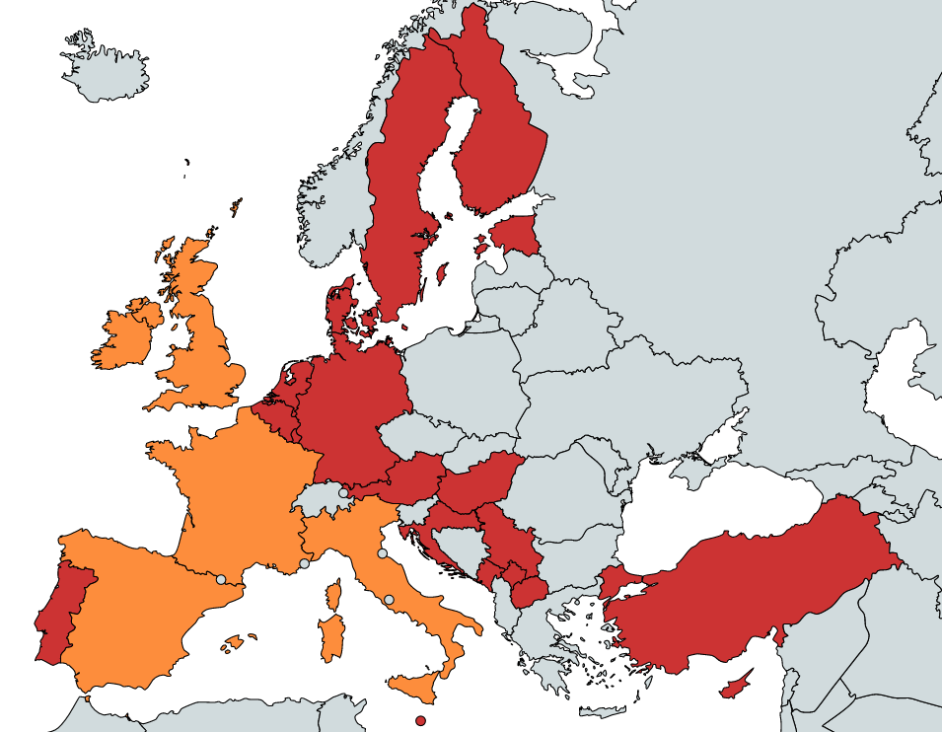
SCOPE AND METHODOLOGY: - Online questionnaire to EFJ members - 20 replies from 20 countries - Testimonies - Desk research in other countries
Telework and home office of journalists: a labour rights perspective for a hybrid future

Slide 3
WHAT ARE WE TALKING ABOUT?
Remote working: occurs when work is fully or partially carried out outside the normal place of work, not necessarily from home
Telework: generally restricted to employees and entails the use of information technology and digital devices
Home office/WFH: takes place fully or partly within the worker's own home, can be performed by both dependent and independent workers
Telework and home office of journalists: a labour rights perspective for a hybrid future

Slide 4
QUESTIONS AND ISSUES - COMMON CHALLENGES
General information:
Is telework / home office voluntary or compulsory?
Is telework / home office implemented full time or in a hybrid way?
What are the main consequences in terms of salary, working-time and work-life balance?
What are the main consequences in terms of health and safety, both physical and mental?
Do journalists have a “right to disconnect”?
Role and the expectations of the unions:
Is telework / home office covered by national regulations?
Is telework / home office subject to collective agreements, sectorial or at company-level?
How to reach journalists out the usual working place?
What are the plans of the unions of the future where “hybrid work” will become the norm?
Telework and home office of journalists: a labour rights perspective for a hybrid future

Slide 5
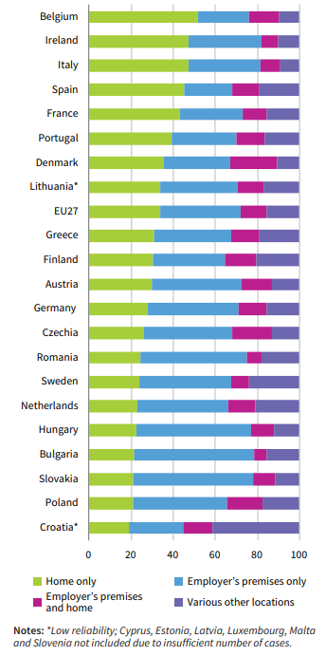
GENERAL SITUATION DURING THE PANDEMIC
Source: Eurofound, 2020
Telework and home office of journalists: a labour rights perspective for a hybrid future

Slide 6
SPECIFIC ISSUES FOR JOURNALISTS
Health and safety of the work environment
Journalism is a teamwork (“danger to lose the emotional connection with the society and with colleagues”)
Issues of privacy and confidentiality of sources (“a source would fear that a call is being recorded or tapped”)
Right to disconnect (“I feel like I live at work”)
Telework and home office of journalists: a labour rights perspective for a hybrid future

Slide 7
SPECIFIC ISSUES FOR JOURNALISTS
Different perspective between staff and freelance journalists
Not only negative aspects, also positive experiences
→ The role of unions / association is to defend and improve the situation of journalists
Telework and home office of journalists: a labour rights perspective for a hybrid future

Slide 8
GENERAL REGULATIONS/ PROTECTION
EU instruments:
Working Time Directive Work-life Balance Directive Transparent and Predictable Working Conditions Directive European Framework Directive on Safety and Health at Work, European Social Partners' Framework agreements on telework (2002) and on Digitisation (2020)
States: different instruments, from ‘hard’ law to ‘soft’ law
State regulations Collective agreements (sector / company level) Simple guidelines.
Telework and home office of journalists: a labour rights perspective for a hybrid future

Slide 9
EXAMPLES
Italy, law of 2017: in the agreement between employer and worker on ‘smart working’, the worker's rest times must be identified as well as the technical and organizational measures necessary to ensure the disconnection of the worker from the technological work tools
Romania, law of 2020: workers’ representatives have access to the telework place for verifying the work conditions of teleworkers
Denmark: all workers are subject to the Danish Working Environment Act, which also applies to teleworking from home
Germany: Workplace Ordinance (Arbeitsstättenverordnung) includes minimum requirements in terms of health and safety of employees such as the lighting and temperature, computer monitors and laptops. But lack of respect in practice
Finland: the employers’ general duty is to take care of the health and safety of their employees under the general rules of the Occupational Safety and Health Act. BUT one large media company’s agreement had a clause stating that ”an employee is liable for his/her own safety and health when teleworking” -> contested by union.
Telework and home office of journalists: a labour rights perspective for a hybrid future

Slide 10
FOCUS ON RIGHT TO DISCONNECT
Telework and home office of journalists: a labour rights perspective for a hybrid future

Slide 11
FOCUS ON RIGHT TO DISCONNECT
Ireland: Code of Practice on the “Right to Disconnect” in April 2021. “the right to disengage from work, and refrain from engaging in work-related electronic communications outside of “normal” working hours”, Also recognises three important elements such as:
- the right of an employee to not have to routinely perform work outside their normal working hours
- the right not to be penalised for refusing to attend to work matters outside of normal working hours
- the duty to respect another person’s right to disconnect (for example: by not routinely emailing or calling outside normal working hours)
France: Labour Law of 2016 the right to disconnect is explicitly mentioned in the legislation, without providing a clear definition of the “disconnection” itself. The employer must define precisely the "time slots during which the employee is available". Although the employee must remain available and active during these time slots, this does not mean that he or she does not have the right to take breaks, including lunch breaks. The law foresees that negotiations have to deal with disconnection in any company where there is trade union representation, which includes all companies with more than 50 employees. Smaller companies have to implement a non-binding “Charter”.
Telework and home office of journalists: a labour rights perspective for a hybrid future

Slide 12
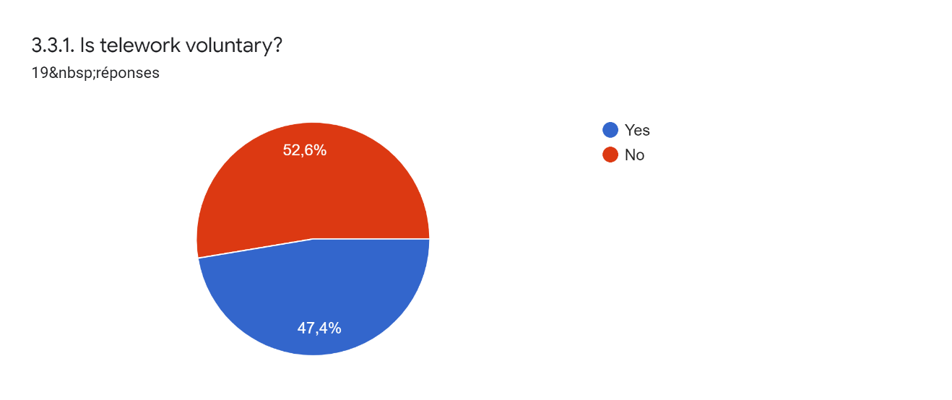
MAIN FINDINGS OF SURVEY
Telework and home office of journalists: a labour rights perspective for a hybrid future

Slide 13
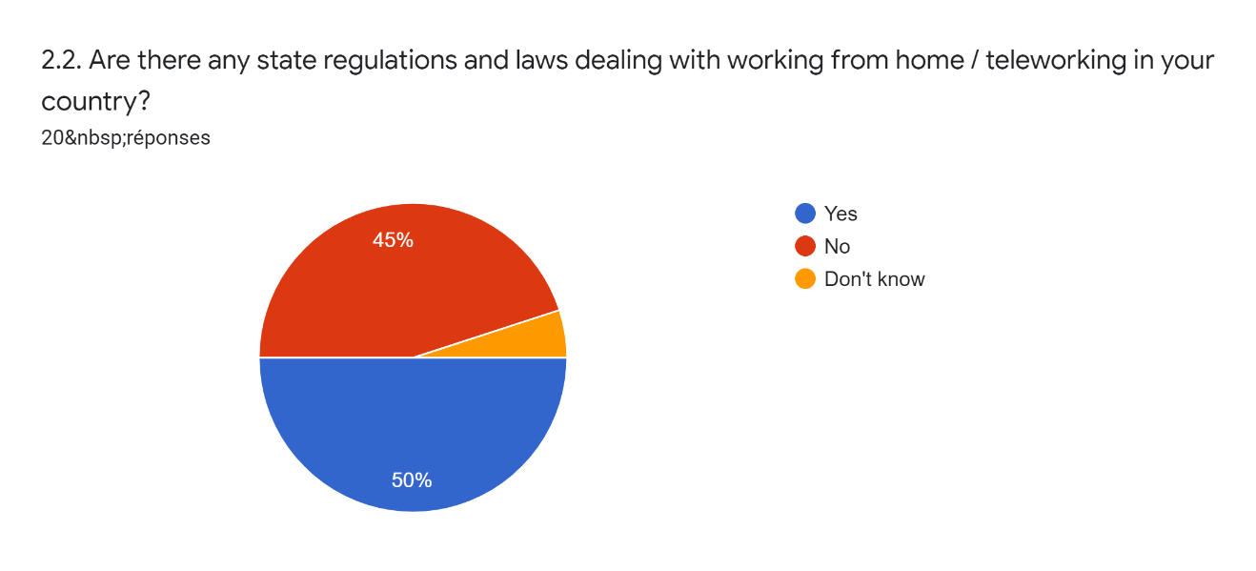
MAIN FINDINGS OF SURVEY
Telework and home office of journalists: a labour rights perspective for a hybrid future

Slide 14
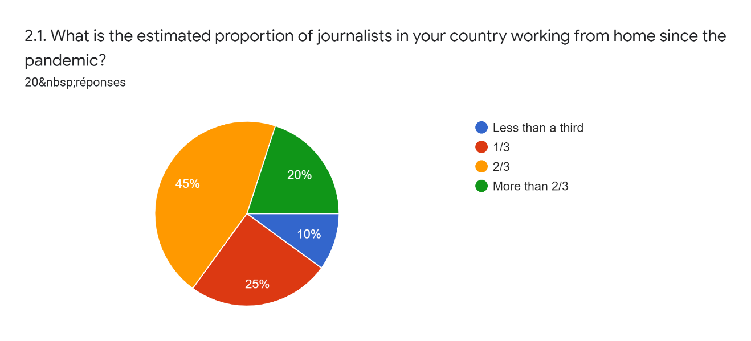
MAIN FINDINGS OF SURVEY
Telework and home office of journalists: a labour rights perspective for a hybrid future

Slide 15
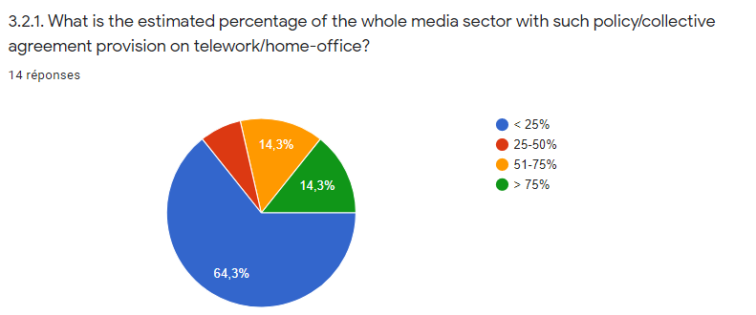
MAIN FINDINGS OF SURVEY
Telework and home office of journalists: a labour rights perspective for a hybrid future

Slide 16
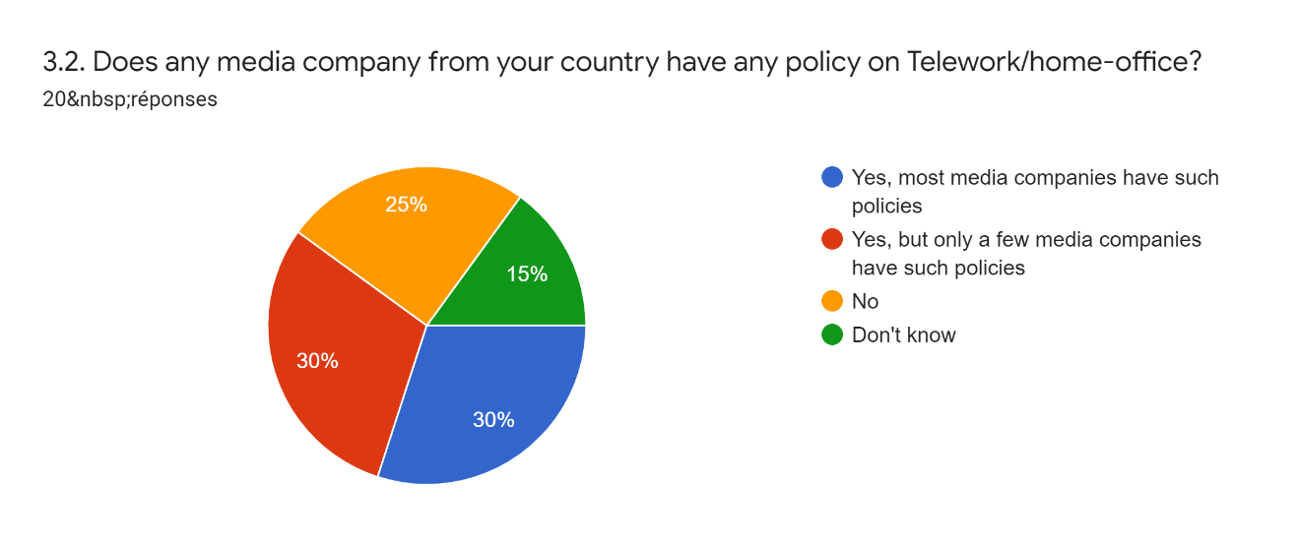
MAIN FINDINGS OF SURVEY
Telework and home office of journalists: a labour rights perspective for a hybrid future

Slide 17
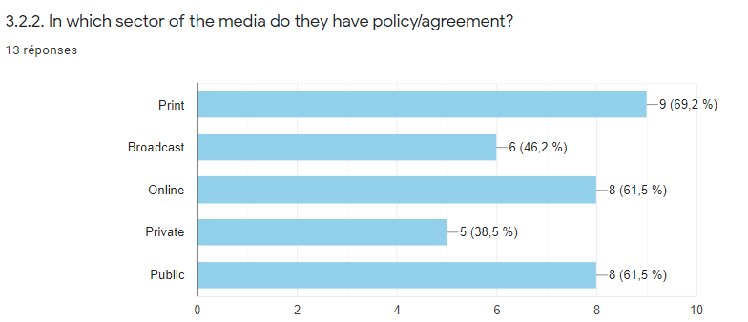
MAIN FINDINGS OF SURVEY
Telework and home office of journalists: a labour rights perspective for a hybrid future

Slide 18
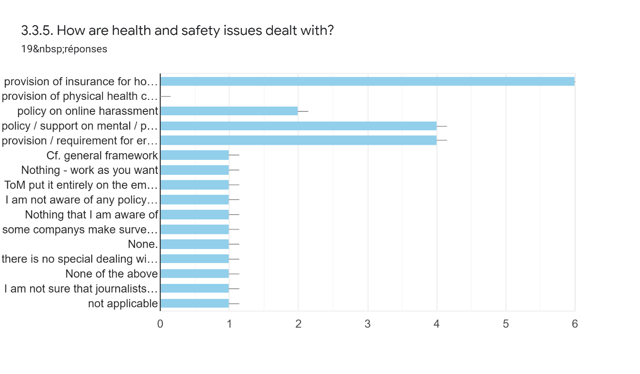
MAIN FINDINGS OF SURVEY
Telework and home office of journalists: a labour rights perspective for a hybrid future

Slide 19
MAIN FINDINGS OF SURVEY
Example: new agreement on home office at French public broadcaster France Télévisions
Since March 2021, it is possible for each employee to request a "telework addendum” to their working contracts, subject to the agreement from their superiors. The major commitments of this agreement are:
a voluntary basis: "the implementation of teleworking is the result of an employee's choice"
a commitment to maintain the current office space and not to introduce “flex office”: "teleworking will not have any consequences on the layout of the [newsroom] premises (...) France Télévisions does not link teleworking and reduction of the allocated offices".
Full text in French : http://snj-francetv.fr/wp-content/uploads/2021-03-18-Accord-teletravail-signe-SNJ.pdf
Telework and home office of journalists: a labour rights perspective for a hybrid future

Slide 20
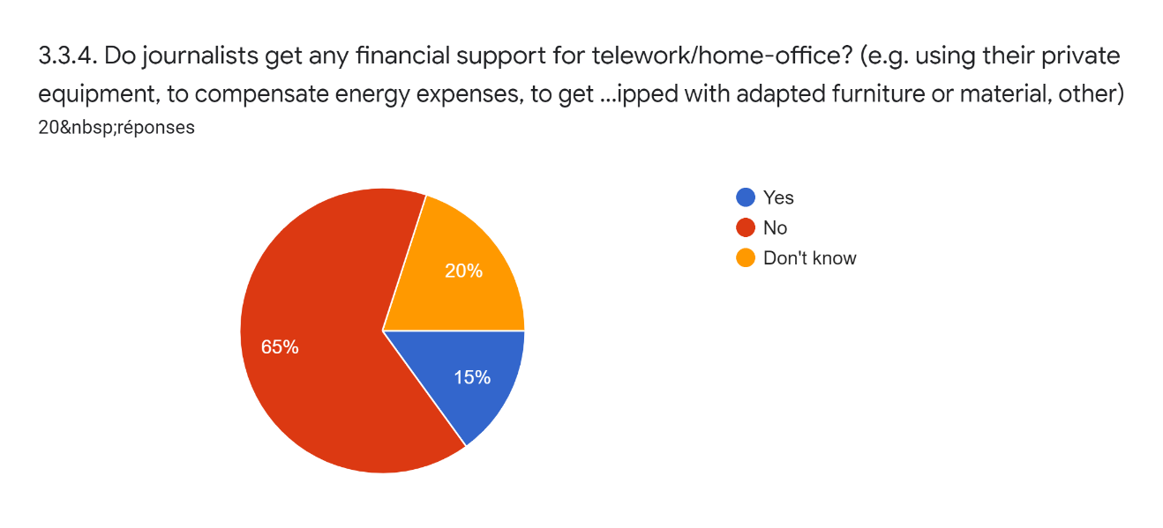
MAIN FINDINGS OF SURVEY
Telework and home office of journalists: a labour rights perspective for a hybrid future

Slide 21
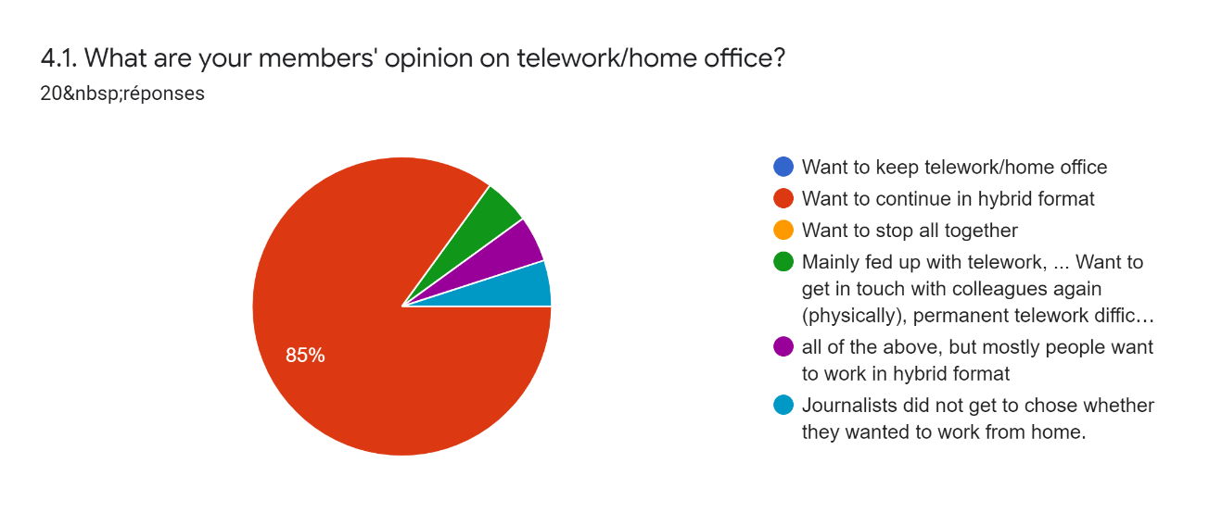
MAIN FINDINGS OF SURVEY THE FUTURE IS HYBRID!
Telework and home office of journalists: a labour rights perspective for a hybrid future

Slide 22
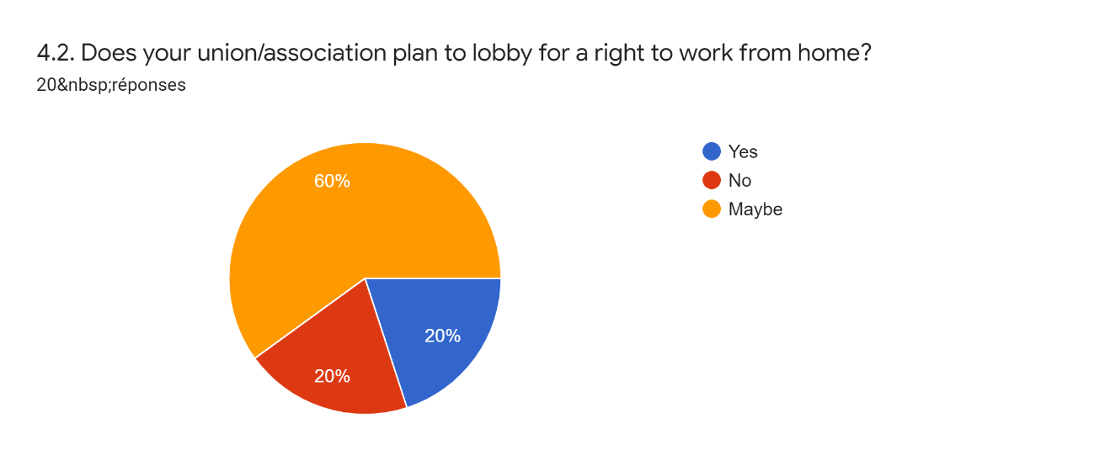
Telework and home office of journalists: a labour rights perspective for a hybrid future

Slide 23
CONCLUSIONS - RECOMMENDATIONS
Voluntary: telework / home office must be voluntary for both workers and employers and subject to an agreement
Reversibility: a person who teleworks for a certain time must be able to return to work in person, and vice-versa.
Non-discrimination: no distinction should be made between office workers and teleworkers. The employer must provide work equipment and cover the expenses that the worker incurs when working from home. Employers are responsible for investing in technology and training, as well as for health and safety measures.
Equal rights: trade unions/associations must be able to contact and organise all workers, independently from their actual workplace.
Right to disconnect: the right to digital disconnection must be guaranteed either by law or by “soft” regulations such as collective agreements.
Telework and home office of journalists: a labour rights perspective for a hybrid future

Slide 24
WORK IN PROGRESS:
Please send comments and information to
grubmarc@gmail.com
THANK YOU!
Marc Gruber - Media & Europe
www.grubermarc.blogspot.com
Telework and home office of journalists: a labour rights perspective for a hybrid future

