Slide 1
Social Networks and online communication CCOO – Spain
Oscar Sánchez Feijoo
@OscarSanchez
@OscarSanchez.es

Slide 2
What is my function in CCOO
Content publication 24 hours x 365 days
Strategy design, general and particular
Online communication training

Slide 3
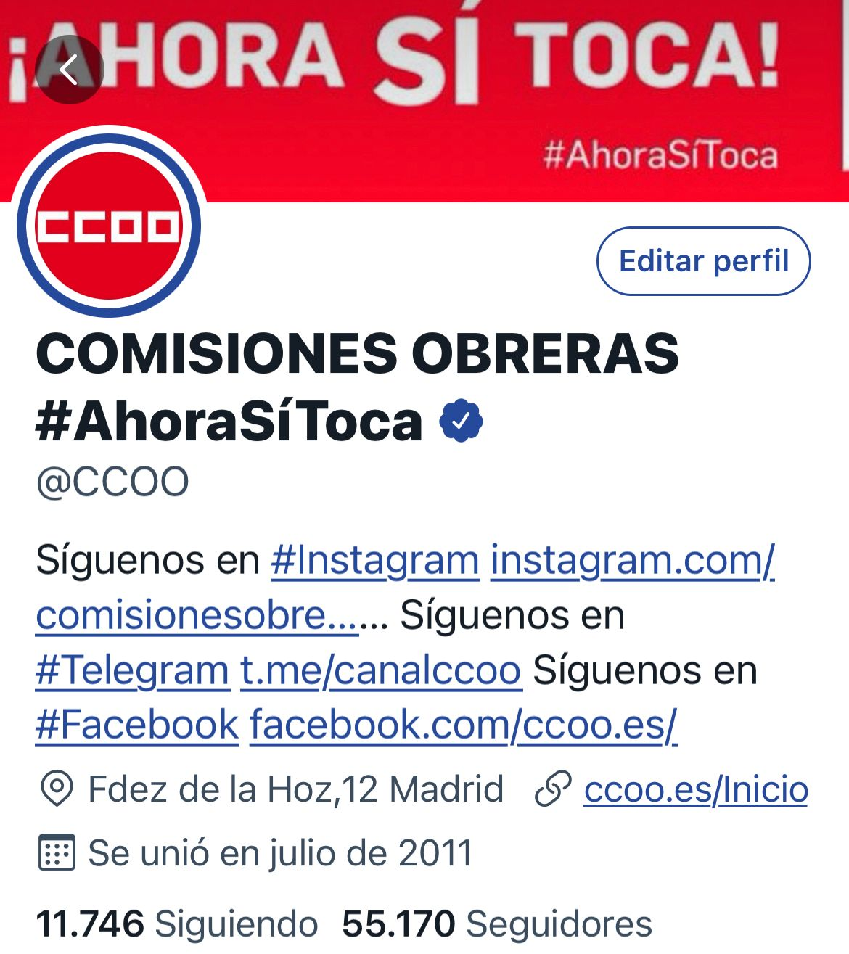
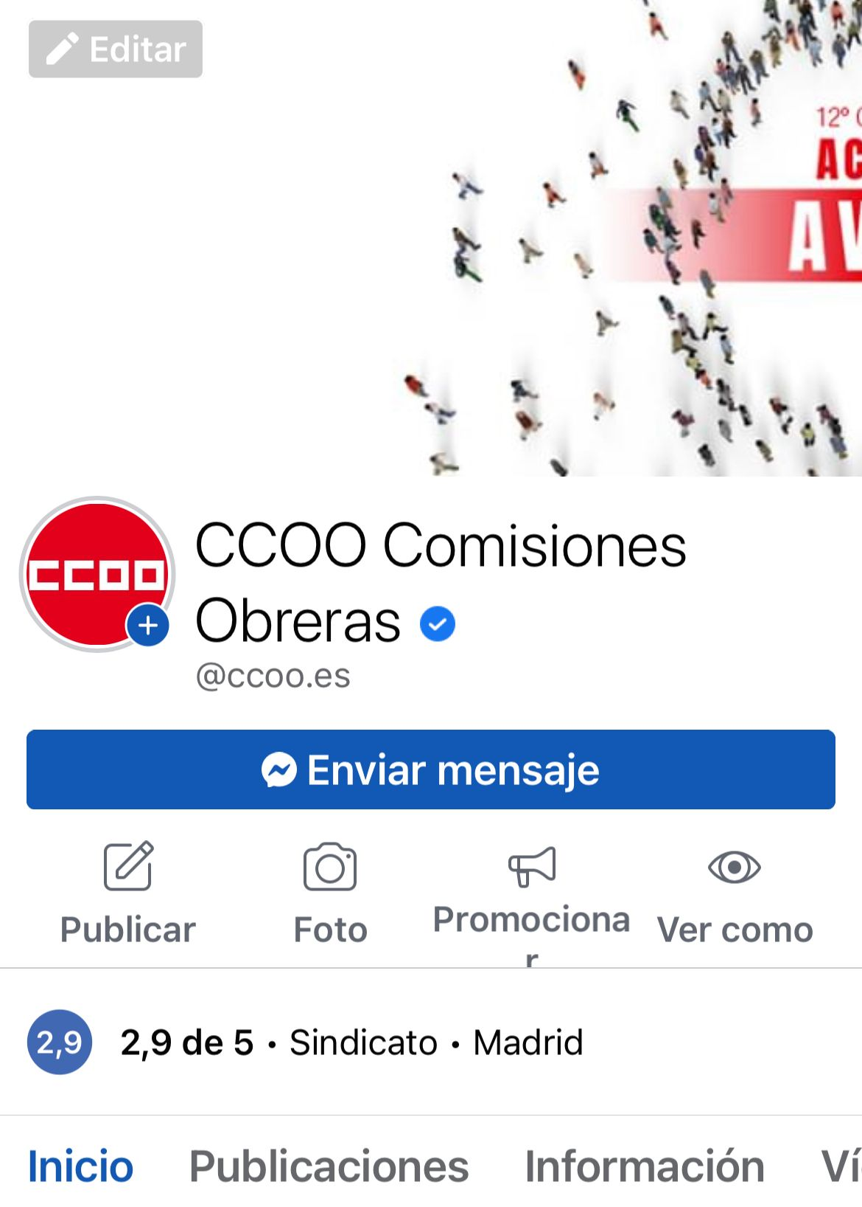
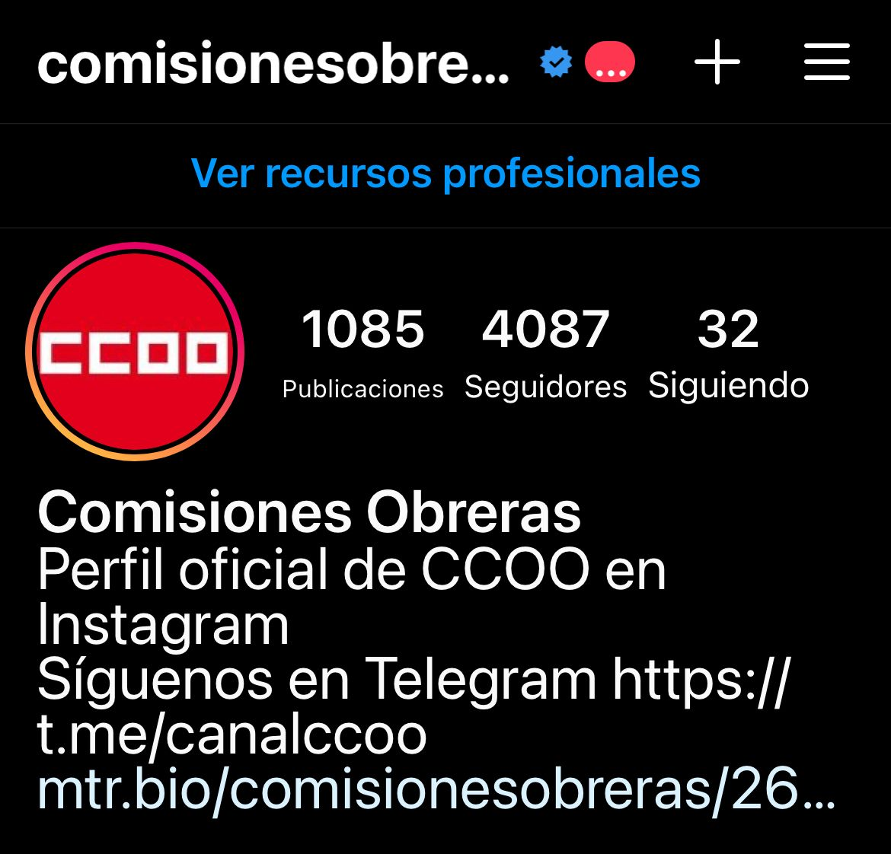
10 years of experience

Slide 4
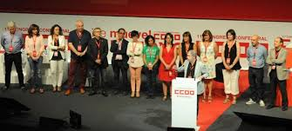
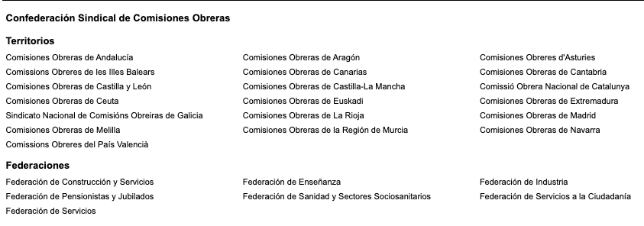
Content types
Own content
Our secretary general
Our executive
Our territories
Our sectors

Slide 5
content segmentation
Yesterday’s news
Day’s agenda
Content in real time
Timeless content

Slide 6
Target audience in each social network
Twitter 35-55 years male and female
Facebook 40-75 years male and female
Instagram 18-35 years and female

Slide 7
Social media priority
Twitter first, real time
Facebook Second, a post for content
We end with Telegram and Instagram

Slide 8
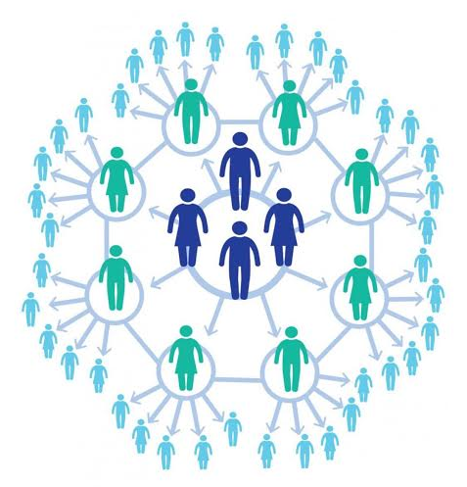
Virality in social networks
Segmentation in telegram
We retweet the most interesting content

Slide 12
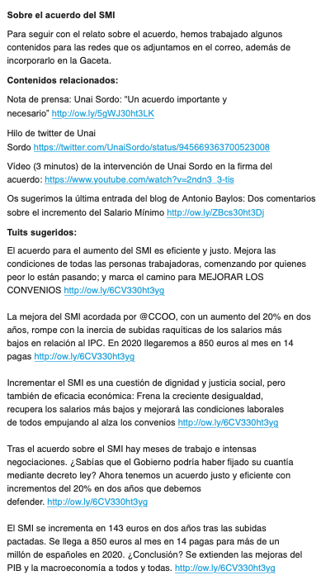
Cyberactivism 2019…..

Slide 13
Confederal Matriarchal system of content segmentation

Slide 14
COFEDERACIÓN
19 Territorios
Ejecutiva Confederal
Federaciones Estatales
Uniones Comarcales
Federaciones Territoriales
Secciones Sindicales

Slide 15
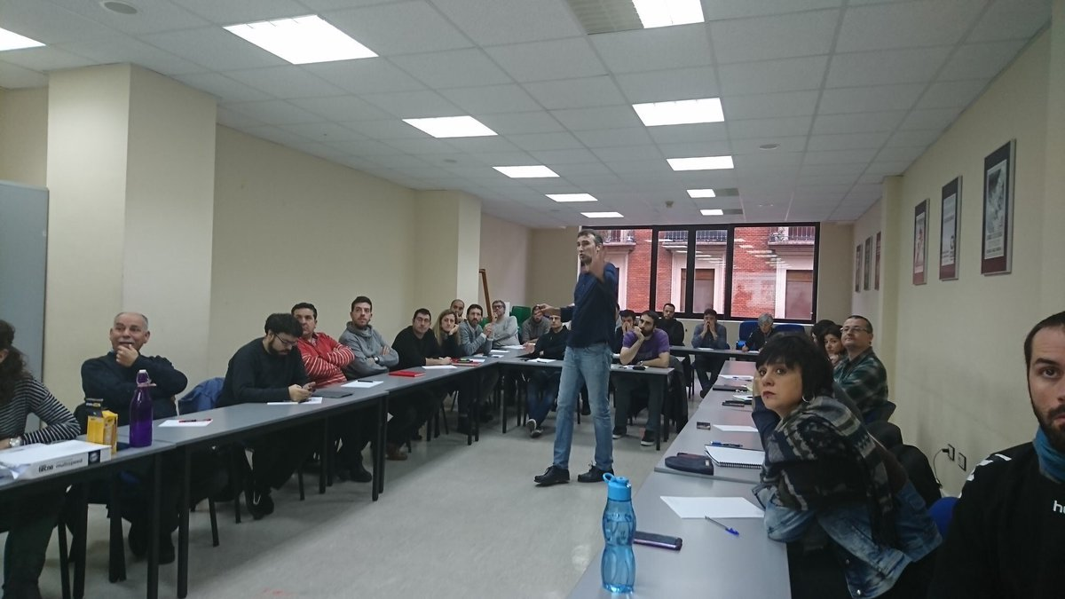
#EnREDandoCCOO

Slide 16
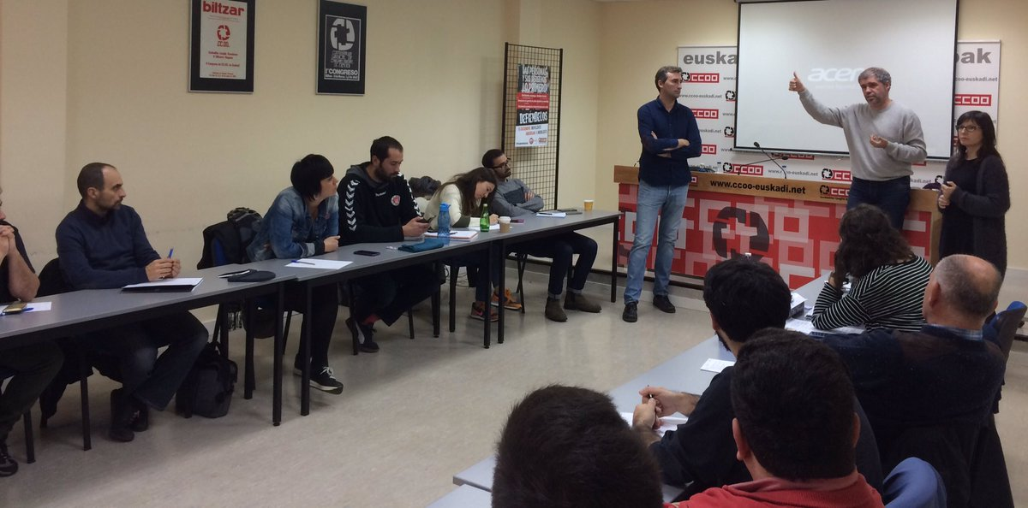
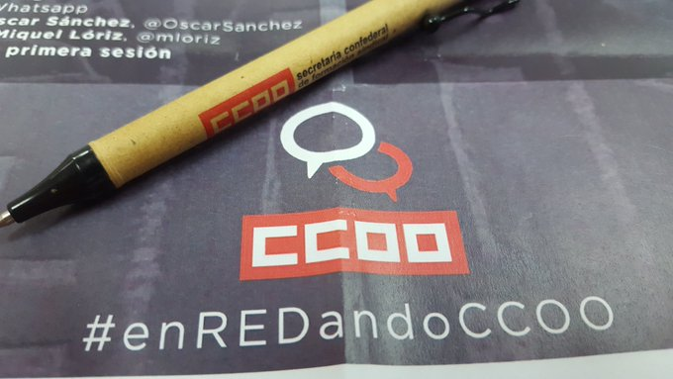

Slide 17
oscarsanchez@ccoo.es
+34 666143171
@oscarsanchez
@oscarsanchez.es

