Slide 1

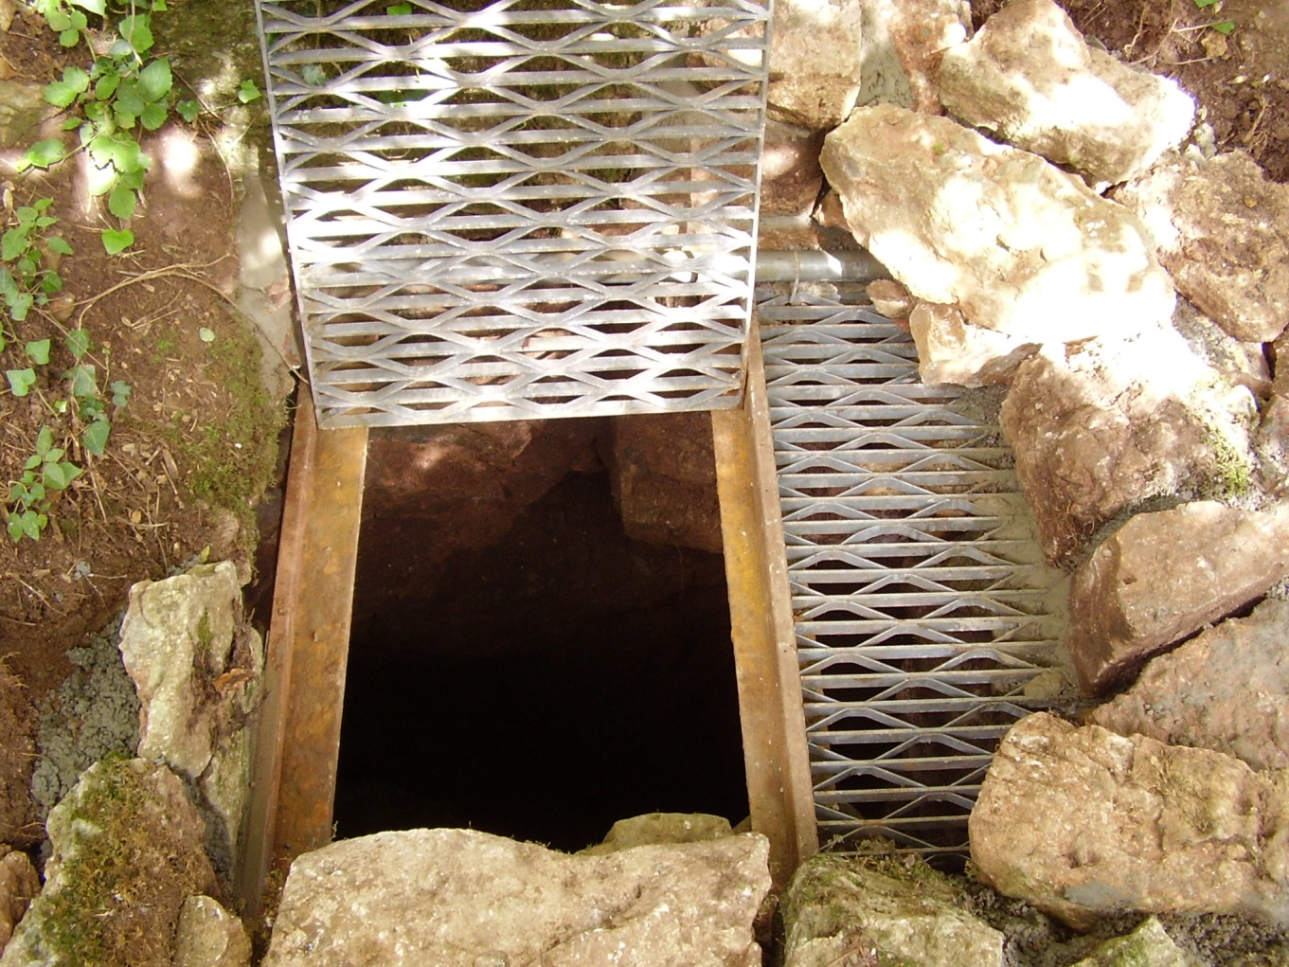
The continuing exploration of Hallowe’en Rift, Lower Milton.

Slide 2
The exploration of Hallowe'en Rift was started in 1982 by Trevor Hughes and other members of the Bristol Exploration Club. Then during the early 1990's Vince Simmonds and other local diggers were active at a number of locations within the cave, including the start of the present dig site in December 1991.
The current phase of exploration was commenced in 2009, with the majority of the early work being carried out by Vince Simmonds and Alex Gee; in 2012/2013 Rob 'Tav' Taviner, Graham 'Jake' Johnson and Nick Hawkes joined the regular digging team.
A number of others have offered their help on occasion including:
John 'Tangent' Williams, Bob Smith, Callum Simmonds, and a guest appearance by Ray Deasy from Australia.

Slide 3
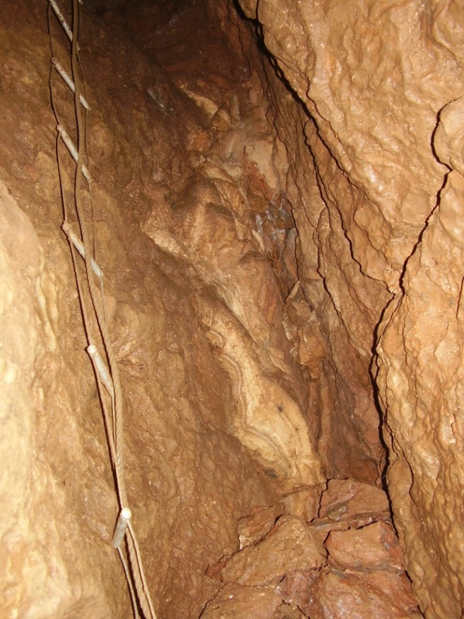
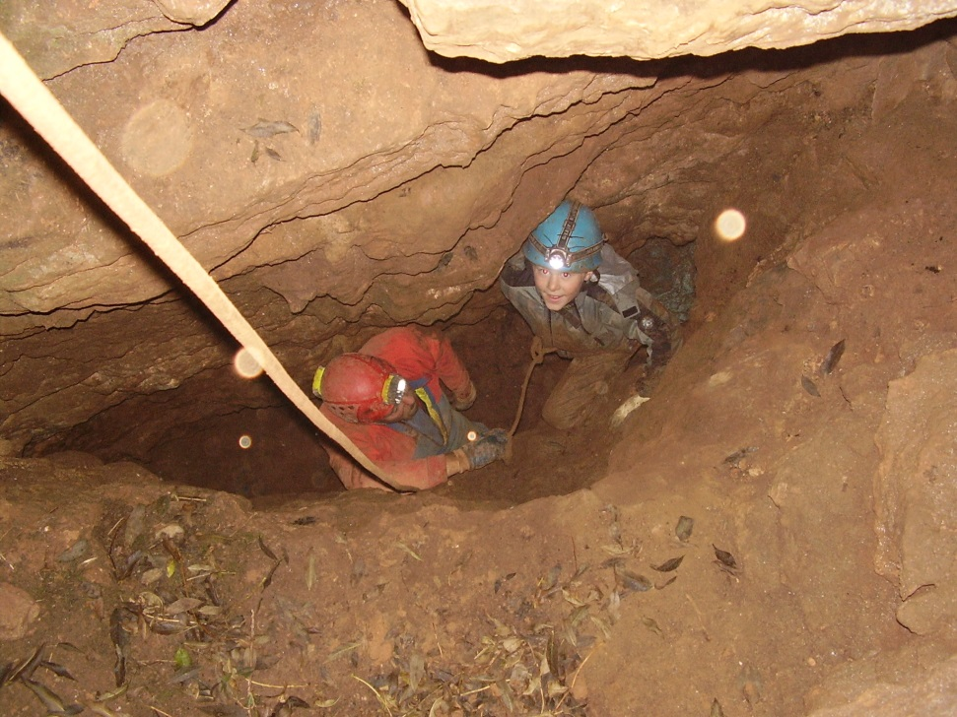
At the bottom of the entrance the early exploration in the 1980 - 1990’s was concentrated to the west side of the rift.
In 1991 a low ‘wormhole’ was started to the east of the rift…

Slide 4
…but by the mid ‘90s interest waned at Hallowe’en Rift as elsewhere a number of other projects were being pursued with gusto including Wigmore Swallet, Welsh’s Green, White Pit, Ogof Draenen and others, further afield.
In 2009 there was refreshed interest in Hallowe’en Rift initiated by Alex Gee and Bob Smith who were joined by Vince Simmonds and the team decided to pursue the ‘wormhole’ to the east of the entrance.

Slide 5
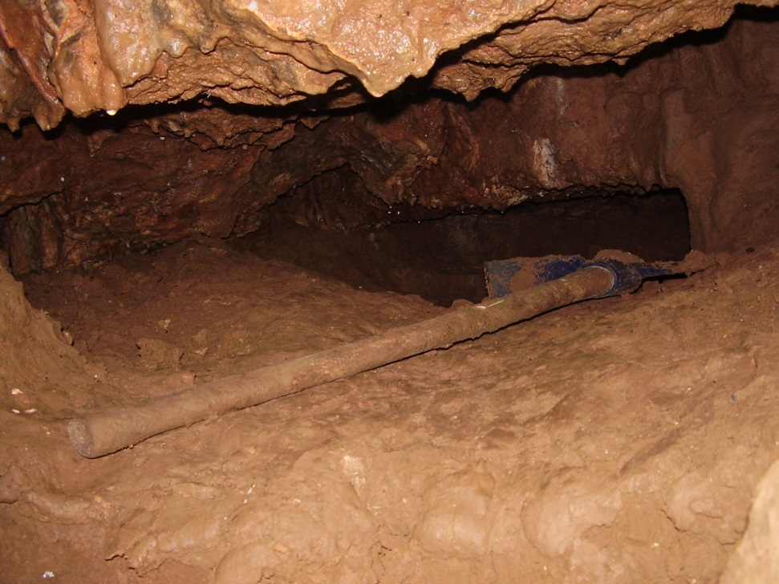
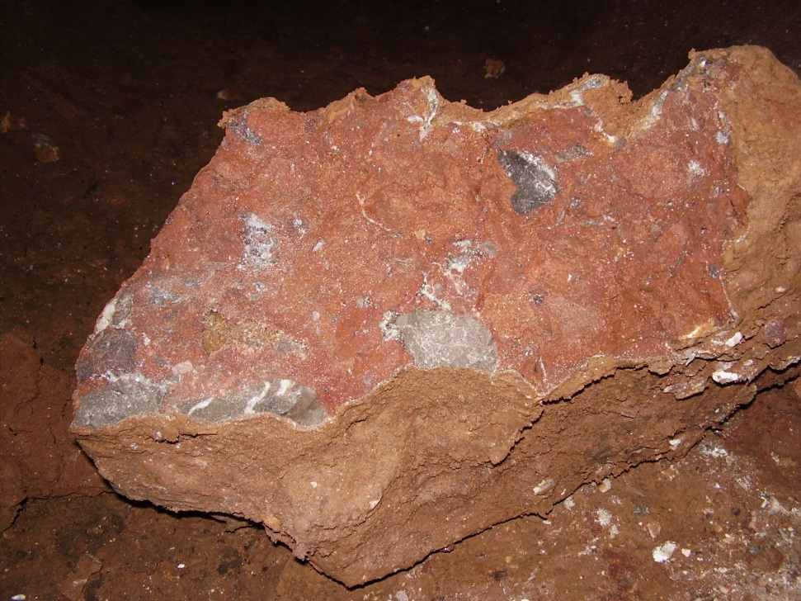
The task to remove the sediment, boulders and other obstacles began in earnest.

Slide 6
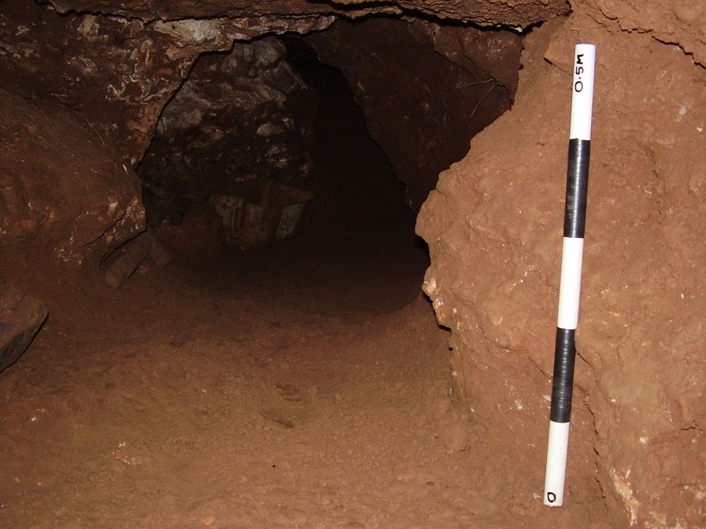
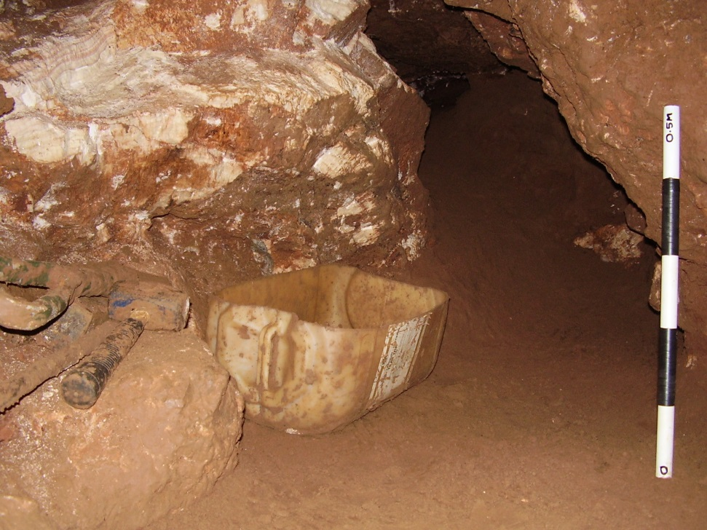
A year later in 2010, after some arduous excavation including passing a massive calcite obstruction, the passage was now a comfortable working size, and we had located a good draught!

Slide 7
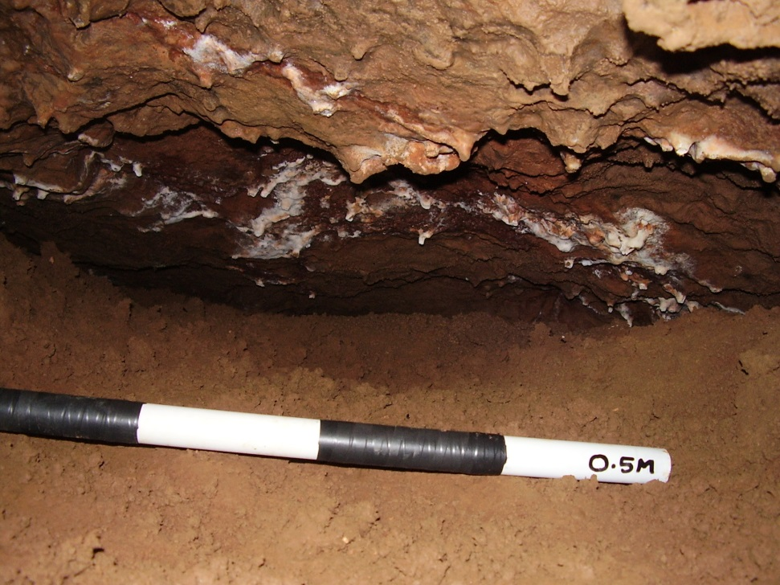
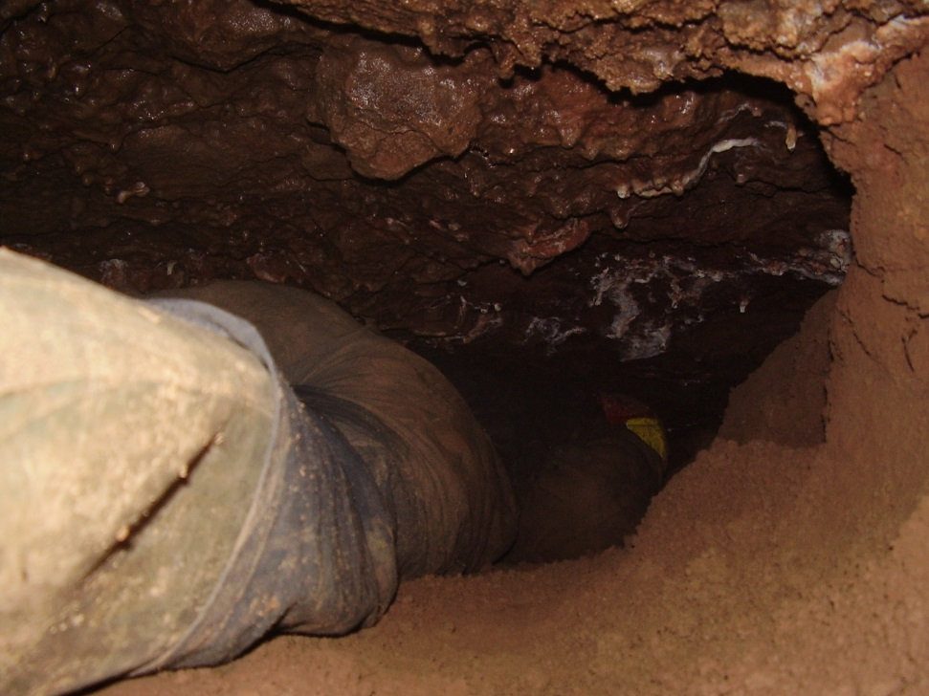
Around the corner there was a small airspace that appeared to go on, the digging was relatively easy – nice dry sediment with the odd boulder to make us work a bit, and there was a draught to follow.

Slide 8
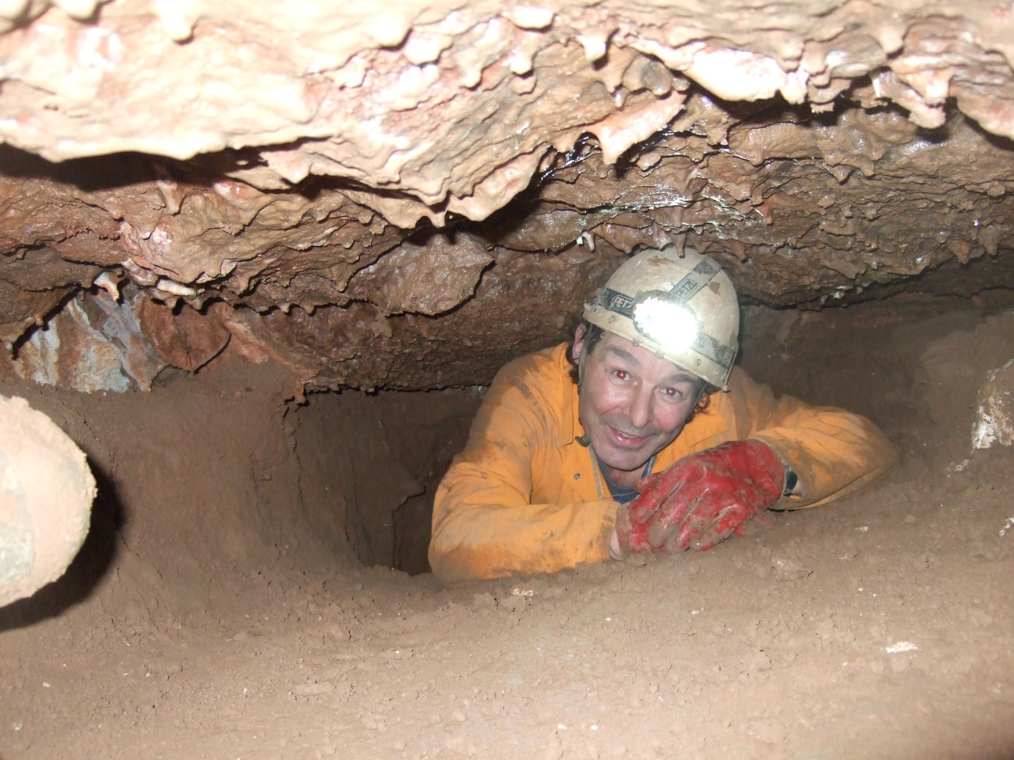
Happy days!
after another fine digging session.

Slide 9
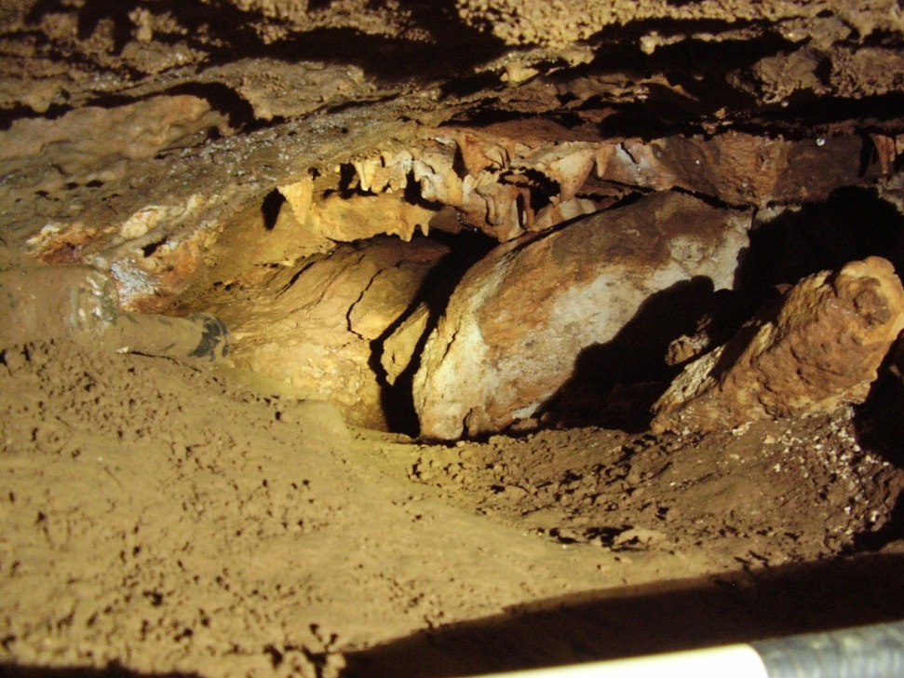
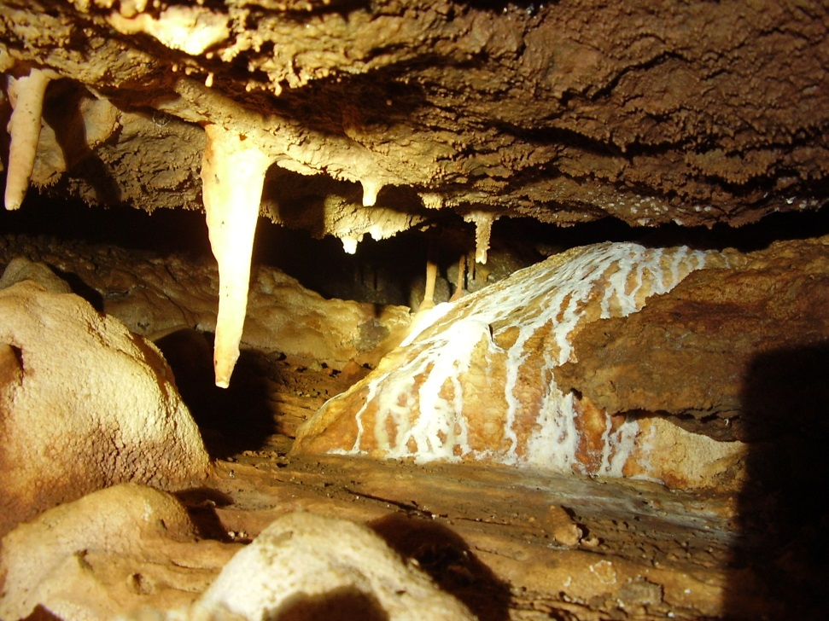
After a couple of longer digging sessions the passage began to open up a bit and there were some small but decent formations along the way.

Slide 10
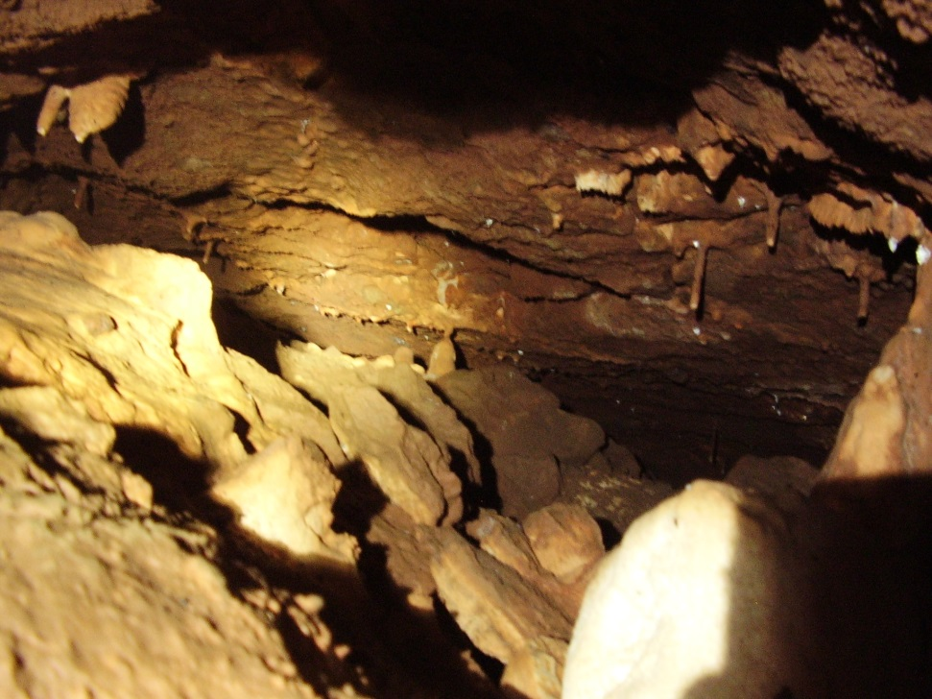
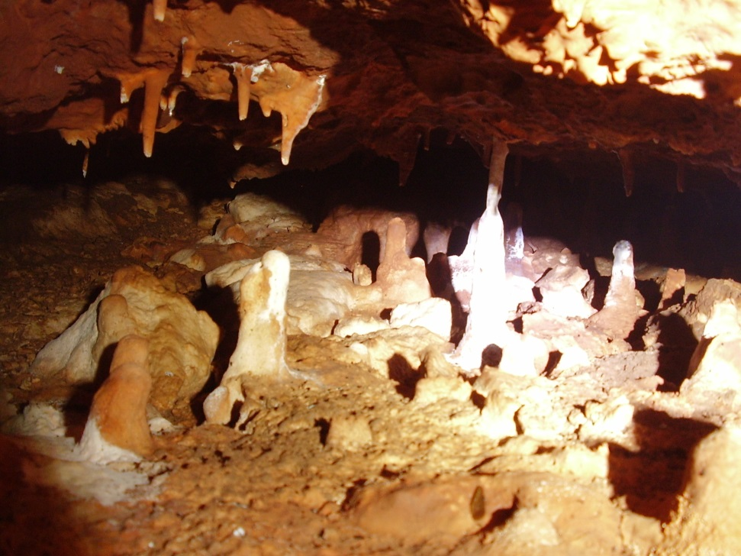
With a bit more effort and boulders shifted to the side the passage led with a wriggle into ‘Merlin’s Magic Milk Parlour’ where there are some fine formations.

Slide 11
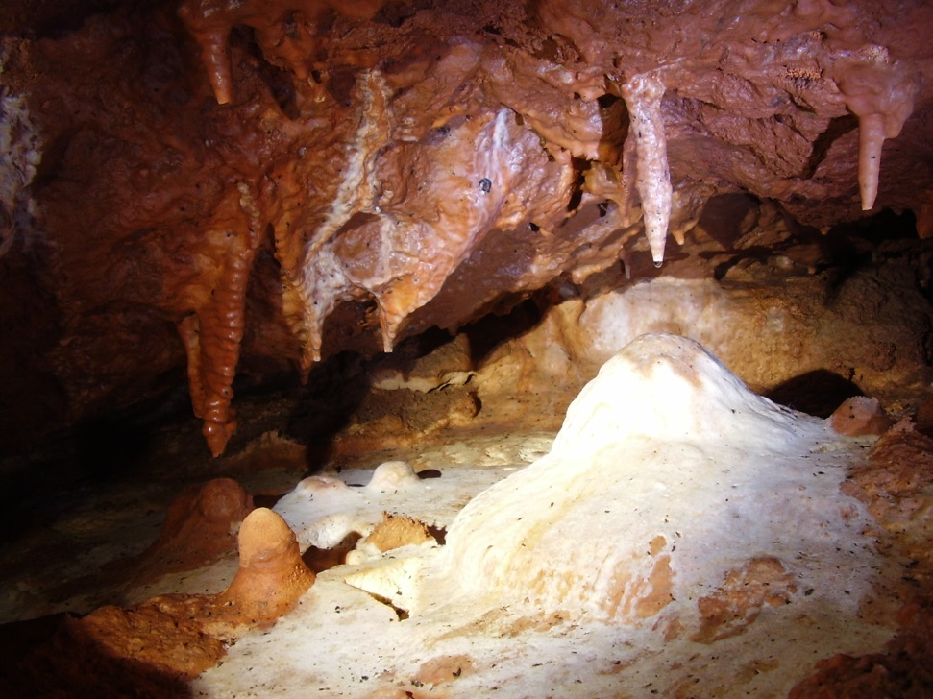
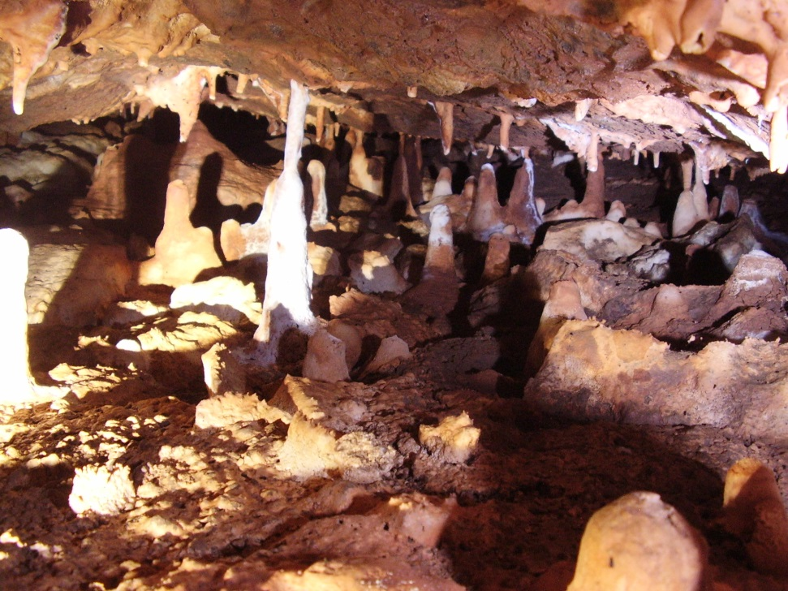
Now we had a dilemma, how to avoid the formations?
Fortunately we had passed over a pot in the floor and it was this that we decided to follow and see if we could find an alternative route.

Slide 12
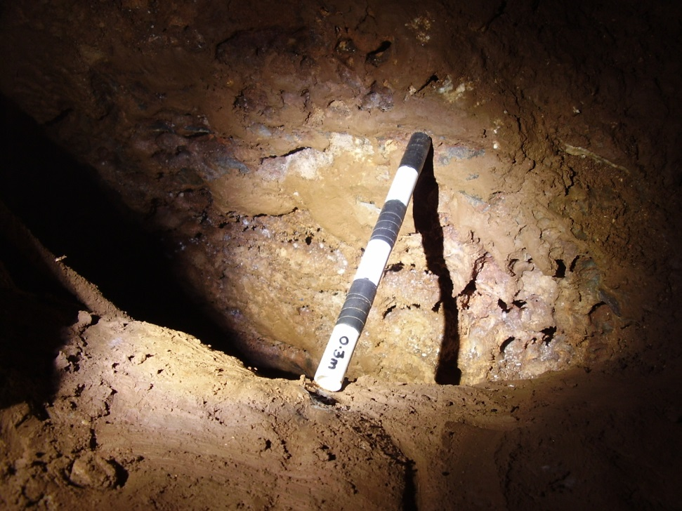
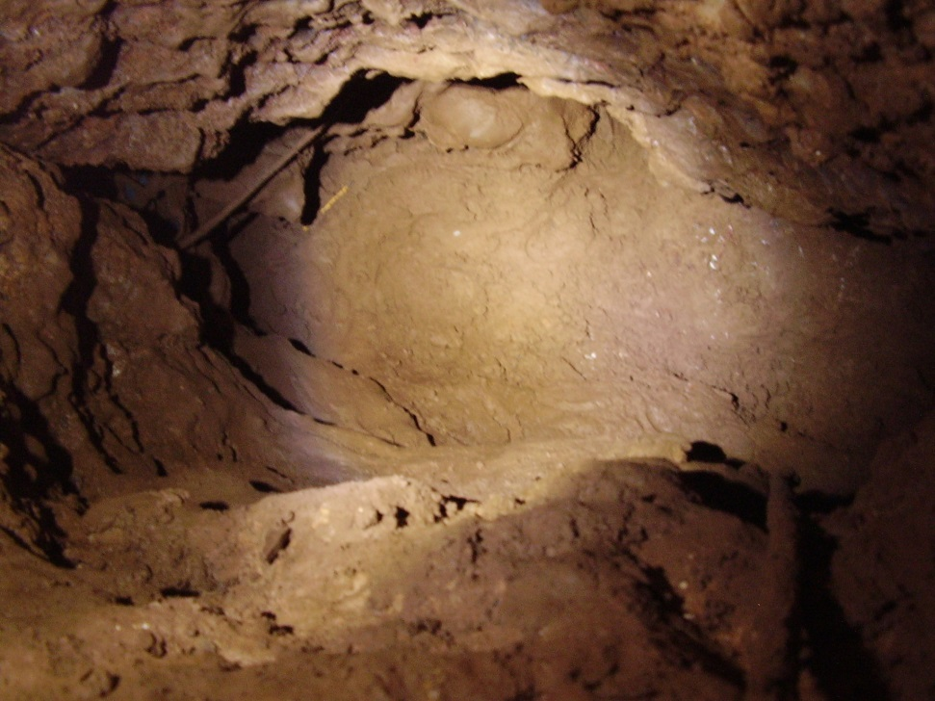
After a lot of grunting and cussing during the removal of some stubborn boulders we were able to access the pot - ‘Witches Cauldron’

Slide 13
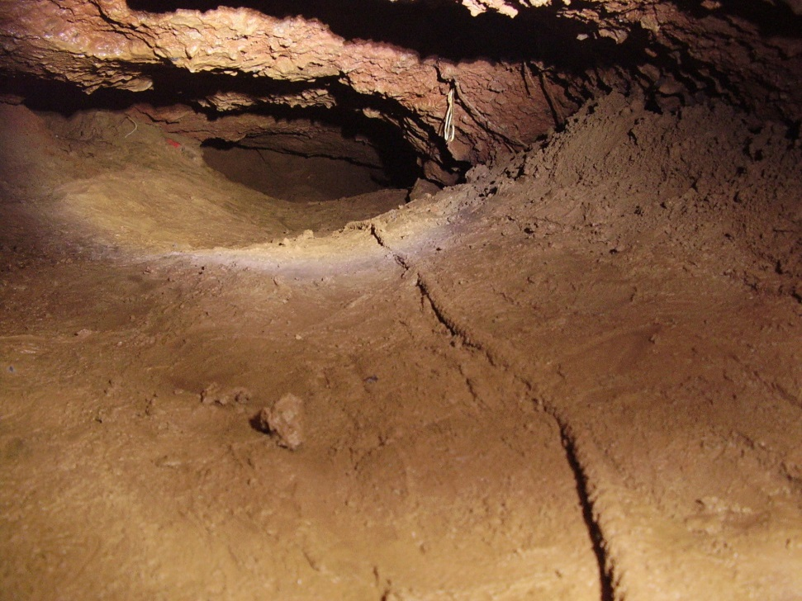
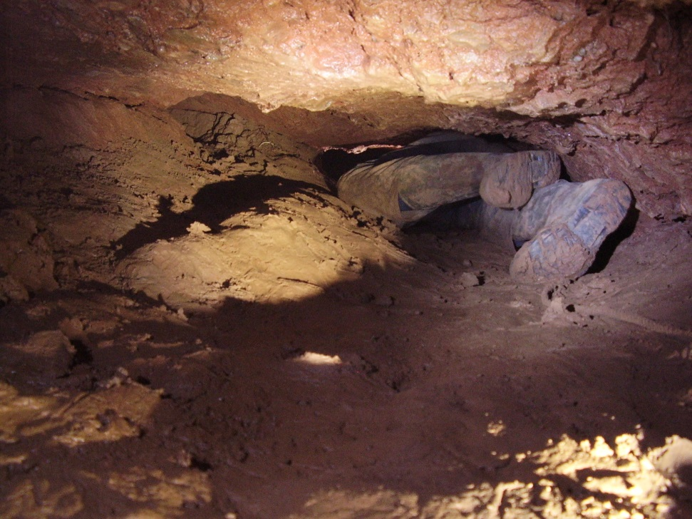
Leading off the bottom of ‘Witches Cauldron’ a partially sediment filled tube – ‘Toil and Trouble’ appeared to offer the alternative we were seeking, and we could still detect a draught!

Slide 14
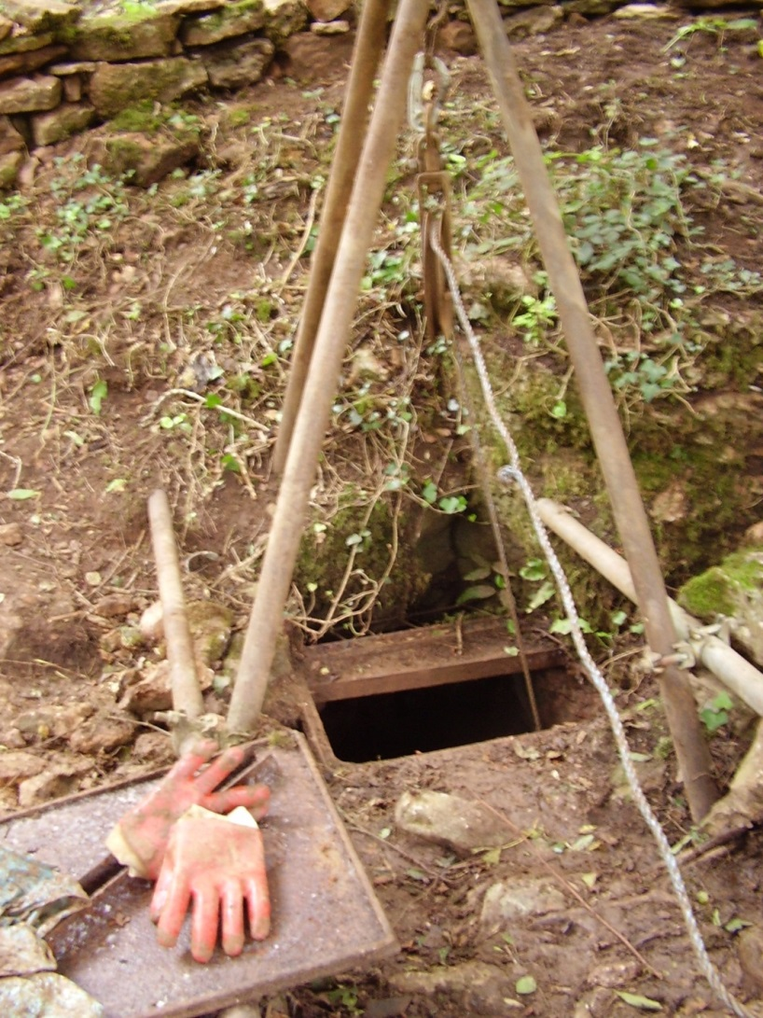
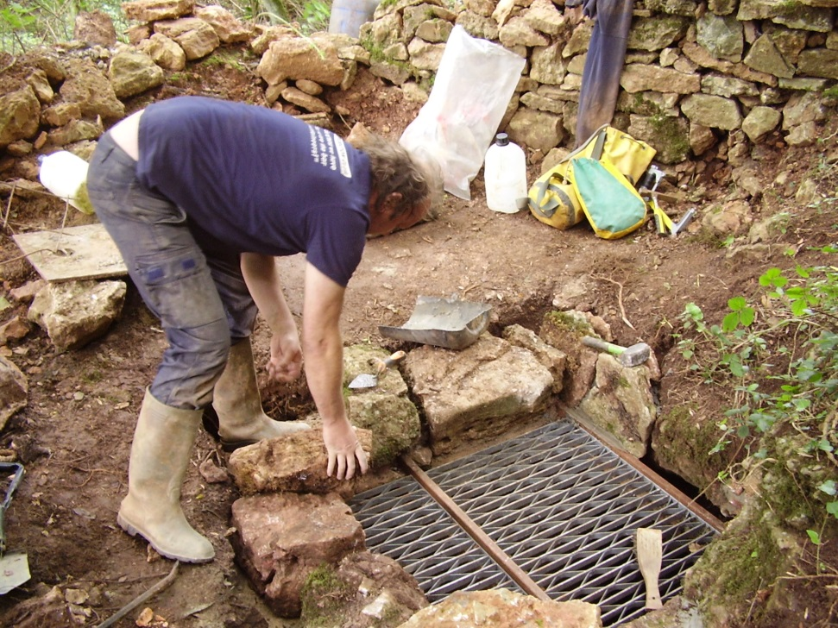
In the late summer of 2011 digging was held up for a while as the old entrance lid was replaced with something more substantial and the cave was locked at the farmer’s request (for access information contact the diggers).

Slide 15
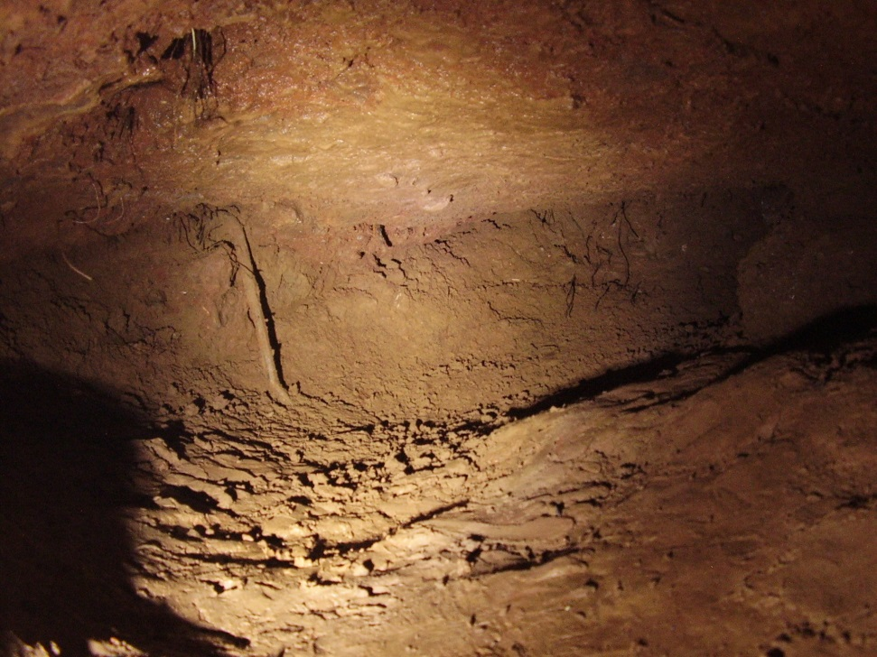
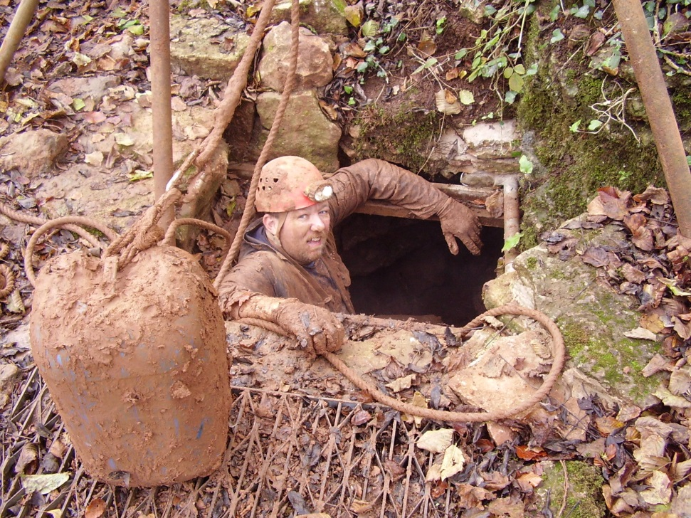
Back to work. Because of the constricted nature of ‘Toil and Trouble’ progress was sometimes a little slow and becoming somewhat sticky. The majority of the digging at this time was being done by Vince Simmonds and Alex Gee.

Slide 16
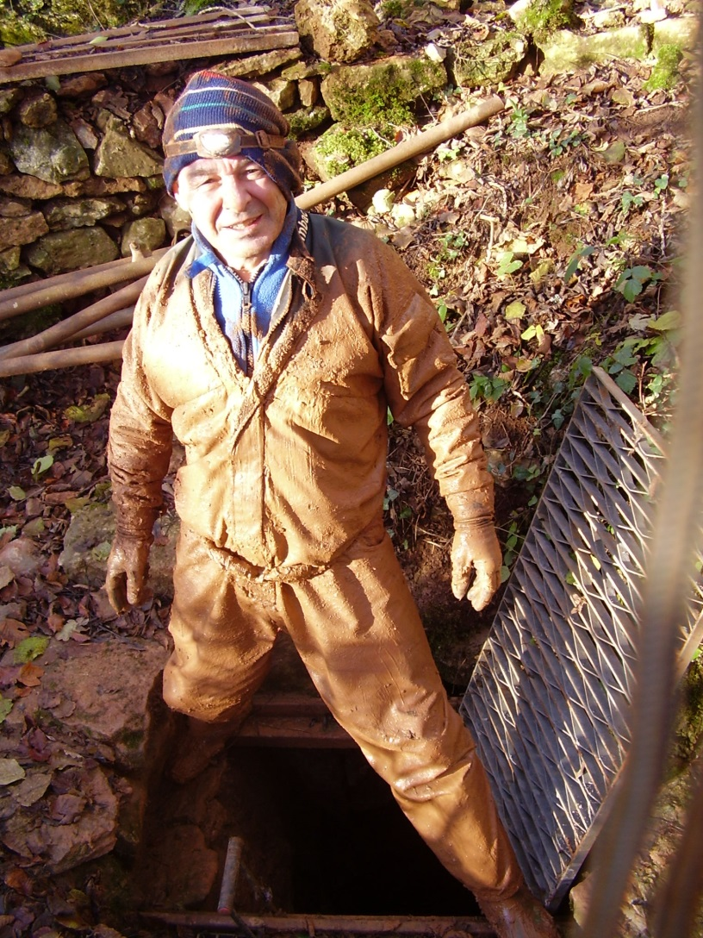
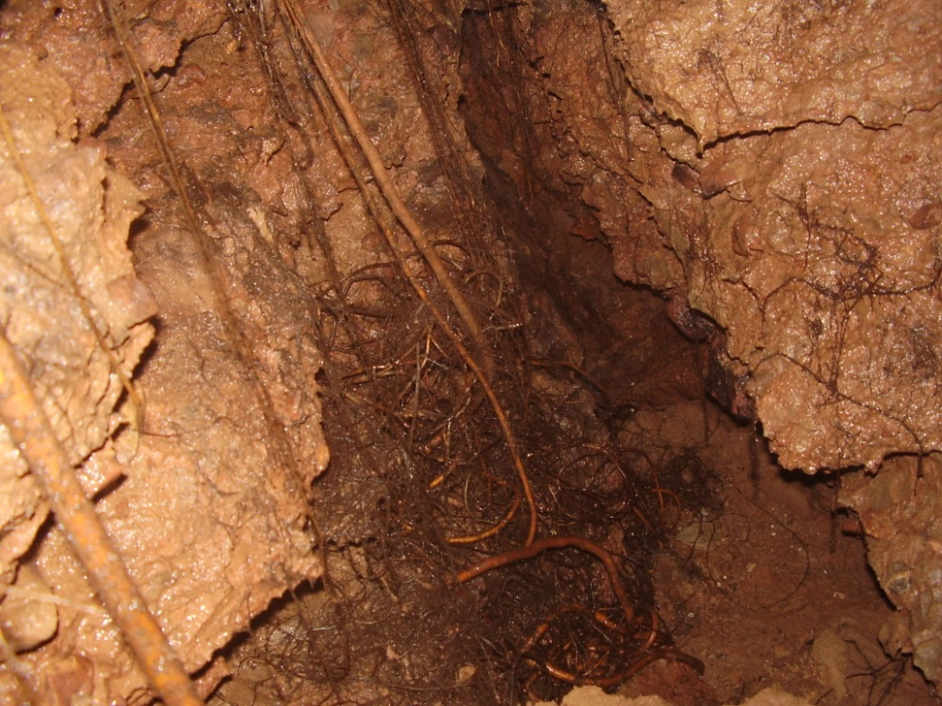
Along the tube a side passage was explored and led to a narrow rift with root growth. Digging was ceased as there was a question about the stability of the area and we returned to following ‘Toil and Trouble’.

Slide 17
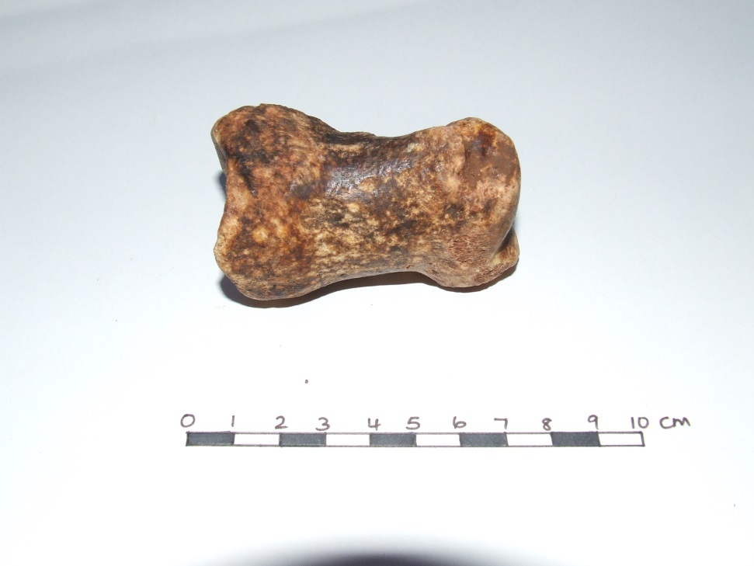
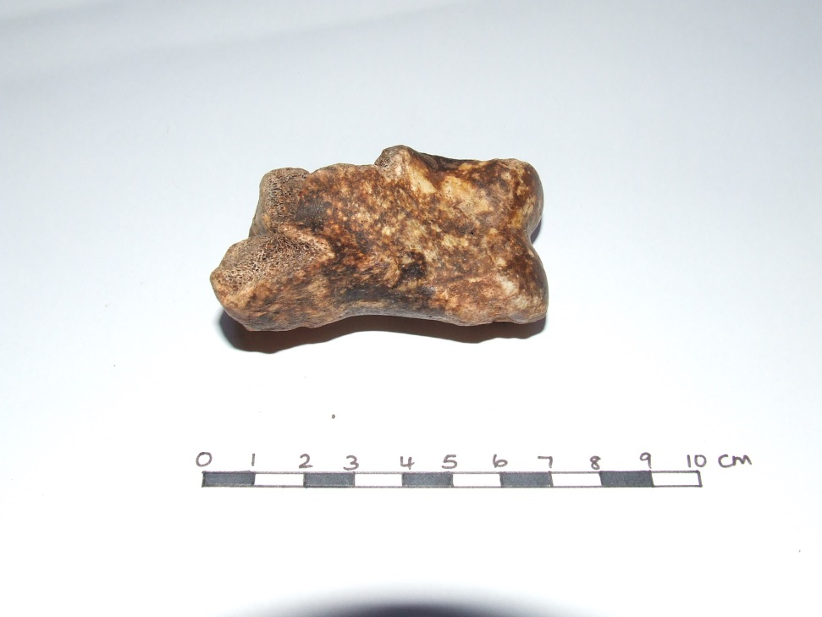
In the sediment we discovered a bone originating from the foreleg of Bison priscus, bones of this species recovered from Banwell Bone Cave have been dated 52,700 ±1900 ¹⁴C age BP to >59,000 ¹⁴C age BP and for Hunters Lodge Inn Sink as >54,800 ¹⁴C age BP.

Slide 18
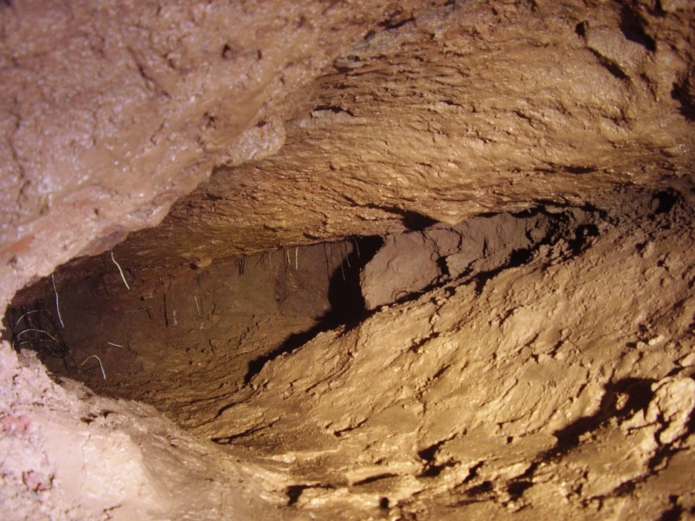
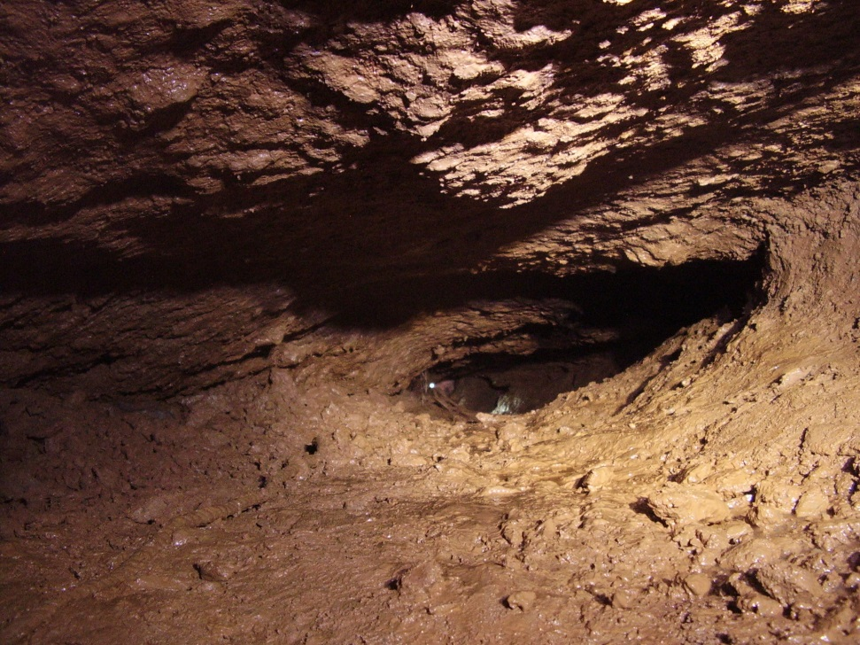
Looking into the side passage from ‘Toil and Trouble’ and back to ‘Witches Cauldron’ through ‘eye of newt’.

Slide 19
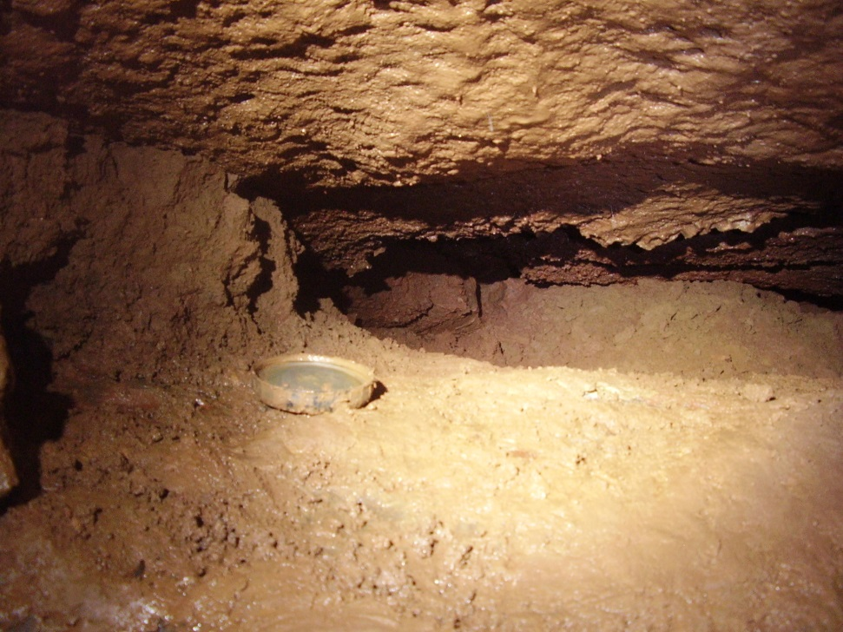
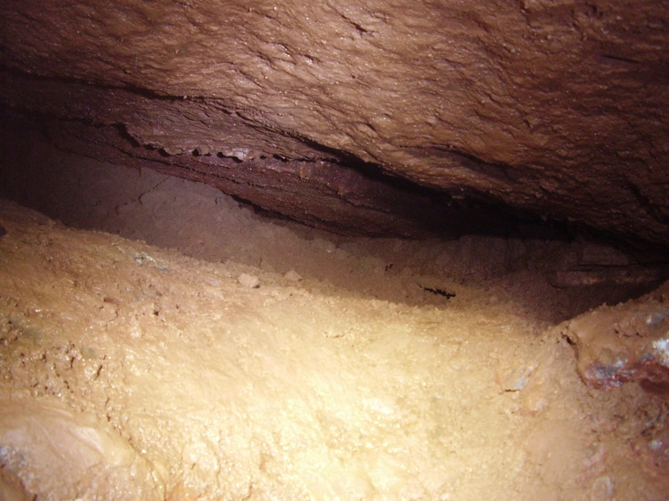
Looking at the way forward in ‘Toil and Trouble’ - there was plenty of work to get on with (the BDH lid is 100mm dia.).

Slide 20
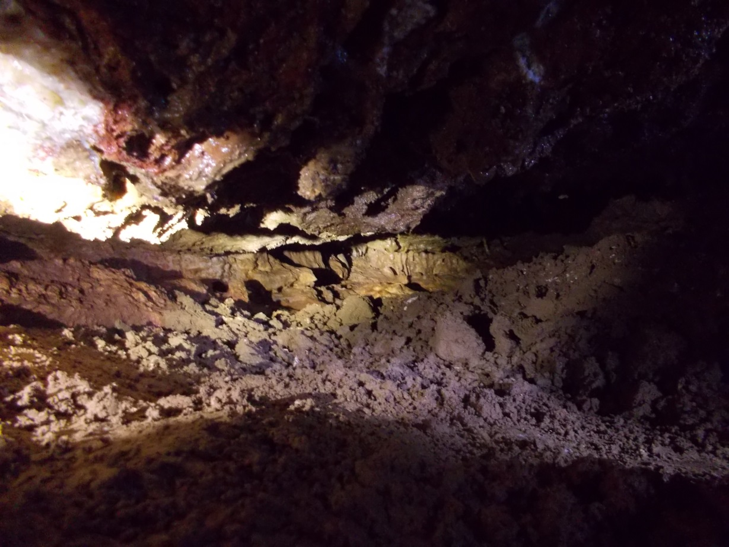
Now, after a good deal of digging at the end of ‘Toil and Trouble’ there is a junction where we spent a while following the left passage, which is still a relatively open and ongoing lead. We had a change of mind and decided to have a go at the passage to the right from where a strong draught emanated and where open space, albeit small, could be seen ahead.
Alex and Vince had now been joined by ‘Tav’ Taviner, ‘Jake’ Johnson and Nick Hawkes.

Slide 21
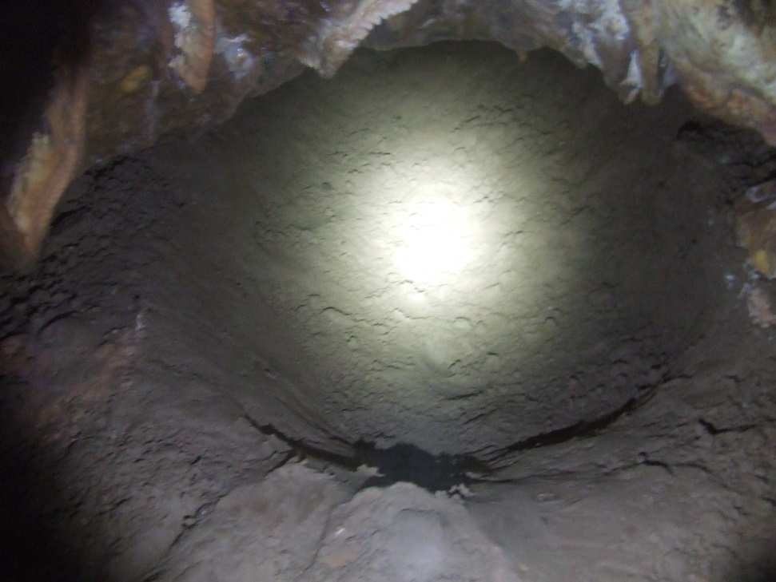
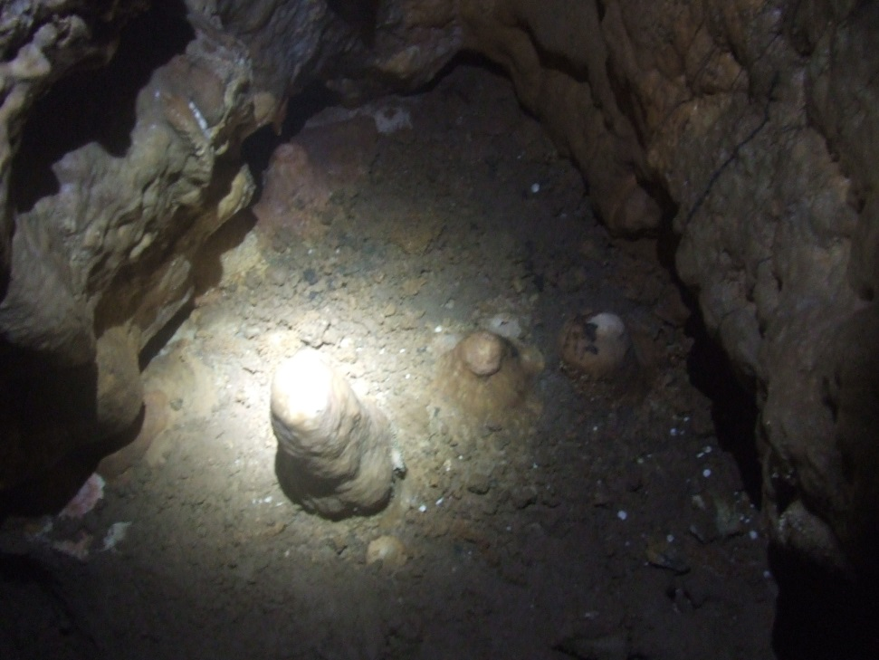
After a considerable enlargement effort , some rapid metres gained and a lot of spoil shifted we managed to dig through into a nicely decorated chamber with a connection into another chamber.
The largest of the stalagmites [below right] is about 300mm high.

Slide 22
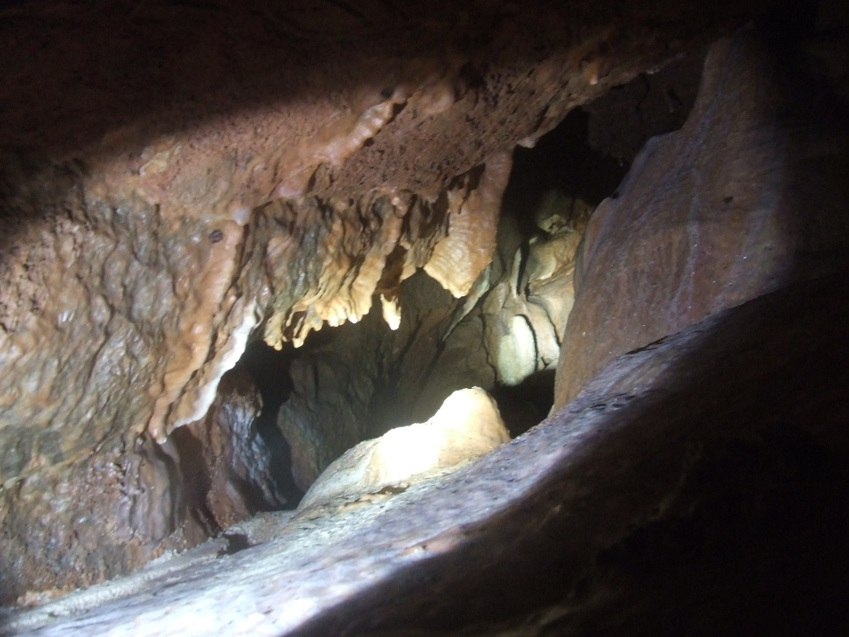
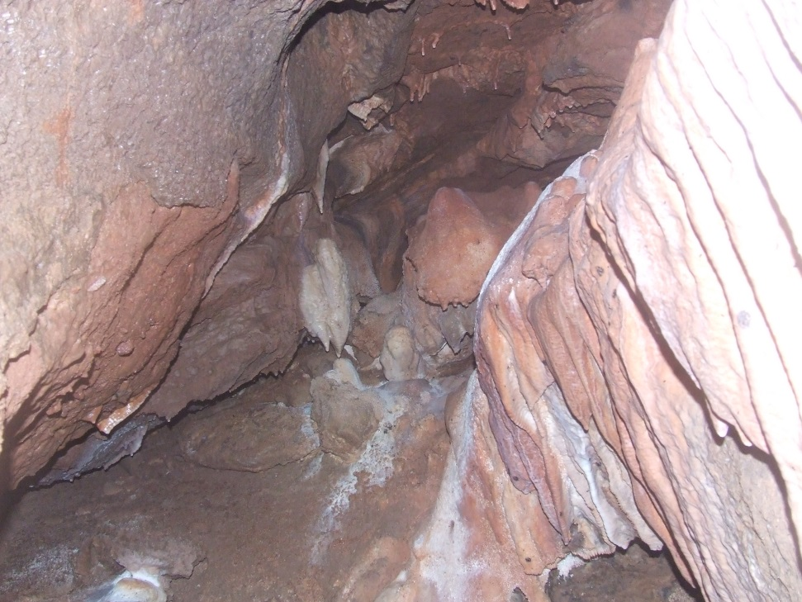
At shoulder height is a slot leading through to the second chamber.

Slide 23
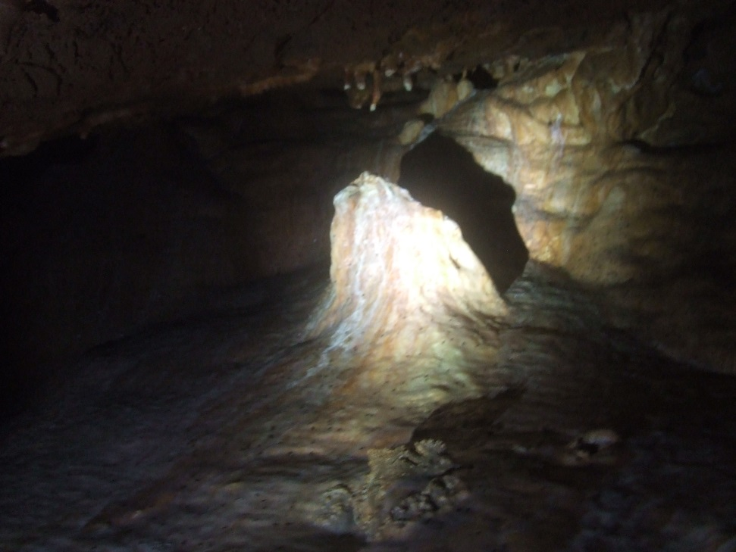
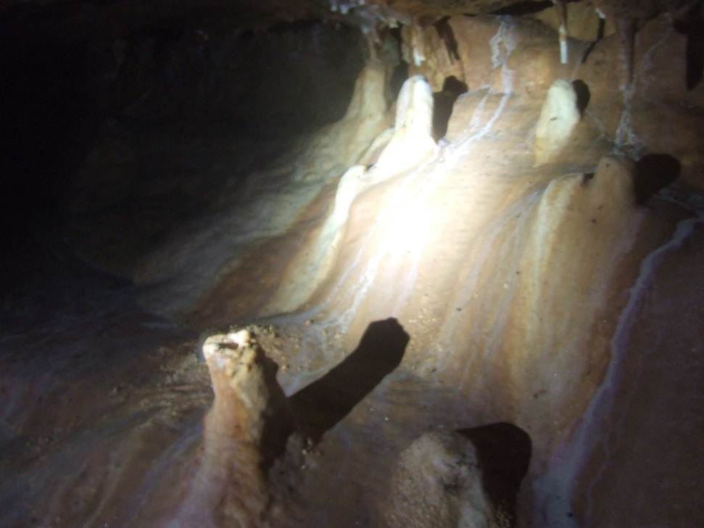
There are a number of decent formations around the first chamber. The new section of cave has been named - ‘Trick or Treat?’ - well it was that time of the year!

Slide 24
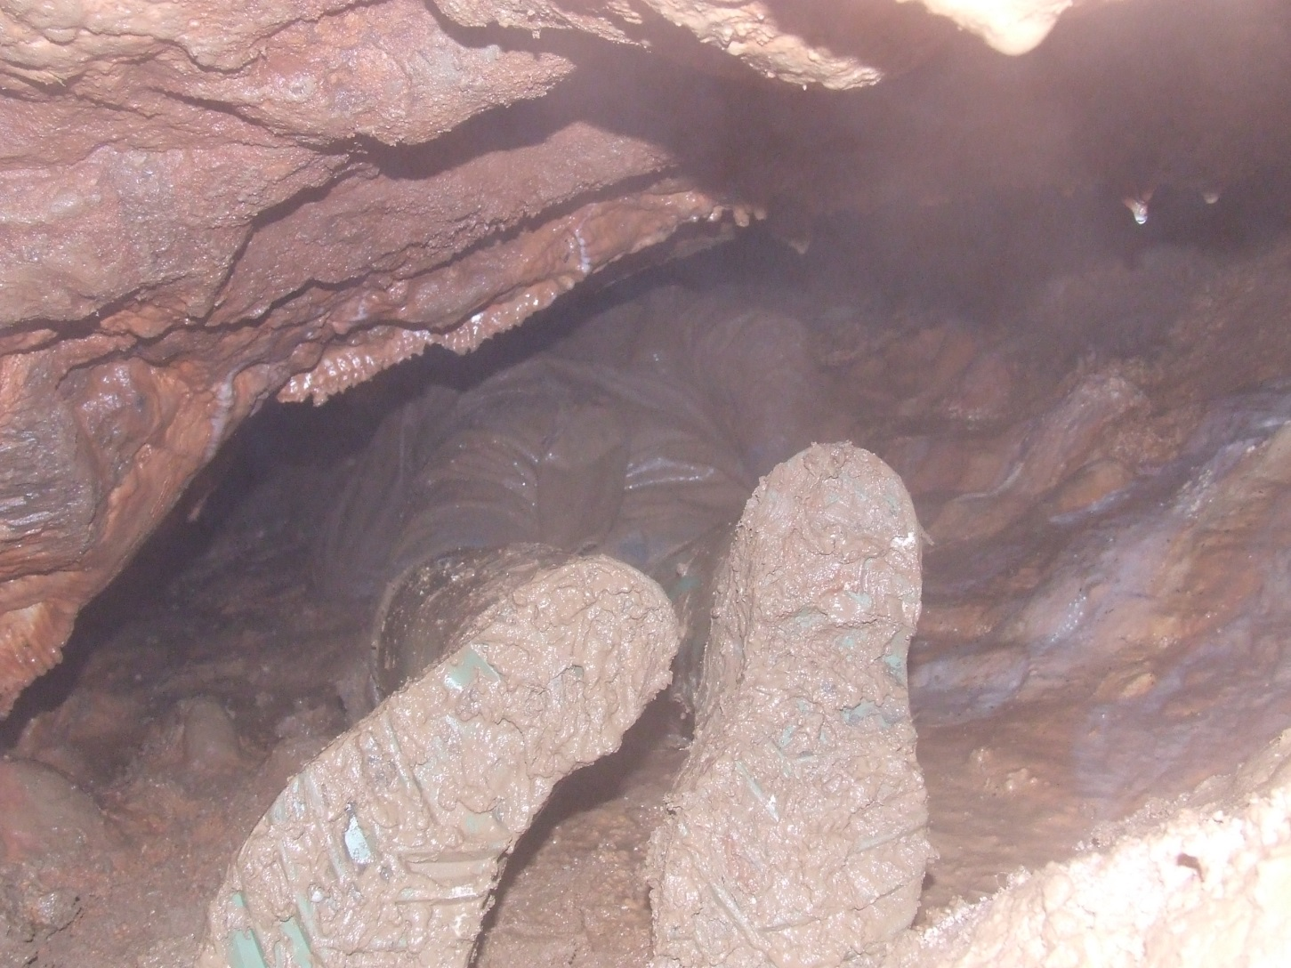
We have passed the slot to enter the second chamber where there is some potential for progress. However, beyond the chamber is a continuation into an inclined bedding that has very good prospects down dip requiring some spoil removal to where the passage, once again, appears to open out a little…

Slide 25
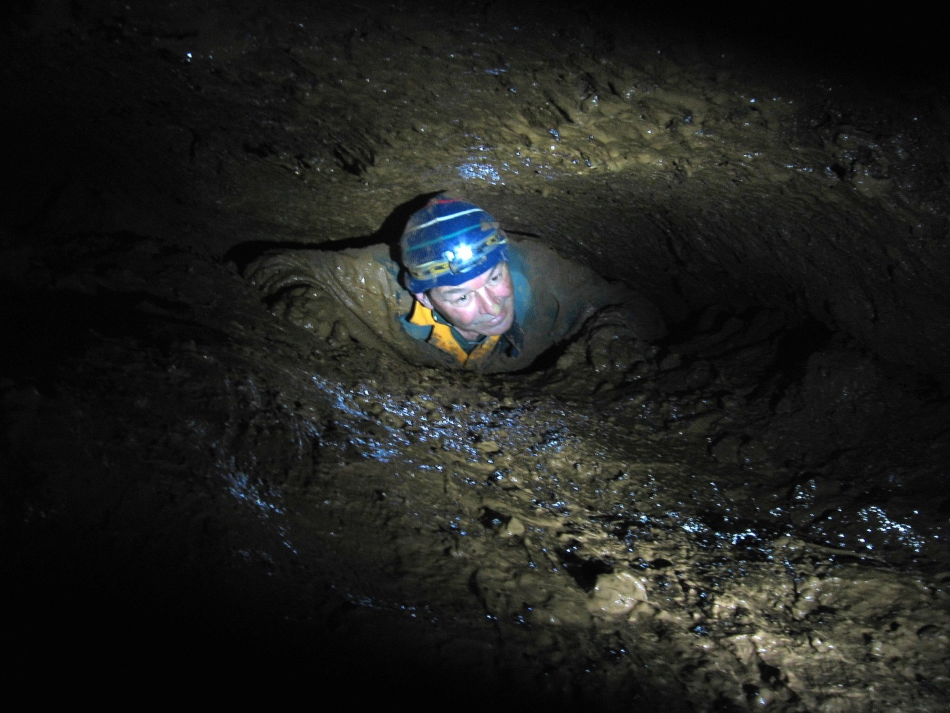
That’s the story so far, but it’s far from over yet!

Slide 26

keep on digging!

