Slide 1
Scaling up Maternal and Child health Handbooks in Lao P.D.R
Dr.Phouthong RATTANAVONG
Mother and Child Health Centre in Lao PDR

Slide 2
I. Demography and health facility in Lao P.D.R
Area: 236,800 square kilometers, 3/4 is mountains and plateau.
18 Provinces, 146 Districts, 10,552 Villages.
Total population 7.3 million
49 ethnic groups.
70% - Buddhist.

Slide 3
I. health facility ( cont)
There are 4 levels for health facility :
National level: 5 National hospitals
Provincial level: 17 provincial hospitals 12 police hospitals,
26 Army hospitals
District level: 135 district hospitals
Group village level: 1062 Health centers

Slide 4
II. Concept of MCH Handbook
Sustainability
Supply
Demand
MCH HAND BOOK USER GUIDE 2019
MCHHB +++
Quality services
5 good 1 satisfaction
Demand creation
Notes:
We had expect to improve MCH handbook on 2019
We had train user guideline all provincials all district hospital and near all health center
All so we successful to printing and useful for all health facilities in 2020
On during of COVID-19 pandemic, we had lock down country, but our service for Mother and child health we are to be continue to take care them all health facility (all the most we follow from WHO guideline)

Slide 5
III. Scaling Up Implementation of MCH Handbook for demand creation
Revising content by adding pictures, laboratory examination, Lab result, comprehensive child well being information and check up,
More than 90% of pregnant women received
Conducting MCH education in MCH services in each health facility. Nurses or health staff demonstrate MCH care by using and reading MCHHB
Notes:
We had expect to improve MCH handbook on 2019
We had train user guideline all provincials all district hospital and near all health center
All so we successful to printing and useful for all health facilities in 2020
On during of COVID-19 pandemic, we had lock down country, but our service for Mother and child health we are to be continue to take care them all health facility (all the most we follow from WHO guideline)

Slide 6
IV. Scaling Up Implementation of MCH HB for supply side
Developing MCHHB user guideline
Conducting training MCHHB user guideline for health providers in all provincial and district hospitals and almost all health centers
Mobilizing fund for MCHHB and user guide printing
Distribution MCHHB to all health facilities,
During country locked down due to COVID-19 pandemic, MCH services have been continuing in all health facilities and integrating with Covid 19 prevention measures according to WHO guidelin
Notes:
We had expect to improve MCH handbook on 2019
We had train user guideline all provincials all district hospital and near all health center
All so we successful to printing and useful for all health facilities in 2020
On during of COVID-19 pandemic, we had lock down country, but our service for Mother and child health we are to be continue to take care them all health facility (all the most we follow from WHO guideline)

Slide 7
IV. Scaling Up MCHHB for sustainability
Institutionalization of MCHHB: making an annual planning and budgeting for MCHHB activities including printing distribution training monitoring and supervision
Incorporating MCHHB into teaching material and subject in the medical schools
Using MCHHB to STRENGTHEN QUALITY OF MCH Services toward hospital accreditation development – 5 good and 1 satisfaction Hospital accreditation policy
Ultimate goal is to strengthen the health system to sustain MCH quality services and better MCH health outcome
Notes:
We had expect to improve MCH handbook on 2019
We had train user guideline all provincials all district hospital and near all health center
All so we successful to printing and useful for all health facilities in 2020
On during of COVID-19 pandemic, we had lock down country, but our service for Mother and child health we are to be continue to take care them all health facility (all the most we follow from WHO guideline)

Slide 8
V. Challenges of MCH Handbook
For Demand side - Mother
Some of pregnant women don’t come for ANC. Therefore, they don’t have their own MCH Handbook for recording on their health status
Some of pregnant women don’t bring MCH handbook with them when they come to the health facility. In case of referral it leads health provider to discontinue to monitor and care mother and children
Some of pregnant women can’t read, so they have to ask someone to read and explain her
Not yet system for community involvement

Slide 9
V. Challenges of MCH Handbook (cont)
For supply side - Health worker
Utilization MCH handbook of some health providers are limited
Less using of the picture in MCHHB for health education
Less recording of the Lab result in the MCHHB
Less checking the history or detail in MCHHB of pregnancy before examination
Not yet establishment of monitoring and assessment of MCH handbook system
Not yet involve by private health facility

Slide 10
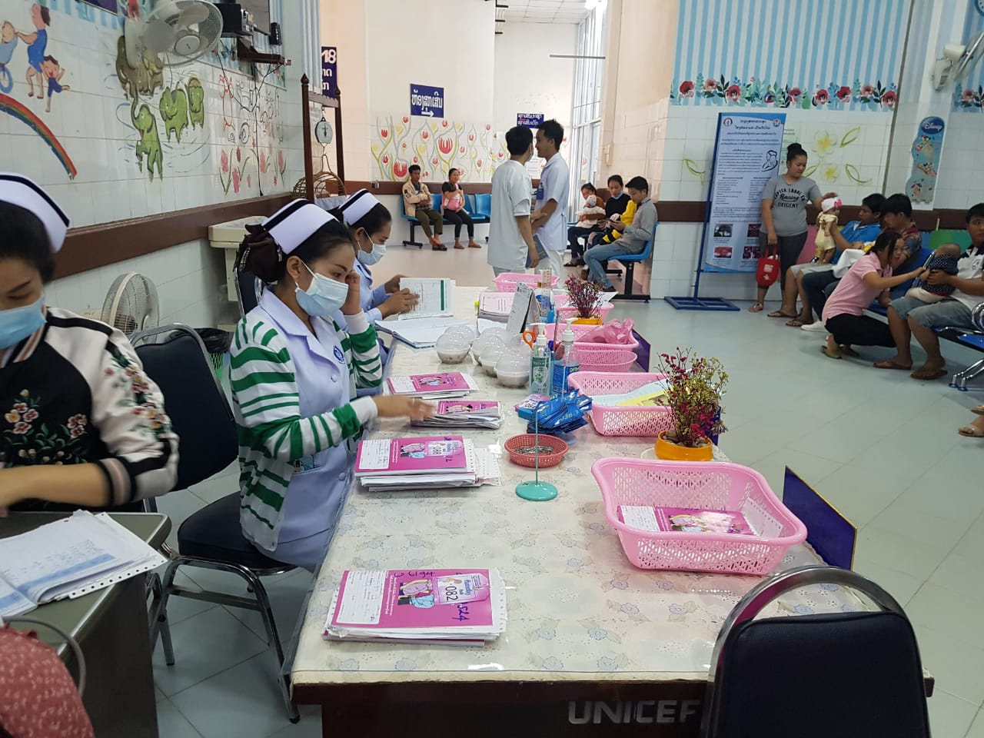
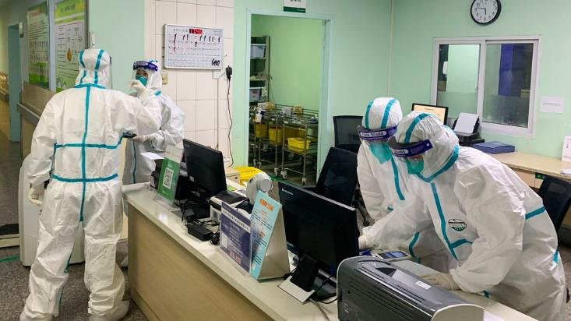
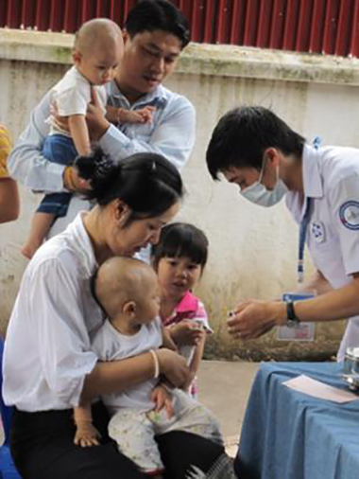
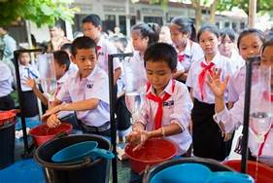
Activities of mother and child health services to continues on during COVID-19 pandemic

Slide 11
VI. Plan for Scaling Up of MCH Handbook in MCH services and beyond
INTEGRATED MCHHB into WELL CHILD SERVICES at provincial hospitals to monitor and promote child growths and developments for reducing triple burden of malnutrition
DEVELOP PACKAGE FOR HIGH RISK PREGNANCY CARE, PNC for central and provincial level
INTEGRATED MCHHB as a tool for strengthening quality and safety of essential MCH services during COVID-19 pandemic for health staff

Slide 12
VI. Scaling Up Plan (cont)
INTEGRATED MCHHB in PILOT PROGRAM FOR TRIPLE ELIMINATION OF HIV, SYPHILIS, HEPATITIS B
INCOORPORATE MCH HB in curriculum of medical doctor, midwife and nurse
ENGAGE PRIVATE HOSPITALS IN USE OF MCH HANDBOOK
STRENGTHENING COMMUNITY INVOLVEMENT Support of MCH promoters, increased involvement of local authority
DEVELOP MOTHER CLASS

Slide 13
Thank You
For Your Attention
Q & A

