Slide 1


Slide 2
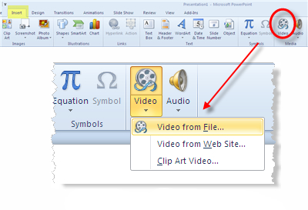
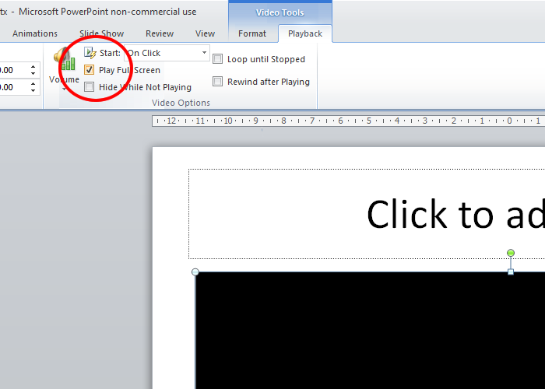
DELETE THIS SLIDE WHEN DONE
To insert a video select Insert from the options above.
Browse to where you have saved the video you downloaded from the site, and then select it.
When the video is inserted, a ‘Playback option will appear.
Select ‘Play Full Screen’
You’re Done – Now DELETE this slide

Slide 3
Insert More_To_Life.mp4 here

Slide 4


Slide 5
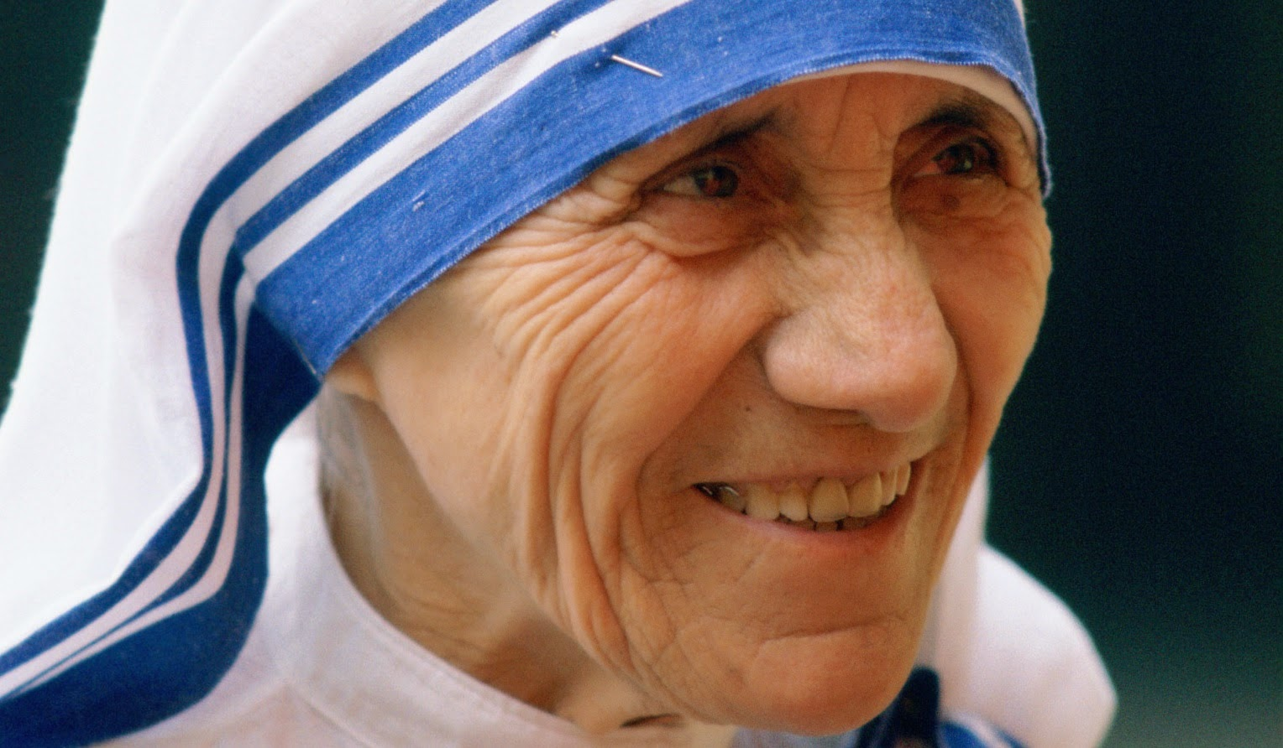

Slide 6


Slide 7
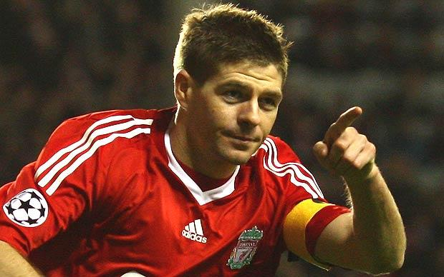

Slide 8


Slide 9
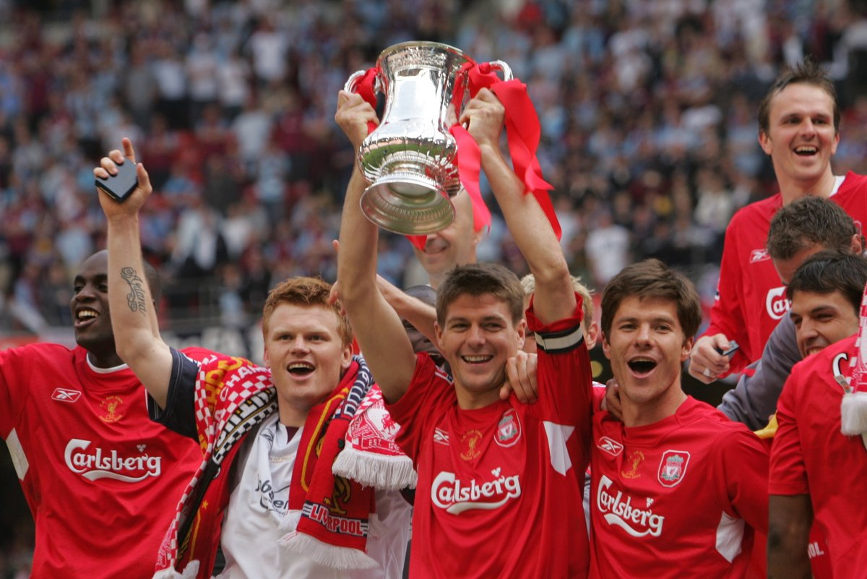

Slide 10


Slide 11
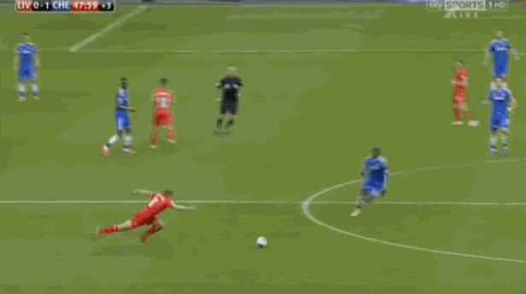

Slide 12
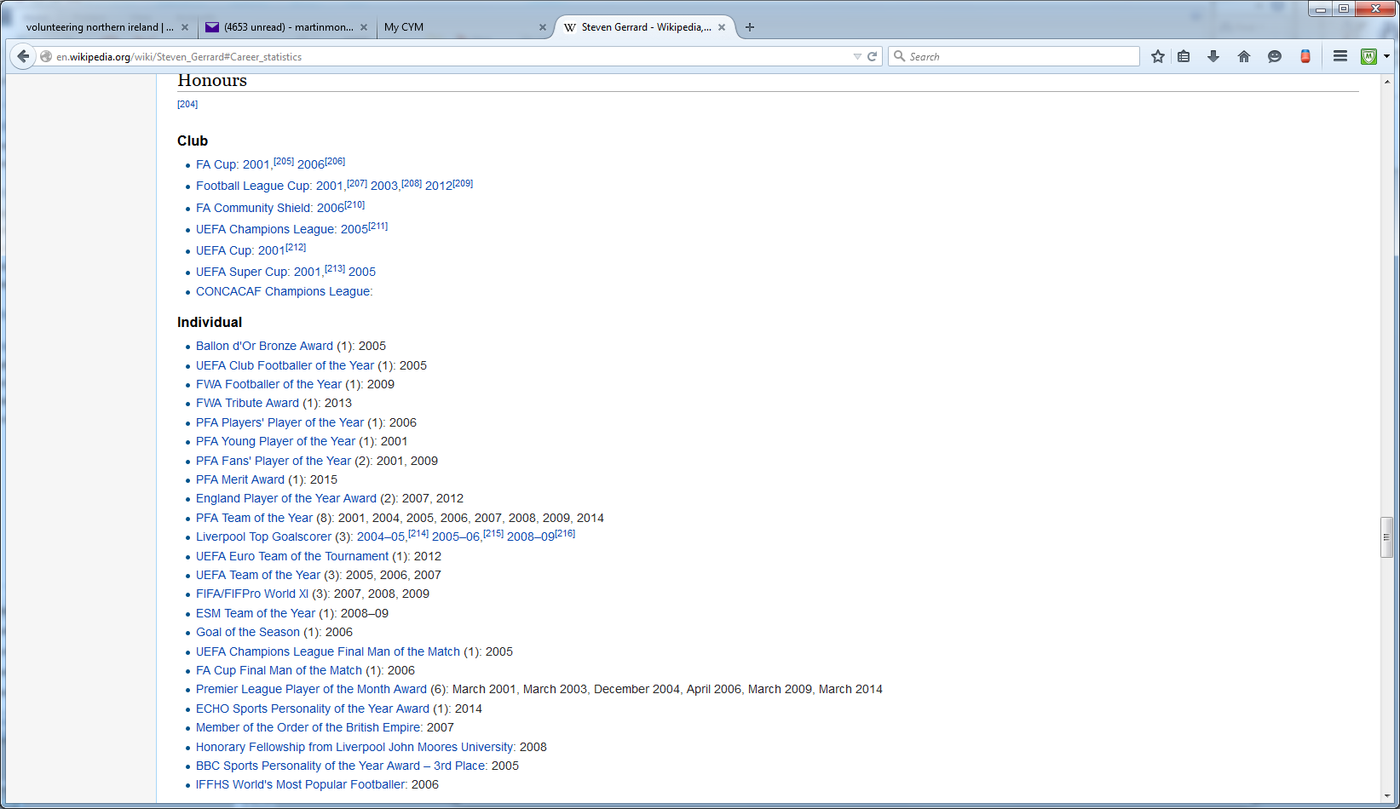

Slide 13
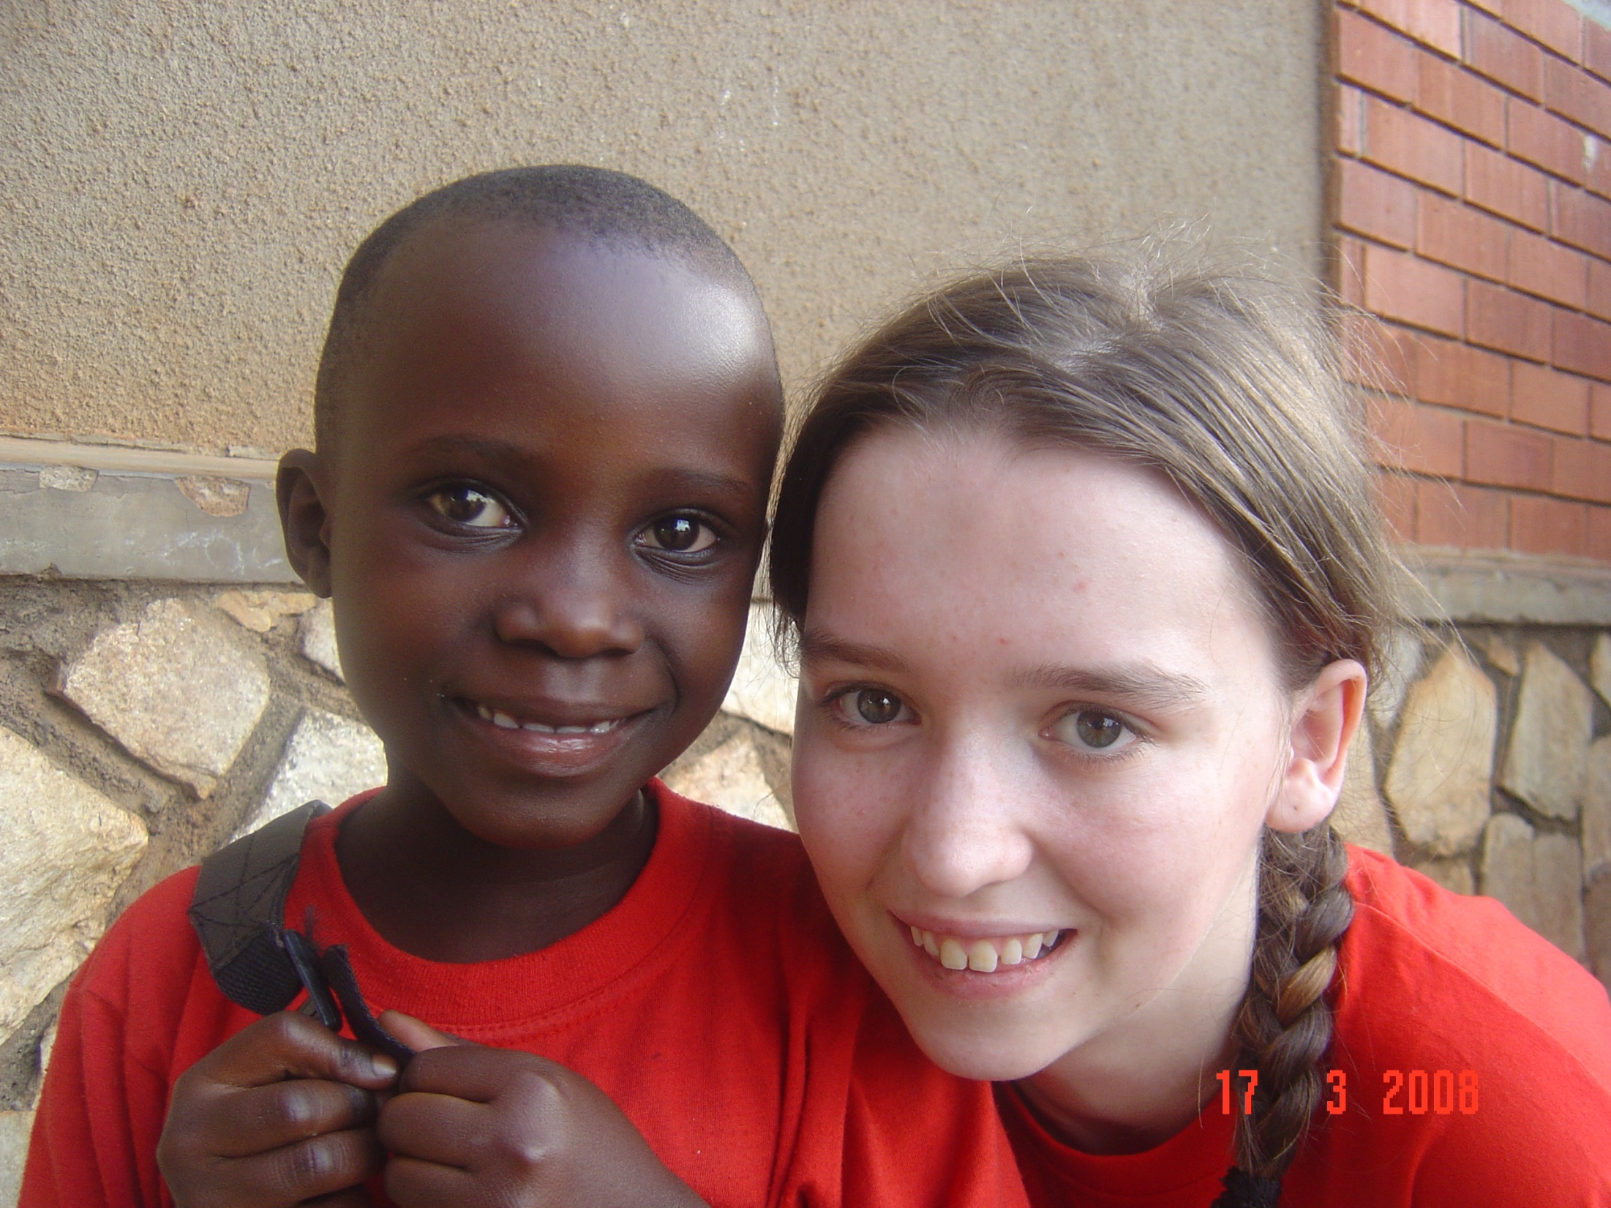

Slide 14
DELETE THIS SLIDE WHEN DONE
To insert a video select Insert from the options above.
Browse to where you have saved the video you downloaded from the site, and then select it.
When the video is inserted, a ‘Playback option will appear.
Select ‘Play Full Screen’
You’re Done – Now DELETE this slide

Slide 15
Insert Charlenes_Story_1.mp4 here
This is optional. If you wish to only include the 3rd video, then delete this slide.

Slide 16
Insert Charlenes_Story_2.mp4 here
This is optional. If you wish to only include the 3rd video, then delete this slide.

Slide 17
Insert Charlenes_Story_3.mp4 here

Slide 18
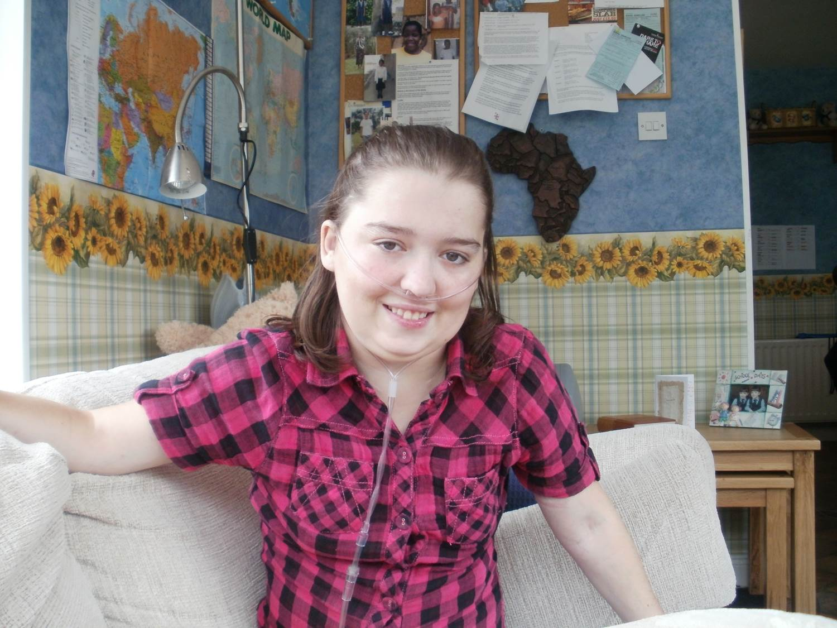

What things held Charlene back in life?

Slide 19

What was Charlene’s attitude to her condition throughout her life?

Slide 20
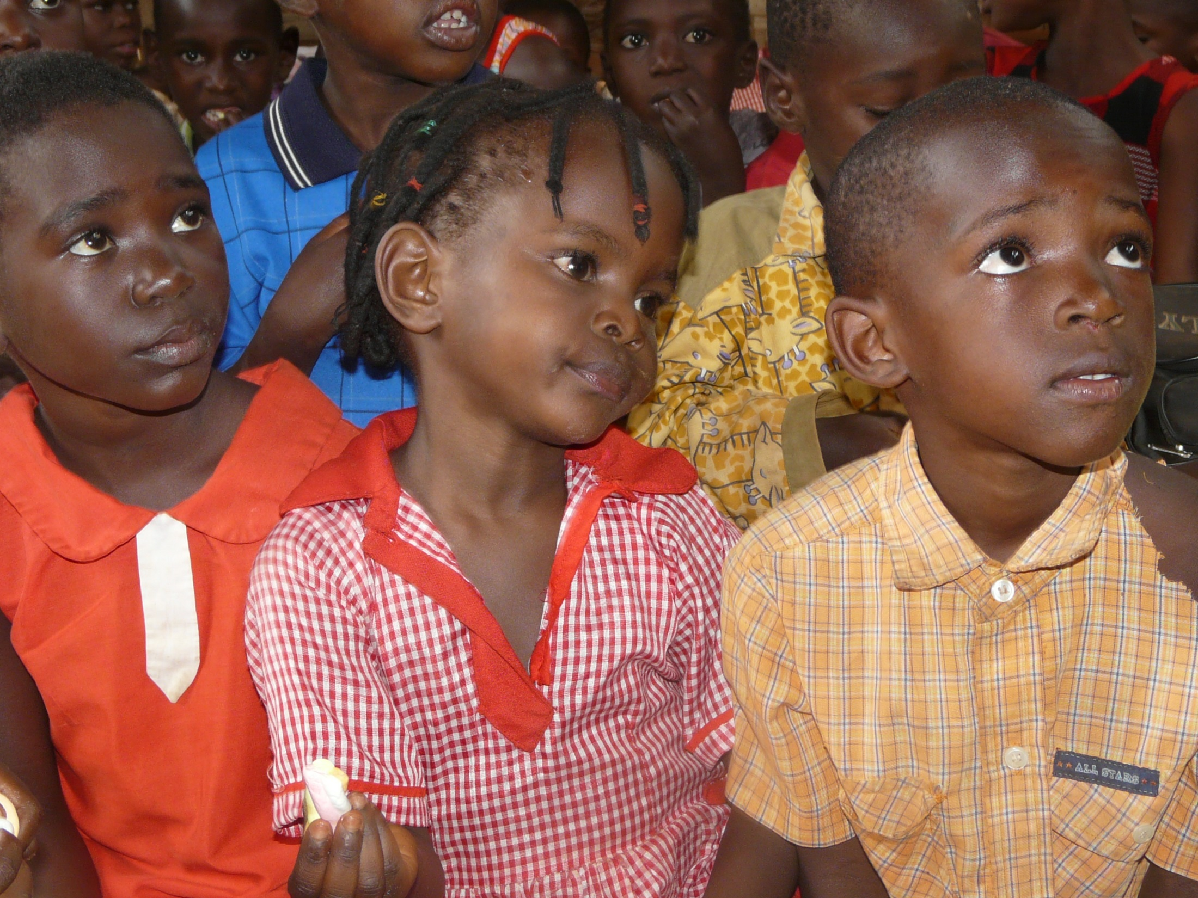

What do you think motivated Charlene to build a school?

Slide 21
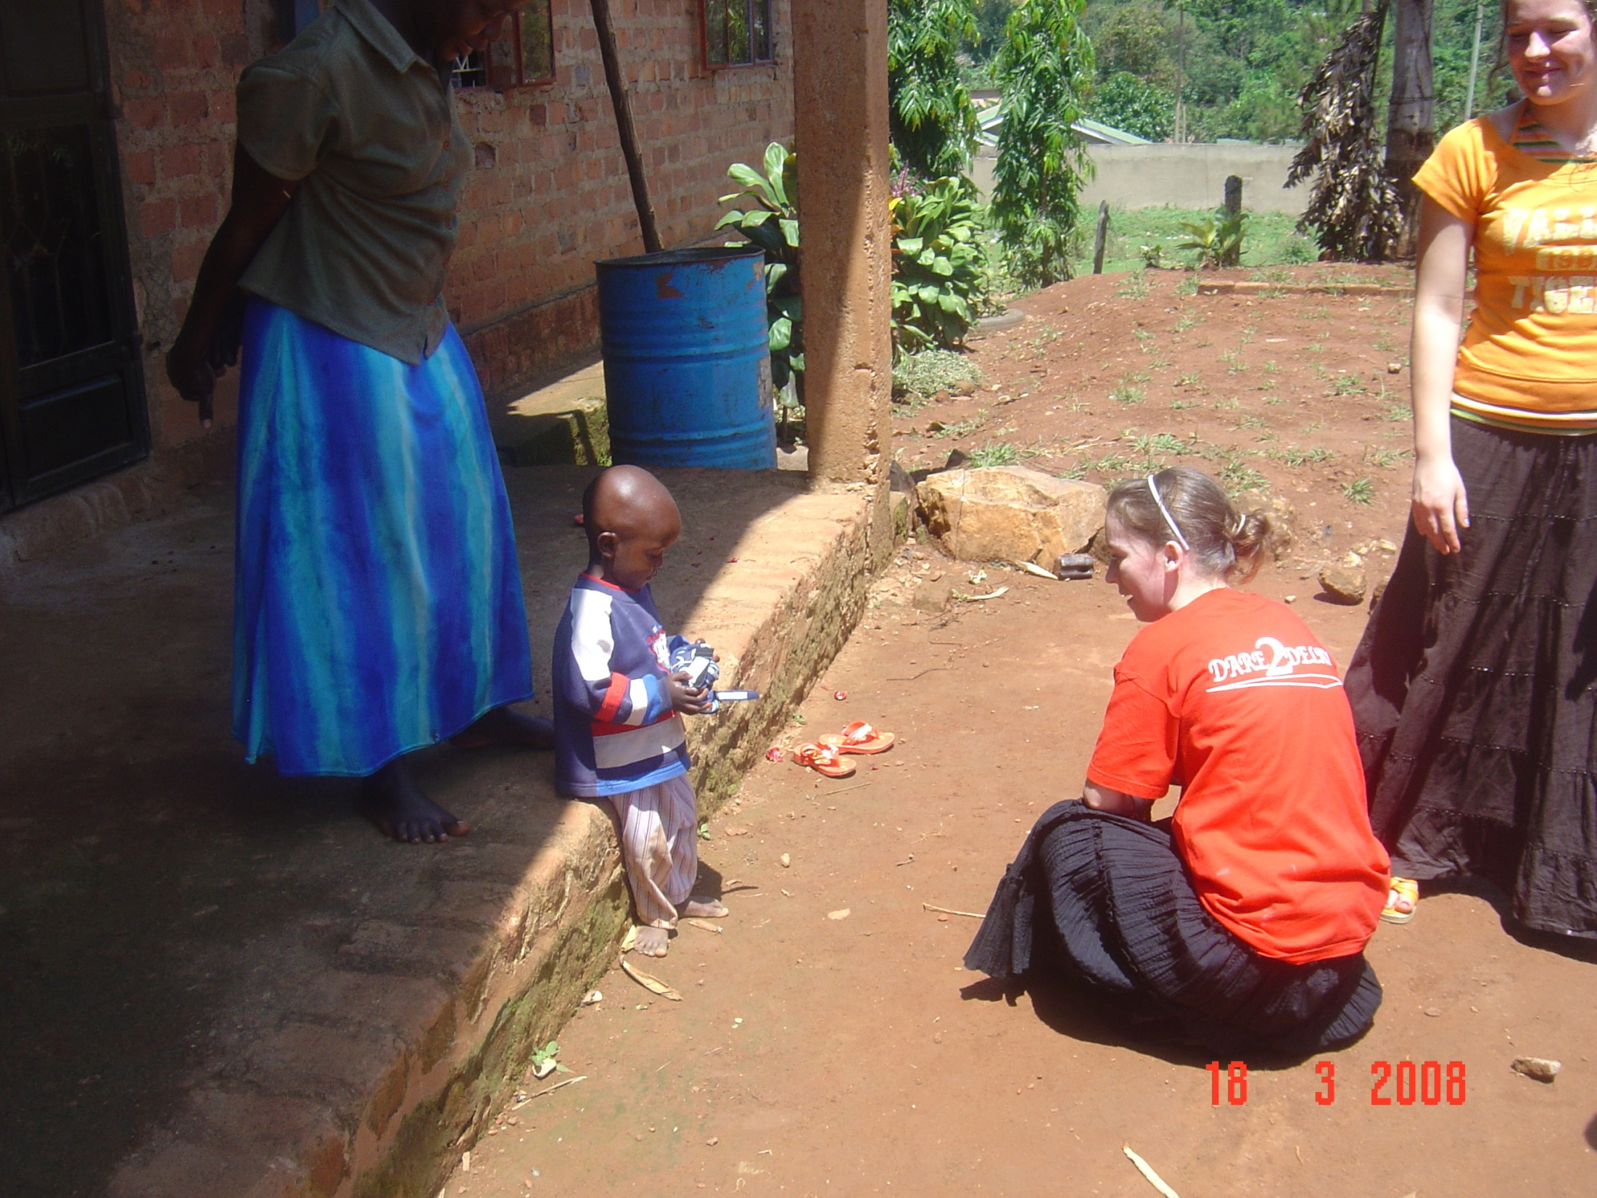
A wise Rabbi once said the most powerful one line prayer he ever read was: “Let me not die while I am still alive.”
Charlene knew that her life could have ended within a matter of days, how do you think she showed the world that she was determined not to ‘die while she was still alive’?

Slide 22
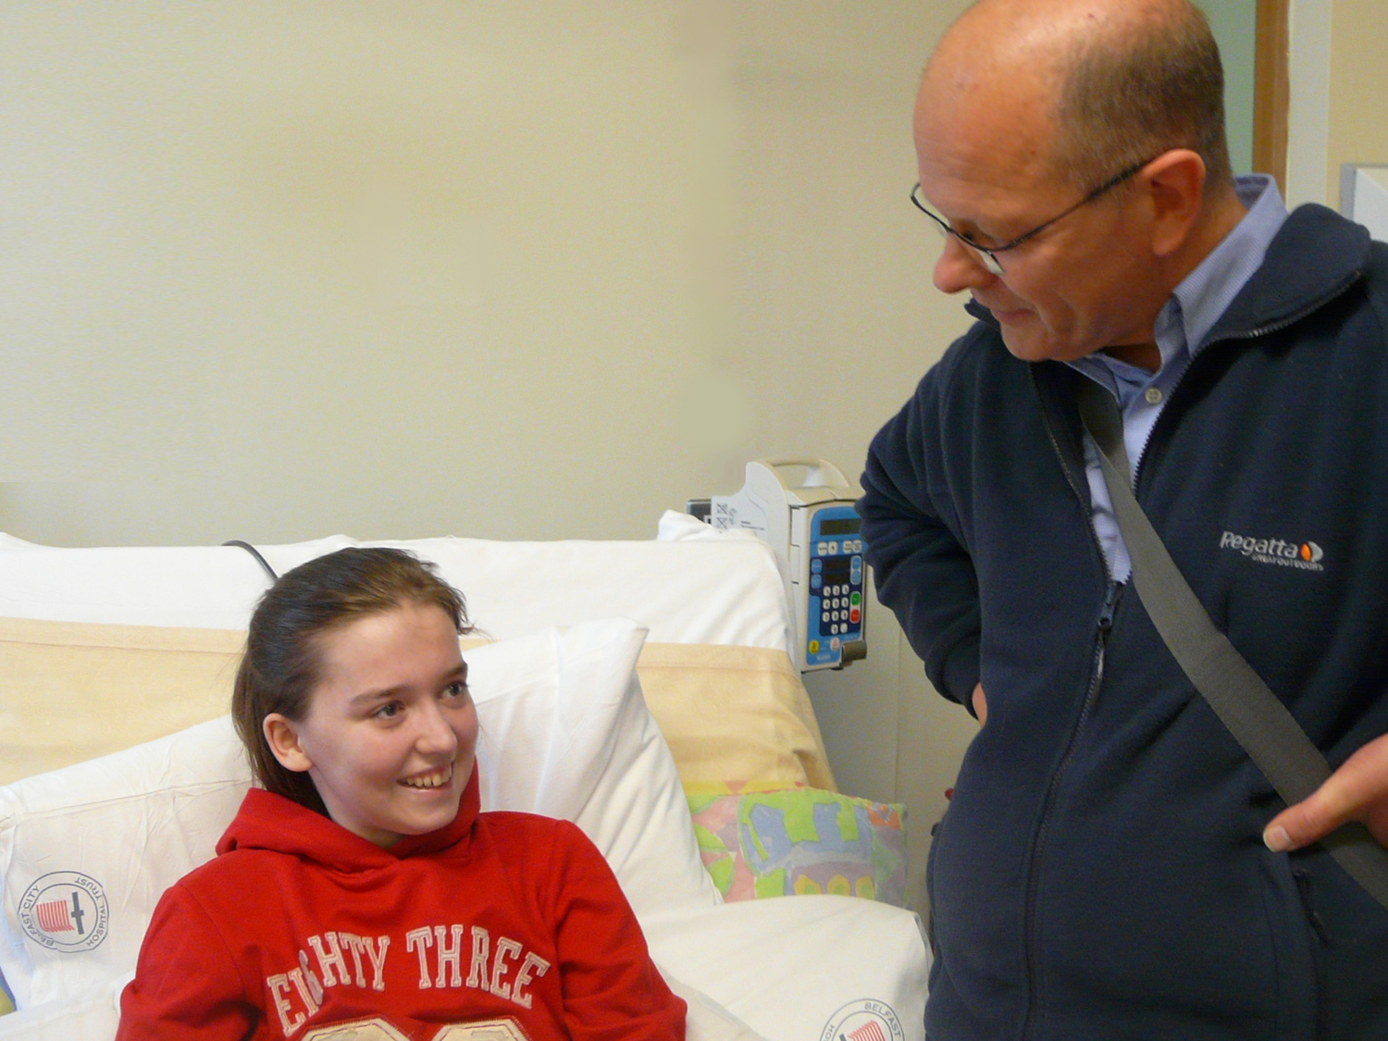
Do you think her positive and selfless outlook made it any easier for her to manage her illness or health issues?

Slide 23
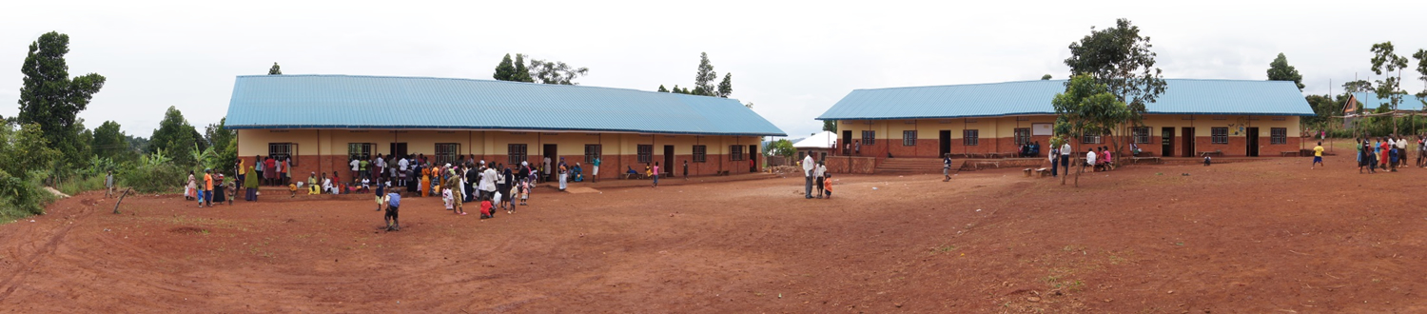
It is unlikely Charlene could have imagined Charlene’s Project would grow to two schools, with another on the way, providing teaching accommodation, community halls and fresh drinking water to whole communities. She would not have imagined over 100 sponsored children, 20 teachers supported, and hundreds of children gaining an education would be achieved in 5 short years.
What do you think Charlene’s role has been?

