Slide 1

Opportunities in Wind Energy
and an overview of Suzlon

Slide 2
Agenda
Why Wind Energy?
Wind Energy : Overview of Opportunities
Suzlon : Leadership & Capabilities
Suzlon : Technology

Slide 3
Renewable energy is gaining momentum
High economic growth leading to exponential demand for energy
Over-dependence on imports of fossil fuel for energy generation
Alarming increase in the cost of fossil fuel due to increased consumption and depleting levels
Looming dangers of global warming
Excessive CO2 emissions as a result of conventional fossil fuel power generation
Mounting global pressure to curb emission levels
Energy
Security
Techno-Economic Maturity and Viability
Protecting
Environment

Slide 4
Why wind energy is most preferred?
RE Source | Scalability Potential | Gestation Period | Execution Risk | Technology Risk | Operational Risk
Share of different RE sources
in India by new capacity addition in 2011*
Wind sector in India has a proven track record of over 15 GW operational assets
With techno-economic maturity and comparatively lower risks, wind is and will continue to be the favorite investment option amongst RE sector options in India
Strong / favoring
Medium
Weak / disadvantage
*Ref: MNRE, Dec. 2011
Notes:
In 2011, as per MNRE data, wind has contributed 74% of the new RE capacity addition, which is very much in line with the cumulative trend of last decade or so
The reason for wind being the favorite for investment in RE sector, not only in India but the world over is not difficult to decipher. Comparatively, wind is techno-economically more matured and also poses least risk.
The scenario will continue even over a longer term

Slide 5
Wind Energy – Global Trend
Wind has emerged as the most viable & matured of alternate energy sources
Global cumulative wind power installed capacity crossed 200GW
& growing rapidly year on tear.
  Three Chinese & one Indian wind turbine suppliers in the Top 10 list
  Asian region and India, along with China are leading growth markets
  Under the GWEO scenarios, by the end of 2015, between 24.7 GW and 29 GW will be installed in India
Source: GWEC Global Wind Report 2010
Estimated

Slide 6
Drivers for wind energy in India
15 GW installed – world’s 5th largest
More than 70 % Share in country’s Renewable Energy
Est. potential of
~ 50 GW, two third is still untapped
Access to latest technology, supply chain and expertise
Annual market size was 2.3 GW in FY11, likely to grow to 4 GW in future
Progressive Policy Support
Matured Wind Power market
Economic growth & surging power demand
High Growth Potential for Wind Power Market in India
Dedicated ministry and established regulatory framework
Strong policy support with multiple revenue options and incentives
Established long term preferential tariff mechanism
Aggressive targets & commitment under govt.’s national action plan (NAPCC)

Slide 7
Agenda
Why Wind Energy?
Wind Energy : Overview of Opportunities
Suzlon : Leadership & Capabilities
Suzlon : Technology

Slide 8
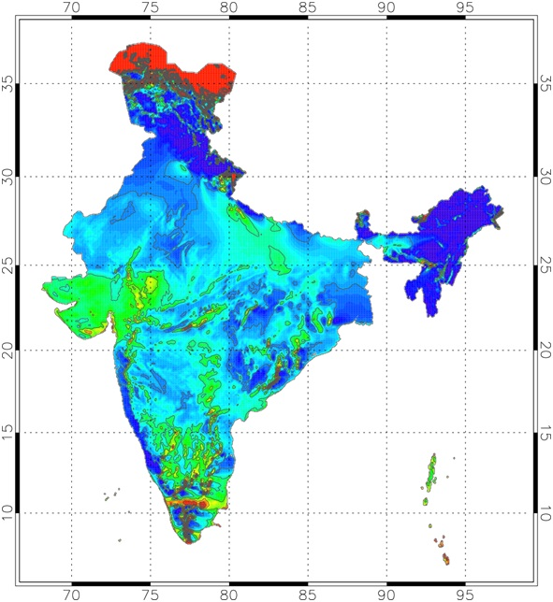

Wind map of India
Nodal development agency, CWET has recently reassessed the estimates of total wind energy potential in the country from earlier 48 GW to over 102 GW
Wind potential is concentrated in southern, western and north-western regions
Grid connected projects
operational in 8 states
Cumulative installed capacity as of Dec. 2011
is over 16 GW
State | Potential | Installed *
TN | 14152 MW | 6577 MW
MAH | 5961 MW | 2530 MW
GUJ | 35071 MW | 2642 MW
KAR | 13593 MW | 1889 MW
RAJ | 5050 MW | 1833 MW
MP | 2931 MW | 286 MW
AP | 14497 MW | 222 MW
Other | 11533 MW | 36 MW
Total | 102788 MW | 16015 MW
*Ref: Market Data as of Dec. 2011

Slide 9

Growth of wind energy market
In FY 2010-11, India added over 2300 MW of new capacity to emerge as world’s 3rd largest market, behind China and USA
Cumulatively, India is 5th biggest market in the world
Market grew almost three fold in size over the last 6 years
Large scale development by IPP players
Future drivers for market acceleration in India
New Policy Initiatives like GBI, REC, RPO & CERC Tariff Reforms
Rising Power Demand & Need for Mitigation of Climate Change
Dec 2011
16000+ MW
2005
4388 MW
2000
1170 MW
Growth of wind energy in India
1995
470 MW

Slide 10
Growth momentum to continue
FY10-11 was a record year : 2300+ MW of capacity addition, 3rd largest global market
FY11-12 is set to register another record-breaking year for wind sector
Market expansion is attributed to new policy drivers (GBI, REC, new Tariffs etc.) enabling big volumes from IPPs and increased number of players in the market
The industry believes that the sector will once gain beat the analyst’s estimates with over 40% Y-o-Y growth, for second successive year
3000+
Source | Est. CAGR for next 5 years
 | 22%
 | 14.7%
 | 11%
Capacity Addition (MW)
MNRE Est.*
Actual
YTD Dec’11
MAKE Est.*
BTM Est.*
*Derived from the estimates given by key analysts on calendar year basis
Notes:
Last year, when the industry clocked more than 40% growth, it was an all time record despite overall slowdown in Indian and global economy
CLICK to show animation and then continue…
This year again, the market is all set to beat many analyst’s expectation to deliver yet another high growth performance and the industry believes that we could end the financial year 2011-12 well above the 3GW mark

Slide 11
Multiple business model options
1
2
    Fixed tariffs under
    a long term (13-20 yrs)
    Power Purchase
    Agreement
Old uniform tariff across the state
CERC’s new wind-zone based tariff
    Fixed tariffs based on CERC framework
    Better returns, linked with site potential
    Risk return trade off available with
    combination
    of various
    models
    Sale to distribution companies @ Avg Pooled purchase cost
    Lower tariffs than
    pref. feed-in tariffs
    Potential for upside
      Rise in APPC
      REC price
6
Business
Models
3
Combo Model
Sale @ APPC + REC revenue
5
4
Captive use
Merchant sale (third party)
    Possibility of substantial savings in power cost
    Limited feasibility for IPPs as the producer needs to be the user of the electricity
    High risk – high returns
    Market discovery
    of price

Slide 12
Measuring the future opportunity
Year | MU Needed (as per CEA Survey) | RE MU (15% as per NAPCC Target) | Derived RE Capacity (@33% PLF)
2011-12 | 969659 | 145449 | 50314
2016-17 | 1392066 | 208810 | 72233
2021-22 | 1914508 | 287176 | 99341
Wind@50% |  |  | 50000
Est. demand in CEA17th Power Survey: 1.91 trillion units.
To meet NAPCC target of 15%, installed capacity of renewables will need to reach 100,000MW (at 33% PLF)
Even with a conservative estimate of 50% share of wind in RE mix, aprox. 4000MW of yearly capacity addition would be needed in
wind alone for next 10 years. A Huge opportunity!
Notes:
12

Slide 13

The investment imperatives
High growth potential
  Economic growth, Power demand, Global warming
Matured market
  Proven performance, Access to technology
Progressive policy support
  Attractive feed in tariff & long term PPAs
  Fiscal incentives AD / GBI, RPO & RECs
Profitable Investment
  Dynamic market environment with multiple revenue model options to suit the risk/return appetite of all investors
  Strong policy support and encouraging fiscal incentives
  Hassle-free ‘End to End’ business model without worries of manpower, material & market management

Slide 14
Winds of change
GBI Benefits
December 2009
Incentives for entry of large IPPs and FDI into wind sector
REC guidelines
Feb 2010
Guideline issued to enable access to merchant market for renewable, through separating the renewable attribute
Jawaharlal Nehru Mission, Nov. 2009
20 GW from solar energy
by 2020
Two broad mechanisms for tariff
Sale at preferential tariff
Electricity component
DISCOM
CERC
September 2009
Revised guidelines for RE tariff across states to promote private investment
Renewable energy source
DISCOMS or consumers voluntary market
REC component
NAPCC
June 2008
Policy document on RE

Slide 15

The GBI scheme
Objective: to expand the market by facilitating large scale investment from IPPs & thru’ FDI and to encourage higher generation efficiencies by WPPs
Eligibility : First 4000 MW of registered grid connected WPPs commissioned between 19th Dec 2009 to 31st March 2012 and not availing the Accelerated Depreciation benefit
MNRE shall pay a special incentive @ Rs. 0.50 per unit (kWh) of wind power fed in to the grid. This shall be in addition to the state specific feed-in tariff
The incentive per MW is capped at Rs. 62 lakhs, with a yearly disbursement limit of Rs 15.5 lakhs per MW for the first four years.
Notes:
15

Slide 16
The REC mechanism
Aimed to facilitate the fulfillment
of RPO by the states / obligated
entities where the RE potential
is not enough for local RE
generation
Obligated entities (distribution
utilities and CPPs) can fulfill
RPO either by procuring RE or
by purchasing equivalent RECs
1 REC = 1 MWh of electrical power
i.e. 1000 units (kWh) fed into the grid.
The RE generator may sell electricity and associated RECs separately
REC can be traded on power exchange at market determined price
To control the trading price of RECs,
the CERC has determined a band of forbearance & floor prices
(Rs. 3.30 to Rs. 1.50 per kWh)
Fixed
Feed-in Tariff
OR
Pooled Cost for Power
Variable
Notes:
16

Slide 17
CERC guidelines on wind zone based tariff
Objective is to bring standardization in determination of feed-in tariffs in different states
Linkage with wind power density of the region over 4 distinct categories
Takes in to account Capex, Cost of Debt and RoI expectations
Intended to create a win-win investment opportunity by making the project viable, bankable for all stakeholders viz. investors, state discoms, developers and financial institutions to get fair returns
WPD (watts/m2) | PLF | Est. Gen. per MW (lac units pa) | Levelised Tariff prescribed (Rs/kWh)
200-250 | 20% | 17.52 | 5.60 to 5.70
250-300 | 23% | 20.4 | 4.90 to 5.00
300-400 | 27% | 23.65 | 4.15 to 4.25
>400 | 30% | 26.28 | 3.60 to 3.65

Slide 18
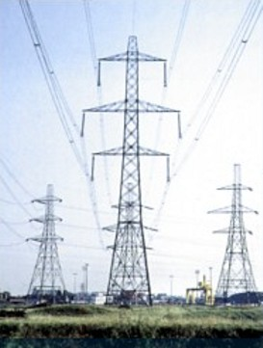
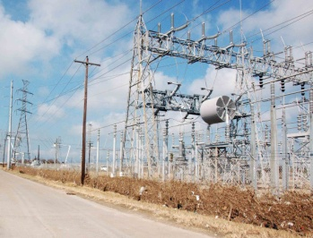
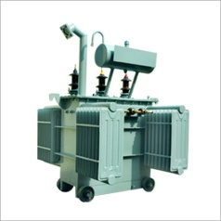
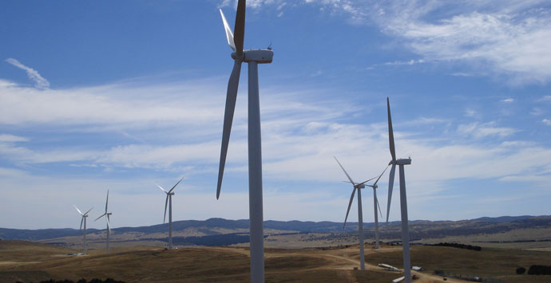
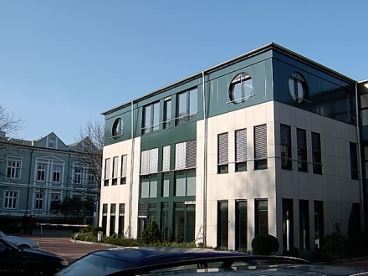
Schematic – Wind power wheeling
Power is fed in
to the state-wide transmission grid
Power drawn at the distribution point substation for supply to consumers
Power is fed in
to nearby substation
of state transmission
utility
(B) T&D and Wheeling Losses
(Losses and charges towards transmission, distribution & wheeling process deductible as per state policy)
Distribution grid of state power distribution utility
(A) Power Metered at the Point of Generation
Power drawn at the HT meter of the consumer
Ex: Customer’s office in
Western Maharashtra
(C) Power Metered at the Point of Consumption
Ex: Wind Power Project
Set-up in South Maharashtra
Customer gets unit to unit set-off in monthly bills
Net billed = C – (A – B) units
Important Condition: The wind power project & the Bank’s beneficiary
office should be located anywhere but within the same state

Slide 19
Snapshot of state-wise policy framework
 | Maharashtra | Karnataka | Gujarat | Rajasthan | Tamil Nadu | MP | Kerala |  | AP
Feed in Tariff for wind power | Rs. Up to Rs.5.37* per unit wrt wind zone | Rs.3.70 per unit flat | Rs.3.56 per unit flat | Rs.4..46 or 4.69 per unit flat MYT model | Rs.3.39 per unit flat | Rs. 4.35 per unit flat | Rs. 3.64 per unit flat |  | Rs. 3.50 per unit flat for first 10 yrs
Duration of PPA / EWA | 13 years | 10 /20 years | 25 years | 20 years | 20 years | 25 years | 20 years |  | 20 years
Avg. tariff of for HT power (Ind. / Comm.) | Ind: Rs. 5-6 Com: Rs. 8-9 | Ind: Rs. 4-5 Com: Rs. 6-7 | Ind: Rs. 5-6 Com: Rs. 6-7 | Ind: Rs. 4-5 Com: Rs. 5-6 | Ind: Rs. 3-4 Com: Rs. 5-6 | Ind: Rs. 3-5 Com: Rs. 3-5 | Ind: Rs. 3-4 Com: Rs. 3-4 |  | Ind: Rs. 3-4 Com: Rs. 5-6
Net W-B-T Losses + Charges | Varies from 17% to 25% | 7% | 10% | 17% | 7% | Lack of Enough Clarity in Policy
Banking of Power | 1 year on TOD basis | 1 year | Not Allowed | 1 year | 1 year
RPO (FY11-12) | 6.75% | 7-10% | 5.5% | 4.5% | 9% | 2.1% | 3.65% | 4.5%
APPC (Rs/kWh) | Not Announced | 2.73 | 2.61 | 2.57 | 2.37 | NA | NA | NA
CDM Rev. Sharing* | No sharing | Max 50%** | Max 50%** | 25% | Max 50%** | Max 50%** | 50% | 10%
* Share of Discom. **First year 10% then gradually increasing by 10% each year till it reaches 50%. Thereafter 50% throughout benefit period
Notes:
19

Slide 20
Agenda
Why Wind Energy?
Wind Energy : Overview of Opportunities
Suzlon : Leadership & Capabilities
Suzlon : Technology

Slide 21
Suzlon – vision and mission
Vision
Mission
Technology leadership in the Wind sector
Be among the top 3 wind companies in all the key markets of the World
Be the global leader in providing profitable end-to-end wind power solutions
Be the “Stakeholders’ Choice” Company
To contribute to sustainable development of Wind Energy sector through an integrated product design and manufacturing strategy
To increase contribution of wind power to meet global energy demand
To create a better, greener tomorrow for all
Strategy
Improving
cost efficiency
Growth
Focus on High
growth markets
R&D
and
Innovation
Vertical integration
Strategic focus on customer needs
End-to-end solutions

Slide 22
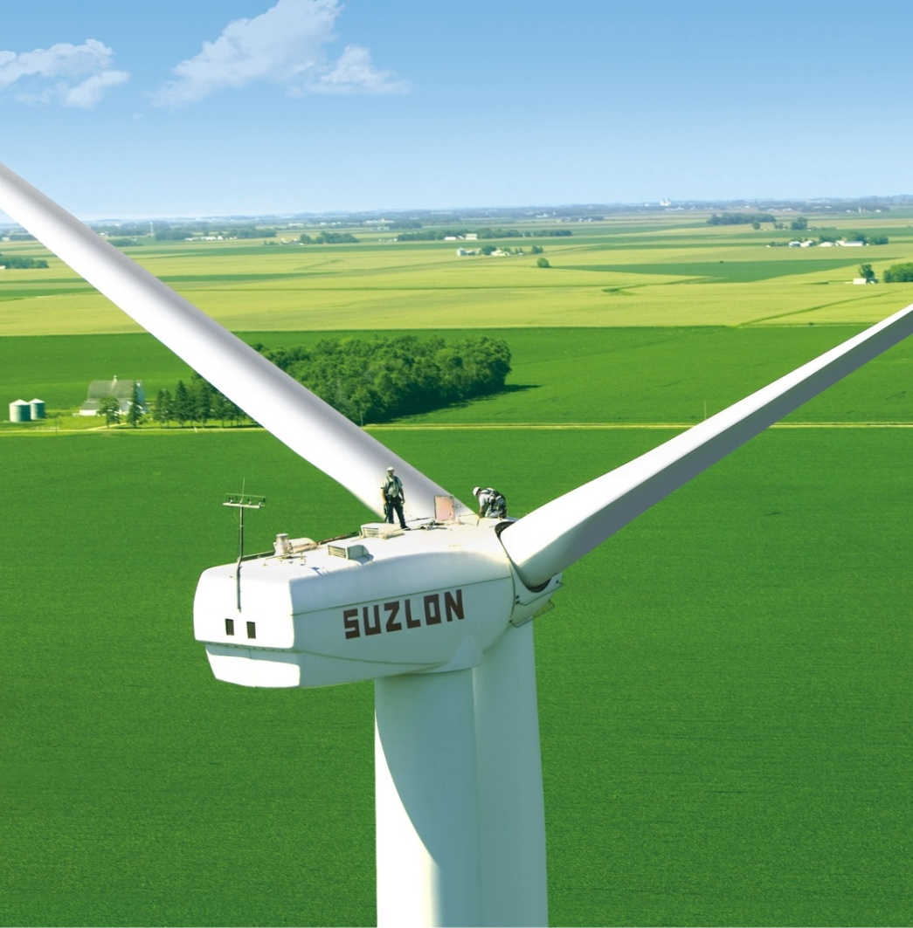
Suzlon group credential
World’s fifth largest wind turbine manufacturer ⁽¹⁾
Relationship with 11 out of top 15 global investors in wind energy
Group global firm order book of 4734 MW (USD 6.5 bn), of which 27% is in India ⁽²⁾
  Selectively vertically integrated with manufacturing base in low cost countries with Best-in-class operational cost structure and superior gross profit margins
1. Combined figures for Suzlon and REpower 2. Order book as on 21st October 2011
Notes:
Suzlon has positioned itself as a true global player with proven credence and vast experience across the global markets
Suzlon also has a sound order book and gross margins which are amongst the best in the industry
Suzlon group, after 100% acquisition of REpower also boasts one of industry’s broadest portfolio of WTGs with a solution for virtually every application either onshore or offshore

Slide 23


Group companies
WIND
Wind turbine manufacturer
and turnkey solution provider
Wind turbine manufacturer (Subsidiary of Suzlon)
Geographical Presence
India, USA, China, Australia, Europe, Latin America, South Africa
China, Europe (mainly Germany), Canada, USA
Market Share
5.9% (8th largest globally)
3.9% (9th largest globally)
Current Mfg. Capacity (MW)
~4,200
~1,700
Product Portfolio
Low to Medium capacity WTGs
(600kW – 2.1 MW)
Medium to High capacity WTGs
(1.5 MW – 6.15 MW incl. offshore)
Integrated Business Model
Infrastructure
Access roads, power evacuation, grid interconnection and power lines
Equipment Supply
Onshore and Offshore WTG & Component design, development and manufacturing
Services
EPC, project execution, installation, commissioning and O&M
Notes:
23

Slide 24
Complete solution capabilities
Casting
Forging
Gearbox
Blades
Panels
Generator
Tower
Transformer
Selectively vertically integrated supply chain
Broad portfolio of onshore & offshore wind turbines
0.6 MW
1.25 – 1.5MW
2.0 – 2.25MW
2.5 – 3.XMW
5.0 – 6.15MW
Suzlon
REpower
Onshore
Offshore
Group capabilities across value chain
Upstream
Midstream
Downstream
Component manufacturing
WTG OEM
Developer
Owner and
operator
Service and
maintenance

Slide 25
Global research & development facilities
Research Centre, Hamburg – Germany
WTG Product Development, Hamburg, Berlin and Rostock – Germany
Blade Development and WTG Product Development , Aarhus – Denmark
Blade Development , Hengelo – Netherlands
Technical Services Group and
WTG Product Development, Shanghai and Tianjin - China
WTG Product Development and Technical Services Group, USA
Blade Testing Centre, Vadodara - India
Technical Services Group, Pune - India
WTG Product Development , Pune
Gearbox Tech Support, Chennai - India
Technology Centres
Proposed Technology Centres
OMS Engineering Regions
Total R&D employees across the globe > 700
Notes:
25

Slide 26

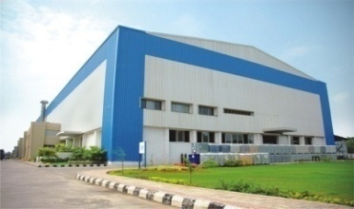
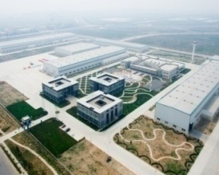


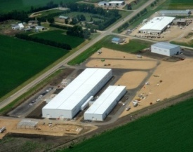

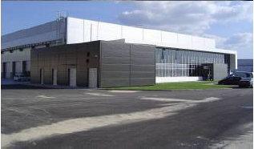
Group’s global manufacturing facilities
Location
Type
Capacity
Bhuj, Gandhidham, Vadodra, Daman, Dhule, Chakan, Padubidri, Coimbatore, Pondicherry
Nacelles, Forging & Foundry components, Rotor blades, Gearbox*, Control Systems, Generators, Towers
Integrated: 3,600MW
Tianjin, Baotau
Nacelles, Rotor blades, Gearbox*, Control Systems, Generators
Integrated: 600MW
WTG Assembly:
100 MW
Rotor Blades: 600MW
Pipestone, Minnesota
Rotor blades
WTG Assembly : 1,600MW
Germany, Portugal
WTG, Rotor blades
Gearbox* - through Hansen
Total 5900 MW

Slide 27
Global footprint
Presence in 30 countries
Cumulative global installed base of ~17 GW
Europe
Germany | 1,985
France | 1,199
UK | 644
Others | 1,398
Total | 5,226
Germany
Belgium
Turkey
Canada
UK
China
N. America
Canada | 4
USA | 2,991
Total | 2,995
France
Portugal & Spain
Italy
Japan
Nicaragua
S. America
Brazil | 384
Nicaragua | 63
Total | 447
India
Sri Lanka
Australia
Total | 770
Brazil
Asia
China | 1063
Japan | 118
India | 6334
Sri Lanka | 10
Total | 7,525
Suzlon
REpower
(Figures in MW)
Both
Data as of June 2011 and comibed at group level (Suzlon + REpower)
Notes:
Suzlon global experience spans across 30 markets with an installed base of nearly 17 GW and flexibility to deliver different business models from only equipment supply in North American and European market to limited turn-key in Australia and also a complete end-to-end solution is India.

Slide 28
Relations with 10 of the world’s top 15 investors in wind energy sector
8
Suzlon Group Relations
Name of operator
Capacity- end of 2010
Iberdrola Renovables (ES)
NextEra Energy Resources (US)
China Longyuan (CN)
EDP Renovaveis (P)
Acciona Energy (ES)
Datang Corporation (CN)
E.ON Climate and Renewables (GE)
Huaneng New Energy (CN)
Enel (IT)
CGN Windpower (CN)
Shenhua Guohua Energy (CN)
EDF Energies Nouvelles (FR)
Invenergy (US)
Eurus Energy Holding (JP)
Huadian Fluxin Energy Corporation (CN)
1
12,136
8,298
6,969
6,676
6,270
4,020
3,567
3,522
2,654
2,300
2,261
2,247
2,209
1,982
1,898
I
2
3
4
5
6
7
8
9
10
11
12
13
14
15

Slide 29
Marquee global clientele
USA
John Deere Credit
Edison Mission Group
PPM Energy
Horizon Wind
Tierra Energy
China
Shandong Luneng
Guohua
Datang
Honiton
Jingneng
India:
Mytrah Energy
Techno Electric Group
CLP Power India
DLF Group
MSPL Group
Green Infra (IDFC)
ONGC
GMDC
Tata Group
Aditya Birla Group
Bajaj Auto Group
GACL
GSPC
Indian Oil
Reliance Group
Larsen & Toubro
HPCL
BPCL
GAIL
ITC Group
Italy:
NeoAnemos Srl
Portugal:
Techneira S.A
Energi Kontoret
Martifer Energy Systems
Romania:
Martifer Energy Systems
Spain:
Iniciativas Energetitas
Eólia Renovables group
Spanish Savings Bank Unicaja
Turkey
Ayen Enerji
Australia / NZ
Australia Gas & Light
TrustPower
Renewable Power Ventures Pty Ltd.
Pacific Hydro
Brazil
SIIF Energies do Brasil Ltda (SIIF)‏
Servtec Instalacoses

Slide 30
Suzlon’s market leadership in India
for
14 years
~6900 MW installed & operated
40+ wind farms in
8 states
1600+ customers &
#1
43%
market
share
45%
repeat
business
Total yearly capacity addition in India (MW)
Suzlon’s share
YoY Capacity Addition in MW

Slide 31
Leadership in key state markets
Suzlon (MW)
State Total (MW)
Suzlon in | Tamil Nadu | Maharashtra | Gujarat | Rajasthan | Karnataka
Market Share | 28% | 64% | 52% | 65% | 38%
Market Ranking | #1 | #1 | #1 | #1 | #1
Market share by cumulative installed MWs in Key States as of 31st Dec.2011

Slide 32
Capabilities across wind energy value chain
End-to-End Capabilities
Wind Resources Mapping
Land and Site Identification
Design & mfg. of WTGs
Site Infrastructure Development
Installation & Commission-ing
Power Evacuation
Life cycle Asset Management
Value Added Services (CSR, CDM assist, Regulatory approvals
Flexible business models
delivered as per customer need;
  Equipment (WTG) supplies
  and warranty service
  Limited turn-key,
  project development on investor’s land & PE infrastructure
  Comprehensive one stop
  end-to-end solution,
  from land and PE to life cycle asset management including host of value added services
Notes:
Suzlon has developed a bandwidth of capabilities across the wind energy value chain in India and has been the pioneer in offering the complete end-to-end solution
Responding to the market transformations, Suzlon has been completely flexible and leveraging the vast capabilities can offer a execution solution tailored for IPP investor’s need – ranging from only supply of WTGs to a limited turn-key solution on investor’s land & PE to a complete comprehensive end-to-end solution inclusive of land and PE developed by Suzlon.

Slide 33
Business organized around needs of IPP
Infrastructure Planning & Development
Business Development
Project Execution
Operations & Maintenance
Wind resource studies
Micro-siting & energy yield assessment
Land acquisition
Securing and building power evacuation infrastructure
Sales & marketing
Techno-commercial negotiations
Contracting & legal
Customer relationship management & Value added service
Resource mobilization
Turn-key EPC with electrical, civil & mechanical construction
Assembly, installation & commissioning of WTG at site
Integration of WTG with grid
WTG stabilization & optimization
Centralized 24X7 operation of WTGs
Routine and breakdown maintenance
SCADA connectivity
Life cycle asset management
Strategic Business Development
Interface with policy & regulatory bodies
Liaison with power utilities
Corporate Social Responsibility
Partnership with the local communities & NGOs for sustainable development thru’ CSR programs
Notes:
Since the IPP segment needs are different than the conventional customers in Indian market, Suzlon has organized its India Business Units around the needs of IPP segment
There is a team of expertise available to service different needs and the business development team forms a SPOC to facilitate the customer’s convenience

Slide 34
Suzlon’s presence in India
Rajasthan : 1029 MW
Wind parks at Jaisalmer (825+MW) & Jodhpur (200+ MW)
2 Marketing offices
#1 position and leading market share in India for 14 consecutive yrs
Installed base of more nearly 6900 MW
Four mega size wind parks, each in Tamil Nadu, Maharashtra, Gujarat and Rajasthan
40 wind farms
across 8 states
World class manufacturing facilities catering to leading world markets
Northern Region:
Regional HO at Delhi
3 Marketing offices
Gujarat : 1231 MW
Wind parks at Kutch (860+ MW - Asia’s largest) and Saurashtra (400+ MW)
Manufacturing plants
Blade Testing Center
Registered Office (SEL)
5 Marketing offices
Madhya Pradesh: 124 MW
Wind farm at Dewas, Ratlam and Mahuria
2 Marketing offices
Eastern Region:
Regional HO at Kolkata
2 Marketing offices
Maharashtra : 1552 MW
Wind parks at Dhule (760+ MW), Sangli (270 MW), Satara (206 MW), Sinnar, Supa, Gude & Sadawagapur
Manufacturing plants
Engineering center
Group Global HQ
6 Marketing offices
Andhra Pradesh: 8.5 MW
Wind farm at Tirupati
Upcoming wind park at Anantpur
2 Marketing offices
Karnataka : 661 MW
Wind parks at Kappatguda (197 MW), Harpanhalli, Chitradurga & Hassan
Manufacturing plant
3 Marketing offices
Tamil Nadu : 1687 MW
Wind parks at Sankaneri (700+MW), Coimbatore (530MW) and Devarkulam (419MW)
Manufacturing plant
4 Marketing offices
Kerala : 21 MW
Wind park at Agali

Slide 35
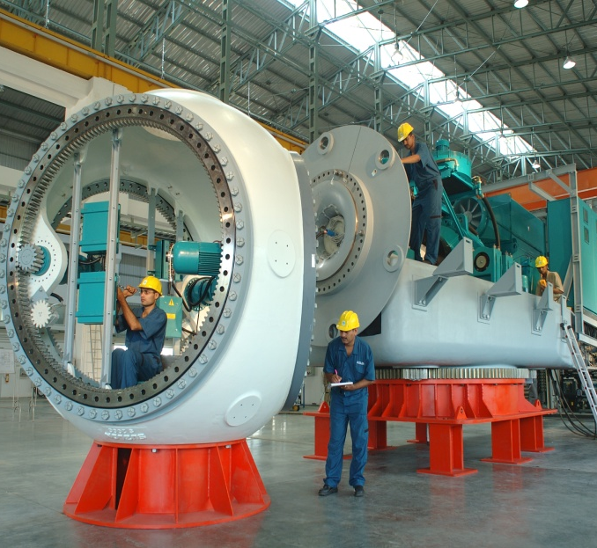
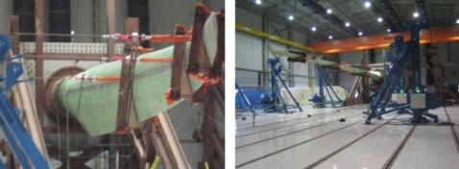
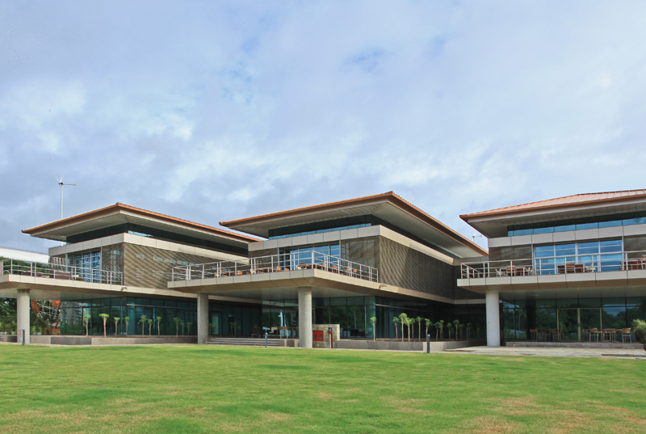
Suzlon’s key facilities in India
Manufacturing capacity of 3500 MW in India
Three fully integrated facilities at Pondicherry , Daman & Pudubidri for manufacturing of nacelle, hub, rotor blades and WTG assembly
Manufacturing
Suzlon’s own blade testing center at Vadodara in India is most modern and only the 2nd such facility globally capable of dynamic testing with loads applied in 2-directions (edgewise and flap wise) simulating on-site conditions
Testing & Development
Global HQ at Pune India,
an environment friendly
LEED Platinum rated GREEN BUILDING complex which is 100% powered by renewable energy
Global HQ

Slide 36
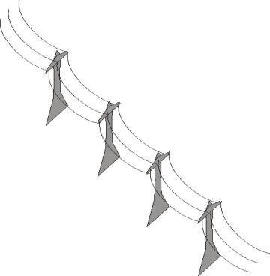



Wind park development process
Ensuring required
sub-station capacity for enabling power evacuation to nearby transmission grid
Scientific wind study at
location using a met-mast
Sourcing the suitable land –bank for project
Infrastructure &
access road development
Turbine erection
and commissioning
Movement of material at site

Slide 37
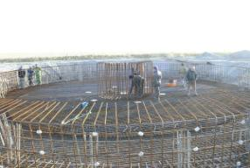
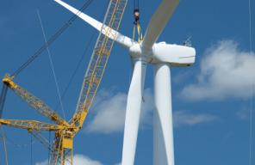
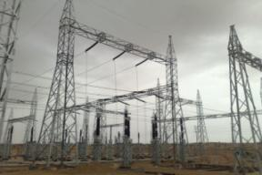

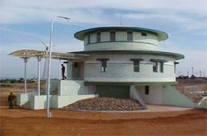
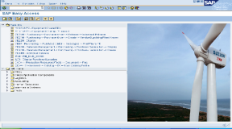
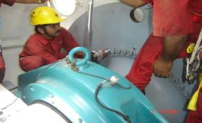
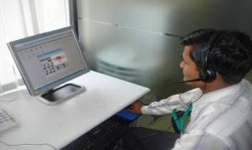

Project execution & asset management
Site Infrastructure & Civil Foundation
Electrical Sub-station &
Local Transmission Lines
Installation & Commissioning
24X7 Centralized Control & Monitoring
Wind Farm Automation with SCADA
On Site Testing & Maintenance
Web enabled reports for customers
Dedicated CRM & KAM Support

Slide 38


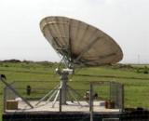
Comprehensive O&M solution
Fully automated wind farm management with SCADA system
24 X 7 service by trained engineers at site
No hidden cost ! All inclusive long term O&M contract (major components, spares, consumables & services)
95% machine availability guarantee
Web Enabled Access to generation reports
Suzlon HO VSAT
Site VSAT
Web enabled access
to reports for customers
Site CMS Center

Slide 39
Key customers in India
Over 1600 customers in India from across the industry sectors & geographies
Customer mix comprising of small / medium businesses, large corporate, PSUs and IPPs
High customer patronage as reflected in repeat business share
Key Customers | MW* | Project States
Mytrah Energy (Caparo) | 1000 | GJ, RJ, MH, TN, KN
Techno Electric | 296 | GJ, RJ, MH, TN, KN
DLF Group | 218 | GJ, RJ, TN
Vedanta Group (HZL) | 150 | TN
MSPL Group | 138 | MH, KN
GSPC Group | 105 | GJ
CLP India | 100 | RJ
Oriental Green Power | 100 | KN, GJ
RSMML | 92 | RJ
Tata Group | 89 | MH
Gujarat NRE Coke | 88 | GJ
Green Infra (IDFC) | 82 | MH, TN
Coromandel Wind | 75 | RJ
Aditya Birla Group | 75 | MH
Bajaj Auto Group | 68 | MH
ONGC | 51 | GJ
Reliance Group | 45 | MH
ITC Group | 41 | MH, TN
ReNew Energy | 35 | RJ, MH
New
Business
Repeat
Business
FY10-11 Orders Distribution by MW
* Includes installed capacity plus orders under execution

Slide 40
Value creation for customers
Trust & Relationship
Leadership in key markets Vast Experience with more than 13 GW installations
High customer patronage
Maximizing Returns
Optimizing cost per kWh, Economies of Scale with Large Wind Parks
Investing with Confidence
Value for money, Timely deliveries & Secure life cycle support
Easy & Hassle-free Business Model
Turbine Supply, Supervision,
Commissioning & Asset management with Single Point Coordination
Choice and Flexibility
Wider options of project locations and turbine sizes to build a scalable portfolio
Peace of Mind
Credibility through proven track record & satisfaction of large customer base

Slide 41

Corporate Social Responsibility

Slide 42
Agenda
Why Wind Energy?
Wind Energy : Overview of Opportunities
Suzlon : Leadership & Capabilities
Suzlon : Technology

Slide 43
Wide range of products
0.60 – 1.25MW
1.25 – 1.5MW
1.5 – 2.25MW
2.5 – 3.XMW
5.0 – 6.15MW
Suzlon
REpower
Onshore
Offshore
Products spanning all capacities - sub-MW to Multi-MW turbines
Products spanning technologies - variable, semi-variable and fixed speeds
Product variants spanning climatic conditions, wind class sites and
grid requirements
Ability to supply large volumes across various geographies

Slide 44
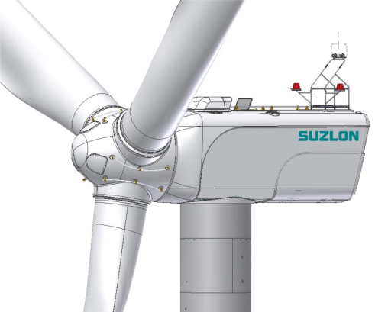
S9X WTGs for harnessing low wind sites
STRONG product backed by proven performance, efficient processes, and a customer-focused team under umbrella of a global company with local reach
Suzlon’s SAFE culture is captured from all aspects: product, people, processes and documentation
SMART enhancements, innovation and comprehensive design for harnessing moderate to low wind sites
STRONG
SAFE
S9X
SMART

Slide 45
S9X – Designed for customer’s aspirations
Suited for the moderate-low wind sites (Class II a and III a applications) in emerging markets like India
2.1 MW rated capacity
Larger rotor diameter (95m & 97m)
Higher hub height (80-90-100m)
Proven and successful Doubly Fed Induction Generator (DFIG)
technology platform

Slide 46

Performance improvement
Suzlon drives reliability throughout the entire S9X design to result in optimal yield and maximized customer ROI.
S95 DFIG
S97 DFIG
Energy Yield Increase
Increase by 13% @ 6 m/s
Increase by 19% @ 6 m/s
Swept Area Increase
Competitive power densities in their wind class
Grid Compliance
Better grid compliance with grid regulation (including LVRT requirements) without need for expensive hardware
Reliability
Increase in reliability due to improved sub-systems (pitch, yaw, etc)
Noise Compliance
Ability to regulate noise due to variable speed operation

Slide 47
Evolution from the proven S88 platform
Current
Product
New S9X
Platform
Enhancements
  Starting point:
  Existing, reliable workhorse S88
  Standardize as many components as possible by strengthening critical points
  Improve performance by moving to variable speed
  Improve performance by using larger rotors
  Improve performance by using new airfoils
  Result:
  Stronger performance and improved reliability
DFIG Technology
95m rotor diameter
Wind class IIa
Optional hub heights
Advanced Pitch System
+
=
S95 DFIG
(2.1 MW)
Current
S88 SFS
+
New Nacelle Design
Robust Gearbox
97m rotor diameter
Wind Class IIIa
Optional hub heights
S97 DFIG
(2.1 MW)
+
=
Taller Tower Heights
Improved Robustness and Performance
Additional Yaw Drive

Slide 48
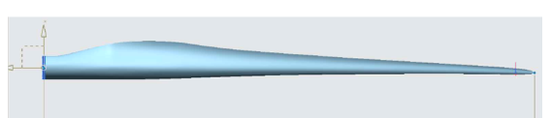

Optimized new blade profiles
To optimize wind capture in two different classes Suzlon has deliberately pursued two different blade designs for the S95 and S97. We’ve used the best knowledge available to provide the most ideal profiles for your wind class through efficient, parallel design from Suzlon and LM Wind Power.
S95 blade – Risø design
S97 blade – LM design

Slide 49
Higher hub height options
Variable tower heights offer low-cost optimization of power generation at low to medium wind speed
Towers at 15% less weight
Tower heights for
North American market
S97 | S95 | S88
80m 90m 100m | 80m 90m 100m | 80m

Slide 50
The DFIG platform overview
  The generators and slip rings remain the same as proven S88 design and are fully capable of variable speed operation from +/- 15 % to maximum of +/- 30 % of synchronous speed.
  Stator is connected to grid circuit, similar to any other induction generator
Grid
Asynchronous generator with slip rings
Machine Side Converter
Line Side Converter
Multi-point mechanical isolation, slip ring grounding, and rotor circuit filter ensure reliable operation of generator mitigating any stray current potential.
Rotor windings are also connected to grid, but through an AC-DC-AC converter circuit.

Slide 51
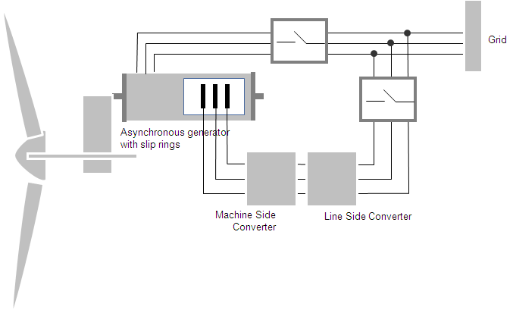
DFIG enabled variable speed operation
Suzlon's DFIG (doubly fed induction generator) based on proven technology, improves customer ROI by offering a system that accommodates fluctuating utility demands through optimal reactive power to feed the necessary consumption patterns. A compact and modular DFIG design allows ease of serviceability and meets the latest grid requirements for smoother wind power plant connectivity.
Increased Energy Yield
Reactive Power Regulation
Variable Speed Operation
Precise Power Regulation
Low Voltage Ride Through
Fully Grid Compliant

Slide 52

DFIG - the proven technology
Industry Proven DFIG
Suzlon Proven DFIG
Reliable and Proven Performance
S95 & S97 utilize industry proven technology: SEG Woodward’s CONCYCLE Power Convertor System
Initial DFIG testing successfully performed on S82
More extensive DFIG testing completed on S88
- Normal operation
- LVRT (extreme conditions)
Over 5,000 CONCYCLE® Wind Systems have been deployed with more than
7,000 MW Installed Power
More than 12 years success - CONCYCLE Wind Systems have been continuously evolving to adapt to
Market and Grid Requirements

Slide 53
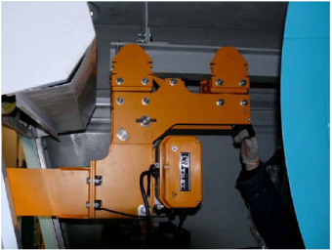
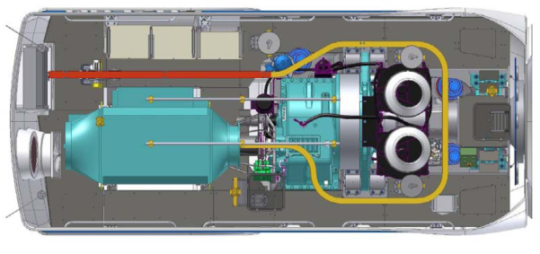
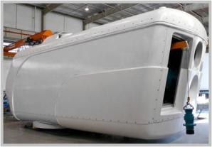
Safe & efficient nacelle design – onboard crane
S9X nacelles are equipped with an onboard crane to help in OMS work
The crane as an extension beam (left) that allows components to be lowered to the ground
Rear end shutter door opening for easy maintenance, material handling and for emergency rescue operation
Long bended crane rail system for handling parts inside nacelle and for easy maintenance
Route of the crane shown above

Slide 54
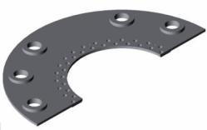
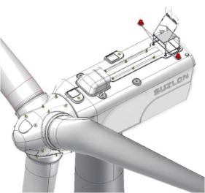

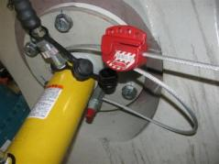
Safe & efficient nacelle design – rotor lock system
  Double redundancy design reviewed by OSHA and received positive response
  Both a hydraulic lock and mechanical lock use two different forms of energy for fail-safe mechanism that exceeds full safety operational requirements
  Manual locking provision provides secure ‘Lock Out Tag Out’ interface

Slide 55
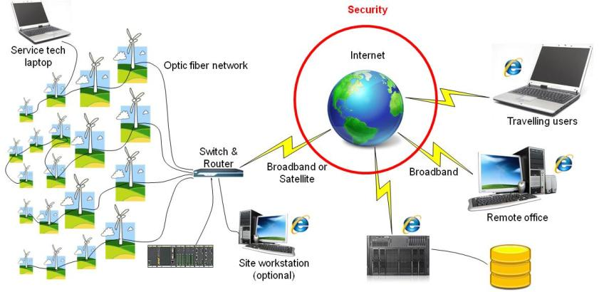
State-of-the-art automation & SCADA
Increased bandwidth and VPN connections provide high speed secure access
‘Out of the Box’ functionality with multiple secure access points and full data viewing capabilities
Fully capable Enterprise Database solution provides customer with easy and flexible access to data for cross-platform monitoring and additional analysis

Slide 56
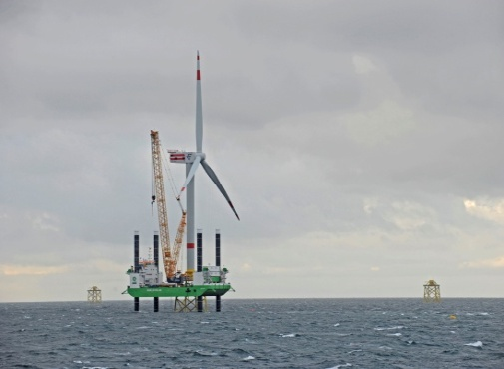
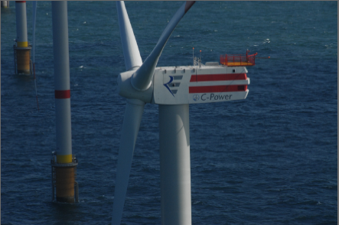
REpower’s strength in offshore wind energy
Some of our large operational offshore projects
Alpha Ventus Project, Germany
Thornton Bank Project, Belgium
Customer: Consortium of EWE, E.ON & Vattenfall
  6 WTGs of 5M
  Installed in 2009
  Availability >97%
  >4,000 load hrs per WTG
Customer: C-Power
  6 WTGs of 5M (Phase I)
  Installed in 2008
  Availability >97%
  Next phase order of 295 MW already received
Other projects under development (740 MW)
Thornton Bank Project, Belgium
Nordsee OST Project,
Germany
Ormonde Project,
UK
Customer: C-Power
  295 MW in Phase II & III (48 WTGs of 6M)
  Largest non recourse financed project (€ 1.3bn)
  Installation by 2012 & 2013
Customer: RWE Innogy
  295 MW (48 WTGs of 6M)
  Part of the Frame contract of 1.2-1.5GW
  Co funded by European Commission under EEPR programme
  Installation by 2012/2013
Customer: Vattenfall
  150 MW (30 WTGs of 5M)
  Project construction underway by 2011

Slide 57
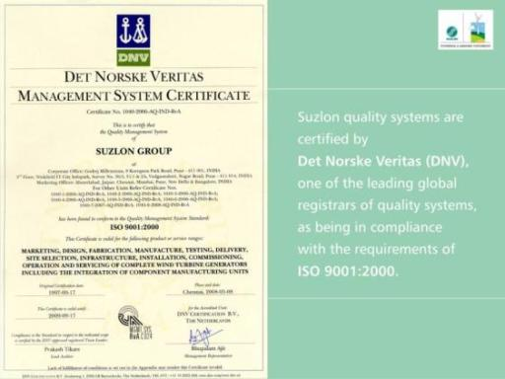
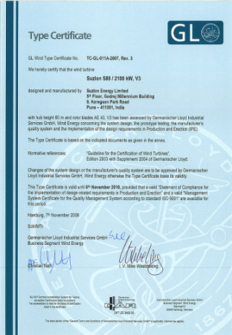
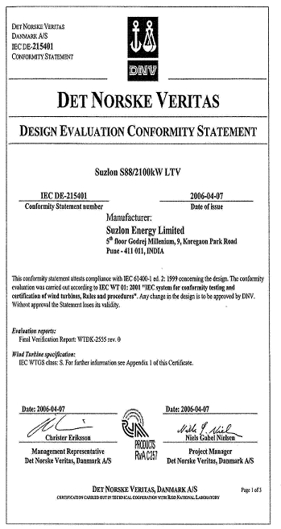
Certifications

Slide 58
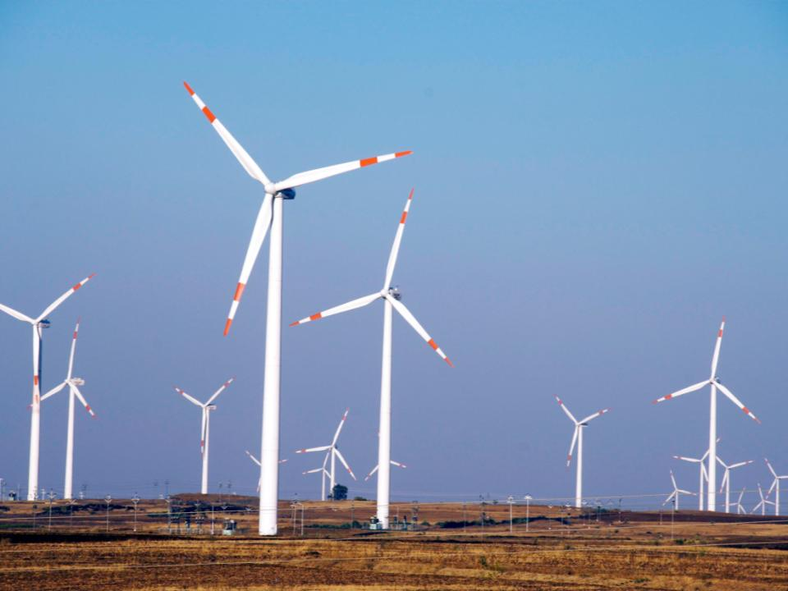
Thank you!
For business enquiries, contact
www.suzlon.com
marketing.india@suzlon.com

