Slide 1
List of useful databases and access systems
MDMa/MIH Programmes, 2012
Compiled by,
Karin Schiøler, Siri Tellier Michael Calopietro and Flemming Konradsen, International Health

Slide 2
Introduction
The following slides represent a list of online databases or access points to databases of relevance to health and/or emergency studies
The list should be considered as a guide only, and is by no means comprehensive
When using data from the listed databases (and others) always consider the source of the data and methods by which the specific data were obtained
Note: You may access the specific website of the listed databases by clicking directly on the slide

Slide 3
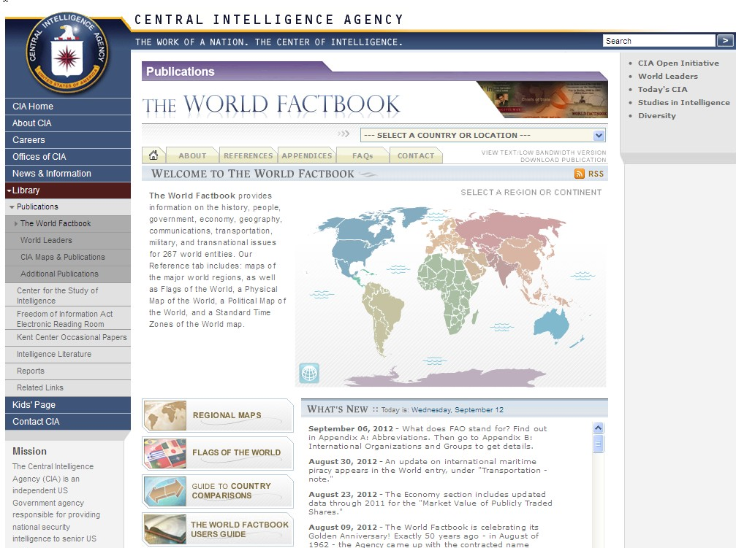

Slide 4
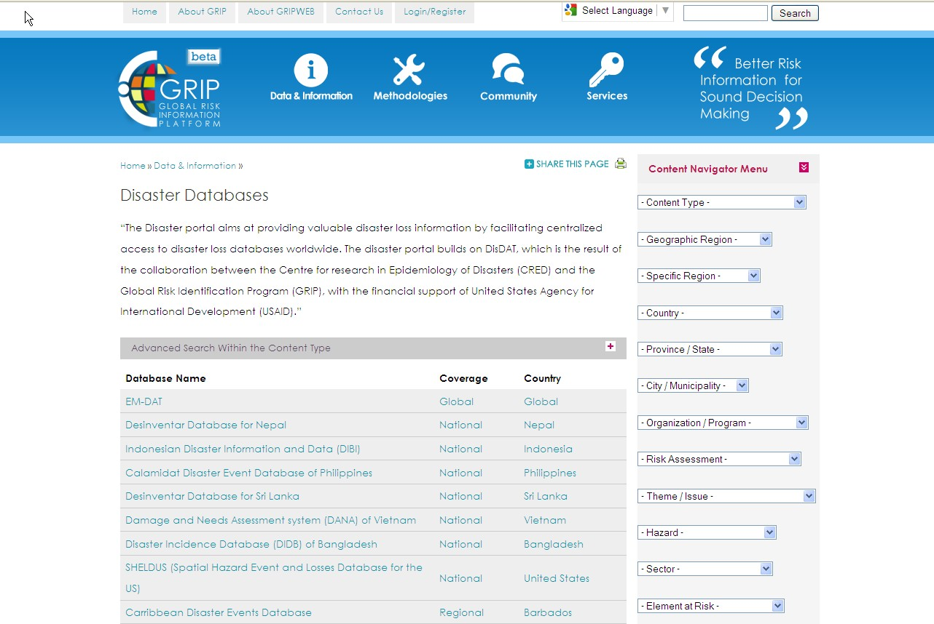

Slide 5
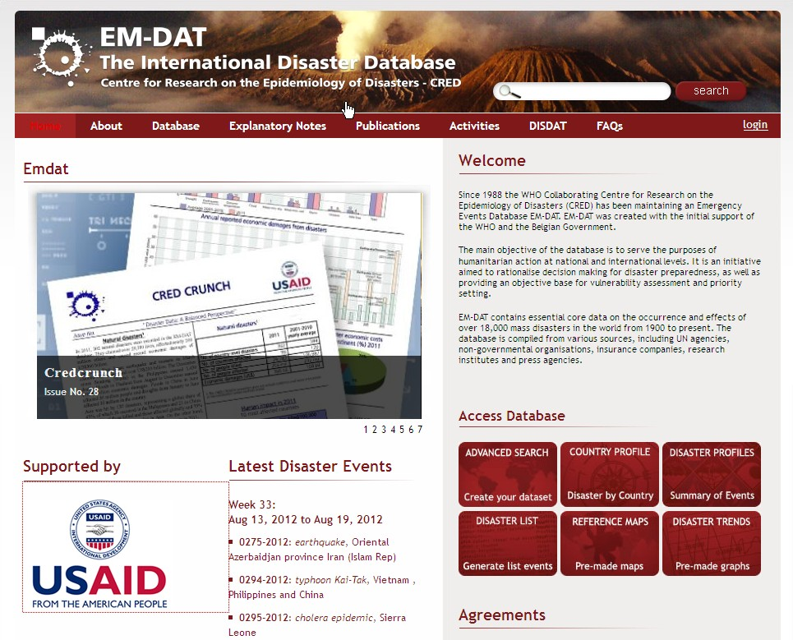

Slide 6
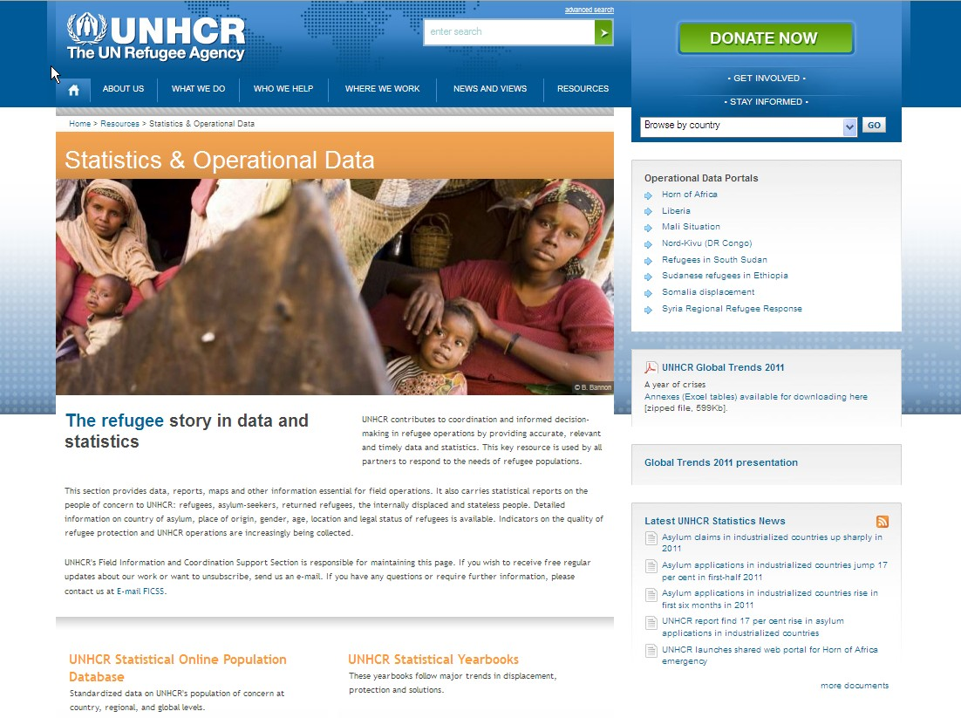

Slide 7
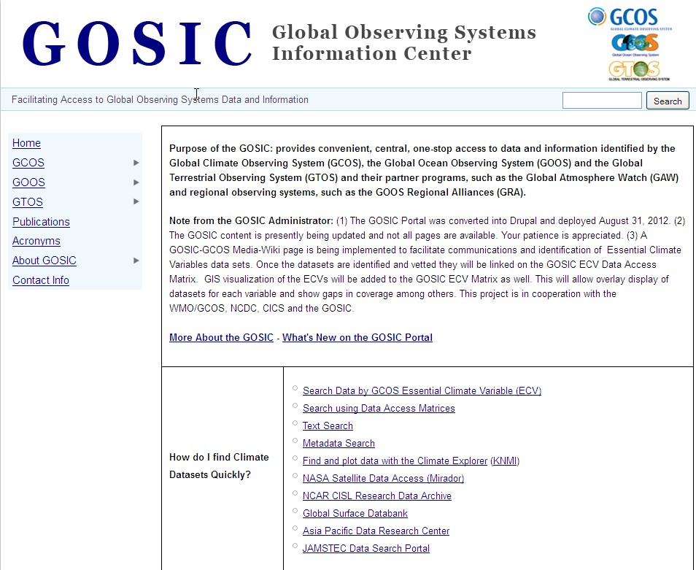

Slide 8
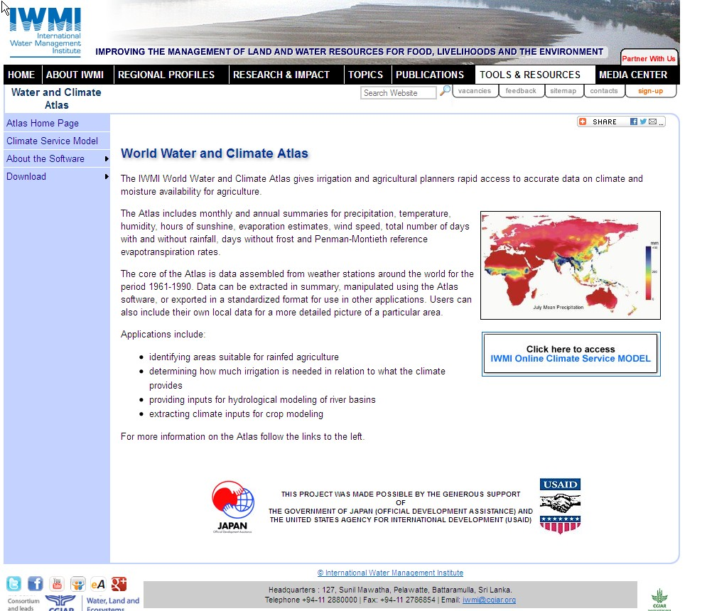

Slide 9
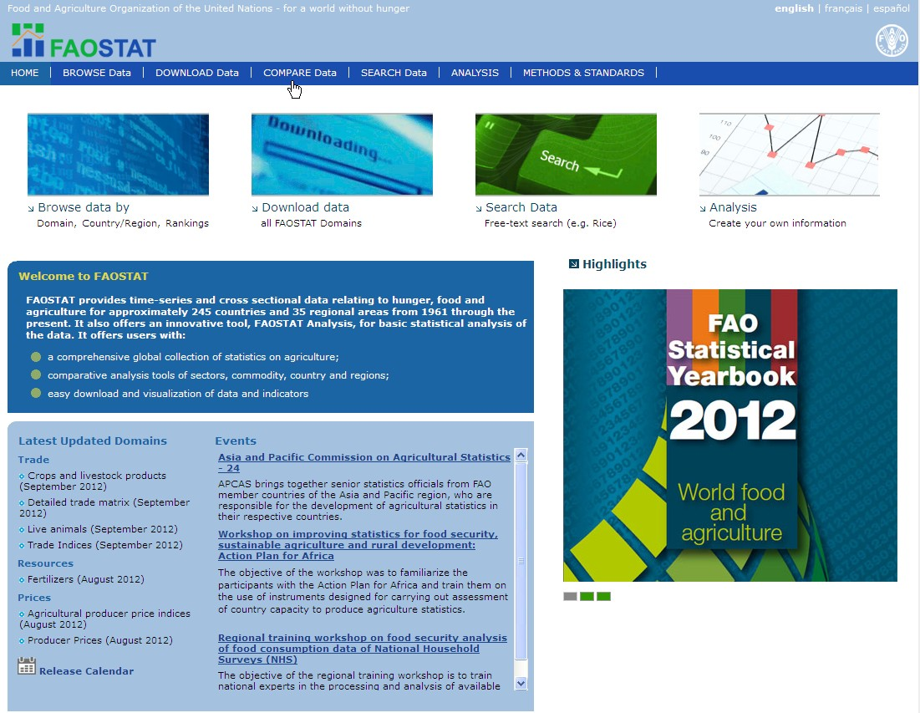

Slide 10
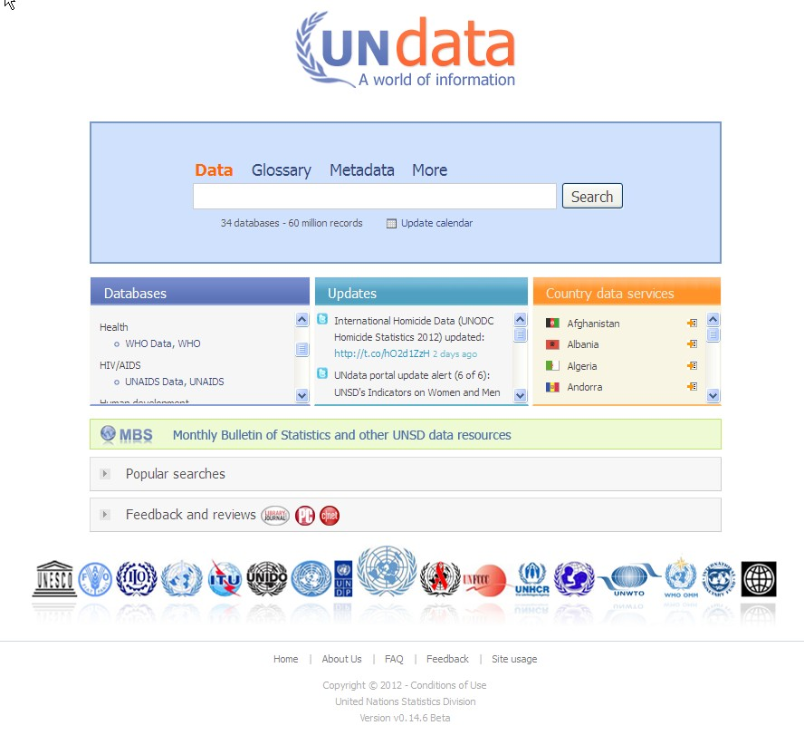

Slide 11
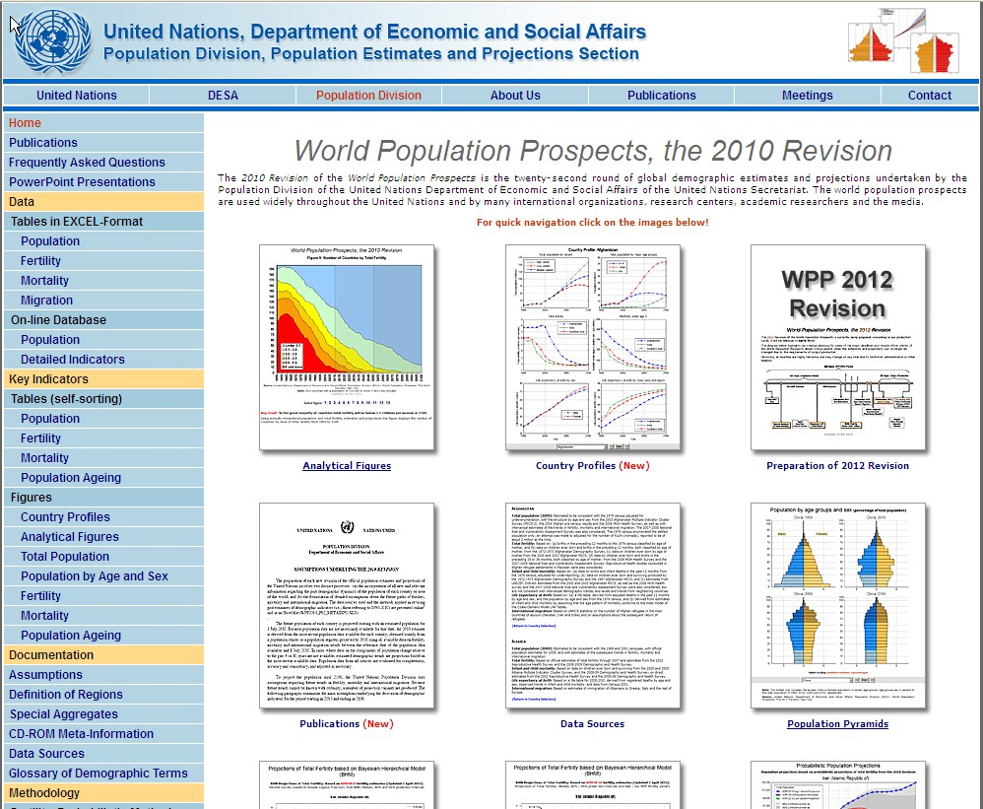

Slide 12
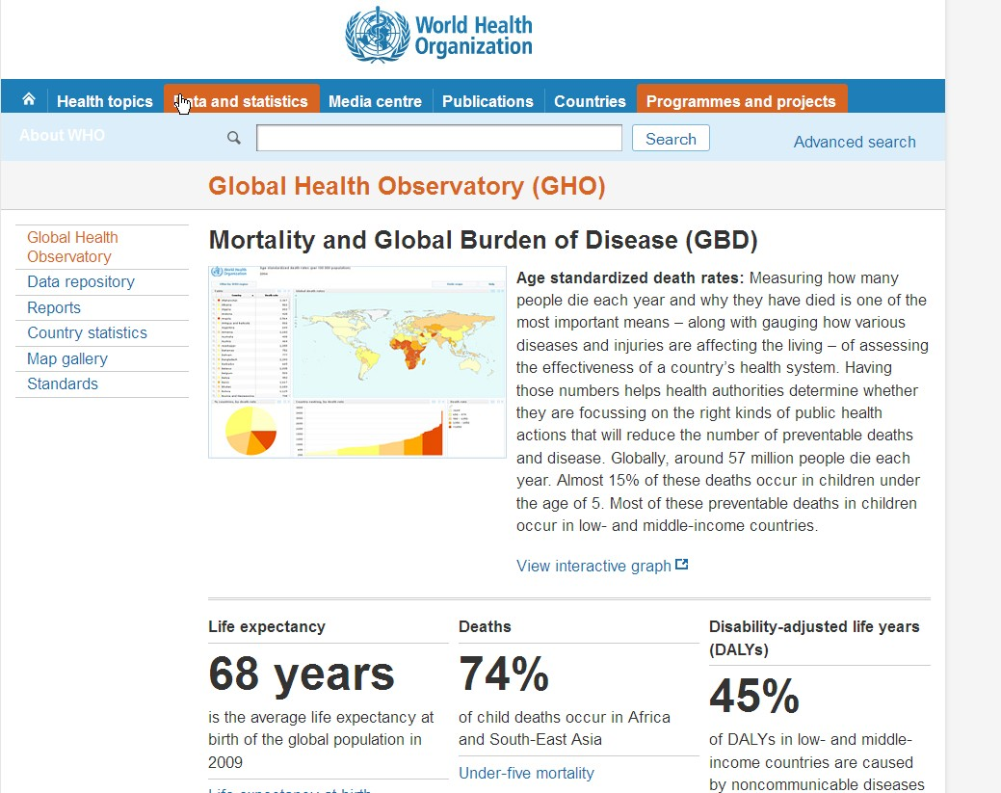

Slide 13
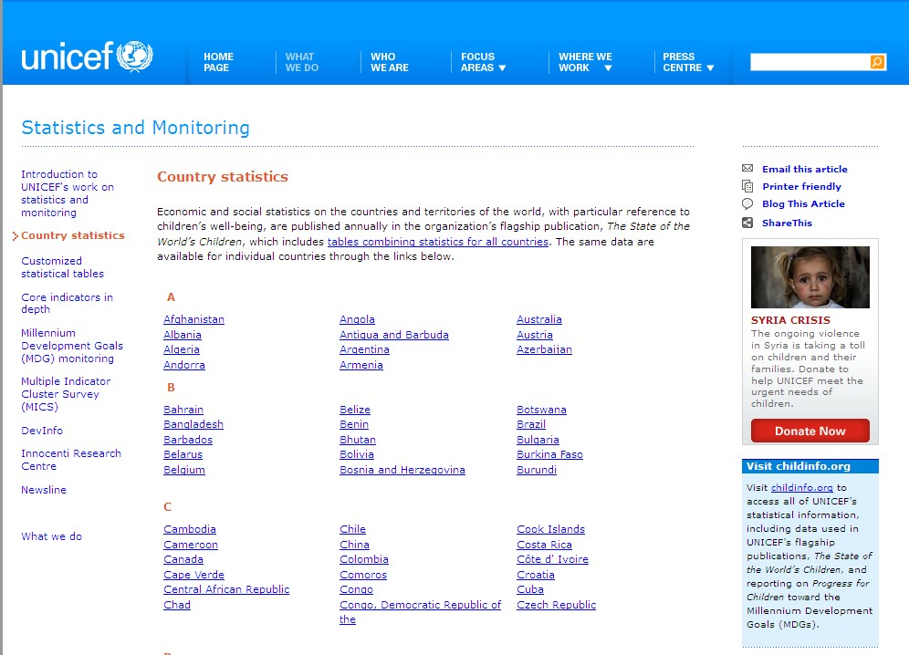

Slide 14
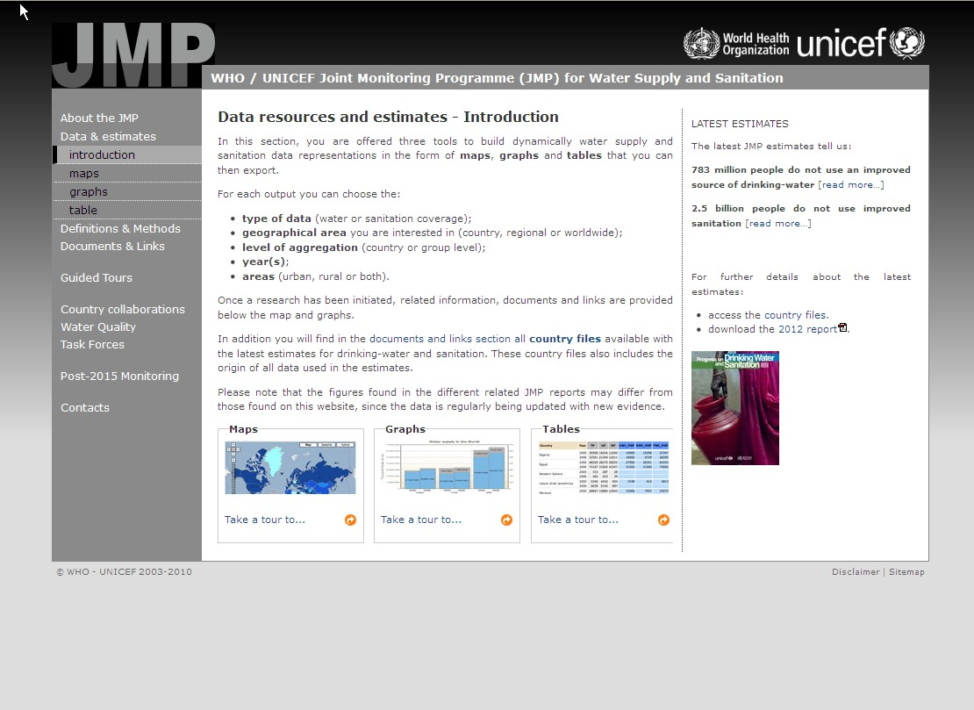

Slide 15
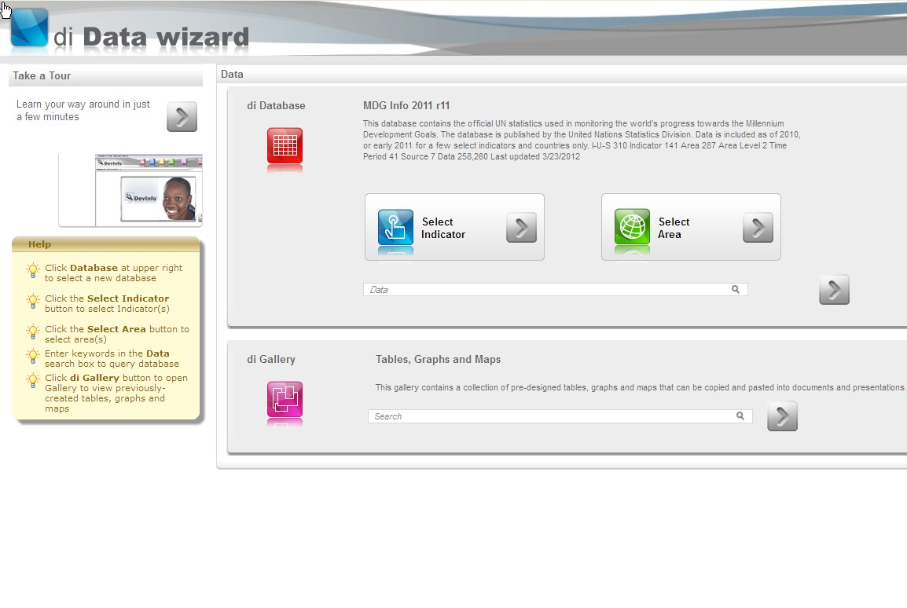

Slide 16
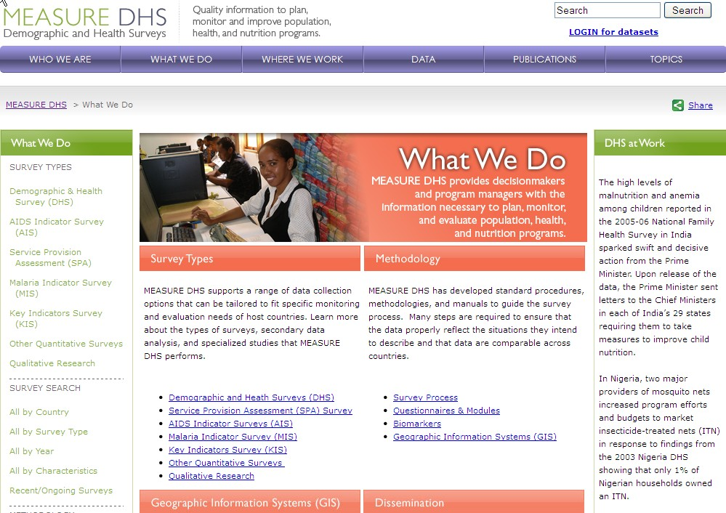

Slide 17
