Slide 1


Slide 2





Barnfind Technologies AS
Established in Sandefjord, Norway December 2012
Developed since early 2010
Privately held, no venture capital
Assembly and QC takes place in our own factory in Norway
Experienced Broadcast/Telco veterans
Large network in electronic production and development
Large sales network, sold to some 50 countries, many high-end references

Slide 3
Where do you install Barnfind optical fiber products?
All kinds of Broadcast applications like in and between studios, in OB vans and between OB vans and stadiums/events, transport of signals between floors and buildings, remote production etc. Typically any kind of signals from 100meter to 100 km distance.
Oil & Gas, Digital Signage, Telemedicine, Campuses, Government, Industry, House of Worship, CCTV/Security, Defense, Entertainment, Events, Education

Slide 4
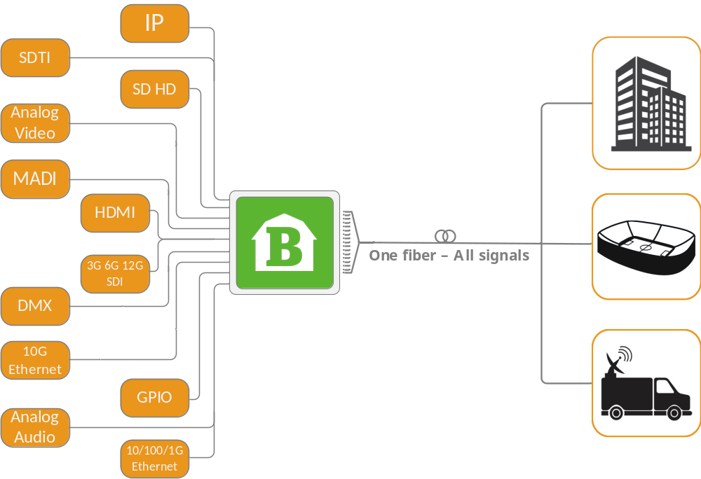
Fiber Transport
Multiplexing
Routing
Conversion
Distribution
IP / Ethernet
4K/60P
CAM - CCU

Slide 5
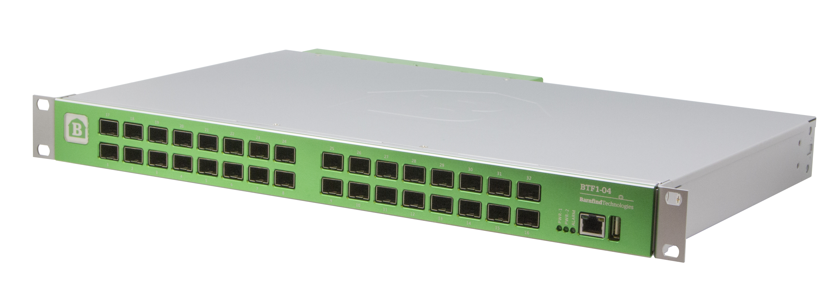
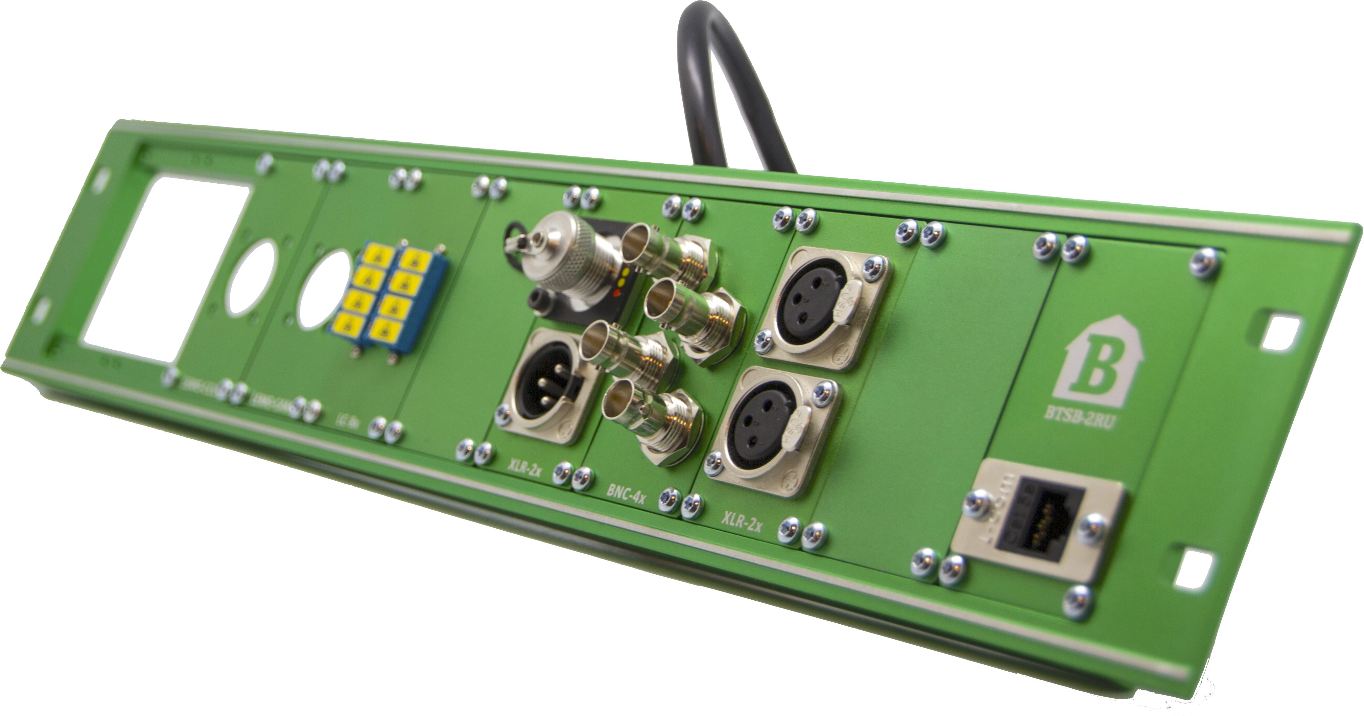
Barnfind Products:
BarnOne
BarnMini
BarnColor
Passive optics
SFPs
StageBox panels
BarnStudio
Barnfind Products:

Slide 6
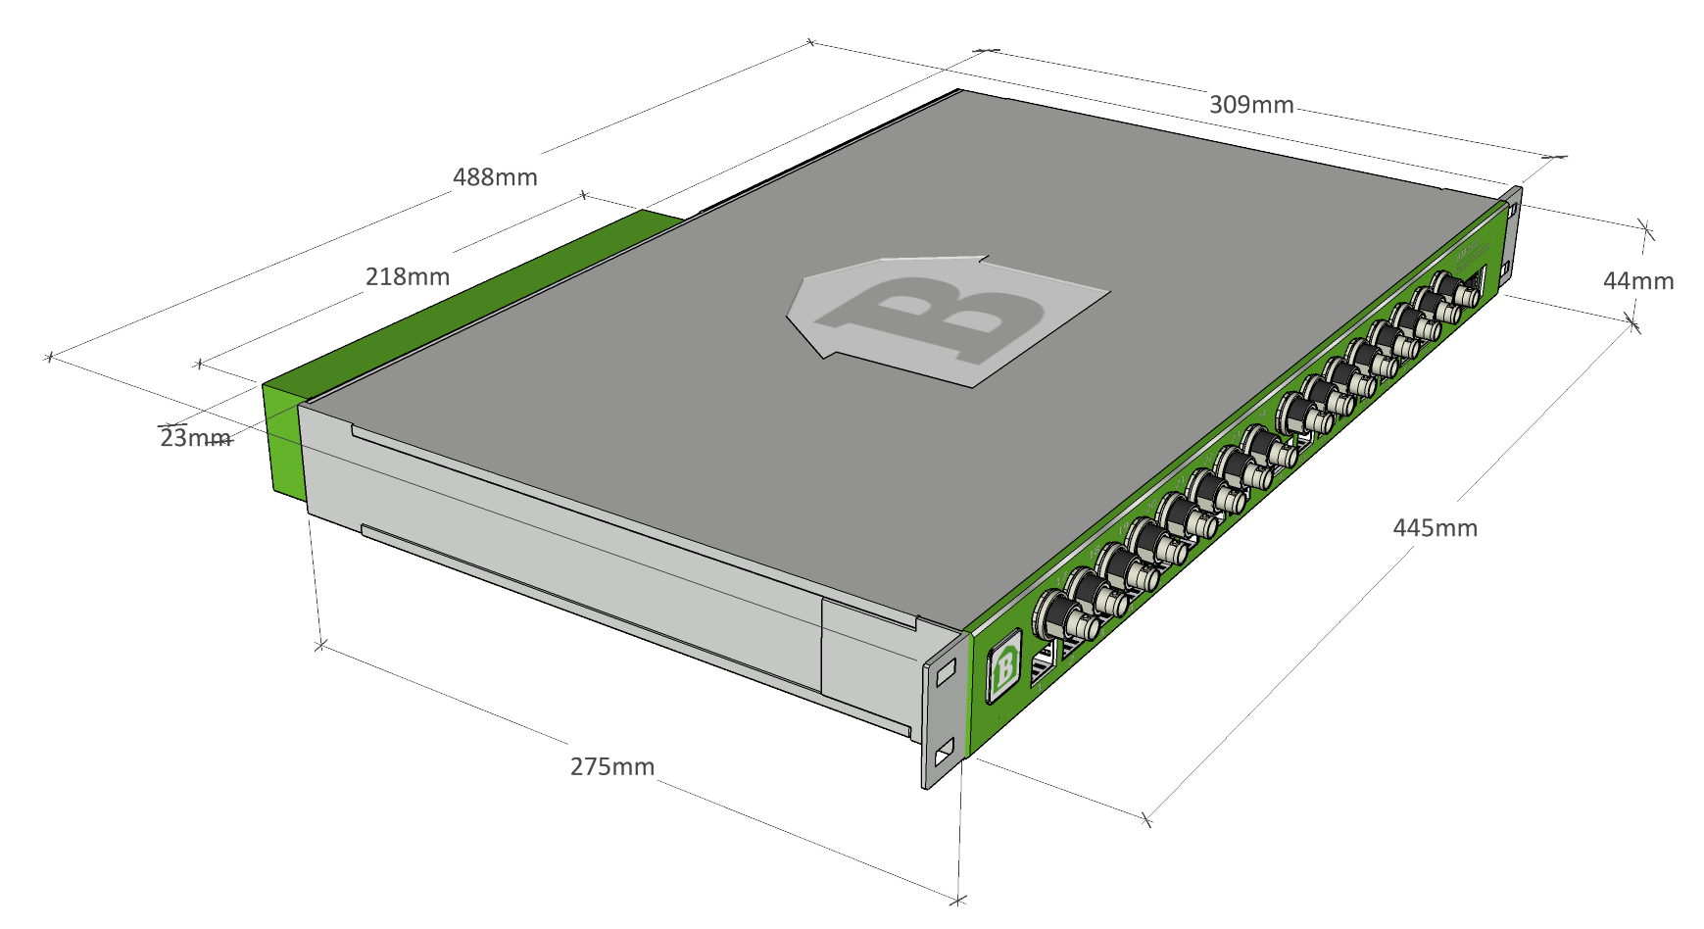
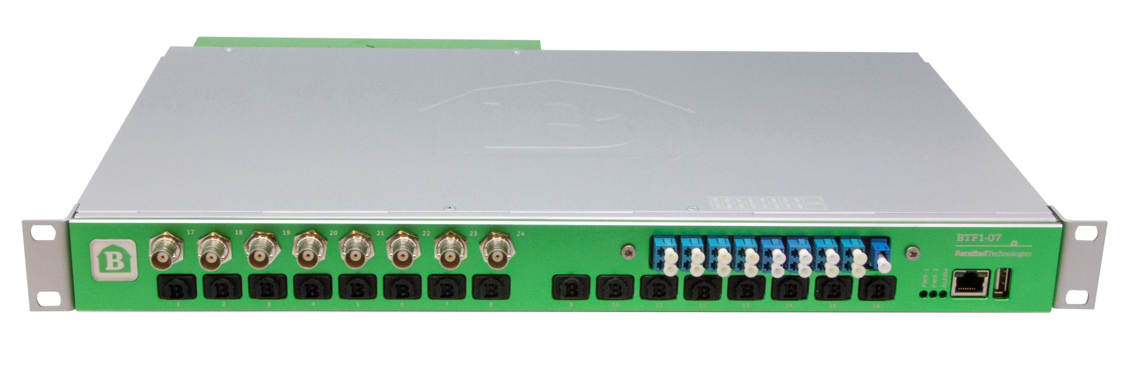
Barnfind products
BarnOne Series:
32x32 crosspoint matrix
All SFP ports are bi-directional
All BNC ports are inputs or outputs
All outputs are reclocked
Handles any MSA compliant SFP

Slide 7
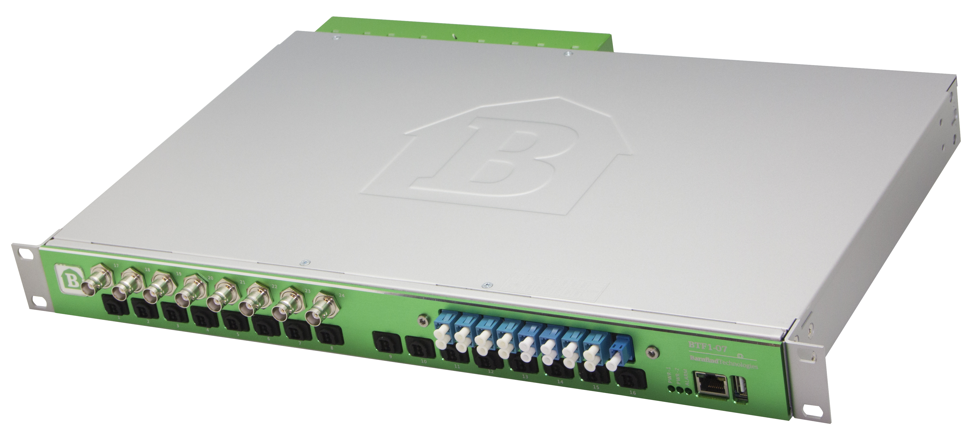
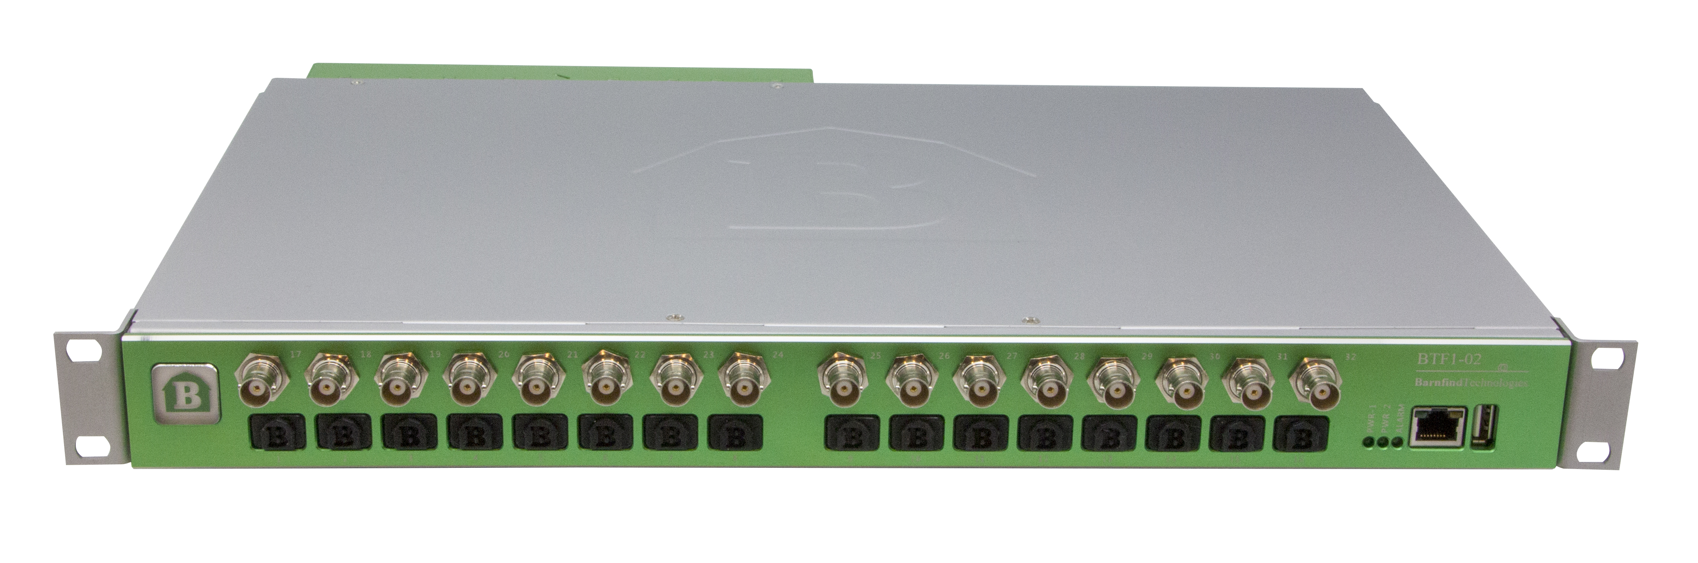
Barnfind products
BarnOne Series:
Replaceable fan cassette
Sync from external or internal source
Redundant powersupply
Front or rear mount in rack
BarnStudio operated

Slide 8
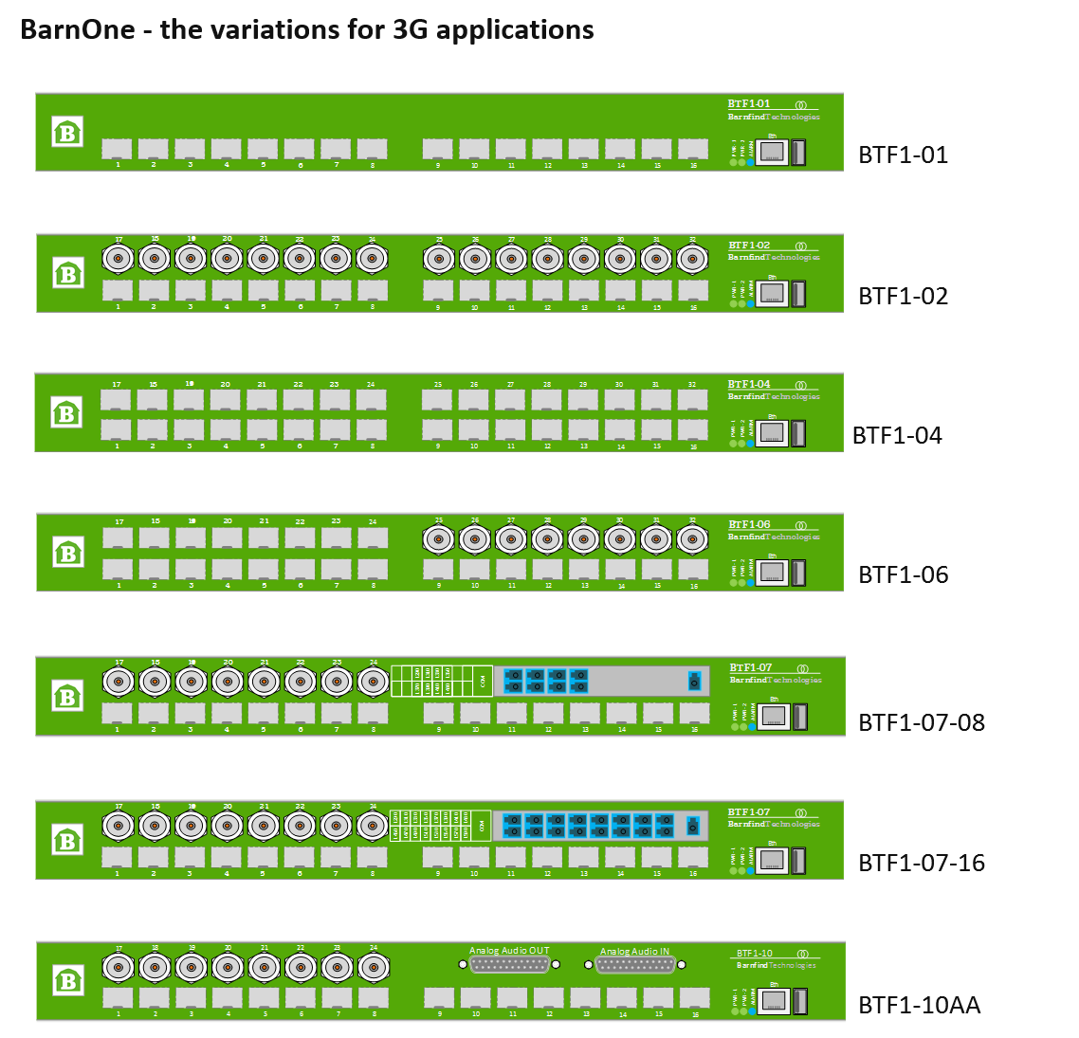

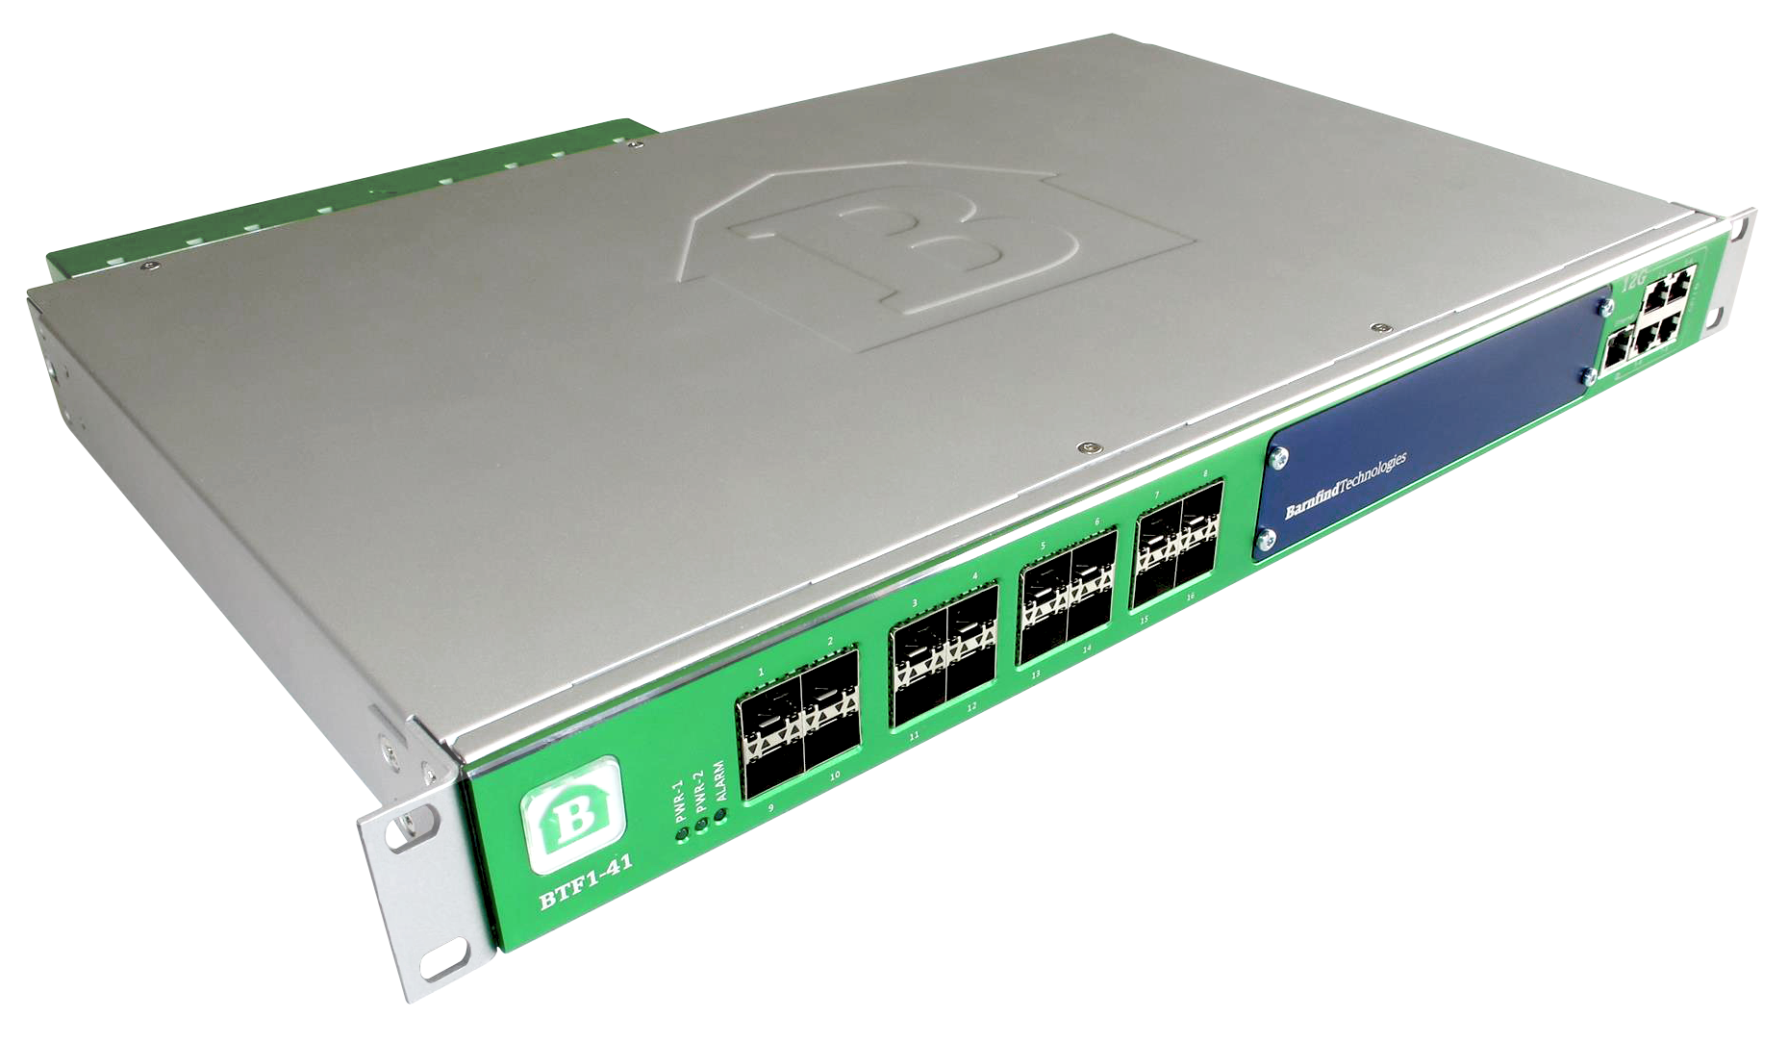
Barnfind products
BarnOne Series:
BTF1-41

Slide 9
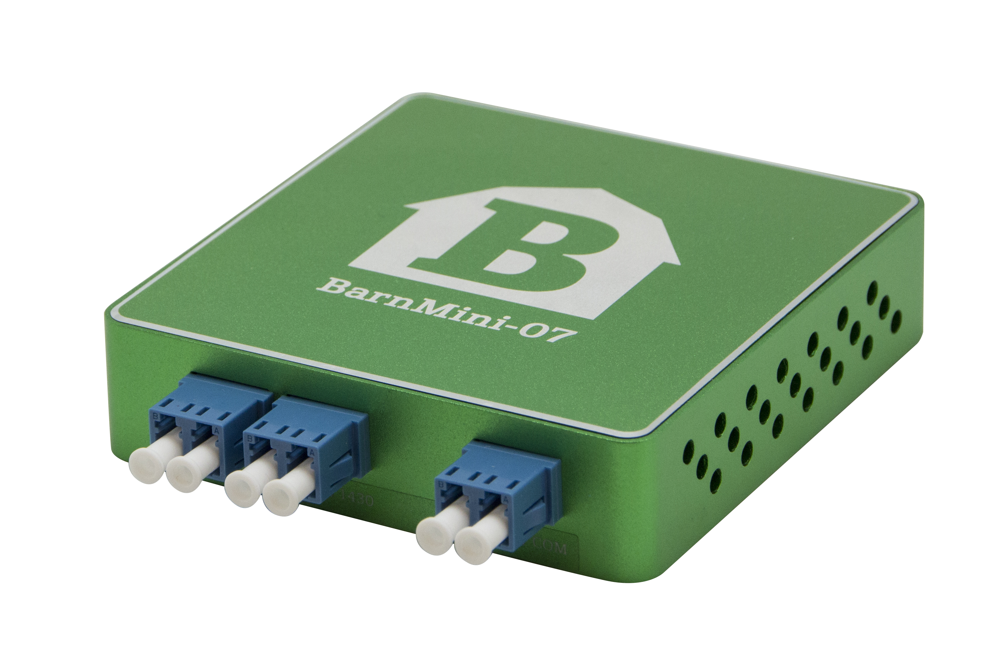
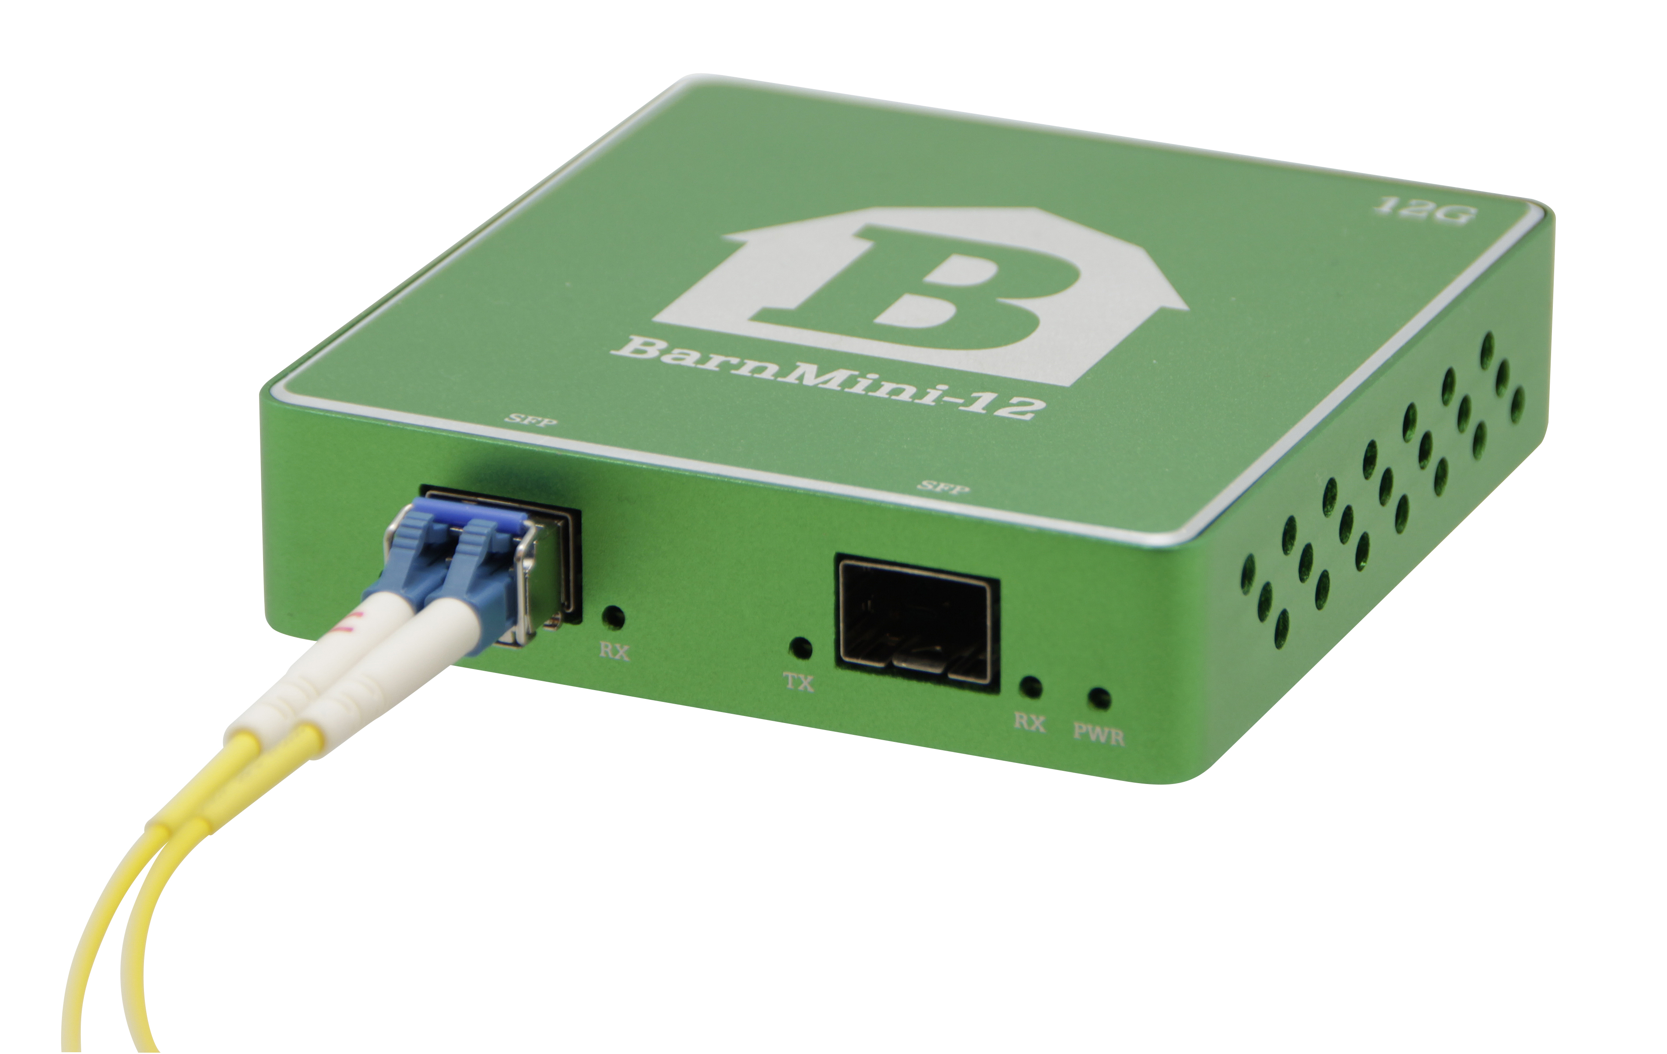
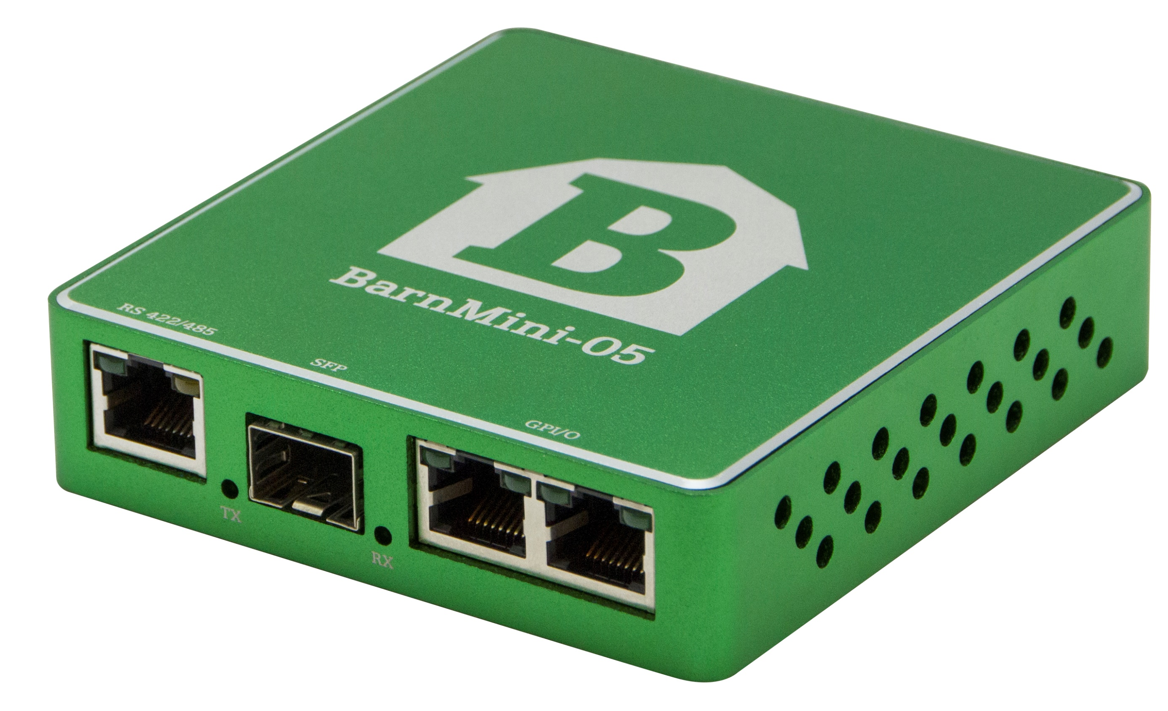
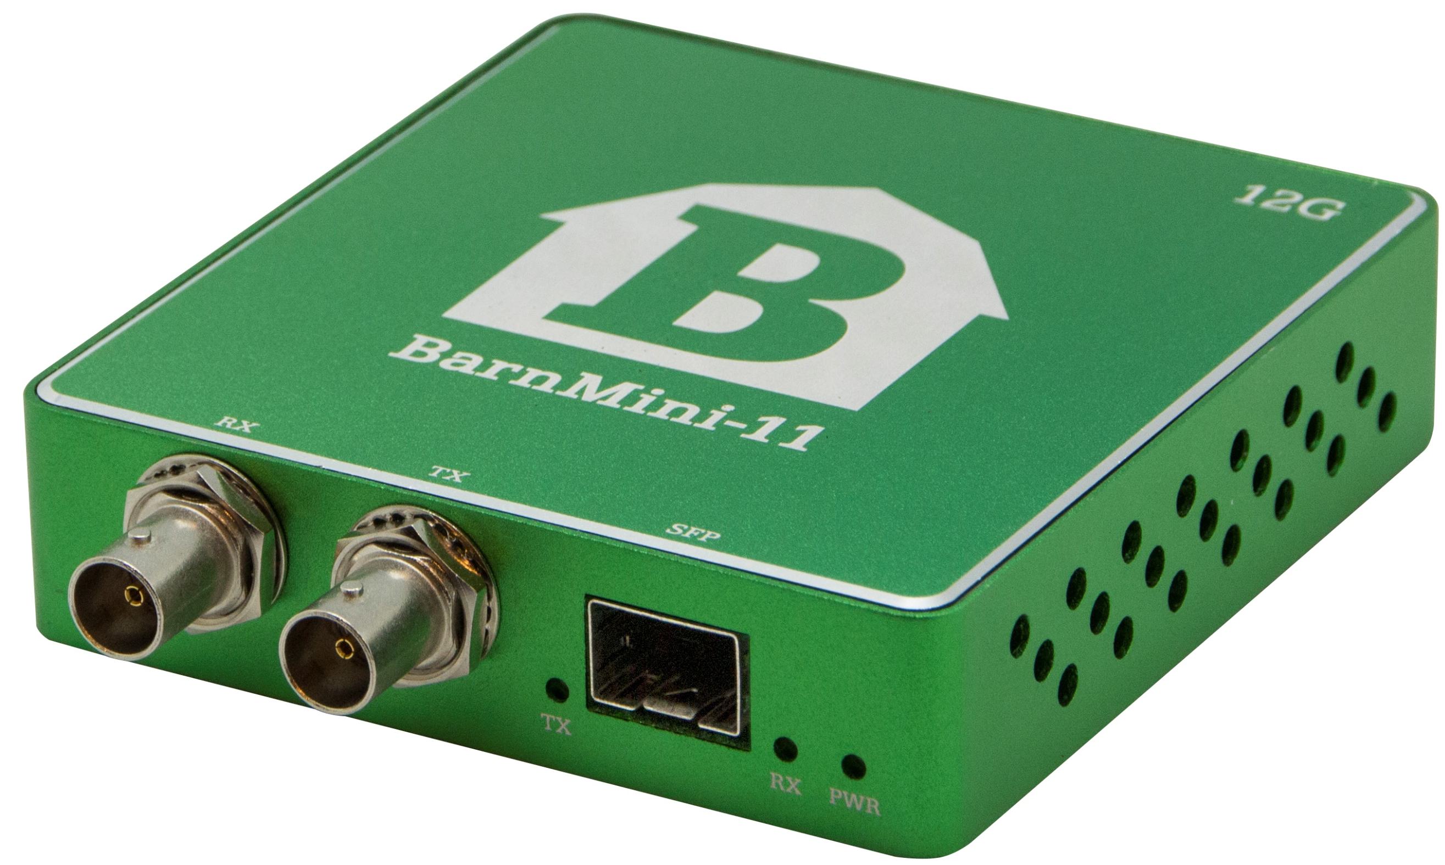
Barnfind Products
BarnMini Series:
Uni/Bi-dierctional
Converter, distributor, multiplexer
P2P or part of a complexed system
12G (some models)
BarnStudio (some models)
Desktop PSU or in Housing (16 pcs)

Slide 10


Slide 11
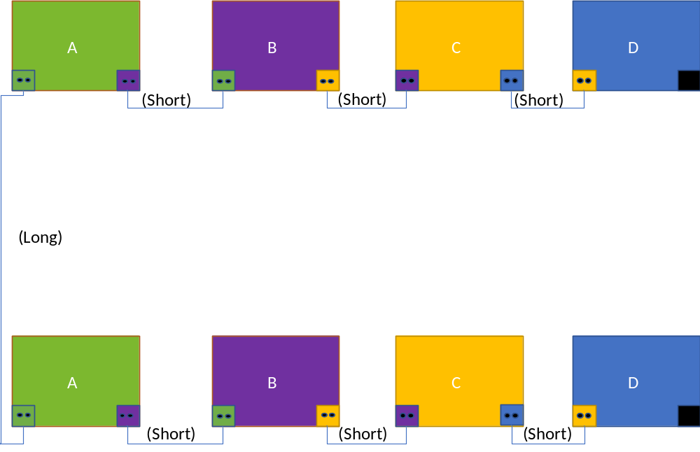
Barnfind products
BarnColor:
The color indicate the position in the cascade. Each color occupy 4 wavelengths in a CWDM range. A maximum of four (4) colors can be used in a cascade.
The color does not represent the functionality of the box. Only the position. In other words, a purple box can be SDI-4x, Eth-4x, HDMI 2.0, AES50-2x….etc.

Slide 12


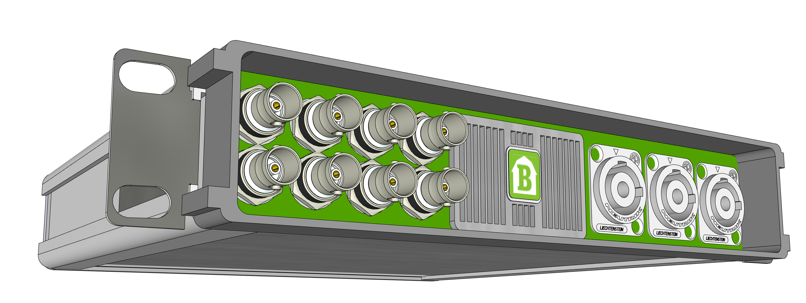
Barnfind products
BarnColor:

Slide 13
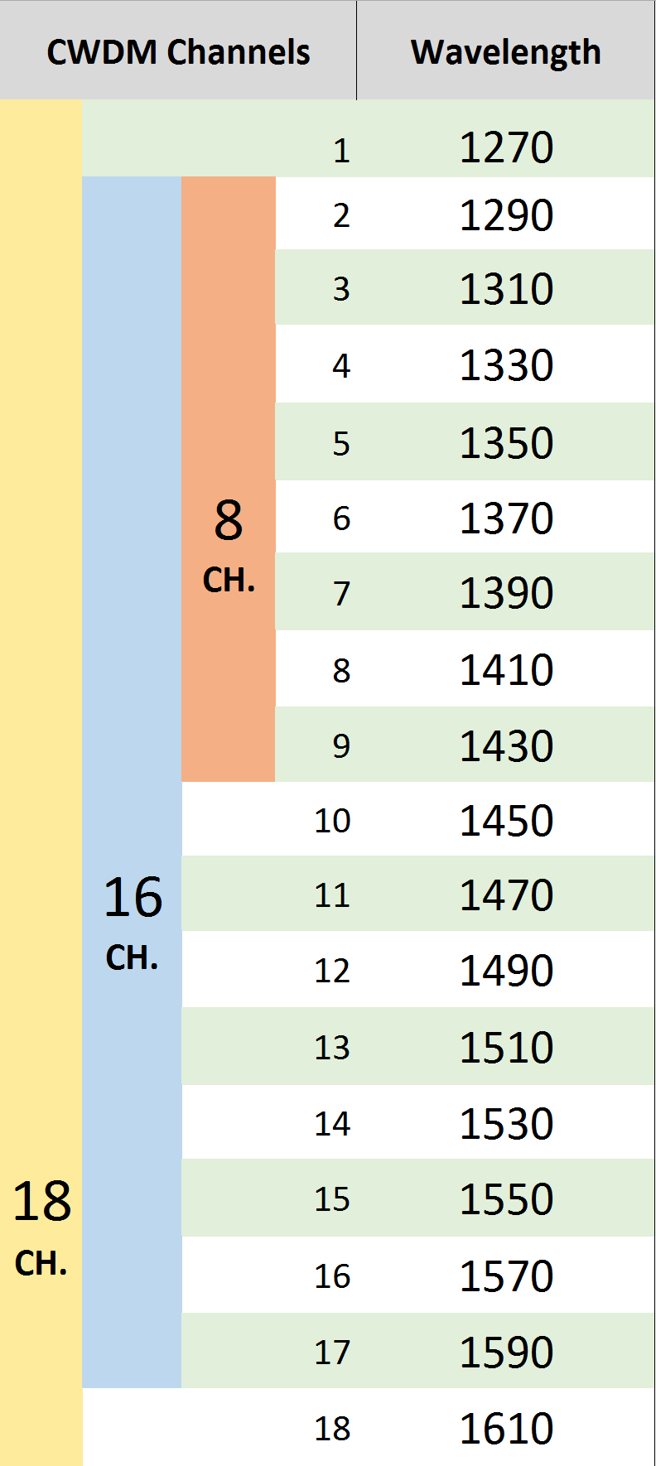
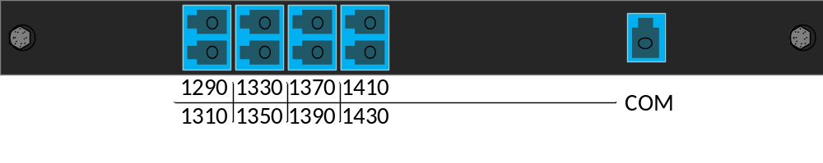
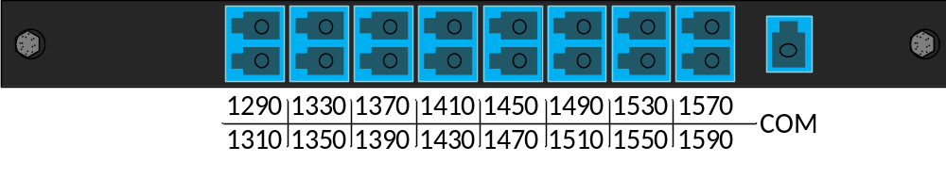
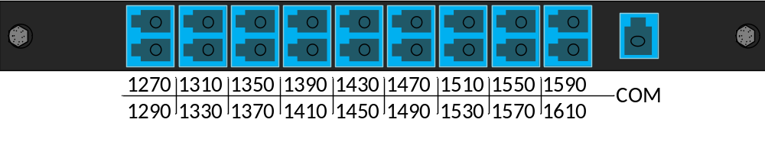
Barnfind products
Passive Optics:

Slide 14
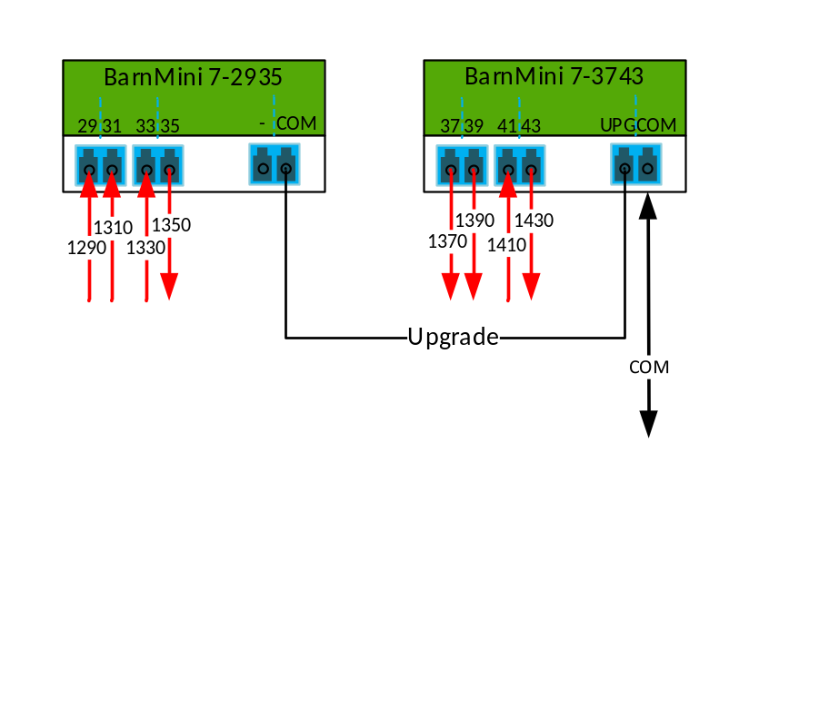
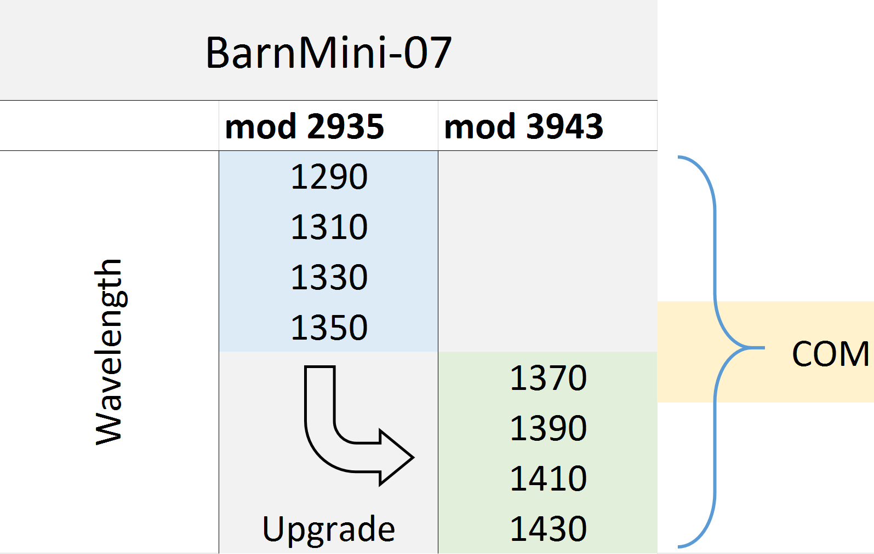
Barnfind products
Passive Optics:
COM
8 ch.

Slide 15
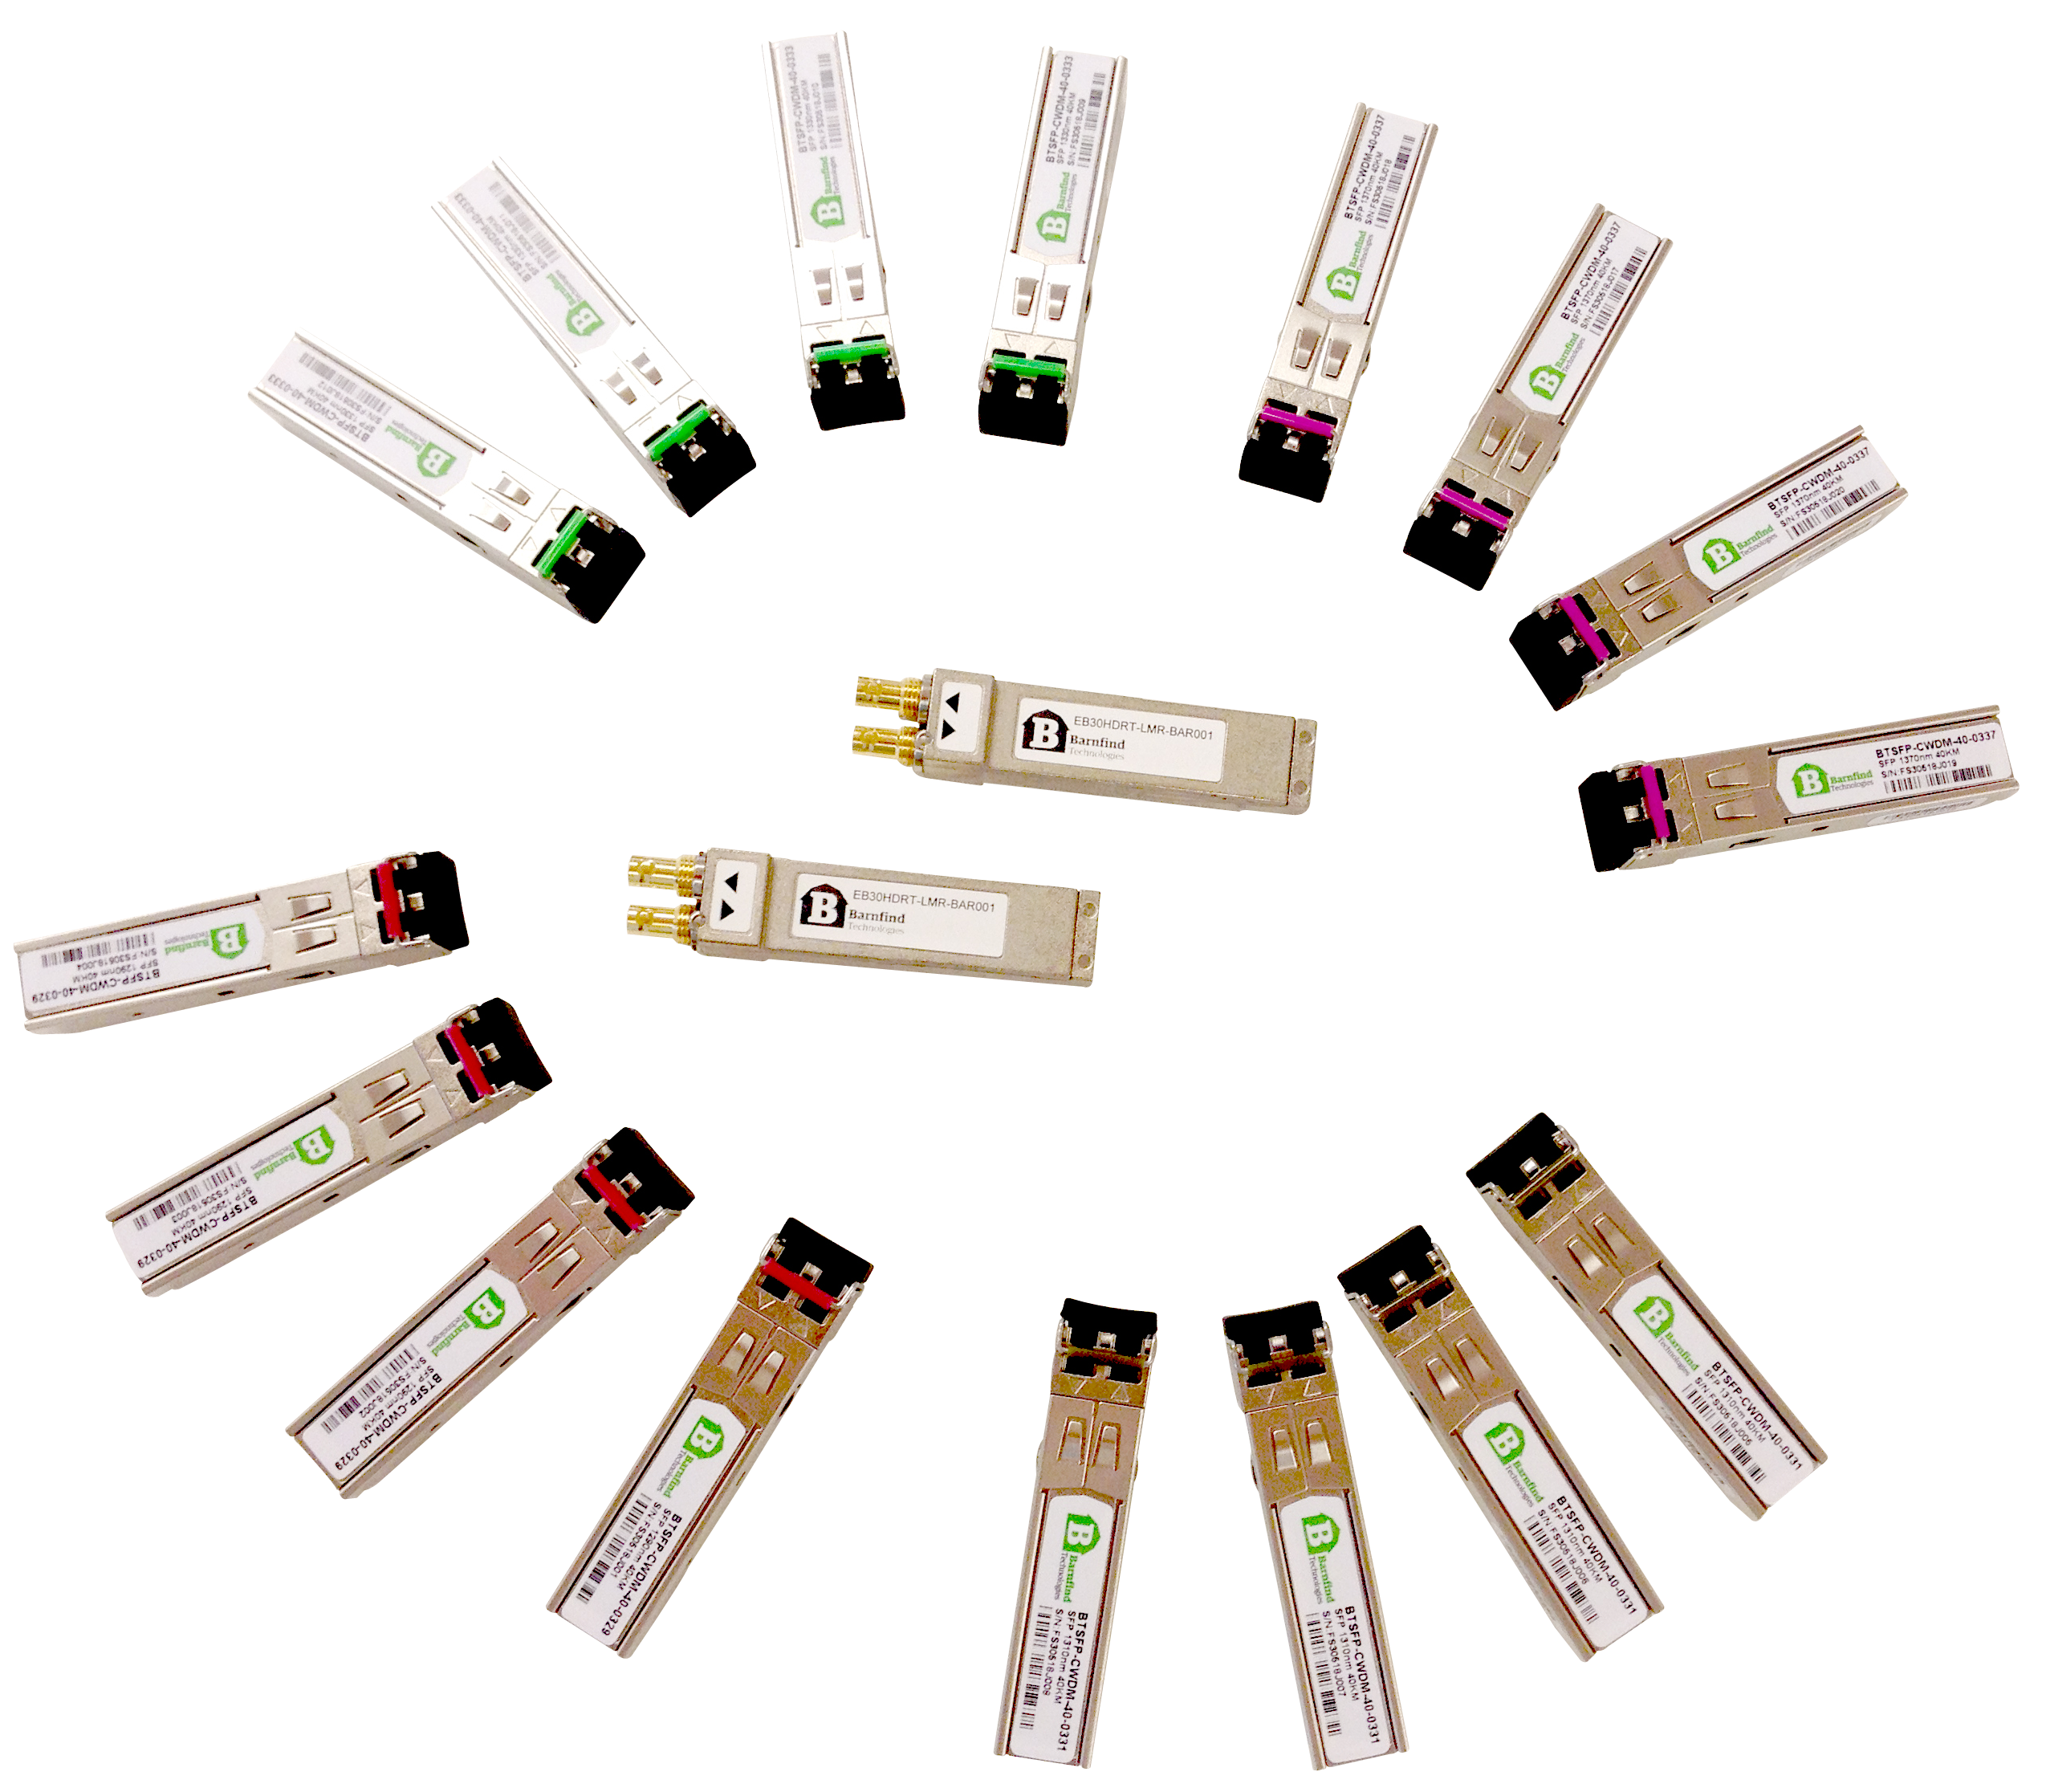
Barnfind products
SFPs:
P2P SFP
BiDi SFP
CWDM SFP
Active SFP
HiLo

Slide 16
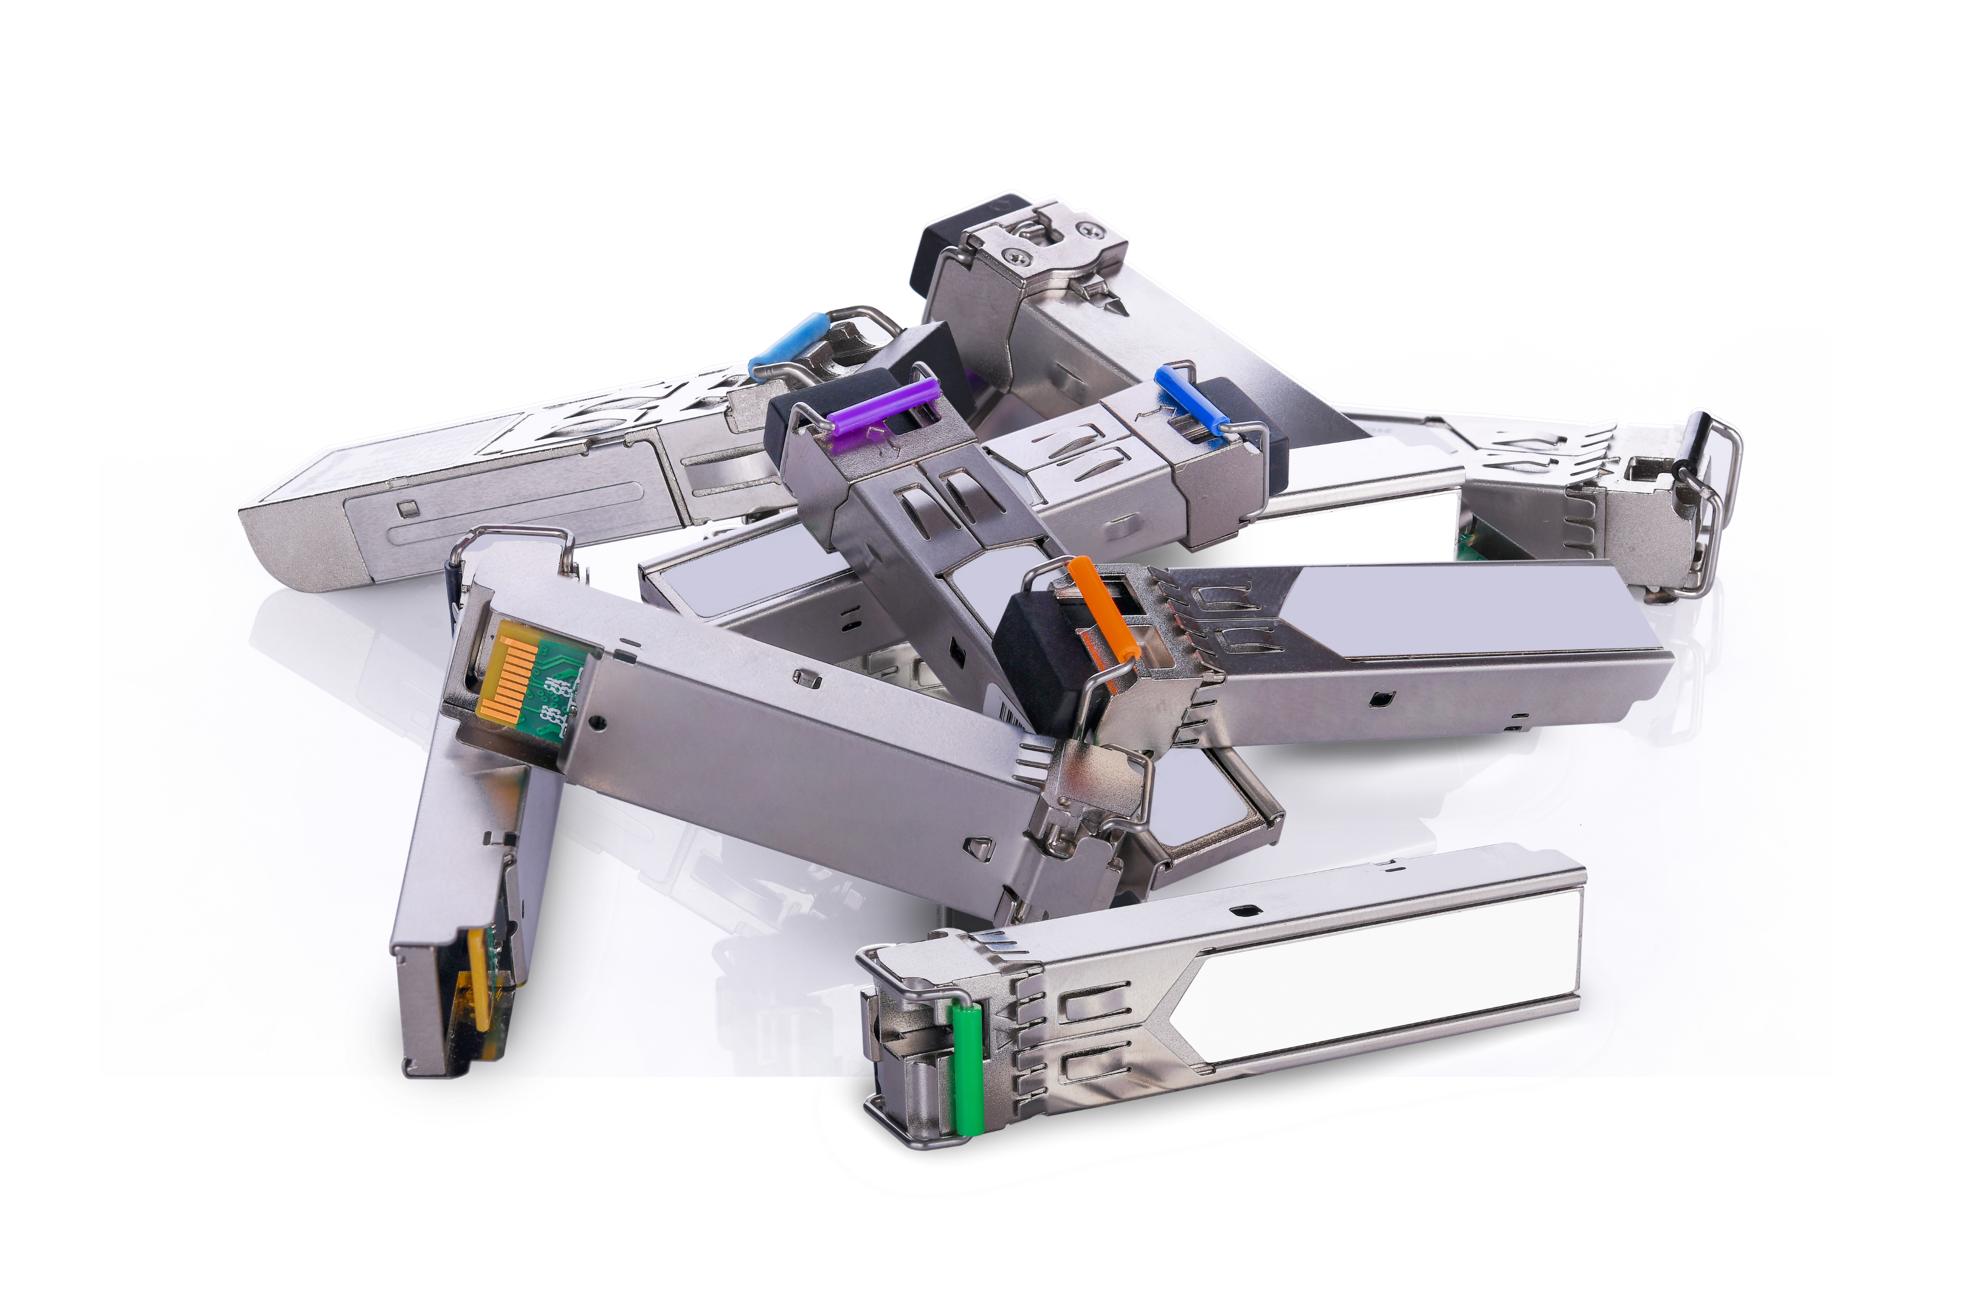
Barnfind products
SFPs:
Point to Point
A transceiver SFP is normally used point to point over short, meduim and long distances. The most significant information is; the maximum distance and the maximum data rate.
BiDi (bi-directional
BIDI SFPs has a WDM multiplexer integrated to transmit and receive on the same port. Normally used for a point to point transmission with only one (1) single fiber.

Slide 17
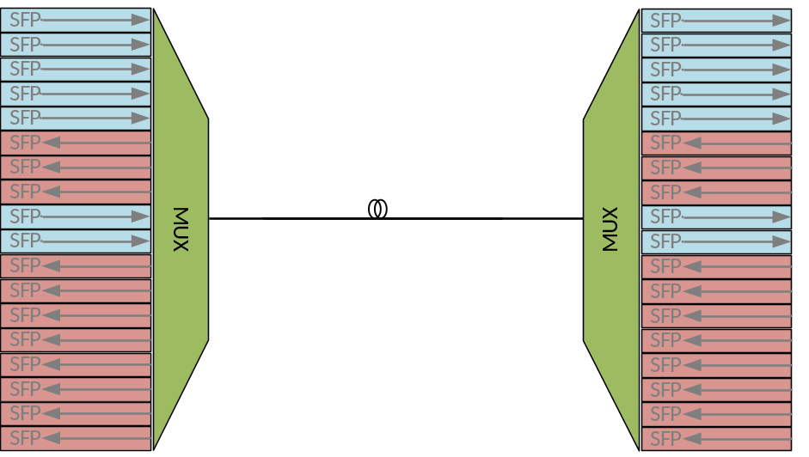
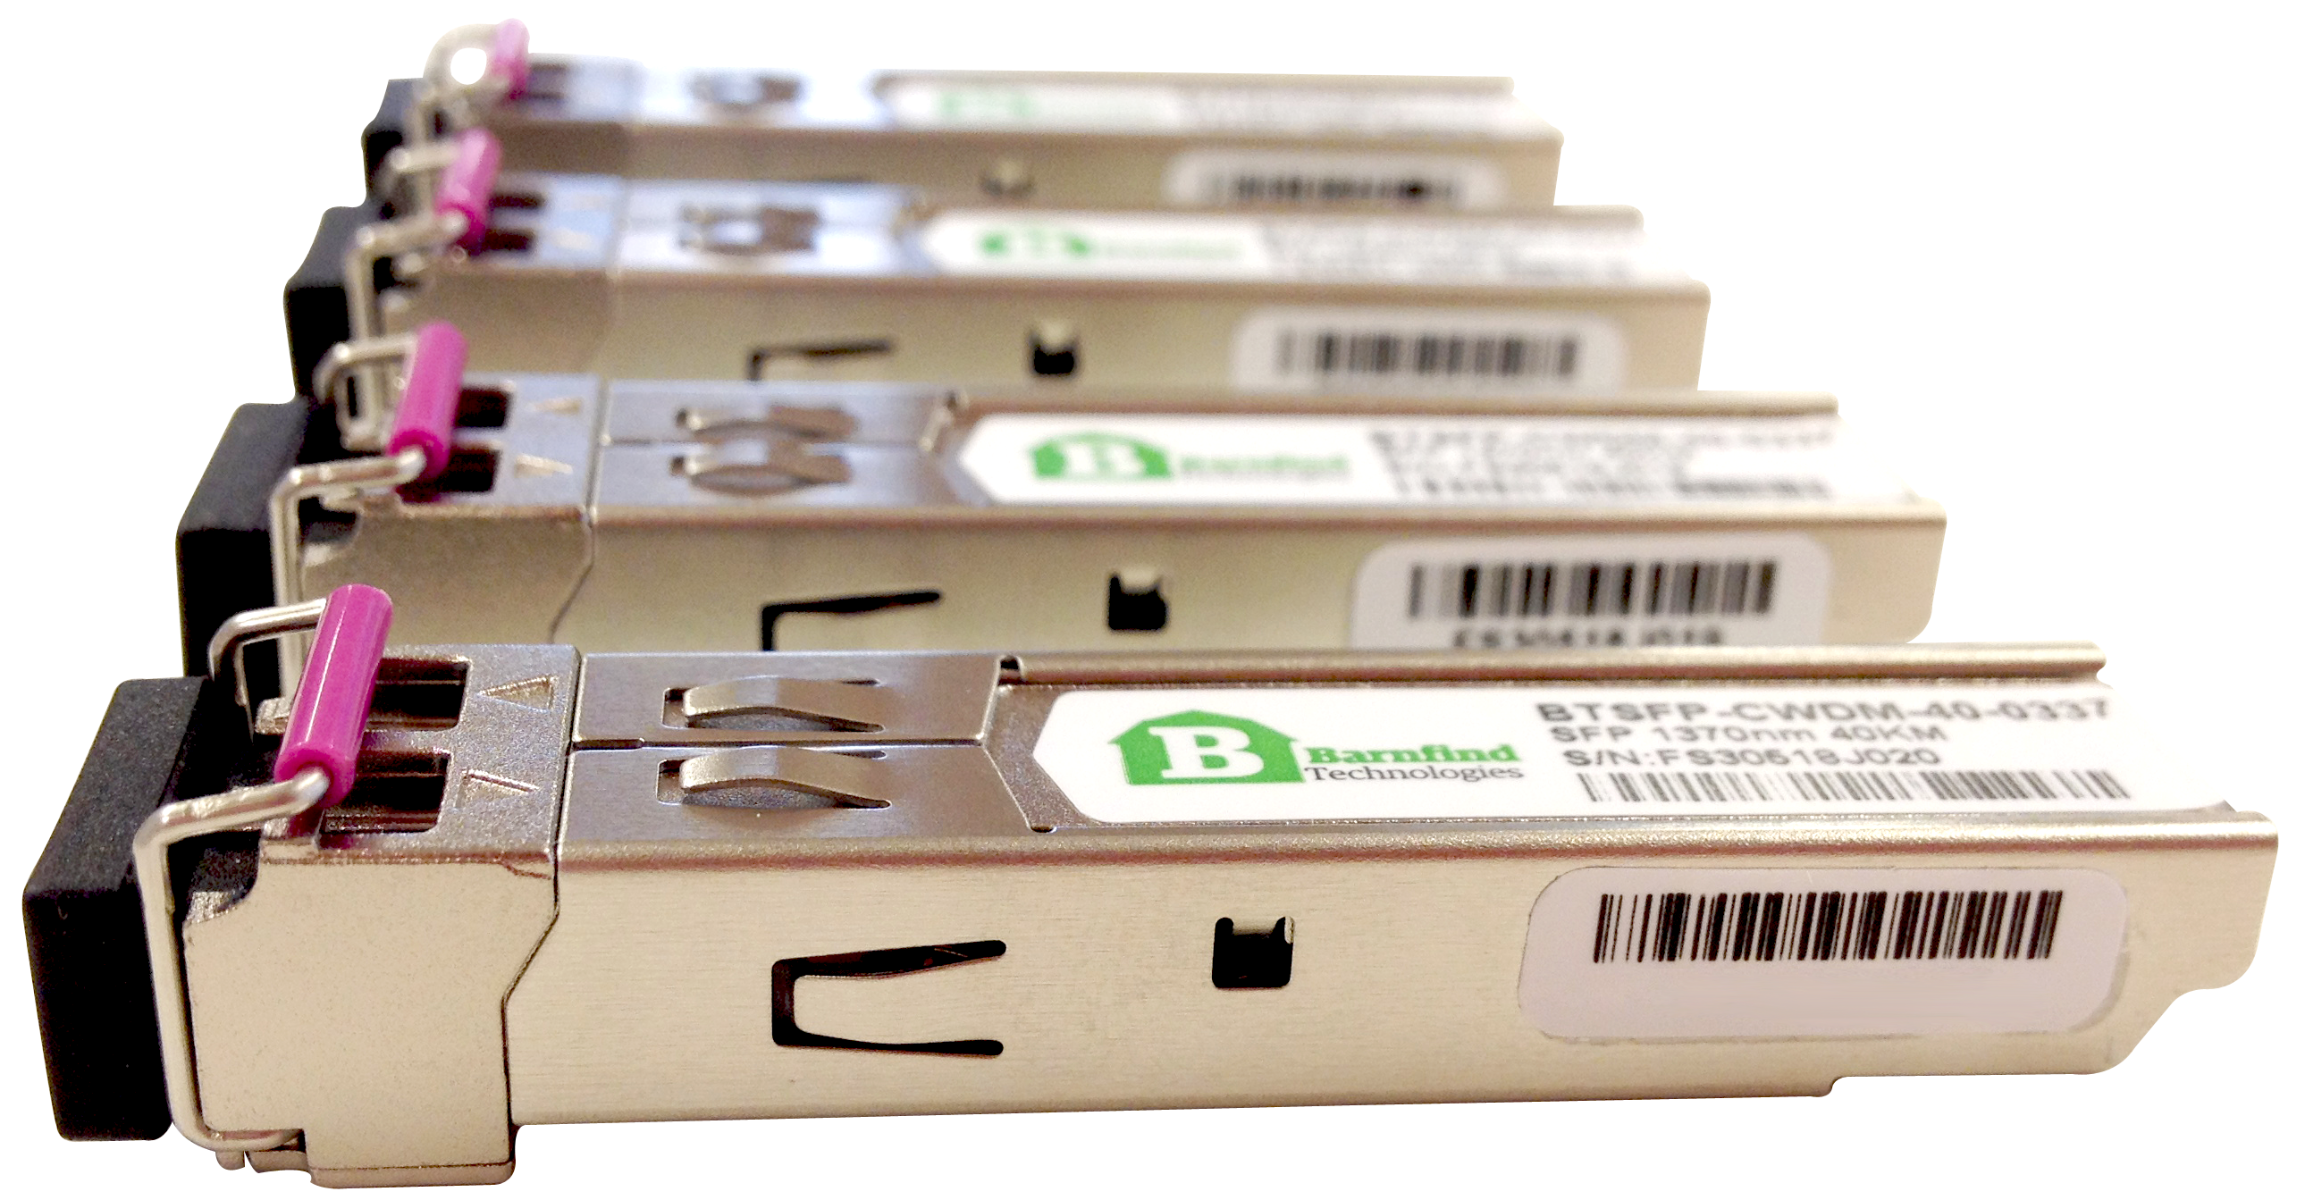
Barnfind products
SFPs:
CWDM
To be able to multiplex a number of signals in one optical fiber, each CWDM channel must have a unique wavelength (frequency).
Coarse Wavelength Division Multiplexing allows up to 18 signals to travel on one fiber strand. Any protocol can travel beside another over the same link, as long as it is a specific wavelength. (e.g. HD-SDI @1570nm can be transported alongside 3G-SDI @1590nm and MADI @1510nm). Channel spacing is 20nm.

Slide 18
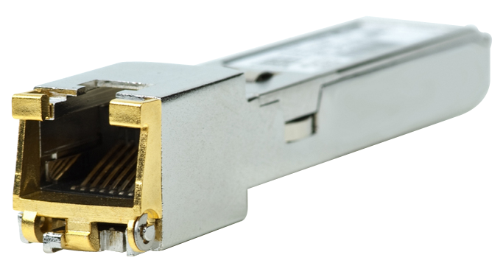
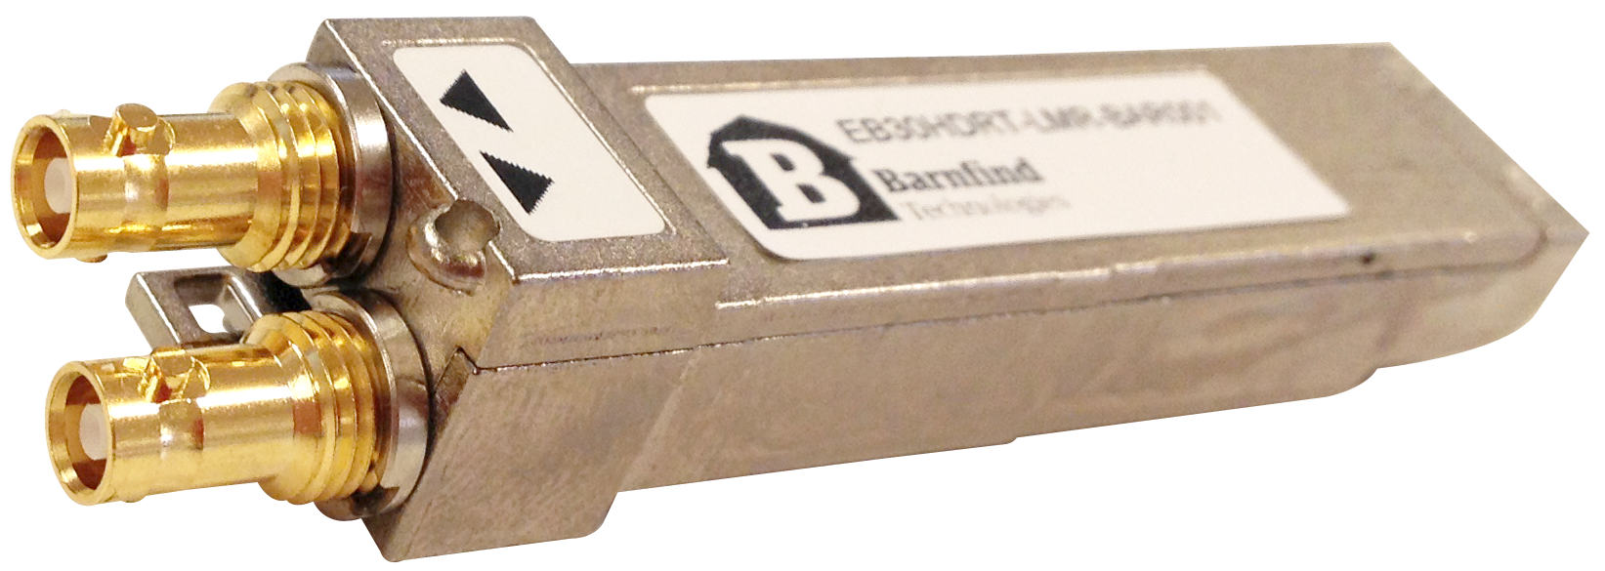
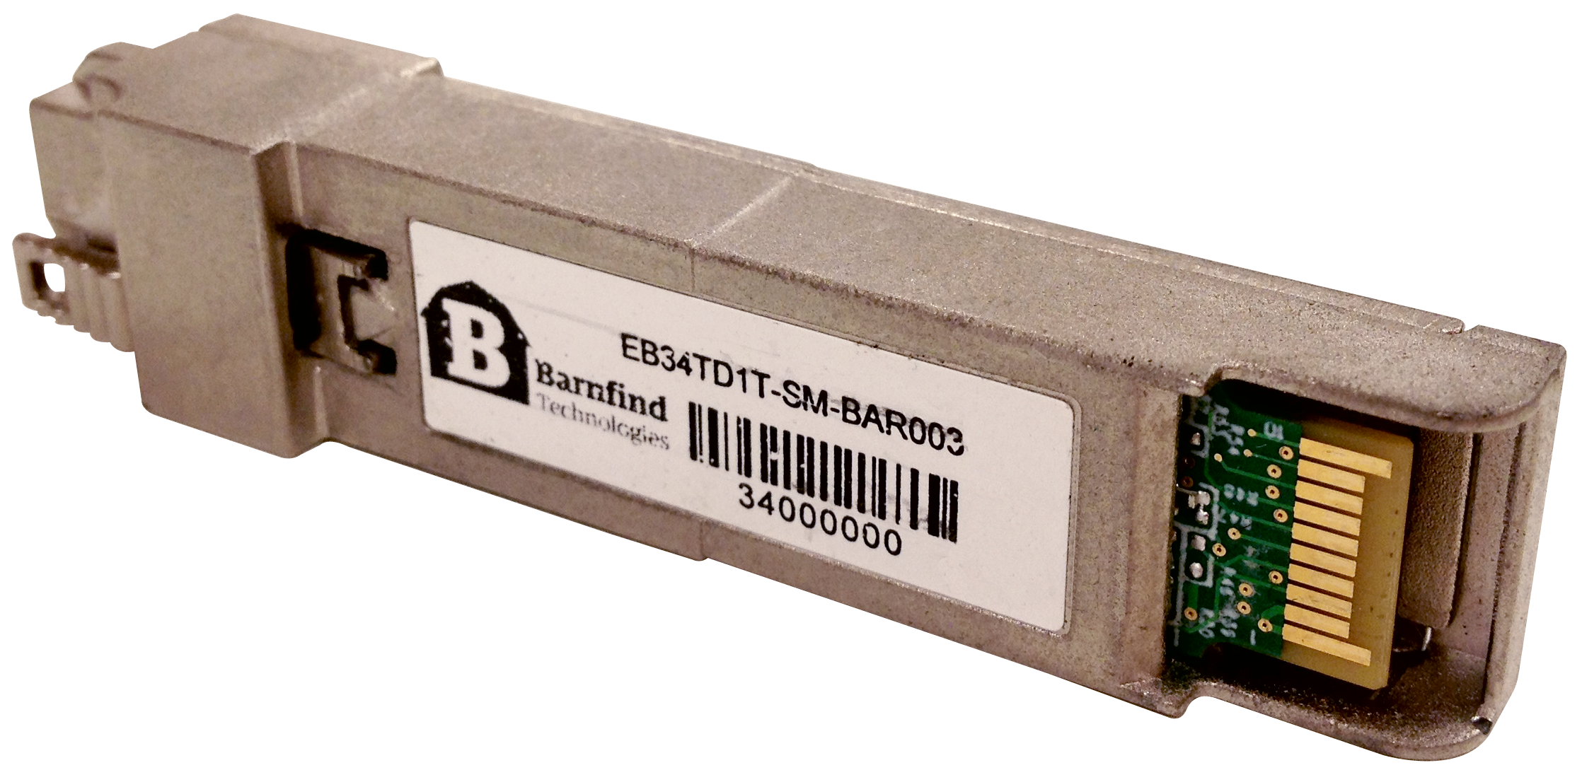
Barnfind products
SFPs:
Active SFP
Some SFPs offer integrated media conversion:
• RJ45 connector for Ethernet
• HDMI converting to/from SDI
• HD-BNC for SDI
• HD-BNC for CVBS converting to/from SDI

Slide 19
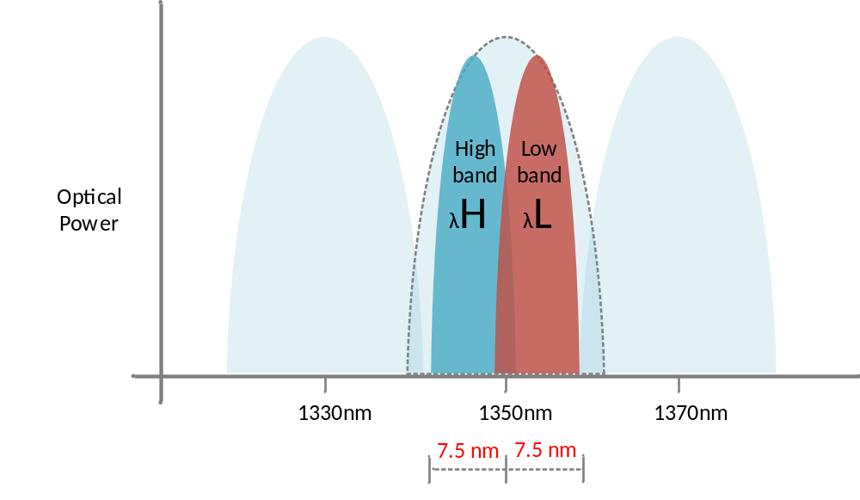
Barnfind products
SFPs:
HiLo SFP
The HiLo SFPs are BIDI SFPs with CWDM transmitter. The SFPs are using a narrow channel spacing and allows you to transmit 2 channels into 1 standard CWDM wavelength. Can be used with a standard CWDM optical multiplexer. They are labeled with H (high) or L (low) and work as pair in the link.
Benefits of using HiLo SFP:
• Up to 18 bi-directional channels in one (1) fiber.
• Can be used with standard optical multiplexer
• Can work along with standard CWDM SFPs to increase the number of channels
• Handles bitrates up to 3Gbps.

Slide 20


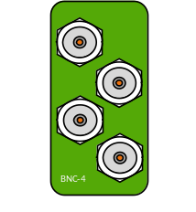

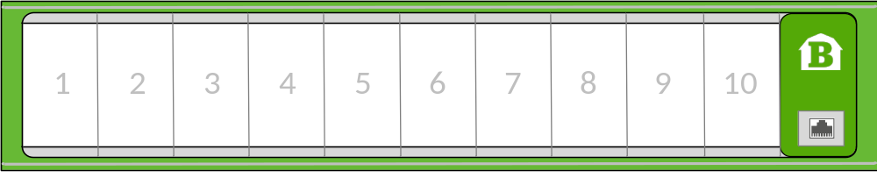
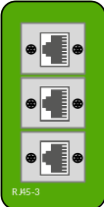

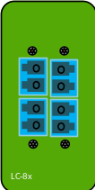

Barnfind products
StageBox Panels:
The Barnfind Stagebox break-out panel allows you to customize your own front panel based on the required connectors. The various selection of modules will be the connection points to one or more frames.

Slide 21
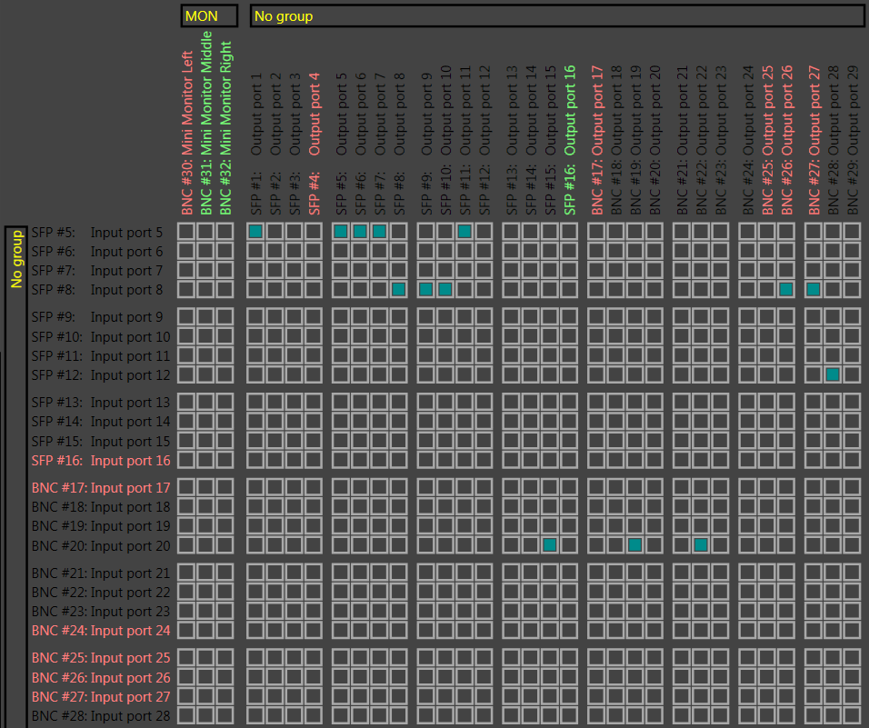

Barnfind products
BarnStudio:

Slide 22
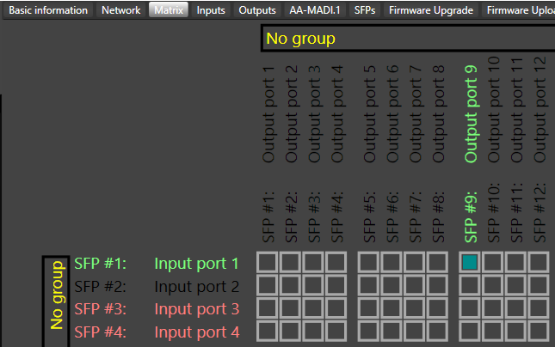
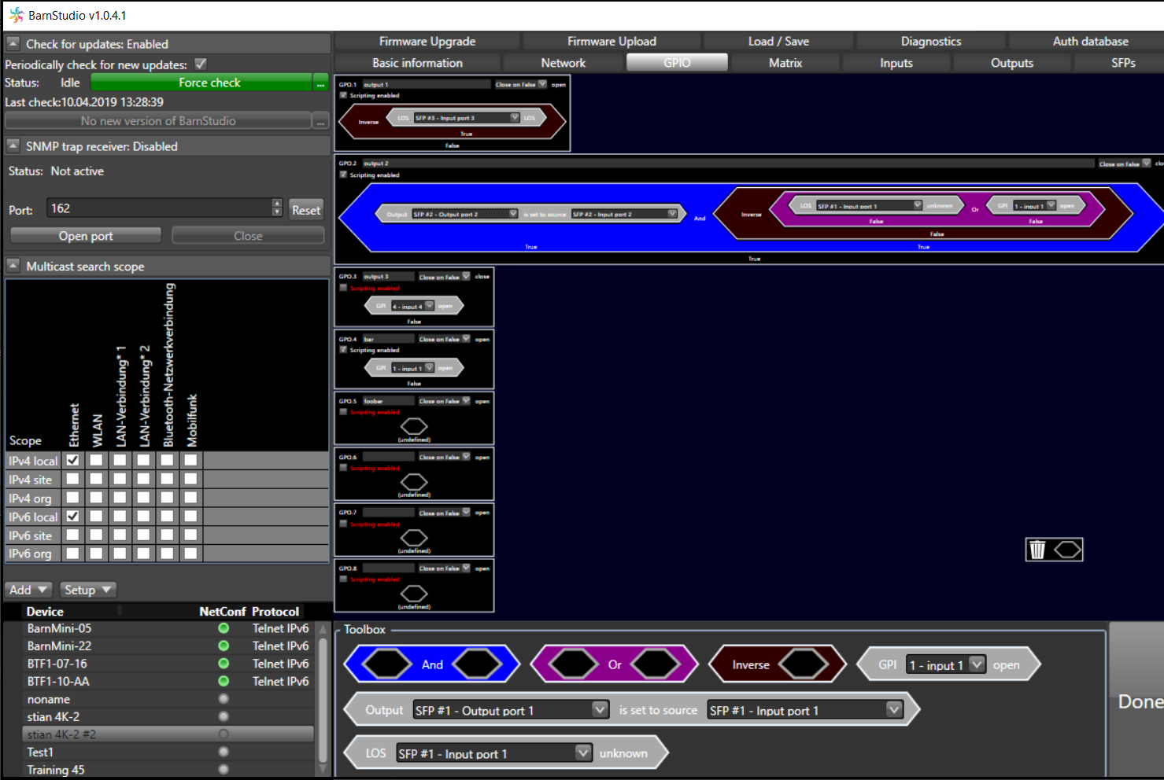
Barnfind products
BarnStudio:
Full matrix control
Arrange automatic redundancy
Analyze input signal
Organize sources and destinations in groups
GPIO logic tool
Full devicelist of all connected units
Full diagnose of all critical components
Rename/regroup

Slide 23
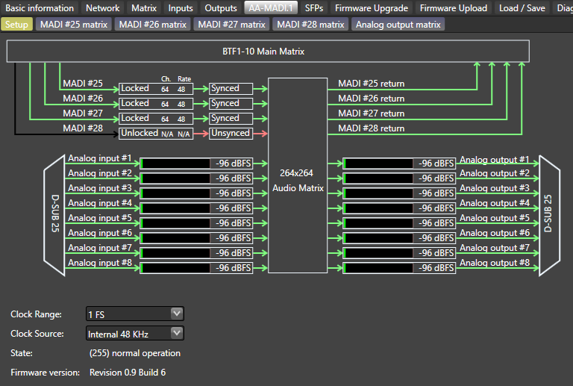
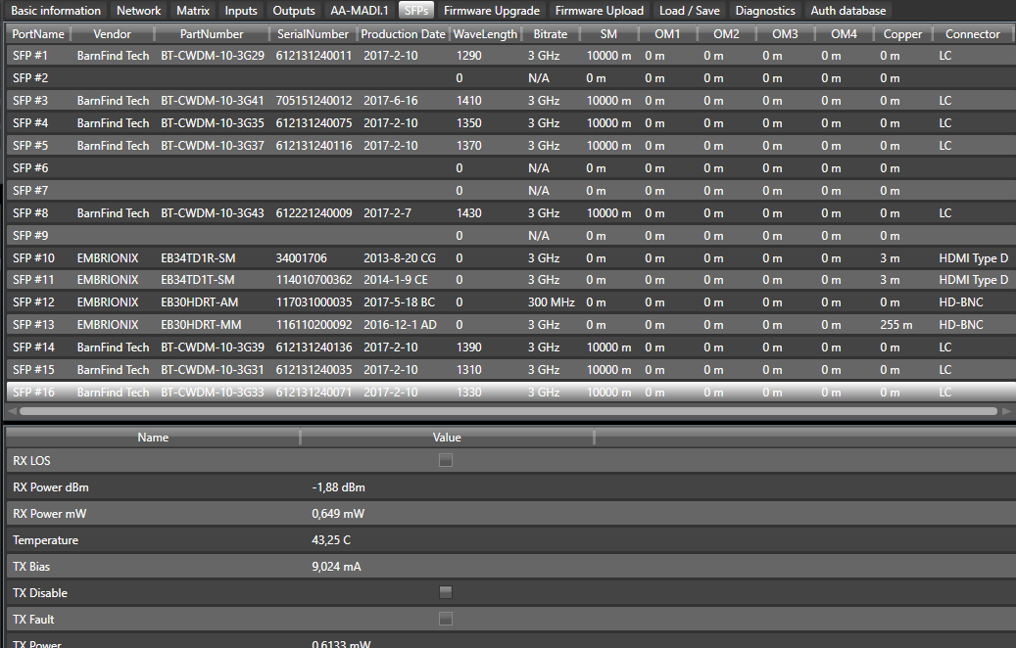
Barnfind products
BarnStudio:
264x264 audio shuffeling matrix
Administrate user levels
Automatic update
Full diagnostic information of all SFPs
Read optical signal strength (dBm or mW)
Temperature control
Download and upgrade devices
….and much more

Slide 24


How to reach us:
Barnfind Technologies, HQ in Sandefjord Norway,
www.barnfind.no
Barnfind China
Barnfind USA
Barnfind Asia
And we have some 60 local distributors and system integrators around the world

