Slide 1
Group 7
Sustainable transitions
2. Semester project
MSc Sustainable Design
AAU, Copenhagen
Oral exam
18th of June

Slide 2
Agenda
Recap of project
Discussion of 'Sociocycle'
Old and new ANT
Action-plan
'Sociocycle' in the DFS framework
Conclusion

Slide 3
Project scope and collaborator
The scope of the project were to analyse for and create a new system for cargo freight in Inner City, Copenhagen, with the use of cargo bikes.
The group engaged with Miljøpunkt Indre By & Christianshavn to part-take in their desire to:
“experiment with sharing schemes regarding zero-emission vehicles for business purposes”
The centre manager, Marianne Spang Bech supported with many years of experience in management and political aspects of introducing sustainable project I Copenhagen
A supportive actor to the project and to our knowledge gain on making changes in rigid systems across sectors and actors

Slide 4
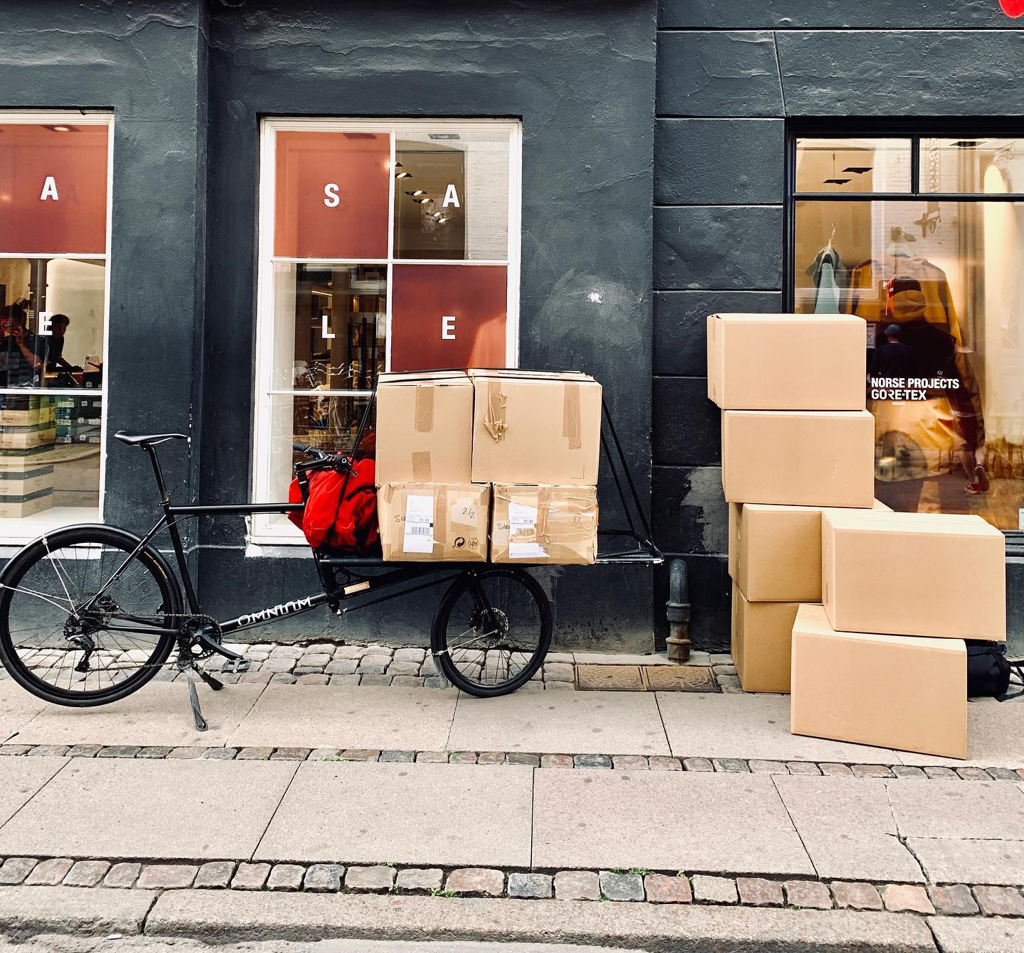
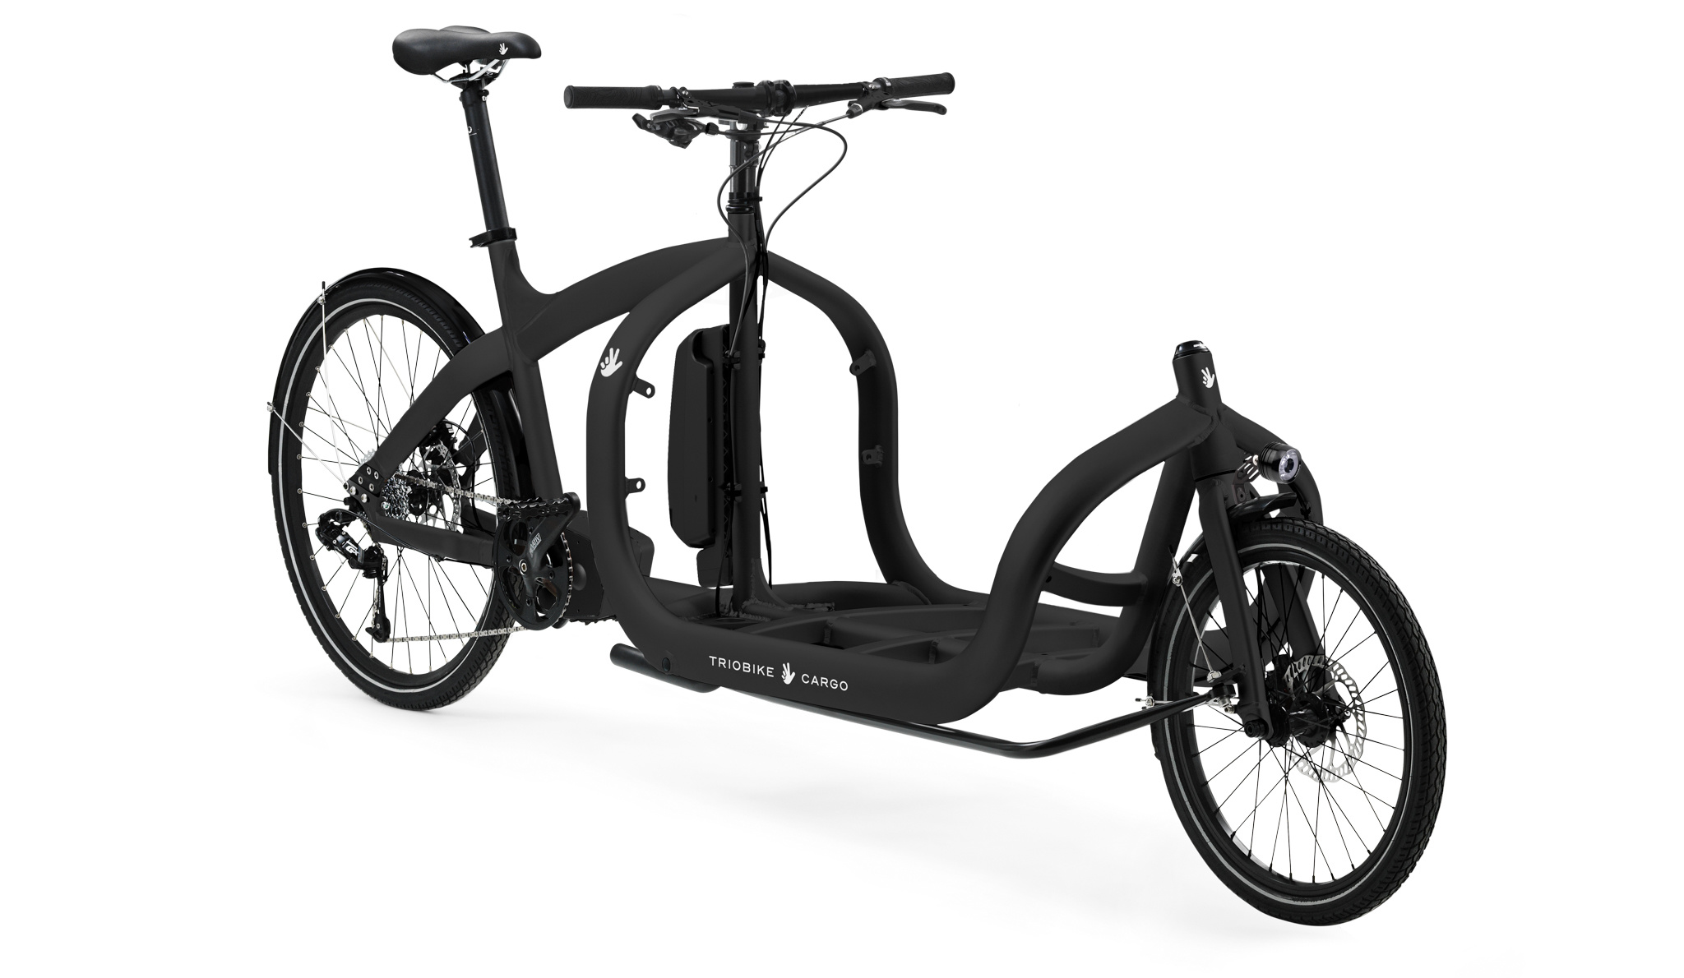
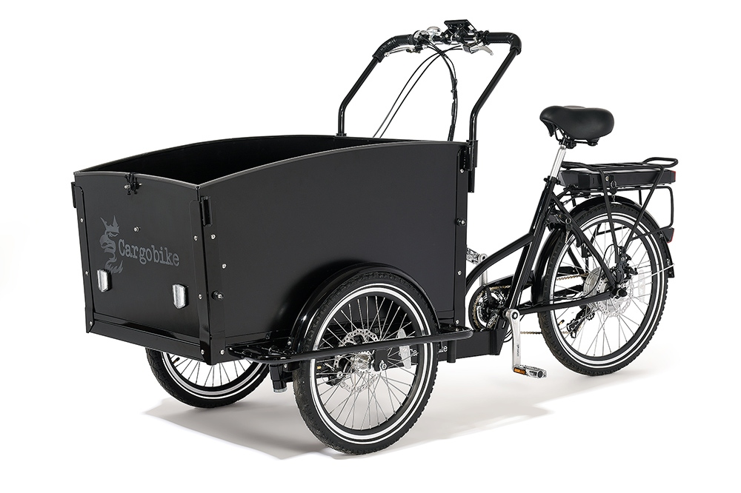
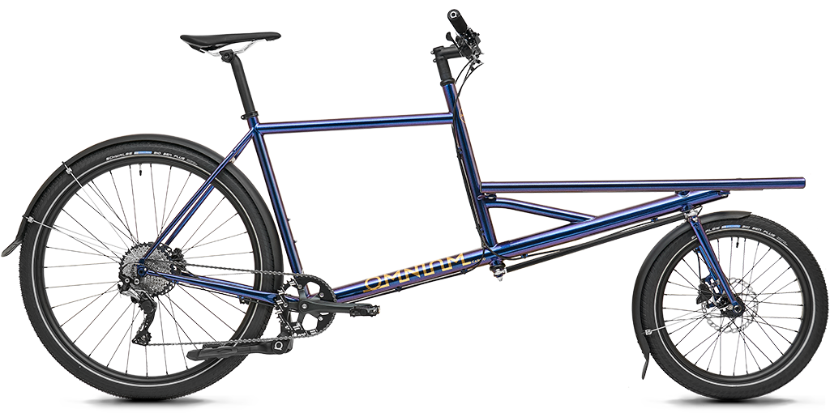
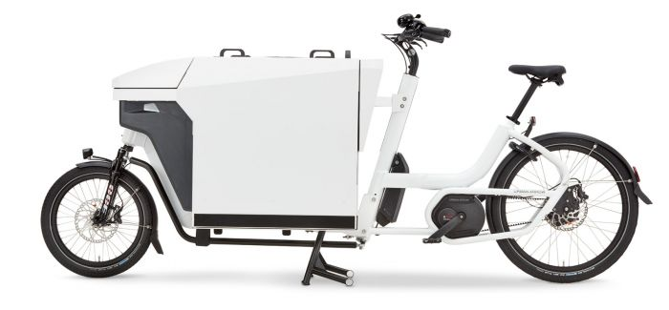
The cargo bike

Slide 5
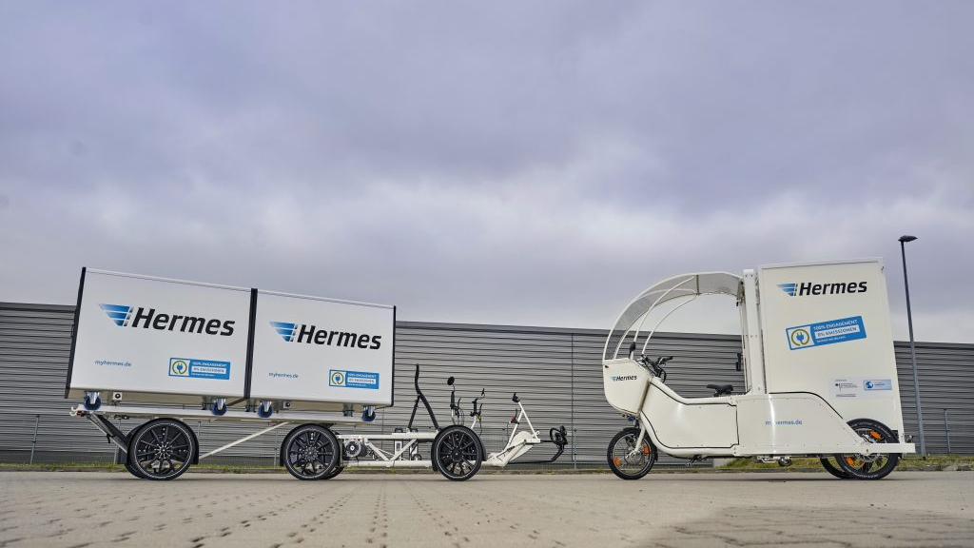
New advancements New possibilities

Slide 6
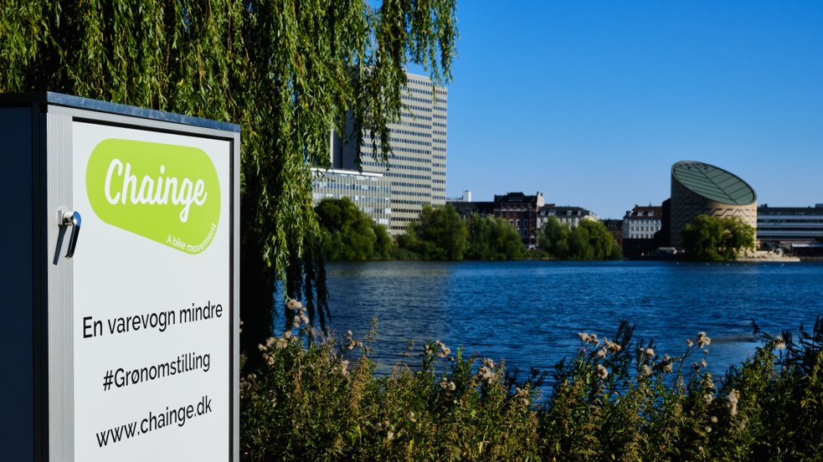

Slide 7
Inner City, Copenhagen
Densly build and populated
Medieval city center with historic and cultural ramifications
Prone to regulations due to municipality ambitions
Stressful and timeconsuming to transport in vans
A dynamic part of the city
Businesses, leisure, shopping, cafe and restaurant, residents

Slide 8
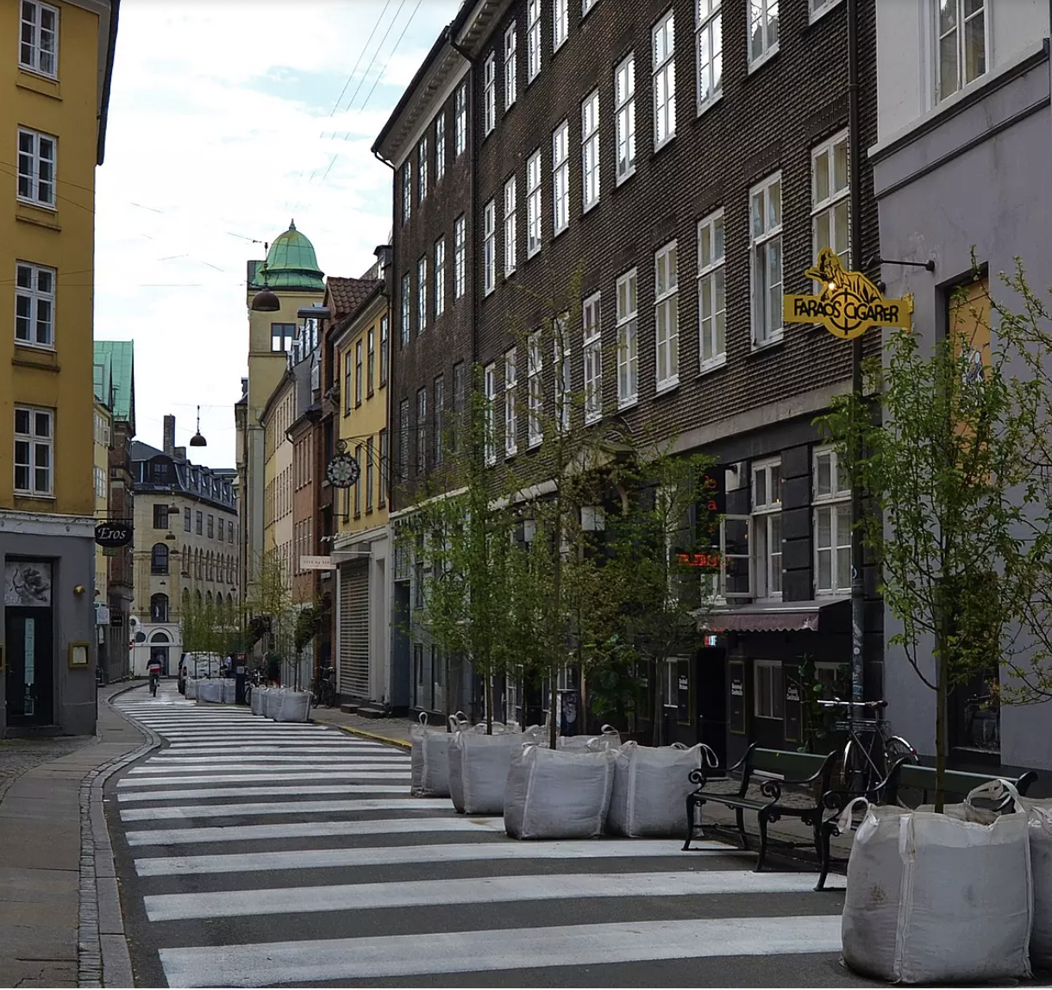
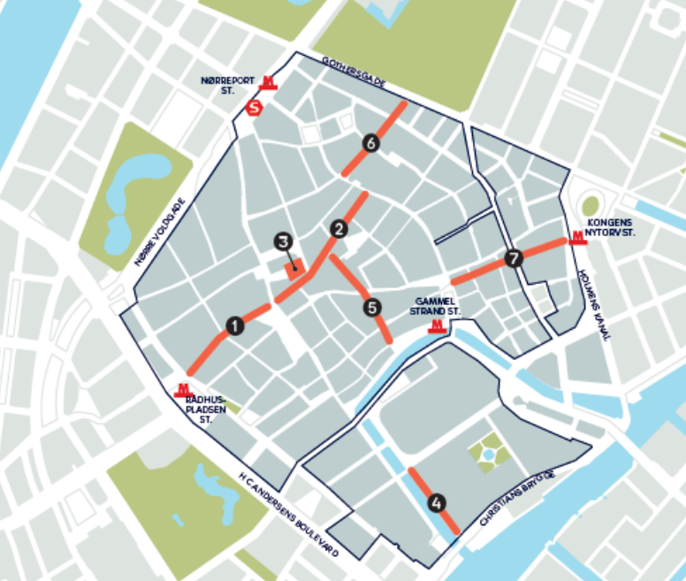
City-space trials

Slide 9
Small-Medium Businesses
Businesses, shops, restaurants and café's are higly represented in a small perimeter
The need for in-and outgoing freight are high and can be challenged by transport and mobility regulations
SMBs are considered as 'users' of the cargo freight system, and key stakeholders with high stakes in a system change
Challenging to change perception of what a cargo bike can do
Economics are prioritized, new system must add value and come at a cheaper cost

Slide 10
Project actors
Municipality, Teknik & Miljøforvaltning
Capital Region
Government NGO Non-profit
IBLU, By-udviklingsgruppen
Miljøpunkt
Apair
SMBs
(surveys)
By-Expressen
Bring
Trade
Distributors
Tante T
Dansk Erhverv
Chainge

Slide 11
Research Question
The current freight system is unsustainable
Pollutes, result in congestion, bad work environment, noisy and chaotic atmosphere in Inner City
Before cargo bikes can be used as the transportation mean it is needed to redesign the freight system
How can freight be delivered sustainably by cargo bikes in the Inner City of Copenhagen?

Slide 12
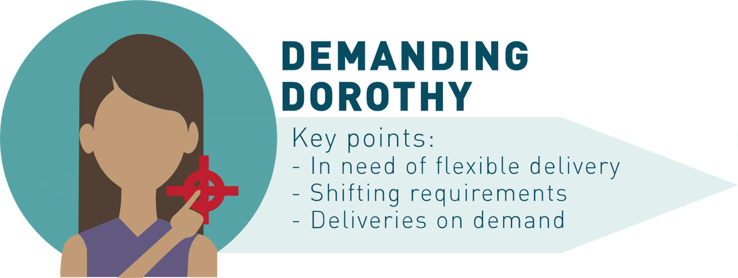
Persona
The personas are based on questionnaire, Interview with SMB's and observations
SMB's have different priorities and opinions
Translated into four different personas
Archetypes that are based on the SMB's
Simplification of SMB's

Slide 13
Requirements and Criteria
Creates the setting for the Ideation
What defines a good concept?
Weighting of the criteria makes it possible to differentiate between the relevance of different criteria
Requirement ID | Requirements:
R1 | Must reduce the car traffic in Inner City
R2 | Must be constructed as a systemic delivery system
R3 | Must reduce the amount of co2 emitted in the Inner City
R4 | Must be able to handle the capacity of the category: small-medium packages
R5 | Must include cargo bikes as last-mile delivery
Criteria ID | To what extend: | Weight from requirement
C1 | It reduces the car traffic in Inner City | 5
C2 | It includes multiple aspects of sustainability | 4
C3 | It matches the personas | 5
C4 | It can carry the same capacity of cargo as current system | 4
C5 | It is feasible to implement | 5
C6 | It is radical compared to the current system | 3
C7 | It can be scaled to replace more of the current regime | 2
C8 | It is fast to implement (relative to 2025 target) | 4

Slide 14
Conceptualization
Making of concepts
Ideation

Slide 15
Systemic design
An entire delivery system
Many pieces must fit together
A baseline

Slide 16
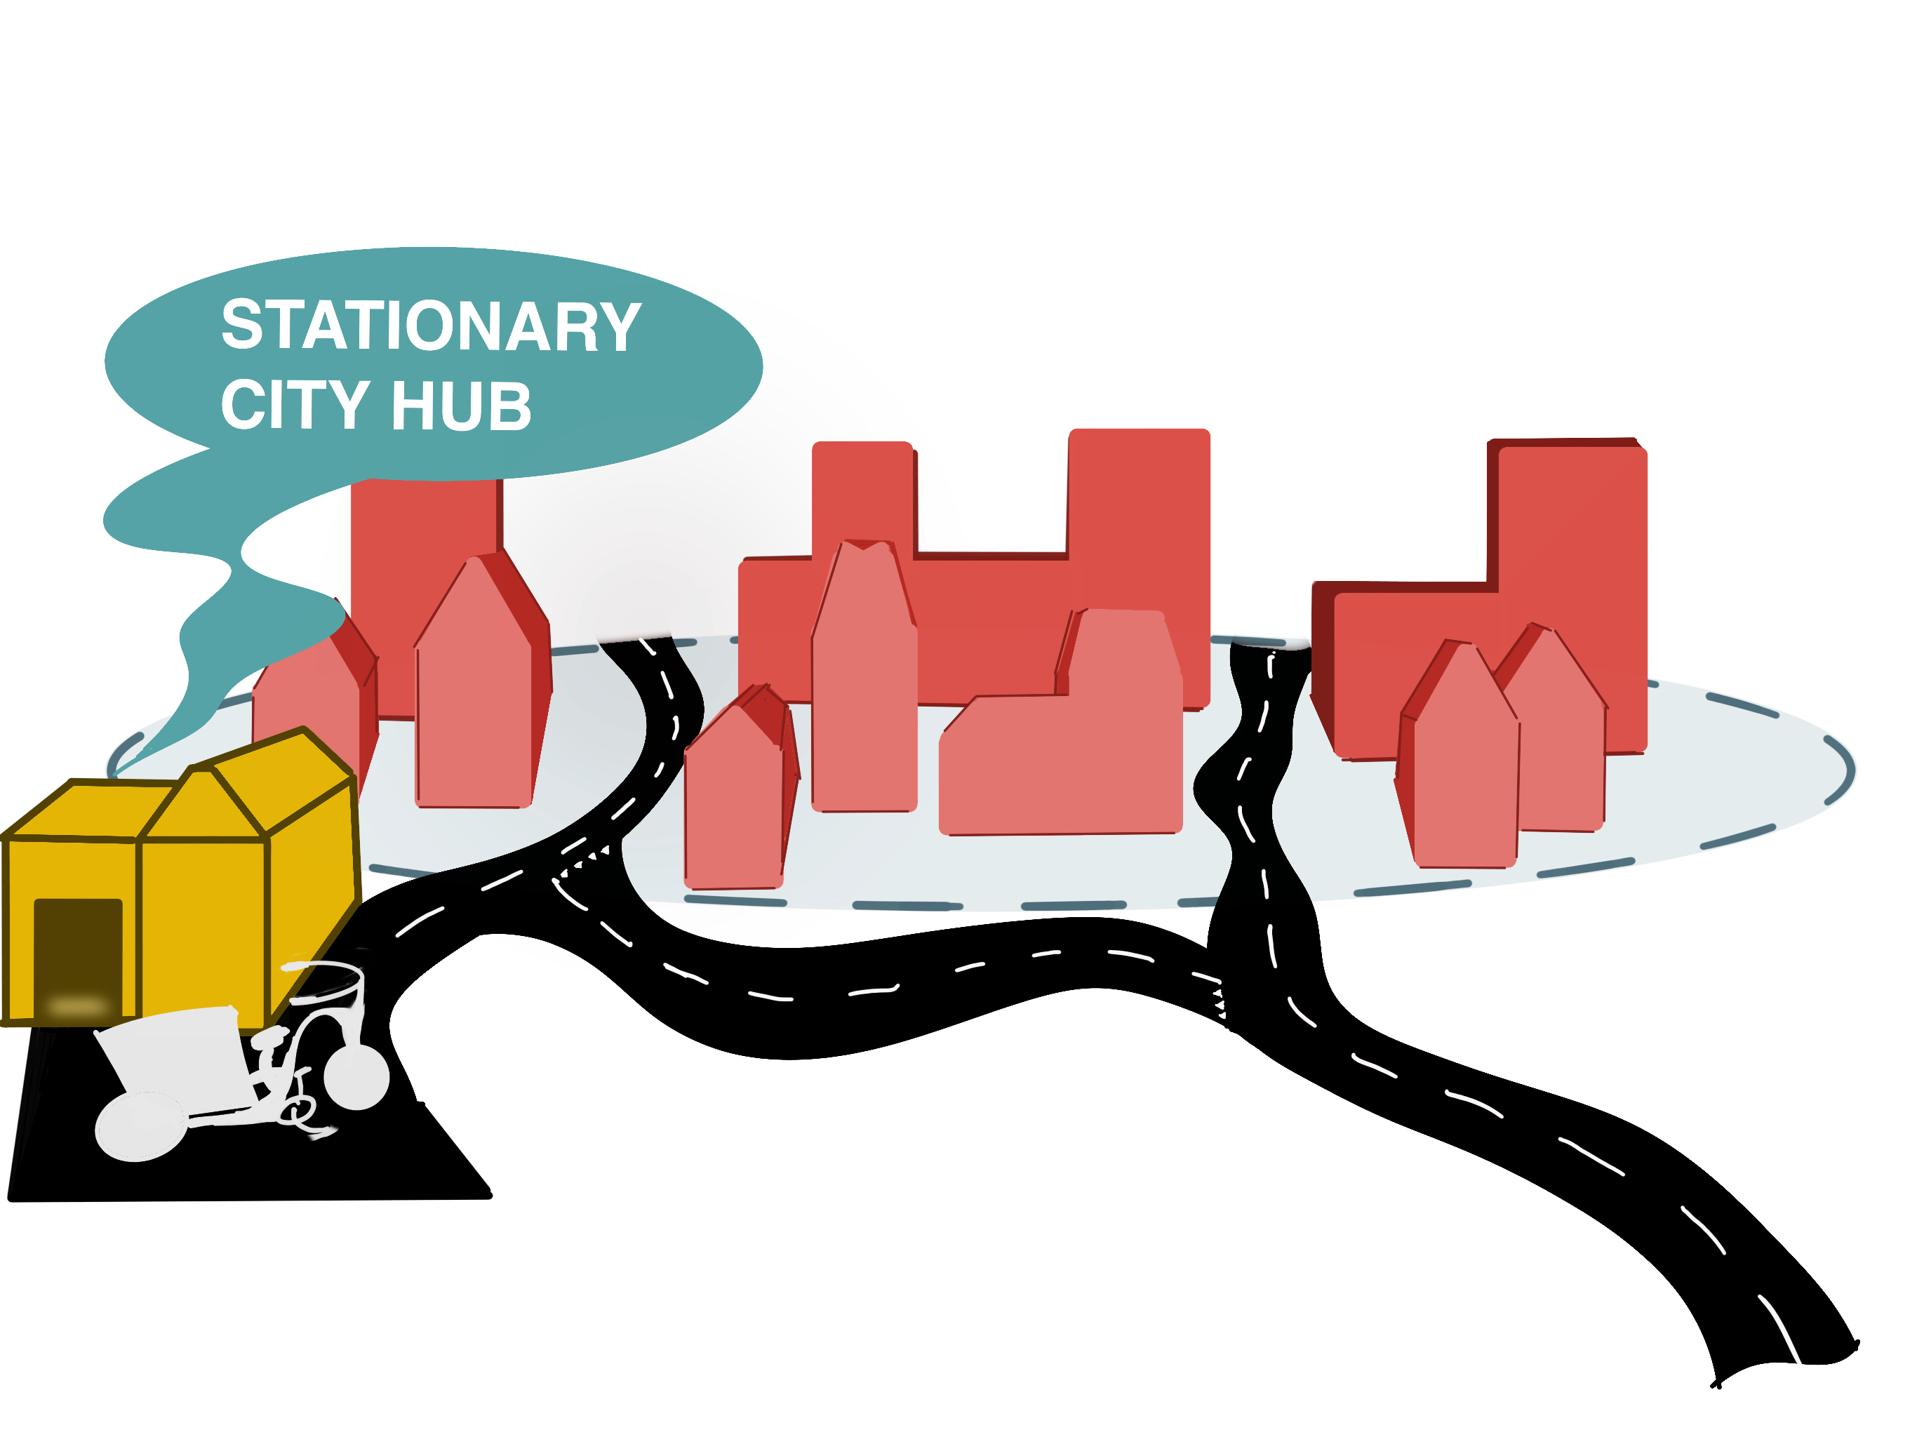
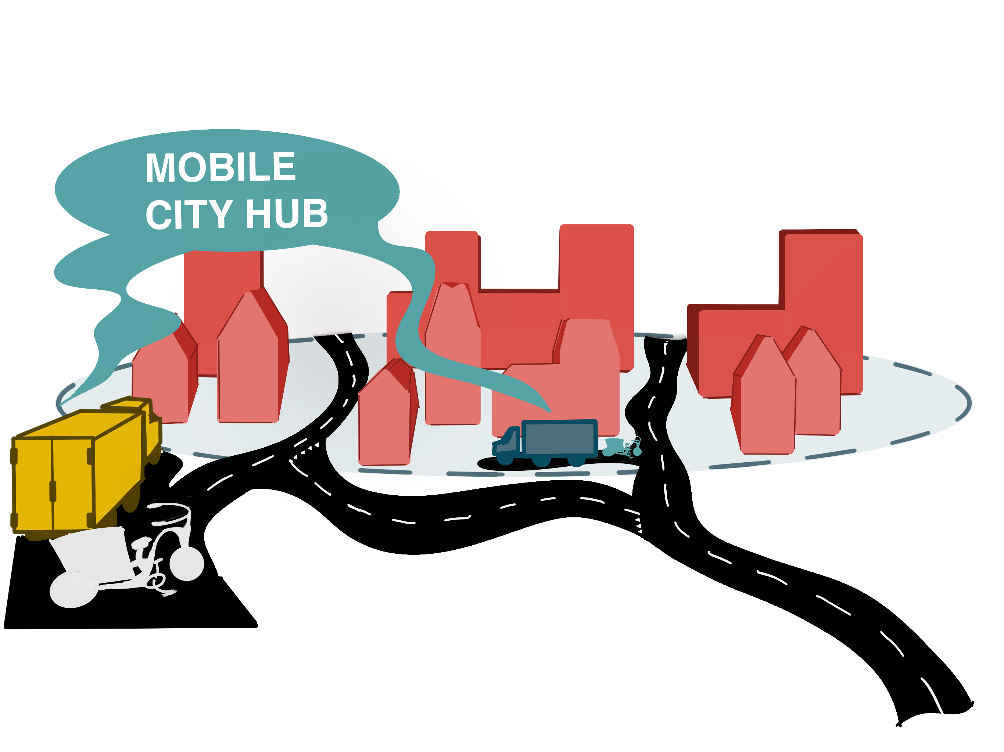
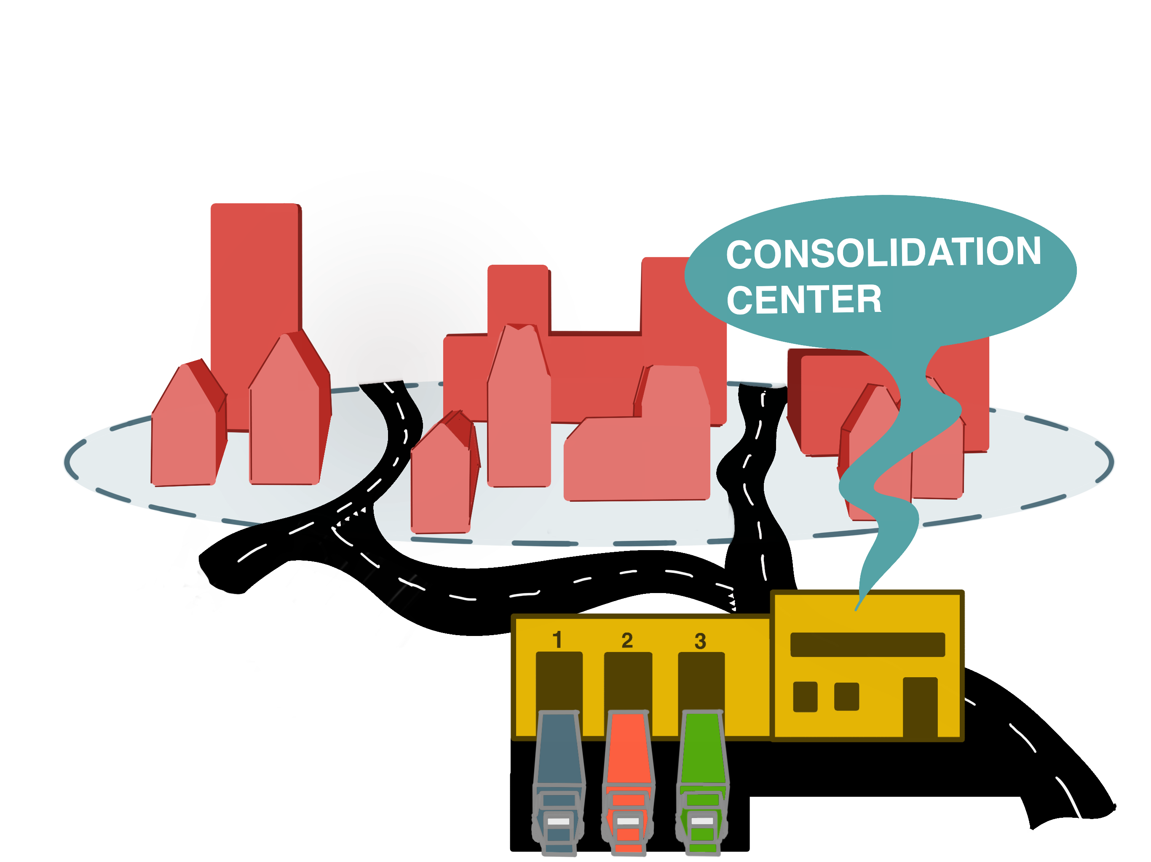
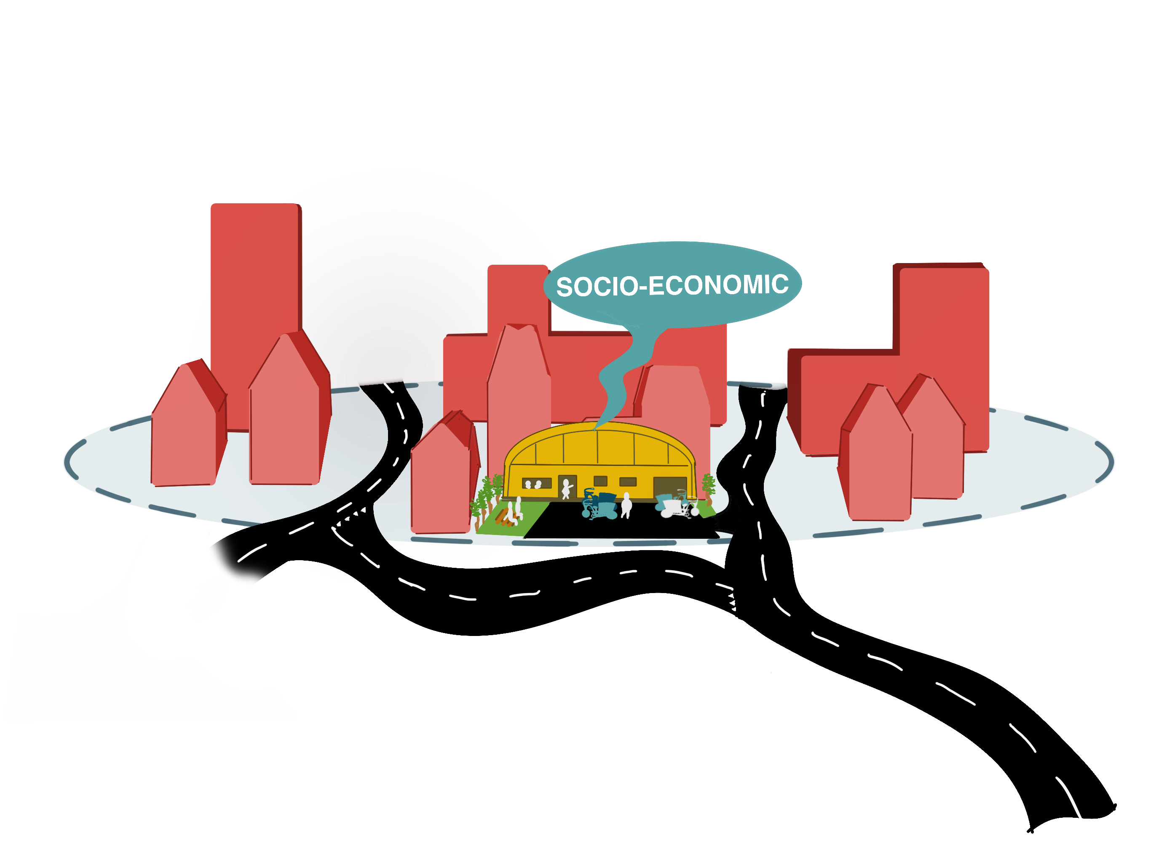
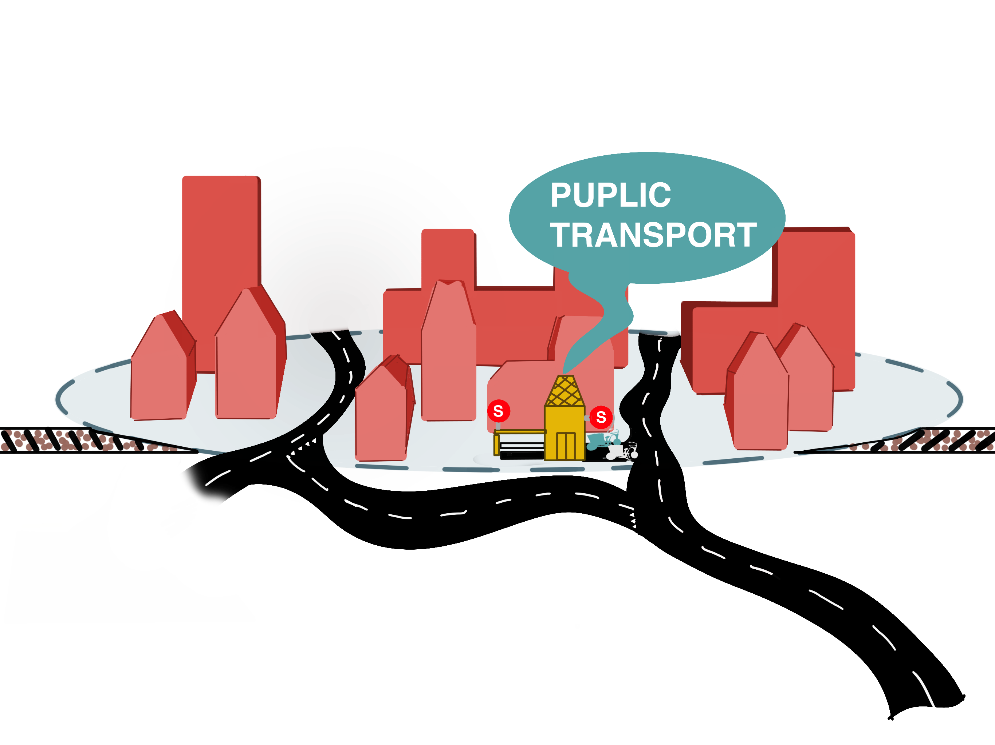
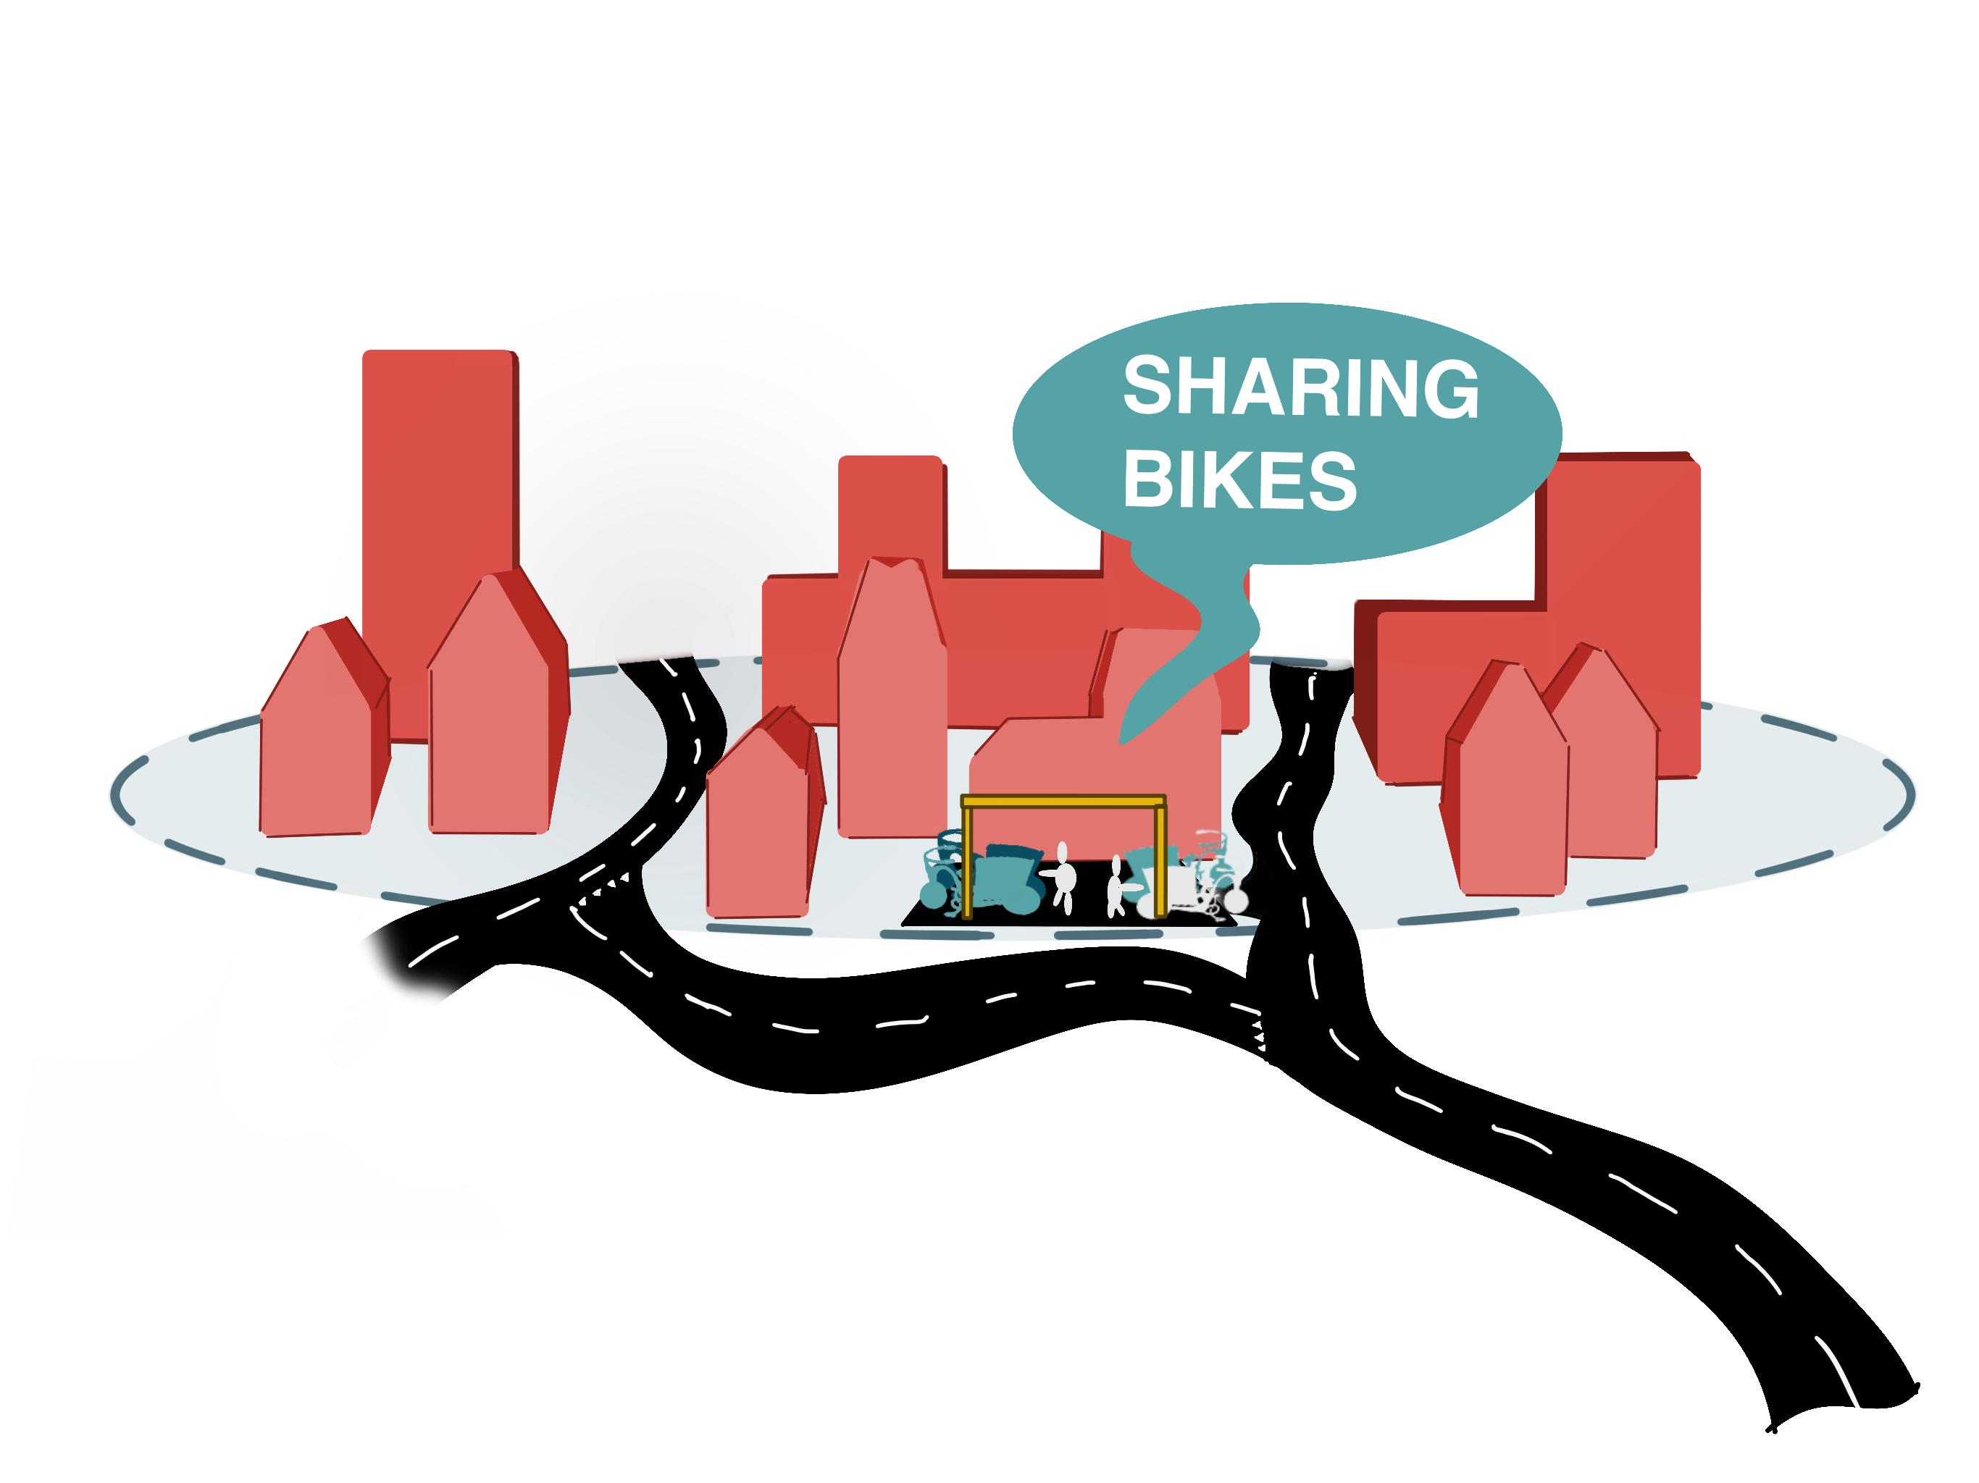
Elements of a concept

Slide 17
Combination of elements
Socio-economic
Sharing bikes

Slide 18
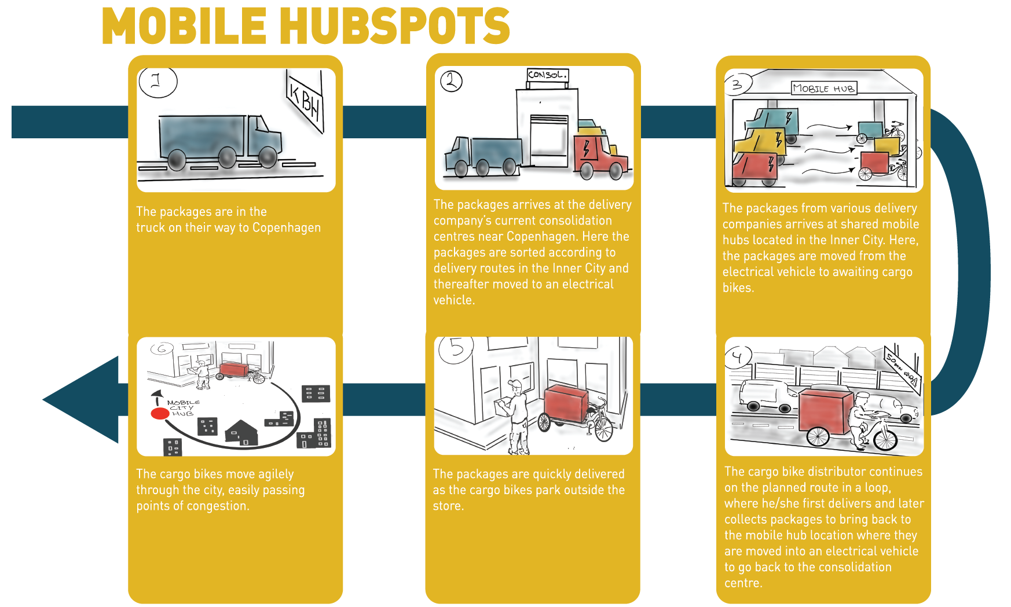
Mobile HubSpots
Consolidation center
Mobile city hub

Slide 19
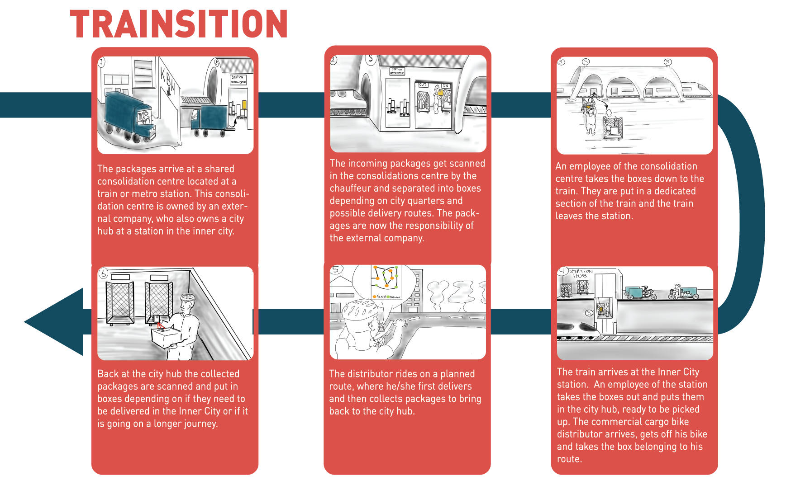
Trainsition
Public transport
Stationary city hub

Slide 20
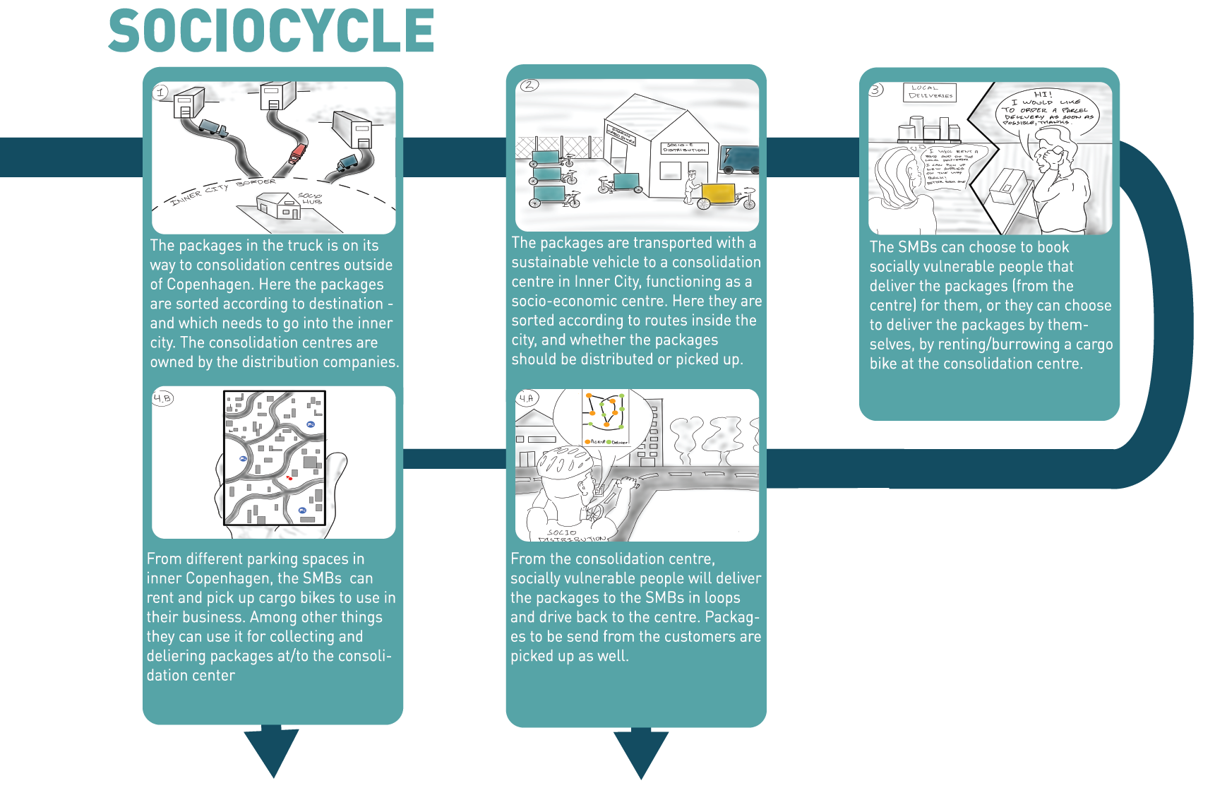
SocioCycle
Socio-economic
Sharing bikes

Slide 21
Storytelling concepts

Slide 22
Deciding on a concept
Criteria
Scenario
Actor feedback

Slide 23
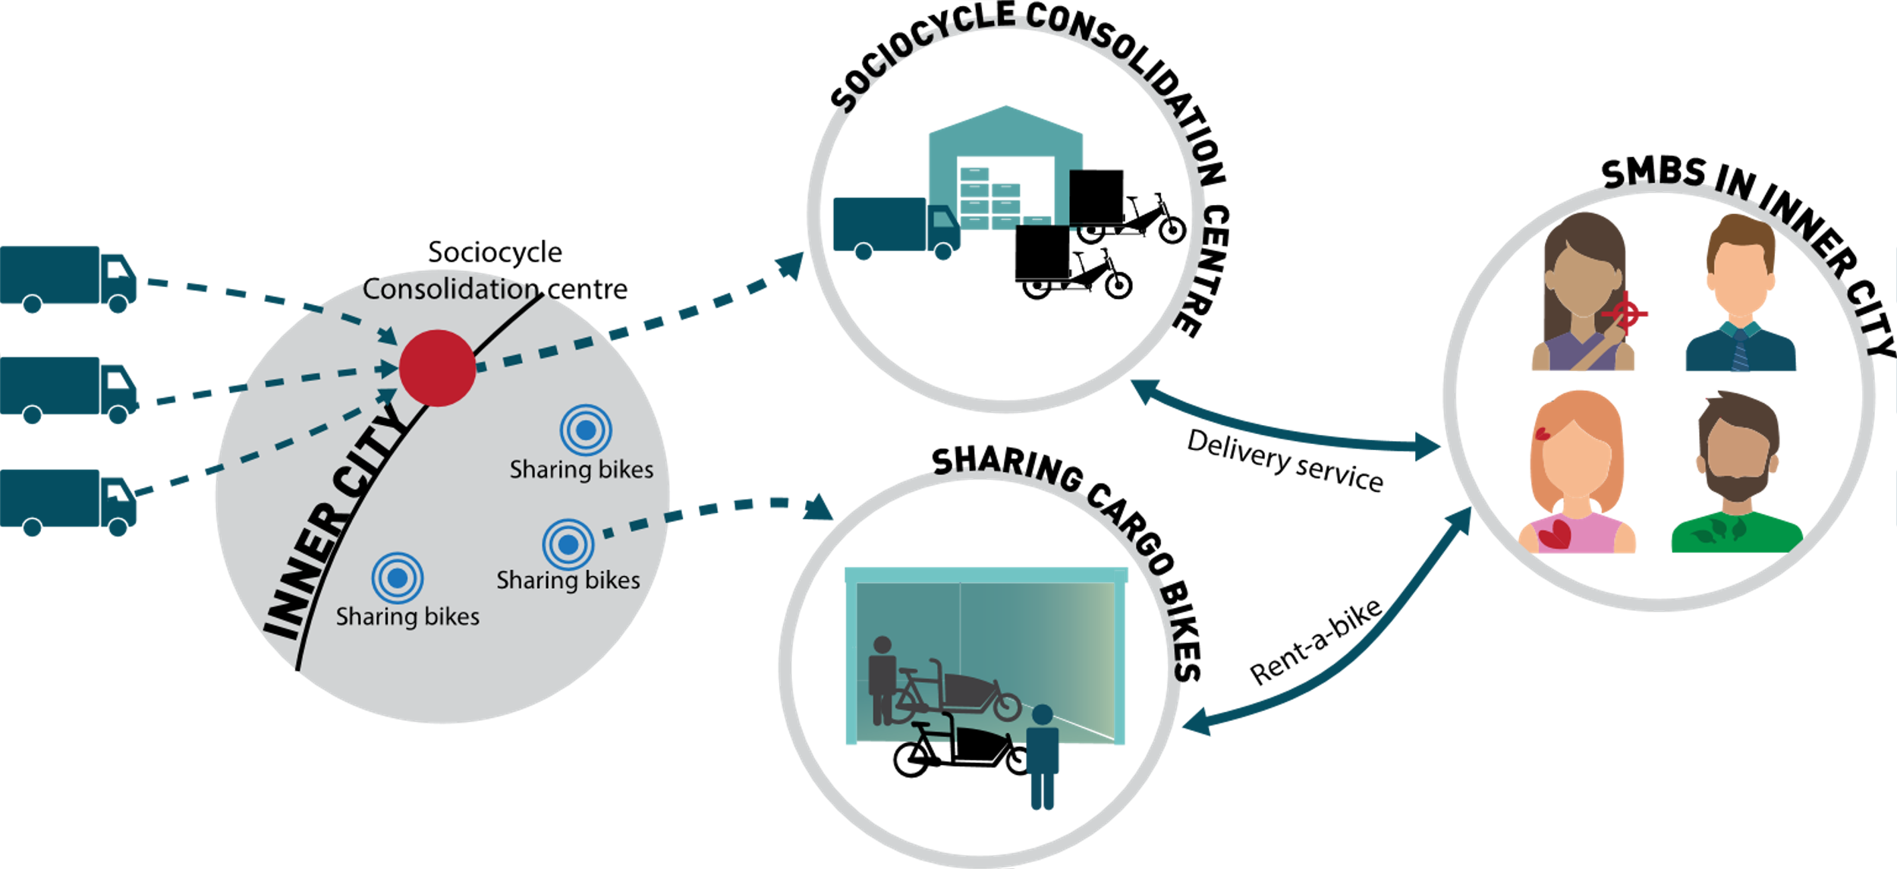
SOCIOCYCLE
Notes:
Go through the slide step by step, what happens?

Slide 24
DISCUSSION OF SOCIOCYCLE
NUMBER OF CONSOLIDATION CENTRES
NUMBER OF BICYCLES NEEDED (CAPACITY NEEDED)
ECONOMIC CONSIDERATIONS
Notes:
Discussion of concept (5 min) Amanda
In the next few slides we will discuss some of the parameters of the concept that we deem important to consider in a future perspective.

Slide 25
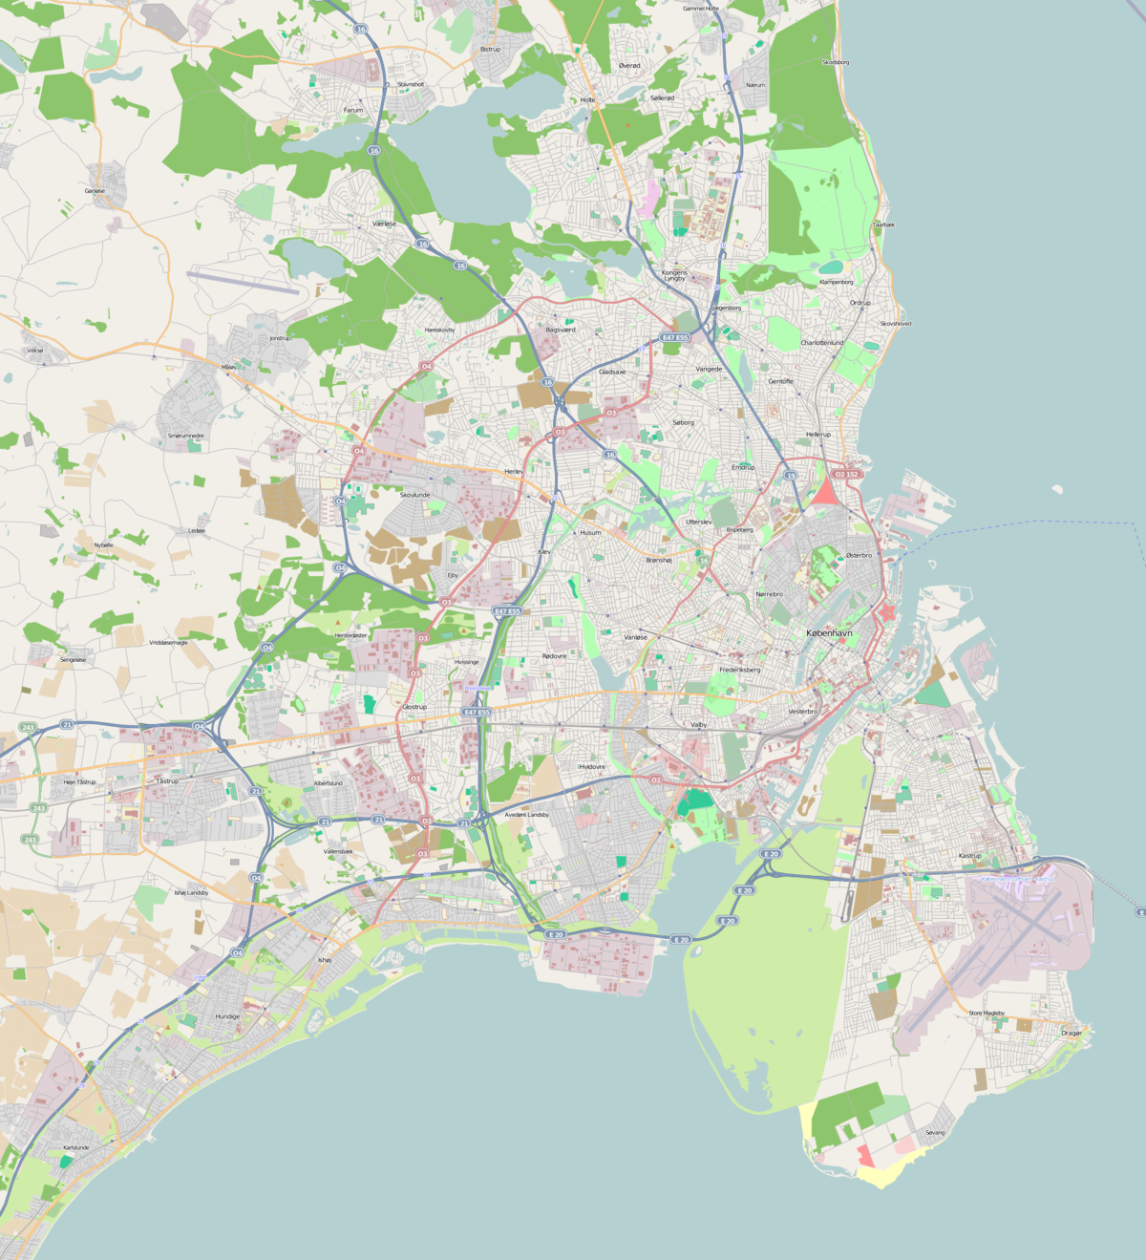
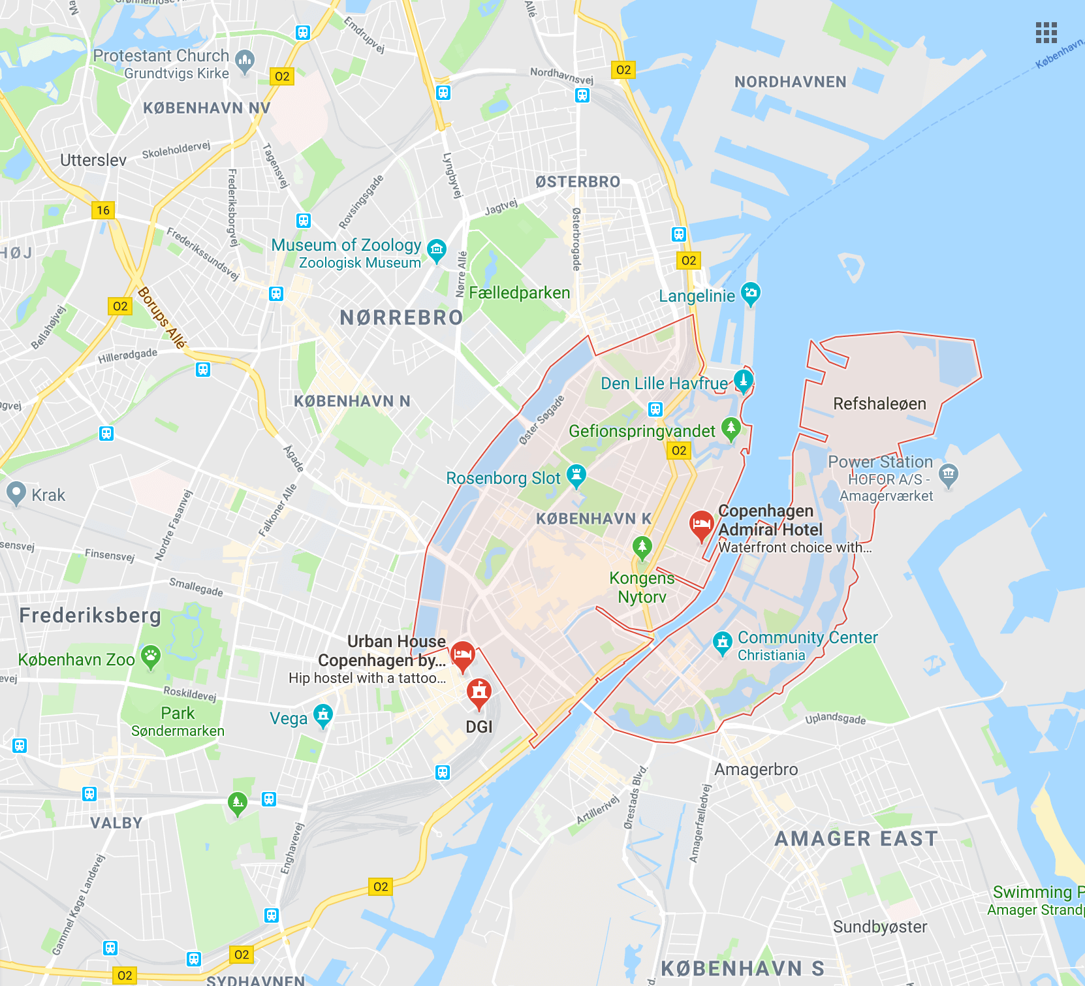
NUMBER OF CONSOLIDATION CENTRES
Notes:
Number of consolidation centres
One or more?
One centre Would need a lot of space, which is difficult to get in inner city, would probably be easier to get 3 smaller spaces.
The distributors at their own consolidation centre will not have to consolidate to as high a degree.
The benefits of having more:
Traffic becomes more distributed.
Less risk of waiting time for drivers.
Possibly you could start with one sociocentre and then later scale it up if deemed necessary, as proof of concept will need to be gained before scaling up.

Slide 26
NUMBER OF BICYCLES NEEDED
614 x
Notes:
Number of bicycles
- Our calculations show that if we were to cover the distribution part of the concept, 614 bicycles would be needed to cover the need in the Medieval City.
This many bikes will inevitable take up a lot of space, and thereby it could yet again be discussed how many centres would be needed AS it would be difficult to get space for them all in one location in rather close proximity to Inner City.
. However, it will be a great logistical and managerial challenge to make work efficiently“.
Furthermore, it will add additional pressure on the bicycling lanes in the rather narrow area.
avoid peak times.
future perspective it would hopefully be possible to redo some of the infrastructure that will be emptied up because of restrictions on cars in the Inner city.
Another concern is that the efficiency of the bikes might vary depending on how packages are packed. If space is not utilized efficiently, more bikes will be needed. However, here it could also be discussed if in the future regulation might change and allow for having a trailer on the bike, effectively allowing them to carry double the capacity.

Slide 27
ECONOMIC CONSIDERATIONS
NOW
FUTURE
Dansk Erhverv: Sustainable often means more expensive while less service.
Dansk Erhverv:
They are slowly tightening the screw. It already pushes companies in new directions.
Rising expectations pushing businesses (distributors and SMBs) towards new ways.
If it costs more it
should at least provide the same service
→ Working like buying CO2 compensation
Notes:
NOW:
It needs to be competitive on the market to gain mainstream support.
We have since the hand in of the report been in contact with Jesper Højte Stenbæk from Dansk Erhverv. As noted here on the Power point he mentioned that sustainable in their experience means it becomes slightly more expensive, while the packages cannot arrive as fast.
Thereby, if it cost more to have it sustainable (because you do have an extra chain in the delivery system which might add expenses), it should at least provide the same service in other areas. This is the resonning behing CO2 compensation bought in other relations, you pay a bit more for sustainability, but you receive the same service.
In our calculations we showed that for a certain SMB the price will be very similar, however, the service they buy will likely not be the same.
- new values provided might make up for this – as the businesses would be able to use it as branding, hopefully gaining respect among customers.
FUTURE:
Futurely, we ecpect that the inner city will be very different. The city representation fo citizens (borgerrepræsentationen) has made the recommendation to cut away 75% of the traffic in the inner city.
Furthermore, discussion has been raised about both implementing zero emission zones and trafic islands that will make it even more difficult to deliver packages the current way with trucks.
This is also mentioned by Jesper: ”however, they slowly tighten the restictions more and more, therefore we need to slowly adapt. We generally like that they try to push the business in the direction of the car free city, as long as the whole picture is thought in”.
Economical considerations
”Will the new concept be competitive in the market?
We have since the delivery of the project been in contatact with jesper ??? From Dansk erhverv. He stated that one of the obstacles they frequently run into is that if they want to do sustainable deliver by e.g. cargo bikes, what they end up offering customers is to get their deliveries later, while paying more for it. This goes completeltely against the current regime that supports that delivery should be fast and cheap. Therefore they currently do not see it as a viable solution, if it cannot be made at at least the same price (or that the time is at least similar, even if it costs less) (somethign you see now with CO2 compensation).
Therefore it is needed to think of what value the SMBs apply to e.g. sustainability, as in our concept, sustainability inhibits the effectivised delivery chain.
Futurely, we ecpect that the inner city will be very different. The city representation fo citizens (borgerrepræsentationen) has made the recommendation to cut away 75% of the traffic in the inner city. This means that a lot of trafic will actually not be allowed in the inner city, with trafical islands and so on, and the shops will need to find alternatives already. This is also mentioned by Jesper: ”however, they slowly tighten the restictions more and more, therefore we need to slowly adapt. We generally like that they try to push the business in the direction of the car free city, as long as the whole picture is thought in”. Thereby, it will be needed that it is thought through both that the inner city hould be nice for citizens, but also that it is needed that cars can still come in there with deliveries, else the SMBs in there will die. However, in that case price becomes not as important. Distributors will also feel this.
Already now it is a large part of the price of deliveries that goes to distribution in Inner City, and its the most expensive part of the chain. They are therefore looking to do it another way, for which reason the Big Players like DHL, Bring and PostNord has already begun their transition to cargo bikes.

Slide 28
Why ANT?

Slide 29
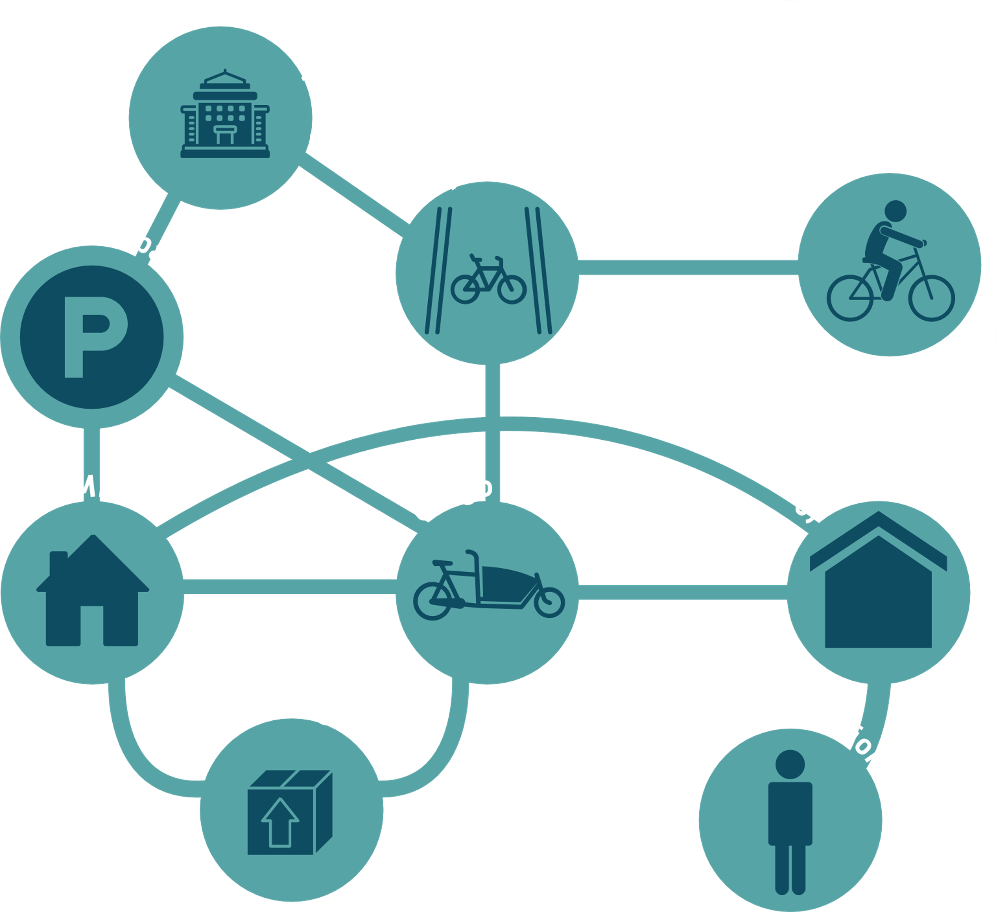
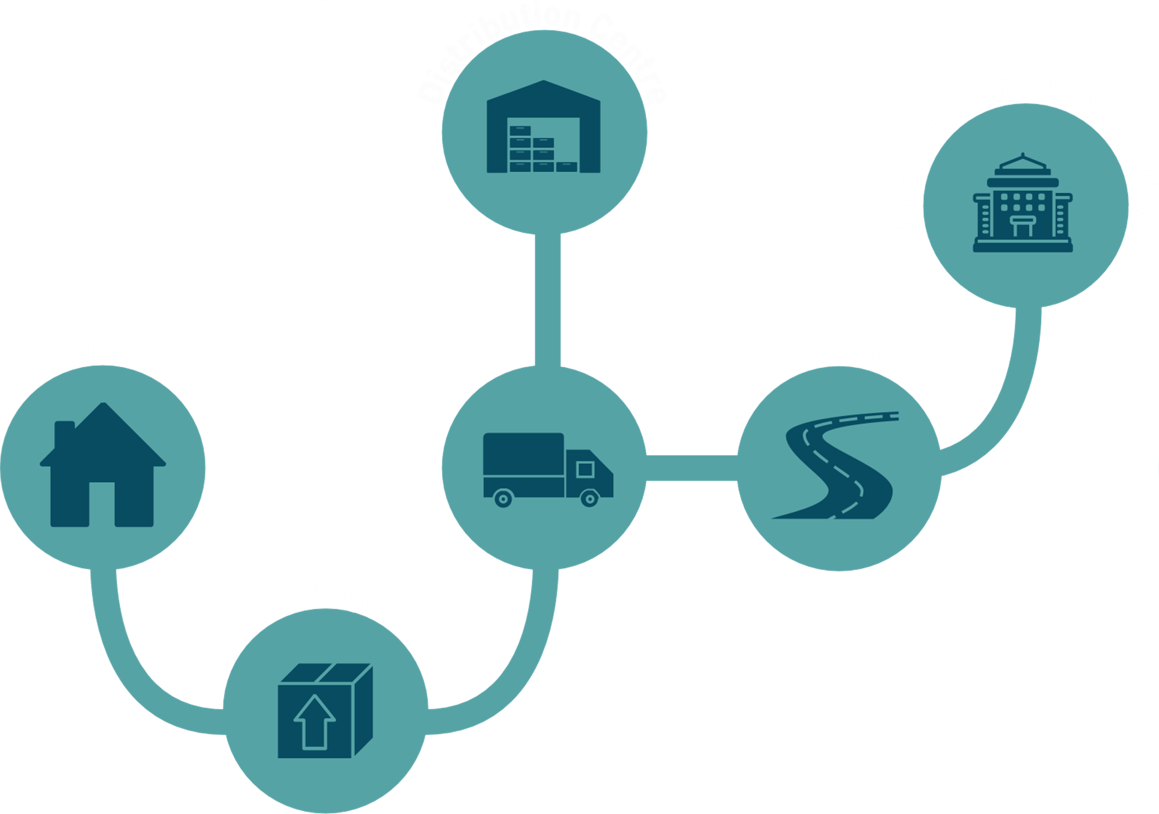
DESIRED
ANT
CURRENT

Slide 30
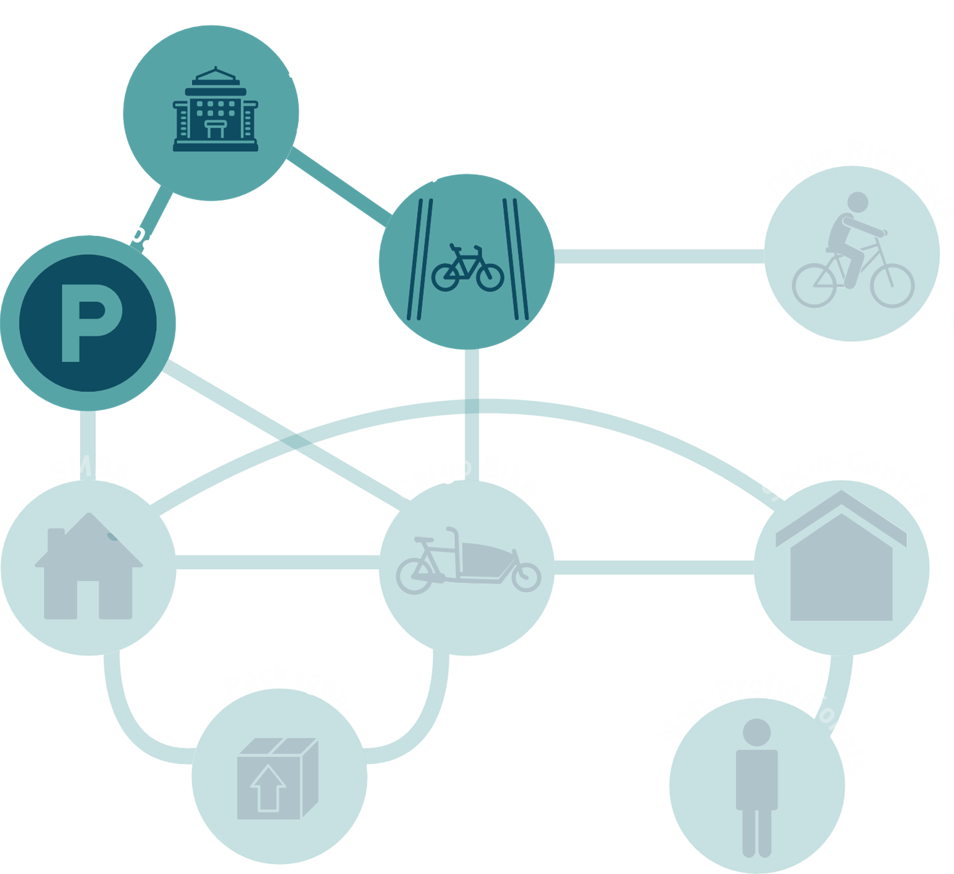
Municipality
Power over efficiency:
- Infrastructure
- Spaces for parking and Socio-Centre

Slide 31
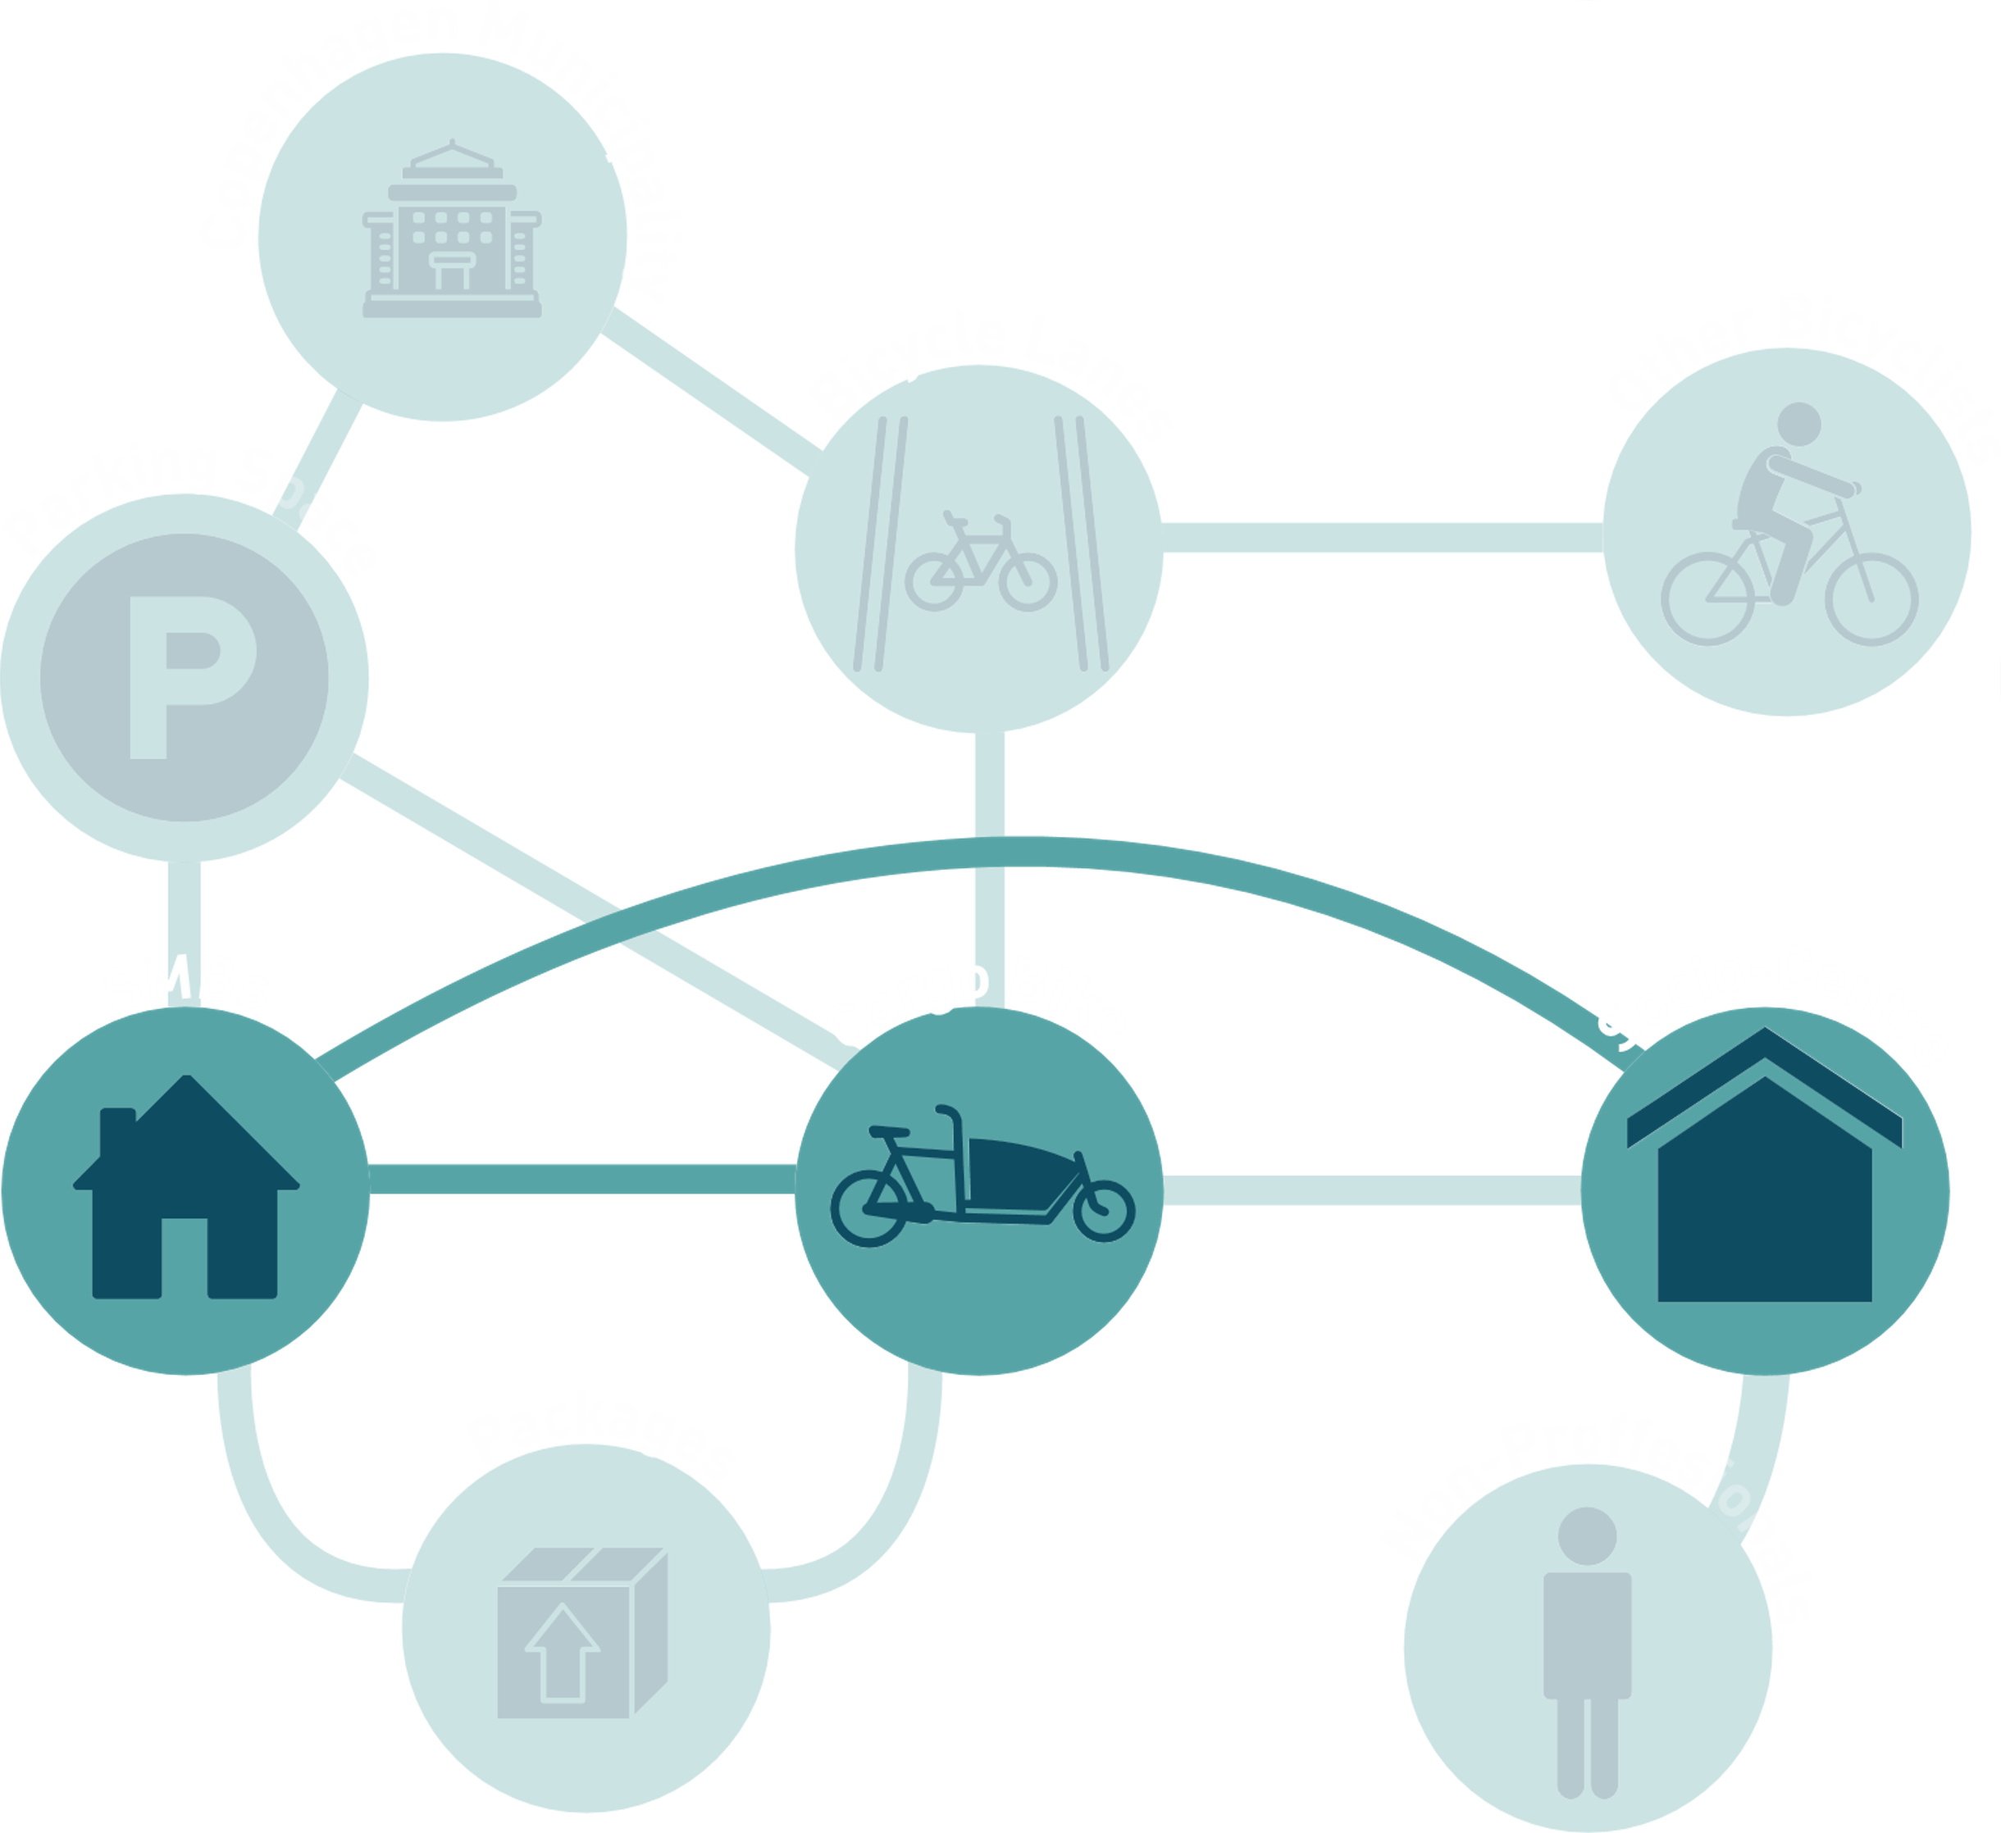
SMB
Cargo bike
Socio-Centre

Slide 32
Actionplan
•Marianne and Tanja
•Dansk Erhverv:
-Already have established projects with cargo bikes – looking for space
-Our concept should target SMB’s that do not have a history of logistic

Slide 33
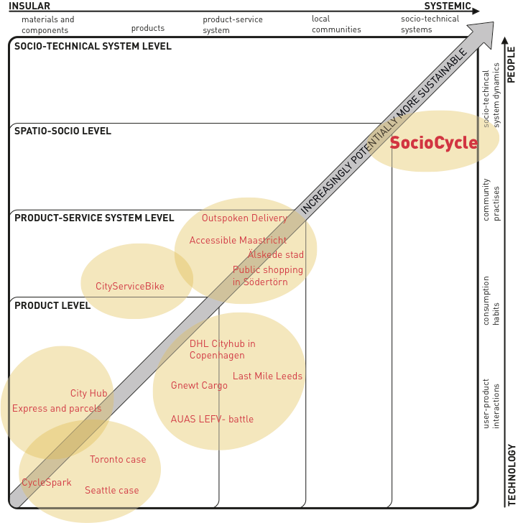
Design for sustainability

Slide 34
Conclusion
How can freight be delivered sustainably by cargo bikes in the Inner City of Copenhagen
Notes:
As concept was developed to answer the problem statement.
We argue that it is sustainable because
1: sociocycle reduces the amount of cars in inner city, and hereby the amount of emissions, road congestion and noise. This leads to a better and safer environment for the citizens of inner city, and reduces stress from drivers?
2: sociocycle provides a new freight system, that makes the cargo bike the better option, and thereby the preferable choice : instead of trying to force the cargo bike into the current freight system.
3: sociocycle might prove that cars aren't needed in dense urban city areas, and thereby counteract the current car-based regime.
Our concept has been developed with sustainability as its main focus, and is sustainable in its core. We therefore believe that that our concept can help the transition towards a sustainable and car free future for inner city.

Slide 35
Thank you!

