Slide 1
Noise

Slide 2
Noise Measurement
Depend on Sound Pressure Levels
Sound pressure or acoustic pressure is the local pressure deviation from the ambient (average, or equilibrium) atmospheric pressure, caused by a sound wave. [Source:Wikipedia]
Sound Pressure Level is high when sound level is high and low when sound level is low
Why isn’t that sufficient?

Slide 3

Case 1
Consider the following two sounds
Which one is louder?
The second is obviously louder, right?
Yes! But here’s the interesting part they have the same measured SPL (A-weighting)

Slide 4
Case 2
Consider the following two sounds
Which one is louder?
Well they are of comparable loudness
But which one is more annoying?

Slide 5
Case 3
Listen to the following sound
Is it annoying?
That is a guitar feedback

Slide 6
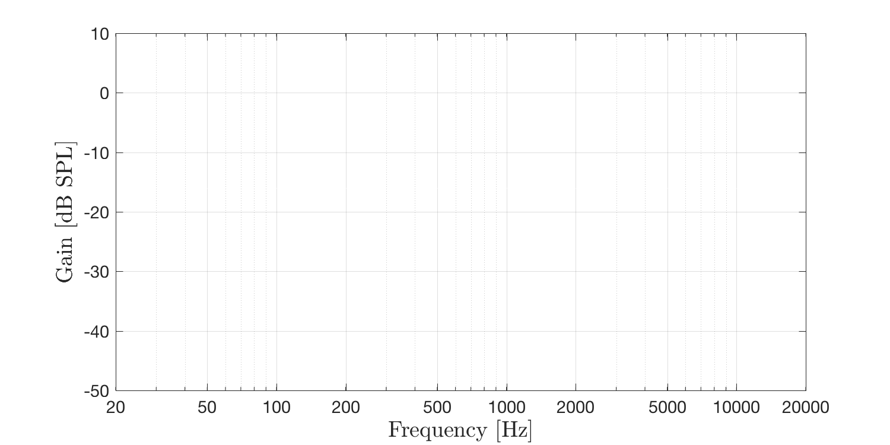
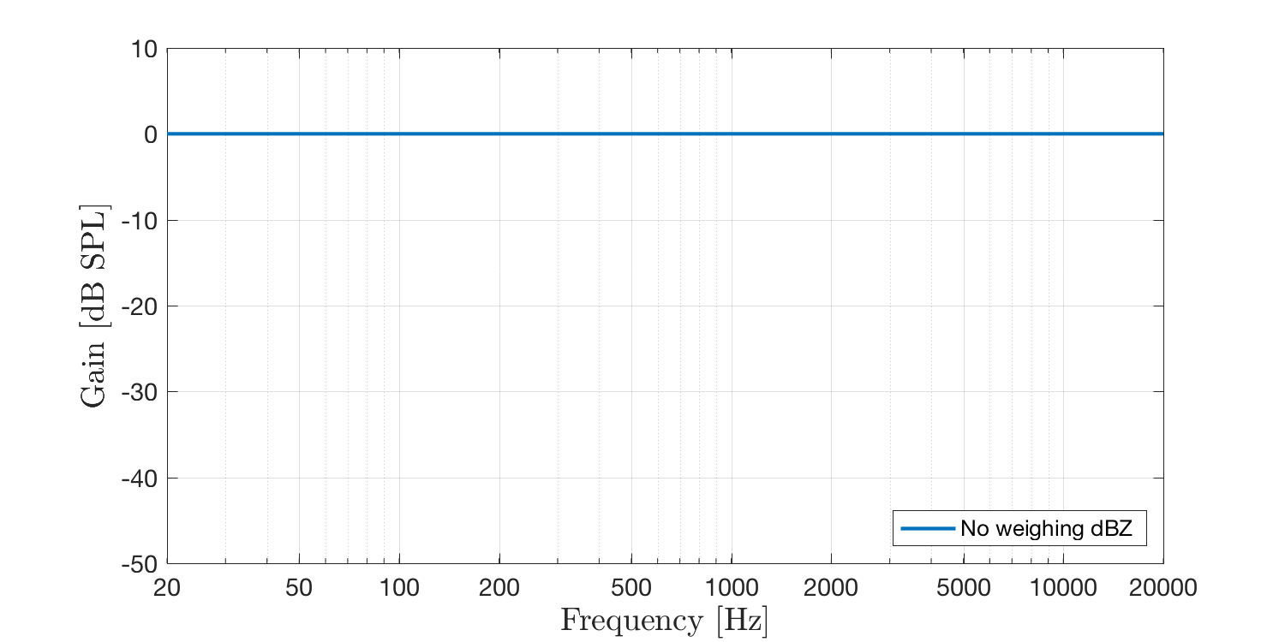
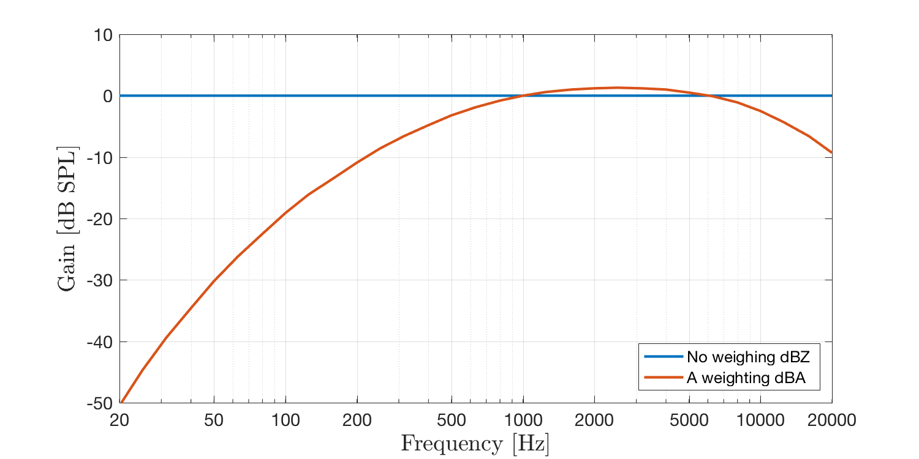
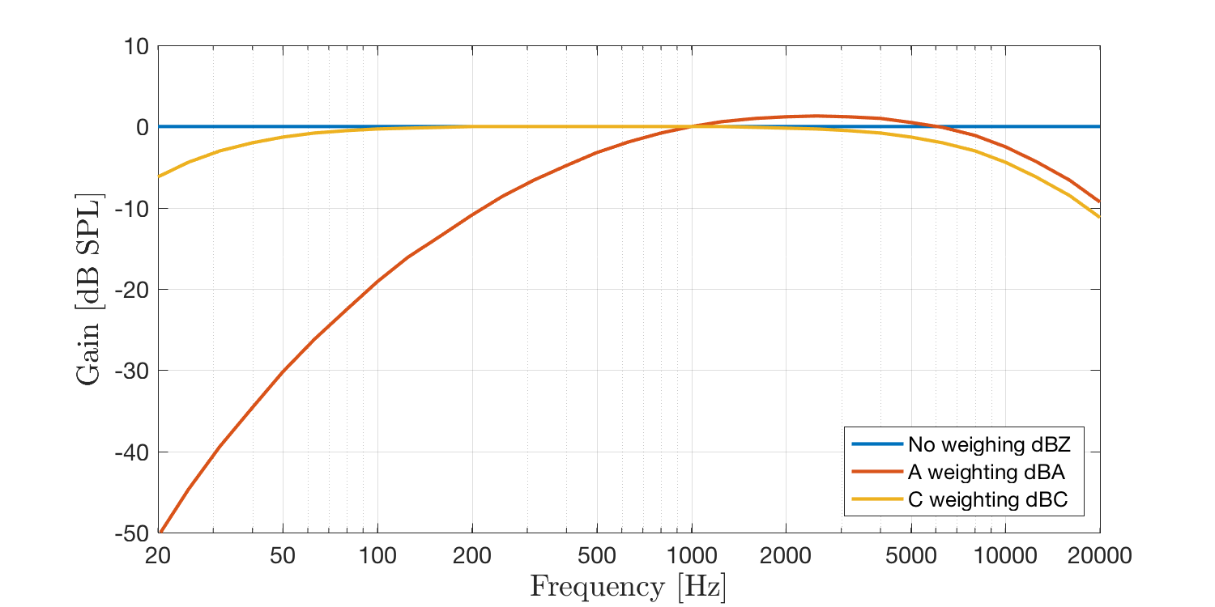
Sound Level Meters

Slide 7
A Practical Soundscape Approach to City Noise
John Yoahann Daniel
Supervisors
Cheol-Ho Jeong, Associate Professor, DTU
Sébastien Santurette, Assistant Professor, DTU
Co-Supervisors
Torben Holm Pedersen, Delta Acoustics
Marianne Spang Bech, Miljøpunkt – Indre by & Christianshavn

Slide 8
What is noise
Noise is defined as unwanted sound
Can noise annoyance be solved by decreasing overall sound levels?
No! We need a certain amount of noise for comfortable living.

Slide 9
Noise is complex
How is to be tackled?
Soundscape analysis is the holistic approach to tackle noise

Slide 10
Silent Events – målinger sommeren 2019

Slide 11
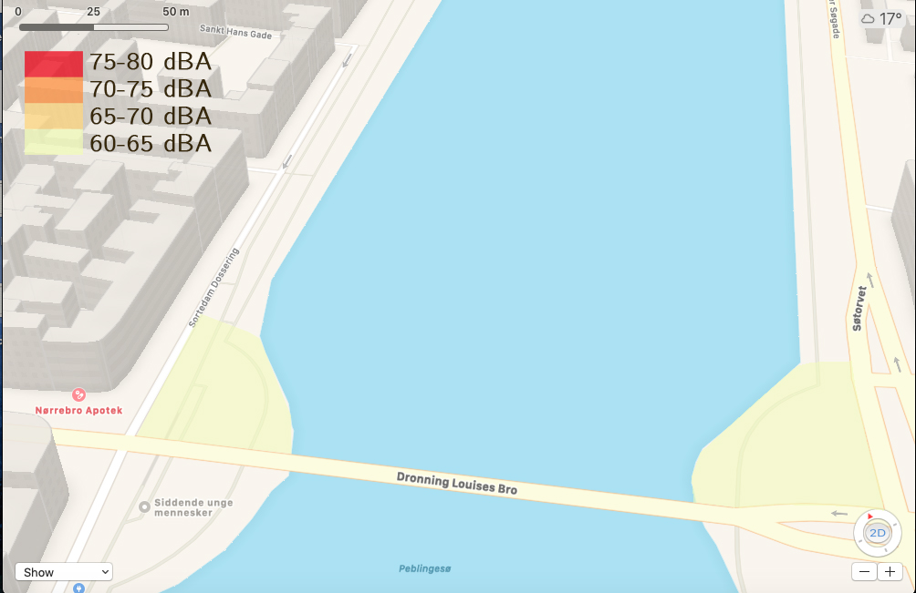

Slide 12
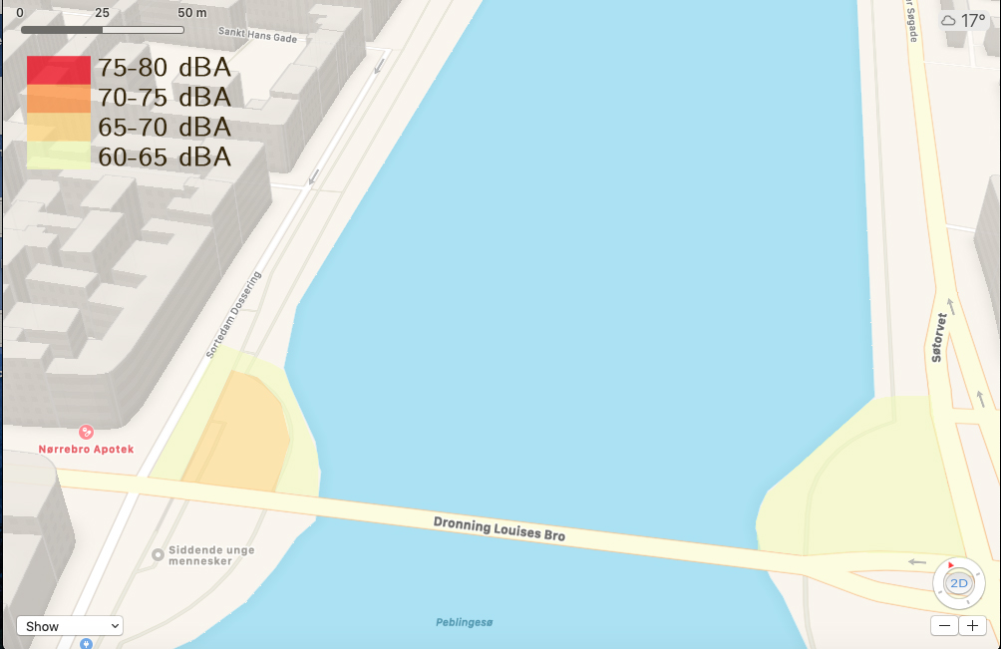
ggg

Slide 13
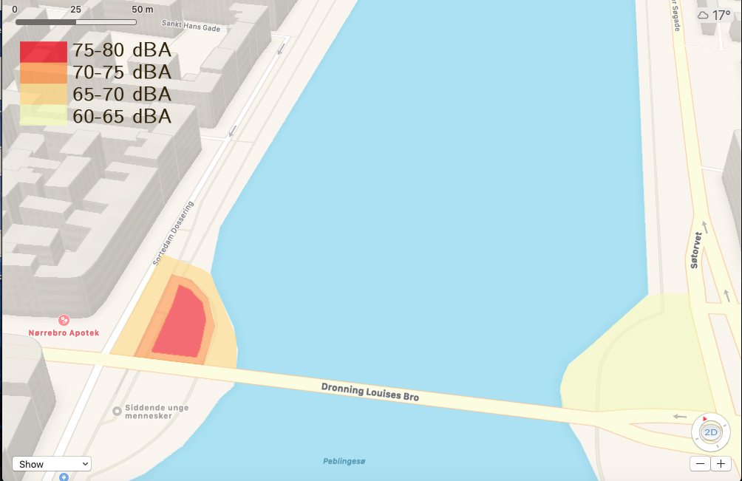

Slide 14
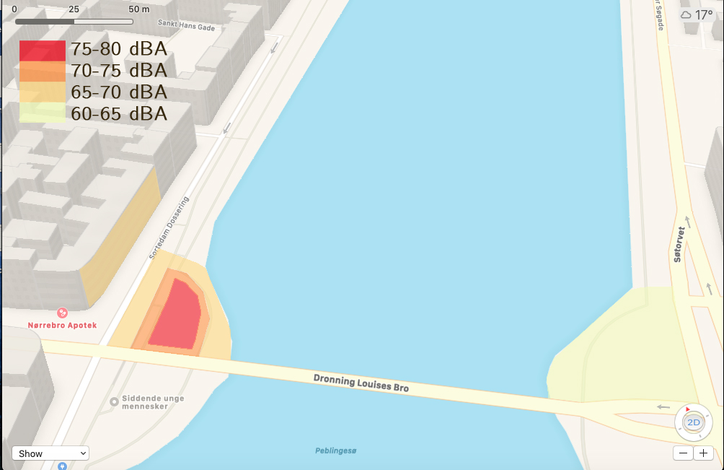

Slide 15
Stille Koncert Målinger
Nr. | Start tid | Varighed | LAeq | LAmax | LAmin | LCpeak | Location
83 | 18:58:23 | 00:00:43 | 64.9 | 71.9 | 56.7 | 89.6 | Silent area w/ traffic
84 | 18:59:46 | 00:00:30 | 63.2 | 70.9 | 55.9 | 89.6 | Silent area w/ traffic
85 | 19:00:36 | 00:00:30 | 61.7 | 68.4 | 55.5 | 89.4 | Silent area w/ traffic
86 | 19:01:19 | 00:00:43 | 56.4 | 63.9 | 51.1 | 81.5 | Silent area w/ traffic
87 | 19:02:10 | 00:00:30 | 63.0 | 78.9 | 53.7 | 81.5 | Silent area w/ traffic
88 | 19:03:28 | 00:00:30 | 63.8 | 70.1 | 55.8 | 87.0 | Silent area w/ traffic
89 | 19:08:15 | 00:00:30 | 61.9 | 73.1 | 54.3 | 87.4 | concert area with 50 pax
90 | 19:09:04 | 00:00:30 | 62.6 | 68.7 | 56.3 | 85.8 | concert area with 50 pax
91 | 19:09:46 | 00:00:30 | 64.9 | 75.0 | 54.5 | 88.0 | concert area with 50 pax
92 | 19:10:38 | 00:00:30 | 64.1 | 71.2 | 57.7 | 88.0 | concert area with 50 pax
93 | 19:11:43 | 00:00:30 | 62.5 | 71.7 | 55.7 | 88.2 | concert area with 50 pax
94 | 19:36:30 | 00:00:30 | 70.0 | 81.0 | 56.3 | 95.7 | inside concert area, before
95 | 19:37:09 | 00:00:30 | 70.1 | 82.0 | 61.4 | 95.9 | inside concert area, before
96 | 19:42:15 | 00:00:42 | 69.4 | 75.8 | 59.8 | 95.8 | inside concert area, before
97 | 20:02:17 | 00:00:30 | 66.8 | 72.6 | 56.7 | 94.4 | inside concert area, before
98 | 20:13:30 | 00:00:30 | 75.1 | 83.9 | 60.2 | 99.3 | inside concert area, during
99 | 20:16:00 | 00:00:30 | 76.5 | 89.3 | 62.5 | 99.9 | inside concert area, during
100 | 20:18:59 | 00:00:30 | 81.0 | 97.6 | 62.3 | 105.7 | inside concert area, during
101 | 20:20:24 | 00:01:52 | 74.7 | 87.8 | 61.4 | 98.6 | inside concert area, during
102 | 20:22:01 | 00:00:30 | 80.2 | 100.0 | 61.8 | 111.1 | inside concert area, during
103 | 20:25:23 | 00:00:30 | 71.3 | 78.5 | 64.0 | 97.5 | 5m away from crowd
104 | 20:26:21 | 00:00:30 | 68.2 | 77.9 | 58.9 | 90.0 | 5m away from concert
105 | 20:29:09 | 00:00:30 | 64.2 | 72.4 | 55.1 | 90.2 | 5m away from test
106 | 22:58:07 | 00:00:30 | 79.2 | 89.2 | 69.4 | 102.9 | inside concert area, during
107 | 22:58:59 | 00:00:30 | 78.9 | 94.8 | 69.8 | 1.6 | inside concert area, during
108 | 23:00:11 | 00:00:30 | 70.0 | 80.8 | 63.0 | 93.5 | 10m away
109 | 23:00:58 | 00:00:30 | 78.3 | 91.0 | 67.9 | 100.5 | 5m away
110 | 23:03:23 | 00:00:30 | 66.8 | 73.2 | 61.6 | 85.3 | house entrance
111 | 23:04:16 | 00:00:30 | 67.4 | 75.9 | 61.5 | 87.4 | house entrance
112 | 23:05:32 | 00:00:30 | 65.9 | 72.2 | 61.3 | 85.1 | house entrance
113 | 23:06:52 | 00:02:08 | 77.2 | 91.0 | 65.7 | 115.3 | across subway
114 | 23:09:10 | 00:00:30 | 83.9 | 99.1 | 73.1 | 110.9 | inside concert area, during
115 | 23:10:09 | 00:00:30 | 75.8 | 87.4 | 68.1 | 100.4 | inside concert area, during
116 | 23:14:29 | 00:00:38 | 65.6 | 78.8 | 59.7 | 91.2 | house entrance

Slide 17
Opsamling og spørgsmål
Hvad er effekterne af støj fra musikarrangementer, og andre aktiviteteter?
Og hvad kan vi bruge undersøgelserne til?
Afrunding

